Slide 1
Using Euler & Slurm

Slide 2
Background
Euler is a supercomputing cluster curated by the UW Simulation Based Engineering Lab in partnership with several labs and groups from the UW campus
Supercomputing (noun) - a field of computation requiring hardware with outstanding performance
Cluster (noun) - a set of computers which work together in such a way that they can be thought of as a single computer
Euler runs Linux – basic Linux skills are needed
Euler is a shared resource – please use it in a way that is courteous toward other users
3

Slide 3
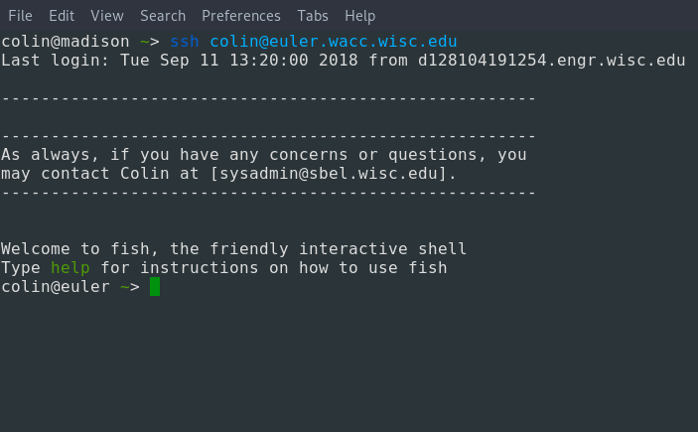
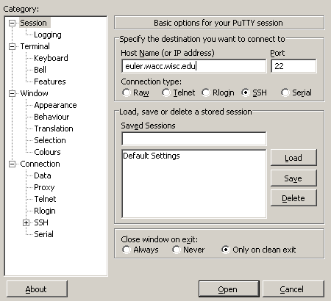
Connecting to Euler
Connecting to Euler is done using SSH
Linux and Mac users will be able to use SSH from their system terminal
Windows users can use the built-In SSH client in PowerShell, or one of these:
PuTTY is an SSH client for Windows that has been around for many years
WinSCP provides a built-in SSH terminal based on PuTTY
Connect to Euler using a command like this
ssh username@euler.wacc.wisc.edu
4

Slide 4
General Rules
Euler is a shared resource; it is often busy.
You aren't the only person using it, so please be courteous to other users.
Allow yourself enough time to get your work done even if Euler is busy.
Euler is a part of the UW, so UW rules apply
You're all very smart people, use your critical thinking before doing things on Euler.
Euler is here for you to learn, but it isn't your playground.
Breaking Euler rules can lead to the cancellation of your jobs and a block on your account
If your account is blocked/suspended, you can’t access your files or submit jobs
It might take up until the next business day to reactivate your account
Be mindful around homework deadlines
Reactivating an account requires you to get in touch with Dan (negrut@wisc.edu) and Colin (sysadmin@sbel.wisc.edu)
Repeat offenses may incur additional penalties
5

Slide 5
DOs and DON’Ts
DO NOT run your programs on the head node.
As a general rule: If you wrote it, don't run it!
DO use Slurm via sbatch for your programs
All Slurm jobs will run safely on a compute node.
DO NOT submit jobs to the research partition
DO use -p wacc for all of your jobs
More on this in a few slides...
DO NOT run interactive jobs
DO provide input to your programs using command line arguments or input files.
DO NOT try to flood the job queue in order to get more time on Euler
DO try to be courteous to other students who also need resources to do their homework
6

Slide 6
DOs and DON’Ts (part 2)
DO NOT request resources which you don’t need
For example, if your program doesn't use CUDA, don't ask for a GPU!
DO think logically about what your program needs
If your program was designed to be accelerated with OpenMP, then it's okay to ask for more than one core.
DO NOT use Euler as your personal storage server
DO clean up data files you aren’t using anymore
DO NOT leave idle sessions running when you aren’t around
DO log out when you aren't using Euler
DO NOT try to gain administrative access to the cluster
This includes the sudo command, which is used to perform administrative tasks.
DO ask the System Administrator if you find that you are missing a program or library
DO NOT try to do something which you think will be against the rules
DO feel free to ask fellow students on Piazza or contact the System Administrator for permission
7

Slide 7
Nuts and bolts
The “module” utility
The “Slurm” scheduling utility

Slide 8
The “module” utility
[dan@euler ~]$ gcc --version
gcc (GCC) 8 ...
[dan@euler ~]$ module load gcc/6.4.0
[dan@euler ~]$ gcc --version
gcc (GCC) 6.4.0 ...
[dan@euler ~]$ nvcc main.cu -o cudaprogram
bash: nvcc: command not found
[dan@euler ~]$ module avail cuda
-------------- /usr/local/share/modulefiles ---------------------
cuda/0_user/cuda cuda/7.5 cuda/8-rc cuda/9 cuda/9.1
cuda/7 cuda/8 cuda/8.0 cuda/9.0 ...
[dan@euler ~]$ module load cuda/9
[dan@euler ~]$ nvcc main.cu -o cudaprogram
[dan@euler ~]$ module list
Currently Loaded Modulefiles:
1) gcc/6.4.0 2) gcc/0_cuda/6.4.0 3) cuda/9
[dan@euler ~]$ module unload cuda gcc
[dan@euler ~]$ nvcc
bash: nvcc: command not found
The module command allows you to add software to your environment
Modules also provide a method to manage multiple versions of the same program
The typical module commands are load, unload, list, and avail
You will need this command to properly build most of your homework on Euler
9
Notes:
8

Slide 9
What is Slurm?
Slurm Workload Manager (originally Simple Linux Utility for Resource Management) is a suite of tools that manage the allotment and scheduling of jobs on clusters and supercomputers
Slurm is used on Euler in order to help researchers, campus organizations, and students efficiently share the variety of hardware and software resources that it has available
Job schedulers such as Slurm are particularly effective because they allow the creation of tasks from batch scripts
10

Slide 10
Slurm Concepts
Slurm Partition
A partition is a logical chunk of Euler
Each partition has its own priority rules, job queue, and time limit
What hardware is assigned to which partition is the decision of the administrator
Euler uses partitions to enforce user priority
NOTE: Students in classes using Euler should only use the partition called “wacc” (from Wisconsin Applied Computing Center)
The flag -p wacc enables this behavior
11

Slide 11
Slurm Concepts
Slurm Task
Describes a single invocation of a script or job command
For many jobs, there is only one task that sequentially executes each line of the job script
Distributed jobs such as those using MPI or client-server protocols sometimes have multiple tasks which run different parts of the script in tandem
Slurm Thread
Describes a concurrent logical path of execution that can be run by a CPU
Slurm will usually allocate one hardware thread per CPU that you request, but will not assign threads from different jobs to the same physical CPU core
12

Slide 12
General concept: A Shell Script
#!/usr/bin/env bash
name_str=
echo “What is your name? ”
read name_str
echo “Hello, $name_str!”
[dan@euler ~]$ bash hello.sh
What is your name?
Dan
Hello, Dan!
#!/usr/bin/env bash
The “shebang” or hash-bang operator #! specifies the absolute path to the interpreter to use for a script
Classically, this would be something like #!/bin/sh or #!/bin/bash
We opted for a more modern command, using /usr/bin/env to locate bash in our environment
name_str=
Just like in the shell, we can declare variables
echo “...”
Again, just like in the shell, we can run commands and their arguments will be substituted and expanded as normal.
read name_str
The read command takes a line of input from the user and stores it in the given variable
bash hello.sh
Running a script is as easy as invoking it in the shell
It is also possible to run a script as if it were a program by marking it executable using chmod +x
A shell script is just a series of shell commands
The commands are read and executed as if you had typed them at the shell prompt
13

Slide 13
Slurm Specific batch scripts are run with “sbatch” (Slurm batch)
#!/usr/bin/env bash
#SBATCH --job-name=HelloScript
#SBATCH -p wacc
#SBATCH --ntasks=1 --cpus-per-task=1
#SBATCH --time=0-00:00:10
#SBATCH --output=“hello_output-%j.txt”
cd $SLURM_SUBMIT_DIR
name_str=“World”
echo “Hello, $name_str!”
#SBATCH ...
#SBATCH is used to set flag[s] that will be passed to the Slurm job
--job-name : the name of the job in the scheduler database
--cpus-per-task : the number of CPU threads that will be allocated for each task
The # character is recognized as a comment by bash, so these directives don’t interfere with the script itself
cd $SLURM_SUBMIT_DIR
Slurm sets some environment variables when it executes a script
In this case, we cd to the directory where the script is submitted from
sbatch hello_slurm.sh
Submit a scheduling script to Slurm
Slurm batch script
[dan@euler ~]$ sbatch hello_slurm.sh
Submitted batch job 1975385
[dan@euler ~]$ cat hello_output-1975385.txt
Hello, World!
How you then use sbatch
A batch script is a type of interpreted program which runs shell commands, often without the need for user interaction
Inside a batch file, a statement beginning with #SBATCH represents a Slurm directive
[https://cmake.org/cmake-tutorial/]
14

Slide 14
Breaking it Down - Basics
#!/usr/bin/env bash
#SBATCH –p wacc
#SBATCH --job-name=DansAwesomeJob
#SBATCH --output=job_output-%j.txt
The #! header tells the system to interpret our file as a bash script
The next thing that goes in the file are the Slurm directives specified via #SBATCH
You must use the wacc partition for this class
It can be helpful to give your job a name
Specifying an output file is helpful too
15

Slide 15
Breaking it Down - Time Limit
#!/usr/bin/env bash
#SBATCH –p wacc
#SBATCH --job-name=DansAwesomeJob
#SBATCH --output=job_output-%j.txt
#SBATCH --time=0-00:15:00
Choosing a Time Limit
The Slurm scheduler is much more deft if users give accurate estimates for how long their jobs will take
If you don’t know for sure, just add 50% onto your best guess
If you leave it blank, your job will try to request the maximum possible time
60 minutes for jobs on wacc
Using too long of a time limit may cause unnecessary delays in launching your job
It might take a while to find a find a 60 min time slot
16

Slide 16
Breaking it Down - CPU Cores
#!/usr/bin/env bash
#SBATCH –p wacc
#SBATCH --job-name=DansAwesomeJob
#SBATCH --output=job_output-%j.txt
#SBATCH --time=0-00:15:00
#SBATCH --nodes=2
#SBATCH --ntasks-per-node=8
#SBATCH --cpus-per-task=4
Requesting CPU Cores
There are three common possibilities
For simple jobs, you usually only need one core
For multithreaded jobs, request however many cores your program will use with --cpus-per-task or -c
Slurm does the dirty work needed to pick out threads and physical cores for you
For MPI software, you will need to request some number of ranks using --ntasks or --nodes with --ntasks-per-node
Do not request more cores than your program can use; it is wasteful and can prevent other cluster users from getting their work done
17

Slide 17
Breaking it Down - Other Resources
#!/usr/bin/env bash
#SBATCH -p wacc
#SBATCH --job-name=DansAwesomeJob
#SBATCH --output=job_output-%j.txt
#SBATCH --time=0-00:15:00
#SBATCH --nodes=2
#SBATCH --ntasks-per-node=8
#SBATCH --cpus-per-task=4
#SBATCH --gres=gpu:1
#SBATCH --constraint=haswell
Requesting Special Hardware
There are two ways to do this on euler
If you need a specific number (N) of things such as graphics cards, request a Generic RESource
--gres=type[:model]:N
e.g., gpu:gtx1080:3 or infiniband:1
Resource selection can be limited to nodes with particular features using constraints
NOTE: a constraint is just a hint to the scheduler and does not guarantee any particular resource will be allocated
18

Slide 18
Breaking it Down - Invoking our Program
#!/usr/bin/env bash
#SBATCH -p wacc
#SBATCH --job-name=DansAwesomeJob
#SBATCH --output=job_output-%j.txt
#SBATCH --time=0-00:15:00
#SBATCH --nodes=2
#SBATCH --ntasks-per-node=8
#SBATCH --cpus-per-task=4
#SBATCH --gres=gpu:1
#SBATCH --constraint=haswell
cd $SLURM_SUBMIT_DIR
date
hostname
mpirun awesome_MPI_CUDA_program -np $SLURM_NTASKS
At this point, the options are very nearly a regular bash script
Slurm invokes the script from your home directory
You can invoke your program with an absolute path or cd to an arbitrary directory
You can also cd to the directory where you ran sbatch
You can capture the output of many commands in a single job
Slurm sets environment variables with information about the running job
19

Slide 19
Breaking it Down - Bash Tricks
#!/usr/bin/env bash
#SBATCH -p wacc
#SBATCH --job-name=DansAwesomeJob
#SBATCH --output=job_output-%j.txt
#SBATCH --time=0-00:15:00
#SBATCH --nodes=2
#SBATCH --ntasks-per-node=8
#SBATCH --cpus-per-task=4
#SBATCH --gres=gpu:1
#SBATCH --constraint=haswell
cd $SLURM_SUBMIT_DIR
date
hostname
mpirun awesome_MPI_CUDA_program -np $SLURM_NTASKS
result=$?
if [ $result -ge 0 ]; then
echo “mpirun in job $SLURM_JOB_ID completed wrongly”
exit $result
fi
Shell features and nuances still apply
Control flow, substitutions, and even arguments all work with normal shell scripts
We can still process the result of our program or substitute output as we would in a standard bash script
20

