Slide 1
ME759 High Performance Computing for Applications in Engineering [Spring 2021]
Lecture 17
03/03/2021
Dan Negrut, 2021 ME759 UW-Madison

Slide 2


Cartoon of the day
[Alex Gregory]$→$

Slide 3
Is BBC recording on?
If my internet connection goes down, I’ll email from my phone to provide more information – go/no-go, next step, etc.

Slide 4
Before we get started…
Last time
Wrap up, using streams in GPU computing: increasing problem size; improving execution speeds
Debugging & profiling GPU code: cuda_gdb, cuda_memcheck
Today
Use of unified memory in CUDA GPU Computing
Other tidbits:
Assignment due on Th, 03/04, at 9 pm
Assignment is tough
Do not run your code on the Euler headnode (use Slurm)
Big PDF file contains all the slides thus far; easy to search into it to find topics covered thus far. Doc is here.

Slide 5
Unified Memory (Managed Memory) in CUDA

Slide 6
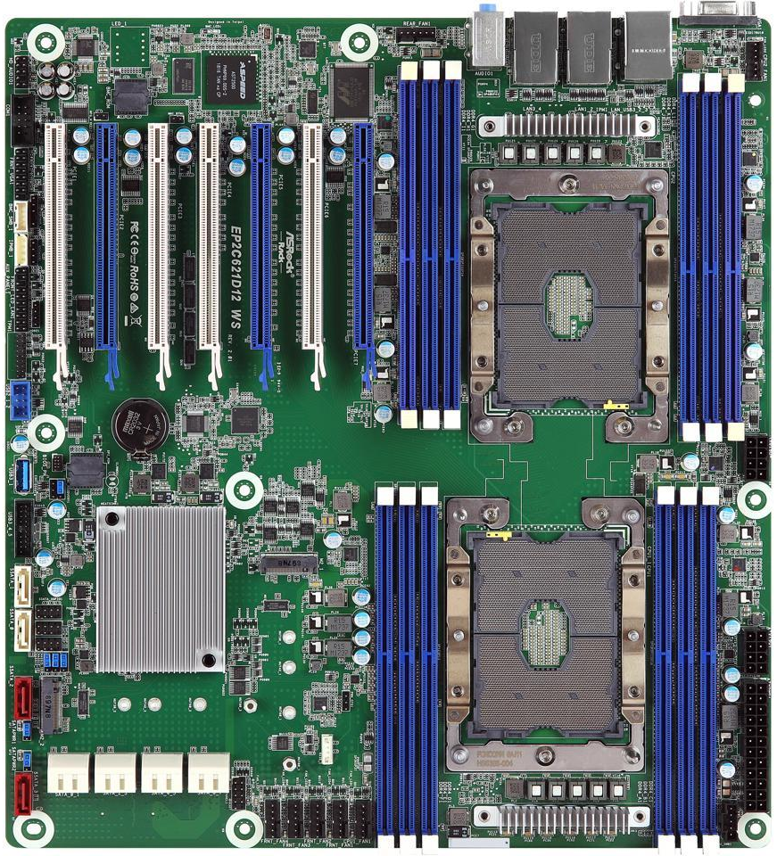
Picture of the day: Multi-Socket Motherboard Configuration [ASRock Rack EP2C621D12 WS EEB Server Motherboard LGA 3647 Intel C621]
Seven of them
: Memory Bank
: CPU Socket
: PCI Socket
[credit]

Slide 7
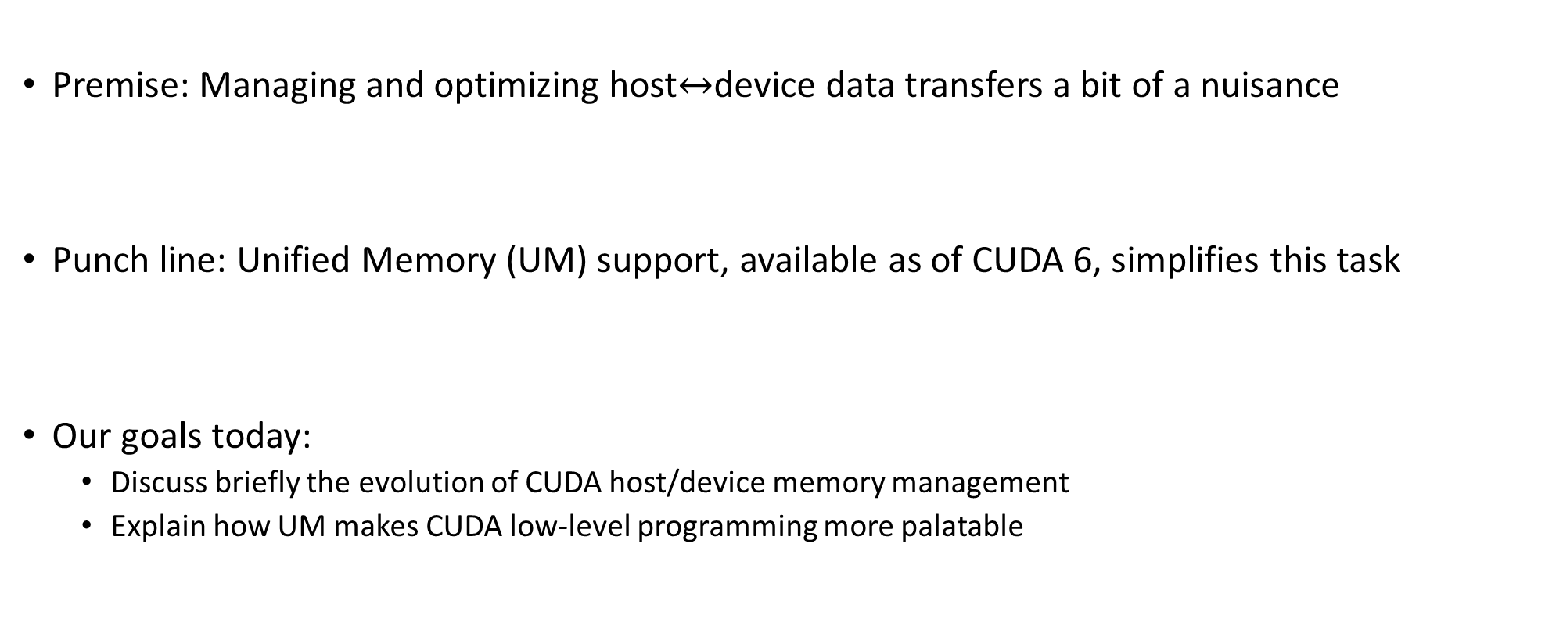
Putting things in perspective, today’s presentation
Premise: Managing and optimizing host$↔$device data transfers a bit of a nuisance
Punch line: Unified Memory (UM) support, available as of CUDA 6, simplifies this task
Our goals today:
Discuss briefly the evolution of CUDA host/device memory management
Explain how UM makes CUDA low-level programming more palatable

Slide 8
Good to keep in mind
In this Unified Memory discussion:
We are not going to learn anything that we couldn’t live without
Discussion focus: how GPU programming became more friendly/convenient in relation to data movement
A matter of improved productivity
Remark: A byproduct of this discussion is a better understanding of how CUDA is evolving
Happens as we speak…

Slide 9
Backdrop, cudaMemcpy
cudaMemcpy: A staple of CUDA, available in release 1.0
The drill
Get some memory space in device memory (cudaMalloc call)
Data transferred from host memory into device memory with cudaMemcpy
Data processed on the device by invoking a kernel
Results transferred from device memory into host memory with cudaMemcpy
Free the cudaMalloc-ed memory on the device
Kick back and relax. Perhaps reach out for brewski

Slide 10
Backdrop, cudaMemcpy
Memory allocated on the host with new
Memory allocated on the device using the CUDA runtime function cudaMalloc
Data moved back-and-forth, host to/from device, over the PCI-E pipe

Slide 11
The PCI-E Pipe, Putting Things in Perspective
PCIe x 16: peak bandwidth (what’s reasonable to expect in parentheses) (per direction data)
V1: 4.0 (3) GB/s
V2: 8.0 (6) GB/s
V3: 15.8 (12) GB/s
V4: 31.5 (???) GB/s
Bandwidths above relatively small, see for instance (values provided are middle of the road)
Host memory bus: about 25 – 50 GB/s per socket
GPU global memory bandwidth: 400 – 1500 GB/s
Notes:
(now, Haswell is higher?)

Slide 12
cudaHostAlloc: helps improve host/device transfer speeds
Host/Device data transfer speeds could be improved if host memory was not pageable
Therefore, rather than malloc-ing, allocate host memory using CUDA’s cudaHostAlloc()
Nothing magic, data still moves back-and-forth through same PCI-E pipe albeit at a faster clip

Slide 13
cudaHostAlloc: A friend, with its pluses and minuses
cudaHostAlloc cons
cudaHostAlloc-ing large amounts of memory can negatively impact overall system performance
Why? It reduces the amount of system memory available for paging
How much is too much? Not clear, dependent on the system and the applications running on the machine
cudaHostAlloc memory allocation speed is low - ballpark 5 GB/s
Allocating 5 GB of memory time-wise comparable to moving that much memory over the PCI-E bus

Slide 14
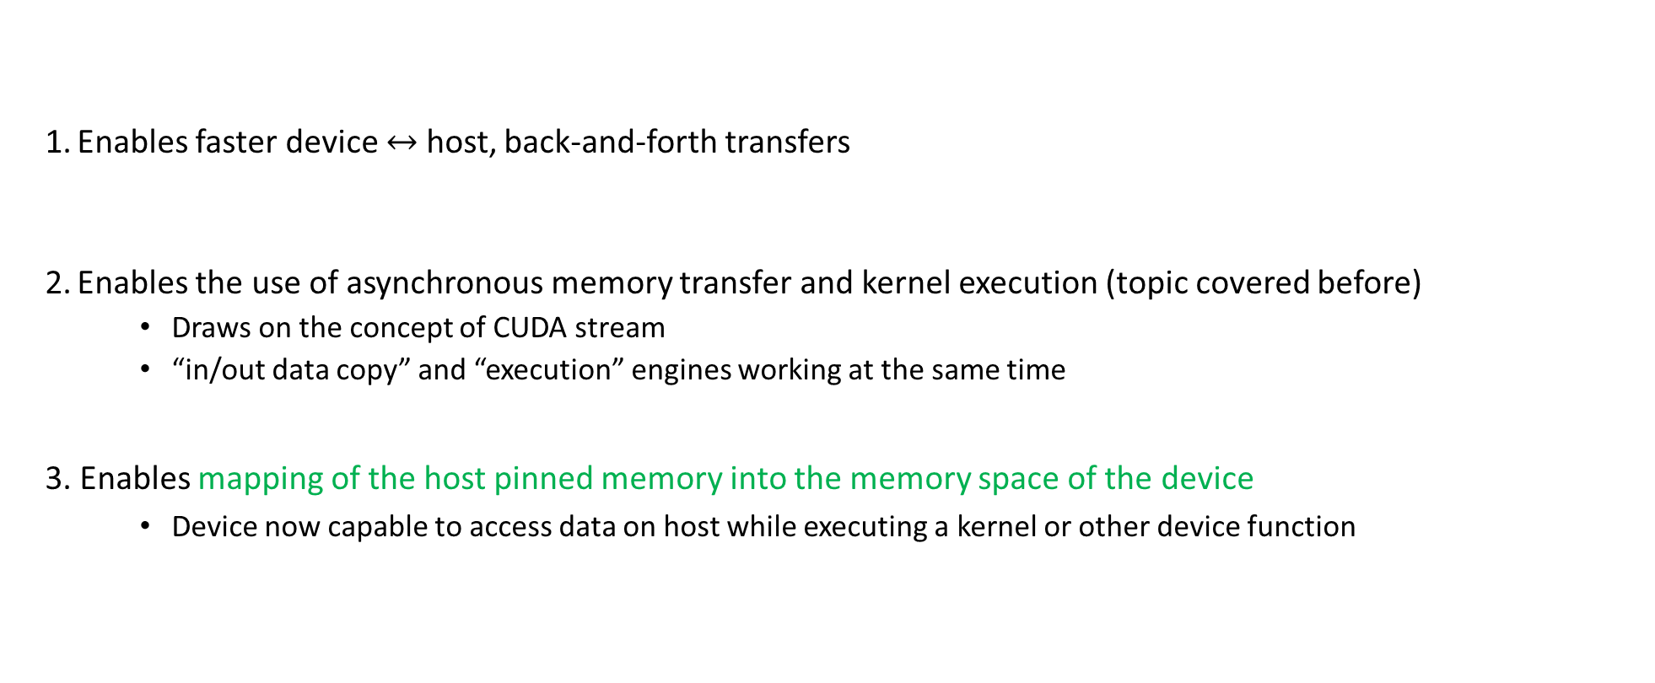
cudaHostAlloc: A friend, with its pluses and minuses
Enables faster device $↔$ host, back-and-forth transfers
Enables the use of asynchronous memory transfer and kernel execution (topic covered before)
Draws on the concept of CUDA stream
“in/out data copy” and “execution” engines working at the same time
3. Enables mapping of the host pinned memory into the memory space of the device
Device now capable to access data on host while executing a kernel or other device function

Slide 15
cudaHostAlloc: Function Prototype
cudaError_t cudaHostAlloc(void** pHst, size_t sz, unsigned int flag);
Last argument (“flag”) controls the magic
“flag” values: cudaHostAllocPortable, cudaHostAllocWriteCombined, etc.
The “flag” of most interest is “cudaHostAllocMapped”
Maps the memory allocated on the host in the memory space of the device for direct access

Slide 16
Zero-Copy (Z-C) GPU-CPU Interaction
What more* is gained if you pin host memory via cudaHostAlloc?
The ability to access a piece of data from pinned and mapped host memory by a thread running on the GPU without a CUDA runtime copy call to explicitly move data onto the GPU
This is called zero-copy (Z-C) GPU-CPU interaction, from where the name “zero-copy memory”
Calling cudaMemcpy not a must anymore
Notes:
Data is still red/written through the PCI-E pipe
Process managed by the runtime, in a transparent fashion
The device memory ballooned, to include main memory that physically resides on the host
Footnote: recall that cudaHostAlloc enables asynchronous operations in streams, as well as faster H2D/D2H data transfers

Slide 17
From Z-C to UVA: CUDA 2.2 to CUDA 4.0
Pain in the rear: Z-C enabled access of data on the host from the device required one additional runtime call to cudaHostGetDevicePointer()
cudaHostGetDevicePointer(): given a pointer to pinned host memory produces a new pointer that can be invoked within the kernel to access data stored on the host
The need for the cudaHostGetDevicePointer() call was eliminated in CUDA 4.0 with the introduction of the Unified Virtual Addressing (UVA) mechanism

Slide 18
How one can think of the host & device memory ecosystem
Helpful to not think of the physical memory as one contiguous thing
Rather, an amalgamation of bits and pieces
Regard it as a “pool of physical memory”
Why: these days the pool of physical memory includes the memory of the GPU[s]

Slide 19
Finding the needle in the haystack
If the pool includes all the memory of the system, how do you find what you need?
Rely on the page table & the concept of virtual memory
Use 49 instead of 48 bits to represent addresses in this virtual memory
NOTE: although the OS is 64 bits, modern systems typically use only 48 bits for addresses
64 bits would index 18,446,744,073,709,551,615 bytes – way more than what we see in reality

Slide 20
Virtual vs. Physical Memory [old slide; updated with relevant information]
Virtual memory: dally and quaint fictitious space of 2³² addresses (on 32 bit architectures) in which a process sees its data being placed, the instructions stored, etc.
Correction, for this segment of the course: you actually have 49 bits instead of 32
You can index into 562,949,953,421,311 bytes (about 562 Terabytes) – hundreds of times more than what in use on a system nowadays
Physical memory: a busy [perhaps heterogeneous] place that hosts at the same time data and instructions associated with many applications simultaneously running on the system
Notes:
The Virtual Memory paradigm allows:
running programs that require more memory than physically available
running multiple programs “simultaneously” (multi-tasking)
allows handling of memory segmentation
allows transparent and unitary handling of memory and secondary storage (hard disk / solid state disk)
gets away with the need to use relative addresses or program relocation
Hardware component in charge: Memory Management Unit (MMU)

Slide 21
Virtual Memory: The Page Table [old slide]
Virtual memory allows the processor to work in a virtual world in which a process seems to have exclusive access to a very large memory space
This virtual world is connected back to, or mapped back into, the physical memory through a Page Table
This is one level of indirection
Notes:
Back to the MMU’s job: Translating between virtual addresses and physical addresses. This is done through a so-called Page Table
To see how the PT works, let’s first dissect a virtual memory address…

Slide 22
The UVA
Key observation: relatively recently, the GPU and CPU decided to share together one virtual memory space
UVA: Unified Virtual Address
UVAS: Unified Virtual Address Space
The trick is to translate an address from this 49-bit UVAS into the pool of physical memory
Notes:
Back to the MMU’s job: Translating between virtual addresses and physical addresses. This is done through a so-called Page Table
To see how the PT works, let’s first dissect a virtual memory address…

Slide 23
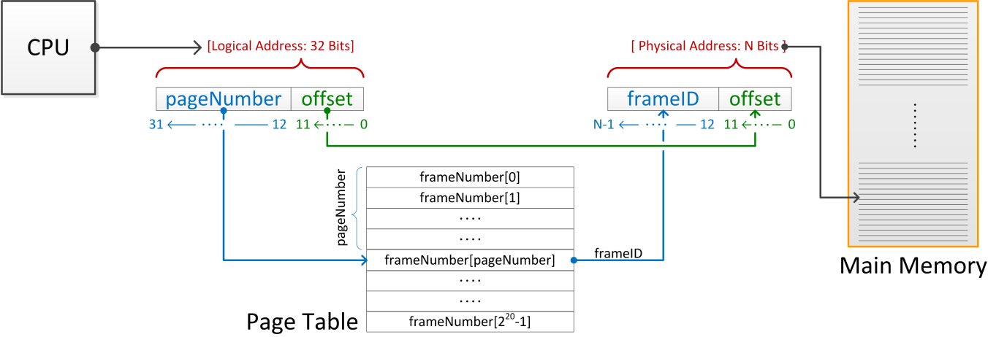

The Page Table & The Translation Process
A virtual address has two parts (address butchering):
The page number
The offset (last 12 bits)
Example below assumes a 32-bit OS with virtual pages of $4096=2^{12}$ bytes
process
Pool of Physical Memory (includes GPU memory now)
[physical memory]
Notes:
The virtual memory is split into pages.
The physical memory is split into frames.
This is for a 32-bit OS with virtual pages of 4096 bytes.
4096 = 2^12 → need 12 bits to indicate the offset in the page.
(Note: unit of address resolution is 8 bits → a virtual page holds 4 KB)
The remaining 32-12 = 20 bits used to index into the Page Table to get the corresponding frame number (which is held in N bits)

Slide 24
Anatomy of a Virtual Memory Address
A page of virtual memory corresponds to a frame of physical memory
The size of a page (or frame, for that matter) is typically 4096 bytes
Compare to 64 bytes, the size of a cache block (line)
2¹² = 4096: 12 bits of the address are sufficient to relatively position each byte in a page
Bits marked 0 through 11 on the previous slide

Slide 25
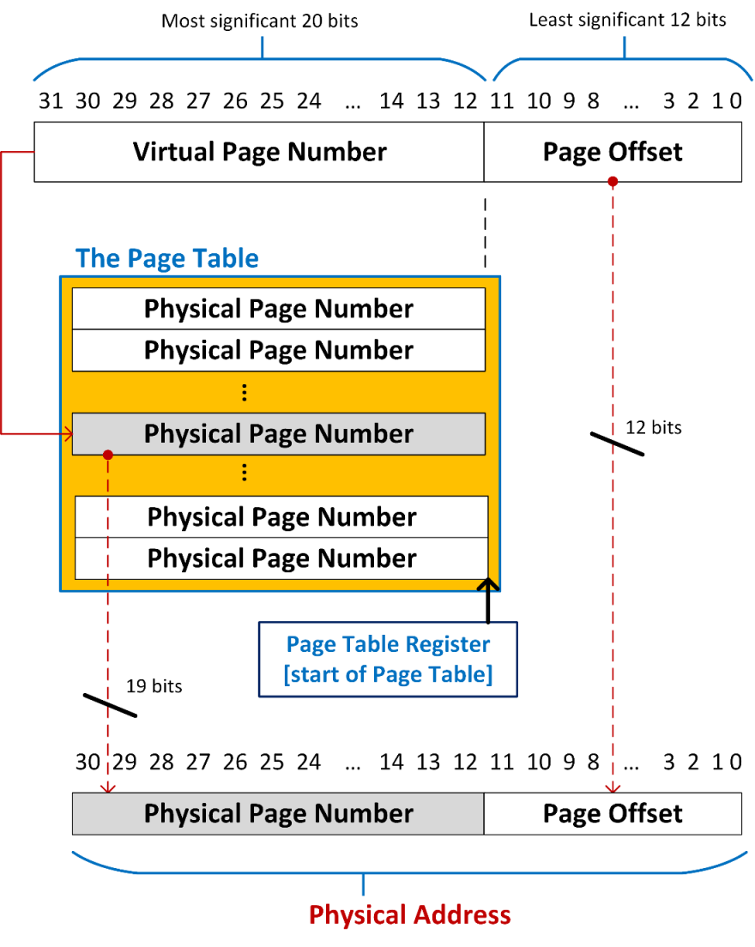
The Translation Process
Example: imagine that your physical memory is 2 GB
The physical address has 31 bits: 2³¹=2GB
Then the page table converts the bits 12 through 31 of the virtual address into bits 12 through 30 of the physical address
Notes:
N depends on the amount of available RAM:
e.g. for 2GB of RAM, N=19. Because 2GB=2^31 bits and 31=12+19
since N max = 20 → a 32-bit OS can reference 4GB of memory → a maximum of 1 million pages
each address requires 4bytes → the PT takes 4MB
each active application has its own PT → lots of memory just for the PTs

Slide 26

Unified Virtual Address Space: From CUDA programming guide
All host memory allocations made via CUDA API calls and all device memory allocations on supported devices are within the UVAS. As a consequence:
Today, the location of any memory on any of the devices or on the host allocated through CUDA can be determined from the value of the pointer using cudaPointerGetAttributes()
When copying to or from the memory of any device the cudaMemcpyKind parameter of cudaMemcpy*() can be set to cudaMemcpyDefault to determine locations from the pointers
Allocations via cudaHostAlloc() are automatically portable across all the devices
Pointers returned by cudaHostAlloc() can be used directly from within kernels running on a device
[NVIDIA]$→$

Slide 27
UVA - Consequences
CUDA runtime can identify where the data is stored based on the value of the pointer
Possible since one virtual address space was used for the CPU and GPU memory allocated through CUDA
There is no need to deal with cudaMemcpyHostToHost, cudaMemcpyHostToDevice, cudaMemcpyDeviceToHost, and cudaMemcpyDeviceToDevice scenarios
Simply use the generic cudaMemcpyDefault flag
What this buys us: ability to do, for instance, an inter-device copy that does not rely on the host for staging data movement
cudaMemcpy(gpuDst_memPntr, gpuSrc_memPntr, byteSize, cudaMemcpyDefault)

Slide 28
UVA – Showcasing Its Versatility…
Set of commands below can be issued by one host thread to multiple devices
No need to use anything beyond cudaMemcpyDefault
cudaMemcpy(gpu1Dst_memPntr, host_memPntr, byteSize1, cudaMemcpyDefault)
cudaMemcpy(gpu2Dst_memPntr, host_memPntr, byteSize2, cudaMemcpyDefault)
cudaMemcpy(host_memPntr, gpu1Dst_memPntr, byteSize1, cudaMemcpyDefault)
cudaMemcpy(host_memPntr, gpu2Dst_memPntr, byteSize2, cudaMemcpyDefault)
UVA support is the enabler for the peer-to-peer (P2P), inter-GPU, data transfer
P2P not discussed here
UVA is the underpinning technology for P2P
Notes:
SR: I don’t follow this? A single thread could have done this before. With our without cudaMemcpyHostToDevice (etc.)

Slide 29
UVA is a Step Forward Relative to Z-C
Z-C Key Accomplishment: use pointer within device function to access host data
Z-C focused on a data access, an issue relevant in the context of functions executed on the device
UVA had a data access component but also a data transfer component:
Data access: A GPU could access data on a different GPU, a novelty back in CUDA 4.0
Data transfer: copy data in between GPUs
cudaMemcpy is the main character in this play, data transfer initiated on the host side

Slide 30
UVA & Unified Memory (UM)
The Unified Virtual Address idea had ok impact, perhaps good enough to write home about
Why was UVA less than the sliced bread idea?
Because it didn’t allow the host to join the party: the device could read host memory, but not vice-versa
The device can party with the host, but the host cannot party with the device
Unified Memory (UM) is like UVA but enabled the CPU to tap into GPU memory
UM works in conjunction with a “managed memory pool”
Fallout: improved significantly CUDA ease of use, particularly for multi-GPU systems

Slide 31
Unified Memory, a first example
#include <cstdio>
#define SZ 8
__global__ void AplusB(int *ret, int a, int b) {
ret[threadIdx.x] = a + b + threadIdx.x;
}
int main() {
int *ret;
cudaMalloc(&ret, SZ * sizeof(int));
AplusB<<<1, SZ>>>(ret, 10, 100);
int *host_ret = new int[SZ];
cudaMemcpy(host_ret, ret, SZ * sizeof(int), cudaMemcpyDefault);
for (int i = 0; i < SZ; i++)
std::printf("%d: A+B = %d\n", i, host_ret[i]);
delete[] host_ret;
cudaFree(ret);
return 0;
}
12 lines of code
#include <cstdio>
#define SZ 8
__global__ void AplusB(int *ret, int a, int b) {
ret[threadIdx.x] = a + b + threadIdx.x;
}
int main() {
int *ret;
cudaMallocManaged(&ret, SZ * sizeof(int));
AplusB<<<1, SZ>>>(ret, 10, 100);
cudaDeviceSynchronize();
for (int i = 0; i < SZ; i++)
std::printf("%d: A+B = %d\n", i, ret[i]);
cudaFree(ret);
return 0;
}
10 lines of code
TRUMAN Debug> ./unifMemCUDAexPart1.exe
0: A+B = 110
1: A+B = 111
2: A+B = 112
3: A+B = 113
4: A+B = 114
5: A+B = 115
6: A+B = 116
7: A+B = 117
#include <cstdio>
#define SZ 8
__device__ __managed__ int ret[SZ];
__global__ void AplusB(int *ret, int a, int b) {
ret[threadIdx.x] = a + b + threadIdx.x;
}
int main() {
AplusB<<<1, SZ>>>(10, 100);
cudaDeviceSynchronize();
for (int i = 0; i < SZ; i++)
std::printf("%d: A+B = %d\n", i, ret[i]);
return 0;
}
8 lines of code
(can make it 7)

Slide 32
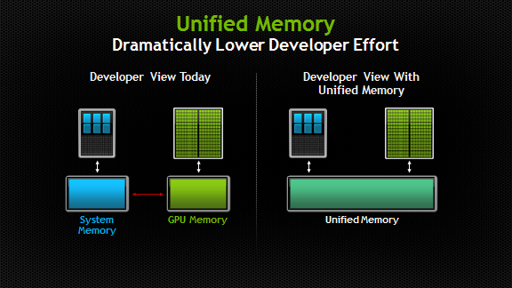
Unified Memory: further thoughts
One memory allocation call takes care of memory setup at both ends; i.e., device and host
The main actor: the CUDA runtime function cudaMallocManaged()
New way of perceiving the memory interplay in GPGPU computing
No distinction is made between memory on the host and memory on the device
It’s just a pool of memory, albeit with different access times when accessed by different processors
“processor”: any independent execution unit with a dedicated memory management unit (MMU)
Includes both CPUs and GPUs of any type and architecture
Old Memory Perception
New Perception with Unified Memory
[NVIDIA]→

Slide 33
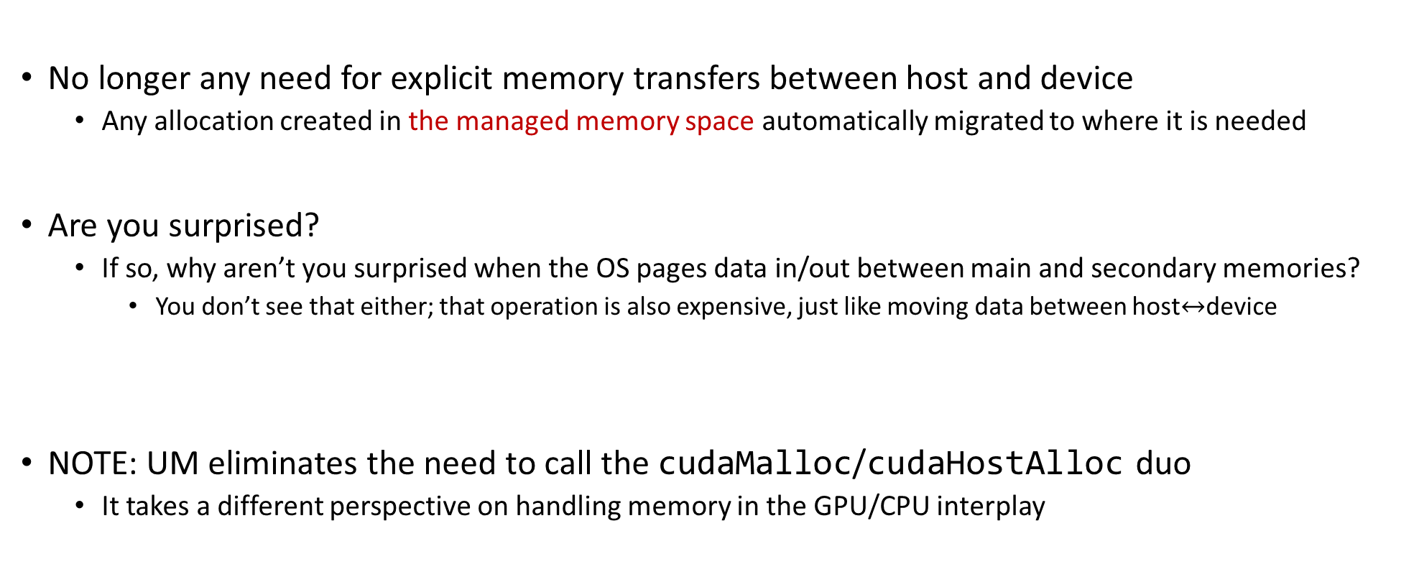
The UM innovation
No longer any need for explicit memory transfers between host and device
Any allocation created in the managed memory space automatically migrated to where it is needed
Are you surprised?
If so, why aren’t you surprised when the OS pages data in/out between main and secondary memories?
You don’t see that either; that operation is also expensive, just like moving data between host$↔$device
NOTE: UM eliminates the need to call the cudaMalloc/cudaHostAlloc duo
It takes a different perspective on handling memory in the GPU/CPU interplay

Slide 34
UM - Other interesting tidbits
Reliance on a managed memory space in which all processors see a single coherent memory image with a common address space
The runtime manages data access and locality within a CUDA program without need for explicit memory copy calls
Memory is migrated where it is used, the page table of the processors is simply updated
One can now oversubscribe the amount of memory on the device
Allocate more than available; might spill into host memory

Slide 35
Then and Now: no-UM vs. UM
#include <cmath>
#include <iostream>
const int ARRAY_SIZE = 1000;
using namespace std;
__global__ void increment(double *aArray, double val, unsigned int sz) {
unsigned int indx = blockIdx.x * blockDim.x + threadIdx.x;
if (indx < sz)
aArray[indx] += val;
}
int main(int argc, char **argv) {
double *hA;
double *dA;
hA = new double[ARRAY_SIZE];
cudaMalloc(&dA, ARRAY_SIZE * sizeof(double));
for (int i = 0; i < ARRAY_SIZE; i++)
hA[i] = 1. * i;
double inc_val = 2.0;
cudaMemcpy(dA, hA, sizeof(double) * ARRAY_SIZE, cudaMemcpyHostToDevice);
increment<<<2, 512>>>(dA, inc_val, ARRAY_SIZE);
cudaMemcpy(hA, dA, sizeof(double) * ARRAY_SIZE, cudaMemcpyDeviceToHost);
double error = 0.;
for (int i = 0; i < ARRAY_SIZE; i++)
error += fabs(hA[i] - (i + inc_val));
cout << "Test: " << (error < 1.E-9 ? "Passed" : "Failed") << endl;
cudaFree(dA);
delete[] hA;
return 0;
}
#include <cmath>
#include <iostream>
const int ARRAY_SIZE = 1000;
using namespace std;
__global__ void increment(double *aArray, double val, unsigned int sz) {
unsigned int indx = blockIdx.x * blockDim.x + threadIdx.x;
if (indx < sz)
aArray[indx] += val;
}
int main(int argc, char **argv) {
double *mA;
cudaMallocManaged(&mA, ARRAY_SIZE * sizeof(double));
for (int i = 0; i < ARRAY_SIZE; i++)
mA[i] = 1. * i;
double inc_val = 2.0;
increment<<<2, 512>>>(mA, inc_val, ARRAY_SIZE);
cudaDeviceSynchronize();
double error = 0.;
for (int i = 0; i < ARRAY_SIZE; i++)
error += fabs(mA[i] - (i + inc_val));
cout << "Test: " << (error < 1.E-9 ? "Passed" : "Failed") << endl;
cudaFree(mA);
return 0;
}

Slide 36
Requirements, UM
GPU with SM architecture 3.0 or higher (Kepler class or newer)
A 64-bit host application and non-embedded operating system (Linux, Windows, macOS)
CUDA 6.0 or higher
NOTE: UM is very much work in progress, not all features supported on Windows or MacOS
Linux kernel has good support for UM

Slide 37
UM vs. Z-C
Recall that with Z-C, data is always on the host in pinned CPU system memory
The device can update data on the host (if host memory pinned), but not vice-versa
UM: data stored on the device but migrated where needed
Data access and locality managed by CUDA runtime, handling transparent to the user
UM provides “single-pointer-to-data” model
The host can finally modify data that is stored on the device
Before, the host could drop data in device memory, but not directly modify it

Slide 38
UM: Required API Changes
As far as the CUDA API is concerned, UM led to *three* new family members :
cudaMallocManaged
__managed__
cudaStreamAttachMemAsync()
There is a lot more that doesn’t meet the eye. Very tough nut to crack, managed memory

Slide 39
cudaMallocManaged
Function Prototype:
cudaError_t cudaMallocManaged(void** devPtr, size_t size, unsigned int flag)
A drop-in replacement for cudaMalloc() – they are semantically identical
Allocates managed memory on the device
First two arguments have the expected meaning
Caveats:
devPtr: pointer accessible from both Host and Device
flag controls the default stream association for this allocation
cudaMemAttachGlobal - memory is accessible from any stream on any device
cudaMemAttachHost – memory on this device accessible by host only
Free memory with the same cudaFree()

Slide 40
__managed__
Global/file-scope variable annotation combines with __device__
Declares global-scope migrate-able device variable
Variable accessible from both GPU and CPU code
#include <stdio.h>
#include <stdlib.h>
#define SZ 8
__device__ __managed__ int ret[SZ];
__global__ void AplusB(int a, int b) {
ret[threadIdx.x] = a + b + threadIdx.x;
}
int main() {
AplusB<<<1, SZ>>>(10, 100);
cudaDeviceSynchronize();
for (int i = 0; i < SZ; i++)
printf("%d: A+B = %d\n", i, ret[i]);
return 0;
}

Slide 41
cudaStreamAttachMemAsync()
Manages concurrency in multi-threaded CPU applications
Not relevant here

Slide 42
UM, other quick points
Managed memory is interoperable and interchangeable with device-specific allocations, such as those created using the cudaMalloc() routine
Translation:
Memory allocated w/ cudaMallocManaged() behaves in all situations like mem. allocated w/ cudaMalloc()
But not vice-versa
All CUDA operations that are valid on device memory are also valid on managed memory

Slide 43
UM, other quick points
On Pascal and later GPUs, managed memory might not be physically allocated when cudaMallocManaged() returns
It might be virtually allocated, but not physically allocated
It may only be populated on access (or prefetching)
Page table entries and memory frames might not be created until they are accessed by the GPU or the CPU
The pages can migrate to any processor’s memory at any time, and the CUDA runtime employs heuristics to maintain data locality and prevent excessive page faults
[https://devblogs.nvidia.com/unified-memory-cuda-beginners]$→$

Slide 44
UM, Nuts and Bolts
Managed memory migration is at the page level
The default page size is currently the same as the OS page size today (typically 4 KiB)
In general, the following happen in a transparent fashion:
Pages touched by the CPU are moved back to the device when needed on the device
Pages touched by the GPU are moved back to the host when needed on the host
Done how?
For instance, if CPU needs data, the runtime intercepts CPU dirty pages and detects page faults
Then, the runtime moves from device over PCI-E only the dirty pages to present the host with updated data
Notes:
A lot of this picked up from http://devblogs.nvidia.com/parallelforall/unified-memory-in-cuda-6/

Slide 45
UM, Nuts and Bolts
Simultaneous access to managed memory from the CPU & GPUs with CC<6.0 not possible
Pre-Pascal GPUs lack hardware page faulting, so coherence can’t be guaranteed
Therefore, if CC<6.0, an access from the CPU while a kernel is running will cause a segmentation fault
On Pascal and later GPUs, the CPU & the GPU can simultaneously access managed memory, since they can both handle page faults
NOTE: up to application developer to ensure there are no race conditions caused by simultaneous accesses
In other words, you’ll have the traditional RAW, WAW, WAR hazards of parallel computing
Notes:
A lot of this picked up from http://devblogs.nvidia.com/parallelforall/unified-memory-in-cuda-6/

Slide 46
UM: Access to managed memory pool
Playing it safe: use cudaDeviceSynchronize() before having the host work on memory that the GPU is also working on
Note: Any function that logically guarantees the GPU finished execution is actually acceptable
Examples: cudaStreanSynchronize(), cudaMemcpy(), cudaMemset(), etc.

Slide 47
UM: Access to managed pool – Example, for CC<6.0
Bad: Execution seg. faults
Good: Code runs ok
__device__ __managed__ int x, y = 2;
__global__ void kernel() {
x = 10;
}
int main() {
kernel << < 1, 1 >> >();
y = 20; // ERROR: CPU access concurrent with GPU
cudaDeviceSynchronize();
return 0;
}
__device__ __managed__ int x, y = 2;
__global__ void kernel() {
x = 10;
}
int main() {
kernel << < 1, 1 >> >();
cudaDeviceSynchronize();
y = 20; // GPU is idle so access is OK
return 0;
}
[NVIDIA, Programming Guide]→

Slide 48

Unified Memory, under the hood
GPU A
(better yet, processor A)
GPU B
(better yet, processor B)
 | page1 |  | page2
Single virtual memory shared between processors
[Nikolay Sakharnykh]$→$

Slide 49
Unified Memory, under the hood
A’s page table
B’s page table
page1
page2
page1
page2
A’s phys mem
B’s phys mem
GPU A
(better yet, processor A)
GPU B
(better yet, processor B)
The virtual
memory
 | page1 |  | page2
All processors operate in/perceive one single virtual memory. The physical memory is a odd thing
[Nikolay Sakharnykh]$→$

Slide 50
Unified Memory, under the hood
A’s page table
B’s page table
page1
page2
page3
page1
page2
page3
*addr1 = 1
local access
A’s phys mem
B’s phys mem
*addr3 = 1 page fault
[Nikolay Sakharnykh]$→$

Slide 51
Unified Memory, under the hood
A’s page table
B’s page table
page1
page2
page3
page 1
A’s phys mem
B’s phys mem
page 2
*addr3 = 1 access replay
page 3
page3 populated and mapped into B’s memory
[Nikolay Sakharnykh]$→$

Slide 52
Unified Memory, under the hood
A’s page table
B’s page table
page1
page2
page3
page1
A’s phys mem
B’s phys mem
page2
*addr2 = 1 page fault
page3
*addr3 = 7
page fault
[Nikolay Sakharnykh]$→$

Slide 53
Unified Memory, under the hood
A’s page table
B’s page table
page1
page2
page3
page1
A’s phys mem
B’s phys mem
page2
*addr2 = 1 page fault
page3
*addr3 = 7
page fault
page2 and page3 unmapped from B’s memory
[Nikolay Sakharnykh]$→$

Slide 54
Unified Memory, under the hood
A’s page table
B’s page table
page1
page2
page3
page1
A’s phys mem
B’s phys mem
page2
*addr2 = 1 page fault
migration
(runtime managed)
page3
*addr3 = 7
page fault
pages data migrated to A’s physical memory
[Nikolay Sakharnykh]$→$

Slide 55
Unified Memory, under the hood
A’s page table
B’s page table
page1
page2
page3
page1
A’s phys mem
B’s phys mem
page2
*addr2 = 1 access replay
page3
*addr3 = 7
access replay
[Nikolay Sakharnykh]$→$

Slide 56
Unified Memory, under the hood
A’s page table
B’s page table
page1
page2
page3
page4
page1
page2
page3
page4
A’s phys mem
B’s phys mem
[Nikolay Sakharnykh]$→$

Slide 57
Unified Memory, under the hood
A’s page table
B’s page table
page1
page2
page3
page4
page5
page1
page2
page3
page4
page5
A’s phys mem
B’s phys mem
[Nikolay Sakharnykh]$→$

Slide 58
Unified Memory, under the hood
A’s page table
B’s page table
page1
page2
page3
page4
page5
page1
page2
page3
page4
page5
A’s phys mem
B’s phys mem
*addr5 = 9
page fault
[Nikolay Sakharnykh]$→$

Slide 59
Unified Memory, under the hood
A’s page table
B’s page table
page1
page2
page3
page4
page5
page1
page2
page3
page4
page5
A’s phys mem
B’s phys mem
*addr5 = 9
page fault
page4 unmapped from A’s memory and migrated
[Nikolay Sakharnykh]$→$

Slide 60
Unified Memory, under the hood
A’s page table
B’s page table
page1
page2
page3
page4
page5
page1
page2
page3
page4
page5
A’s phys mem
B’s phys mem
*addr5 = 9
page fault
page4 mapped in B’s memory, page5 unmapped and migrated to A
[Nikolay Sakharnykh]$→$

Slide 61
Unified Memory, under the hood
A’s page table
B’s page table
page1
page2
page3
page4
page5
page1
page2
page3
page4
page5
A’s phys mem
B’s phys mem
*addr5 = 9
access replay
[Nikolay Sakharnykh]$→$

Slide 62
UM level of support
Linux is most mature in UM support
E.g.: additional Unified Memory features on Linux (only)
On-demand page migration
GPU memory oversubscription
Windows and MacOS support UM but not have the two features above

Slide 63

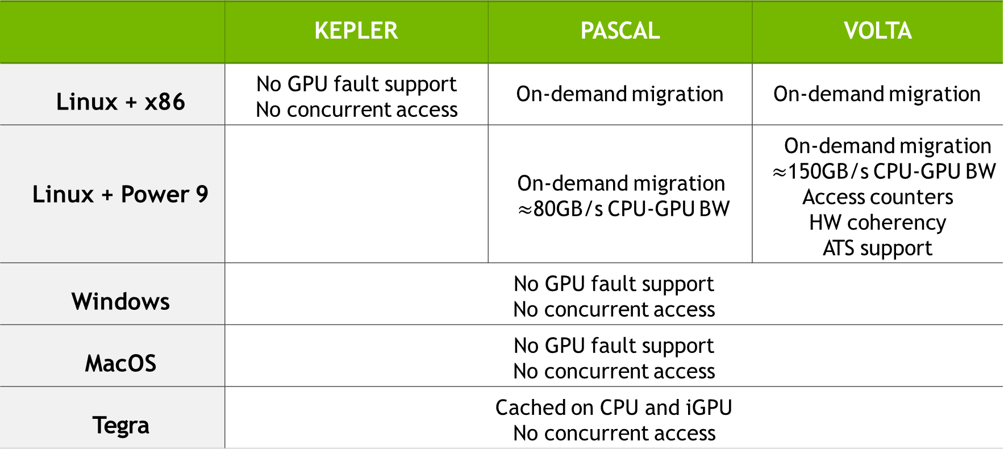
Unified Memory platforms
 | KEPLER | PASCAL | VOLTA
Linux + x86 | No GPU fault support No concurrent access | On-demand migration | On-demand migration
Linux + Power 9 |  | On-demand migration $≈$80GB/s CPU-GPU BW | On-demand migration $≈$150GB/s CPU-GPU BW Access counters HW coherency ATS support
Windows | No GPU fault support No concurrent access
MacOS | No GPU fault support No concurrent access
Tegra | Cached on CPU and iGPU No concurrent access
[Nikolay Sakharnykh]$→$

Slide 64
CUDA + Power 9 on Euler
#include <cstdio>
#define SZ 8
__global__ void AplusB(int a, int b, int* result){
result[threadIdx.x] = a + b + threadIdx.x;
}
int main() {
int ret[SZ];
AplusB <<<1, SZ >>>(10, 100, ret);
cudaDeviceSynchronize();
for (int i = 0; i < SZ; i++)
std::printf("%d: A+B = %d\n", i, ret[i]);
return 0;
}
me759@euler ~/t/cuda> nvprof ./ats_static
==19313== NVPROF is profiling process 19313, command: ./ats_static
0: A+B = 110
1: A+B = 111
2: A+B = 112
3: A+B = 113
4: A+B = 114
5: A+B = 115
6: A+B = 116
7: A+B = 117
==19313== Profiling application: ./ats_static
==19313== Profiling result:
Type Time(%) Time Calls Avg Min Max Name
GPU activities: 100.00% 5.5040us 1 5.5040us 5.5040us 5.5040us AplusB(int, int, int*)
API calls: 98.68% 196.71ms 1 196.71ms 196.71ms 196.71ms cudaLaunchKernel
0.83% 1.6498ms 1 1.6498ms 1.6498ms 1.6498ms cuDeviceTotalMem
0.44% 884.81us 96 9.2160us 199ns 357.96us cuDeviceGetAttribute
0.04% 76.012us 1 76.012us 76.012us 76.012us cuDeviceGetName
0.00% 8.8440us 1 8.8440us 8.8440us 8.8440us cudaDeviceSynchronize
0.00% 2.6110us 1 2.6110us 2.6110us 2.6110us cuDeviceGetPCIBusId
0.00% 1.9410us 3 647ns 363ns 1.0430us cuDeviceGetCount
0.00% 1.1720us 2 586ns 326ns 846ns cuDeviceGet
0.00% 316ns 1 316ns 316ns 316ns cuDeviceGetUuid

Slide 65
CUDA & Power 9
CPU vs GPU
GPU code w/ Unified Memory
CPU code
float *data;
data = new float[N];
cpu_func1(data, N); cpu_func2(data, N);
cpu_func3(data, N);
delete[] data;
float *data;
data = new float[N];
cpu_func1(data, N);
gpu_func2<<<...>>>(data, N);
cudaDeviceSynchronize();
cpu_func3(data, N);
This function call not needed if synchronous kernel calls
delete[] data;
[Nikolay Sakharnykh]$→$

Slide 66
CUDA & Power 9
Explicit mem. Management vs. Unified Memory
Explicit Memory Management GPU code w/ Unified Memory
float *data, *d_data; data = new float[N];
cpu_func1(data, N);
cpu_func3(data, N); delete[] data;
float *data;
data = new float[N];
cpu_func1(data, N);
gpu_func2<<<...>>>(data, N); cudaDeviceSynchronize();
cpu_func3(data, N);
delete[] data;
cudaMalloc(&d_data, N * sizeof(float));
cudaMemcpy(d_data, data, N, ...)
gpu_func2<<<...>>>(d_data, N); cudaMemcpy(data, d_data, N, ...) cudaFree(d_data);
[Nikolay Sakharnykh]$→$

Slide 67
CUDA & Power 9
Full Control with Prefetching
Explicit Memory Management Unified Memory + Prefetching
float *data, *d_data;
data = new float[N];
cudaMalloc(&d_data, N * sizeof(float));
cpu_func1(data, N);
cudaMemcpy(d_data, data, N,...);
gpu_func2<<<...>>>(d_data, N);
cudaMemcpy(data, d_data, N,...);
cudaFree(d_data);
cpu_func3(data, N);
delete[] data;
float *data; data = new float[N]; cpu_func1(data, N);
gpu_func2<<<...>>>(data, N);
cudaDeviceSynchronize(); cpu_func3(data, N); delete[] data;
cudaMemPrefetchAsync(data, N, GPU)
cudaMemPrefetchAsync(data, N, CPU)
[Nikolay Sakharnykh]$→$

Slide 68
CUDA & Power 9
Deep Copy
Explicit Memory Management GPU code w/ Unified Memory
char **data;
// allocate and initialize data on the CPU
char **data;
// allocate and initialize data on the CPU
gpu_func<<<...>>>(data, N);
char **d_data;
char **h_data = new char*[N];
for (int i = 0; i < N; i++) {
cudaMalloc(&h_data[i], N);
cudaMemcpy(h_data[i], data[i], N, ...);
}
cudaMalloc(&d_data, N*sizeof(char*)); cudaMemcpy(d_data, h_data, N*sizeof(char*), ...);
gpu_func<<<...>>>(d_data, N);
[Nikolay Sakharnykh]$→$

Slide 69
UM – Why Bother?
A matter of convenience
Much simpler to write code using this memory model
For the casual programmer, the code will probably run faster due to data locality
The CUDA runtime will take care of moving the data where it ought to be
Looking ahead, we’ll see more of this
Already the case for integrated GPUs that are part of the system chipset (Tegra Xavier)
Better support coming for Windows & MacOS

Slide 70
High vantage point, the big picture
In the beginning, to have data on the host changed on the device you would have to first use cudaMemcpy to trigger a data transfer from the host to the device
The same held in the other direction; i.e., changing data on the device by the host – you needed a transfer
Then, the device could access memory on the host (Z-C memory access)
Still required pointer de-mangling
Then, the idea of a unified virtual space took off and we had UVA
P2P communication, no need for pointer de-mangling
Finally, the UM (managed memory) came along; processors can access each other’s memory
The field is in flux

Slide 71
GPU Computing with thrust

Slide 72
Three Ways to Accelerate on GPU
Application
Libraries
Directives
Programming Languages
Easiest Approach
Maximum Performance
Direction of increased performance
(and effort)
NVIDIA [C. Woolley]→
Notes:
On the NVIDIA website, Thrust is listed under “Libraries” (https://developer.nvidia.com/gpu-accelerated-libraries).

Slide 73
Acknowledgments
The thrust slides include material provided by Nathan Bell previously of NVIDIA (at Google now)
Modified here and there, responsible for inaccuracies

Slide 74
Design Philosophy, thrust
Increase programmer productivity
Build applications quickly via generic programming
Leverage a template-based approach
Should be running fast
Efficient leveraging of GPU hardware
NVIDIA [N. Bell]→

Slide 75
What is thrust?
A template library for parallel computing on GPU and CPU*
Mimics the C++ STL
Heavy use of C++ containers
The one lecture where C++ comes into play heavily
Provides ready to use generic algorithms
Sorting, reduction, scan, etc.
NVIDIA [N. Bell]→

Slide 76
What is thrust?
thrust is a header library
All its functionality accessed by #include-ing the appropriate thrust header file
Program is compiled with nvcc as per usual, no special tools are required
C++ syntax. Related to high-level, host-side code that you have to produce
The concepts of execution configuration, shared memory, occupancy, blah, blah, blah: all but gone
NVIDIA [N. Bell]→

Slide 77
Work Plan, thrust
Namespaces, containers, iterators
Algorithms
General transformations. Zipping & fusing
Thrust example: Processing rainfall data

Slide 78
Namespaces
Avoid name collisions: thrust vs. std namespaces
// allocate host memory
thrust::host_vector<int> h_vec(10);
// call STL sort
std::sort(h_vec.begin(), h_vec.end());
// call Thrust sort
thrust::sort(h_vec.begin(), h_vec.end());
// for brevity
using namespace thrust;
// without namespace
int sum = reduce(h_vec.begin(), h_vec.end());
NVIDIA [N. Bell]→
Notes:
You’ll notice that we use things like thrust::host_vector or thrust::copy in our examples. The thrust:: part tells the C++ compiler that we want to look inside the thrust namespace for a specific function or class. Namespaces are a nice way to avoid name collisions. For instance,thrust::copy is different from std::copy provided in the STL. C++ namespaces allow us to distinguish between these two copy functions.

Slide 79
thrust containers: host_vector & device_vector
thrust provides two vector containers: host_vector and device_vector
host_vector is stored in host memory
device_vector lives in GPU device memory
thrust’s vector containers are just like std::vector in the C++ STL
Like std::vector, host_vector & device_vector are generic containers – they store whatever
[NVIDIA]$→$

Slide 80
thrust containers: host_vector & device_vector
Common operations become concise & readable through use of containers
// allocate host vector with two elements
thrust::host_vector<int> h_vec(2);
// copy host vector to device
thrust::device_vector<int> d_vec;
// manipulate device values from the host
d_vec[0] = 13;
d_vec[1] = 27;
std::cout << "sum: " << d_vec[0] + d_vec[1] << std::endl;
// copy host vector to device
h_vec = d_vec;
// vector memory automatically released w/ free() or cudaFree()
Notes:
Thrust provides two vector containers, host_vector and device_vector.
the = operator can be used to copy a host_vector to a device_vector (or vice-versa). The = operator can also be used to copy host_vector to host_vector or device_vector to device_vector.
note that individual elements of a device_vector can be accessed using the standard bracket notation. However, because each of these accesses requires a call to cudaMemcpy, use sparingly. We’ll look at some more efficient techniques later.

