Slide 1
ME759 High Performance Computing for Applications in Engineering [Spring 2021]
Lecture 16
03/01/2021
Dan Negrut, 2021 ME759 UW-Madison

Slide 2


Cartoon of the day
[Roz Chast]$→$

Slide 3
Is BBC recording on?
If my internet connection goes down, I’ll email from my phone to provide more information – go/no-go, next step, etc.

Slide 4
Before we get started…
Last time
One more case study: parallel prefix scan
The prefix scan fast algorithm is convoluted; lack of grid-level synchronization is partially to blame
Using streams in GPU computing
Today
Wrap up, using streams in GPU computing: increasing problem size; improving execution speeds
Debugging & profiling GPU code: some nuts and bolts
Other tidbits:
Assignment due on Th, 03/04, at 9 pm
Next two assignments are probably most difficult of the semester
Start early. Drop them if you are overwhelmed. Stay focused, make the right call
Do not run your code on the Euler headnode (use Slurm)
You can download the recording onto your machine, don’t need to listen to lecture through Canvas
Big PDF file contains all the slides thus far; easy to search into it to find topics covered thus far. Doc is here.

Slide 5
Example: Use of cudaStreamWaitEvent
Assume stream1 and stream2 have been defined/initialized already
The point of this example:
Use the two copy sub-engines at the same time: copy in (stream1), copy out (stream2)
Postpone launching of myKernel in stream2 until the copy operation in stream1 is completed
cudaEvent_t event;
cudaEventCreate (&event); // create event
cudaMemcpyAsync ( d_in, in, size, H2D, stream1 ); // 1) H2D copy of new input
cudaEventRecord (event, stream1); // record event
cudaMemcpyAsync ( out, d_out, size, D2H, stream2 ); // 2) D2H copy of previous result
cudaStreamWaitEvent ( stream2, event ); // wait for event in stream1
myKernel<<< 1000, 512, 0, stream2 >>> ( d_in, d_out ); // 3) GPU must wait for 1 and 2
someCPUfunction ( blah, blahblah ) // this gets executed right away
[S. Rennich, NVIDIA]→

Slide 6
Example 1: Using One Stream [Enable both CPU and GPU to mind their business at the same time]
Example draws on material presented in the “CUDA By Example” book
J. Sanders and E. Kandrot, authors
What is the purpose of this example?
Shows strategy that you can invoke when dealing with applications that require more memory than you can accommodate on the GPU
Remark:
In this example the magic happens on the host side. Focus on host code, not on the kernel executed on the GPU (the kernel code is basically irrelevant)

Slide 7
This Example’s Kernel
Computes some average, it’s not important, simply something that gets done and allows us later on to gauge efficiency gains when using *multiple* streams (for now dealing with one stream only)
Inputs: a and b
Output: c
#include "../common/book.h"
#define N 1048576 // this is 1024*1024
#define FULL_DATA_SIZE (N*20)
__global__ void kernel( int *a, int *b, int *c ) {
int idx = threadIdx.x + blockIdx.x * blockDim.x;
if (idx < N) {
int idx1 = (idx + 1) % 256;
int idx2 = (idx + 2) % 256;
float as = (a[idx] + a[idx1] + a[idx2]) / 3.0f;
float bs = (b[idx] + b[idx1] + b[idx2]) / 3.0f;
c[idx] = (as + bs) / 2;
}
}

Slide 8
The “main()” Function
01| int main( void ) {
02| cudaEvent_t start, stop;
03| float elapsedTime;
04|
05| cudaStream_t stream;
06| int *host_a, *host_b, *host_c;
07| int *dev_a, *dev_b, *dev_c;
08|
09| // start the timers
10| cudaEventCreate( &start );
11| cudaEventCreate( &stop );
12|
13| // initialize the stream; only one stream for now…
14| cudaStreamCreate( &stream );
15|
16| // allocate the memory on the GPU
17| cudaMalloc( (void**)&dev_a, N * sizeof(int) );
18| cudaMalloc( (void**)&dev_b, N * sizeof(int) );
19| cudaMalloc( (void**)&dev_c, N * sizeof(int) );
20|
21| // allocate host pinned memory, used to stream
22| cudaHostAlloc( (void**)&host_a, FULL_DATA_SIZE * sizeof(int), cudaHostAllocDefault );
23| cudaHostAlloc( (void**)&host_b, FULL_DATA_SIZE * sizeof(int), cudaHostAllocDefault );
24| cudaHostAlloc( (void**)&host_c, FULL_DATA_SIZE * sizeof(int), cudaHostAllocDefault );
25|
26| for (int i=0; i<FULL_DATA_SIZE; i++) {
27| host_a[i] = rand();
28| host_b[i] = rand();
29| }
Stage 1
Stage 2

Slide 9
The “main()” Function [Cntd.]
30|
31| cudaEventRecord( start, 0 );
32| // now loop over full data, chunk by chunk
33| for (int i=0; i<FULL_DATA_SIZE; i+= N) {
34| // copy the locked memory to the device, async
35| cudaMemcpyAsync( dev_a, host_a+i, N * sizeof(int), cudaMemcpyHostToDevice, stream );
36| cudaMemcpyAsync( dev_b, host_b+i, N * sizeof(int), cudaMemcpyHostToDevice, stream );
37|
38| kernel<<<(N+255)/256,256,0,stream>>>( dev_a, dev_b, dev_c );
39|
40| // copy the data from device to locked memory
41| cudaMemcpyAsync( host_c+i, dev_c, N * sizeof(int), cudaMemcpyDeviceToHost, stream );
42|
43| }
44|
45| cudaStreamSynchronize( stream );
46|
47| cudaEventRecord( stop, 0 );
48|
49| cudaEventSynchronize( stop );
50| cudaEventElapsedTime( &elapsedTime, start, stop ) );
51| printf( "Time taken: %3.1f ms\n", elapsedTime );
52|
53| // cleanup the streams and memory
54| cudaFreeHost( host_a );
55| cudaFreeHost( host_b );
56| cudaFreeHost( host_c );
57| cudaFree( dev_a );
58| cudaFree( dev_b );
59| cudaFree( dev_c );
60| cudaStreamDestroy( stream );
61|
62| return 0;
63|}
Here’s the important code
Stage 3
Stage 4
Stage 5

Slide 10
Example 1, Summary
Stage 1 sets up the events needed to time the execution of the program
Stage 2 allocates page-locked memory on the host side so that we can fall back on asynchronous memory copy operations between host and device
Stage 3 enques the set of GPU operations that need to be undertaken (the “chunkification”)
Stage 4 needed for timing reporting
Stage 5: clean up time

Slide 11
Example 1, Summary
Note that Example 1 only dealt w/ handling a very large problem via “chunkification”
“chunkification” somewhat similar to “tiling”
However,
“tiling” is something that happens exclusively on the device (from global to shared memory).
“chunkification” happens on the host
Focus next: using streams to gain speed

Slide 12
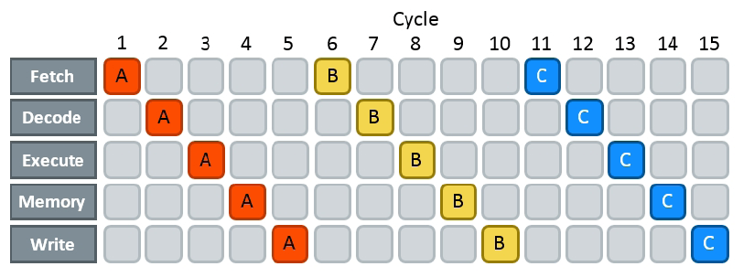
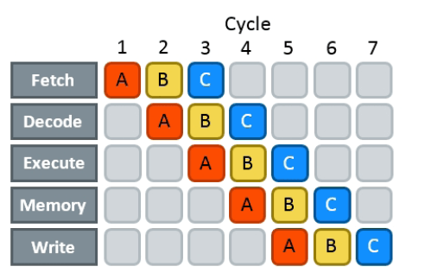

Warmup slide: Using streams is similar to pipelining (from ILP)
Cycle
No pipelining:
Cycle
Pipelining: The CU takes care of business, with some early help from the compiler
With pipelining:
[https://techdecoded.intel.io/resources/understanding-the-instruction-pipeline/#gs.665w4j]$→$

Slide 13

Gaining speed through concurrency. Looks like “manual pipelining”
Legend: DH-device2host copy ; K-kernel execution ; HD-host2device copy
No concurrency (1x)
4-way concurrency (3x+)
cudaMemcpyAsync(HD)
Kernel <<< >>>
cudaMemcpyAsync(DH)
HD1
K1
DH1
Time
HD2
K2
DH2
HD3
K3
DH3
thread on CPU
thread on CPU
2-way concurrency (up to 2x speedup)
K4 on CPU
Time
cudaMemcpyAsync(H2D)
K1 DH1
K2
DH2
K3
DH3
5+ way concurrency
K4
DH4
K1.1 K1.2 K1.3
HD1
DH1
Time
HD2
K2.1 K2.2 K2.3
DH2
HD3 K3.1 K3.2 K3.3 DH3
3-way concurrency (up to 3x speedup)
HD4
K4.1 K4.2 K4.3
DH4
HD5
K5.1 K5.2 K5.3
DH5
K1
HD6 K6.1 K6.2 K6.3 DH6
HD1
DH1
thread on CPU
HD2
K2
DH2
thread on CPU
HD3
K3
DH3
thread on CPU
HD4 K4 DH4
Time
Time
[Justin Luitjens - NVIDIA]$→$

Slide 14
Example 2: Using Multiple Streams [Version 2.1]
Similar to Example1, but use two streams
Goal this time around: increase speed of execution
Why would you want to use multiple streams?
Overlapping GPU execution with host ↔ device data movement can improve overall performance
See previous slide, use “manual pipelining”
Two ideas underlie the process
The idea of “chunkification” of the computation
Computation is broken into pieces that are queued up for execution on the device (we already saw this in Example 1, which uses one stream)
The idea of overlapping execution with PCI host ↔ device data movement

Slide 15
Overlapping Execution and Data Transfer: A Desirable Scenario
 | Stream0 |  | Stream1
 | memcpy a0 to GPU
 | memcpy b0 to GPU
 | kernel |  | memcpy a1 to GPU
 |  |  | memcpy b1 to GPU
 | memcpy c0 from GPU |  | kernel
 |  |  | memcpy c1 from GPU
 | memcpy a0 to GPU
 | memcpy b0 to GPU
 | kernel |  | memcpy a1 to GPU
 |  |  | memcpy b1 to GPU
 | memcpy c0 from GPU |  | kernel
 |  |  | memcpy c1 from GPU
 | Timeline of intended application execution
 | using two independent streams
Time
Observations:
“memcpy” actually represents an asynchronous cudaMemcpyAsync() memory copy call
White (empty) box: time when one stream is waiting to execute an operation that it cannot overlap with other stream’s operation
The goal: keep both GPU engine types (execution and mem copy) busy
Note: recent hardware allows two copies to take place simultaneously: one from host to device, at the same time one goes on from device to host (you have two copy subengines). This example shows only one copy-engine (old CC).

Slide 16
The “main()” Function, Two Streams
01| int main( void ) {
02| cudaDeviceProp prop;
03| int whichDevice;
04| HANDLE_ERROR( cudaGetDevice( &whichDevice ) );
05| HANDLE_ERROR( cudaGetDeviceProperties( &prop, whichDevice ) );
06| if (!prop.deviceOverlap) {
07| printf( "Device will not handle overlaps, so no speed up from streams\n" );
08| return 0;
09| }
10|
11| cudaEvent_t start, stop;
12| float elapsedTime;
13|
14| cudaStream_t stream0, stream1;
15| int *host_a, *host_b, *host_c;
16| int *dev_a0, *dev_b0, *dev_c0;
17| int *dev_a1, *dev_b1, *dev_c1;
18|
19| // start the timers
20| cudaEventCreate( &start );
21| cudaEventCreate( &stop );
22|
23| // initialize the streams
24| cudaStreamCreate( &stream0 );
25| cudaStreamCreate( &stream1 );
26|
27| // allocate the memory on the GPU
28| cudaMalloc( (void**)&dev_a0, N * sizeof(int) );
29| cudaMalloc( (void**)&dev_b0, N * sizeof(int) );
30| cudaMalloc( (void**)&dev_c0, N * sizeof(int) );
31| cudaMalloc( (void**)&dev_a1, N * sizeof(int) );
32| cudaMalloc( (void**)&dev_b1, N * sizeof(int) );
33| cudaMalloc( (void**)&dev_c1, N * sizeof(int) );
34|
35| // allocate host locked memory, used to stream
36| cudaHostAlloc( (void**)&host_a, FULL_DATA_SIZE * sizeof(int), cudaHostAllocDefault );
37| cudaHostAlloc( (void**)&host_b, FULL_DATA_SIZE * sizeof(int), cudaHostAllocDefault );
38| cudaHostAlloc( (void**)&host_c, FULL_DATA_SIZE * sizeof(int), cudaHostAllocDefault );
Stage 1
Stage 2
Stage 3

Slide 17

Quiz: Overlapping Execution and Data Transfer
 | Stream0 |  | Stream1
 | memcpy a0 to GPU
 | memcpy b0 to GPU
 | kernel |  | memcpy a1 to GPU
 |  |  | memcpy b1 to GPU
 | memcpy c0 from GPU |  | kernel
 |  |  | memcpy c1 from GPU
 | memcpy a0 to GPU
 | memcpy b0 to GPU
 | kernel |  | memcpy a1 to GPU
 |  |  | memcpy b1 to GPU
 | memcpy c0 from GPU |  | kernel
 |  |  | memcpy c1 from GPU
 | Timeline of intended application execution
 | using two independent streams
The pic above is for an older device, back then there was only overlap of kernel execution with H $↔$D mem transfer
Question: how is the picture above going to change if you can have at the same time a copy-in and copy-out mem transfer between the GPU and host?
Time

Slide 18
The “main()” Function, Two Streams [Cntd.]
39| for (int i=0; i<FULL_DATA_SIZE; i++) {
40| host_a[i] = rand();
41| host_b[i] = rand();
42| }
43|
44| cudaEventRecord( start, 0 );
45| // now loop over full data, in bite-sized chunks
46| for (int i=0; i<FULL_DATA_SIZE; i+= 2*N) {
47| // copy data from pinned memory to the device, async
48| cudaMemcpyAsync( dev_a0, host_a+i, N * sizeof(int), cudaMemcpyHostToDevice, stream0 );
49| cudaMemcpyAsync( dev_b0, host_b+i, N * sizeof(int), cudaMemcpyHostToDevice, stream0 );
50|
51| kernel<<<(N+255)/256,256,0,stream0>>>( dev_a0, dev_b0, dev_c0 );
52|
53| // copy the data from device to locked memory
54| cudaMemcpyAsync( host_c+i, dev_c0, N * sizeof(int), cudaMemcpyDeviceToHost, stream0 );
55|
56|
57| // copy the locked memory to the device, async
58| cudaMemcpyAsync( dev_a1, host_a+i+N, N * sizeof(int), cudaMemcpyHostToDevice, stream1 );
59| cudaMemcpyAsync( dev_b1, host_b+i+N, N * sizeof(int), cudaMemcpyHostToDevice, stream1 );
60|
61| kernel<<<(N+255)/256,256,0,stream1>>>( dev_a1, dev_b1, dev_c1 );
62|
63| // copy the data from device to locked memory
64| cudaMemcpyAsync( host_c+i+N, dev_c1, N * sizeof(int), cudaMemcpyDeviceToHost, stream1 );
65| }
66|
Still Stage 3
Stage 4
Here’s the important code

Slide 19
The “main()” Function, Two Streams [Cntd.]
67| cudaStreamSynchronize( stream0 );
68| cudaStreamSynchronize( stream1 );
69|
70| cudaEventRecord( stop, 0 );
71|
72| cudaEventSynchronize( stop );
73| cudaEventElapsedTime( &elapsedTime, start, stop ) );
74| printf( "Time taken: %3.1f ms\n", elapsedTime );
75|
76| // cleanup the streams and memory
77| cudaFreeHost( host_a );
78| cudaFreeHost( host_b );
79| cudaFreeHost( host_c );
80| cudaFree( dev_a0 );
81| cudaFree( dev_b0 );
82| cudaFree( dev_c0 );
83| cudaFree( dev_a1 );
84| cudaFree( dev_b1 );
85| cudaFree( dev_c1 );
86| cudaStreamDestroy( stream0 );
87| cudaStreamDestroy( stream1 );
88|
89| return 0;
90|}
Stage 5
NOTE: the kernel doesn’t actually change…

Slide 20
Example 2.1 [Version 1], Summary
Stage 1 ensures that your device supports your attempt to overlap kernel execution with host↔device data transfer
Stage 2 sets up the events needed to time the execution of the program
Stage 3 allocates page-locked memory on the host side so that we can fall back on asynchronous memory copy operations between host and device and initializes data
Stage 4 enques the set of GPU operations that need to be undertaken (the “chunkification”)
Stage 5 takes care of timing reporting and clean up

Slide 21
Comments, Using Two Streams [Version 2.1]
Timing results provided by “CUDA by Example: An Introduction to General-Purpose GPU Programming,”
Sanders and Kandrot reported results on NVIDIA GTX285
Using one stream (in Example 1): 62 ms
Using two streams (this example, version 1): 61 ms
Lackluster performance goes back to the way the two GPU engines (kernel execution and copy) are scheduled

Slide 22
The Two Stream Example, Version 2.1 Looking Under the Hood
Stream 0 |  | Copy Engine
memcpy a0 |  | memcpy a0
memcpy b0 |  | memcpy b0
kernel 0 |  | memcpy c0
memcpy c0 |  | memcpy a1
 |  | memcpy b1
Stream 1 |  | memcpy c1
memcpy a1
memcpy b1 |  | Kernel Engine
kernel 1 |  | kernel 0
memcpy c1 |  | kernel 1
Mapping of CUDA streams onto GPU engines
Copy Engine |  | Kernel Engine
Stream 0: memcpy a0 |  | Stream 0: kernel
Stream 0: memcpy b0 |  | Stream 1: kernel
Stream 0: memcpy c0
Stream 1: memcpy a1
Stream 1: memcpy b1
Stream 1: memcpy c1
Arrows depicting the dependency of cudaMemcpyAsync ()
calls on kernel executions in the 2 Streams example
At the left:
An illustration of how the work queued up in the streams ends up being assigned by the CUDA driver to the two GPU engines (copy and execution)
Important remark: FIFO is also observed in relation to scheduling the engines (not only the streams)
At the right
Image shows dependency that is implicitly set up in the two streams given the way the streams were defined in the code
The queue in the Copy Engine combined with the implied stream dependencies determines the scheduling of the Copy and Kernel Engines (next slide)

Slide 23
The Two Stream Example Looking Under the Hood
 | Copy Engine |  | Kernel Engine
 | Stream 0: memcpy a0
 | Stream 0: memcpy b0
 |  |  | Stream 0: kernel
 | Stream 0: memcpy c0
 | Stream 1: memcpy a1
 | Stream 1: memcpy b1
 |  |  | Stream 1: kernel
 | Stream 1: memcpy c1
 | Execution timeline of the 2 Stream example (blue line shows dependency; empty boxes represent idle segments)
Time
Note that due to the *specific* way in which the streams were defined (depth first), basically there is no overlap of copy & execution…
Explains the no net-gain in efficiency compared to the one stream example
Remedy: go breadth first, instead of depth first
In the current version, execution on the two engines was inadvertently blocked by the way the streams have been set up and the existing scheduling and lack of dependency checks available in the current version of CUDA

Slide 24
The Two Stream Example [Version 2.2: A More Effective Implementation: Breadth First]
The way we just went about business (the depth first approach):
Assign the copy of a0, copy of b0, kernel execution, and copy of c0 to stream0
Assign the copy of a1, copy of b1, kernel execution, and copy of c1 to stream1
New way (the breadth first approach):
Add the copy of a0 to stream0, and then add the copy of a1 to stream1
Next, add the copy of b0 to stream0, and then add the copy of b1 to stream1
Next, enqueue the kernel invocation in stream0, then enqueue one in stream1
Finally, enqueue the copy of c0 back to the host in stream0 followed by the copy of c1 in stream1

Slide 25

The Two Stream Example
A| // loop over full data, in bite-sized chunks
B| for (int i=0; i<FULL_DATA_SIZE; i+= N*2) {
C| // enqueue copies of a in stream0 and stream1
D| cudaMemcpyAsync( dev_a0, host_a+i, N * sizeof(int), cudaMemcpyHostToDevice, stream0 );
E| cudaMemcpyAsync( dev_a1, host_a+i+N, N * sizeof(int), cudaMemcpyHostToDevice, stream1 );
F| // enqueue copies of b in stream0 and stream1
G| cudaMemcpyAsync( dev_b0, host_b+i, N * sizeof(int), cudaMemcpyHostToDevice, stream0 );
H| cudaMemcpyAsync( dev_b1, host_b+i+N, N * sizeof(int), cudaMemcpyHostToDevice, stream1 );
I|
J| // enqueue kernels in stream0 and stream1
K| kernel<<<(N+255)/256,256,0,stream0>>>( dev_a0, dev_b0, dev_c0 );
L| kernel<<<(N+255)/256,256,0,stream1>>>( dev_a1, dev_b1, dev_c1 );
M|
N| // enqueue copies of c from device to locked memory
O| cudaMemcpyAsync( host_c+i , dev_c0, N * sizeof(int), cudaMemcpyDeviceToHost, stream0 );
P| cudaMemcpyAsync( host_c+i+N, dev_c1, N * sizeof(int), cudaMemcpyDeviceToHost, stream1 );
Q| }
Replaces Previous Stage 4
Copy Engine |  | Kernel Engine
Stream0: memcpy a0
Stream1: memcpy a1
Stream0: memcpy b0
Stream1: memcpy b1 |  | Stream0: kernel
Stream0: memcpy c0 |  | Stream1: kernel
Stream1: memcpy c1
Execution timeline of the breadth-first approach (blue line shows dependency)
A 20% More Effective Implementation (48 vs. 61 ms)

Slide 26
Using Streams, Lessons Learned
Streams provide a basic mechanism that enables “manual pipelining”
Two requirements underpin the use of streams in CUDA C
1. cudaHostAlloc() should be used to allocate memory on the host so that it can be used in conjunction with a cudaMemcpyAsync() non-blocking copy command
Use of pinned host memory improves data transfer performance even when only working with one stream
2. Effective latency hiding of kernel execution with memory copy operations requires a breadth-first approach to enqueuing operations in different streams
This is a consequence of the two-engine setup associated with a GPU

Slide 27
CUDA Streams: Two flavors of concurrency enabled by streams [old slide]
A programmer can manage concurrency through streams
“concurrency” refers to one of two things
The copy and the execution engines of the GPU working at the same time
Several different kernels (like kerA, kerB, etc.) being executed at the same time on the GPU

Slide 28
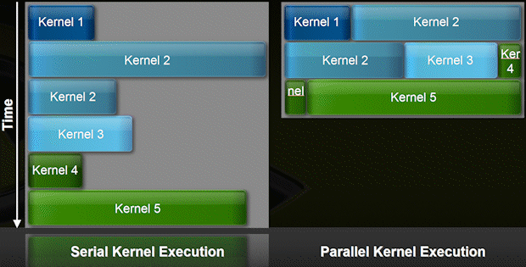
Concurrent Kernel Execution [second type of concurrency enabled by use of CUDA streams]
As early as Fermi one can have multiple kernels run on the device at the same time
Example: up to 16 on Fermi
When is this useful?
A kernel might be launched with an execution configuration that doesn’t fully utilize entire GPU
Main idea: two or three independent kernels can be “squeezed” on GPU at the same time
GPU looks like a MIMD architecture
Requires use of multiple streams
[NVIDIA]→

Slide 29
CUDA Streams: More recent developments
Since CUDA 5.0
Stream Callbacks, will call host function when stream has finished all work
cudaStreamAddCallback( cudaStream_t stream, cudaStreamCallback_t callback, void* userData, unsigned int flags )
Since CUDA 5.5
You can give streams priority
cudaStreamCreateWithPriority
Use cudaDeviceGetStreamPriorityRange to get the available priorities
Since CUDA 7:
nvcc –default-stream per-thread
Each host thread will get its own stream
Each stream becomes a regular non-blocking stream

Slide 30
CUDA basics: departing thoughts

Slide 31
GPU Computing: Good in Engineering?
What applications stand to benefit in the Engineering?
Image processing
FEA
Molecular Dynamics
Granular Dynamics
Finite Differences schemes
Quantum Chemistry
…
Generally, any application that fits the SIMD paradigm

Slide 32
Departing Thoughts
Hardware changes at faster pace than software
CUDA – has been a bright spot in the software landscape. AMD is mounting a challenge (both on HW & SW)
For SIMD applications, GPU can deliver good speedups at small time and financial investments
In general, investing in parallel programming skills bound to pay off

Slide 33
Topics not covered, or not covered yet
Debugging & profiling in CUDA (next)
Unified memory (since CUDA 6.0) cudaMallocManaged, cudaDeviceSynchronize (next lecture)
Dynamic parallelism (not covered)
Using multiple GPUs (not covered; good material/webinars at GTC event, see next slide)
Notes:
CUDA runtime API → cuda.h
Atomic operations → called in kernel functions
Streams unleash the full potential of the GPU (full utilization of the 3 engines)
Streams must be used with pinned memory
Pinned memory → prevent paging (use with caution)
Dynamic parallelism useful for example in AMR

Slide 34
Further Information
CUDA tutorials video/slides at GTC
http://www.gputechconf.com
CUDA webinars covering many introductory to advanced topics
http://developer.nvidia.com/gpu-computing-webinars
CUDA Tools Download: http://www.nvidia.com/getcuda
Notes:
Other available tool: the visual profiler
To visualize where the time is being spent.
All the tools & documentation available for download for free.

Slide 35
Further Reading
Read, in this order:
NVIDIA CUDA Development Tools: Getting Started
NVIDIA CUDA Programming Guide
NVIDIA CUDA C Programming Best Practices Guide
NVIDIA CUDA Reference Manual
Lots of very good examples come with the CUDA SDK distribution
More than 50 applications ready to compile/run
Makefiles available, ready for use
Lots of good code available for reuse + templates for applications
Online material
NVIDIA website: code available for many application fields
Libraries: thrust (http://code.google.com/p/thrust/), cudpp (http://gpgpu.org/developer/cudpp)

Slide 36
End of CUDA basics

Slide 37

Debugging GPU CUDA code
[Satoor, NVIDIA$→$]

Slide 38
cuda-gdb main features
All the standard GDB debugging features
CPU and GPU debugging within a single session
Breakpoints and Conditional Breakpoints
Inspect memory, registers, local/shared/global variables
Supports multiple GPUs, multiple kernels
Source and Assembly (SASS) Level Debugging
Runtime Error Detection (stack overflow,...)
Detailed description: https://docs.nvidia.com/pdf/cuda-gdb.pdf
Quick intro on gdb: see ME459 slides

Slide 39
Recommended Compilation Flags
Compile code for your target architecture:
Example:
Fermi : -gencode arch=compute_20,code=sm_20
Etc.
Pascal : -gencode arch=compute_60,code=sm_60 -gencode arch=compute_61,code=sm_61
Compile code with the debug flags:
Host code : -g
Device code : -G
Example:
$ nvcc -g -G -gencode arch=compute_60,code=sm_60 test.cu -o test
Notes:
The -gencode flags are to compile the cubins offline once and for all (no JIT compilation): better reproducibility and consistency:
Sm_10 -> Tesla chip
SM_20 -> Fermi chip
The –g and –G flags are to generate debug information (function name, local variables)
-g: generate host-code debug info
-G: generate device-code debug info
The line number information is always generated on the device side.

Slide 40
Usage [On your desktop, at home or office]
Invoke cuda-gdb from the command line:
$ cuda-gdb my_application
(cuda-gdb) _
DO NOT use this on Euler (see next slide for Euler)

Slide 41
Usage, cuda-gdb on Euler
Here’s how things get run on Euler:
>> srun -p wacc --pty -u --gres=gpu:1 cuda-gdb myProgramName
If you want some visual aid while debugging, you might use this:
>> srun -p wacc ... cuda-gdb –tui myProgramName

Slide 42
Program Execution Control

Slide 43
Execution Control
Execution Control is identical to host debugging:
Launch the application
Resume the application (all host threads and device threads)
Kill the application
Interrupt the application: CTRL-C
(cuda-gdb) run
(cuda-gdb) continue
(cuda-gdb) kill

Slide 44
Execution Control
Single-Stepping
Behavior varies when stepping __syncthreads()
Single-Stepping | At the source level | At the assembly level
Over function calls | next | nexti
Into function calls | step | stepi
PC at a barrier? | Single-stepping applies to | Notes
Yes | Active and divergent threads of the warp in focus and all the warps that are running the same block. | Required to step over the barrier.
No | Active threads in the warp in focus only.

Slide 45
Stepping: from where, and how
Single-stepping
Every exception is automatically precise
The “autostep” command
Define a window of instructions where we think the offending load/store occurs
cuda-gdb will single-step all the instructions within that window automatically and without user intervention
(cuda-gdb) autostep foo.cu:25 for 20 lines
(cuda-gdb) autostep *$pc for 20 instructions

Slide 46
Breakpoints
By name
By file name and line number
By address
At every kernel launch
(cuda-gdb) break my_kernel (cuda-gdb) break _Z6kernelIfiEvPT_PT0
(cuda-gdb) break test.cu:380
(cuda-gdb) break *0x3e840a8 (cuda-gdb) break *$pc
(cuda-gdb) set cuda break_on_launch appNameHere
Notes:
explain kernel entry breakpoints in more details: other options, when it stops, may hit multiple times if #blocks exceed hw resources., insert hidden breakpoint on first instruction of kernel

Slide 47
Conditional Breakpoints
Only reports hit breakpoint if condition is met
All breakpoints are still hit
Condition is evaluated every time for all the threads
Typically slows down execution
Condition
C/C++ syntax
No function calls
Supports built-in variables (blockIdx, threadIdx, ...)

Slide 48
Conditional Breakpoints
Set at breakpoint creation time
Set after the breakpoint is created
Breakpoint 1 was previously created
List all breakpoints:
(cuda-gdb) break my_kernel if threadIdx.x == 13
(cuda-gdb) condition 1 blockIdx.x == 0 && n > 3
(cuda-gdb) info breakpoints

Slide 49
Thread Focus

Slide 50
Thread Focus
There might be thousands of threads to deal with. Can’t display all of them
Thread focus dictates which thread you are looking at
Some commands apply only to the thread in focus
Print local or shared variables
Print registers
Print stack contents
Attributes of the “thread focus”
Kernel index : unique, assigned at kernel’s launch time
Block index : the application blockIdx
Thread index : the application threadIdx
Notes:
Thousands of threads to deal with.
Cannot display all at once.
Thread focus dictates which thread the user is currently looking at.

Slide 51
Devices
To obtain the list of devices allocated to job:
The * indicates the device of the kernel currently in focus
Provides an overview of the hardware that supports the code
(cuda-gdb) info cuda devices Dev Desc Type SMs Wps/SM Lns/Wp Regs/Ln Active SMs Mask
* 0 gf100 sm_20 14 48 32 64 0xfff
1 gt200 sm_13 30 32 32 128 0x0
Notes:
Just say that is shows the compute properties of each device (and the list of visible devices in the system)
About the “active sms mask”, just say that it’s a hardware concept not covered in this presentation and you will be happy to answer questions about it offline. You just do not want to go too deep into details in this presentation.

Slide 52
Kernels
To obtain the list of running kernels:
The * indicates the kernel currently in focus
There is a one-to-one mapping between a kernel id (unique id across multiple GPUs) and a (dev,grid) tuple. The grid id is unique per GPU only
The name of the kernel is displayed as are its parameters and the associated execution configuration
Provides an overview of the code running on the hardware
(cuda-gdb) info cuda kernels Kernel Dev Grid SMs Mask GridDim BlockDim Name Args * 1 0 2 0x3fff (240,1,1) (128,1,1) acos parms=... 2 0 3 0x4000 (240,1,1) (128,1,1) asin parms=...
Notes:
1:1 mapping between a kernel id (unique id across multiple gpus) and a (dev,grid) tuple. The grid id is unique per gpu only. Imagine it as dev.grid
The name of the kernel is displayed as are its size and its parameters.
Do not explain SMs Mask. Out of the scope of this presentation.

Slide 53
Thread Focus
To switch focus to any currently running thread
(cuda-gdb) cuda kernel 2 block 1,0,0 thread 3,0,0
[Switching focus to CUDA kernel 2 block (1,0,0), thread (3,0,0) (cuda-gdb) cuda kernel 2 block 2 thread 4
[Switching focus to CUDA kernel 2 block (2,0,0), thread (4,0,0) (cuda-gdb) cuda thread 5
[Switching focus to CUDA kernel 2 block (2,0,0), thread (5,0,0)
Notes:
When a component is not specified, the current value is assumed. If the current value is not valid, then the closest value is chosen (best-effort).
Error message if there is no such thread.
Similar to the host-equivalent command to switch focus to a different host thread: “thread N”
Hardware focus: device id, sm id, warp id, lane id & there is 1:1 mapping

Slide 54
Thread Focus
To obtain the current focus:
(cuda-gdb) cuda kernel block thread kernel 2 block (2,0,0), thread (5,0,0) (cuda-gdb) cuda thread thread (5,0,0)

Slide 55
Threads
To obtain the list of running threads for kernel 2:
Threads are displayed as (block,thread) ranges
Divergent threads are in separate ranges
The * indicates the range where the thread in focus resides
Cnt indicates the number of threads within each range
All threads in the same range are contiguous (no hole)
All threads in the same range shared the same PC (and filename/line number)
(cuda-gdb) info cuda threads kernel 2 Block Thread To Block Thread Cnt PC Filename Line * (0,0,0) (0,0,0) (3,0,0) (7,0,0) 32 0x7fae70 acos.cu 380 (4,0,0) (0,0,0) (7,0,0) (7,0,0) 32 0x7fae60 acos.cu 377
Notes:
Threads displayed as (block,thread) ranges.
Cnt indicates the number of threads within each range
All threads in the same range are contiguous (no hole).
All threads in the same range shared the same PC (and filename/lineno).
Similar command to the host command “info threads” that displays the list of host threads.

Slide 56
Program State Inspection

Slide 57
Stack Trace
Same (aliased) commands as in gdb:
Applies to the thread in focus
NOTE: backtrace command, or its alias bt, prints a back-trace of the entire stack
(cuda-gdb) where (cuda-gdb) bt (cuda-gdb) info stack
Notes:
Because
Device stack trace detached from host stack trace
because the kernel launches are asynchronous

Slide 58
Stack Trace
(cuda-gdb) info stack
#0 fibo_aux (n=6) at fibo.cu:88 #1 0x7bbda0 in fibo_aux (n=7) at fibo.cu:90 #2 0x7bbda0 in fibo_aux (n=8) at fibo.cu:90 #3 0x7bbda0 in fibo_aux (n=9) at fibo.cu:90 #4 0x7bbda0 in fibo_aux (n=10) at fibo.cu:90 #5 0x7cfdb8 in fibo_main<<<(1,1,1),(1,1,1)>>> (...) at fibo.cu:95
Notes:
Not a good example – recursive call & so it can be confusing

Slide 59
Source Variables
Source variable must be live (in the scope)
Read a source variable
Write a source variable
(cuda-gdb) print my_variable
$1 = 3
(cuda-gdb) print &my_variable
$2 = (@global int *) 0x200200020
(cuda-gdb) print my_variable = 5
$3 = 5
Notes:
Code optimization with debug builds is required because limited stack space to store local variables. Cannot afford spilling all the source variables all the time. Also, it’s very slow.

Slide 60
Memory
Memory read & written like source variables
To print multiple consecutive elements in an array, use @:
The debugger may require storage specifier, to eliminate ambiguity
@global, @shared, @local
@generic, @texture, @parameter
(cuda-gdb) print *my_pointer
(cuda-gdb) print array[3]@4
(cuda-gdb) print * (@global int *) my_pointer
(cuda-gdb) print ((@texture float **) my_texture)[0][3]
Notes:
Textures
read-only
must be cast to the type of the array they are bound to
indexed like standard multi-dimensional C arrays

Slide 61
Hardware Registers
CUDA Registers
Virtual PC: $pc (read-only)
SASS registers: $R0, $R1,...
Show a list of registers (no argument to get all of them)
Modify one register
(cuda-gdb) info registers R0 R1 R4 R0 0x6 6 R1 0xfffc68 16776296 R4 0x6 6
(cuda-gdb) print $R3 = 3

Slide 62
Code Disassembly
Must have cuobjdump in $PATH
Meaning of the ‘x/10i $pc’ command:
X = disassemble (eXtract)
10i = 10 instructions
(cuda-gdb) x/10i $pc
0x123830a8 <_Z9my_kernel10params+8>: MOV R0, c [0x0] [0x8]
0x123830b0 <_Z9my_kernel10params+16>: MOV R2, c [0x0] [0x14]
0x123830b8 <_Z9my_kernel10params+24>: IMUL.U32.U32 R0, R0, R2
0x123830c0 <_Z9my_kernel10params+32>: MOV R2, R0
0x123830c8 <_Z9my_kernel10params+40>: S2R R0, SR_CTAid_X
0x123830d0 <_Z9my_kernel10params+48>: MOV R0, R0
0x123830d8 <_Z9my_kernel10params+56>: MOV R3, c [0x0] [0x8]
0x123830e0 <_Z9my_kernel10params+64>: IMUL.U32.U32 R0, R0, R3
0x123830e8 <_Z9my_kernel10params+72>: MOV R0, R0
0x123830f0 <_Z9my_kernel10params+80>: MOV R0, R0
Notes:
Do not mention the device PC. The offset is self-explicity.
X = disassemble (eXtract)
10i = 10 instructions

Slide 63
Going on a tangent: SASS vs PTX
Previous slide: we saw SASS
When nvcc compiles CUDA code it generates in the process PTX code
PTX code then converted to SASS which finally converted to machine instructions
SASS: the low-level assembly language that compiles to binary microcode, which executes natively on NVIDIA GPU hardware
PTX: low-level parallel-thread execution virtual machine and instruction set architecture (ISA). PTX exposes the GPU as a parallel computing device.
C, C++, FORTRAN code is first converted to PTX

Slide 64
Run-Time Error Detection

Slide 65
cuda-memcheck
Stand-alone run-time error checker tool
Detects memory errors like stack overflow, illegal global address,...
Similar to valgrind
No need to recompile the application
Not all the error reports are precise
Can be used within cuda-gdb
Notes:
Not precise =

Slide 66
cuda-memcheck errors
Illegal global address
Misaligned global address
Stack memory limit exceeded
Illegal shared/local address
Misaligned shared/local address
Instruction accessed wrong memory
PC set to illegal value
Illegal instruction encountered
Illegal global address
Notes:
User stack
CRS stack
Hardware stack

Slide 67
cuda-memcheck
Integrated in cuda-gdb
More precise errors when used from within cuda-gdb
Must be activated before the application is launched
What does it mean “more precise”?
Precise
Exact thread idx
Exact PC
Not precise
A group of threads or blocks
The PC is several instructions after the offending load/store
(cuda-gdb) set cuda memcheck on
Notes:
Precise
Exact thread idx
Exact PC
Not precise
A group of threads or blocks
The PC is several instructions after the offending load/store

Slide 68
Example
(cuda-gdb) set cuda memcheck on
(cuda-gdb) run
[Launch of CUDA Kernel 0 (applyStencil1D) on Device 0]
Program received signal CUDA_EXCEPTION_1, Lane Illegal Address.
applyStencil1D<<<(32768,1,1),(512,1,1)>>> at stencil1d.cu:60
(cuda-gdb) info line stencil1d.cu:60 out[ i ] += weights[ j + RADIUS ] * in[ i + j ];
Notes:
Note that line where the out-of-bounds access occurs is accessing a couple of different arrays… need to narrow it down

Slide 69
Tips & Miscellaneous Notes

Slide 70
Best Practices
Determine scope of the bug
Incorrect result
Unspecified Launch Failure (ULF)
Crash
Hang
Slow execution
Reproduce with a debug build
Compile your app with –g –G
Rerun, hopefully you can reproduce problem in debug model
Notes:
Here’s a typical CUDA debug workflow.

Slide 71
Best Practices
Correctness Issues
First throw cuda-memcheck at it in stand-alone
Then cuda-gdb and memcheck if needed
printf is also an option, but not recommended
Performance Issues (once no bugs evident)
Use a profiler (discussed later)
Change the code, might have to go back to Step 1. above…
Notes:
Here’s a typical CUDA debug workflow.

Slide 72
Tips
Always check the return code of the CUDA API routines!
If you use printf from the device code…
Make sure to synchronize so that buffers are flushed

Slide 73
Tips
To hide devices, launch the application with
CUDA_VISIBLE_DEVICES=0,3
where the numbers are device indexes.
To increase determinism, launch the kernels synchronously:
CUDA_LAUNCH_BLOCKING=1
Notes:
[DN] Useful info here: http://www.resultsovercoffee.com/2011/02/cudavisibledevices.html

Slide 74
Profiling GPU CUDA code

Slide 75
Code Timing/Profiling
Approach 1: Nsight Compute
Collect timeline of GPU (and some CPU) activities
Headless profile collection
Use ncu on headless node to collect data
Visualize timeline with Visual Profiler (see below)
Visualization
Use ncu-ui to run the profiler interactively, or import the results of a previous collection
Approach 2: Nsight Systems
Visualize activity for the entire system
A lot of system integration in exchange for a lot of information
Targets only Linux systems, remote GUI runs on Mac, Windows, Linux
Approach 3 (before CUDA 11): nvprof
Deprecated in newer CUDA versions for security reasons
Command line interface is similar to ncu
Notes:
NVIDIA visual profiler is one tool that is available to help with optimization phase
As we will see visual profiler does not just produce a lot of data which you must interpret
Performs automated analysis of your application to identify optimization opportunities
VP is cross platform (linux, mac, windows), but on windows you also have option of using Parallel Nsight for Visual Studio

Slide 76
ncu Usage
$ ncu [ncu_args] <appName> [app_args]
On Euler, don’t forget to use sbatch (that is, rely on Slurm)
Help on usage and arguments: $ ncu –-help
Save profile to file: $ ncu –o profile.out <appName> [app_args]
Import into GUI (ncu-ui):
NOTE: Not an option on Euler, but you can download the UI from Nvidia for your system.
Import into ncu to generate reports: $ ncu –-import profile.out $ ncu –-import profile.out –-print-summary per-kernel

Slide 77
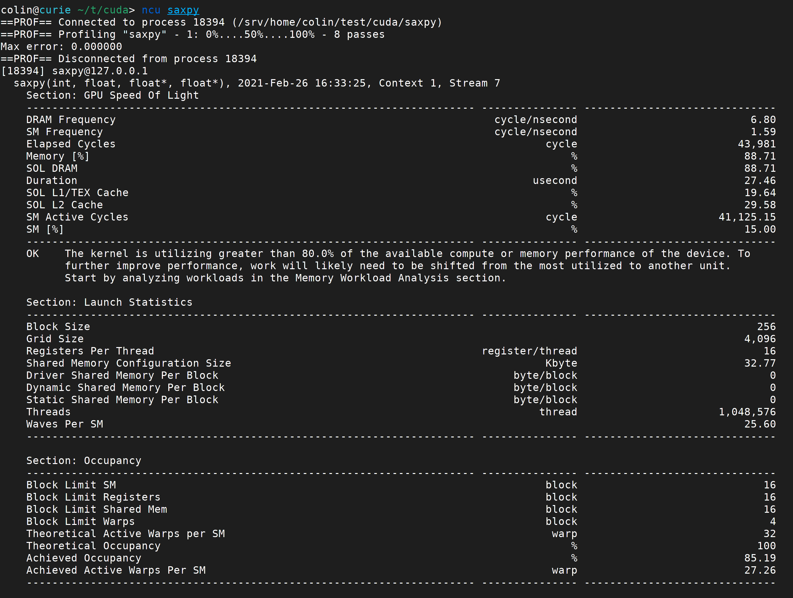
ncu – GPU Summary
$ ncu saxpy
Generate CSV output $ ncu --csv saxpy
Notes:
One possible optimization here: use multiple streams to copy pieces of the two vectors and work on those, while the next pieces come in.

Slide 78
Older Profiling Examples
NOTE: these examples were generated on an older CUDA version using nvprof and nvvp.
On recent GPUs, ncu is recommended.

Slide 79
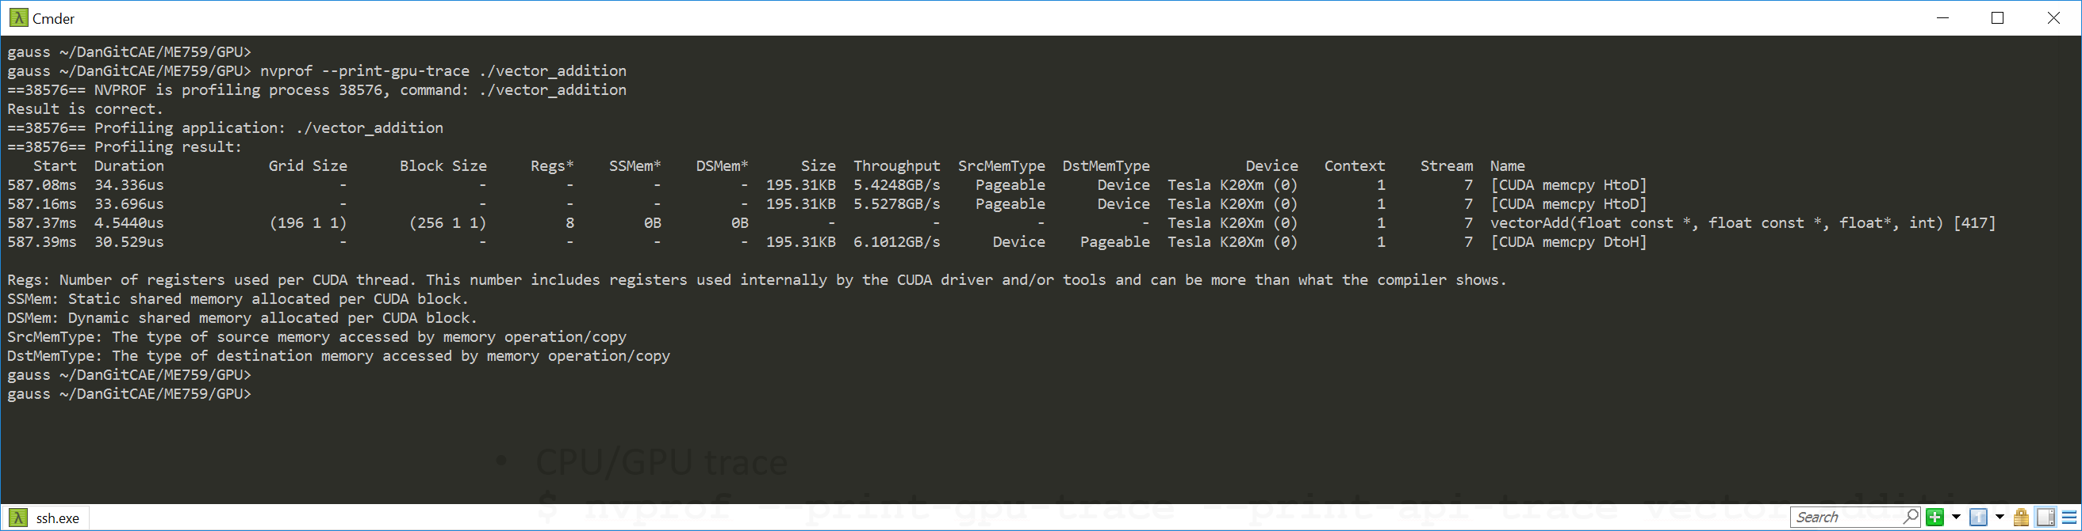
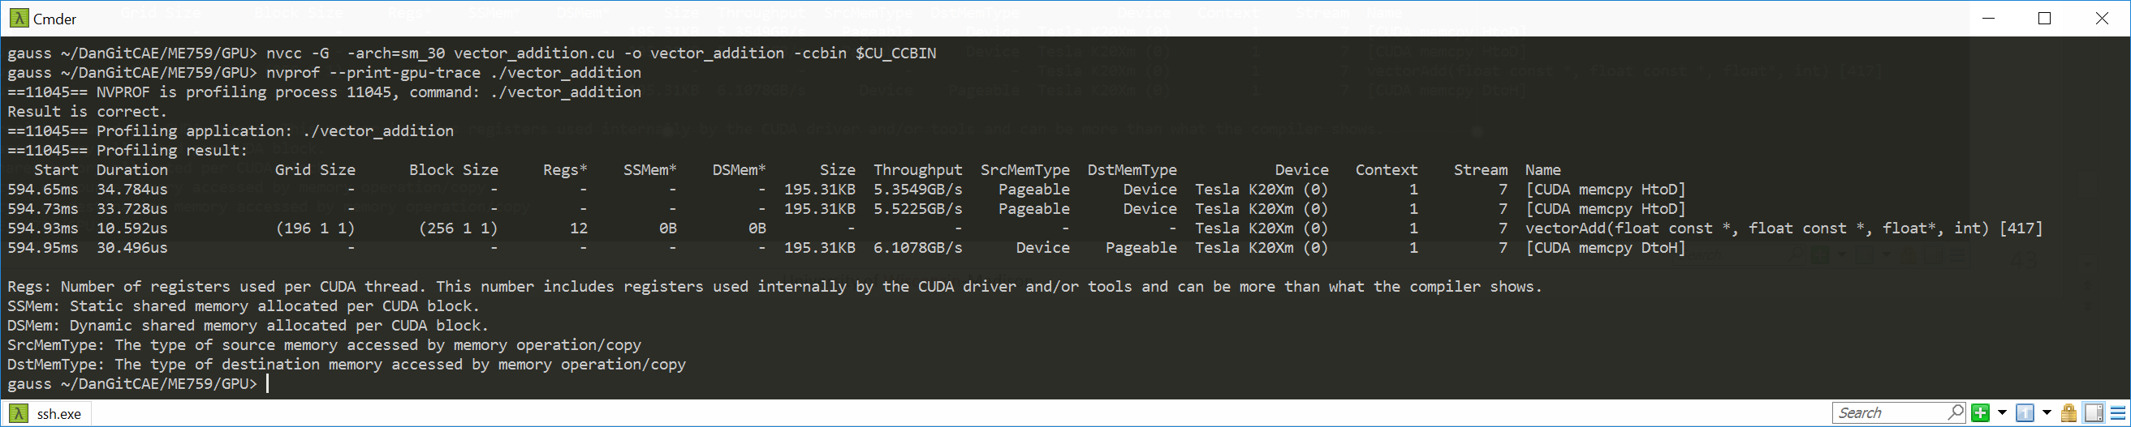
nvprof – GPU Trace
$ nvprof –-print-gpu-trace vector_addition
CPU/GPU trace $ nvprof –-print-gpu-trace -–print-api-trace vector_addition
>> nvcc –O3 -arch=sm_30 vector_addition.cu -o vector_addition -ccbin $CU_CCBIN
>> nvcc -G -arch=sm_30 vector_addition.cu -o vector_addition -ccbin $CU_CCBIN

Slide 80
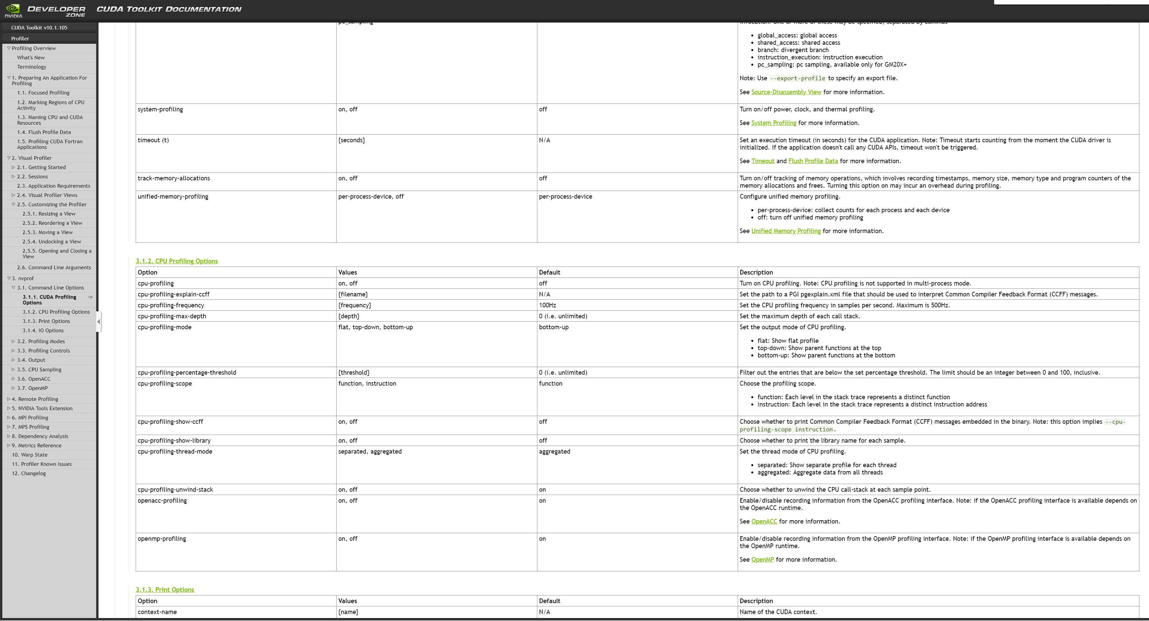
nvprof – Powerful for getting insights into what happens on the host as well
[NVIDIA]$→$

Slide 81
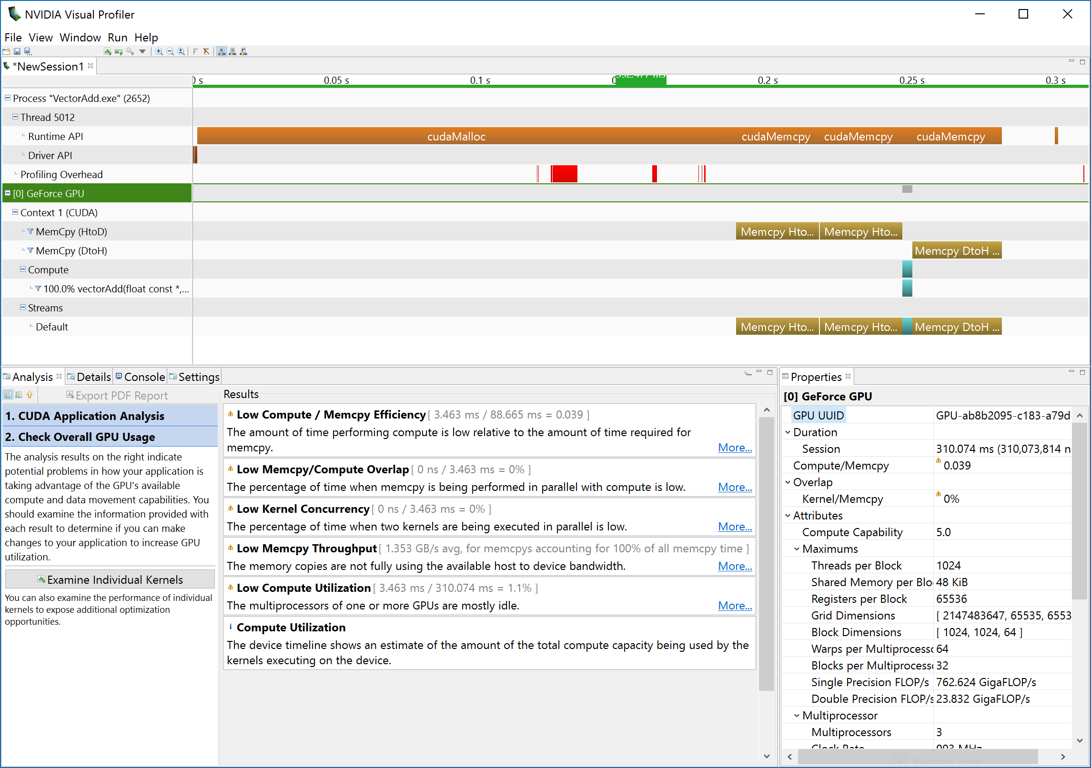
nvvp: NVIDIA Visual Profiler
Notes:
Provides a nice GUI and ample information regarding your run
Available on Euler

Slide 82
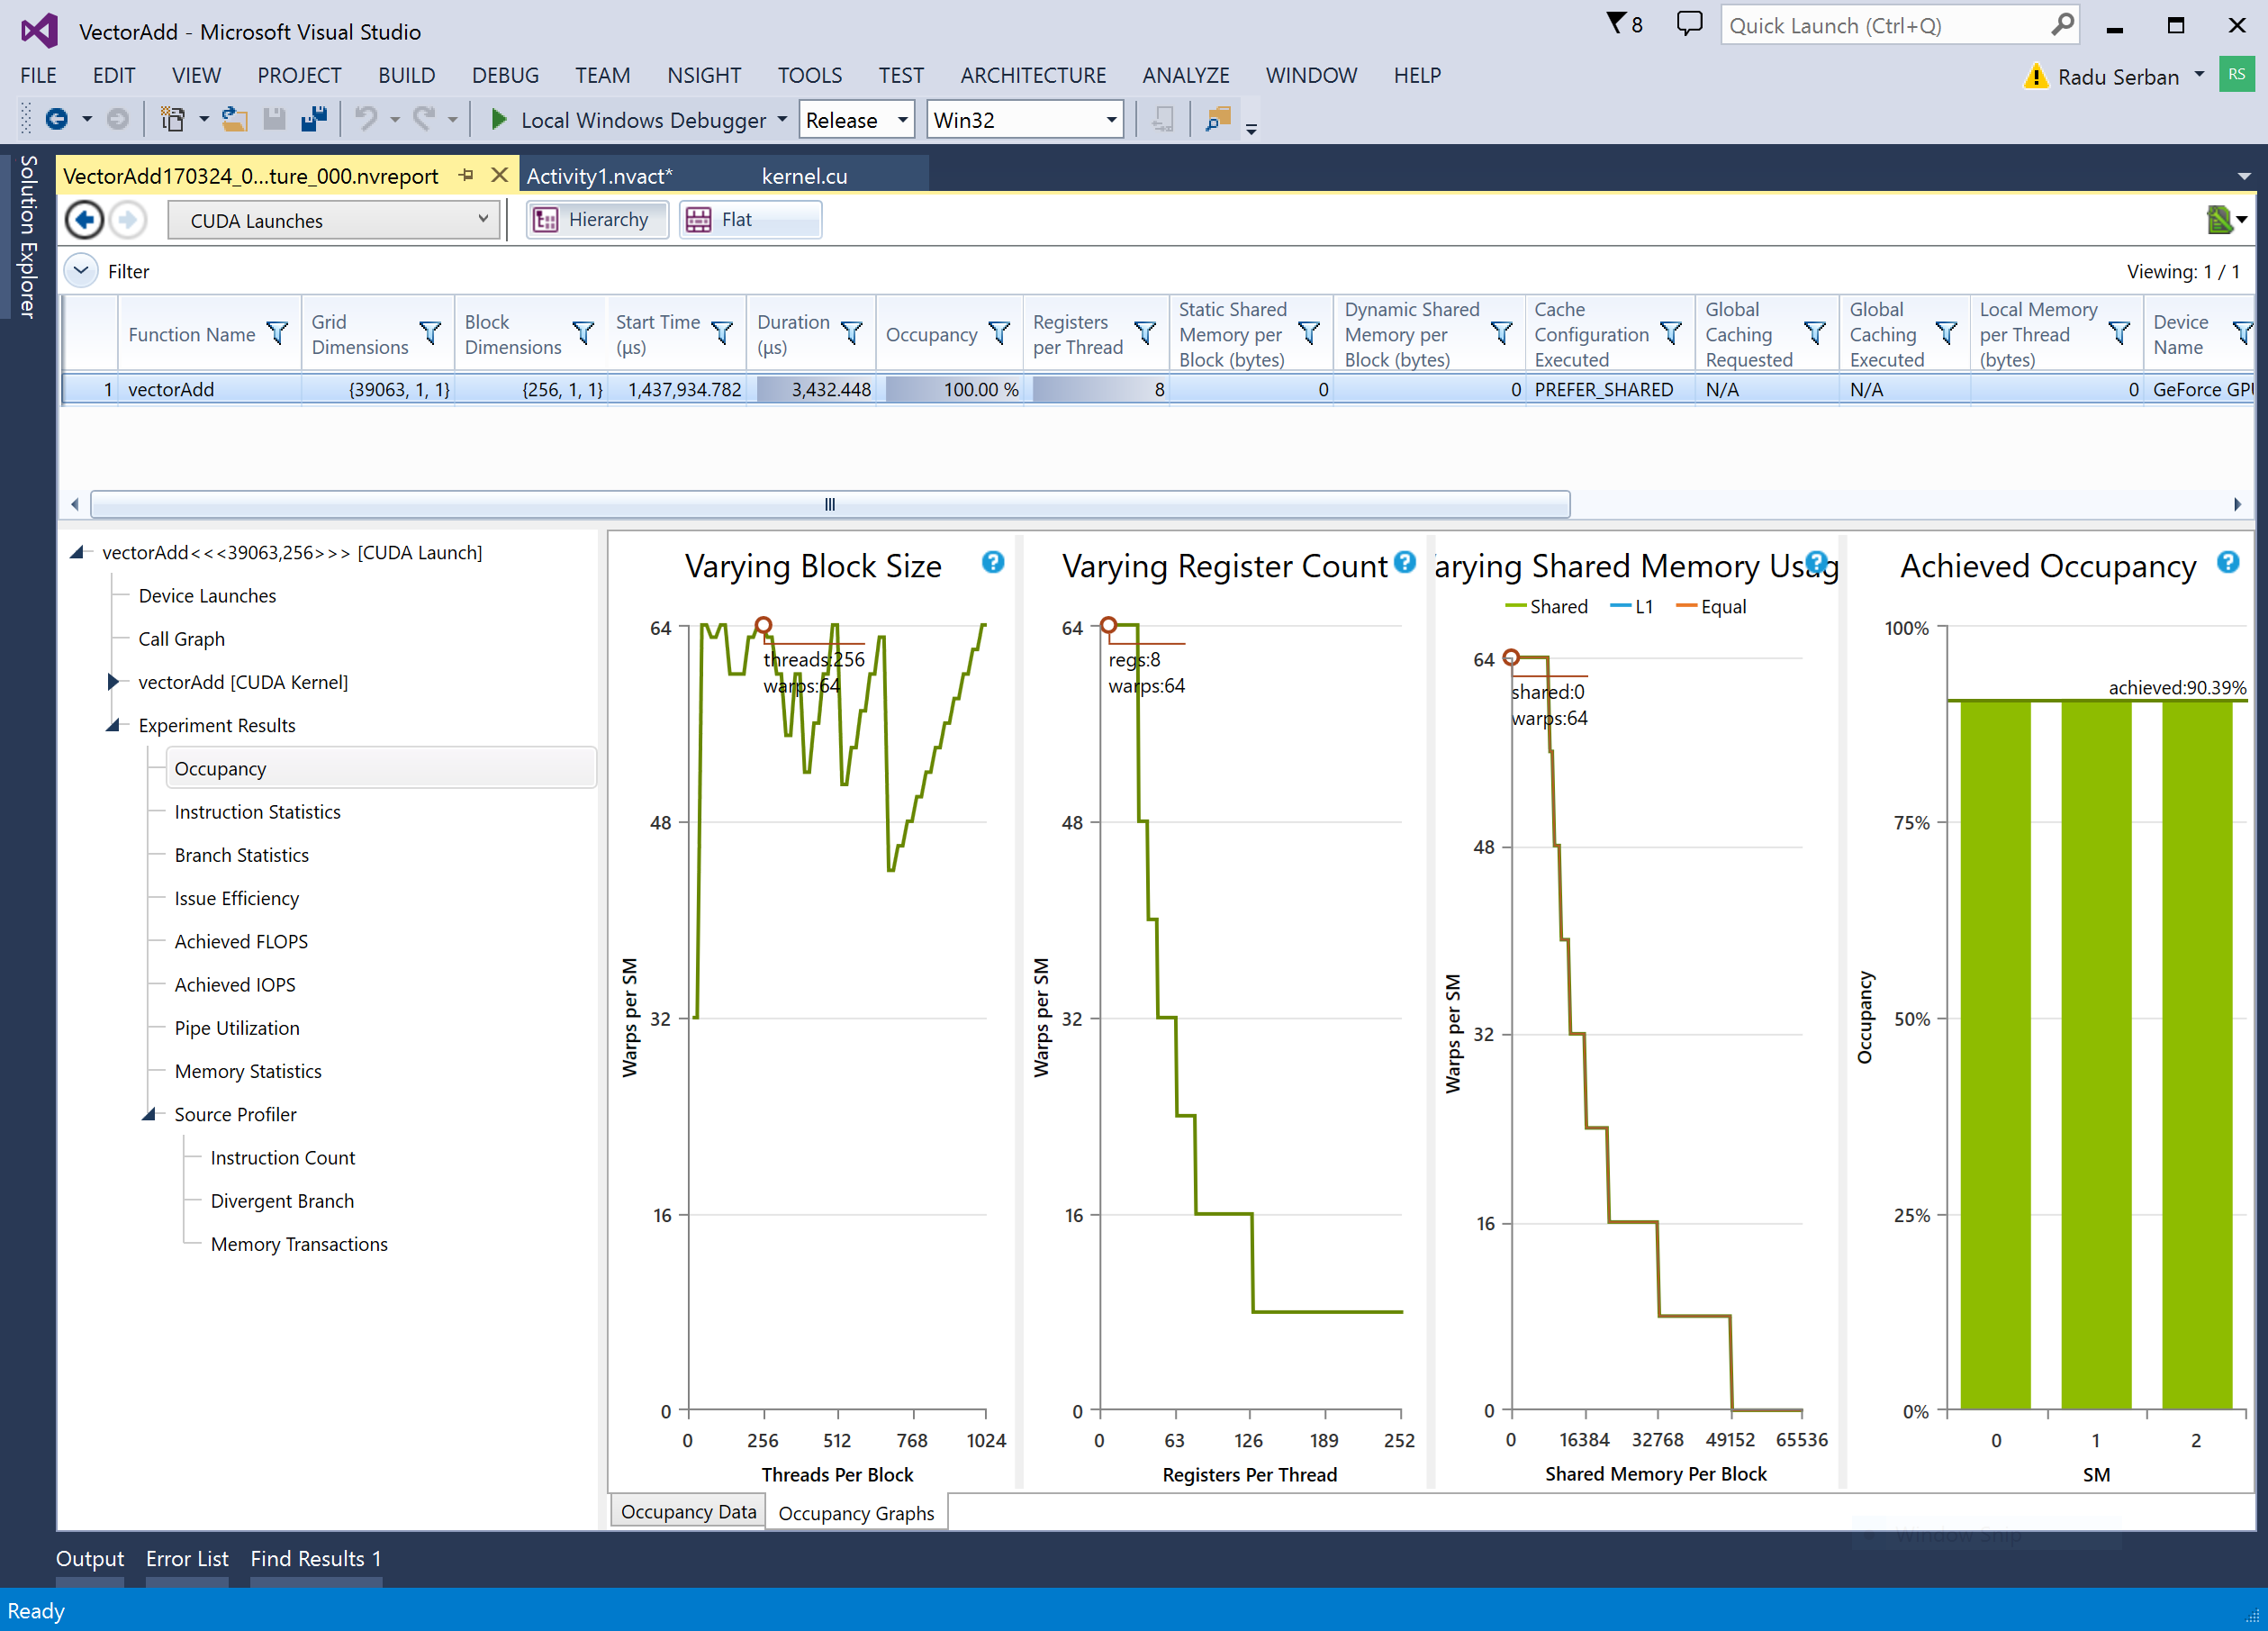
Nsight: Visual Studio Edition
Notes:
Integrated with IDEs (Visual Studio, Eclipse)
Debugging and profiling tools

Slide 83
The CUDA Profiling Tools Interface (CUPTI)
CUPTI: Enables the creation of profiling and tracing tools that target CUDA applications
CUPTI provides the following APIs:
The Activity API
The Callback API
The Event API
The Metric API
The Profiler API
Using APIs above, one can develop sharp & customized profiling tools
Can provide very detailed insights into the CPU and GPU behavior of CUDA applications
CUPTI delivered as a dynamic library on all platforms supported by CUDA
[https://developer.nvidia.com/CUPTI ]$→$

