Slide 1
ME759 High Performance Computing for Applications in Engineering [Spring 2021]
Lecture 09
02/12/2021
Dan Negrut, 2021 ME759 UW-Madison

Slide 2
Tune of the day
96 Tears
? and the Mysterians (of Bay City, Michigan) - #1 on the Billboard Hot 100, back in 1966
(one of the first garage band hits)

Slide 3
Is BBC recording on?
If my internet connection goes down, I’ll email from my phone to provide more information – go/no-go, next step, etc.

Slide 4
Before we get started…
Last time
Flynn’s Taxonomy
Amdahl's Law
Started GPU computing: discussion of hardware aspects
Today
GPU computing: generalities
GPU computing: execution configuration
GPU computing: scheduling execution (start, maybe?)
Other tidbits:
Assignment due on Th, 02/18, at 9 pm
Do not run your code on the Euler headnode (use Slurm)
1/3 of the semester feedback

Slide 5
1/3 of lectures behind us. Your feedback makes a difference
A link to an anonymous google form emailed to you. Also, it’s here.
Please take 60 second to provide input:
What works ok?
How can Lijing, Ruochun, Colin and Dan tweak things for a better ME759 experience?
Other comments
Why bother?
Perhaps there are things that can be tweaked to improve the 759 experience

Slide 6
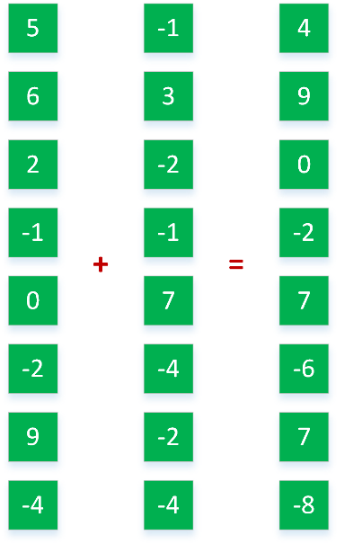
Coarse Grain vs. Fine Grain Parallelism
#pragma omp parallel sections
{
#pragma omp section
a = alice();
#pragma omp section
b = bob();
#pragma omp section
k = kate();
}
double s = boss(a, b);
double result = bigboss(s,k);
Fine Grain
Coarse Grain
alice
bob
[IOMPP]→
Control
ALU
ALU
boss
kate
GPU
ALU
ALU
CPU
Cache
bigboss
DRAM
DRAM

Slide 7
Coarse Grain vs. Fine Grain Parallelism
Coarse grain parallelism (good for CPUs)
Few tasks
Tasks are heterogeneous
Tasks are in general complex, lots of control flow
Example: baking a cake, making coffee, broiling fish – all at the same time
Fine grain parallelism (very good for GPU, ok for CPU)
Many, many tasks
Tasks are basically identical
Tasks are in general pretty straightforward, lots of math, not much control flow
Example application: image processing – lots of pixels to deal with

Slide 8
GPGPU Computing: when it started, why it started
GPGPU: General Purpose GPU Computing
Done in early 2000s using graphics libraries
Piggyback on the gaming hardware
Why was GPGPU attractive?
GPUs had high bandwidths
Something dampening everybody’s enthusiasm: data needs to be moved into the GPU to process it
16-32 GB/s is typical today (PCIe)
NVLink: 5-12 times faster than PCIe 3
Notes:
People realized quickly that GPUs can be used for more, beyond graphics.
GPGPU – first utilization of GPUs for General Purpose.
The idea was to “hijack” shader programs to make them do other useful computations
very awkward and difficult
limited (e.g. communication limited between pixels: only gather, but no scatter – could only write to 1 pixel, no support for integer arithmetic)

Slide 9

GPU computing: the basic idea
[Christopher Weyant]$→$

Slide 10
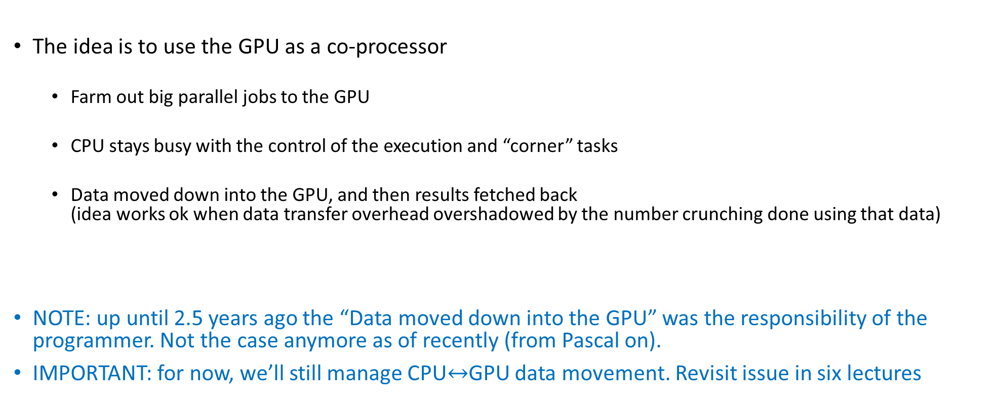
GPGPU Computing: how carried out
The idea is to use the GPU as a co-processor
Farm out big parallel jobs to the GPU
CPU stays busy with the control of the execution and “corner” tasks
Data moved down into the GPU, and then results fetched back (idea works ok when data transfer overhead overshadowed by the number crunching done using that data)
NOTE: up until 2.5 years ago the “Data moved down into the GPU” was the responsibility of the programmer. Not the case anymore as of recently (from Pascal on).
IMPORTANT: for now, we’ll still manage CPU$↔$GPU data movement. Revisit issue in six lectures
Notes:
People realized quickly that GPUs can be used for more, beyond graphics.
GPGPU – first utilization of GPUs for General Purpose.
The idea was to “hijack” shader programs to make them do other useful computations
very awkward and difficult
limited (e.g. communication limited between pixels: only gather, but no scatter – could only write to 1 pixel, no support for integer arithmetic)

Slide 11
CUDA: Making the GPU Tick…
CUDA: “Compute Unified Device Architecture” – freely distributed by NVIDIA
Now at version 11.2
When introduced (in 2006) it eliminated the graphics-constraints associated with GPGPU
CUDA enables a general-purpose programming model
User kicks off batches of threads on the GPU to execute a function (kernel)
Targeted software stack
Scientific computing-oriented drivers, language, and tools
Interface designed for compute (i.e., graphics-free API)
Explicit GPU memory management
Notes:
NVIDIA introduced CUDA (2006) to make the GPU programmable

Slide 12
CUDA Programming Model: GPU as a Highly Multithreaded Coprocessor
The GPU is viewed as a compute device that:
Is a co-processor to the CPU or host
Has its own memory (device memory, in CUDA parlance)
Runs many threads in parallel
Data-parallel portions of an app. run on the device as kernels executed in parallel by many threads
Differences between GPU and CPU threads
GPU threads are extremely lightweight
Very little creation overhead
GPU needs 1000s of threads for full efficiency
Multi-core CPU needs only a few heavy ones
Notes:
The model is:
host copies data to device
host launches a computation (kernel) on the device
host copies back data from device

Slide 13
Compute Capability [of a Device] vs. CUDA Version
“Compute Capability of a Device” refers to hardware
Defined by a major revision number and a minor revision number
Example:
Tesla C1060 is compute capability 1.3
Fermi architecture is capability 2
Kepler architecture is capability 3
Maxwell architecture is capability 5
Pascal architecture is capability 6 (available on Euler)
Turing and Volta are compute capability 7 (available on Euler)
Ampere is compute capability 8 (available on Euler)
A higher compute capability indicates a more able piece of hardware
The “CUDA Version” indicates what version of the software is used to manage on the hardware
In a perfect world
You would run the most recent CUDA (version 11.2) software release
You would use the most recent architecture (compute capability 8.0)
Notes:
Tesla V100: compute capability 7.0

Slide 14
NVIDIA Compute Capability

Slide 15
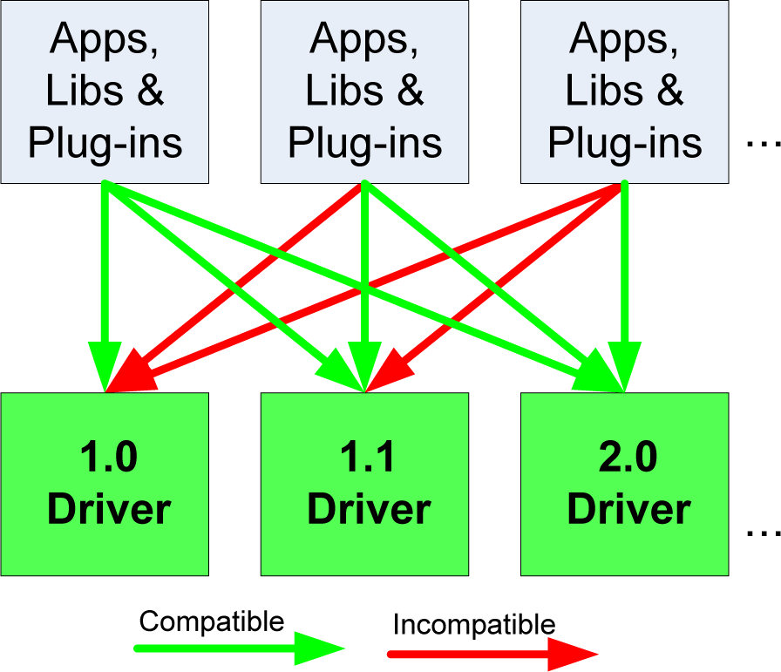
Compatibility Issues, software-wise
The basic rule: the CUDA Driver API is backward, but not forward compatible
The functionality in later versions increased, was not there in previous versions
Code you ran ok w/ CUDA 8.0 will work w/ CUDA 10.0 as well (at least in theory)
Not the other way around though
Passing of time

Slide 16
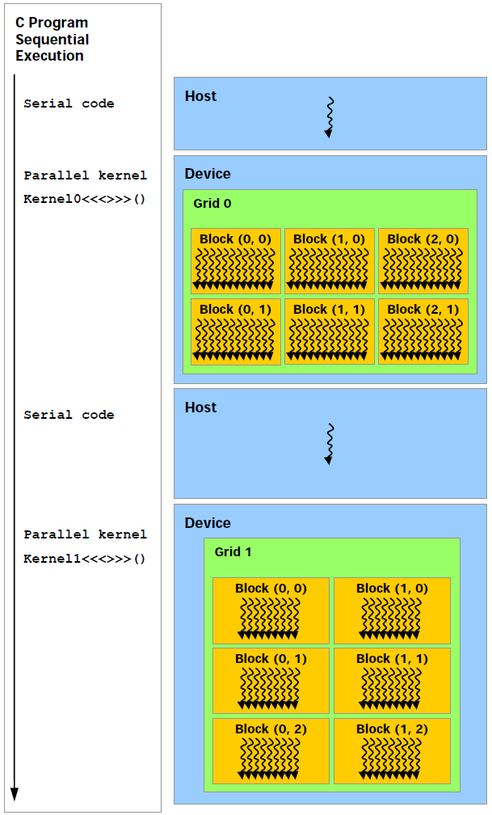
The CUDA Execution Model
Execution of Kernel0
Execution of Kernel1
This is how your C code looks like
This is how the code gets executed on the hardware in heterogeneous computing. GPU calls are asynchronous…
Notes:
NOTE: Execution on the GPU is ORDERED!
You can COUNT on this + global memory PERSISTENT → split work in multiple kernels.
Asynchronous: Important because you can do useful work on the CPU while the GPU works
Beware of this when timing kernel execution – see later
If you really need to make the CPU wait for the GPU, use cudaDeviceSynchronize(), which enforces the CPU to wait until all preceding commands in all streams of all host threads have completed.
Copying data from device back to host is a synchronization point in that stream: cudaMemcpy is synchronous.
There are asynchronous versions of cudaMemcpy

Slide 17
The CUDA Execution Model
Data needs to be copied into GPU device memory and the results need to be fetched back
This happens over a PCI-Express 3.0/4.0 connection
Can also happen over NVLink (5-12 times faster than PCI-E)
NVLink: Available on one Euler node only
IMPORTANT:
For GPU computing to pay off, the data transfer overhead should be overshadowed by the GPU number crunching that draws on that data
The CUDA kernel calls and copying to/from GPU are managed by the CUDA runtime in a separate stream associated w/ the GPU execution
Notes:
The GPU has actually 3 engines which can be used simultaneously.
We will not get into this more advanced topic (streams)
GPU cards support multiple streams so that you can execute in a stream and copy data in another stream. The streams are independent, so you must explicitly synchronize. Working with a single stream (0), synchronization at copying time is automatic.

Slide 18
The concept of “CUDA host stream”
“CUDA host stream”: it has nothing to do with the SM (Stream Multiprocessor), which is a hardware thing
The CUDA runtime places all calls that invoke the GPU in a stream (i.e., ordered collection) of calls
This stream is a FIFO (first-in-first-out) stream
In example of two slides ago, Kernel1 will only be called once Kernel0 finished execution
Important: there is an a-synchronicity between host and device
Host: minds its business, continuing execution right away after launching a kernel
Device: minds its business, taking on the next assignment in the stream
Notes:
The GPU has actually 3 engines which can be used simultaneously.
We will not get into this more advanced topic (streams)
GPU cards support multiple streams so that you can execute in a stream and copy data in another stream. The streams are independent, so you must explicitly synchronize. Working with a single stream (0), synchronization at copying time is automatic.

Slide 19
Further comments, on the “asynchronous” aspect of GPU computing
Caveat to a-synchronicity
There are implicit synchronization points: A H2D or D2H memory data copy cannot take place (stalls the host) until all other CUDA operations in the stream have completed
You can even force everything to be synchronous during the execution of the code
Simply set CUDA_LAUNCH_BLOCKING environment variable to 1.
If you force kernel calls to be synchronous, you lose the opportunity to do something on the host while the device is busy running your kernel
Notes:
The GPU has actually 3 engines which can be used simultaneously.
We will not get into this more advanced topic (streams)
GPU cards support multiple streams so that you can execute in a stream and copy data in another stream. The streams are independent, so you must explicitly synchronize. Working with a single stream (0), synchronization at copying time is automatic.

Slide 20
More specifics: GPU operations that are asynchronous
The following calls made on the host return the control to host right away
CUDA kernel launches
CUDA memory copies within a single device's memory
On the host, you ask the GPU to copy bytes from the GPU’s device memory to some other GPU mem location
CUDA memory copies from host to device of a memory block of 64 KB or less
CUDA memory copies performed by functions that are suffixed with Async
CUDA “memory set” function calls

Slide 21
The CUDA Execution Model: Three Opportunities for Asynchronous Execution
Three opportunities, listed in increasing order of use/engagement complexity
Opportunity 1: The GPU and CPU work in asynchronous mode
The CPU moves on right away after a kernel launch
The GPU works at the same time the CPU works
Opportunity 2: the GPU has three engines that can work at the same time
copy-in engine + copy-out engine + execution engine
More later (when we talk about streams)
Opportunity 3: Multiple GPUs can work at the same time on one host
Notes:
The GPU has actually 3 engines which can be used simultaneously.
We will not get into this more advanced topic (streams)
GPU cards support multiple streams so that you can execute in a stream and copy data in another stream. The streams are independent, so you must explicitly synchronize. Working with a single stream (0), synchronization at copying time is automatic.

Slide 22
Languages Supported in CUDA
CUDA: very good friends with C and C++
Yet minor extensions are needed to flag the fact that a function actually represents a kernel, that there are functions that will only run on the device, etc.
You end up working in a superset of C and C++
There is support for C++ language features (operator overload, lambda functions, etc.) up to the C++17 Standard (ISO/IEC 14882:2017)
Other language support is available:
CUDA Fortran is available from the NVIDIA HPC SDK (https://developer.nvidia.com/hpc-sdk)
PyCUDA maps the entire CUDA API into Python (https://documen.tician.de/pycuda/)
Notes:
C++ support for templates as well
PGI (acquired by NVIDIA) provides FORTRAN support

Slide 23
The CUDA-enabled ecosystem for GPU Computing
[NVIDIA]→
Notes:
NPP: image and signal processing
VSIPL: Vector Signal Image Processing Library
MAGMA is a collection of next generation linear algebra (LA) GPU accelerated libraries

Slide 24
The NVIDIA CUDA-enabled hardware
Remarks:
There is no CC of gen 4
Fermi was CC 2
The name “Tesla” used for high-end GPUs for non-graphics apps
[NVIDIA]→

Slide 25
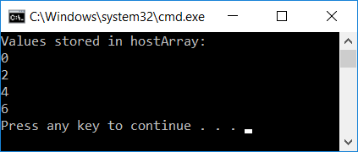
CUDA, First Example
#include<cuda.h>
#include<iostream>
__global__ void simpleKernel(int* data)
{
//this adds a value to a variable stored in global memory
data[threadIdx.x] += 2*(blockIdx.x + threadIdx.x);
}
int main()
{
const int numElems = 4;
int hostArray[numElems], *devArray;
//allocate memory on the device (GPU); zero out all entries in this device array
cudaMalloc((void**)&devArray, sizeof(int) * numElems);
cudaMemset(devArray, 0, numElems * sizeof(int));
//invoke GPU kernel, with one block that has four threads
simpleKernel<<<1,numElems>>>(devArray);
//bring the result back from the GPU into the hostArray
cudaMemcpy(&hostArray, devArray, sizeof(int) * numElems, cudaMemcpyDeviceToHost);
//print out the result to confirm that things are looking good
std::cout << "Values stored in hostArray: " << std::endl;
for (int i = 0; i < numElems; i++)
std::cout << hostArray[i] << std::endl;
//release the memory allocated on the GPU
cudaFree(devArray);
return 0;
}
Notes:
Shows the main elements of CUDA programming (80/20 rule)
Explain:
__global__
cudaMalloc
kernel execution configuration
cudaMemcpy
nvcc looks for such keywords and separates code that is supposed to run on CPU and GPU

Slide 26
CUDA Function Declarations: (the “C with extensions” part)
 | Executed on the: | Only callable from the:
__device__ float myDeviceFunc() | device | device
__global__ void myKernelFunc() | device | host
__host__ float myHostFunc() | host | host
__global__ defines a kernel function, launched by host, executed on the device
Must return void
NOTE: can combine __device__ with __host__
See CUDA Reference Manual http://docs.nvidia.com/cuda/cuda-c-programming-guide/index.html
Notes:
Can combine: __device__ __host__

Slide 27
Quiz: Following Up on “CUDA, First Example” [and segue into the “Execution Configuration”]
In our code, we invoked the kernel like this:
simpleKernel<<<1,4>>>(devArray)
What happens if we invoke the kernel like this:
simpleKernel<<<1,12>>>(devArray)
What happens if we invoke the kernel like this:
simpleKernel<<<2,4>>>(devArray)
Notes:
<<<1,12>>> : writing out of bound

Slide 28
GPU Execution Configuration

Slide 29
Review of Nomenclature
The HOST
This is your CPU executing the “master” thread
The DEVICE
This is the GPU card, connected to the HOST through a PCIe connection
The HOST (the master CPU thread) instructs the DEVICE to execute KERNEL
When launching a KERNEL, the HOST has to inform the DEVICE how many threads should each execute KERNEL
This is called “defining the execution configuration”

Slide 30
[New Topic] The concept of Execution Configuration
A kernel function must be called with an execution configuration:
__global__ void kernelFoo(...); // declaration
dim3 DimGrid(100, 50); // 2D grid structure, w/ total of 5000 thread blocks
dim3 DimBlock(4, 8, 8); // 3D block structure, with 256 threads per block
kernelFoo<<< DimGrid, DimBlock>>>(...your arg list comes here…);
Notes:
How many threads do you want to use?
Difference with an OpenMP parallel for loop (forward reference)
on CPU you typically use as many threads as (virtual) cores you have
on a GPU you launch many more threads than SPs!
if you have a loop with 1 million iterations, those will be divided into 8 chunks on CPU
on a GPU you launch 1 million threads
You must divide the threads into blocks → these are executed by one SM (quantum of GPU scalability)
Max. number threads / block = 1024

Slide 31
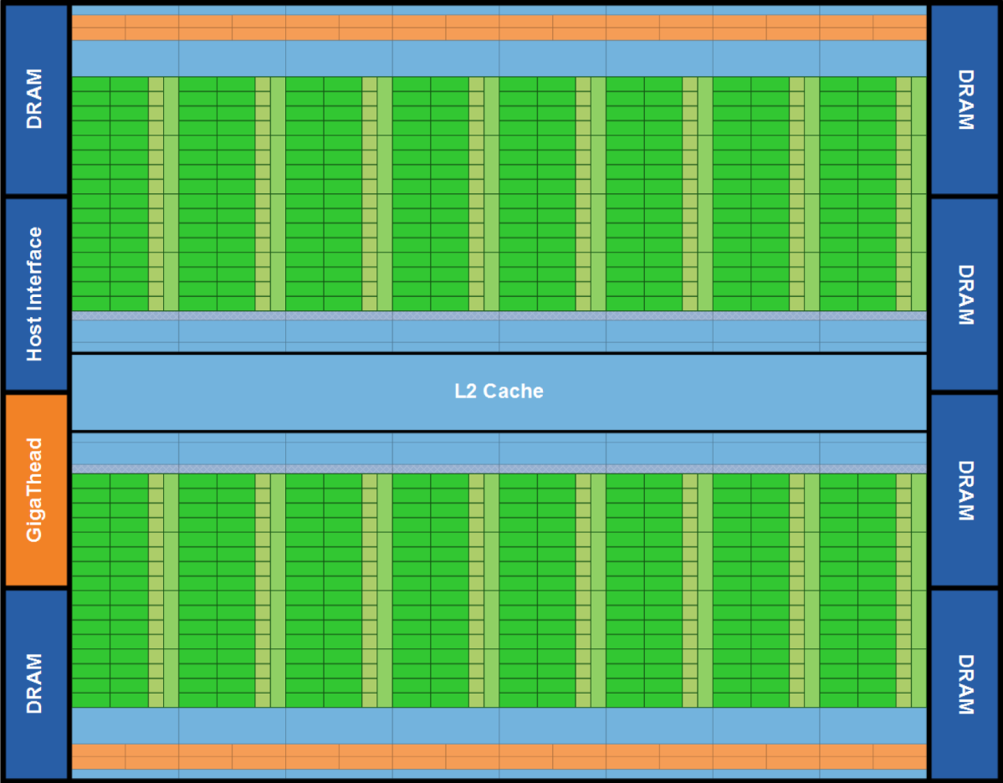
Example
The host call below instructs the GPU to execute the function (kernel) “foo” using 25,600 threads
Two arguments are passed down to each thread executing the kernel “foo”
foo<<<100, 256>>>(p_matrixD, p_vectorD);
In this execution configuration, the host instructs the device it is supposed to run 100 blocks each having 256 threads in it
The concept of block is important since it represents the entity that gets executed by an SM (stream multiprocessor)
Notes:
These 100 blocks will be distributed (by the GPU-level scheduler) onto the available SMs (max. 32 blocks resident on an SM)
Concept of block is important:
They are the unit that gets executed on an SM.
Also, only threads in a block can be synchronized.

Slide 32
Execution Configuration Constraints
Threads in each block:
The threads can be organized as a 3D structure (x,y,z)
Maximum x- or y-dimension of a block is 1024
Maximum z-dimension of a block is 64
The maximum number of threads in each block is 1024
There is a limitation on the number of blocks in a grid:
The grid of blocks can be organized as a 3D structure: max of 2³¹-1 by 65,535 by 65,535 grid of blocks
Notes:
Discuss 1-D, 2-D, 3-D configurations.
As of compute capability 5.x:
Maximum number of resident blocks per multiprocessor: 32
Maximum number of resident warps per multiprocessor: 64
Maximum number of resident threads per multiprocessor: 2048
Question: what do you do when you have more threads than possible? Launch multiple kernels!

Slide 33
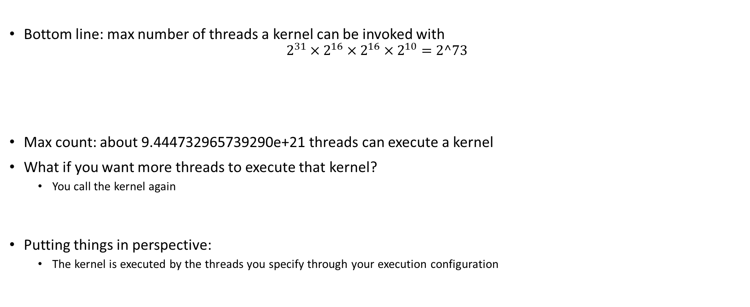
More on the Execution Configuration
Max number of threads in a block
Bottom line: max number of threads a kernel can be invoked with
$$2^{31}×2^{16}×2^{16}×2^{10}=2^73$$
Max count: about 9.444732965739290e+21 threads can execute a kernel
What if you want more threads to execute that kernel?
You call the kernel again
Putting things in perspective:
The kernel is executed by the threads you specify through your execution configuration
Max number of blocks in x-direction
Max number of blocks in z-direction
Max number of blocks in y-direction
Notes:
Discuss 1-D, 2-D, 3-D configurations.
As of compute capability 5.x:
Maximum number of resident blocks per multiprocessor: 32
Maximum number of resident warps per multiprocessor: 64
Maximum number of resident threads per multiprocessor: 2048
Question: what do you do when you have more threads than possible? Launch multiple kernels!

Slide 34

Block and Thread Index (Idx)
Threads and blocks have indices
Used by each thread the decide what data to work on (more later)
Block Index: a triplet of uint
Thread Index: a triplet of uint
Why this 3D layout?
Simplifies memory addressing when processing multidimensional data
Handling matrices
Solving PDEs on 3D subdomains
…
Device
Grid 1
Block
(0, 0)
Block
(1, 0)
Block
(2, 0)
Block
(0, 1)
Block
(1, 1)
Block
(2, 1)
Block (1, 1)
Thread
(0, 0)
Thread
(1, 0)
Thread
(2, 0)
Thread
(3, 0)
Thread
(4, 0)
Thread
(0, 1)
Thread
(1, 1)
Thread
(2, 1)
Thread
(3, 1)
Thread
(4, 1)
[NVIDIA]$→$
Thread
(0, 2)
Thread
(1, 2)
Thread
(2, 2)
Thread
(3, 2)
Thread
(4, 2)
Notes:
A block is a collection of threads that can cooperate with each other by:
Synchronizing their execution
Efficiently sharing data through a low-latency shared memory
Each thread must know what piece of data it’s working on → must be able to “differentiate” itself from other threads in the same block or in a different block
Exercise:
How was the grid defined here (how many dimensions, how many blocks in each direction)?
How was a block defined?

Slide 35
A Couple of Built-In Variables [Critical in supporting the SIMD parallel computing paradigm]
Each thread can find out the grid and block dimensions and its block index and thread index
This info used to figure out what work the thread needs to do
Each thread when executing a kernel has access to the following read-only built-in variables
threadIdx (uint3) – contains the thread index within a block
blockDim (dim3) – contains the dimension of the block
blockIdx (uint3) – contains the block index within the grid
gridDim (dim3) – contains the dimension of the grid
[ warpSize (uint) – provides warp size, we’ll talk about this later… ]
Notes:
dim3 → unspecified dimensions are initialized to 1 (not zero!)
warpSize → not used directly by CUDA code

Slide 36
Quiz: Related to Execution Configuration
Host
Device
How was the grid defined for this pic?
I.e., how many blocks in X and Y directions?
How was a block defined in this pic?
Grid 1
Kernel 1
Block
(0, 0)
Block
(1, 0)
Block
(2, 0)
Block
(0, 1)
Block
(1, 1)
Block
(2, 1)
Grid 2
Kernel 2
Block (1, 1)
Thread
(0, 0)
Thread
(1, 0)
Thread
(2, 0)
Thread
(3, 0)
Thread
(4, 0)
Thread
(0, 1)
Thread
(1, 1)
Thread
(2, 1)
Thread
(3, 1)
Thread
(4, 1)
Thread
(0, 2)
Thread
(1, 2)
Thread
(2, 2)
Thread
(3, 2)
Thread
(4, 2)
Notes:
The grid of blocks: (3,2)
The block of threads: (5,3)

Slide 37
Matrix Multiplication Example

Slide 38
Simple Example: Matrix Multiplication
Reason for covering: A straightforward matrix multiplication example that illustrates the basic features of memory and thread management in CUDA
Highlights:
Use only global memory (don’t bring shared memory into picture yet)
Matrix will be of small dimension; job can be done using one block of threads
Concentrate on
Thread ID usage
Memory data transfer API between host and device
NOTE: Related to some of your HWs
Notes:
Show the main CUDA API functions at work.

Slide 39
Preamble: on the Matrix Data Structure
The following data structure will come in handy
Purpose: store matrix-related data
Note that the matrix is stored in row-major order in a one-dimensional array pointed to by “elements”
// IMPORTANT - Matrices are stored in row-major order:
// M(row, col) = M.elements[row * M.width + col]
typedef struct {
int width;
int height;
float* elements;
} Matrix;

Slide 40
Square Matrix Multiplication Example
Compute P = M * N
The matrices P, M, N are of size WIDTH x WIDTH
Assume WIDTH was defined to be 32
Software Design Decisions:
One thread handles one element of P
Each thread will access all the entries in one row of M and one column of N
2*WIDTH read accesses to global memory
One write access to global memory
N
WIDTH
M
P
WIDTH
WIDTH
WIDTH
Notes:
Dot product of 2 32-long array done 1024 times.
Launch 1024 threads.
NOTES:
from an arithmetic intensity pov, this is as bad as it gets! Each thread brings in a lot of data to calculate only one entry
there is a lot of wasted trips to memory, as neighboring threads will need to bring in the same data over and over from global memory

Slide 41

Multiply Using One Thread Block
One Block of threads computes matrix P
Each thread computes one element of P
Each thread does a dot product
Loads a row of matrix M
Loads a column of matrix N
Perform one multiply and addition for each pair of M and N elements
Compute to off-chip memory access ratio close to 1:1
Not that good…
Size of matrix limited by the number of threads allowed in a thread block
Grid 1
N
Block 1
Thread
(2, 2)
48
M
P
width
[UIUC]$→$
Notes:
Low arithmetic intensity! We’ll come back to this (shared memory)

Slide 42

Matrix Multiplication: sequential approach, coded in C++
// Matrix multiplication on the (CPU) host in double precision;
void MatrixMulOnHost(const Matrix M, const Matrix N, Matrix P)
{
for (int i = 0; i < M.height; ++i) {
for (int j = 0; j < N.width; ++j) {
double sum = 0;
for (int k = 0; k < M.width; ++k) {
double a = M.elements[i * M.width + k]; //march along a row of M
double b = N.elements[k * N.width + j]; //march along a column of N
sum += a * b;
}
P.elements[i * N.width + j] = sum;
}
}
}
[UIUC]$→$
Notes:
On the CPU, you need 3 loops.
On the GPU, we do not need the 2 outer loops.
Note the stride 1 when reading in a row, but width when reading in a column

Slide 43
Step 1: Matrix Multiplication, Host-side. Main Program Code
int main(void) {
// Allocate and initialize the matrices.
// The last argument in AllocateMatrix: should an initialization with
// random numbers be done? Yes: 1. No: 0 (everything is set to zero)
Matrix M = AllocateMatrix(WIDTH, WIDTH, 1);
Matrix N = AllocateMatrix(WIDTH, WIDTH, 1);
Matrix P = AllocateMatrix(WIDTH, WIDTH, 0);
// M * N on the device
MatrixMulOnDevice(M, N, P);
// Free matrices
FreeMatrix(M);
FreeMatrix(N);
FreeMatrix(P);
return 0;
}
[UIUC]$→$

Slide 44
Step 2: Matrix Multiplication [host-side code]
void MatrixMulOnDevice(const Matrix M, const Matrix N, Matrix P)
{
// Load M and N to the device
Matrix Md = AllocateDeviceMatrix(M);
CopyToDeviceMatrix(Md, M);
Matrix Nd = AllocateDeviceMatrix(N);
CopyToDeviceMatrix(Nd, N);
// Allocate P on the device
Matrix Pd = AllocateDeviceMatrix(P);
// Setup the execution configuration
dim3 dimGrid(1, 1, 1);
dim3 dimBlock(WIDTH, WIDTH);
// Launch the kernel on the device
MatrixMulKernel<<<dimGrid, dimBlock>>>(Md, Nd, Pd);
// Read P from the device
CopyFromDeviceMatrix(P, Pd);
// Free device matrices
FreeDeviceMatrix(Md);
FreeDeviceMatrix(Nd);
FreeDeviceMatrix(Pd);
}
[UIUC]$→$

Slide 45
Step 3: Matrix Multiplication - Device-side Kernel Function
// Matrix multiplication kernel – thread specification
__global__ void MatrixMulKernel(Matrix M, Matrix N, Matrix P) {
// 2D Thread Index; computing P[ty][tx]…
int tx = threadIdx.x;
int ty = threadIdx.y;
// Pvalue will end up storing the value of P[ty][tx].
// That is, P.elements[ty * P. width + tx] = Pvalue
float Pvalue = 0;
for (int k = 0; k < M.width; ++k) {
float Melement = M.elements[ty * M.width + k];
float Nelement = N.elements[k * N. width + tx];
Pvalue += Melement * Nelement;
}
// Write matrix to device memory; each thread one element
P.elements[ty * P. width + tx] = Pvalue;
}
N
WIDTH
M
P
tx
WIDTH
Note: Pvalue is a local value; stored in a register. Access global memory once at the very end
ty
WIDTH
WIDTH
Notes:
Discuss why we have the local variable Pvalue
if we updated directly into the desired entry of P, we would make trips to global memory at each iteration
Pvalue declared here is local (and stored in a register)
we make a single trip to global memory to deposit the aggregate Pvalue
Note: a similar “trick” used in CPU code. There it has to do with not trashing the cache.

Slide 46
Step 4: Some Loose Ends
// Allocate a device matrix of same size as M.
Matrix AllocateDeviceMatrix(const Matrix M) {
Matrix Mdevice = M;
int size = M.width * M.height * sizeof(float);
cudaMalloc((void**)&Mdevice.elements, size);
return Mdevice;
}
// Copy a host matrix to a device matrix.
void CopyToDeviceMatrix(Matrix Mdevice, const Matrix Mhost) {
int size = Mhost.width * Mhost.height * sizeof(float);
cudaMemcpy(Mdevice.elements, Mhost.elements, size, cudaMemcpyHostToDevice);
}
// Copy a device matrix to a host matrix.
void CopyFromDeviceMatrix(Matrix Mhost, const Matrix Mdevice) {
int size = Mdevice.width * Mdevice.height * sizeof(float);
cudaMemcpy(Mhost.elements, Mdevice.elements, size, cudaMemcpyDeviceToHost);
}
// Free a device matrix.
void FreeDeviceMatrix(Matrix M) {
cudaFree(M.elements);
}
void FreeMatrix(Matrix M) {
delete[] M.elements;
}
[UIUC]$→$
Notes:
QUESTION: why is the 1st argument of cudaMalloc a void**? Must return a pointer
Note: The C malloc returns by return value, not through an argument! So, it can have a signature void *malloc(size_t size)

Slide 47
Before Moving On… [Some Words of Wisdom]
In GPU computing you use as many threads as data items (tasks, jobs) you have to perform
This replaces the purpose in life of the “for” loop
Number of threads & blocks is established at run-time
In many cases, the rule is Number of threads = Number of data items
You’ll have to come up with a rule to match a thread to data item that this thread needs to process
Understanding what thread does what job: very common source of errors in GPU computing
This issue never fails to deliver (frustration)
:-(
Notes:
RECALL: make sure you do not access outside of bounds.
Always, check the thread ID against the data size.
Mapping threads <-> work is a recurring theme in CUDA programming. Important to do it right! Frustrating arithmetic and logic.

Slide 48
CUDA, Another Example (1/2) [Highlighted aspect: a thread figuring out its work order]
Multiply, pairwise, two arrays of 3 million integers
int main(int argc, char* argv[])
{
const int arraySize = 3000000;
int *hA, *hB, *hC;
setupHost(&hA, &hB, &hC, arraySize);
int *dA, *dB, *dC;
setupDevice(&dA, &dB, &dC, arraySize);
cudaMemcpy(dA, hA, sizeof(int) * arraySize, cudaMemcpyHostToDevice);
cudaMemcpy(dB, hB, sizeof(int) * arraySize, cudaMemcpyHostToDevice);
const int threadsPerBlock = 512;
const int blocksPerGrid = (arraySize + threadsPerBlock – 1)/threadsPerBlock;
multiply_ab<<<blocksPerGrid, threadsPerBlock>>>(dA, dB, dC, arraySize);
cudaMemcpy(hC, dC, sizeof(int) * arraySize, cudaMemcpyDeviceToHost);
cleanupHost(hA, hB, hC);
cleanupDevice(dA, dB, dC);
return 0;
}
Notes:
Why do we use:
blocksPerGrid = arraySize/threadsPerBlock + 1 ?
Is this the best way to calculate the blockSize? NO
What happens if we have arraySize = 1024?
How many blocks do we need? 2
How many do we actually configure? 3
Better:
blocksPerGrid = (arraySize + threadsPerBlock – 1) / threadsPerBlock

Slide 49
CUDA, Another Example (2/2)
__global__ void multiply_ab(int* a, int* b, int* c, int size)
{
int whichEntry = threadIdx.x + blockIdx.x * blockDim.x;
if( whichEntry<size )
c[whichEntry] = a[whichEntry] * b[whichEntry];
}
void setupDevice(int** pdA, int** pdB, int** pdC, int arraySize)
{
cudaMalloc((void**) pdA, sizeof(int) * arraySize);
cudaMalloc((void**) pdB, sizeof(int) * arraySize);
cudaMalloc((void**) pdC, sizeof(int) * arraySize);
}
void cleanupDevice(int *dA, int *dB, int *dC)
{
cudaFree(dA);
cudaFree(dB);
cudaFree(dC);
}
Notes:
Kernel: sequence of steps that a thread performs
Discuss the mapping from thread index to task

Slide 50

if( whichEntry<size ): Why Do I Need this Test?
Important observation before answering question above
All blocks launched have the same number of threads
Answer to our question: the if is needed to prevent out of bounds indexing
Sometimes the product of the number of blocks $×$ number of threads per block is not exactly how many jobs need to be done

Slide 51
Execution Configuration Related
Assume arrays of 1493 elements (instead of 3,000,000)
Largest CUDA block that you can get has 1024 threads
Also, 1493 is a prime number
You’ll have to use at least two CUDA blocks of threads
Perhaps you want to use three blocks of 512 each…
You’ll have some threads that do no work (there’ll be an if statement in there)
Problem becomes more interesting in two dimension when you have square blocks to pad a matrix and end up overshooting in two directions

Slide 52
1493 entries in 1D array
You are overshooting here, some threads do no work
Block 0: 512 threads
Block 1: 512 threads
Block 2: 512 threads
1D Example
You are overshooting here
Block 16 by 16
Block 16 by 16
Block 16 by 16
Block 16 by 16
Block 16 by 16
Block 16 by 16
Here’s what can happen in a 2D problem:
Block 16 by 16
Block 16 by 16
Block 16 by 16
Block 16 by 16
Block 16 by 16
Block 16 by 16
You are overshooting here as well

