Slide 1
ME759 High Performance Computing for Applications in Engineering [Spring 2021]
Lecture 01
01/25/2021
Dan Negrut, 2021 ME759 UW-Madison

Slide 2
Quote of the day
“Human beings only use ten percent of their brains. Ten percent! Can you imagine how much we could accomplish if we used the other sixty percent?”
Ellen DeGeneres, American comedian, television host, actress, writer, and producer [1958 - ]

Slide 3
Dwelling on the 60%, ME759 relation to “Quote of the Day”
“In most cases, we use 10% of the compute power at our disposal. Ten percent! Can you imagine what we could accomplish if we used the other 60 %?”
Dan Negrut, Romanian wannabe comedian, television host, actor, writer, and producer [1968 - ]

Slide 4
Is BBC recording on?

Slide 5
Before we get started…
Today
30,000 feet perspective of ME759
All sorts of disjoint information
Note: everything in blue and underlined, like syllabus, contains a link that you can follow to a relevant doc/page
Other tidbits:
Additional Reading: check the on-line syllabus
First assignment, goes out on Th
Due one week later, on Th, 02/04, at 9 pm
Information on homework submission provided in the text of the assignment

Slide 6
Instructor: Dan Negrut
Polytechnic Institute of Bucharest, Romania
B.S. – Aerospace Engineering (1992)
University of Iowa
Ph.D. – Mechanical Engineering (1998)
MSC.Software
Product Development Engineer 1998-2005
University of Michigan
Adjunct Assistant Professor, Dept. of Mathematics (2004)
Division of Mathematics and Computer Science, Argonne National Laboratory
Visiting Scientist 2004-2005, 2006, 2010
University of Wisconsin-Madison, Joined in Nov. 2005
Research Focus: Computational Dynamics
Technical lead, Simulation-Based Engineering Lab (http://sbel.wisc.edu)

Slide 7
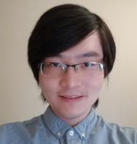
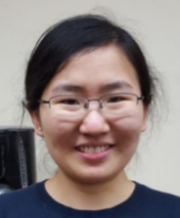
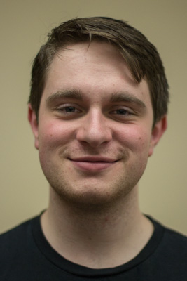
The rest of the crew
TA: Ruochun Zhang, Department of Mechanical Engineering
rzhang294@wisc.edu
PhD student
TA: Lijing Yang, Department of Mechanical Engineering
lyang296@wisc.edu
PhD student
Sysadmin: Colin Vanden Heuvel
Will take care of the hardware & software side of things
The person taking care of Euler

Slide 8
Good to Know…
Lecture Time 11:00-12:15 PM → Mo & Wd & Fr (75 minutes lectures)
Course Delivery On-line, synchronous
Office (as though it’s relevant) 4150ME
Phone 608 772 0914
E-Mail negrut@wisc.edu
How people call me Dan (because my name is Dan)

Slide 9
The Course Webpage
Course website managed under Canvas: https://canvas.wisc.edu/courses/243107
Canvas page contains links to
Piazza discussion forum
Conferencing tool
Drop box
Grades
Etc.

Slide 10
Course related information
A link to the “today’s slides” emailed to you 15 mins before the beginning of each lecture
Call this “slide deck A”
Link to PPT slides is also available online at class website (Canvas)
Call this “slide deck B”
In theory, no difference between “slide deck A” and “slide deck B”
The official deck of slides is “slide deck B”
Rationale:
I correct/amend the slides in the “slide deck A”
Usually, I email out more slides than I end up covering in the lecture
Bottom line: What’s in Canvas (“slide deck B”) it’s what you’ll be probed on in the comprehensive exam

Slide 11

Course Related Information
Syllabus will contain info about
Suggested readings $⇐$ these are useful
Topics we cover
Homework due dates
Syllabus will likely change to reflect the day-to-day progress
Both the syllabus & course description available at the Canvas course website

Slide 12
Course Related Information
Lectures are video recorded. Available online, probably 15 mins after class is over
Download the recording: can be done from Canvas, under Blackboard Collaborate Ultra, look under “Recordings”

Slide 13
Going on a tangent
A slide with this orange heading means we’re going on a tangent, leaving the topic at hand behind to briefly pursue something else

Slide 14
Quiz-type question heading
A slide with this reddish heading indicates that this is a quiz-type slide
When you prepare for the exam, make sure you understand well what is on these slides

Slide 15
Other conventions
A word that has this color highlights something that it’s more important
A word that has this color highlights something that it’s very important
A word that has this color means that it’s going to be discussed in the very next slide
An underlined word like syllabus - click on it and it’ll take you to an online resource
The name of utilities such as git, scp, etc. will be in a different font (consolas)

Slide 16
Office Hours
All times CST
Notes:
Call or email to arrange for meetings outside office hours
Office Hours (all online, in Canvas)
Monday: 1:00 – 2:30 PM (Ruochun)
Monday: 7:30 – 8:30 PM (Dan)
Tuesday: 1:00 – 2:30 PM (Lijing)
Tuesday: 7:00 – 8:00 PM (Ruochun, Lijing, alternating)
Wednesday: 1:00 – 2:30 PM (Lijing)
Wednesday: 7:30 – 8:30 PM (Dan)
Thursday: 2:00 – 3:30 PM (Ruochun)
Euler Supercomputer consultation
Any workday, by appointment with Colin, the Sysadmin

Slide 17
Textbook/Pointers to Info
No textbook required, but there are some recommended books/docs:
R. Bryant and D. O’Hallaron, Computer Systems: A Programmer’s Perspective, Prentice Hall, 3rd Edition, 2015
NVIDIA, GPU Programming Guide, version 11.2
David B. Kirk and Wen-mei W. Hwu: Programming Massively Parallel Processors: A Hands-on Approach, Morgan Kaufmann, 2016
Jason Sanders and Edward Kandrot: CUDA by Example: An Introduction to General-Purpose GPU Programming, Addison-Wesley, 2010
Peter Pacheco: An Introduction to Parallel Programming, Morgan Kaufmann, 2011
T. Mattson, et al.: Patterns for Parallel Programming, Addison Wesley, 2005

Slide 18
Another source of info: ME459
ME459: “Computing Concepts for Applications in Engineering”
The less mature brother of ME759
ME459 vs ME759: how they compare
ME459: getting started with computing in science and engineering
ME759: using parallel processing, in the pursuit of speed
There is a 2.5 weeks worth of content overlap between ME459 & ME759
A lot of reading assigned from the ME459 slides (Fall 2020 slides are here)

Slide 19
ME459: quick overview of topics covered
Shell programming (bash, sh)
The Linux command line
Scheduling for execution on Euler
Version control with git
Interpreted languages: Matlab/Python/R
Elements of C programming
Building/linking/debugging/profiling
Build management with CMake
Instruction Level Parallelism issues
The memory hierarch
Caches
Virtual memory
Elements of code optimization
Finite precision arithmetic
Elements of operating systems
Intro to parallel computing w/ OpenMP
There is an expectation that you are familiar with the concepts above or are ready to go through some of the ME459 slides and assigned readings

Slide 20
ME759: Course Related Information
Course offered on an accelerated track
Three lectures per week, each 75 minutes long
Why accelerated track?
Gives us one month to work on a meaningful Final Project (more on this later)
Last lecture: March 29
28 lectures: Just like a regular semester yet compressed in about 2 months
After March 29:
Office hours will run as before
Homework will continue to be assigned

Slide 21
Final grade breakdown
Homework 45%
Final Project 25%
Final Exam 25%
Course Participation 5%
Total 100%
NOTE:
Questions related to homework/exam scores must be raised within seven days after receiving the grade

Slide 22
Assignments
There will be 10 assignments
Assigned on Th, due next Th (one week turnaround)
Homework due at 9 PM on Th
Class demanding because of the time-consuming assignments, particularly early on
First three or four assignments: start early, give yourself plenty of time
It’ll be challenging to set up a process to work on your assignment
Use Piazza to ask questions about how to get going on Euler, about the work process
Notes:
DAN: say about participation

Slide 23
ME759: Assignment, the work cycle
Write your solution using your favorite editor/IDE (Atom/Vis. Studio/Vis. Code) on your computer
Build & test the code on your computer until you are convinced that it works as intended
Get your files over to Euler using scp or git
Build your executable on Euler, on the head node
Write/Recycle slurm script to define how your executable will be managed by Slurm
Run slurm script to place your executable in the Slurm queue
Examine the output of your job once it has finished
By default, output of your program is written to a file starting with "slurm-"
If there are any small problems, use a terminal text editor on Euler (like vim) to make minor changes to your code and then rerun your slurm script to test your program again on Euler
NOTE: If the results look bad, you might need to go back to 1)
Once you are convinced that program works as expected on Euler, push solution into your git repo
Note: Your code will be graded based on how it runs on Euler, not how it works on your computer
[Nic Olsen]$→$

Slide 24
Assignments: Nuts and Bolts
Each of you will have own git private repo. Everything will be under git-enabled version control
Setting up your git repo: part of the first assignment, instructions provided to you
TAs and instructor have access to your private git repo
More instruction provided in each assignment

Slide 25
Assignments
On the due date, the TAs will pull your git repo at 9:01 pm to start grading
Anything that goes into your repo after 9 pm will not be picked up
No exceptions made, a matter of keeping the playing field level
Trying to submit at 9:04 pm: not fun to not be able to, but it is fair that way
If you must change due date of homework/project: contact us at least 3 weeks in advance
Examples, what would fly: deadline for research project, conference paper deadline, prelim exam, etc.
In most cases, homework deadline will be moved early for you (and you’ll get the assignment early too)
Notes:
DAN: say about participation

Slide 26
Re-emphasizing, the “late homework” issue
There are more than 100 students registered right now
We will not offer exceptions for late work (keeping the playing field level)
Mechanism in place for accommodating unforeseen circumstances:
Two assignments with lowest scores will be automatically dropped when computing your final HW score

Slide 27
Rules of Academic Conduct [read the Course Description for a detailed account of what constitutes cheating & what the consequences are]
You are encouraged to discuss assignments with other class students
Post and read posts on Piazza
Getting verbal advice and suggestions from anybody when all parties are away from a computer is fine
copy/paste of non-trivial code is not acceptable
Non-trivial = more than a line or so
Includes reading someone else’s code and then going off to write your own
Use of third-party libraries that directly implement the solution of a HW/Project is not acceptable unless explicitly asked to do so
We will use Stanford’s Moss to detect code plagiarism

Slide 28
Cheating, consequences
First time
Everybody involved gets the assignment[s] score to be zero
The 5% associated with the Class Participations forfeited
The assignment[s] of concern cannot be dropped anymore
Second time
The Dean of your college will be brought into the loop

Slide 29
Historical perspective
People cut corners mid-semester
Most often issues show up in assignments 4-5-6
In the early part of the GPU computing part of the course
Typically, three cases of cheating each semester
Most of the people who have cheated in the past were actually very knowledgeable
Assignment was too simple until it was not too simple
Please, please, please: if you can’t finish a homework, drop it (you can drop two of them)

Slide 30
Hitting the Ground Running
First assignment goes out on Th (emailed to you)
Perhaps even earlier week, as early as tomorrow – more time to get going
Available on Canvas
Due on Th of subsequent week
Assignment is a C/C++ programming warm up + learning the Euler ropes

Slide 31
Exams-related issues
No midterm exam
Final exam will be comprehensive – Tuesday, April 13, at 7 pm
There will be a review session for the Final Exam
April 12, at 7 pm
Organized online, through Canvas
Review session will be recorded

Slide 32
759 Final Project
Final Project Proposal due on March 22 (9 PM, in Canvas)
You’ll receive feedback no later than March 29
Final Project due date: 05/07/2021, 10:05 AM

Slide 33
Final Project
Final Project (accounts for 25% of final grade)
It is an individual project or outcome of a 2- or 3-student team
You choose a problem that suites your research or interests
I encourage you to tackle a meaningful problem
Attempt to solve a useful problem rather than a problem that you are confident you can solve
Projects that are not successful are ok, provided you aim high enough and demonstrate good work

Slide 34
Example, Previous Final Project: GPU Scheduling on a Cluster
2011 Final Project
Used today at the Large Hadron Collider (LHC) – CERN
One petabyte of data processed every day
The equivalent of around 210,000 DVDs
The center hosts 11,000 servers with 100,000 processor cores
Some 6000 changes in the database are performed every second
The Grid runs more than two million jobs per day
For some jobs, LHC used the Condor Scheduler
Started at UW-Madison, Professor Miron Livny
Two Condor students took 759 back in the day…
[https://home.cern/about/computing]→

Slide 35
Final Project: Default Options
In case you don’t have any research topic that you could use as a vehicle for this project there will be at least two default choices
Here’re the choices of 2020, they might get changed though:
Project 1: work with a granular dynamics code
Profile existing code
Improve performance of the implementation via parallel computing
Project 2: work on fluid dynamics code
Profile existing code
Improve performance of the implementation via parallel computing

Slide 36
Class Participation
Accounts for 5% of final grade
The mechanics of getting the 5% credit
Before 05/07/2021, 10:05 AM, drop in the Canvas folder called “ClassParticipationFolder” your participation portfolio file (participationPortfolio.pdf)
Provide links to up to five of your posts on Piazza that you are most proud of
Provide links to other things that demonstrate your engagement in ME759:
Two “Good Answer” badges that you got from instructor/TA
A report of a couple of “Recommended Readings”
Etc.
Why do this?
To stay engaged
To contribute to the “ME759 community” – sad & depressing when nobody cares/engages/participates

Slide 37
Examples, Piazza related
Post on Piazza your approach to working on your Windows box and interacting with Euler, which runs Linux
Comment on an IDE such as Visual Studio Code
How to clone the git repo
How to use a debugger other than gdb
Etc.

Slide 38
Piazza has been a great resource for ME759
To all you good citizens out there: please answer questions on Piazza
Ideally, you’d beat the TAs and instructor to suggesting a fix or answering a question
Don’t worry if you only get it 75% right – no problem…

Slide 39
Scores and Grades
Score Grade
93-100 A
86-91 AB
78-85 B
70-77 BC
60-69 C
50-59 D
Grading will not be done on a curve
Final score will be rounded to the nearest integer prior to having a letter assigned
Example:
85.59 becomes AB
85.27 becomes B

Slide 40
Staying in Touch…
Email me only if you have a personal problem
Examples:
Good: Schedule a one-on-one meeting outside office hours
Bad: Asking me clarifications on Problem 2 of the current assignment (this needs to be on the Forum)
Bad: telling me that you can’t compile your code (this should also go to the Forum)
Any course-related question should be posted on the Forum
We continuously monitor the Forum
If you can answer a Forum post, please do so (counts towards your 5% class participation and helps me as well)
Keeps all of us on the same page
The forum is **very** useful

Slide 41
Diversity, at UW-Madison
Statements below lifted from https://diversity.wisc.edu
Diversity is a source of strength, creativity, and innovation for UW-Madison
We value the contributions of each person and respect the profound ways their identity, culture, background, experience, status, abilities, and opinion enrich the university community
We commit ourselves to the pursuit of excellence in teaching, research, outreach, and diversity as inextricably linked goals
The University of Wisconsin-Madison fulfills its public mission by creating a welcoming and inclusive community for people from every background - people who as students, faculty, and staff serve Wisconsin and the world

Slide 42
Prerequisites
This is a high-level graduate class in a fluid topic
Familiarity with C or C++ is expected
You can probably be fine if you are a friend of Java or another C-like language
You are expected to be at ease with handling ME459 concepts. Skim through these ME459 slides
Modest programming skills and a perseverant spirit are necessary
Understanding pointers
Being able to wrestle on your own with a compiler error
You have heard of a debugger
You have heard of a profiler

Slide 43
We’ll speak C++ in this class
ME759: it’s a one-semester journey in the pursuit of speed (high-performance computing)
C++ supports all of the features of C, plus some extra capabilities that make things less clunky
C programming is what’s being used for low level stuff. Because it’s fast.
The Linux kernel and the Windows kernel are both written in C.
CUDA, OpenMP, MPI: they cater to the C/C++ programmer (and FORTRAN too)
A low-level language like C is not friendly but the sky is the limit: you can do as you wish
Notes:
NOTE: The vast majority of C programs are also valid C++ programs!

Slide 44
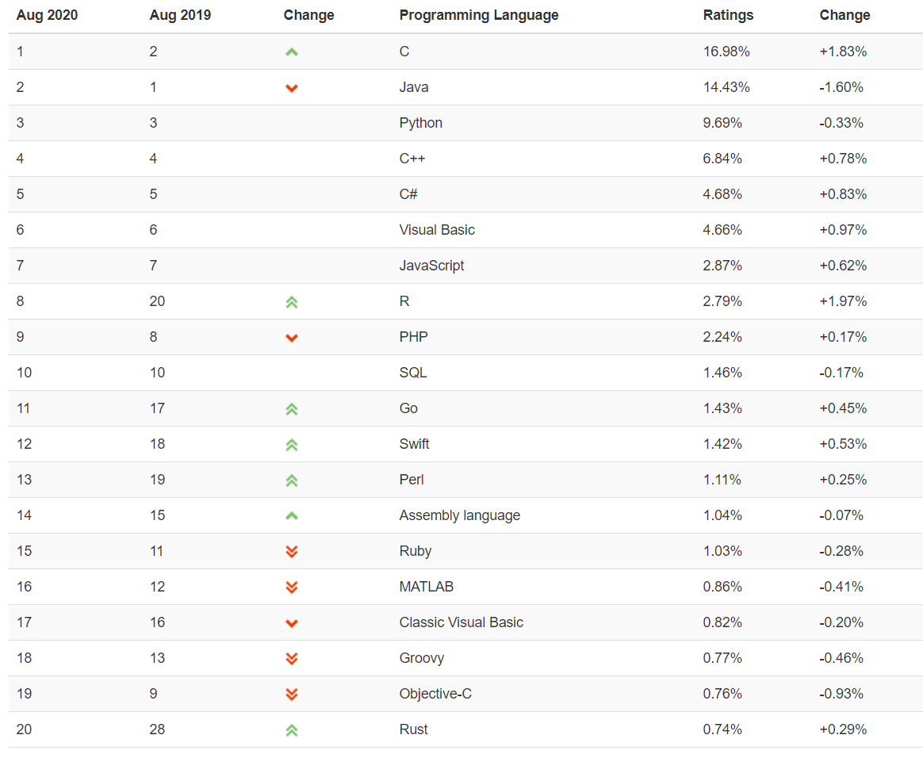

Info tidbit of the day… [ME459 slide, recycled]
Discussed in ME459
Discussed in ME459
Discussed in ME759
Discussed in ME459
Discussed in ME459
[https://www.tiobe.com/tiobe-index]$→$
“R is on schedule to become TIOBE's programming language of the year 2020”

Slide 45
Hardware aspects
The course designed to leverage a dedicated CPU/GPU cluster
Called Euler
pronounced: /ˈɔɪlər/ (IPA) or OY-lər (Phonetic) or "oiler" (approximate)
Each student receives an individual account that will be used for
GPU computing
OpenMP multi-core computing
MPI-enabled parallel computing
Version control (through git)
Advice: if possible, do all the programming on a local or CAE machine. Move to Euler for “production” runs
Do the homework on your favorite laptop or desktop
Caveat: make sure your code runs on Euler since there’s where the TA will run your code

Slide 46
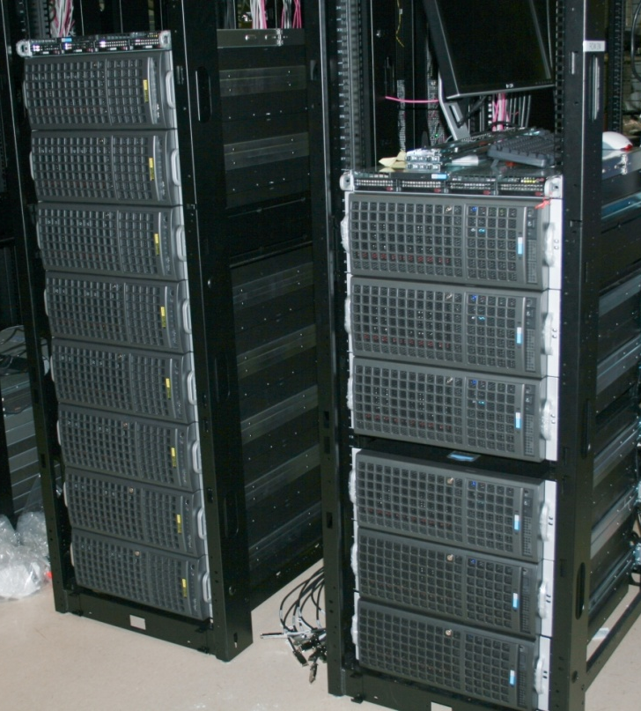
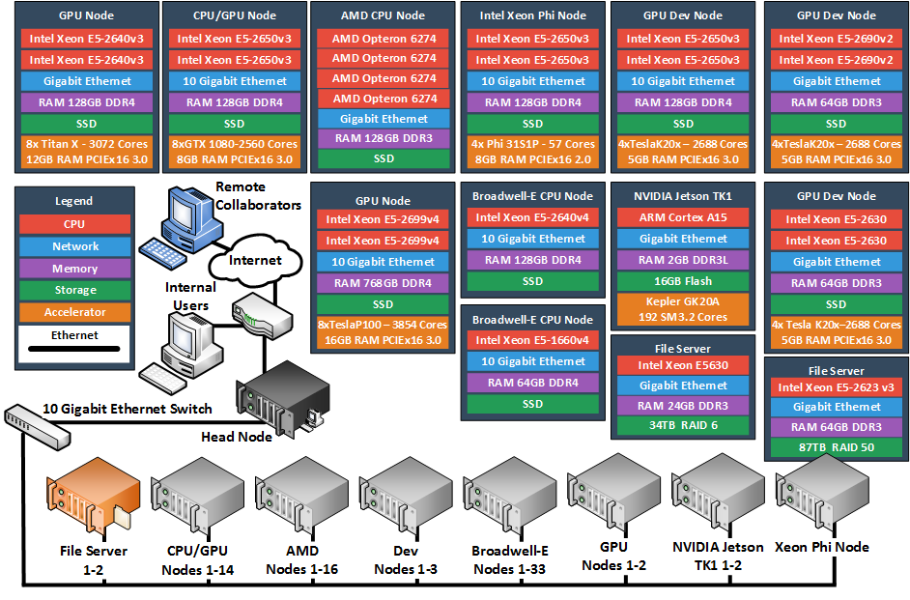
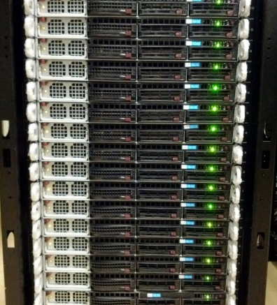
The Euler Cluster [pic is obsolete, but gives you an idea]
http://wacc.wisc.edu/infrastructure/

Slide 47
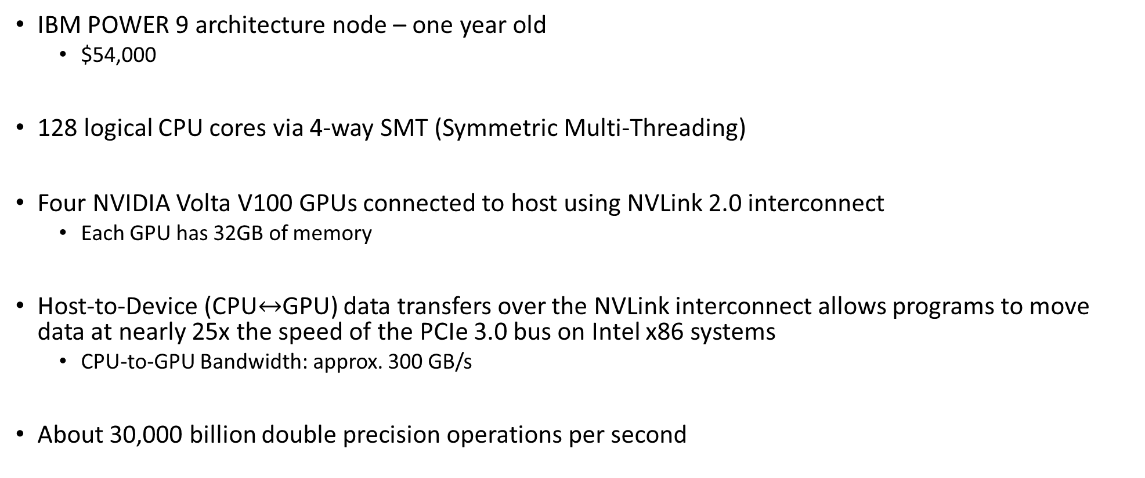
Example, an Euler node
IBM POWER 9 architecture node – one year old
$54,000
128 logical CPU cores via 4-way SMT (Symmetric Multi-Threading)
Four NVIDIA Volta V100 GPUs connected to host using NVLink 2.0 interconnect
Each GPU has 32GB of memory
Host-to-Device (CPU$↔$GPU) data transfers over the NVLink interconnect allows programs to move data at nearly 25x the speed of the PCIe 3.0 bus on Intel x86 systems
CPU-to-GPU Bandwidth: approx. 300 GB/s
About 30,000 billion double precision operations per second

Slide 48
Supercomputer [mis]use
Euler: over 200 accounts each year
Crashing Euler is not good
Stuff is due 24/7 on Euler: assignments, project deadlines, research, papers, conference presentations, etc.
Gold rule: do not run your code on the Euler *head* node
“head node” – where you land when you ssh into Euler
Head node used to schedule how the entire supercomputer works
Through Slurm scheduling you will get your job scheduled for execution
Execution will take place on a Euler node
The said Euler node is chosen by the scheduler, in a process transparent to you

Slide 49
Supercomputer [mis]use
Your account will be temporarily blocked if you run code on the head node
You’ll need to email Dan and Euler sysadmin to unblock your account
Pay attention, particularly right before the homework is due
That’s the worst time to get your account frozen

Slide 50
Software Issues
Operating system of choice in ME759: Linux
Euler runs CentOS Linux release 8
Miscellaenous libraries/releases:
CUDA: 11.2
OpenMPI: 4.0.2
OpenMP: 5.0
Compilers and such
gcc 8.2.1 for most of your homework
clang 9.0.0 and PGI 19.10 for some OpenMP/OpenACC jobs

Slide 51
Software Issues
Debugging and profiling tools:
gdb: debugger under Linux
cuda-gdb: debugger for CUDA applications running on the GPU
cuda-memcheck: memory checker, for CUDA applications
NVIDIA Profiler: Nsight
Most of these tools are embedded in Visual Studio and Eclipse
OK to work under Windows, yet make sure your code compiles/runs on Euler before submitting

Slide 52
Course Emphasis
There are multiple choices when it comes to implementing parallelism
PThreads, Intel’s TBB, OpenMP, MPI, Ct, Cilk, CUDA, etc.
Course focuses on parallelism enabled by
CUDA running on Graphics Processing Unit (GPU) cards, for fine-grain parallelism
OpenMP standard, aimed both at fine and coarse-grain parallelism
Message Passing Interface (MPI) standard, aimed at coarse grain parallelism

Slide 53
Course Objectives
Recognize applications/problems that can draw on advanced computing
Get familiar with today’s software and hardware that can speed up your code
Mostly done through parallel computing, at multiple levels
Gain basic skills that will help you map these applications onto a parallel computing hardware/software stack
Write code, build, link, run, debug, profile
Help you approach the task of writing software from a different (and hopefully better) point of view (mindset)

Slide 54
Course Objectives [Cntd.]
What I’ll try to accomplish, in plain English
Provide enough information for you to start writing software that can leverage parallel computing to hopefully reduce the amount of time required by your simulations to complete
I will not attempt to…
Propose new parallel computing languages or language features
Establish how compilers should support advanced computing
Etc.
To summarize,
We are interested in this stuff since we are consumers of parallel computing

Slide 55
How we’ll go about it…
Before talking about how to write software to run on a piece of hardware, we’ll learn something about that hardware asset
“learn something” – pick up those things we need to know as *programmers*
Level of detail provided not enough to be useful to people whose interests are in hardware
One theme of this course “know your hardware before you write your software”
Focus not on low level hardware detail
Dedicated courses already available
E C E 353: Introduction to Microprocessor Systems
E C E 354: Machine Organization and Programming
E C E 552: Introduction to Computer Architecture
E C E 752: Advanced Computer Architecture I

Slide 56
“High Performance Computing for Applications in Engineering.” Why This Title?
Computer Science: ISA, Limits to Instruction Level Parallelism and Multithreading, Speculative Execution, Pipelining, Memory Hierarchy, Memory Models, Cache Coherence, etc.
Long story short: how should a processor be built?
Computer Engineering: how can we build the processor that the CS colleagues have in mind?
Lots of microarchitecture issues
Science & Engineering: we’re faced with solving large problems
This class: Use parallel computing to solve these large problems

Slide 57
The Big Picture
“Big Data”: everybody’s talking about it
Two parts to “Big Data”
Producing it (data collection/sensing/computer simulation)
Processing it (data analysis)
We are not going to always works with big data, but the methods discussed that are aimed at it

Slide 58
Overview of Material Covered
Warm up: Basic concepts related to sequential computing (review, mostly ME459 material)
Overview of parallel computation paradigms and supporting hardware/software
GPU computing and the CUDA programming model
OpenMP programming
MPI programming
Heterogeneous parallel computing with CUDA and/or OpenMP and/or MPI

Slide 59
At the beginning of the road…
This field (advanced computing) is very much in flux, high rate of change
There will be issues that I don’t know and/or don’t understand
I always end up learning something new, in most cases with your help
There might be questions that you ask for which I don’t have an answer
I’ll follow up on these and get back with you (on the Forum)
Most of my statements should be qualified by the preamble “On most systems…”, or “By and large…”
You can always find exceptions, relatively few true blanket statements that can be made

Slide 60
The ME759, how I see it
Class is time consuming because of the assignments
The Piazza forum is a place where you learn a lot
There will be a lot of “googling” for the class
Dealing w/ situations when you’ll have to address pesky hurdles on your own

Slide 61
What ME759 offers
Access to top of the line hardware
Exposure to new programming techniques for speeding up computing in your work/research
In some cases, this might be a game changer
Winning ticket: top notch hardware + new programming approaches
An opportunity to try something big (the opportunity presents itself w/ the Final Project)

Slide 62
The Price of reaching 1 Gflop/second
1961:
Combine 17 million IBM-1620 computers
At $64K apiece, when adjusted for inflation, this would cost $160 billion (adjusted for inflation, 2019 US dollars)
2000:
About $1,000
Kentucky Linux Athlon Testbed, a 64+2 node Beowulf cluster built by the University of Kentucky COE in 2000
2015:
8 cents
Celeron G1830 & Radeon R9 295X2 System
2018: 6 cents
NVIDIA GTX 1080 Ti @ $699 apiece
2020 (November): 3 cents
AMD Ryzen 3600 & NVIDIA RTX 3080
[Wikipedia]$→$

Slide 63
GPU Acceleration: Ampere A100
Ampere A100: 9,000,000,000,000 double precision FMA operations per second
Very high bandwidth: 1555 GB/sec (HBM2)
Previous generation, Pascal had 720 GB/s
Amazing at data processing (data parallelism)
Euler has four A100s GPUs right now; eight more to come before the end of the semester

Slide 64
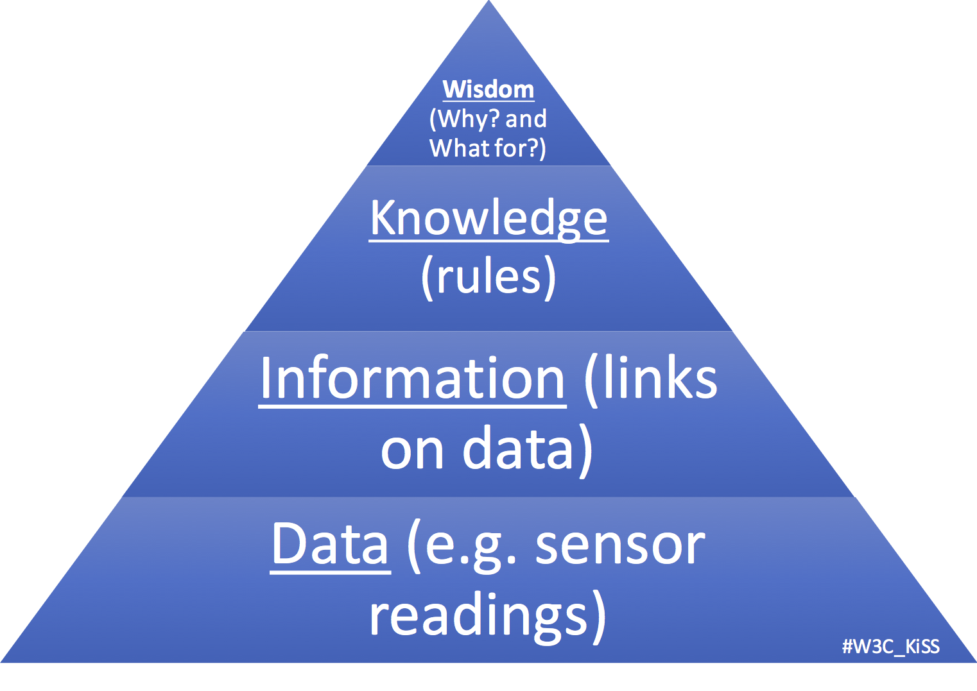
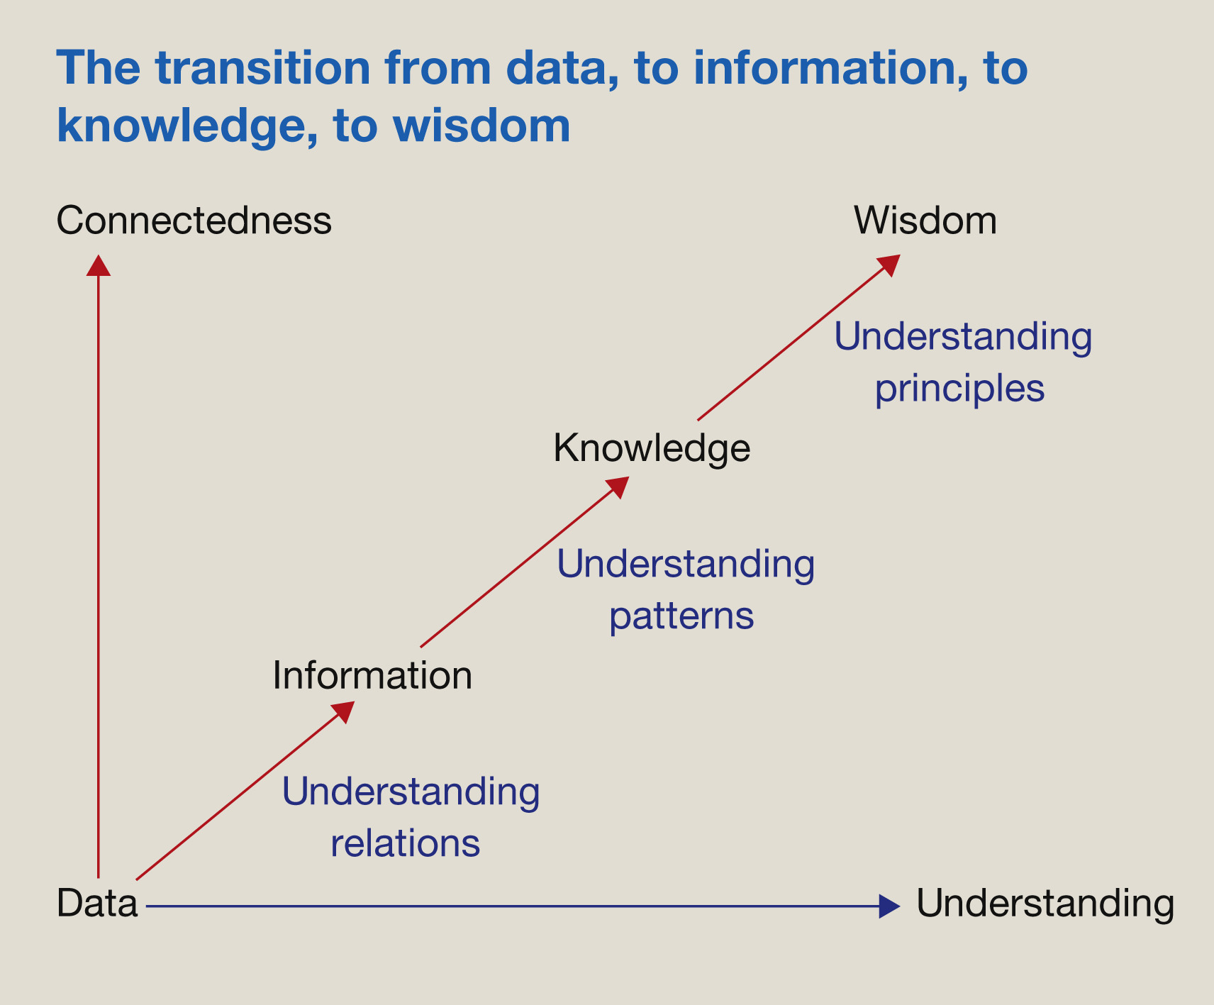
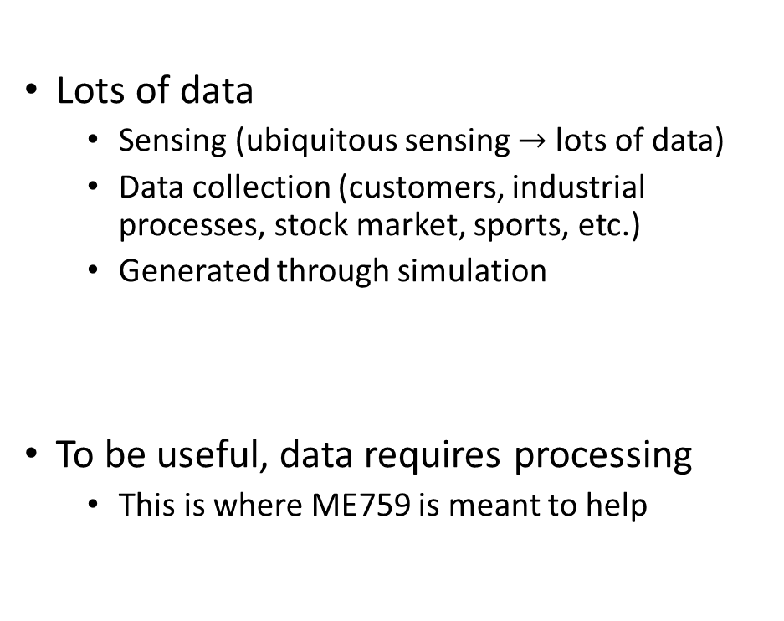
Computing, as a means to a goal: from information to wisdom
Lots of data
Sensing (ubiquitous sensing $→$ lots of data)
Data collection (customers, industrial processes, stock market, sports, etc.)
Generated through simulation
To be useful, data requires processing
This is where ME759 is meant to help
[https://www.w3.org/community/kiss/files/2017/02/DIKW.png]$→$
[https://www.sciencedirect.com/science/article/pii/S1472029916301813]$→$

Slide 65

High Performance Computing (HPC), and where useful
People from Oakridge National Lab, Argonne National Lab, Los Alamos National Lab:
HPC: The activity of using, for instance, 10,000 nodes to run one very large application
This application can’t be run on one machine: not enough memory space, for instance
People from ME759 and many other folks
HPC: The ability to tap into the resources of commodity hardware to extract speed for data generation and/or processing
Unlikely: You might have 10,000 nodes to use
Likely: you have one GPU, or four multi-core CPUs on one motherboard, or perhaps 10 nodes in a cluster
Measurement
Sensing
Simulation
HPC
HPC
Knowledge/Wisdom

