Slide 1
ME759 High Performance Computing for Applications in Engineering [Spring 2021]
Lecture 24
03/19/2021
Dan Negrut, 2021 ME759 UW-Madison

Slide 2
Quote of the day [reminging you how far you’ve made it already; you are already living somebody’s dream here.]
“Quiet you kids. If I hear one more word, Bart doesn't get to watch cartoons, and Lisa doesn't get to go to college.”
-- Homer Simpson, nuclear safety inspector at the Springfield Nuclear Power Plant (1989- )

Slide 3
Is BBC recording on?
If my internet connection goes down, I’ll email from my phone to provide more information – go/no-go, next step, etc.

Slide 4
Before we get started…
Last time
Parallel computing, multi-core: how caches come into play
Critical thinking, and similar tricks for speeding up your code
Today
Critical thinking, and other similar tricks for speeding up your code
Other tidbits:
Assignment due on Th, 03/18, at 9 pm. Novelty: you’ll have to deal w/ OpenMP
Final Project *Proposal*, due Monday at 9 pm. Post related questions on Piazza
Details about the proposal are here
The template for the two-page proposal is here
Suggestion: we discussed “Case Studies”; re-study a Case Study to see how modern architecture changes outcomes
Big ME759 PDF is here
Do not run your code on the Euler head-node (use Slurm)

Slide 5
Assessing performance, common sense things to keep in mind
“cold start” also applies to loading data into memory
“memory”: can be L1 cache, L2 cache, L3 cache, main memory, secondary memory, etc.
Example:
Suppose your program uses 20 KB of data
This would fit in L1 cache, on a quiet machine with a decent chip
20KB of data:
It can be buried on the disk since you haven’t used it since last year: cold start
It can be already in L1 since you run your code 1000 times to get statistical info about run times: hot start
Thus, if you measure repeatedly, your data is not going to be brought over from disk
Thus, you’re not going to have a “cold start” if you measure repeatedly with a code-embedded timer

Slide 6
Assessing performance, common sense things to keep in mind
“quiet machine”
Recall difference between “wall-clock time” and “execution time”
Good idea to time on a quiet machine
Alternative 1: You are one of 40 programs running, and you do so at some sad priority level
Alternative 2: Other than the kernel, you are perhaps the only show in town, on that machine

Slide 7
Profile on the target machine
In general, if you are assessing performance for improving speed, carry out timing/profiling exercise on the platform/chip on which you’ll be running the code
Assessing & improving performance for on a Windows machine w/ Microsoft compiler and a fat Intel chip with large caches will produce different results than running gcc-compiled code on Raspberry Pi w/ Linux

Slide 8
Rules of thumb, squeezing performance out of solution
Get to know your hardware: core count, how much memory, what latencies, bandwidth, etc.
Choose the right algorithm for your problem
Write compiler-friendly code [more to come, on this topic]
Watch out for optimization blockers; i.e., procedure calls & memory references
Look carefully at innermost loops (where most work is done)

Slide 9
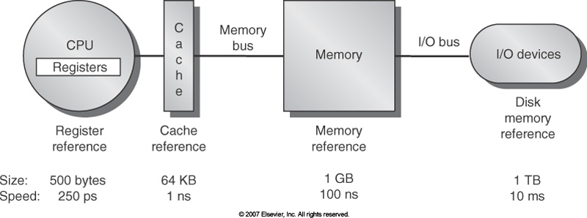
Know your memory latencies [typical embedded, desktop, and server computers]
[Computer Architecture, Hennessey and Patterson, fourth edition]$→$
Notes:
These numbers are by now obsolete, but orders of magnitude still relevant.
What does this imply?
For a frequency of 2GHz, 100ns for a memory access translates into 200 cycles.
But in one single cycle, a multi-core CPU, e.g. AMD Intralagos, can perform 32 fused multiply-add (FMA).
Conclusion: performance is dictated by efficiency of memory transactions <-> number crunching is free.
Goal: try to keep data in cache. You cannot directly control this, but you can arrange your code to provide good temporal and spatial locality.

Slide 10
Know bandwidths/latencies in your system
Latency:
Low
GPU cores
CPU Core
Cache
NOTE: The width of the black lines is proportional to the bandwidth.
80GB/s
50-100
GB/s
1550
GB/s
Latency:
Medium Low
Latency:
Rel.Low
System Memory
GPU Memory
Infiniband to next Compute Node
6GB/s
8-16 GB/s
Latency:
High
Latency:
Medium

Slide 11
Thinking critically about the expected speedup outcome
You are trying to optimize your code for speed
What makes for a good speed-up? What would make you happy?
1.2X speedup?
1.5X speedup?
2X speedup?
10X speedup?
Answer depends on how polished the code is when you pick it up; whether or not hardware is changed
Rule of thumb in engineering: if your job finishes overnight, it’s most often ok
“Job”: might be running a long program once, or running a short one a million times
“Job”: something that when completed produces data that yields information that leads to knowledge that produces insights that assist your decision making

Slide 12
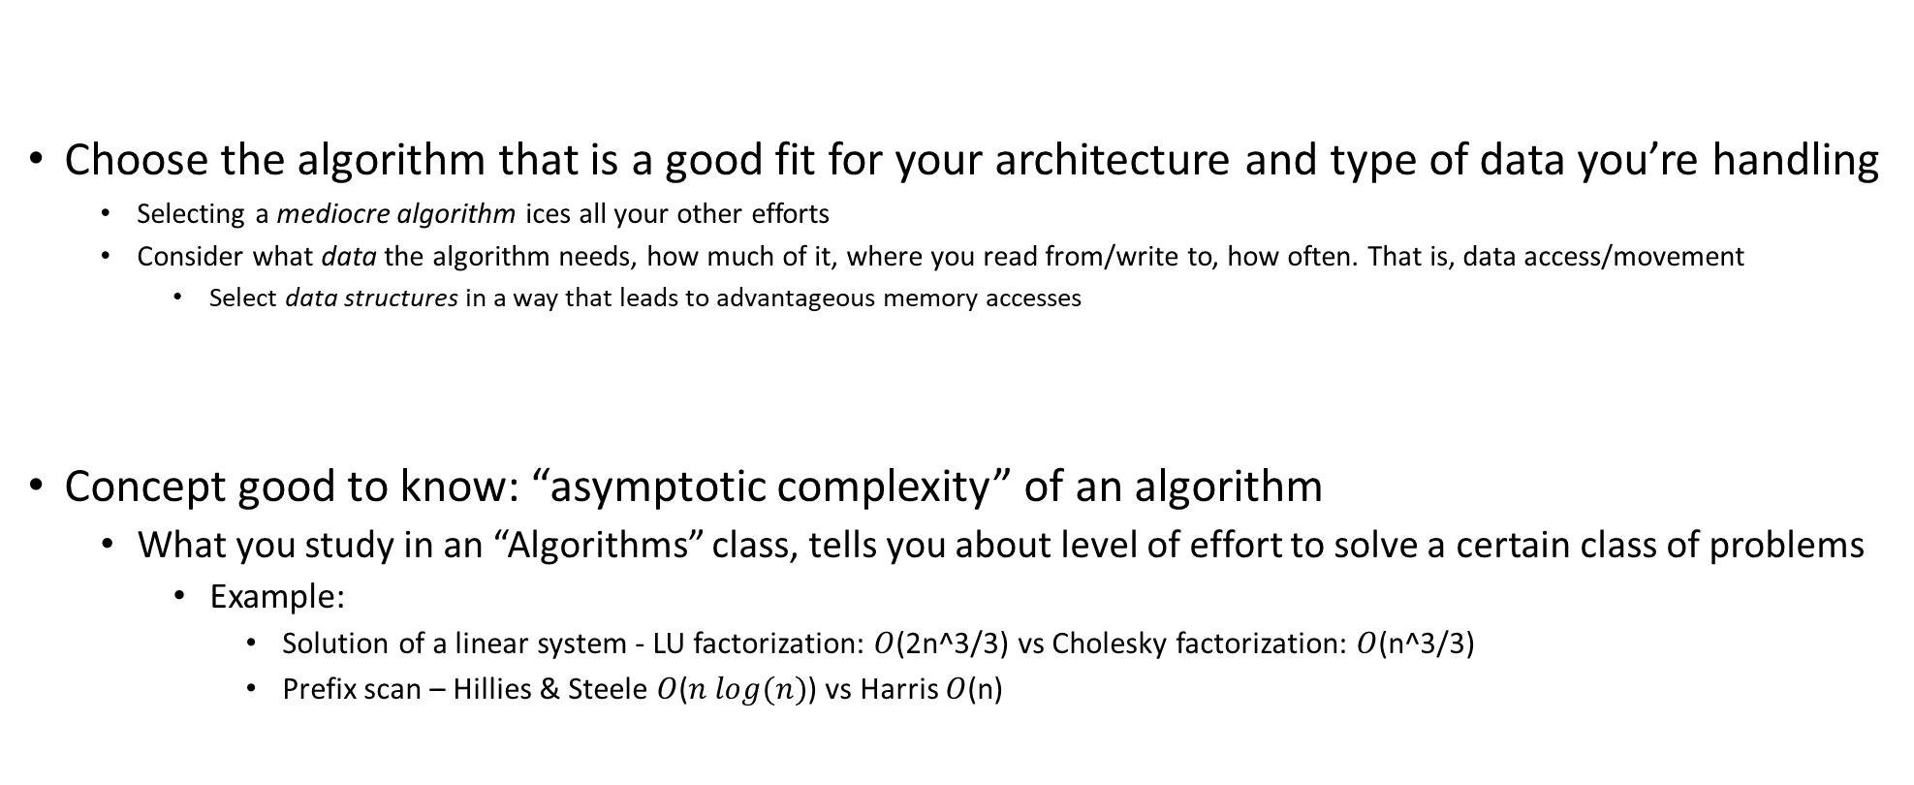
Starting off on the right foot: choose the right algorithm
Choose the algorithm that is a good fit for your architecture and type of data you’re handling
Selecting a mediocre algorithm ices all your other efforts
Consider what data the algorithm needs, how much of it, where you read from/write to, how often. That is, data access/movement
Select data structures in a way that leads to advantageous memory accesses
Concept good to know: “asymptotic complexity” of an algorithm
What you study in an “Algorithms” class, tells you about level of effort to solve a certain class of problems
Example:
Solution of a linear system - LU factorization: $O$(2n^3/3) vs Cholesky factorization: $O$(n^3/3)
Prefix scan – Hillies & Steele $O$($n log(n)$) vs Harris $O$(n)

Slide 13
Starting off on the right foot: choose the right algorithm
When working on problem, there’s more to performance than asymptotic complexity
Why?
Because asymptotic complexity is most often defined by number of operations
Memory transactions are rarely considered – they are specific to the hardware you’ll eventually use to run
If you understand how the computer works, it can guide you in designing a good/fast solution
Indeed, there is hope:
A problem can be solved by many algorithms (or approaches)
Also, one algorithm can have many implementations
NOTE: You should spend time reflecting on your solution before writing any line of code!

Slide 14
Asses the “Arithmetic Intensity” associated w/ your problem
Arithmetic intensity: how much math you do per byte of data you bring from memory
FLOPs/Byte
You can be in one of three cases:
Case 1: high arithmetic intensity
You’ll likely be compute-bound – the ALU works a lot, not a whole amount of data movement to/from memory
Case 2: low arithmetic intensity
You’ll likely be memory bound
You are moving data back and forth, likely only small parts of the data moved gets changed and/or used
Think cache misses
Case 3: “middle-earth” (J. R. R. Tolkien)
Somewhere in between
Your HPC mission in this case: become either compute-bound or memory-bound

Slide 15
Arithmetic Intensity: Putting things in perspective
J. R. R. Tolkien’s “Middle-earth”
Increasingly likely to be compute bound
Increasingly likely to be memory bound
FLOP/Byte
Low arithmetic intensity
High arithmetic intensity
SAXPY
FFT
SGEMM (matrix-matrix multiplication)

Slide 16
Simple Optimization Technique: Fusing Transformations
Fusing: One way to move towards higher arithmetic intensity
Basic idea
Do not bring data into cache twice
If you use data X, Y, and Z – bring this data from memory once and then forget about it
Why is it better?
You avoid memory traffic
for (int i = 0; i < N; i++)
U[i] = F(X[i],Y[i],Z[i]);
for (int i = 0; i < N; i++)
{
U[i] = F(X[i],Y[i],Z[i]);
V[i] = G(X[i],Y[i],Z[i]);
}
for (int i = 0; i < N; i++)
V[i] = G(X[i],Y[i],Z[i]);
Loop Fusion
Notes:
So what can we do to maximize the work we do for the same amount of data transferred?
Simple idea… But powerful

Slide 17
Fusing transformations on previous slide
Original implementation
More thoughtful implementation
12 Bytes
4 Bytes
12 Bytes
12 Bytes
8 Bytes
CPU
4 Bytes
Mem
CPU
Mem
Memory traffic cut by a factor of 1.6 (=32/20)
Notes:
What does this fusing get us?
Since the operation is completely memory bound the expected speedup is ~1.6x (=32/20)

Slide 18
Fusing Transformations
for (int i = 0; i < N; i++)
Y[i] = F(X[i]);
for (int i = 0; i < N; i++)
sum += F(X[i]);
for (int i = 0; i < N; i++)
sum += Y[i];
Loop Fusion
Mem traffic cut by a factor of 3
Less memory used (no need to have Y)
NVIDIA [N. Bell]→
Notes:
Another example of loop fusion

Slide 19
Fusing Transformations in Previous Example
Original Implementation
Optimized Implementation
4 Bytes
4 Bytes
4 Bytes
4 Bytes
CPU
DRAM
CPU
DRAM
TAKE AWAY MESSAGE: Think if you can reduce in your code data movement since it is expensive:
Power costs
Time waiting for data to move around
Notes:
Since the operation is completely memory bound the expected speedup is ~3x (=12/4)
The numbers of bytes are showing what happens for each i, from i=1 to 3 (or lengths of array)

Slide 20
Outside the scope of course: The roofline model
I encourage you to read about the “roofline model” to assess code performance
“Are you compute bound?” ; “Am I memory bound?” ; “What chip/architecture might help me?”
Access here “roofline model” material from Supercomputing 2019

Slide 21
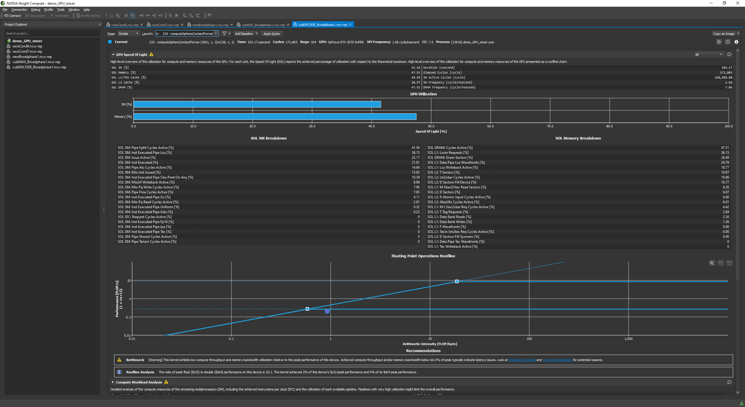

Slide 22
The roofline model, in one slide
On the previous slide, the “roofline” is an attribute of the hardware you use
What the roofline analysis gives you: the point (circle) on the previous slide
The X coordinate of the point plotted by the tool:
Aggregate arithmetic intensity for the piece of code you’re analyzing
The Y coordinate of the point plotted by the tool
Aggregate flops/second rate for the piece of code you’re analyzing
If the point/circle is not close to the roof, you are not doing “high-performance computing”

Slide 23
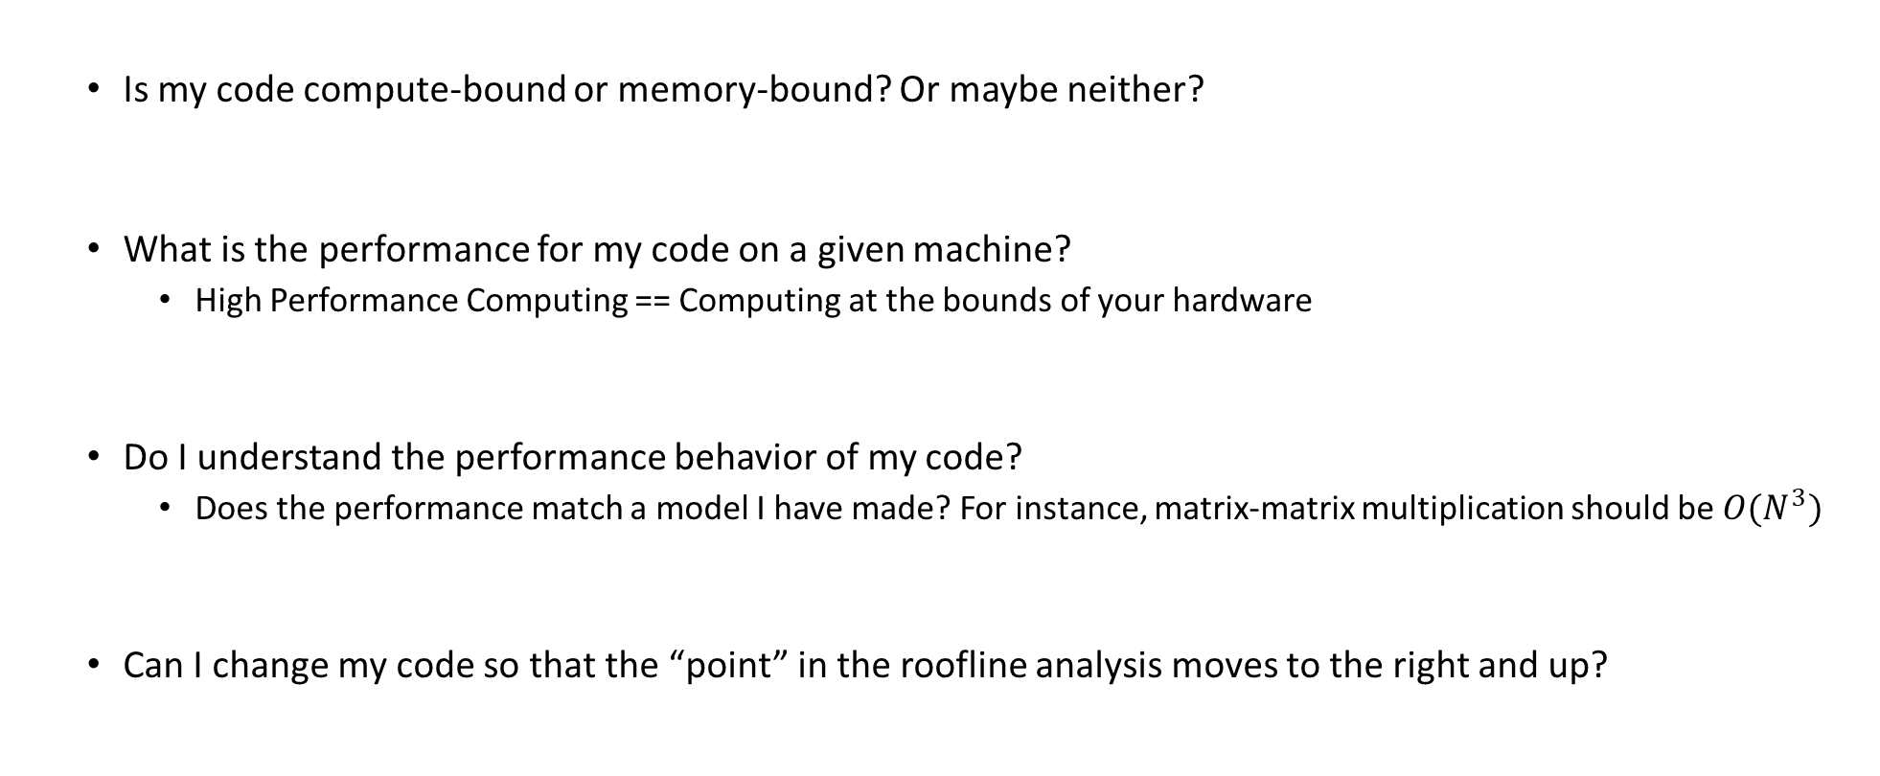
“High Performance Computing”: Questions to Ask
Is my code compute-bound or memory-bound? Or maybe neither?
What is the performance for my code on a given machine?
High Performance Computing == Computing at the bounds of your hardware
Do I understand the performance behavior of my code?
Does the performance match a model I have made? For instance, matrix-matrix multiplication should be ${O(N}^{3})$
Can I change my code so that the “point” in the roofline analysis moves to the right and up?

Slide 24
Let’s talk next about the compiler…
When you time/profile your code, you’ll have to play with the compile flags
Execution speed impacted heavily by compiling flags (3-4X speedup)
NOTE: Aggressive optimization done by compiler might change behavior of your code
Might change results
Might uncover skeletons in the closet
Side note: fair comparison of compilers is tricky
Different compilers have different flags
Tons of compilers out there: gcc, clang, g++, icl, cl, xl, etc.
Some compilers very adept at leveraging the underlying processor

Slide 25
How compilers come into play
A compiler has a tough job
Register allocation
Instruction selection and ordering
Dead code elimination
Fix minor inefficiencies
The expectation is that the compiler will provide an efficient mapping of program onto the chip
Compilers may or may not support features that have been included in a language recently (C++11, C++14, C++17, C++20, C++23, etc.)
Something to think about:
At least in theory, Intel compiler ought to be best positioned when it comes to compiling code for Intel chips
It ought to know all the dark corners of the microarchitecture
Well positioned to first implement any new/exotic ISA features

Slide 26
How compilers come into play
Compilers don’t improve asymptotic efficiency of your algorithm
Up to programmer to select the right algorithm for the problem & the architecture
Compilers have difficulty overcoming “optimization blockers”
Potential memory aliasing
“function call” side-effects

Slide 27
The compiler has a tough job
Most often, compiler ends up doing analysis only at the function level
Newer versions of gcc and clang do inter-procedural analysis within individual files
Whole-program analysis for some reason not done too often
More on this later
int functionFromOtherFile(double*);
double someOtherRemoteFunc(double*);
double myFunc() {
const size_t N = 1024;
double foo[N];
double accumulator = 0.;
for (int i = 0; i < functionFromOtherFile(foo); i++) {
accumulator += someOtherRemoteFunc(foo);
}
return accumulator;
}
Compiler in a tough spot: function bodies are often hidden from call sites, compiler can only see their declaration

Slide 28
The compiler has a tough job
The compiler operates under tight constraints
It must obey all the rules in the C/C++ standard
Often prevents compiler from making optimizations that would only affect behavior under pathological conditions
Rule above possibly ignored though when your code is making use of nonstandard language features
This is what gets the compiler confused and it needs to play it super safe so that you are not mad at it
Behavior that may be obvious to the programmer can be obfuscated by coding styles and poor understanding of the language
Don’t be too smart/cute when you write code; keep it simple and trust the compiler
Use of pointers is a big stumbling block (see more in 10 slides)

Slide 29
The compiler has a tough job
Most analysis based only on static information
Compiler can’t anticipate run-time inputs (in general)
One way in which we don’t help compilers is by writing code that is ambiguous, open to interpretation
The compilers can’t read our minds
When in doubt, the compiler must be conservative

Slide 30
Tricks of the trade, done by compiler
Function inlining – this is a big one
Wherever you call a function, the compiler simply replaces the call to function foo with the entire body of function foo (the entire function body dropped in)
Not always possible, you must explicitly call for it (by function decoration and/or compile flags)
Nowadays you can ask the compiler to report back what functions it successfully inlined
Quick consequences, if you can inline:
You have one less jump
No stack operations
More important: the compiler sees way more code and therefore engages in more fruitful optimizations
It’s one thing to optimize when you have 5 lines of code, and a different one for 500 lines of code
[Matt Godbolt]$→$

Slide 31
Other tricks of the trade, done by compiler
Constant propagation
Compiler substitutes all references to myApplePie with the constant value
Common subexpression elimination
Dead code removal
There may be areas of the code that have no effect on the output, and these can be removed
This includes loads and stores whose values are unused, as well as entire functions and expressions
Tail call removal
Set of recursive calls to same function get replaced by a loop
const double myApplePie = 3.1415;

Slide 32
How can you help the compiler?
A) Allow it to see as much code as possible
You set it free, so to speak
Recall that typically compiler sees only one file at a time
Can’t peek at some function you use that is defined in a different file
B) Provide flags to convey to it information
E.g.: telling compiler your target architecture can help quite a lot

Slide 33
Compilers, and link time optimization (LTO)
Compilers are becoming faster and smarter
It’s affordable and profitable to do program-level, not function level optimization
LTO (also known as LTCG, for “link time code generation”) can be used to allow the compiler to see across translation unit boundaries
Likely to provide good speed up for complex codes with many source files

Slide 34
LTO: Done how?
Individual translation units compiled to an intermediate representation (IR) instead of machine code
Machine code is generated during the link process—when the entire program is visible
The compiler can take advantage of this to inline across translation units, or at least use information about the side effects of called functions
NOTE: Invoking LTO can be done today; controlled through compile flags

Slide 35
Other tricks pulled off by the compiler [called “strength reduction”]
for (int i = 0; i < 100; ++i)
{
func(i * 1234);
}
You wrote this:
This is what the compiler will generate on your behalf:
for (int iTimes1234 = 0; iTimes1234 < 100 * 1234; i += 1234)
{
func(iTimes1234);
}
[Matt Godbolt]$→$

Slide 36
Other lesser trick: Share Common Subexpressions
Reuse portions of expressions
GCC will take care of this for you with –O1 flag
/* Sum neighbors of i,j */
up = val[(i-1)*n + j ];
down = val[(i+1)*n + j ];
left = val[i*n + j-1];
right = val[i*n + j+1];
sum = up + down + left + right;
long inj = i*n + j;
up = val[inj - n];
down = val[inj + n];
left = val[inj - 1];
right = val[inj + 1];
sum = up + down + left + right;
Up
Down
Stencil Operations
Left
Right
3 multiplications: i*n, (i–1)*n, (i+1)*n
1 multiplication: i*n
leaq 1(%rsi), %rax # i+1
leaq -1(%rsi), %r8 # i-1
imulq %rcx, %rsi # i*n
imulq %rcx, %rax # (i+1)*n
imulq %rcx, %r8 # (i-1)*n
addq %rdx, %rsi # i*n+j
addq %rdx, %rax # (i+1)*n+j
addq %rdx, %r8 # (i-1)*n+j
imulq %rcx, %rsi # i*n
addq %rdx, %rsi # i*n+j
movq %rsi, %rax # i*n+j
subq %rcx, %rax # i*n+j-n
leaq (%rsi,%rcx), %rcx # i*n+j+n
[15-213 @ CMU]$→$

Slide 37
Other lesser tricks: Replace costly operations with simpler ones
Examples:
Compiler will use “shift” whenever you multiply by a power of 2
16*x --> x << 4
Do not do this yourself, let the compiler do it, since it’s machine dependent
Compiler will go to great lengths to avoid divisions of integers
Around 20 times slower than an addition, and 5 times more expensive than multiplication
Division by power of 2 is simple (shift the other way, let the compiler do it)
Here’s a divide by 3, there is no division, actually:
divideByThree(unsigned int):
mov eax, edi ; eax = edi
mov edi, 2863311531 ; edi = 0xaaaaaaab
imul rax, rdi ; rax = rax * 0xaaaaaaab
shr rax, 33 ; rax >>= 33
ret
unsigned divideByThree(unsigned x){
return x / 3;
}
Computes 0.33333333337213844 of the input
[Matt Godbolt]$→$

Slide 38
One common theme for speeding up code: code motion
Code Motion
Reduce frequency with which some computation is performed
Particularly rewarding when a piece of code can get moved out of a loop
Typically done by the compiler, under higher optimization levels – if this is possible (more later)
Caveat: Make sure the new code produces same result (if you, rather than the compiler goes for it)
Code motion, basic idea, captured in this code snippet:
void set_row(double *a, double *b, int i, int n) {
for (int j = 0; j < n; j++)
a[n*i + j] = b[j];
}
void set_row(double *a, double *b, int i, int n) {
int dummy = n * i;
for (int j = 0; j < n; j++)
a[dummy + j] = b[j];
}
Typically done by compiler, if no red flags encountered

Slide 39
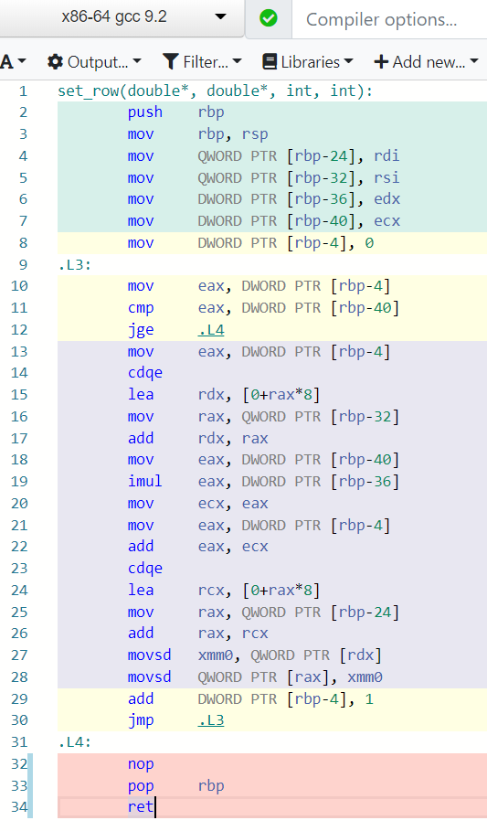
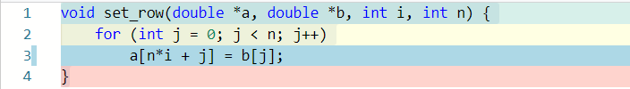

Assembly code, no optimization
See line 3 (left) and line 19 (right)
[https://godbolt.org/]$→$

Slide 40
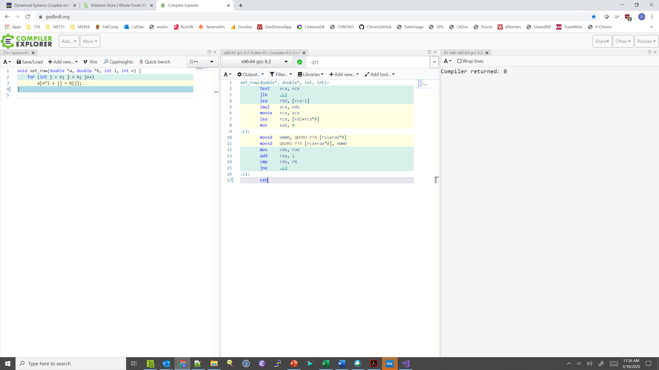
Assembly code, optimization –O1
Multiplication moved out of loop by compiler!
Bring b[j] into xmm0
Move xmm0 into a
Move value of j into rdx
Take home message: the compiler is your friend
Increment rax; i.e., j, by 1
Compare j with n (in r8)
Jump to .L3 if not equal
[https://godbolt.org/]$→$

Slide 41
[Next thing to consider:] Function calls are optimization blockers
Procedure to convert UPPER case characters in a string to lower case characters
void lower(char *s)
{
size_t i;
for (i = 0; i < strlen(s); i++)
if (s[i] >= 'A' && s[i] <= 'Z')
s[i] -= ('A' - 'a');
}
[15-213 @ CMU]$→$

Slide 42

Calling strlen
strlen performance
Only way to determine length of string is to scan its entire length, looking for null ‘\0’ character
We have N calls to strlen
Each call runs loop over N elements to find ‘\0’
What’s the impact?
Overall, this will lead to O(N²) performance of our solution for conversion to lower case
/* My version of strlen */
size_t strlen(const char *s)
{
size_t length = 0;
while (*s != '\0') {
s++;
length++;
}
return length;
}
[15-213 @ CMU]$→$

Slide 43
Lower Case Conversion Performance: version V1
Time quadruples when double string length
Quadratic performance
lowerV1
[15-213 @ CMU]$→$

Slide 44
Improving Performance
Move call to strlen outside of loop
Note that you know that the length len does not change from one iteration to another
You took it upon yourself to perform “code motion”
void lower(char *s)
{
size_t i;
size_t len = strlen(s);
for (i = 0; i < len; i++)
if (s[i] >= 'A' && s[i] <= 'Z')
s[i] -= ('A' - 'a');
}
[15-213 @ CMU]$→$

Slide 45
Lower Case Conversion Performance: version V2
Time doubles when double string length
Linear performance of lower2
lowerV1
lowerV2
[15-213 @ CMU]$→$

Slide 46
Optimization Blocker: Procedure Calls
This, and nothing more, is the content of a file in which your strlen function is defined
Why couldn’t compiler move strlen out of inner loop?
A function might have side effects
e.g., alters global state each time called
Function might not return same value for given arguments
e.g., depends on global state (for instance, in multi-core parallelism)
The takeaway message
Compiler must treat procedure call as a black box
Weak optimizations near/around procedure call (stumbling block)
Compiler cannot read your mind; it does exactly what you told it to do
Possible remedies:
Try to do your own code motion (you should know if it’s safe or not)
C++: Use of inline functions
GCC does this with –O1
Within single file
Use LTO (as we discussed)
static size_t lencnt = 0;
size_t strlen(const char *s)
{
size_t length = 0;
while (*s != '\0') {
s++; length++;
}
lencnt += length;
return length;
}
In this example, each time this strlen is called a variable is incremented (cooked up, but makes a point)
[15-213 @ CMU]$→$

Slide 47
[Next thing to consider:] Memory matters, and the trickiness of pointers
// sum entries in each row of A and store in vector b
void sum_rows1(double *A, double *b, long n) {
long i, j;
for (i = 0; i < n; i++) {
b[i] = 0;
for (j = 0; j < n; j++)
b[i] += A[i*n + j];
}
}
Assembly code, sum_rows1, inner loop (after j)
(gcc, optimized w/ -O1, from https://godbolt.org/)
.L3:
movsd xmm0, QWORD PTR [rdx]
addsd xmm0, QWORD PTR [rax]
movsd QWORD PTR [rdx], xmm0
add rax, 8
cmp rax, rcx
jne .L3
Bring b[i] from memory into register xmm0
Add to register xmm0 the right A entry from memory
Move updated b[i] value back into memory
Make rax have the address to next entry in A (double takes 8 bytes)
Compare i with n (latter stored in rcx)
Jump to .L3 if not equal
Code updates b[i] in memory on every iteration
Why couldn’t compiler optimize this away?

Slide 48
Memory Aliasing
A,9 | 0x000000ff3a8ffc60 | double[9]
[0] | 0 | double
[1] | 1 | double
[2] | 2 | double
[3] | 3 | double
[4] | 22 | double
[5] | 224 | double
[6] | 32 | double
[7] | 64 | double
[8] | 128 | double
b,3 | 0x000000ff3a8ffc78 | double[3]
[0] | 3 | double
[1] | 22 | double
[2] | 224 | double
#include <stdlib.h>
/* Sum rows of n X n matrix A and store in vector b */
void sum_rows1(double *A, double *b, long n) {
long i, j;
for (i = 0; i < n; i++) {
b[i] = 0;
for (j = 0; j < n; j++)
b[i] += A[i * n + j];
}
}
double A[9] =
{ 0, 1, 2,
0, 8, 16},
32, 64, 128};
double A[9] =
{ 0, 1, 2,
0, 8, 16},
32, 64, 128};
double A[9] =
{ 0, 1, 2,
1, 8, 16},
32, 64, 128};
double A[9] =
{ 0, 1, 2,
3, 8, 16},
32, 64, 128};
double A[9] =
{ 0, 1, 2,
3, 0, 16},
32, 64, 128};
double A[9] =
{ 0, 1, 2,
3, 3, 16},
32, 64, 128};
double A[9] =
{ 0, 1, 2,
3, 6, 16},
32, 64, 128};
double A[9] =
{ 0, 1, 2,
3, 22, 16},
32, 64, 128};
double A[9] =
{ 0, 1, 2,
3, 22, 0},
32, 64, 128};
double A[9] =
{ 0, 1, 2,
3, 22, 32},
32, 64, 128};
double A[9] =
{ 0, 1, 2,
3, 22, 96},
32, 64, 128};
double A[9] =
{ 0, 1, 2,
3, 22, 224},
32, 64, 128};
Value of b:
int main() {
double A[9] = {0, 1, 2, 4, 8, 16, 32, 64, 128};
double *b;
b = A + 3;
sum_rows1(A, b, 3);
return 0;
}
init: [4, 8, 16]
i = 0: [3, 8, 16]
i = 1: [3, 22, 16]
i = 2: [3, 22, 224]
The code updates b[i] on every iteration. It does so because:
Must consider possibility that these updates will affect program behavior
Value of “b” might change from when i=3 to when i=4 (parallel thread might interfere)
[15-213 @ CMU]$→$

Slide 49
Removing Aliasing
Assume that there is no aliasing
That is, no monkey business in main driver
You can do code motion
Result: Accessing array b only once!!!
Number of instructions drops down
Performance goes up
/* Sum rows of n X n matrix A and store in vector b */
void sum_rows2(double *A, double *b, long n) {
long i, j;
for (i = 0; i < n; i++) {
double val = 0;
for (j = 0; j < n; j++)
val += A[i*n + j];
b[i] = val;
}
}
Assembly code, sum_rows2, inner loop (after j)
(gcc, optimized w/ -O2, from https://godbolt.org/)
.L3:
addsd xmm0, QWORD PTR [rax]
add rax, 8
cmp rax, rcx
jne .L3
Bring A entry from memory and add to what’s in xmm0
Make rax point to next entry in row of A
Have you exhausted all entries in row “i” of A?
Jump back and do another trip if not more elems in row “i”

Slide 50
[Next thing to consider:] Memory Matters
.L3:
movsd xmm0, QWORD PTR [rdx]
addsd xmm0, QWORD PTR [rax]
movsd QWORD PTR [rdx], xmm0
add rax, 8
cmp rax, rcx
jne .L3
.L3:
addsd xmm0, QWORD PTR [rax]
add rax, 8
cmp rax, rcx
jne .L3
Bottom line: $→$ QWORD PTR shows up: three times (left) vs. one time (right)
That is, three vs. one memory accesses. Leads to significant speedup

Slide 51
Optimization Blocker: Memory Aliasing
Aliasing
Two different memory references specify single location
Easy to have happen in C - you have low level access to memory through pointers
Way around it:
Used local variables, like in the previous example – handy to accumulate within loops
You’ll help the compiler – it can issue better instructions
Use the restrict keyword, see code snippet
Feature added to the standard in 1999 (C99)
#include <stdlib.h>
/* Sum rows of n X n matrix A and store in vector b */
void sum_rows1(double * restrict A, double * restrict b, long n) {
long i, j;
for (i = 0; i < n; i++) {
b[i] = 0;
for (j = 0; j < n; j++)
b[i] += A[i * n + j];
}
}

