Slide 1
ME759 High Performance Computing for Applications in Engineering [Spring 2021]
Lecture 05
02/03/2021
Dan Negrut, 2021 ME759 UW-Madison

Slide 2
Quote of the day
“Weaseling out of things is important to learn. It's what separates us from the animals... except the weasel.”
-- Homer Simpson, Safety Inspector [1989 - ]. Regarding his son’s upbringing.

Slide 3
Is BBC recording on?
If my internet connection goes down, I’ll email from my phone to provide more information – go/no-go, next step, etc.

Slide 4
Before we get started…
Last time
Execution times
Memory related issues
The memory hierarchy
Caches
Today
Caches, wrap up
Virtual memory
Other tidbits:
Assignment due tomorrow evening at 9 pm
Please be mindful of how to use Euler (see doc that emailed on Sat night)
Please register for an Euler account (details provided in email of Th night)
Please read the ME459 “elements of C” material if malloc/new & pointers are not your friends

Slide 5
Next step: discuss how caches work
It’ll help us understand why caches are our friend (as long as we write code that maintains spatial and/or temporal locality)

Slide 6
Cache Line (aka Cache Block)
When data is brought in cache because a piece of data is needed, the MMU brings more than just the needed piece of data
Why bring more data than what absolutely necessary?
Because penalty is not high for bringing more: wide buses, little extra cost in bringing more data than exactly what needed
Corollary: you will reduce the number of trips to main memory if you use multiple times data from a cache line
“cache line”
Many systems have cache line of 64 Bytes (8 doubles OR 16 floats OR 16 ints OR 64 chars, etc.)
Cache line size is the same for L1, L2 and L3 caches

Slide 7
[Back to caches: The inner workings of caches] General Cache Concepts
Everything handled in hardware. Invisible to programmer
Smaller, faster, more expensive
memory can store a subset of
the main memory blocks
The Cache
8
4
9
14
10
3
Data copied in block-sized transfer units. Each block (such as block 10, for instance) typically holds 64 bytes of data (the “cache line”).
4
10
0
1
2
3
4
4
5
6
7
8
9
10
The Main Memory
10
11
Main Memory: Larger, slower, cheaper memory
(shown here as partitioned into “blocks” that are
mapped into cache lines)
12
13
14
15
[Bryant and O‘Hallaron: Computer Systems - A Programmer's Perspective 3rd edition] →

Slide 8
General Cache Concepts: Hit
Delivery to registers…
Request: 14
Data in block b is needed
Block b is in cache:
Hit!
Cache
8
9
14
3
14
Memory
0
1
2
3
4
5
6
7
8
9
10
11
Hit Rate: on average, how many out of 100 mem requests hit the cache?
12
13
14
15
[Bryant and O‘Hallaron: Computer Systems - A Programmer's Perspective 3rd edition] →

Slide 9
General Cache Concepts: Miss
Delivery to registers…
Request: 12
Data in block b is needed
Block b is not in cache:
Miss!
Cache
8
9
14
3
12
Block b is fetched from
memory
12
Request: 12
Memory
0
1
2
3
Block b is stored in cache
Placement policy: determines where Block b goes
Replacement policy: determines which block gets evicted (victim)
4
5
6
7
8
9
10
11
12
12
13
14
15
[Bryant and O‘Hallaron: Computer Systems - A Programmer's Perspective 3rd edition] →

Slide 10
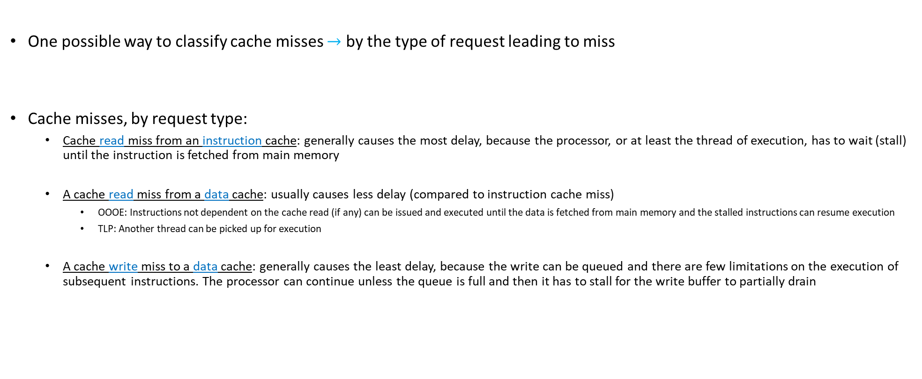
Cache Miss Classification, by Request Type
One possible way to classify cache misses $→$ by the type of request leading to miss
Cache misses, by request type:
Cache read miss from an instruction cache: generally causes the most delay, because the processor, or at least the thread of execution, has to wait (stall) until the instruction is fetched from main memory
A cache read miss from a data cache: usually causes less delay (compared to instruction cache miss)
OOOE: Instructions not dependent on the cache read (if any) can be issued and executed until the data is fetched from main memory and the stalled instructions can resume execution
TLP: Another thread can be picked up for execution
A cache write miss to a data cache: generally causes the least delay, because the write can be queued and there are few limitations on the execution of subsequent instructions. The processor can continue unless the queue is full and then it has to stall for the write buffer to partially drain

Slide 11
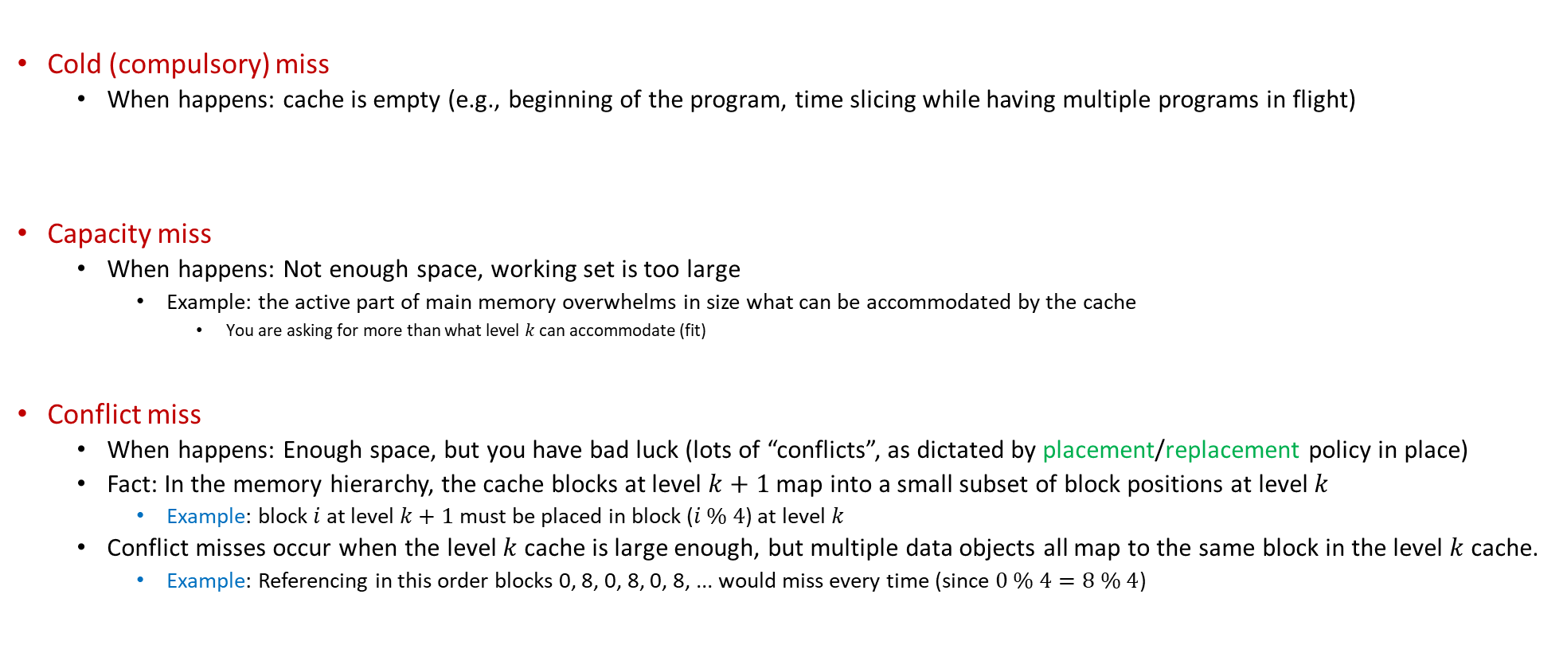
Reasons for Cache Misses
Cold (compulsory) miss
When happens: cache is empty (e.g., beginning of the program, time slicing while having multiple programs in flight)
Capacity miss
When happens: Not enough space, working set is too large
Example: the active part of main memory overwhelms in size what can be accommodated by the cache
You are asking for more than what level $k$ can accommodate (fit)
Conflict miss
When happens: Enough space, but you have bad luck (lots of “conflicts”, as dictated by placement/replacement policy in place)
Fact: In the memory hierarchy, the cache blocks at level $k+1$ map into a small subset of block positions at level $k$
Example: block $i$ at level $k+1$ must be placed in block ($i \% 4$) at level $k$
Conflict misses occur when the level $k$ cache is large enough, but multiple data objects all map to the same block in the level $k$ cache.
Example: Referencing in this order blocks 0, 8, 0, 8, 0, 8, ... would miss every time (since $0 \% 4=8 \% 4$)

Slide 12
Placement & Replacement Policies
The cache is small, while the memory that you try to cache in this cache is large
The cache: prime real estate – when somebody comes in, somebody else has to be evicted
Caching: like bringing visitors from a large city to live in one apartment building next to some prime attraction
“prime attraction”: the registers and the ALU/CU
placement policy: deciding at which “floor of the building” to host the new visitors (the new cache line)
If there are 2 or 4 or 8, etc. apartments (cache lines) at each floor level, which apartment do you choose?
“replacement policy” – if you have Option A and Option B, which one should you choose: A or B?
You’ll kick out tenants from apartment A, or tenants from apartment B?

Slide 13
Placement & Replacement Policies [continued]
Policies that are common:
“When you bring a line of cache…”
You can only put it in one place (direct mapped cache): skyscraper, but with one apartment per floor
Based on the address of the request you can put it in one of the 4 floors (many floors, and four apartments at each floor level)
You can have, for instance, 2 apartments, or 8 apartments, or k places (for k-way associative cache)
You are free to place wherever (fully associative cache): Only 1 floor in the building (ranch-style apartment building), but lots of apartments
Note: you always have to place; sometimes you have to replace, too

Slide 14
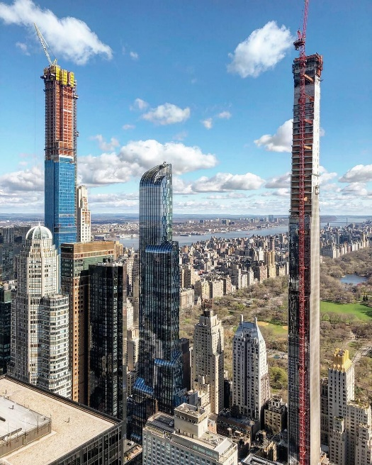
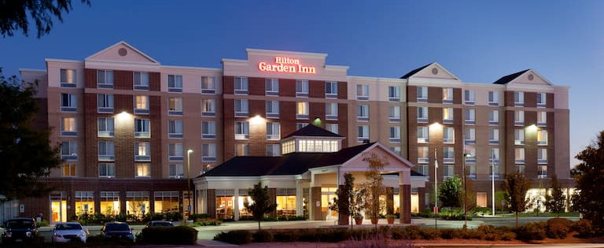

Placement & Replacement Policies [continued]
Direct mapped: cache is skinny skyscraper, with one apartment per floor
Recall that apartment is large enough to accommodate 64 folks (Bytes)
Associative, K-way: a certain number of floors, each with K apartments
Fully associative cache: apartment level with ground level only

Slide 15
Placement & Replacement Policies: further discussion
Direct mapped (the tall skinny skyscraper)
Pros: very fast to find if in cache or not
Cons: sometimes, you’ll have to evict a line cache that sees a lot of use (no freedom at all in the placement policy)
K-way associative (Hilton Garden Inn)
Decent compromise:
It yields a reasonably decent replacement policy – you have K options to choose from
At the same time, you don’t have to search too many apartments at a floor level
NOTE: Intel and AMD chips - 2, 4, 8, 16-way associative
Depends on cache level and which chip model
Fully associative (the ranch)
Pros: you have full control which old cache line you want to kick out (lots of freedom for replacement policy)
Cons:
Higher overhead to find what you’re looking for (data can be anywhere in cache)
Higher overhead to decide whom to evict (the “victim”)

Slide 16
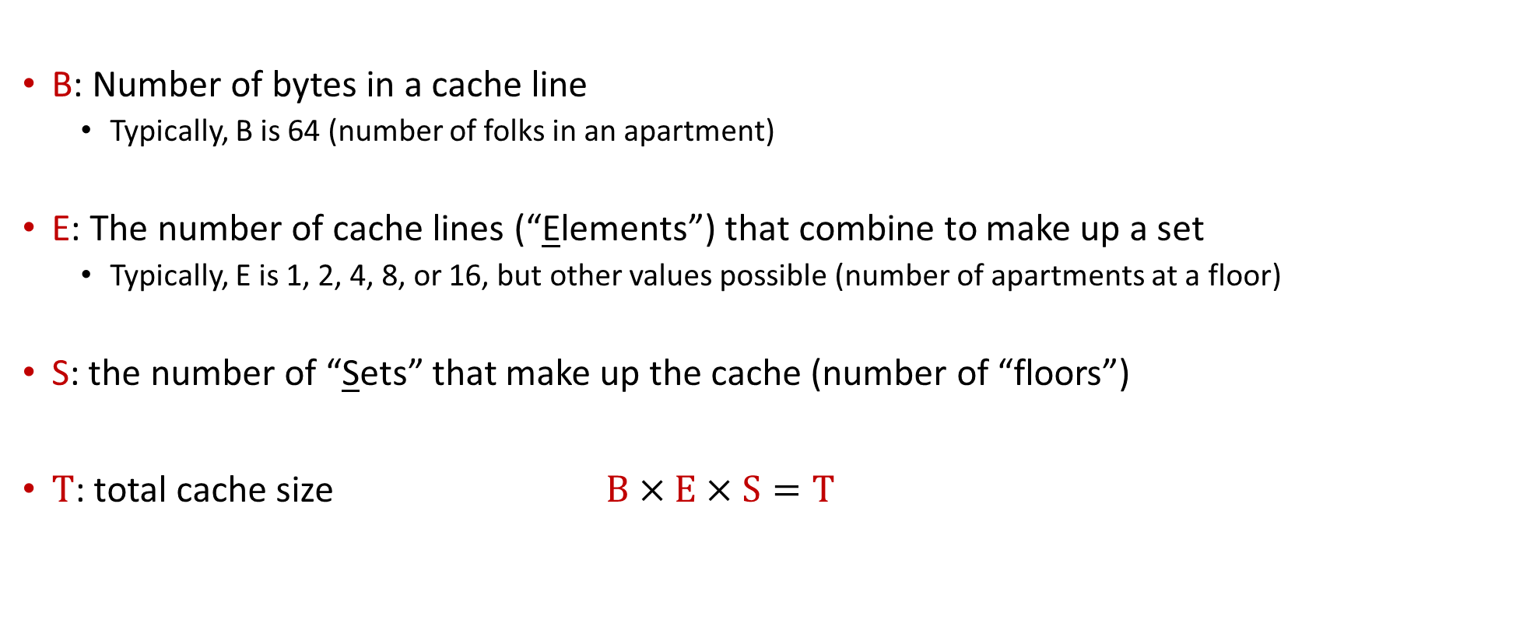
[New Topic:] General Cache Organization [Symbols Used and Their Meaning]
B: Number of bytes in a cache line
Typically, B is 64 (number of folks in an apartment)
E: The number of cache lines (“Elements”) that combine to make up a set
Typically, E is 1, 2, 4, 8, or 16, but other values possible (number of apartments at a floor)
S: the number of “Sets” that make up the cache (number of “floors”)
$T$: total cache size $B×E×S=T$

Slide 17
General Cache Organization (B, E, S)
E = 2e lines per set
a “cache Set”
a “cache Element” (it wraps inside a cache line; an element belongs to a set)
S = 2^{s} sets
Cache size:
B x E x S=T data bytes
How a “cache Element” is organized
v
tag
0
1
2
B-1
valid bit
B = 2^{b} bytes of data per cache block (cache line)
[Bryant and O‘Hallaron: CMU] →

Slide 18
On finding if data from a main memory address is in cache
The mission: Read into register a variable at a given memory address
The important question: Is the value stored at this address by any chance in cache?
To answer this question, the addressed is partitioned in three chunks
Memory address (either 32 or 64 bits)
t bits
s bits
b bits
tag
set
index
block
offset

Slide 19
The key ingredient is the set index
The set index give me “the floor in the hotel where I should look for Joe who lives at 12 Main St.
The s bits of the address
Hotel must have 2^{s} floors
Important remark: there are many addresses in main memory that will have the same set index
Translation: folks from many neighborhoods of the town assigned to the same hotel floor
Memory address (either 32 or 64 bits)
t bits
s bits
b bits
tag
set
index
block
offset

Slide 20
How Cache Read Takes Place
E = 2e lines per set
Memory address (either 32 or 64 bits):
t bits
s bits
b bits
S = 2^{s} sets
tag
set
index
block
offset
data begins at this offset
How the game is played:
v
tag
0
1
2
B-1
Locate set
Check if any element in set has matching tag
Yes + line valid = hit
Locate data starting at offset
valid bit
B = 2^{b} bytes – the cache block (the data)
[Bryant and O‘Hallaron: Computer Systems - A Programmer's Perspective 3rd edition] →

Slide 21
Example: Direct Mapped Cache (E = 1)
Direct mapped: One line per set
Assume: cache block size 8 bytes (instead of 64)
Address of int:
v
tag
0
1
2
3
4
5
6
7
t bits
0…01
100
v
tag
0
1
2
3
4
5
6
7
find set
S = 2^{s} sets
v
tag
0
1
2
3
4
5
6
7
v
tag
0
1
2
3
4
5
6
7
[Bryant and O‘Hallaron: CMU] →

Slide 22
Example: Direct Mapped Cache (E = 1)
Direct mapped: One line per set
Assume: cache block size 8 bytes (instead of 64)
Address of int:
valid? +
match: assume yes = hit
t bits
0…01
100
v
tag
0
1
2
3
4
5
6
7
tag
block offset
[Bryant and O‘Hallaron: CMU] →

Slide 23
Example: Direct Mapped Cache (E = 1)
Direct mapped: One line per set
Assume: cache block size 8 bytes (instead of 64)
Address of int:
valid? +
match: assume yes = hit
t bits
0…01
100
v
tag
0
1
2
3
4
5
6
7
block offset
int (4 Bytes) that you care about is here
If tag doesn’t match: old line is evicted and replaced
[Bryant and O‘Hallaron: CMU] →

Slide 24
E-way Set Associative Cache (Here: E = 2)
E = 2: Two elements/lines per set
Assume: cache block size 8 bytes (instead of 64)
Address of short int:
2 elements per set
t bits
0…01
100
v
tag
0
1
2
3
4
5
6
7
v
tag
0
1
2
3
4
5
6
7
v
tag
0
1
2
3
4
5
6
7
v
tag
0
1
2
3
4
5
6
7
find set
v
tag
0
1
2
3
4
5
6
7
v
tag
0
1
2
3
4
5
6
7
v
tag
0
1
2
3
4
5
6
7
v
tag
0
1
2
3
4
5
6
7
S sets
[Bryant and O‘Hallaron: CMU] →

Slide 25
E-way Set Associative Cache (Here: E = 2)
E = 2: Two elements/lines per set
Assume: cache block size 8 bytes (instead of 64)
Address of short int:
compare both
t bits
0…01
100
valid? +
match: yes = hit
v
tag
0
1
2
3
4
5
6
7
tag
v
tag
0
1
2
3
4
5
6
7
block offset
[Bryant and O‘Hallaron: CMU] →

Slide 26
E-way Set Associative Cache (Here: E = 2)
E = 2: Two elements/lines per set
Assume: cache block size 8 bytes (instead of 64)
Address of short int:
compare both
t bits
0…01
100
valid? +
match: yes = hit
v
tag
0
1
2
3
4
5
6
7
v
tag
0
1
2
3
4
5
6
7
block offset
short int (2 Bytes) is here
No match:
One line in set is selected for eviction and replacement
Replacement policies: random, least recently used (LRU), …
[Bryant and O‘Hallaron: CMU] →

Slide 27
Quiz: How many neighborhoods sent folks to same hotel floor?
There are many addresses in main memory that will have the same set index
Translation: folks from many neighborhoods of the town assigned to the same hotel floor
Assume 32 bit OS, and the set index is 6 bits wide (64 sets)
How many “neighborhoods” of the main memory send folks to the same floor of the hotel?
How is associativity helping?
Memory address (either 32 or 64 bits)
t bits
s bits
b bits
tag
set
index
block
offset
Notes:
6 bits for cache line + 6 bits for set index: 12 bits.
32-12=20.
Therefore, there are 2^20, about 4 million neighborhoods that send folks to the same floor of the hotel.
Having K-way associativity saves eviction

Slide 28
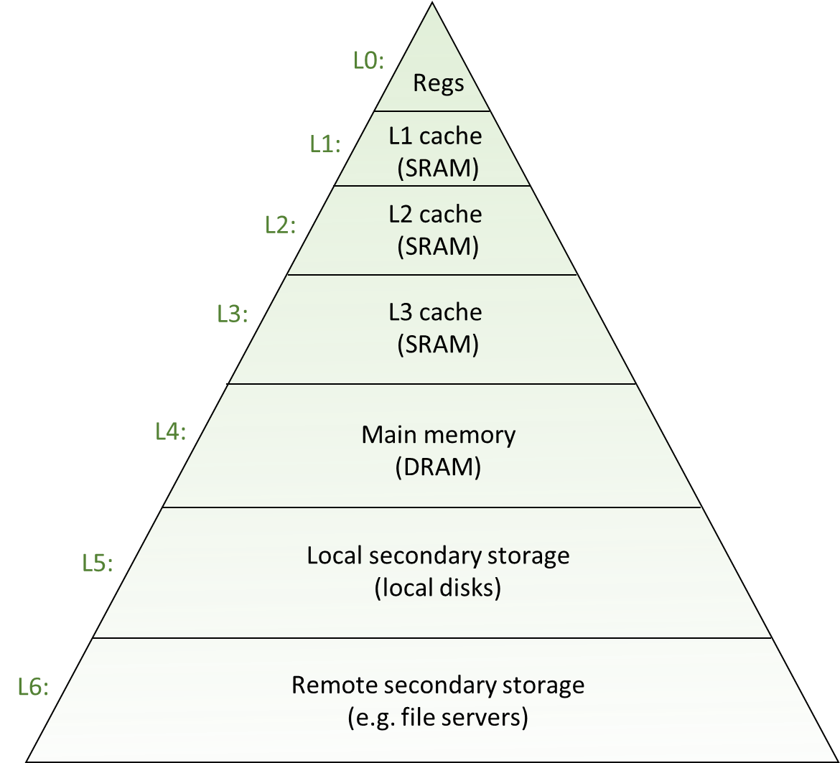
Why these acrobatics?
Trying to fit a lot of memory (system memory, GBs of it) into little memory (cache, MBs of it)
Common sense: you have to use tricks to accommodate stuff from a big pot into a small pot
This dilemma of storing a lot of information in a small space is pervasive
Because of the memory hierarchy reality we are operating under
Similar tricks for placing data in main memory relative to placing in secondary memory

Slide 29
Example: Adding the Entries in a 2D Matrix
Example is used over several slides to show how “locality” and caches impact performance

Slide 30
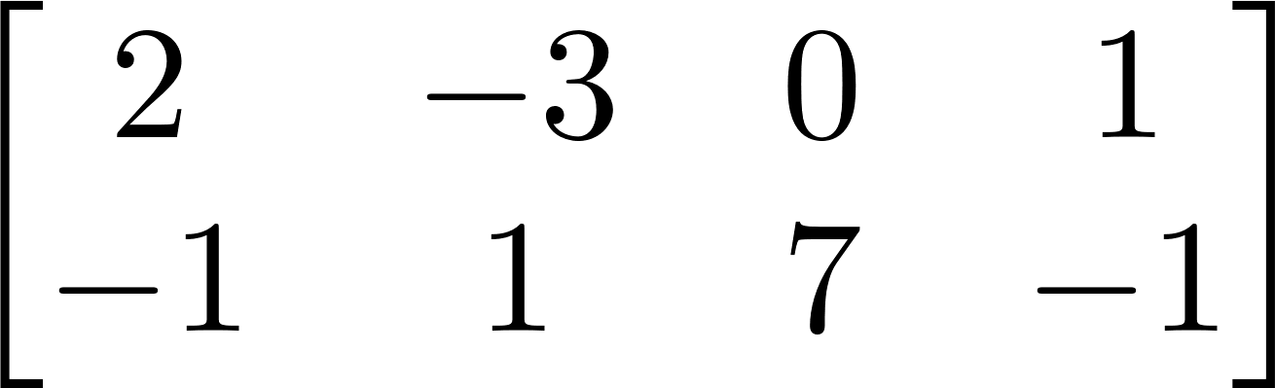
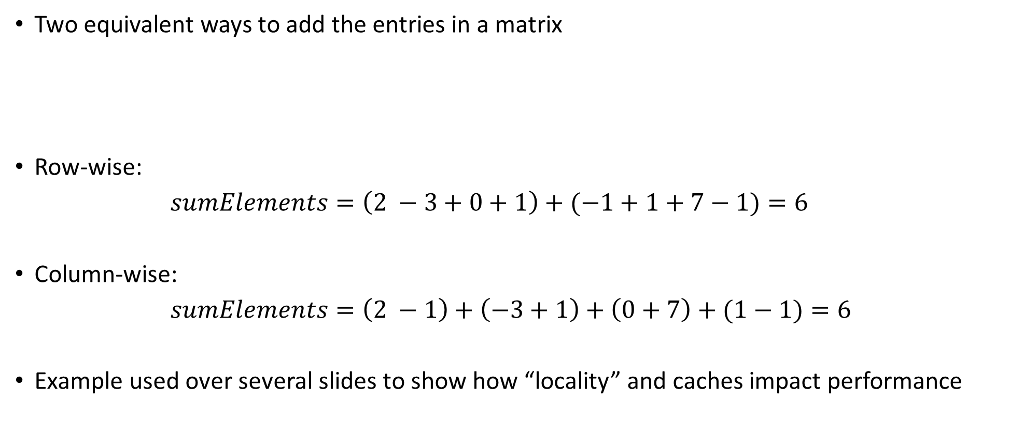
Example [motivation]: Adding the Entries in a 2D Matrix
Two equivalent ways to add the entries in a matrix
Row-wise:
$sumElements=\left(2 −3+0+1\right)+(−1+1+7−1)=6$
Column-wise:
$sumElements=\left(2 −1\right)+\left(−3+1\right)+\left(0+7\right)+(1−1)=6$
Example used over several slides to show how “locality” and caches impact performance
First row
Second row
First column
Second column
Third column
Fourth column

Slide 31
Squashed format vs. 2D format
Storing a matrix: squashed format OR 2D format
Example:
The 1D (squashed) format – using one long contiguous array of 8 entries. Used in homework
The 2D format – using two arrays:
Each has 4 entries
Each of the two arrays stored somewhere in the memory (they might be far from each other)

Slide 32
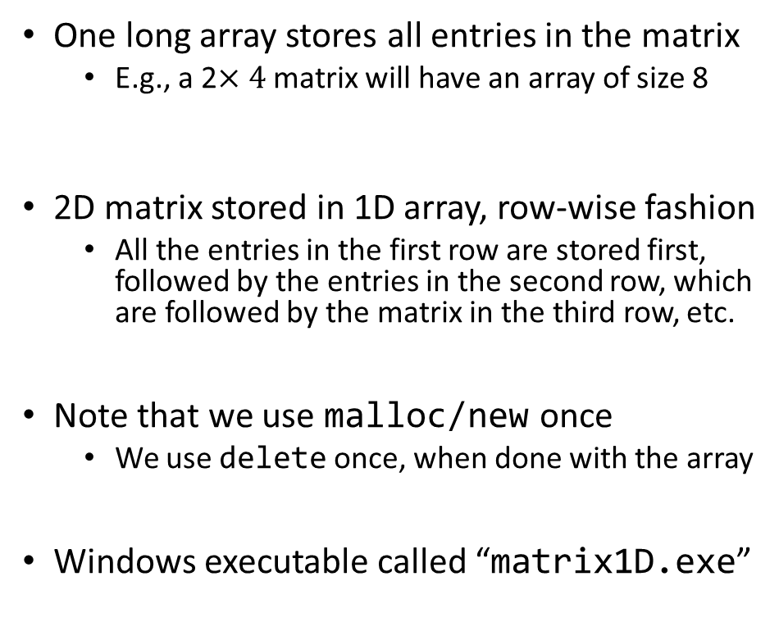
First way to represent 2D matrix: the “squashed,” 1D approach
#include <cstdio>
struct squashedMatrix {
/// 2D matrix stored row-wise in a one dimensional array
unsigned int height; /// number of rows in matrix
unsigned int width; /// number of columns in matrix
double *pMatVals;
};
int main() {
struct squashedMatrix mat1D;
mat1D.height = 1000; // perhaps you set this based on user input
mat1D.width = 2000; // perhaps you set this based on user input
mat1D.pMatVals = new double[mat1D.height * mat1D.width];
unsigned int i, j;
for (i = 0; i < mat1D.height; i++)
for (j = 0; j < mat1D.width; j++)
mat1D.pMatVals[i * mat1D.width + j] = 1. / (i + j + 1.);
// Compute sum of elements
double sum = 0.;
for (i = 0; i < mat1D.height; i++)
for (j = 0; j < mat1D.width; j++)
sum += mat1D.pMatVals[i * mat1D.width + j];
std::printf("The sum of the elements is: %f\n", sum);
// Done with the matrix; free the memory
delete[] mat1D.pMatVals;
return 0;
}
One long array stores all entries in the matrix
E.g., a 2$×4$ matrix will have an array of size 8
2D matrix stored in 1D array, row-wise fashion
All the entries in the first row are stored first, followed by the entries in the second row, which are followed by the matrix in the third row, etc.
Note that we use malloc/new once
We use delete once, when done with the array
Windows executable called “matrix1D.exe”

Slide 33
Example: matrix stored in squashed (1D) format
Color used with indexing when accessing (visiting) by row
Matrix dimensions: 250,000 rows × 4 columns
Color used with indexing when accessing (visiting) by column
The Memory
1st row
2nd row
250,000th row
…
0
1
2
3
4
5
6
7
8
9
999999
0
1
2
249999
250000
250001
499999

Slide 34

The squashed approach, revisited: locality vs. non-locality
#include <chrono> // need this for cross-platform timers in C++
#include <cstdio>
#include <cstdlib>
struct squashedMatrix {
/// 2D matrix stored row-wise in a one dimensional array
unsigned int height; /// number of rows in matrix
unsigned int width; /// number of columns in matrix
double *pMatVals;
};
int main(int argc, char *argv[]) {
if (argc != 2) {
std::printf("Pass 1 for row-wise, pass 2 for column-wise sum.\n");
return 1;
}
int option = std::atoi(argv[1]);
struct squashedMatrix mat1D;
mat1D.height = 2000; // perhaps you set this based on user input
mat1D.width = 2000; // perhaps you set this based on user input
mat1D.pMatVals = new double[mat1D.height * mat1D.width];
unsigned int i, j;
for (i = 0; i < mat1D.height; i++)
for (j = 0; j < mat1D.width; j++)
mat1D.pMatVals[i * mat1D.width + j] = 1. / (i + j + 1.);
// Compute sum of elements
double sum = 0.;
auto start = std::chrono::high_resolution_clock::now(); // Get a timestamp
if (option == 1) {
for (i = 0; i < mat1D.height; i++)
for (j = 0; j < mat1D.width; j++)
sum += mat1D.pMatVals[i * mat1D.width + j];
} else if (option == 2) {
for (j = 0; j < mat1D.width; j++)
for (i = 0; i < mat1D.height; i++)
sum += mat1D.pMatVals[i * mat1D.width + j];
} else {
std::printf("Bad input option.\n");
return 1;
}
auto end = std::chrono::high_resolution_clock::now(); // Get a timestamp
auto elapsed = end – start; // Get difference between timestamps
std::printf("The sum of the elements is: %f\n", sum);
std::printf("Time spent in nanoseconds: %d\n",
std::chrono::duration_cast<std::chrono::nanoseconds>(elapsed).count()
);
// Done with the matrix; free the mem
delete[] mat1D.pMatVals;
return 0;
}

Slide 35
Results, release build: 6 to 7 times faster if accessed w/ locality
TRUMAN Release> ./matrixRep1D.exe
Pass 1 for row-wise, pass 2 for column-wise sum.
TRUMAN Release> ./matrixRep1D.exe 1
The sum of the elements is: 2772.088785
Time spent in nanoseconds: 3
TRUMAN Release> ./matrixRep1D.exe 2
The sum of the elements is: 2772.088785
Time spent in nanoseconds: 23
OS Name Microsoft Windows 10 Enterprise 2016 LTSB
System Type x64-based PC
Processor Intel(R) Core(TM) i7-6800K CPU @ 3.40GHz, 3401 Mhz, 6 Core(s), 12 Logical Processor(s)
Installed Physical Memory (RAM) 32.0 GB
Compiler Visual Studio 2015 (Enterprise)

Slide 36
A second way to represent the matrix: the 2D approach
#include <cstdio>
struct Matrix2D {
/// 2D matrix stored row-wise in a one dimensional array
unsigned int height; /// number of rows in matrix
unsigned int width; /// number of columns in matrix
double **pRows;
};
int main() {
struct Matrix2D mat2D;
mat2D.height = 1000; // perhaps you set this based on user input
mat2D.width = 2000; // perhaps you set this based on user input
mat2D.pRows = new double*[mat2D.height];
unsigned int i;
for (i = 0; i < mat2D.height; i++)
mat2D.pRows[i] = new double[mat2D.width];
// Get meaningful values in this matrix
unsigned int j;
for (i = 0; i < mat2D.height; i++)
for (j = 0; j < mat2D.width; j++)
mat2D.pRows[i][j] = 1. / (i + j + 1.);
// Compute sum of elements
double sum = 0;
for (i = 0; i < mat2D.height; i++)
for (j = 0; j < mat2D.width; j++)
sum += mat2D.pRows[i][j];
std::printf("The sum of the elements is: %f\n", sum);
// Don't data anymore, free mem; note that free is used twice
for (i = 0; i < mat2D.height; i++)
delete[] mat2D.pRows[i];
delete[] mat2D.pRows;
return 0;
}
First, we allocate room to store a bunch of pointers to double
There are “height” of these “double *” pointers
These pointers stored in the array pRows
For each matrix row (and there are “height” of them), we allocate enough room to store “width” doubles
These are the values that show up in a row of the matrix
Note that we use new/malloc multiple times
We’ll have to use delete multiple times
Windows executable called “matrix2D.exe”

Slide 37
Example: matrix stored in 2D format
Color used with indexing when accessing (visiting) by row
Matrix dimensions: 250,000 rows × 4 columns
Color used with indexing when accessing (visiting) by column
1st row
3rd row
The Memory
2nd row
0
1
2
3
8
9
10
11
0
2
some other row
some other row
4
5
6
7
1
0
5th row
some other row
4th row
16
17
18
19
4
12
13
14
15
3

Slide 38
The 2D approach, revisited: locality vs. non-locality
#include <chrono> // need this for cross-platform timers in C++
#include <cstdio>
#include <cstdlib>
struct Matrix2D {
/// 2D matrix stored row-wise in a one dimensional array
unsigned int height; /// number of rows in matrix
unsigned int width; /// number of columns in matrix
double **pRows;
};
int main(int argc, char *argv[]) {
if (argc != 2) {
std::printf("Pass 1 for row-wise, pass 2 for column-wise sum.\n");
return 1;
}
int option = std::atoi(argv[1]);
struct Matrix2D mat2D;
mat2D.height = 2000; // perhaps you set this based on user input
mat2D.width = 2000; // perhaps you set this based on user input
mat2D.pRows = new double*[mat2D.height];
unsigned int i;
for (i = 0; i < mat2D.height; i++)
mat2D.pRows[i] = new double[mat2D.width];
// Get meaningful values in this matrix
unsigned int j;
for (i = 0; i < mat2D.height; i++)
for (j = 0; j < mat2D.width; j++)
mat2D.pRows[i][j] = 1. / (i + j + 1.);
// Compute sum of elements
double sum = 0;
auto start = std::chrono::high_resolution_clock::now(); // Get a timestamp
if (option == 1) {
for (i = 0; i < mat2D.height; i++)
for (j = 0; j < mat2D.width; j++)
sum += mat2D.pRows[i][j];
} else if (option == 2) {
for (j = 0; j < mat2D.width; j++)
for (i = 0; i < mat2D.height; i++)
sum += mat2D.pRows[i][j];
} else {
std::printf("Bad input option.\n");
return 1;
}
auto end = std::chrono::high_resolution_clock::now(); // Get a timestamp
auto elapsed = end – start; // Get difference between timestamps
std::printf("The sum of the elements is: %f\n", sum);
std::printf("Time spent in nanoseconds: %d\n",
std::chrono::duration_cast<std::chrono::nanoseconds>(elapsed).count()
);
// Don't need data anymore, free mem; note that delete is needed twice
for (i = 0; i < mat2D.height; i++)
delete[] mat2D.pRows[i];
delete[] mat2D.pRows;
return 0;
}

Slide 39
Results, release build: $≈$ 5 times faster if accessed w/ locality
TRUMAN Release> ./matrixRep2D.exe
Pass 1 for row-wise, pass 2 for column-wise sum.
TRUMAN Release> ./matrixRep2D.exe 1
The sum of the elements is: 2772.088785
Time spent in nanoseconds: 4
TRUMAN Release> ./matrixRep2D.exe 2
The sum of the elements is: 2772.088785
Time spent in nanoseconds: 20
OS Name Microsoft Windows 10 Enterprise 2016 LTSB
System Type x64-based PC
Processor Intel(R) Core(TM) i7-6800K CPU @ 3.40GHz, 3401 Mhz, 6 Core(s), 12 Logical Processor(s)
Installed Physical Memory (RAM) 32.0 GB
Compiler Visual Studio 2015 (Enterprise)

Slide 40
The two scenarios, side by side: squashed and proper 2D
TRUMAN Release> ./matrixRep1D.exe
Pass 1 for row-wise, pass 2 for column-wise sum.
TRUMAN Release> ./matrixRep1D.exe 1
The sum of the elements is: 2772.088785
Time spent in nanoseconds: 3
TRUMAN Release> ./matrixRep1D.exe 2
The sum of the elements is: 2772.088785
Time spent in nanoseconds: 23
TRUMAN Release> ./matrixRep2D.exe
Pass 1 for row-wise, pass 2 for column-wise sum.
TRUMAN Release> ./matrixRep2D.exe 1
The sum of the elements is: 2772.088785
Time spent in nanoseconds: 4
TRUMAN Release> ./matrixRep2D.exe 2
The sum of the elements is: 2772.088785
Time spent in nanoseconds: 20
OS Name Microsoft Windows 10 Enterprise 2016 LTSB
System Type x64-based PC
Processor Intel(R) Core(TM) i7-6800K CPU @ 3.40GHz, 3401 Mhz, 6 Core(s), 12 Logical Processor(s)
Installed Physical Memory (RAM) 32.0 GB
Compiler Visual Studio 2015 (Enterprise)

Slide 41
Final Exam type question: Qualitative Estimates of Locality
Being able to look at code and get a qualitative sense of its locality is a key skill for a professional programmer
Question: Below, do we have good locality with respect to array a?
int sum_array_rows(int** a)
{
int i, j, sum = 0;
for (i = 0; i < M; i++)
for (j = 0; j < N; j++)
sum += a[i][j];
return sum;
}
[Bryant and O‘Hallaron: Computer Systems - A Programmer's Perspective 3rd edition] →

Slide 42
Final Exam type question: Qualitative Estimates of Locality
Question: Does this function have good locality with respect to array a?
int sum_array_cols(int** a)
{
int i, j, sum = 0;
for (j = 0; j < N; j++)
for (i = 0; i < M; i++)
sum += a[i][j];
return sum;
}
[Bryant and O‘Hallaron: Computer Systems - A Programmer's Perspective 3rd edition] →

Slide 43
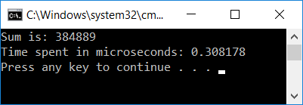
Taking it to the next level: 3D Matrices – good locality
OS Name Microsoft Windows 10 Enterprise 2016 LTSB
System Type x64-based PC
Processor Intel(R) Core(TM) i7-6800K CPU @ 3.40GHz, 3401 Mhz, 6 Core(s), 12 Logical Processor(s)
Installed Physical Memory (RAM) 32.0 GB
Compiler Visual Studio 2015 (Enterprise)
#include <iostream>
#include <chrono> // need this for timing
int main() {
const int M = 700;
double*** bPPP = new double**[M]; // use this to store 3d matrix
for (int i = 0; i < M; i++) {
bPPP[i] = new double*[M];
for (int j = 0; j < M; j++) {
bPPP[i][j] = new double[M];
for (int k = 0; k < M; k++)
bPPP[i][j][k] = 1. / (i + j + k + 1.); // storing some smallish number
}
}
double sum = 0.;
auto start = std::chrono::high_resolution_clock::now();
// sum up all entries in 3D array
for (int i = 0; i < M; i++)
for (int j = 0; j < M; j++)
for (int k = 0; k < M; k++)
sum += bPPP[i][j][k];
auto end = std::chrono::high_resolution_clock::now();
auto elapsed = end – start;
auto as_micro = std::chrono::duration_cast<std::chrono::duration<double, std::micro>>(elapsed);
std::cout << "Sum is: " << sum << std::endl;
std::cout << "Time spent in microseconds: " << as_micro.count() << std::endl;
return 0;
}
NOTE: We didn't delete[] our memory in this example, but you should always do it in your code.

Slide 44
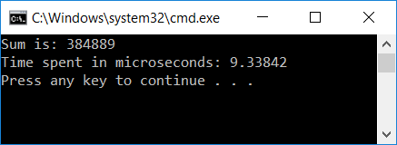
Taking it to the next level: 3D Matrices – bad locality
OS Name Microsoft Windows 10 Enterprise 2016 LTSB
System Type x64-based PC
Processor Intel(R) Core(TM) i7-6800K CPU @ 3.40GHz, 3401 Mhz, 6 Core(s), 12 Logical Processor(s)
Installed Physical Memory (RAM) 32.0 GB
Compiler Visual Studio 2015 (Enterprise)
#include <iostream>
#include <chrono> // need this for timing
int main() {
const int M = 700;
double*** bPPP = new double**[M]; // use this to store 3d matrix
for (int i = 0; i < M; i++) {
bPPP[i] = new double*[M];
for (int j = 0; j < M; j++) {
bPPP[i][j] = new double[M];
for (int k = 0; k < M; k++)
bPPP[i][j][k] = 1. / (i + j + k + 1.); // storing some smallish number
}
}
double sum = 0.;
auto start = std::chrono::high_resolution_clock::now();
// sum up all entries in 3D array
for (int k = 0; k < M; k++)
for (int j = 0; j < M; j++)
for (int i = 0; i < M; i++)
sum += bPPP[i][j][k];
auto end = std::chrono::high_resolution_clock::now();
auto elapsed = end – start;
auto as_micro = std::chrono::duration_cast<std::chrono::duration<double, std::micro>>(elapsed);
std::cout << "Sum is: " << sum << std::endl;
std::cout << "Time spent in microseconds: " << as_micro.count() << std::endl;
return 0;
}
NOTE: We didn't delete[] our memory in this example, but you should always do it in your code.

Slide 45
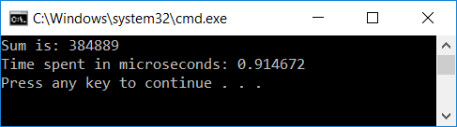
Running the code in Debug vs. Release mode: big difference?
OS Name Microsoft Windows 10 Enterprise 2016 LTSB
System Type x64-based PC
Processor Intel(R) Core(TM) i7-6800K CPU @ 3.40GHz, 3401 Mhz, 6 Core(s), 12 Logical Processor(s)
Installed Physical Memory (RAM) 32.0 GB
Compiler Visual Studio 2015 (Enterprise)
#include <iostream>
#include <chrono> // need this for timing
int main() {
const int M = 700;
double*** bPPP = new double**[M]; // use this to store 3d matrix
for (int i = 0; i < M; i++) {
bPPP[i] = new double*[M];
for (int j = 0; j < M; j++) {
bPPP[i][j] = new double[M];
for (int k = 0; k < M; k++)
bPPP[i][j][k] = 1. / (i + j + k + 1.); // storing some smallish number
}
}
double sum = 0.;
auto start = std::chrono::high_resolution_clock::now();
// sum up all entries in 3D array
for (int i = 0; i < M; i++)
for (int j = 0; j < M; j++)
for (int k = 0; k < M; k++)
sum += bPPP[i][j][k];
auto end = std::chrono::high_resolution_clock::now();
auto elapsed = end – start;
auto as_micro = std::chrono::duration_cast<std::chrono::duration<double, std::micro>>(elapsed);
std::cout << "Sum is: " << sum << std::endl;
std::cout << "Time spent in microseconds: " << as_micro.count() << std::endl;
return 0;
}
“Debug” mode
“Release” mode

Slide 46
Three observations related to our 2D and 3D examples
Observation 1: Final value for sum - stays the same (at least as far as we can tell)
We’ll talk more about this when we do parallel computing w/ CUDA and then OpenMP
Observation 2: Difference between Debug vs Release builds
3X to 4X speedup normal to see when going from debug to release (see also results on next slide)
Observation 3: Amount of time to get the result quite different
Release mode build: the undesirable solution for 3D matrix is 30 times slower
This is the case you see in practice – you build in release

Slide 47
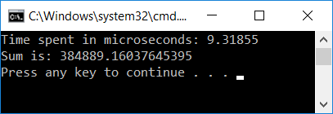
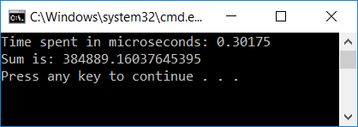

Observations on “Observation 1”
The fact that the results are the same is remarkable
Why remarkable?
Finite precision arithmetic: addition loses its commutative and associative attributes
Because of finite precision
$$A_{1}+…+A_{10}≈A_{10}+…+A_{1}$$
$${((…((A}_{1}+A_{2})+A_{3})+A_{4})+…+A_{10})≈{(A}_{1}+{(A}_{2}+(…+(A_{9}+A_{10}))…))$$
Because of finite precision

Slide 48
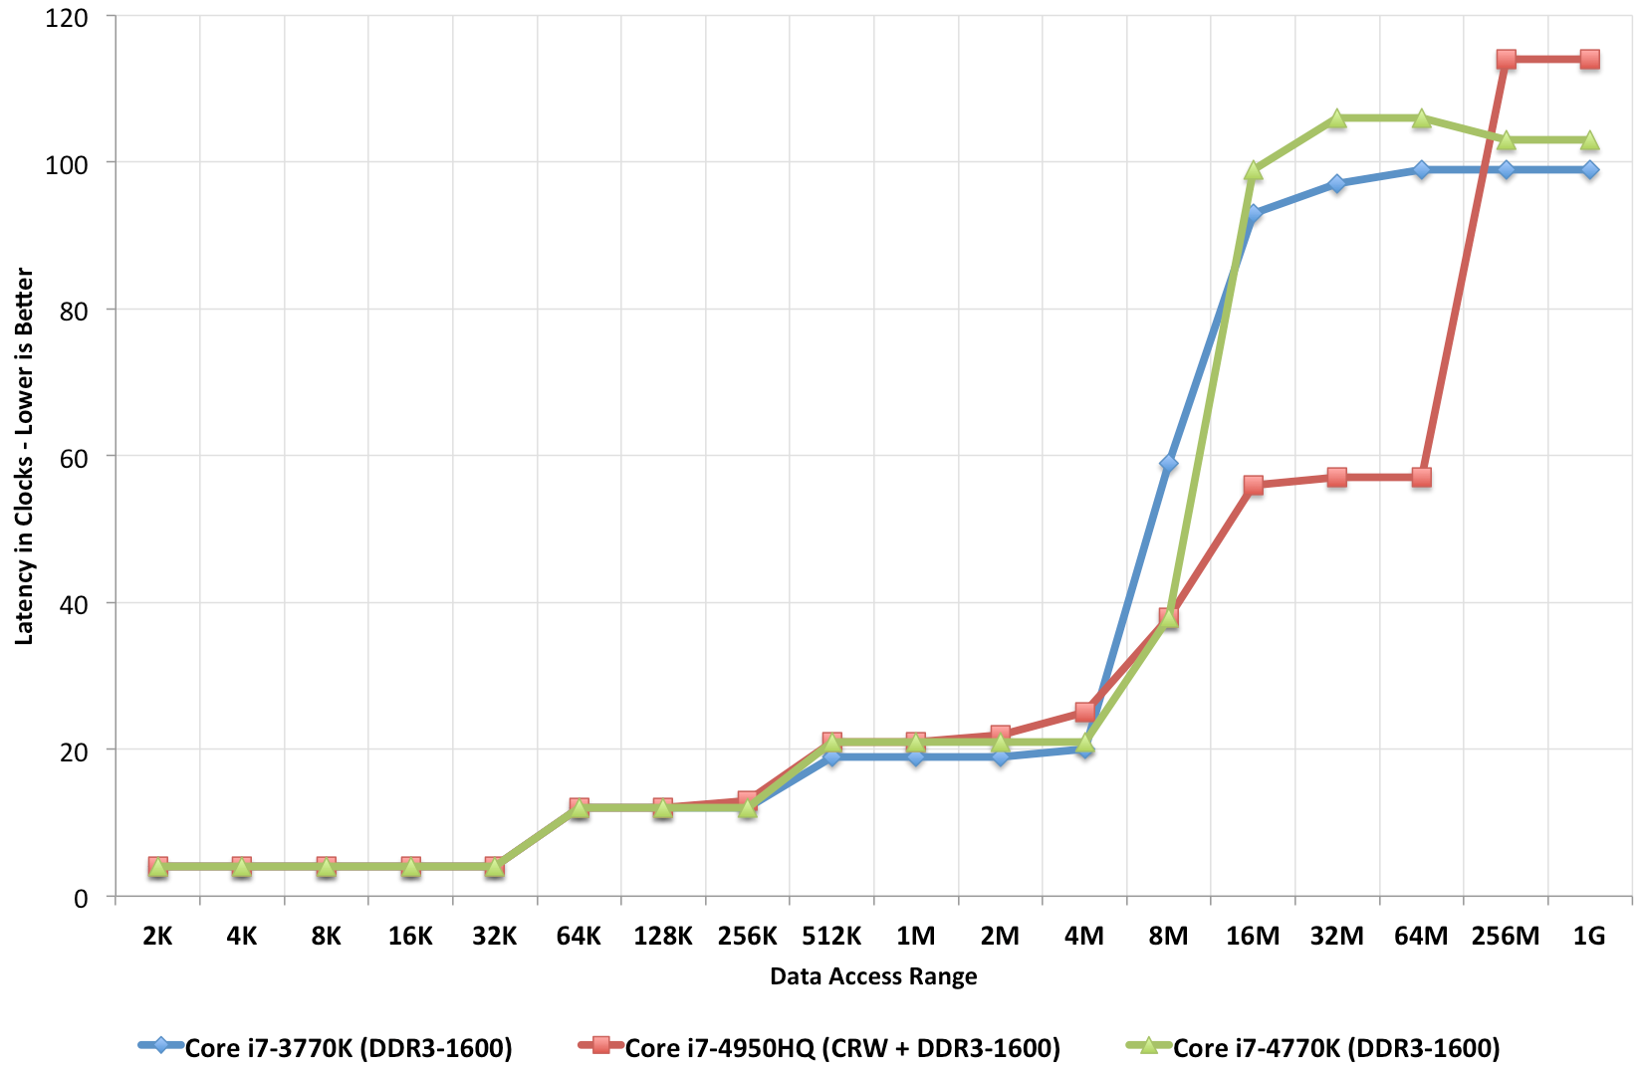
Observations on “Observation 3” (most important)
First time in 759 discussing how to improve performance
This type of gain; i.e., 30X speed up, not encountered every day…
Q: What mechanism comes into play to yield a 30X speed gain?
A: The cache
L1 cache: 4 cycles
System memory access: 120 cycles

Slide 49
The Lesson Learned
Fact: Wide gap between using data and moving data
Using data: you do sin of that data, log, pow, add, subtract, etc. (processing the data)
Moving data: getting your data from the system memory (64 GB/128/etc. GB that you have on your system)
Fact: The cache used to close the big speed gap
Trait of well-written programs: they manage to leverage data/instruction locality
Locality is what allows caches to come into play
Locality necessary, but not sufficient (more later, “false sharing”)

Slide 50
Going on a tangent: TLP vs ILP [one slide side trip]
Chip can do more than one instruction per cycle
ILP flavor: if chip is superscalar, more than one instruction can be wrapped up/clock cycle
TLP flavor: two threads/processes run at same time, say A and B
Cache implications: TLP at a disadvantage
On each miss by B, the cache victimizes an approximation of the least-recently-used (LRU) cache block
Most of B’s misses will victimize blocks last accessed by A rather than last accessed by itself
Consequences:
The L1 cache turns over sufficiently fast that you can approximately assume that B victimizes all of A’s blocks
Whether L2 cache is completely flushed depends on B’s rate of misses, the L2 size, and how long B runs

Slide 51
Indirection and how it’s hurting… An example. [one slide side trip]
Indirection: given an index i, you don’t need a[i]
Rather, you need a[indir[i]] (this is one level of indirection; can go higher yet…)
What’s hurting here?
First, when stride is large, you index into an array indir of non-negative integers but keep missing
No locality…
Second, you will subsequently jump in the array a all over the place
Very likely you’ll just keep missing
Unfortunately, indirection in computing very common
void loop(int* a, unsigned int* indir, int N, int stride)
{
int sum = 0;
for (int i = 0; i < N; i+=stride)
sum += a[indir[i]];
}

