Slide 1
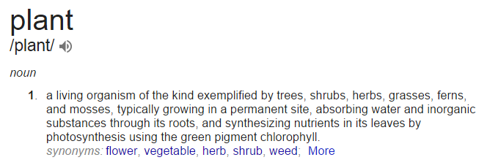
Plant: a “definition” from a pragmatic point of view

Slide 2
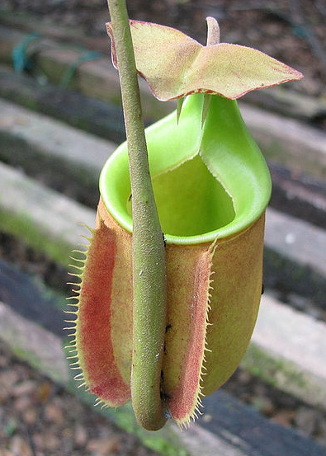
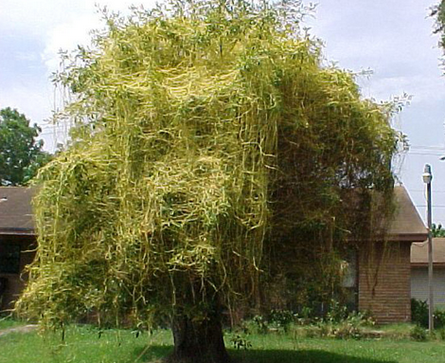
Counter examples are plenty
Plant that does not photosynthesize
Dodder (source: dnr.state.il.us)
Plant that moves (a part) by itself
Monkey cup (source: Wikimedia)

Slide 3
What is stiffness
[Curtiss& Hirschfelder 1952] (historically the first one)
“Stiff equations are equations where certain implicit methods, in particular BDF, perform better, usually tremendously better than explicit ones....“
BDF: Backward differentiation formula
An example appears in the definition!

Slide 4

What is stiffness
[Iserles]
“An ODE system is stiff if its numerical solution by some methods requires (perhaps in a portion of the solution interval) a significant depression of the step size to avoid instability.”
“…the malign version of the Cheshire cat, the rouge eigenvector might seem to have disappeared, but its hideous grin stays and is bound to thwart our endeavours.”
source: wikipedia

Slide 5
What is stiffness
http://www.mathworks.com/company/newsletters/articles/stiff-differential-equations.html
“An ordinary differential equation problem is stiff if the solution being sought is varying slowly, but there are nearby solutions that vary rapidly, so the numerical method must take small steps to obtain satisfactory results.”
“Stiffness is an efficiency issue. If we weren't concerned with how much time a computation takes, we wouldn't be concerned about stiffness. Nonstiff methods can solve stiff problems; they just take a long time to do it.”

