Slide 1


Slide 2
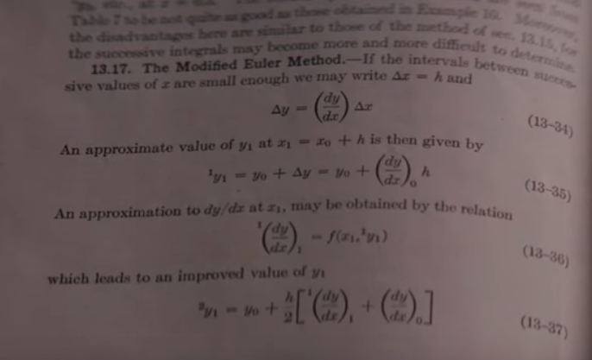
Euler’s method
Always dependable..
Ancient..
Works..
Modified Euler method is a Runge-Kutta scheme, will study later

