Slide 1
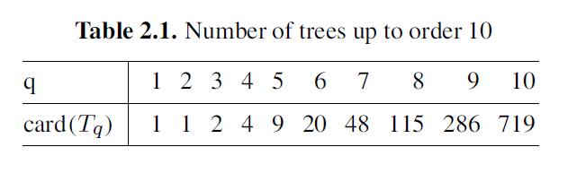
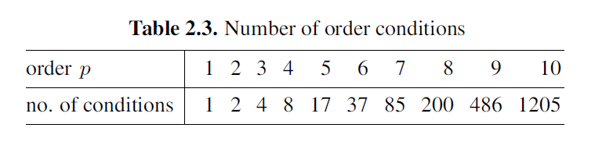
Runge-Kutta order condition [Hai II.2]
It is difficult to design high order RK schemes!

Slide 2
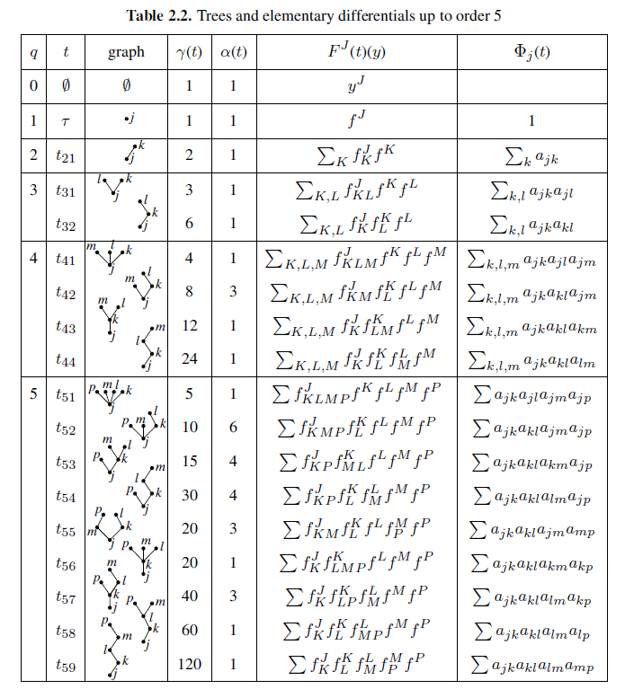

Slide 3
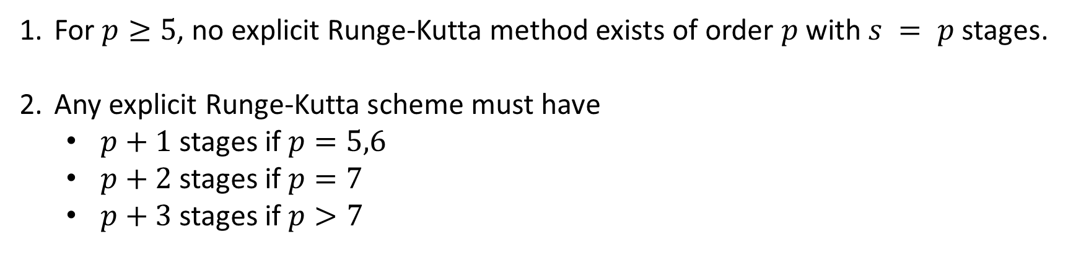
Butcher barriers for explicit Runge-Kutta method
For $p≥5$, no explicit Runge-Kutta method exists of order $p$ with $s = p$stages.
Any explicit Runge-Kutta scheme must have
$p+1$ stages if $p=5,6$
$p+2$ stages if $p=7$
$p+3$ stages if $p>7$

