Slide 1
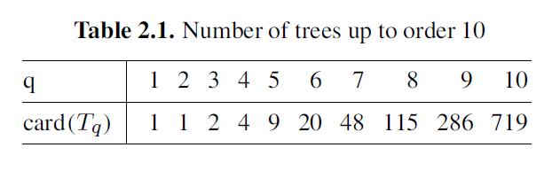
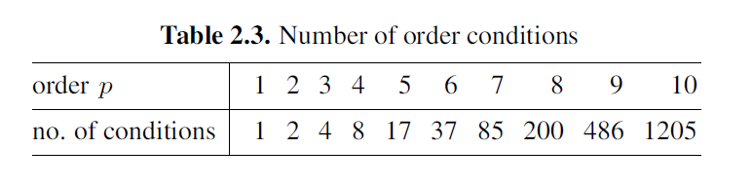
Runge-Kutta order condition [Hai II.2]
It is difficult to design high order RK schemes!

Slide 2
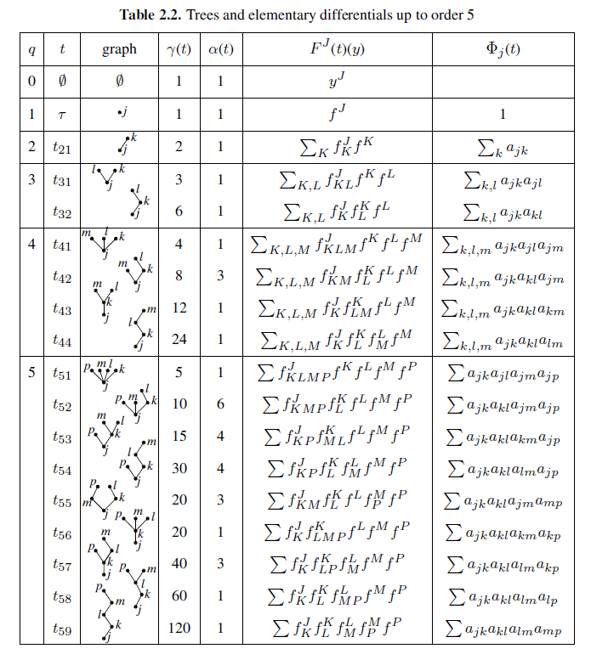

Slide 3
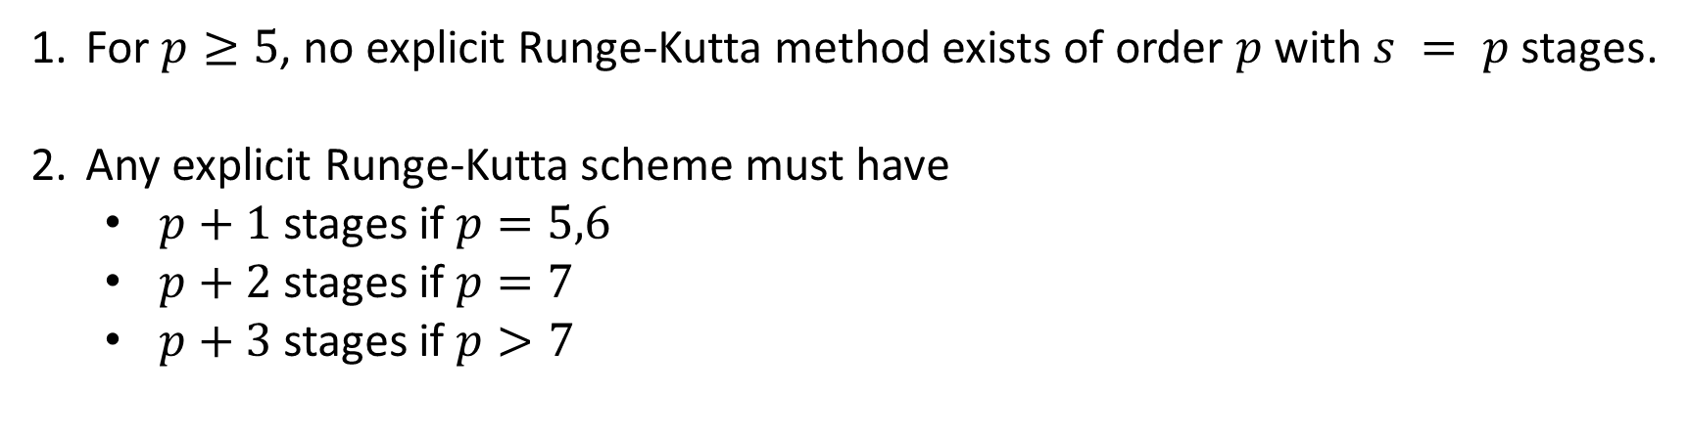
Butcher barriers for explicit Runge-Kutta method
For $p≥5$, no explicit Runge-Kutta method exists of order $p$ with $s = p$stages.
Any explicit Runge-Kutta scheme must have
$p+1$ stages if $p=5,6$
$p+2$ stages if $p=7$
$p+3$ stages if $p>7$

Slide 4
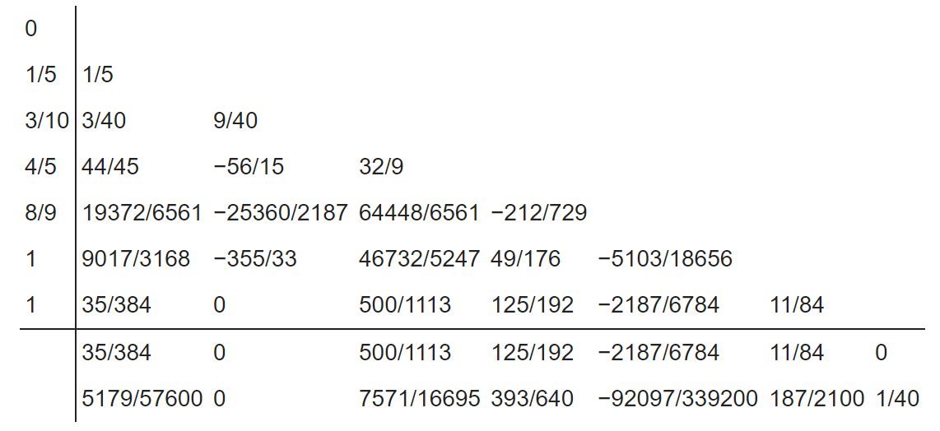
Dormand–Prince Runge-Kutta pair
7-stage method with 4th order propagator and 5th order estimator
designed to be close to have the minimal local truncation error (under the restraint of also having the minimal number of steps to achieve order 5). The extra steps are needed for the order 5 estimator.

