Slide 1
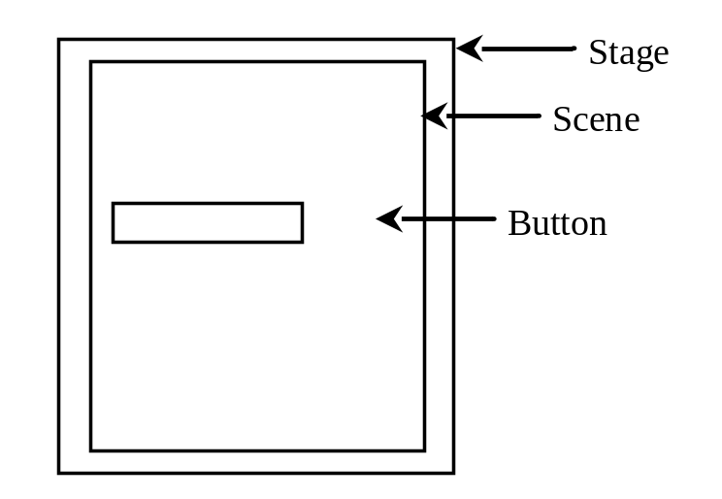
Basic Structure of JavaFX
Application
Override the start(Stage) method
Stage, Scene, and Nodes

Slide 2
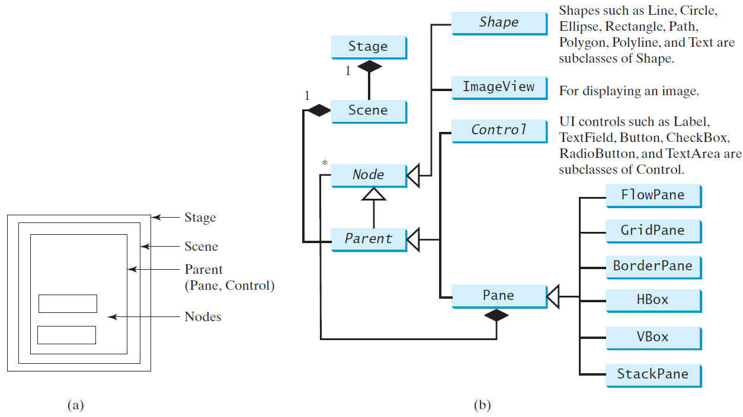
Panes, UI Controls, and Shapes

Slide 3
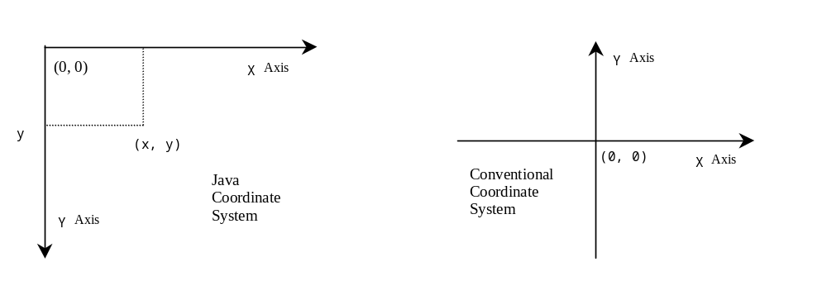
Display a Shape
This example displays a circle in the center of the pane.

Slide 4
Binding Properties
JavaFX introduces a new concept called binding property that enables a target object to be bound to a source object. If the value in the source object changes, the target property is also changed automatically. The target object is simply called a binding object or a binding property.

Slide 5
Common Properties and Methods for Nodes
style: set a JavaFX CSS style
rotate: Rotate a node

Slide 6
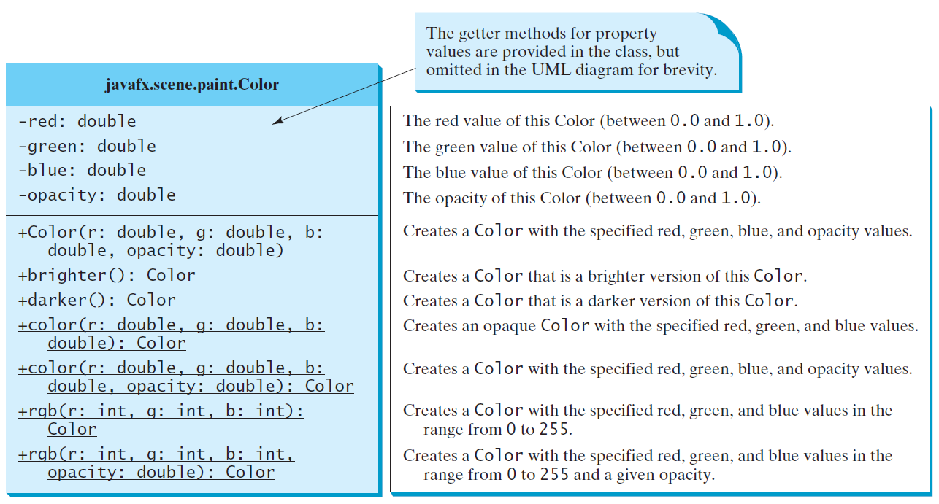
The Color Class

Slide 7
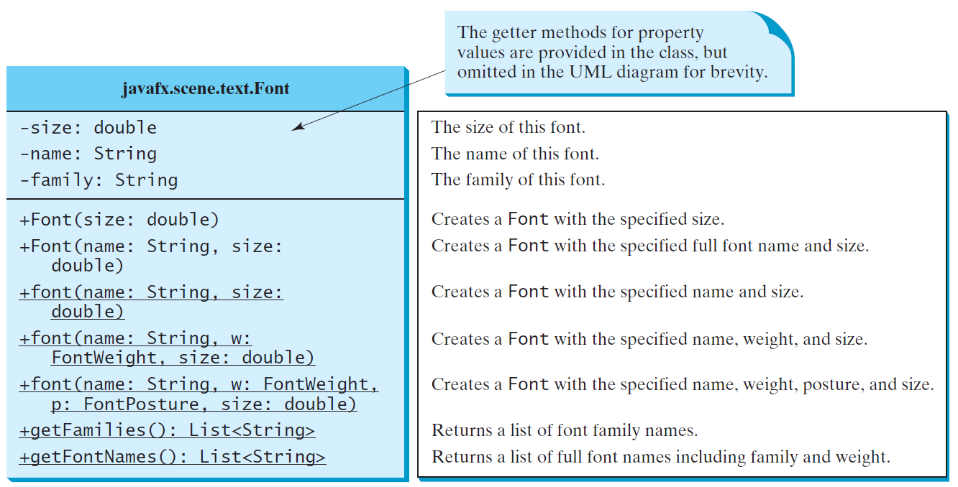
The Font Class

Slide 8
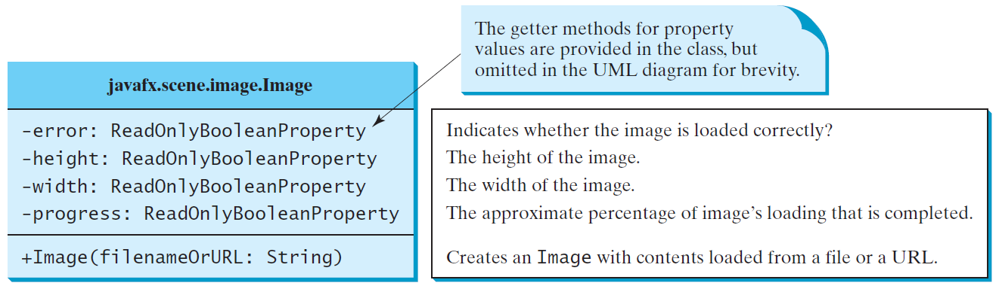
The Image Class

Slide 9
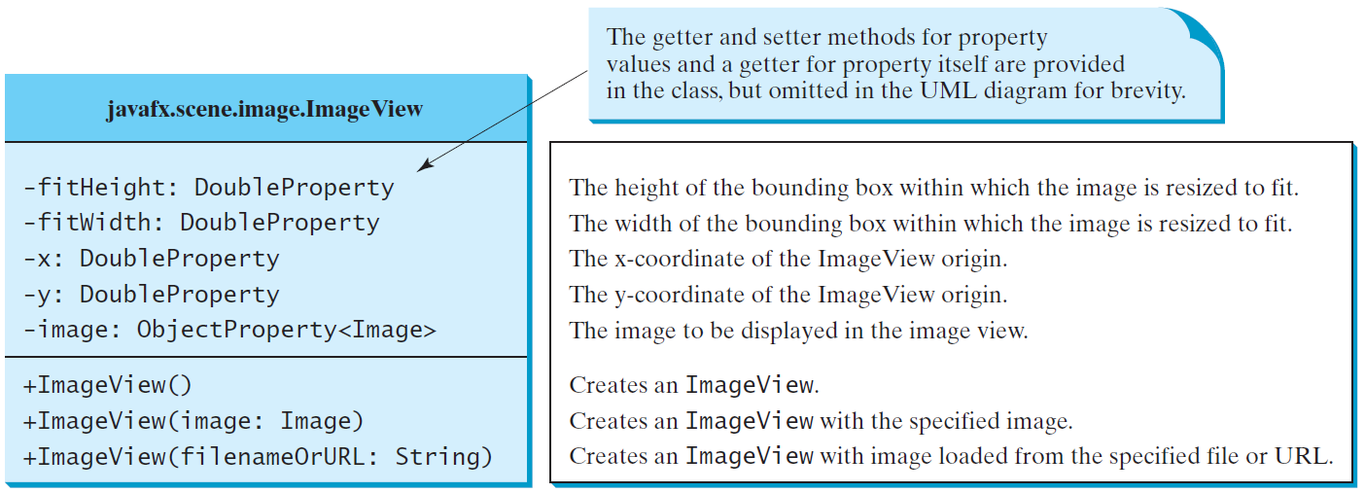
The ImageView Class

Slide 10
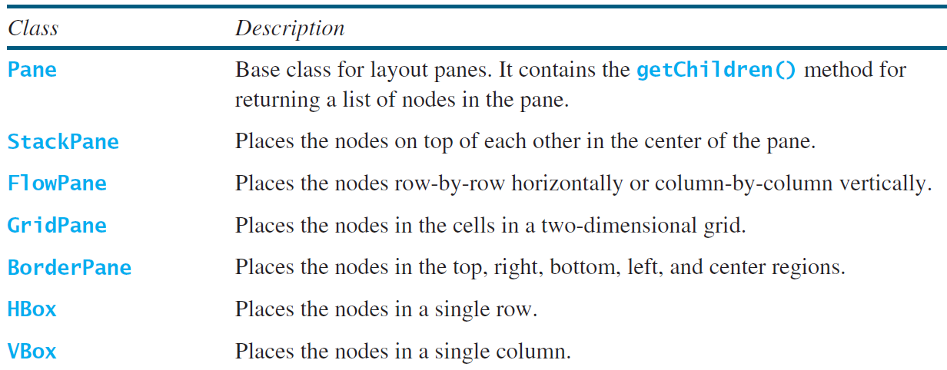
Layout Panes
JavaFX provides many types of panes for organizing nodes in a container.

Slide 11
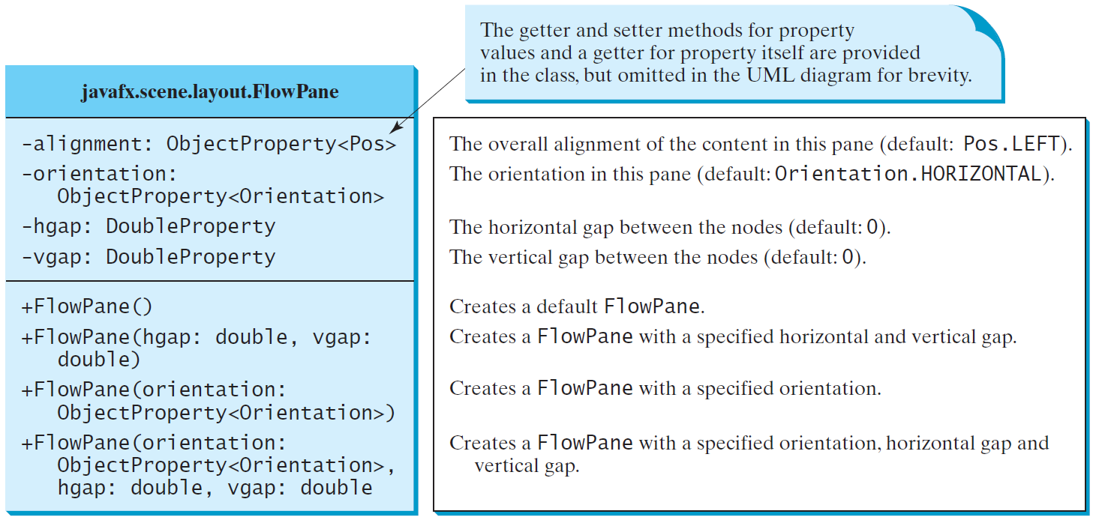
FlowPane

Slide 12
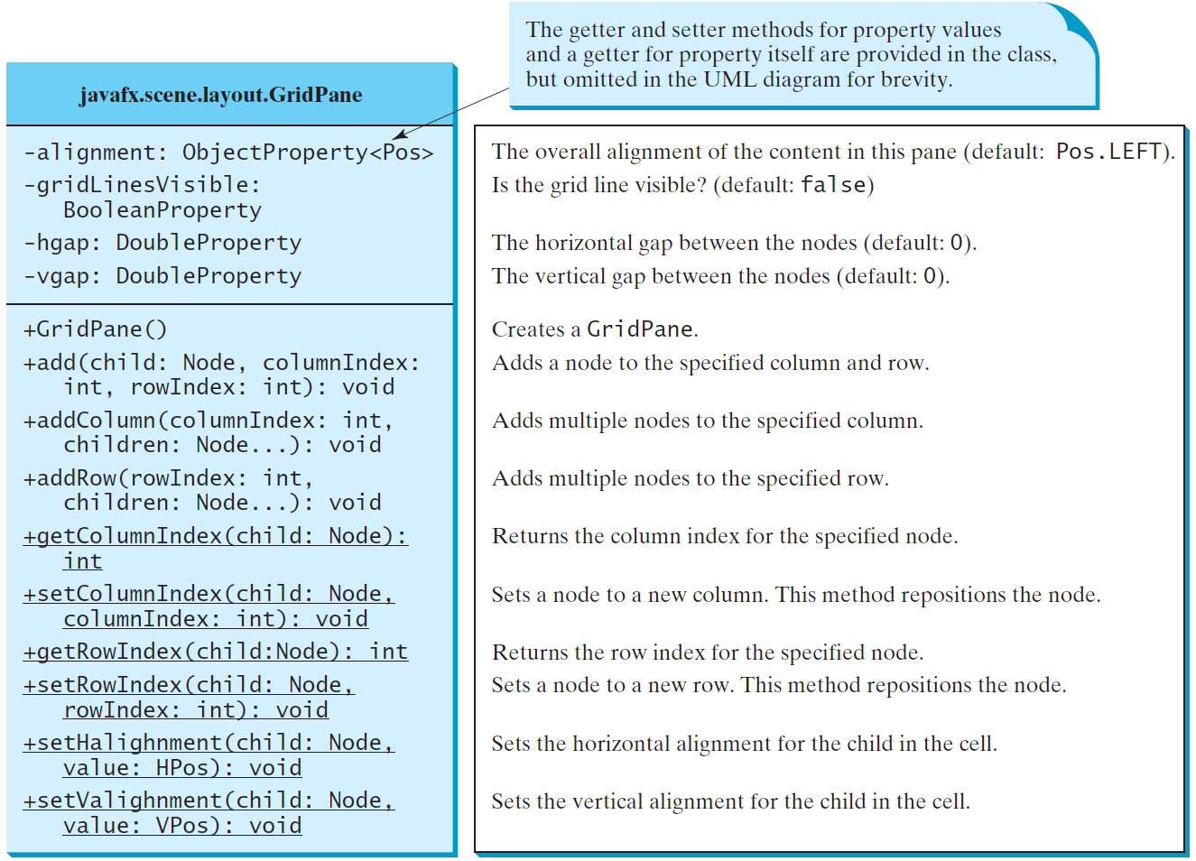
GridPane

Slide 13
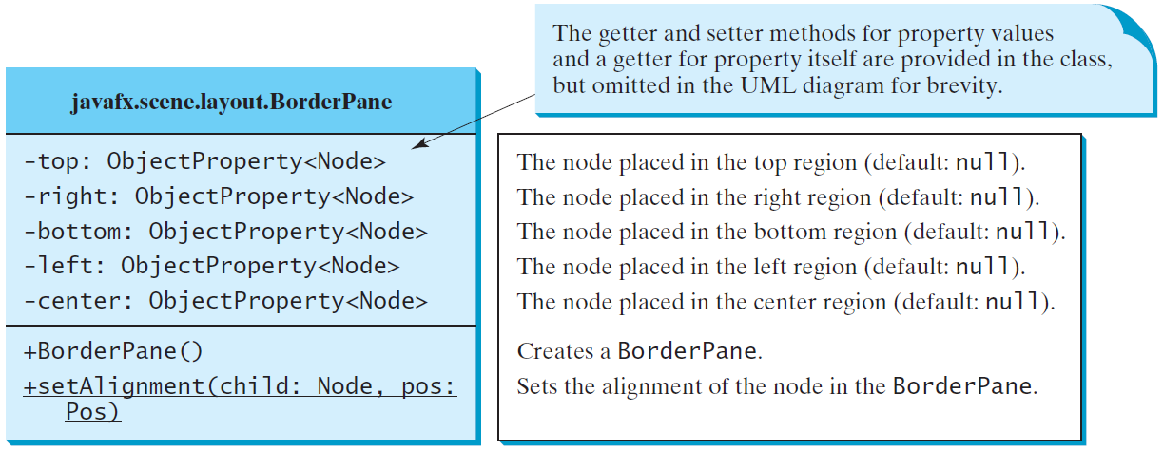
BorderPane

Slide 14
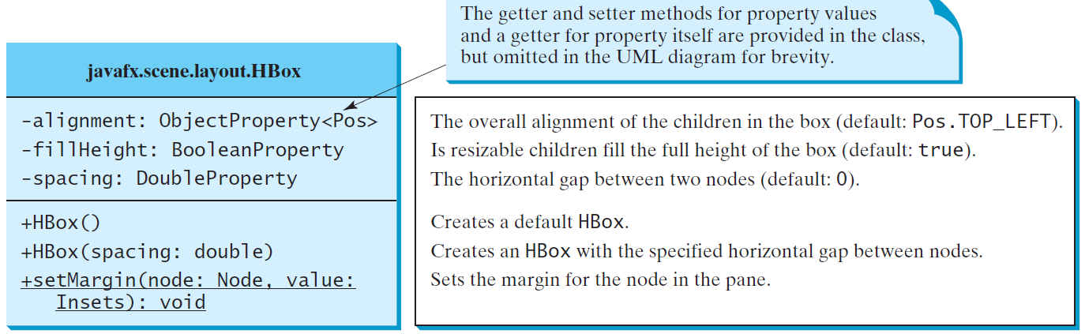
HBox

Slide 15
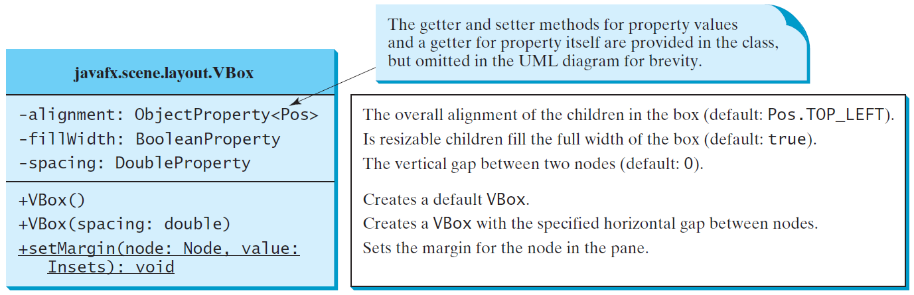
VBox

Slide 16
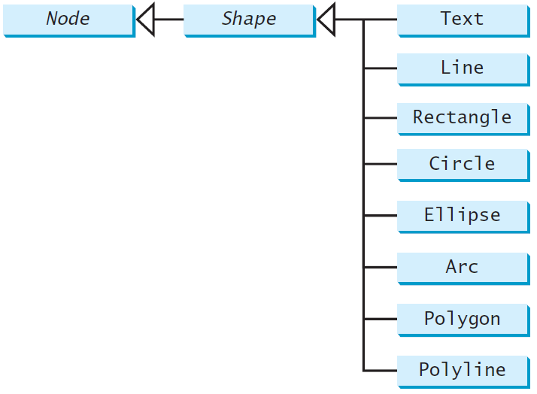
Shapes
JavaFX provides many shape classes for drawing texts, lines, circles, rectangles, ellipses, arcs, polygons, and polylines.

Slide 17
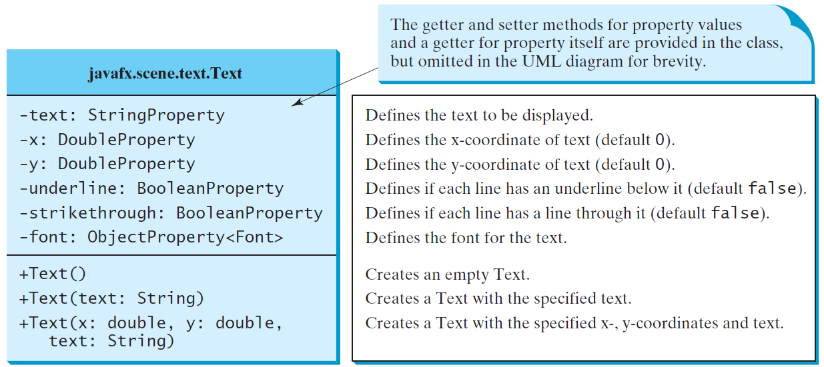
Text

Slide 18
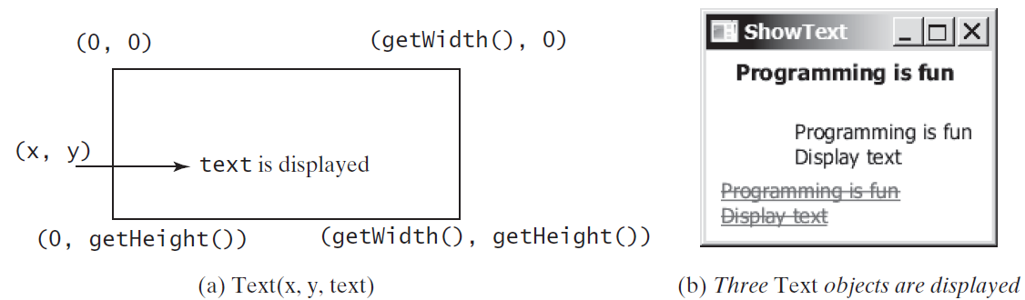
Text Example

Slide 19
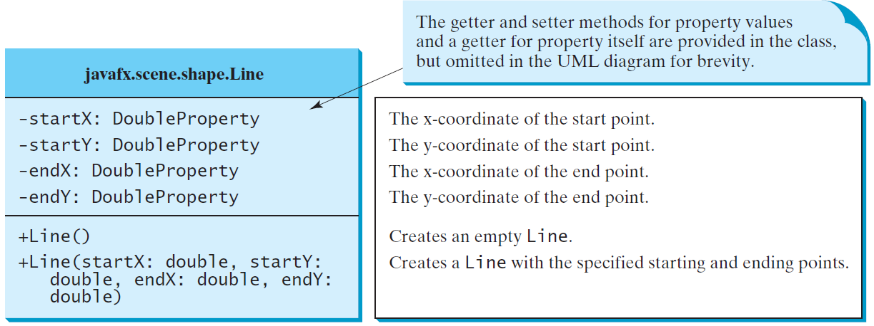
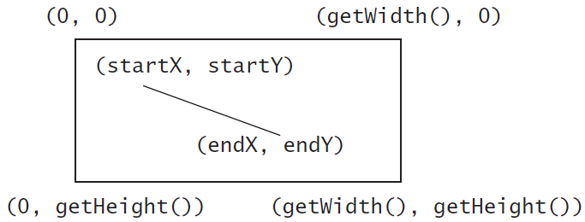
Line

Slide 20
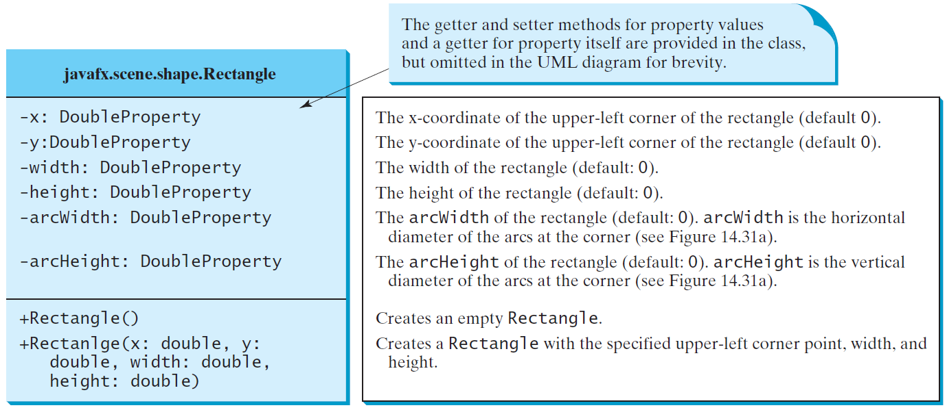
Rectangle

Slide 21
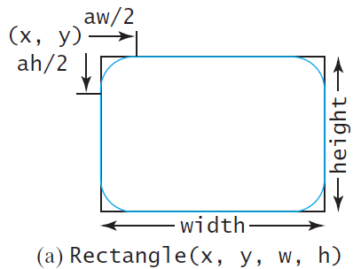
Rectangle Example

Slide 22
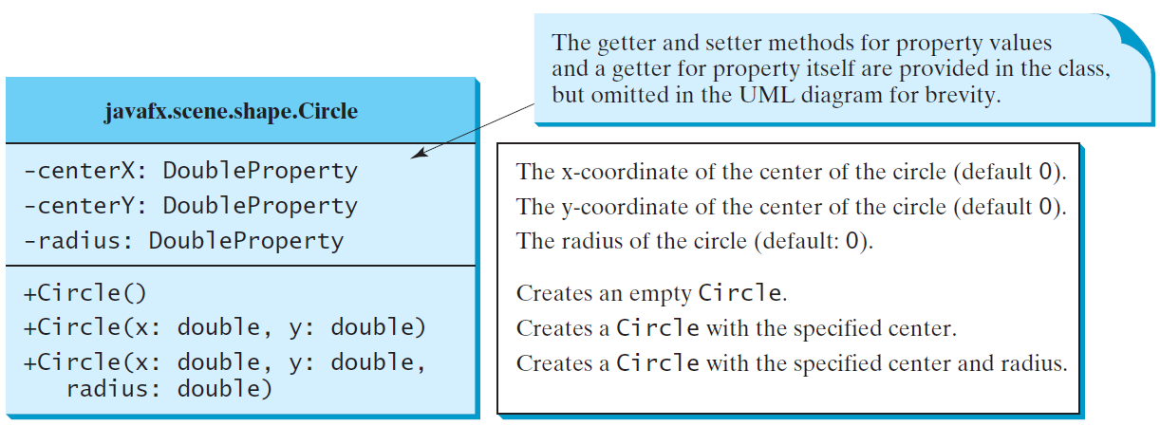
Circle

Slide 23
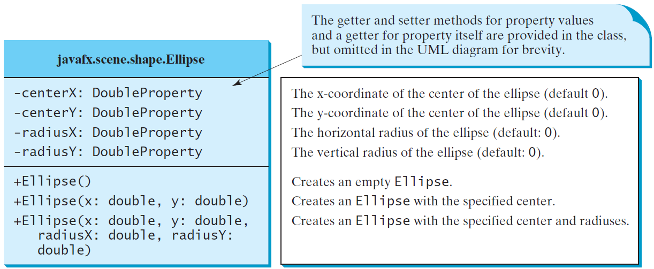
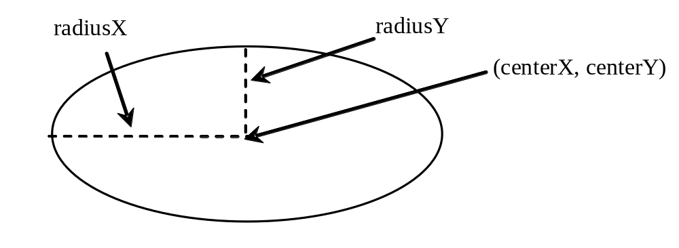
Ellipse

