Slide 1
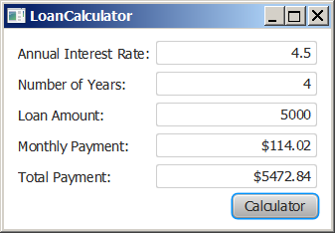
Motivations
Suppose you want to write a GUI program that lets the user enter a loan amount, annual interest rate, and number of years and click the Compute Payment button to obtain the monthly payment and total payment. How do you accomplish the task? You have to use event-driven programming to write the code to respond to the button-clicking event.

Slide 2
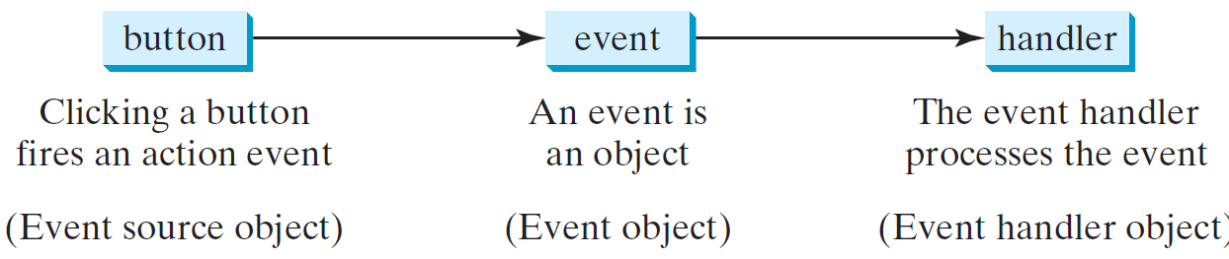
Handling GUI Events
Source object (e.g., button)
Listener object contains a method for processing the event.

Slide 3
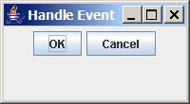
Trace Execution
public class HandleEvent extends Application {
public void start(Stage primaryStage) {
…
OKHandlerClass handler1 = new OKHandlerClass();
btOK.setOnAction(handler1);
CancelHandlerClass handler2 = new CancelHandlerClass();
btCancel.setOnAction(handler2);
…
primaryStage.show(); // Display the stage
}
}
class OKHandlerClass implements EventHandler<ActionEvent> {
@Override
public void handle(ActionEvent e) {
System.out.println("OK button clicked");
}
}
Click OK

Slide 4
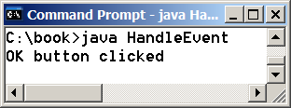
Trace Execution
public class HandleEvent extends Application {
public void start(Stage primaryStage) {
…
OKHandlerClass handler1 = new OKHandlerClass();
btOK.setOnAction(handler1);
CancelHandlerClass handler2 = new CancelHandlerClass();
btCancel.setOnAction(handler2);
…
primaryStage.show(); // Display the stage
}
}
class OKHandlerClass implements EventHandler<ActionEvent> {
@Override
public void handle(ActionEvent e) {
System.out.println("OK button clicked");
}
}
Click OK. The JVM invokes the listener’s handle method

Slide 5
Events
An event can be defined as a type of signal to the program that something has happened.
The event is generated by external user actions such as mouse movements, mouse clicks, or keystrokes.

Slide 6
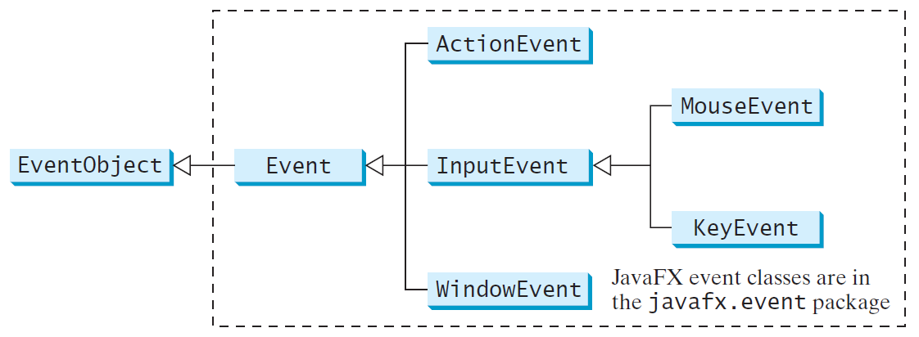
Event Classes

Slide 7
Event Information
An event object contains whatever properties are pertinent to the event. You can identify the source object of the event using the getSource() instance method in the EventObject class. The subclasses of EventObject deal with special types of events, such as button actions, window events, component events, mouse movements, and keystrokes. Table 16.1 lists external user actions, source objects, and event types generated.

Slide 8
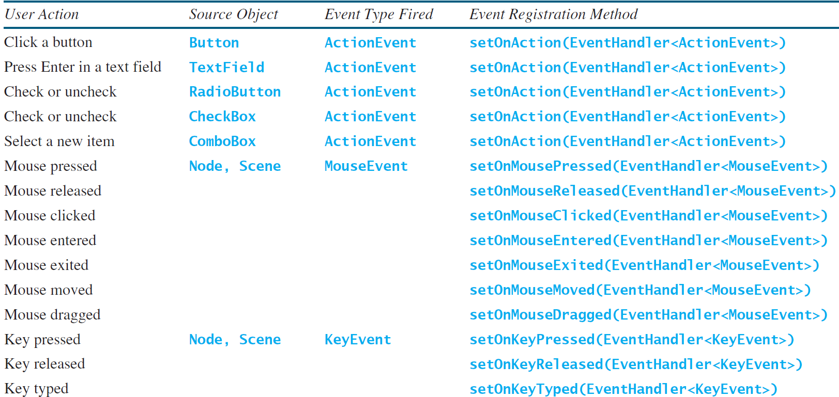
Selected User Actions and Handlers

Slide 9
The Delegation Model: Example
Button btOK = new Button("OK");
OKHandlerClass handler = new OKHandlerClass();
btOK.setOnAction(handler);

Slide 10
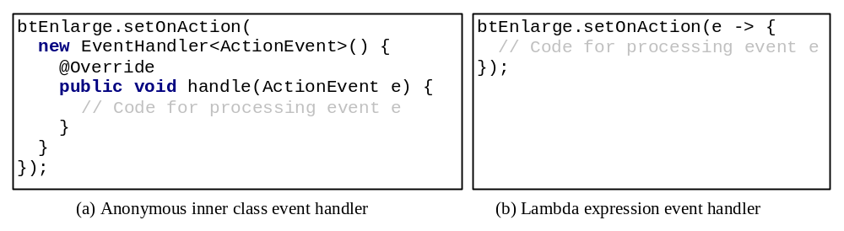
Simplifying Event Handing Using Lambda Expressions
Lambda expression is a new feature in Java 8. Lambda expressions can be viewed as an anonymous method with a concise syntax. For example, the following code in (a) can be greatly simplified using a lambda expression in (b) in three lines.

