Slide 1
News paper article Category classification Sarah Mahlangu Busisiwe Mbewe Kennety Mashishi Gaba Keefelakae

Slide 2
Introduction
Project Overview: The goal is to improve the organization and retrieval of news articles, enhancing user experience in news applications and enabling automated content tagging by building a machine learning model that can automatically classify newspaper articles into predefined categories based on their textual content
Data Overview: The dataset includes features such as the headline, description, content, URL, and category of the articles.
Project Objectives:
Data Preprocessing & Exploration: Cleaning and preprocessing text data, exploring word frequencies, term distributions, and category imbalances.
Feature Engineering: Converting text into numerical representations using techniques like TF-IDF, word embeddings, or deep learning-based embeddings.
Model Development: Training and comparing different machine learning models, optimizing hyperparameters, and fine-tuning models for better accuracy.
Model Evaluation: Using metrics like accuracy, precision, recall, F1-score, and confusion matrices to assess model performance and performing cross-validation.
Application: Building an API or web application to classify new articles in real-time

Slide 3
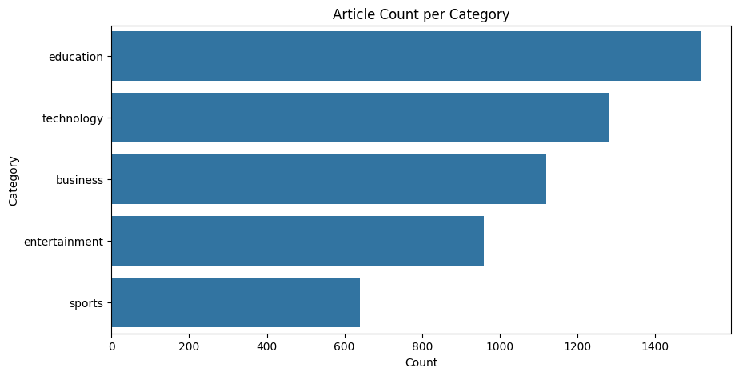
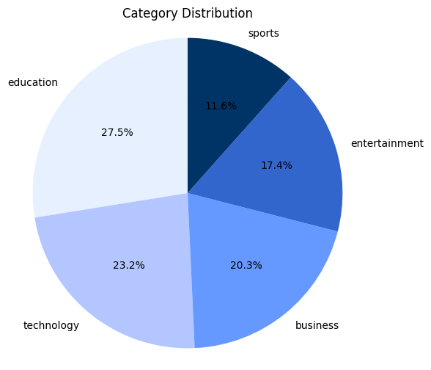
Exploratory data analysis
INSIGHTS
There is an uneven distribution of articles, with education being the most covered topic and sports the least. The difference between the highest and lowest categories is substantial, indicating a bias or focus on education-related articles in the dataset.
INSIGHTSEducation has the highest number of articles, with a count exceeding 1400, making it the dominant category. Technology comes second with over 1200 articles. Business is third, with slightly above 1000 articles. Entertainment follows with fewer than 1000 articles but still a significant count. Sports has the lowest count, with fewer than 800 articles.

Slide 4
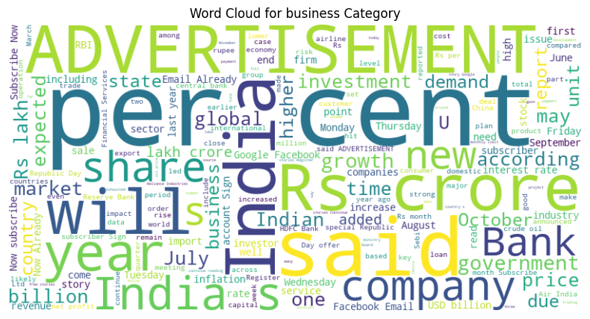
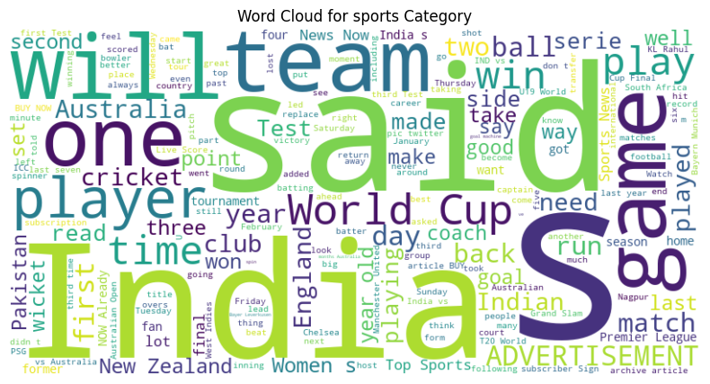
Exploratory data analysis
Sports
Dominant words include "team," "India," "game," "match," "player," "score," and "Cup". These words reflect a strong focus on events, matches, teams, and players, as expected for sports-related articles. Specific terms like "wicket," "run," "cricket," and "World Cup" suggest that cricket is a significant theme.
Business
Prominent words include "percent," "advertisement," "crore," "year," "said," "India," "government," "company," "market," "investment," "growth," "billion," "lakh," "global," "report," "service," "subscriber," "inflation," "revenue," "shares," "business," "time," "rate," "import," "export," "USD," "RBI," "financial services," "industry," and more. This indicates a focus on economics, regions and business activities.

Slide 5
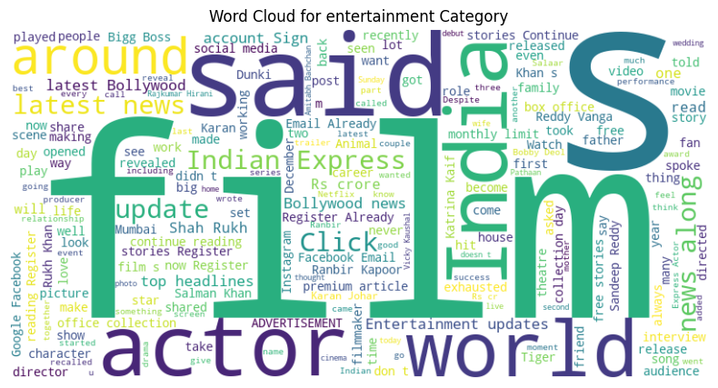
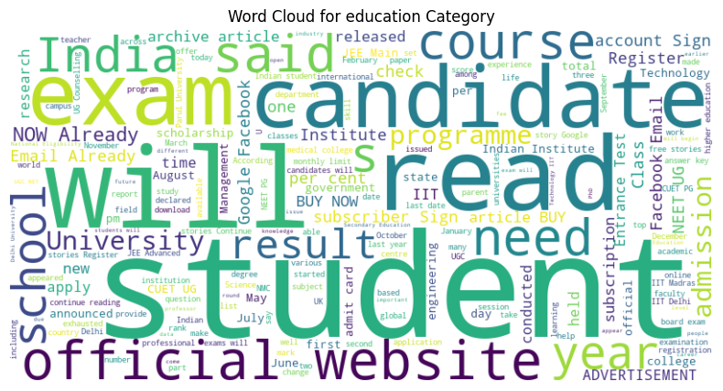
Exploratory data analysis
Education
Key terms include "student," "exam," "result," "admission," "school," and "university." The words reflect topics related to academic exams, admissions, results, and education systems. Specific mentions like "candidate," "check," and "official website" suggest a practical focus, likely including resources and instructions for students.
Entertainment
Prominent words include "film," "actor," "movie," "entertainment," "Bollywood," and "song." This indicates a focus on the film and music industries, likely dominated by updates, reviews, and celebrity news. Words like "release," "trailer," and "star" further emphasize the focus on cinema and celebrity culture.

Slide 6
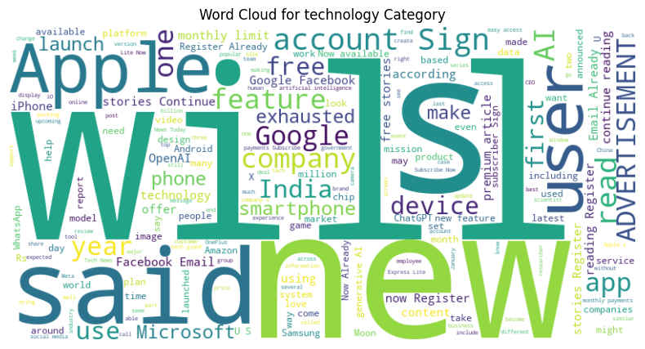

Exploratory data analysis
Technology
Frequently appearing words include "new," "device," "feature," "app," "phone," "update," and "software." These words indicate a focus on product launches, software updates, and new technologies. The presence of "advertisement" might suggest that tech articles include a lot of promotional content.

Slide 7
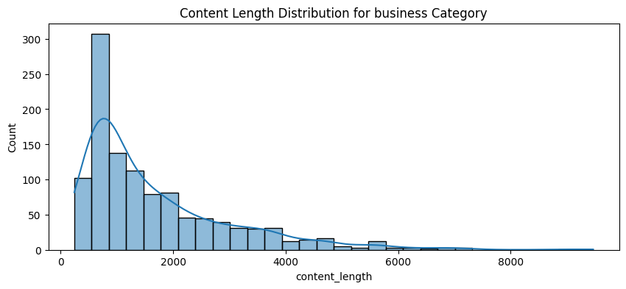
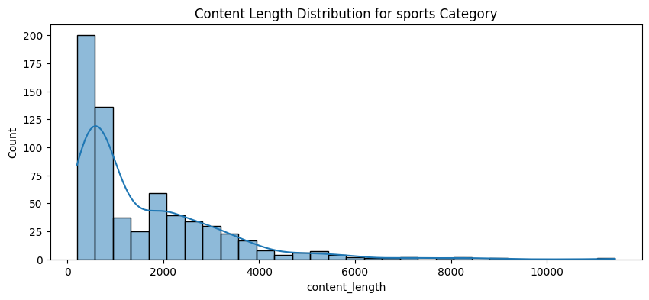
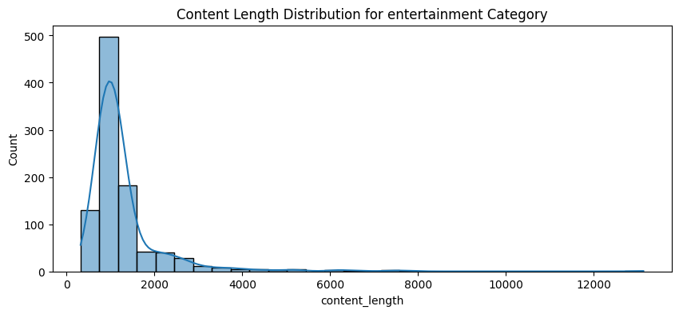
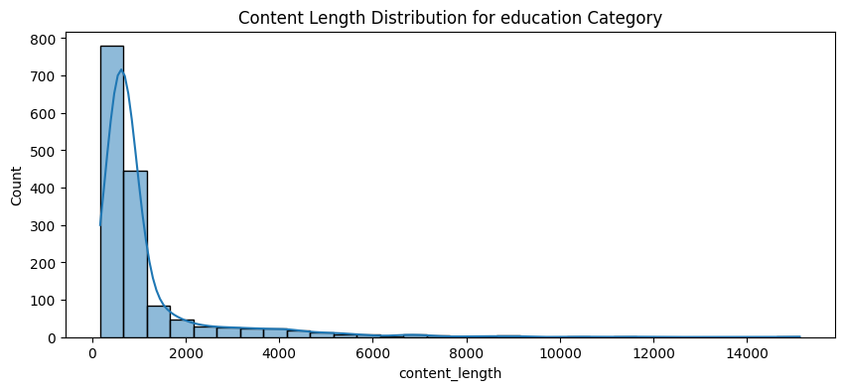
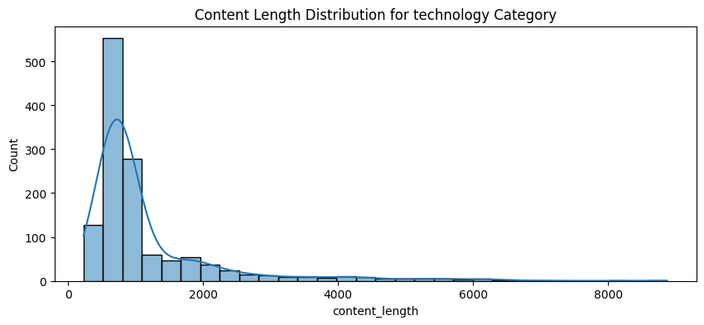

Exploratory data analysis
Each category exhibits a right-skewed distribution, meaning most articles have relatively shorter content lengths, with a few articles having significantly longer lengths. The distributions suggest that shorter articles dominate all categories.
Business: Most articles fall within a content length of 0–2000 words, with a rapid drop-off as the length increases. A small number of articles have content lengths exceeding 6000 words.
Sports: The distribution is heavily concentrated below 2000 words. Compared to other categories, this has fewer articles with longer content lengths, suggesting shorter content is typical for sports articles.
Entertainment: Like sports, most articles are below 2000 words, but the tail extends slightly longer (up to 10,000+ words). This category has a moderate presence of articles with longer content lengths.
Education: The highest concentration is still in the 0–2000 range, but this category shows a more gradual decline compared to others. A significant number of articles have content lengths exceeding 8000 words, making education the category with the longest articles on average.
Technology: Most articles are also below 2000 words, but the distribution has a slightly longer tail than sports or business. Articles exceeding 5000 words are present, but they are fewer compared to education

Slide 8
Model Development
Data collection
Train, test data provided
Data pre-processing
1. Remove special characters
2. Convert to lower case
3. Remove all stop words
4. Stemming
5. Lemmatizing the words
Feature Extraction
1. Bag of features
Model Training
Five classification models trained
1. Logistic Regression
2. Decision Tree
3. Random Forest
4. Support Vector Machine (kernel = Radial Basis Function (RBF))
5. Naive Baiyes
Model Testing
1.Verification data
2. 5-fold cross validation
Evaluation
1. Confusion matrix
2. Accuracy
3. Recall
4. F-score
5. AUC-ROC

Slide 9
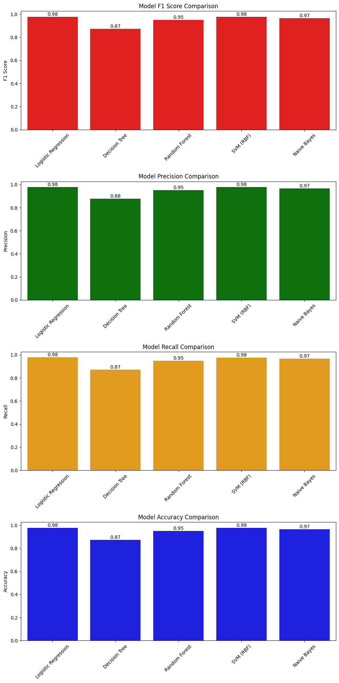
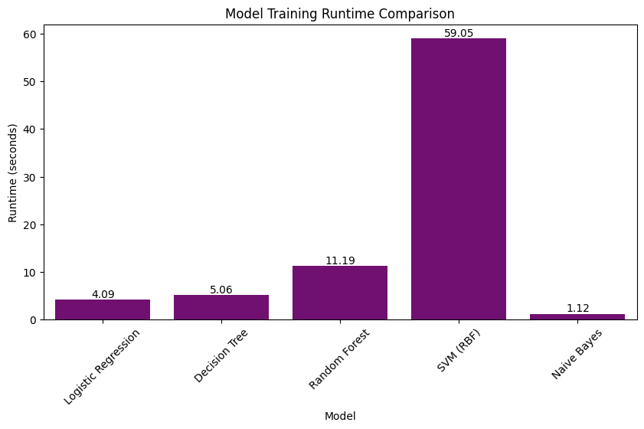
Model RESULTS|MODEL metrics and runtime
Performance Metrics: Model metrics such as the F1 Score, Precision, Recall, and Accuracy for each classification model were compared. The Logistic Regression and Support Vector Machine (RBF) models performed the best across all metrics, with scores around 0.98. The Decision Tree had the lowest performance in all metrics, scoring around 0.88.
Runtime Comparison: Runtimes for each classification model were also compared. The Naive Bayes model has the fastest runtime, making it ideal for real-time applications. The Support Vector Machine model has the slowest runtime, making it less practical for large-scale deployment. The Logistic Regression and Decision Tree models have similar runtimes.

Slide 10
Model RESULTS|Cross validation
Logistic Regression
Validate:
Runtime: 44.79s
Accuracy: 98%
Precision: 98%
Recall: 98%
F1 Score: 98%
Decision Tree
Validate:
Runtime: 57.81s
Accuracy: 88%
Precision: 87%
Recall: 88%
F1 Score: 87%
Random Forest
Validate:
Runtime: 146.80s
Accuracy: 96%
Precision: 96%
Recall: 96%
F1 Score: 96%
SVM (RBF)
Validate:
Runtime: 599.08s
Accuracy: 98%
Precision: 98%
Recall: 98%
F1 Score: 98%
Naive Bayes
Validate:
Runtime: 18.52s
Accuracy: 97%
Precision: 97%
Recall: 97%
F1 Score: 97%
Cross-Validation Purpose: The 5-Fold cross-validation was performed on the training set to evaluate the models' performance more reliably by testing them on multiple subsets of the dataset. This helps in detecting overfitting, improving generalization, and selecting the best model for real-world applications1.
Best Performing Model: The Logistic Regression model emerged as the best performing model, with the highest performance metrics and the best runtime. It achieved an accuracy, precision, recall, and F1 score of 98%, with a runtime of 44.79 seconds1.
Support Vector Machine (SVM): The SVM model had similar performance metrics to the Logistic Regression model, with an accuracy, precision, recall, and F1 score of 98%. However, it had the worst runtime of 599.08 seconds, making it less practical for large-scale deployment1.
Worst Performing Model: The Decision Tree model was the worst performing model according to the metrics, with an accuracy, precision, recall, and F1 score of 88%, and a runtime of 57.81 seconds1.
Other Models: The Random Forest model had an accuracy, precision, recall, and F1 score of 96%, with a runtime of 146.80 seconds. The Naive Bayes model had an accuracy, precision, recall, and F1 score of 97%, with the fastest runtime of 18.52 seconds

Slide 11
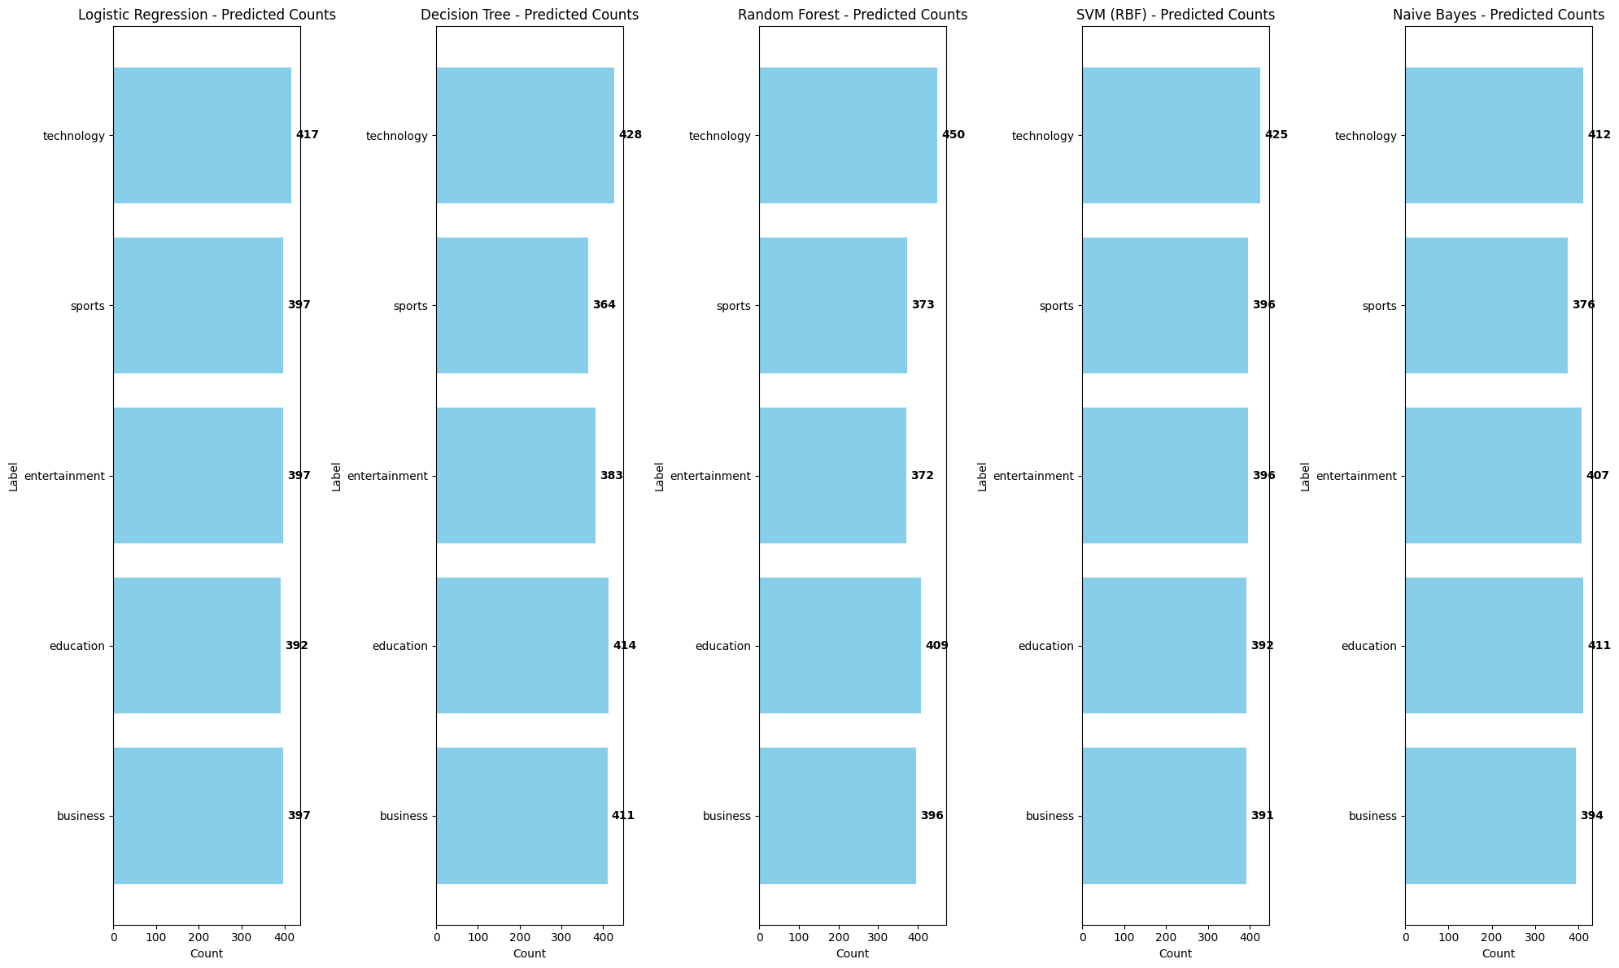
Model RESULTS|Label classification
Technology Category:
The 'Technology' category was classified the most across all models. This suggests that Technology is overrepresented in the dataset, which might cause models to be biased towards predicting this category more frequently.
2. Sports Category:
The 'Sports' category was classified the least across all models. This indicates that Sports is underrepresented in the dataset, making it challenging for the models to learn its distinct features.

Slide 12
Conclusion & Insights
Category Imbalance: Education is the most dominant category with over 1400 articles, while Sports is the least represented with fewer than 800 articles. This imbalance may affect classification performance, as models tend to favor more frequent categories.
Article Length: The article length distribution is right-skewed, with shorter articles being the most common. Education articles are the longest, often exceeding 8000 words, while Sports articles are the shortest, mostly below 2000 words.
Model Performance: The Logistic Regression and SVM (RBF) models performed best across all metrics, achieving accuracy scores of 0.98+. Naïve Bayes was also a strong contender with an accuracy of 0.97, making it a viable choice when prioritizing efficiency. Decision Tree was the weakest model with an accuracy of 0.88.
Computational Efficiency: Naïve Bayes was the fastest model, making it ideal for real-time applications. SVM had the worst runtime, making it impractical for large-scale deployment.
Cross-Validation: Cross-validation results closely aligned with pipeline results, confirming the stability and reliability of the classifier models. Logistic Regression remained the best overall model for efficiency and large-scale deployment.
Category Classification: Technology was the most frequently classified category, aligning with its strong presence in the dataset. Sports was the least classified, reflecting its lower representation and potential difficulty in classification.
Recommendations: To improve model performance, class balance distribution through oversampling or weighting is suggested, especially for underrepresented categories like Sports. Hyperparameter tuning, such as Grid Search, is also recommended for better model performance

