Slide 1


Anime Recommendation System
Collaborative and Content-Based Filtering Approaches

Slide 2
Information
Group Members:
Kennety Mashishi
Wanga Maswime
Nokulinda Mthimunye
Gabamoitse Keefelakae
Git Repo : https://github.com/KennyM28/Explore-Unsupervised-Learning-Project.git
Trello board: https://trello.com/b/Cz8p74XY/unsupervised-learning-project

Slide 3
Problem Statement
Why: We aim to build an anime recommendation system to help users discover titles tailored to their interest.
The Value: Personalised recommendations save users time and improve their viewing experience.
Challenges:
Sparse user ratings
Large anime catalogue
Diverse user preferences

Slide 4
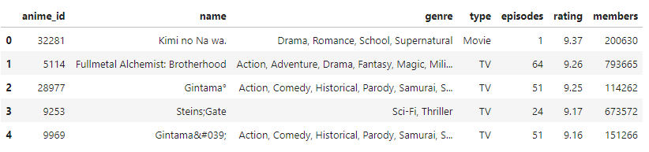
Data set Overview
Data Source:
anime.csv
Shape : 12, 294 rows × 7 columns
Key columns [anime_id, name, genre, type, episodes, rating , members]

Slide 5
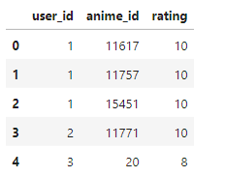
Data Set Overview
train.csv
Shape : 5703555 rows × 3 columns
Key columns [user_id, anime_id, rating]

Slide 6
Initial Observations
The episode column is stored as an object, it might contain non-numeric values like “Unknown”.
The genre column is a string but actually encodes multiple labels.
The rating and members columns could be helpful as popularity/quality indicators.

Slide 7
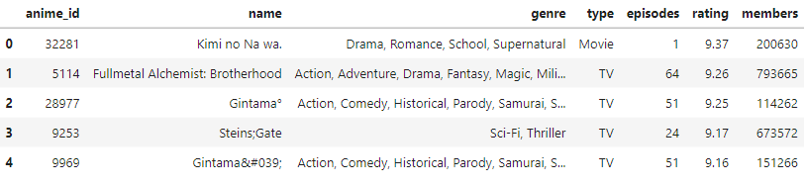
Data Cleaning
anime.csv
Missing values
Genre(62), type(25), and rating(230) had missing values.
Filled using mode for simplicity and consistency.
Applied regex to clean special characters and normalise whitespace in name and genre. For example changing Gintama&#039; to Gintama039.
Before:

Slide 8
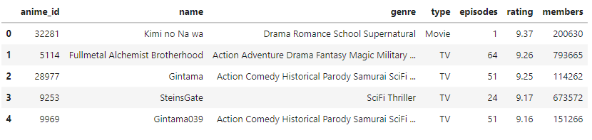
Data Cleaning
After:

Slide 9
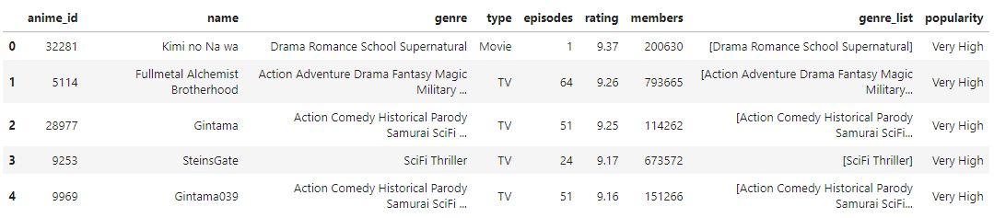
Feature Engineering
Genre Processing: Converted the genre string into a genre_list to allow for easier genre-level analysis.
Popularity Binning: Transformed members (for popularity) into ordinal bins. This helps group anime to levels like Very Low and Very High.

Slide 10
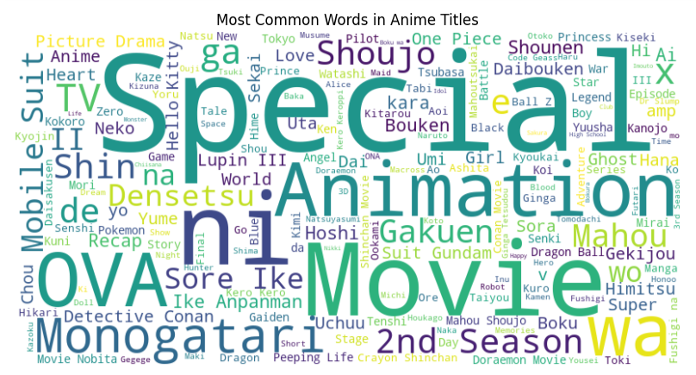
Exploratory Data Analysis
Title Analysis: Used WordCloud to visualise frequent words in anime titles.
These were the results that we got

Slide 11
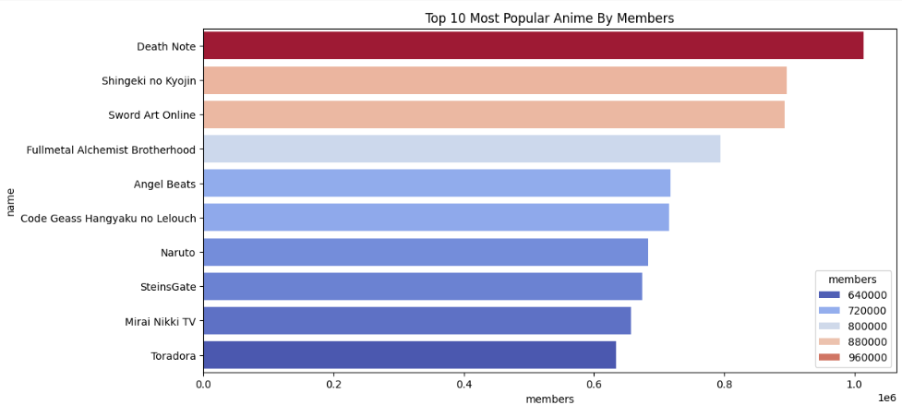
Top 10 Most Popular Anime
Sorted by members. Used to showcase the anime with the highest audience.

Slide 12
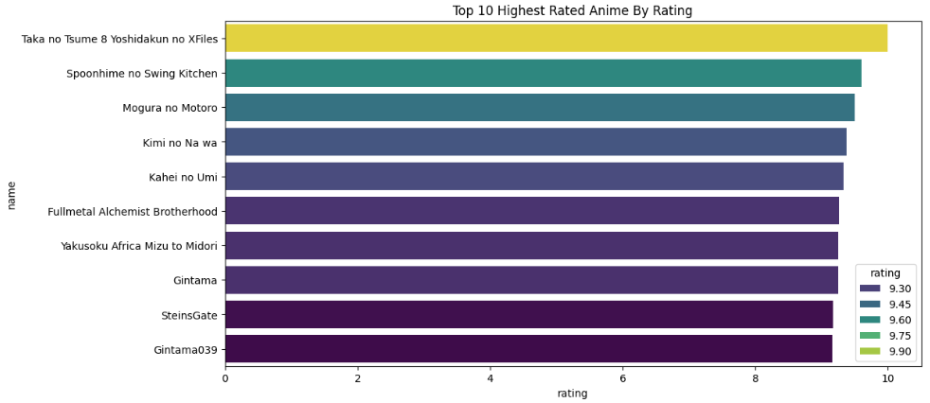
Top 10 Highest Rated Anime
Sorted by rating. Highlights critically loved shows.

Slide 13
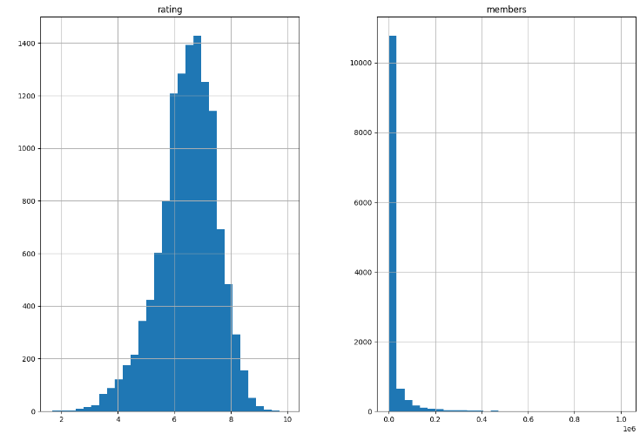
Distribution Analysis
The ratings follow a normal distribution(centered around 5.7 and 6.7)
Most anime are rated between 5 and 8. This suggest users tend to rate anime positive.
The number of members is heavily right-skewed. Most anime have relatively few members, while a small number of titles have extremely high popularity.
Indicates a few blockbusters dominate in terms of community size or following.

Slide 14
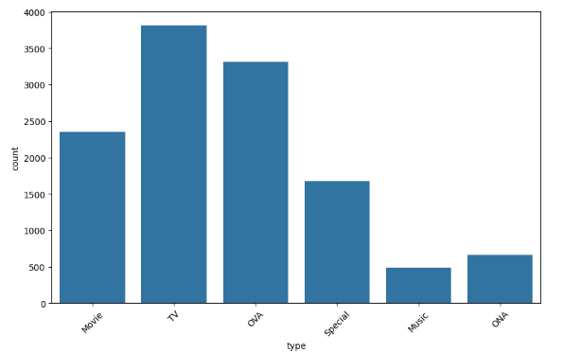
Distribution Analysis By Type
The most dominant type is TV, OVA, and MOVIE. The rest have a low count.

Slide 15
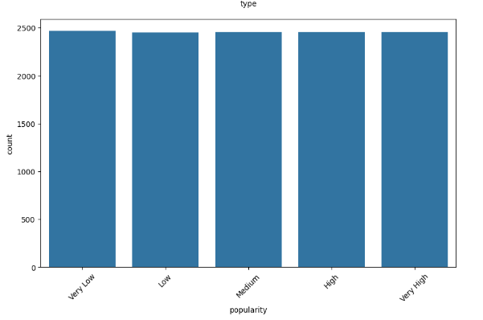
Distribution Analysis By Popularity
Our feature engineering part did not do a lot of difference as we can see that the categories in the popularity column all have the same count.

Slide 16
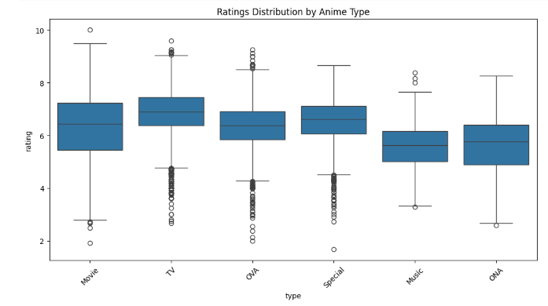
Rating Distribution By Anime Type
TV anime tend to have the highest and consistent ratings (median closed to 7)
Movies shows a wider spread bust still have relatively high medians.
OVAs and Specials have lower median ratings and more variability.
Music and ONA types generally receive lower ratings and more outliers.

Slide 17
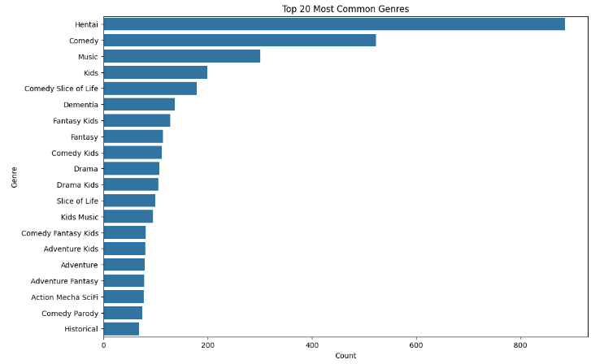
Top 20 Most Common Genres

Slide 18
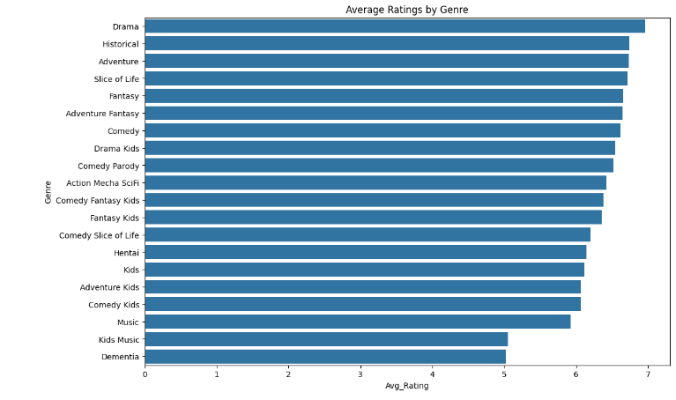
Average Ratings By Genre

Slide 19
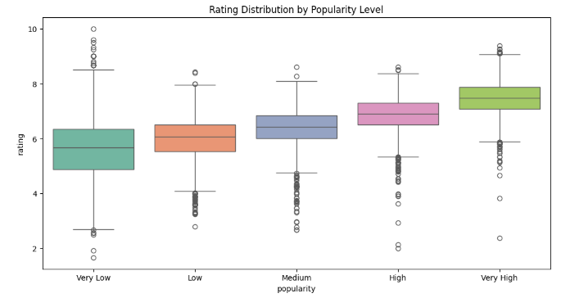
Rating Distribution By Popularity Level
As popularity increases, the median rating also increases.
This suggests that more popular anime tend to be better rated or vice versa - better rated anime attracts more viewers.
Very low and Low popularity show wider variability and more outliers.
Very high popularity anime have tighter distributions with higher medians and fewer low-rating outliers.

Slide 20
Modeling: Collaborative Filtering
Approach: KNN-based User-Filtering
Steps:
Merge anime metadata with user ratings.
Create user-item utility matrix.
Fit KNN model on sparse matrix.
Recommend items rated based on similar ratings.

Slide 21
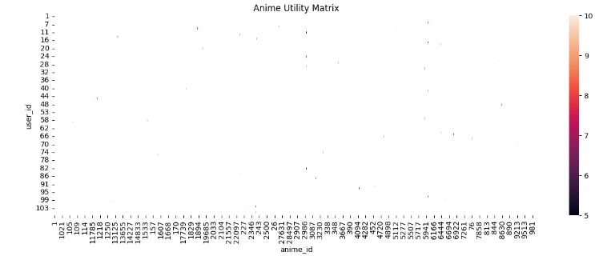
Utility Matrix
The utility matrix contain the past purchase behavior or ratings for each individual user and product combination. Here were chose the first 100 customers to evaluate their ratings for certain animes.
Most of the animes have a rating that is above 5.0 . This shows that quality most of the time is considered for a show to be recommended.

Slide 22
KNN Recommendation Flow
Recommend anime highly rated by nearest neighbors
Get user rating vector
Find similar users via cosine similarity

Slide 23
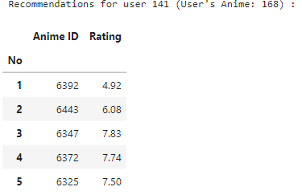
KNN Recommendation Output
We created a function def recommend_anime_for_user(user_id, data_pivot_temp, anime, n_neighbors=6)
Recommends anime for a specific user based on collaborative filtering using KNN.
Returns a DataFrame containing anime recommendations with their distances and ratings.

Slide 24
Modeling: Content-Based Filtering
Approach: Genre-based Similarity using TF-IDF
Steps:
Concatenate name and genre as features.
Apply TF-IDF vectorizer.
Compute cosine similarity between anime.

Slide 25
Cosine Similarity Matrix
Matrix shape: (12294, 12294)
Each cell = to the similarity between two anime title.

Slide 26
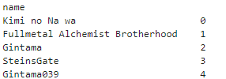
Content Based Recommendations
We created a function def content_generate_top_N_recommendations(anime_name, N=10), it:
Gets the index of the given anime_name.
Gets the cosine similarity scores for the given anime.
Extract the indices of the recommended anime.
Return the titles of the recommended anime.
Here are the indices used :

Slide 27
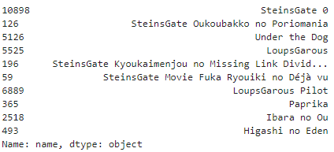
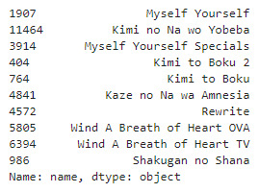
Content Based Recommendations Output
In this example output N=10 and we used “SteinsGate” in the first picture and “Kimi no Na wa” in the second one as indices.

