Slide 1
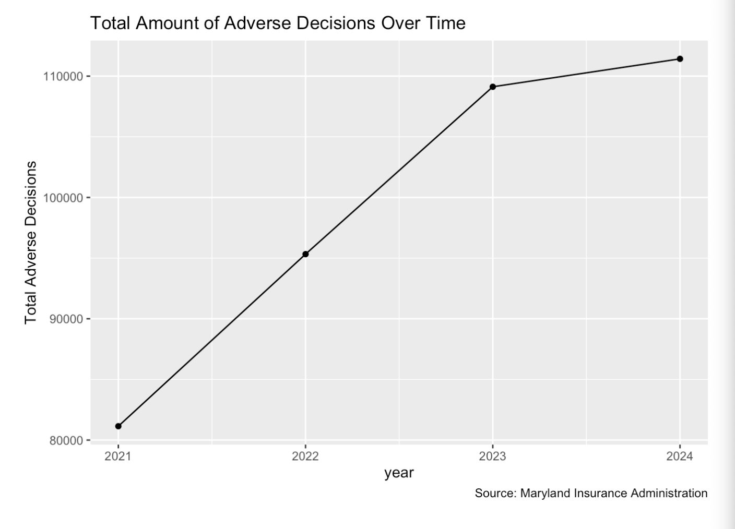
Adverse decisions increased steadily from 81,143 in 2021 to 111,426 in 2024, with the largest growth occurring between 2021 and 2022 (17.48%)
Growth slowed significantly in 2024 (2.11%), suggesting a potential stabilization in the volume of adverse decisions

Slide 2
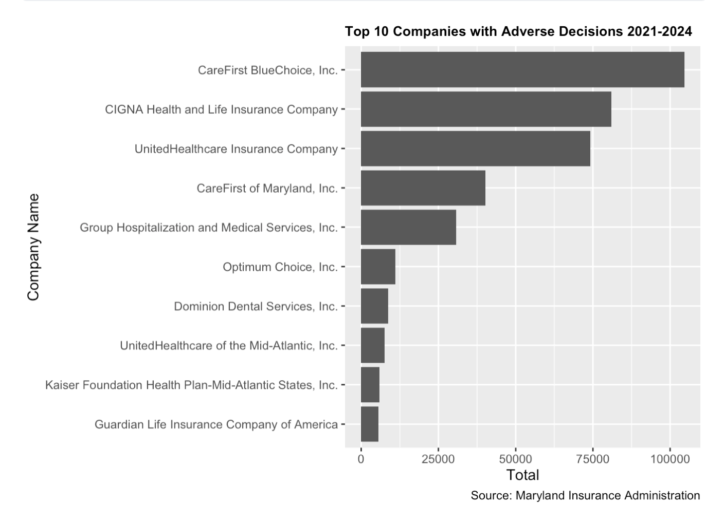
y = "Total Adverse Decisions"
CareFirst BluChoice leads all companies with 104,612 adverse decisions from 2021-2024
The top 3 insurers (CareFirst BluChoice, CIGNA, UnitedHealthcare) account for the majority of all adverse decisions statewide.

Slide 3
Year-over-Year Percentage Change of Adverse Decisions
Year | Count | Percent Change
2021 | 81,143 | NA
2022 | 95,327 | 17.48%
2023 | 109,123 | 14.47%
2024 | 111,426 | 2.11%
The highest single-year increase was 2021-2022 at 17.48%, nearly 8x larger than the 2024 growth rate of 2.11%.
Despite slowing growth, total adverse decisions still rose by over 30,000 cases between 2021 and 2024.

Slide 4
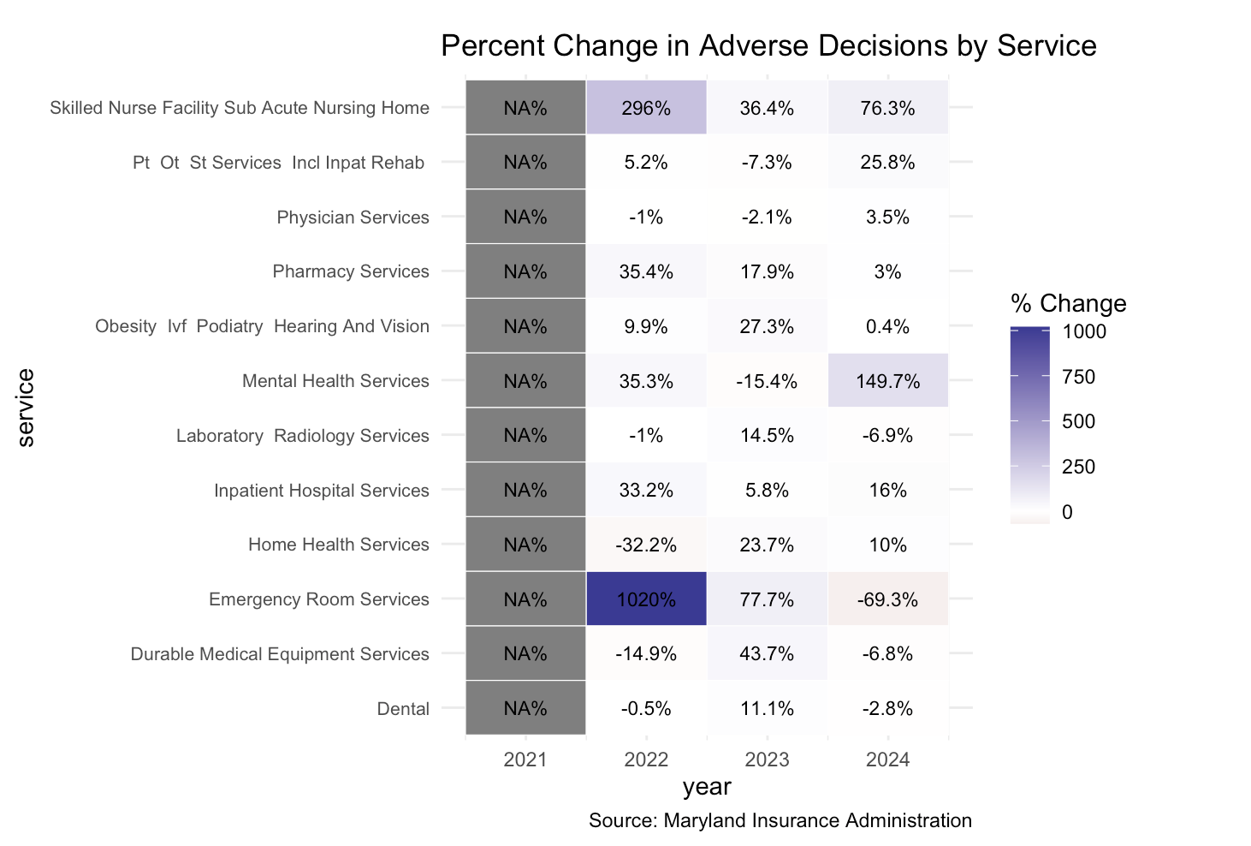
Emergency Room Services saw a 1,020% spike in 2022 going from 10 to 112
Mental Health Services surged 149.7% in 2024

Slide 5
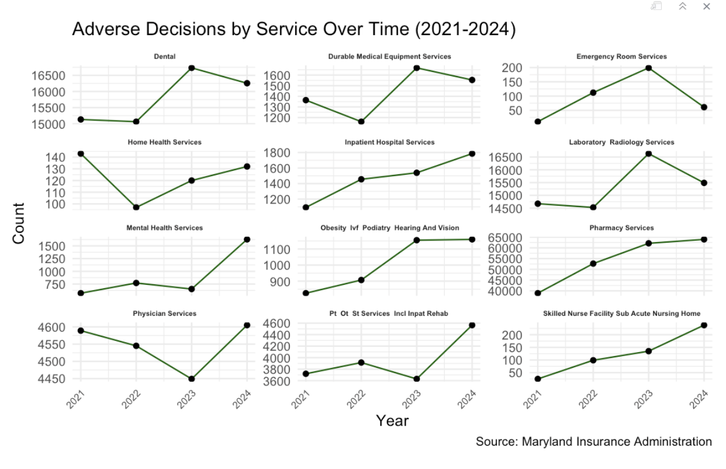
Pharmacy Services had the highest absolute volume and a consistent upward trend, making it the largest driver of adverse decisions by service, possibly due to burnt out workers and high quotas
Laboratory/Radiology & Emergency Services is the only category showing a decline in 2024, contrasting with the broader upward trend across services

Slide 6
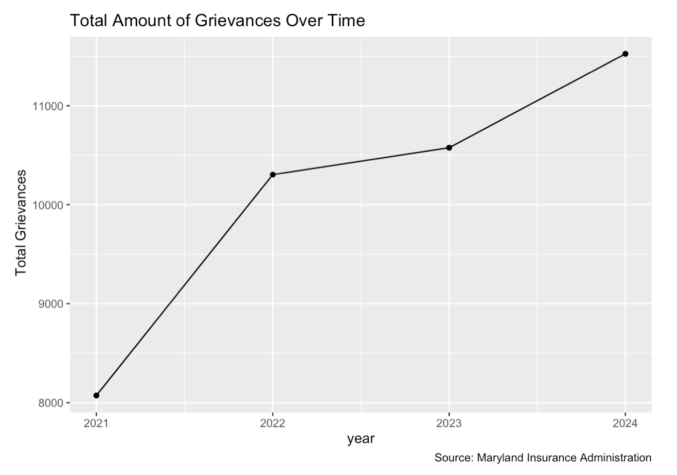
Total grievances grew 43% from 8,073 in 2021 to 11,526 in 2024, indicating consumers are increasingly challenging insurance decisions.

Slide 7
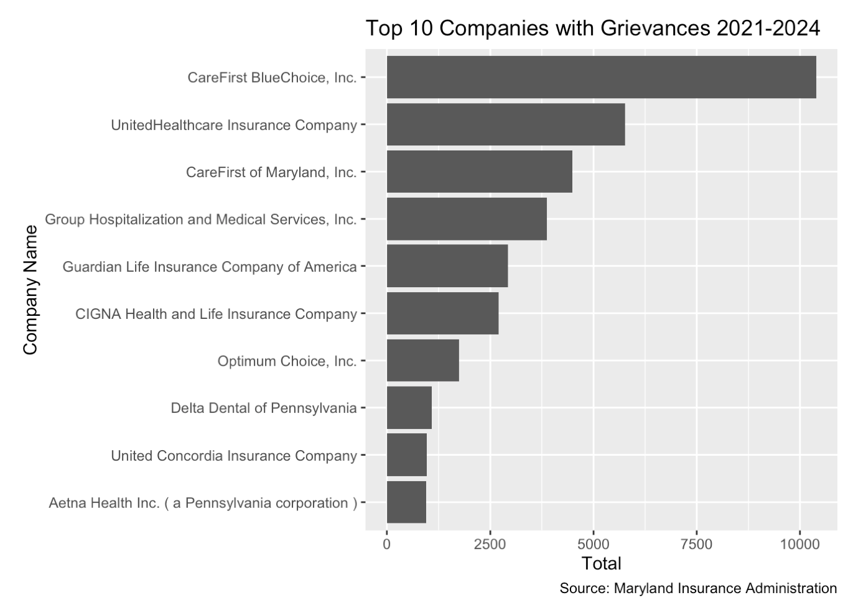
CareFirst BlueChoice ranks 1st in both adverse and grievances
Guardian Life ranks 5th for grievances yet 10th for adverse

Slide 8
Year-over-Year Percentage Change of Grievances
Year | Count | Percent Change
2021 | 8,073 | NA
2022 | 10,305 | 27.64%
2023 | 10,574 | 2.61%
2024 | 11,526 | 9.00%
Grievances grew faster than adverse decisions in 2022 (27.64% vs. 17.48%)
In 2024, grievances rose 9% even as adverse decision growth rose at 2.11%

Slide 9
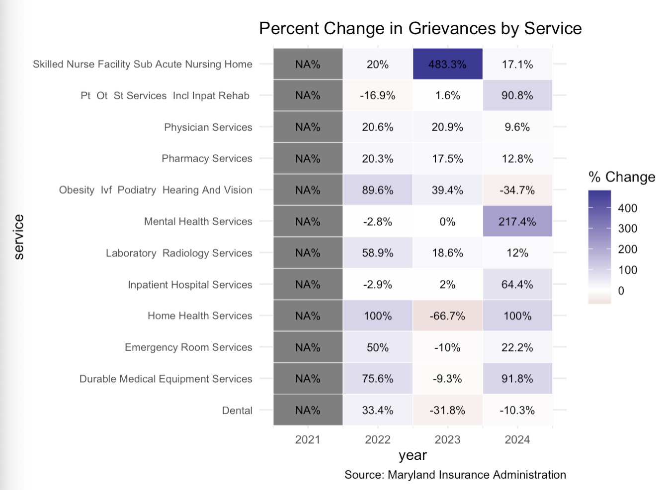
Mental Health Services grievances surged 217.4% in 2024 — the largest jump of any service category and a key area of concern.
Skilled Nursing Facility grievances jumped 483.3% in 2023, then grew another 17.1% in 2024, indicating a persistent and growing problem.

Slide 10
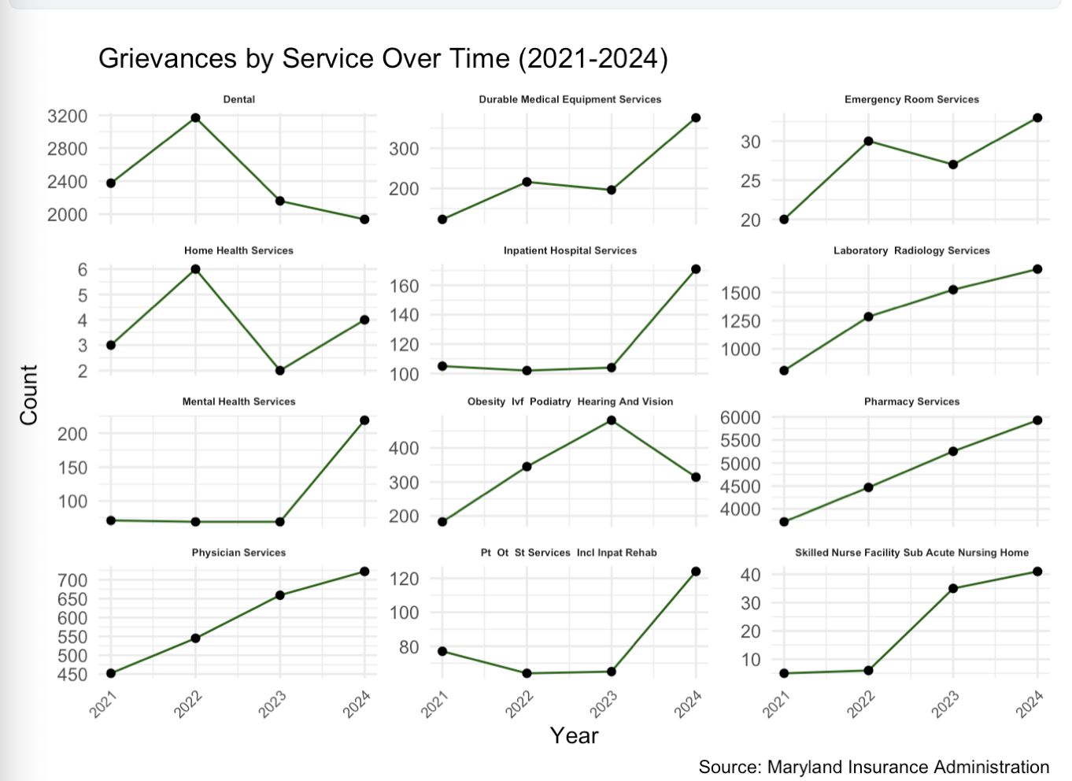
Pharmacy Services grievances are consistently high and rising
Mental Health Services shows a dramatic acceleration in 2024 after years of relative stability — the most significant shift in this dataset.

Slide 11
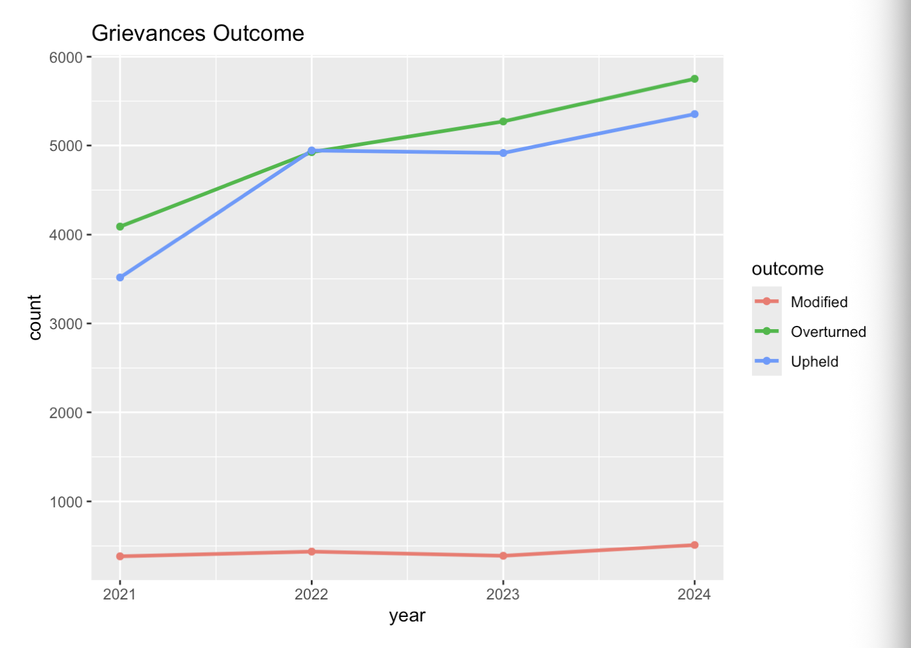
Overturned outcomes are the most common and continue to grow, meaning insurers are increasingly siding with consumers

Slide 12
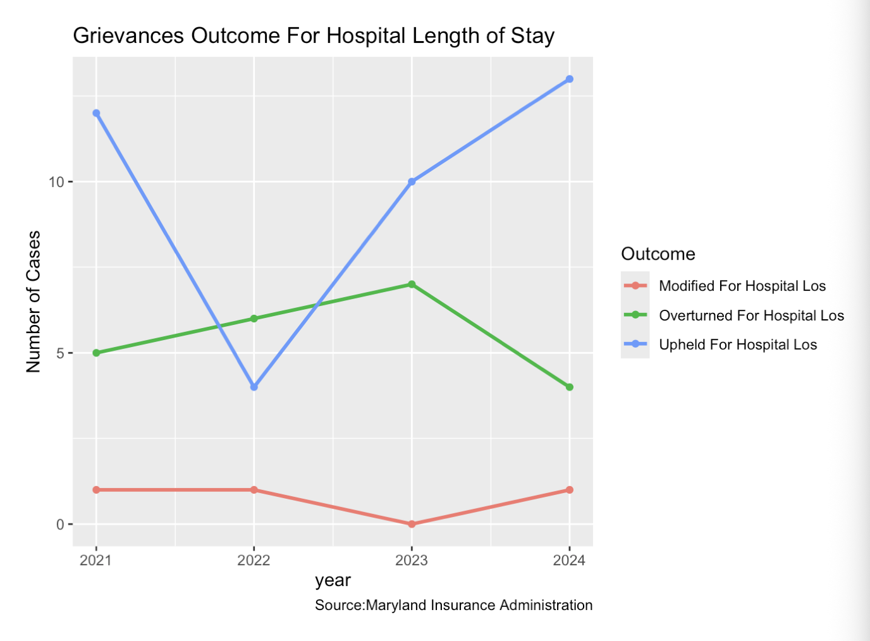
Upheld outcomes for hospital length-of-stay grievances surged in 2024 after a dip in 2022.
Overturned cases declined in 2024 after peaking in 2023 — consumers are having less success challenging hospital stay denials in recent years.

Slide 13
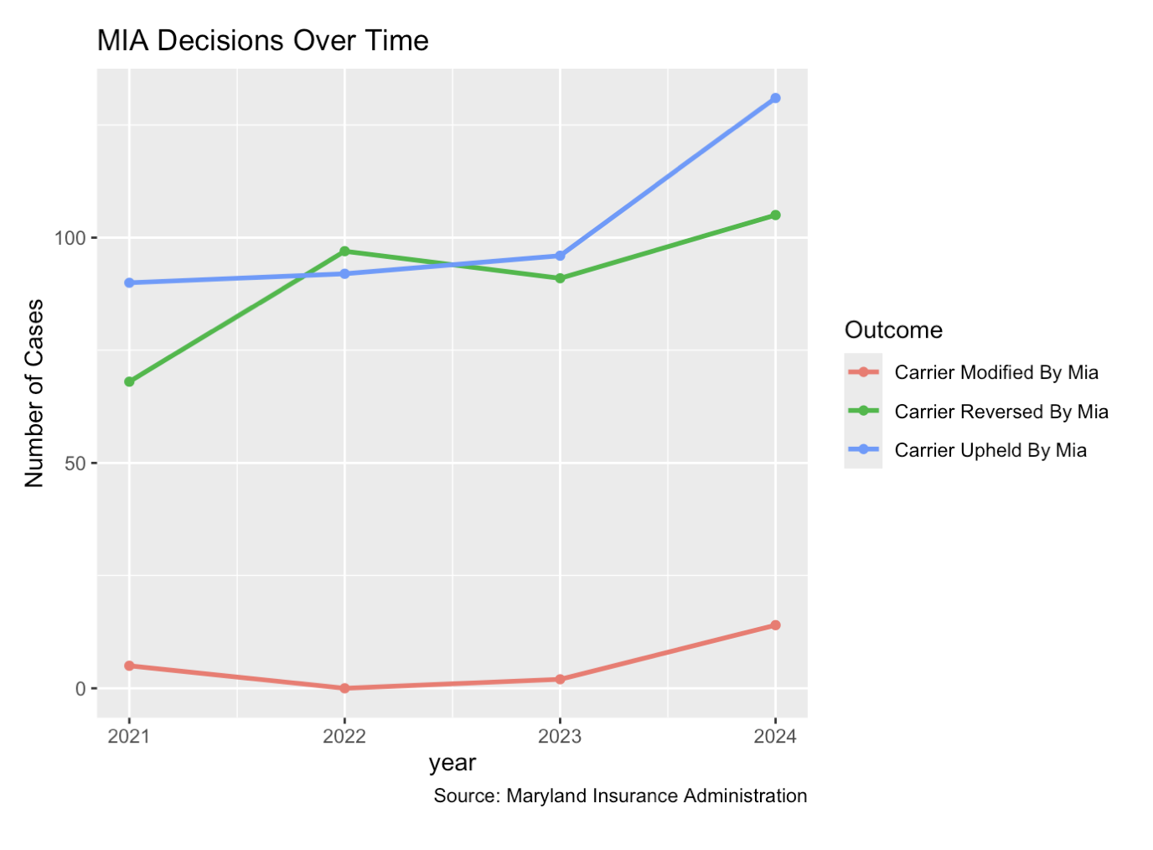
Carrier Upheld by MIA decisions rose sharply in 2024, indicating the MIA is increasingly ruling in favor of insurers across all case types.
Carrier Reversed by MIA cases are also growing, showing the agency remains active in holding insurers accountable in certain circumstances.

Slide 14
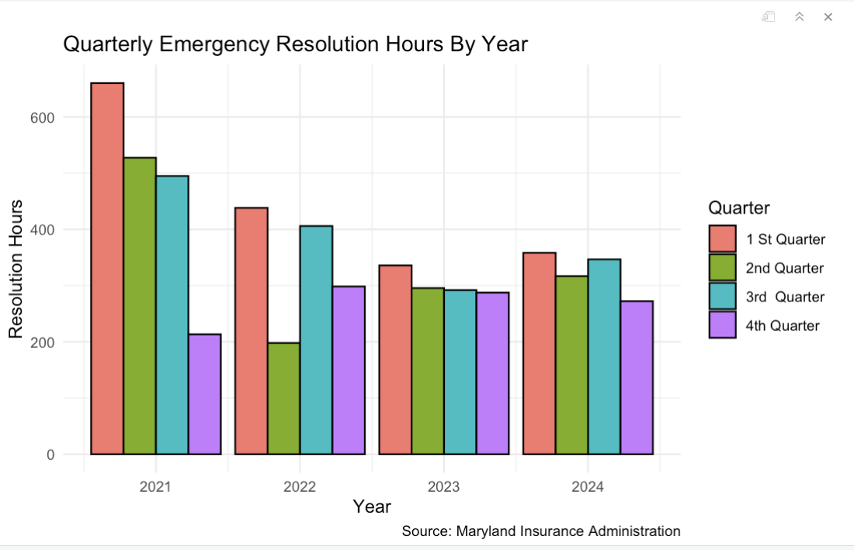
Emergency resolution hours have dropped significantly since 2021, with Q1 2024 averaging less than 400 hours compared to 660.1 in Q1 2021.
Q1 consistently records the highest resolution hours each year , likely reflecting post-holiday backlogs and early-year staffing constraints.

Slide 15
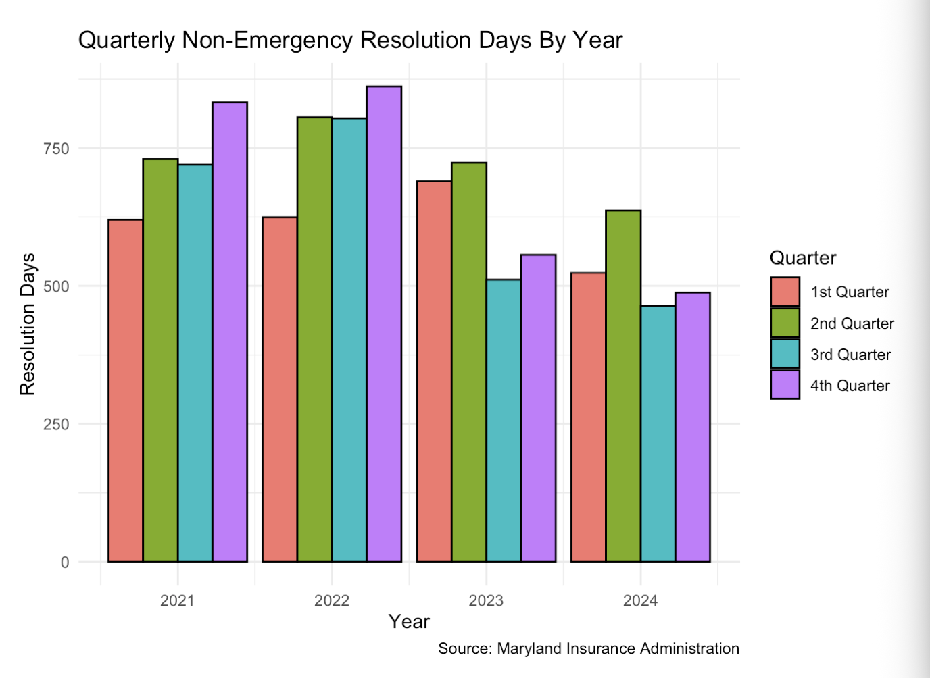
Non-emergency resolution days peaked in Q4 2022 at 861.8 and have been declining since, reflecting improved processing efficiency across all quarters.
All 2024 quarters are well below 2022 peaks, suggesting improvements in handling non-urgent cases.

Slide 16
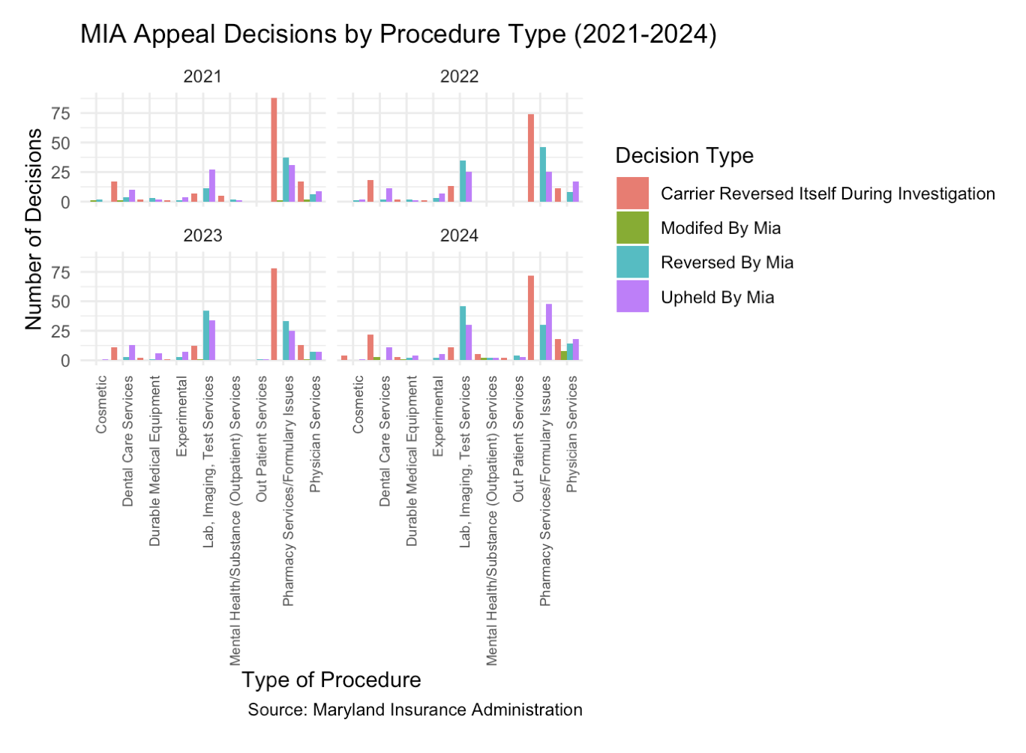
Pharmacy/Formulary Issues and Lab/Imaging and Test generate the most MIA appeal activity each year, making them the highest-friction service categories.
High volumes of Carrier Reversed Itself During Investigation suggest insurers frequently back down when they are being investigated

