Slide 1

Exploring Trust in AI
A MULTILEVEL ANALYSIS OF INFLUENCING FACTORS,
TRUST EROSION AND TRUST CALIBRATION STRATEGIES
AN6002 Analytics & Machine Learning in Business · Group 2
WANG GAOYANG · KAVIN LERTSATTHA · TRISTON CHEONG · TIMOTHY TAN

Slide 2

The AI Trust Problem
Global study, 2025: 48,340 people in 47 countries. Use is high, but trust is often unchecked.
ALL RESPONDENTS
AMONG EMPLOYEES WHO USE AI AT WORK
Two in three
rely on AI output without checking its accuracy
56%
have made mistakes in their work because of AI
Sources: Gillespie et al. (2025), KPMG & University of Melbourne
PRESENTED BY WANG GAOYANG
2

Slide 3
Calibrated Trust, Not More Trust
Under-trust
Calibrated trust
Over-trust
Rejects useful tools and loses their benefits
Relies on AI where it is reliable, questions it where it is not
Accepts wrong outputs without checking
Our Research Questions
1
What leads someone to trust AI in the first place?
2
How does trust change after AI fails?
3
What can be done?
Country level · Individual level
Trust loss and recovery
Proposed solutions to calibrate trust
Calibration framing: Jacovi et al. (2021), ACM FAccT
PRESENTED BY WANG GAOYANG
3

Slide 4
Purpose and Methodology
Goal:
Understand national level factors that may influence AI trust and assess whether machine learning models can reliably predict national trust levels
01
IMPLEMENT
02
PREDICT
03
EXPLAIN
Evaluate and optimize machine learning models to predict AI Trust Percentage
Train the final model with labelled dataset and apply to unlabeled dataset
Identify the most influential national attributes contributing to the predictions
7
47
146
9
PREDICTOR VARIABLES
LABELLED COUNTRIES
UNLABELLED COUNTRIES
REGRESSION MODELS TESTED
PREDICTOR VARIABLES
K-NEAREST NEIGHBOURS (KNN)
k = 3 Neighbours
Age Dependency Ratio
Government effectiveness Score
Internet Usage
Population Density
Life Expectancy at Birth
Mean Years of Schooling
GNI per Capita
R² = 0.26
RMSE = 8.89
PRESENTED BY KAVIN LERTSATTHA

Slide 5
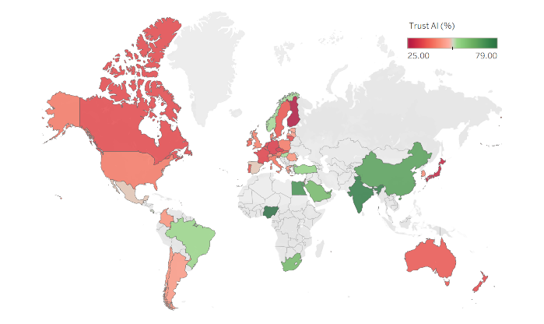
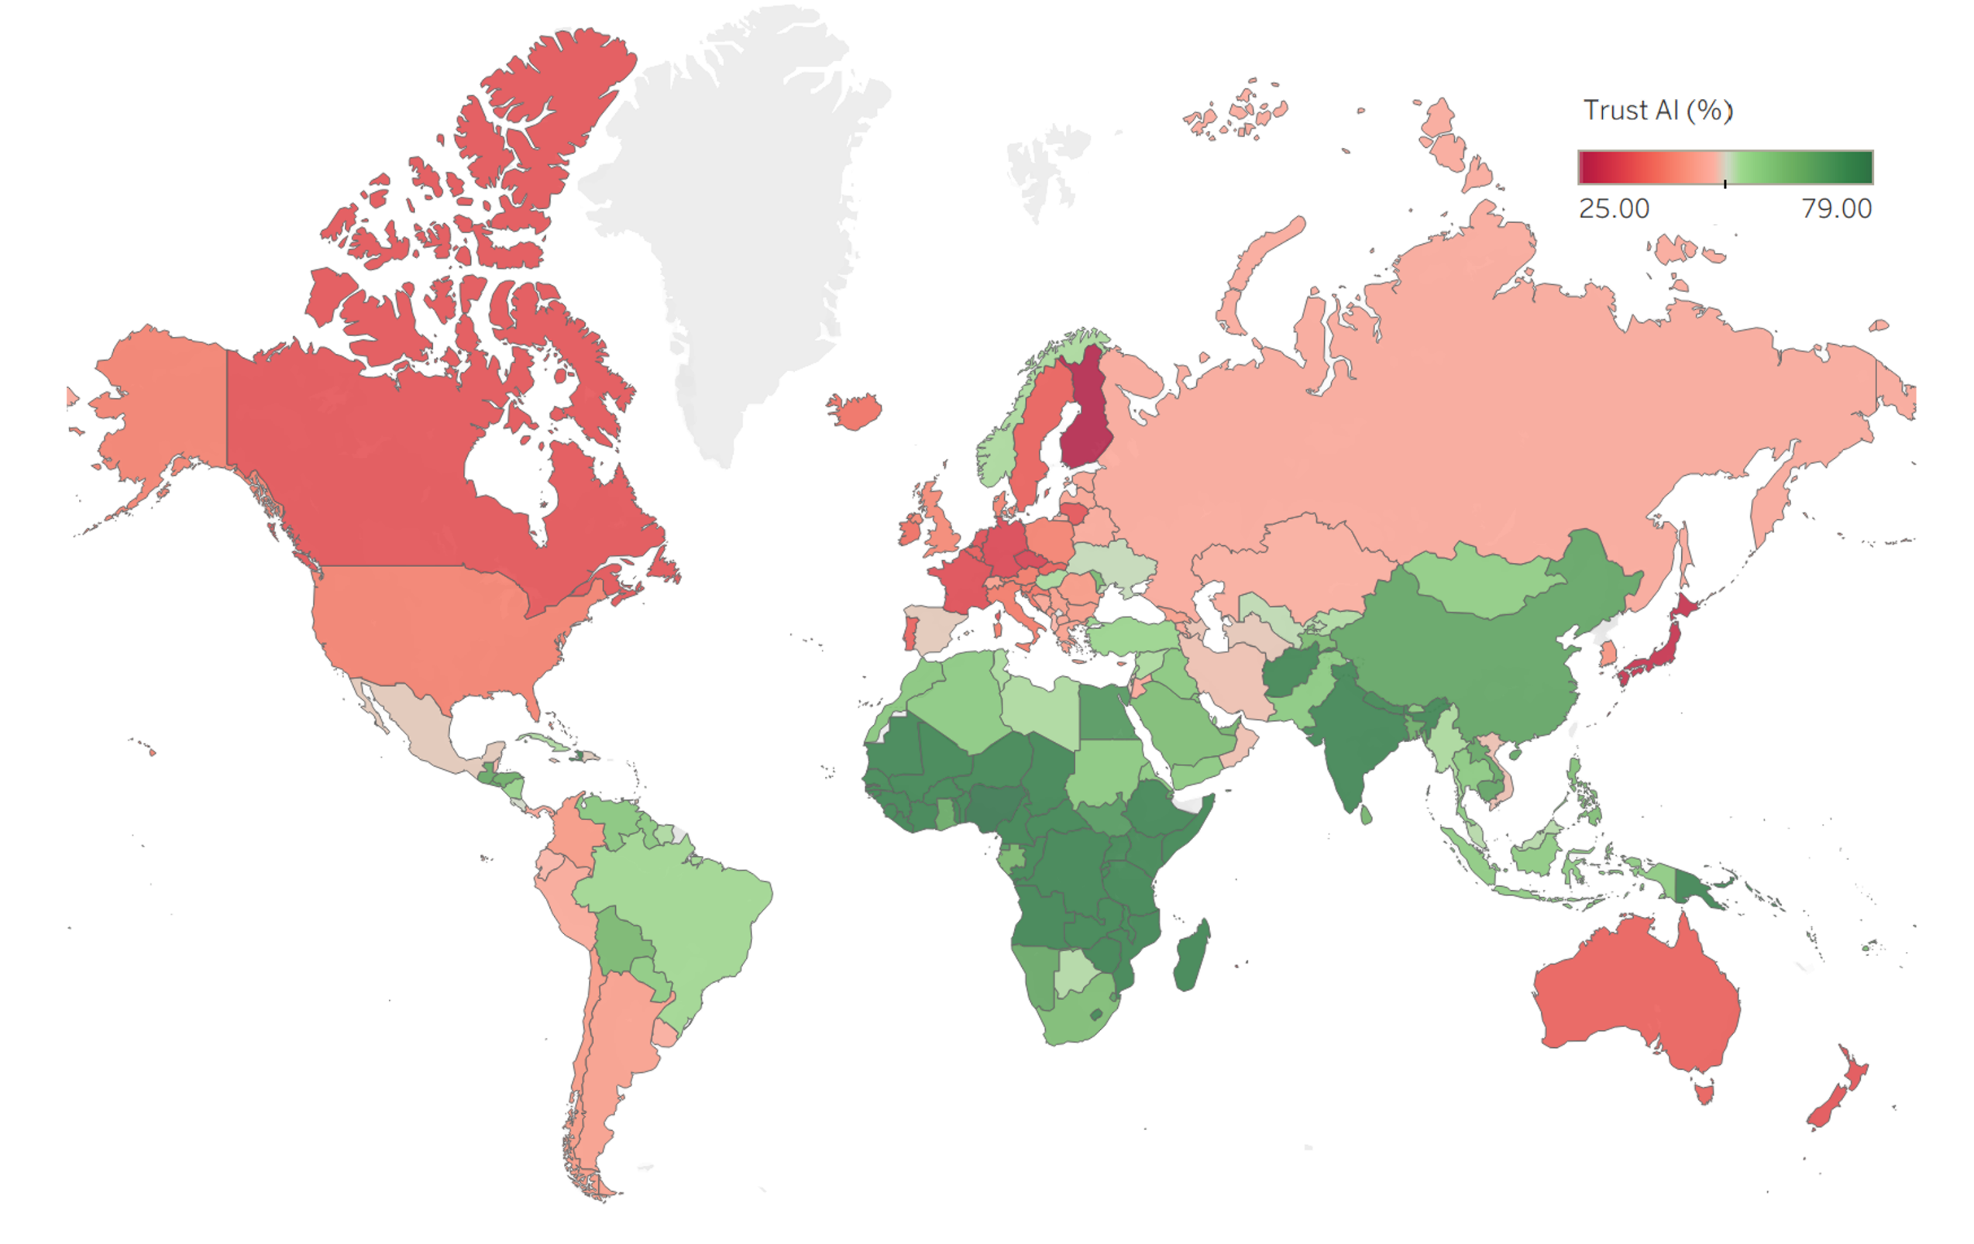
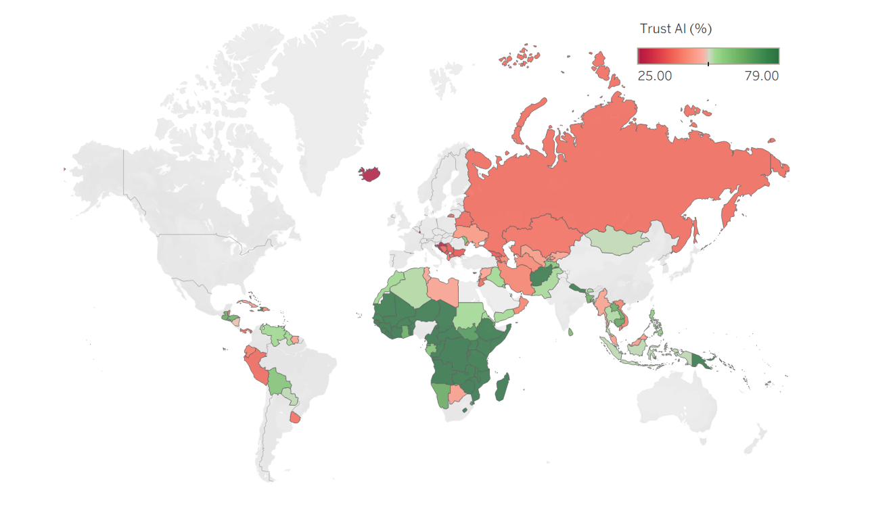
Predictive AI Trust Mapping Results
LABELLED DATASET
47
COMPLETE DATASET
193
COUNTRIES
COUNTRIES
UNLABELED DATASET
146
COUNTRIES
PRESENTED BY KAVIN LERTSATTHA

Slide 6
Predictive Variable Importance
RANKED NATIONAL INDICATORS
FINDINGS
01
Age Dependency Ratio
01
GENERATIONAL DIFFERENCES
National age structure may reflect varying attitudes towards AI across generations due to differences in technological familiarity
02
Mean Years of Schooling
03
Government Effectiveness
02
DIGITAL LITERACY
Importance of education and internet usage may reflect difference in digital literacy and exposure to AI technology
04
Internet Usage
05
GNI per Capita
03
COUNTRY DEVELOPMENT
06
Life Expectancy at Birth
Countries with effective governments, high income levels and life expectancy tend to have greater technological exposure and more regulatory environments
07
Population Density
PRESENTED BY KAVIN LERTSATTHA

Slide 7
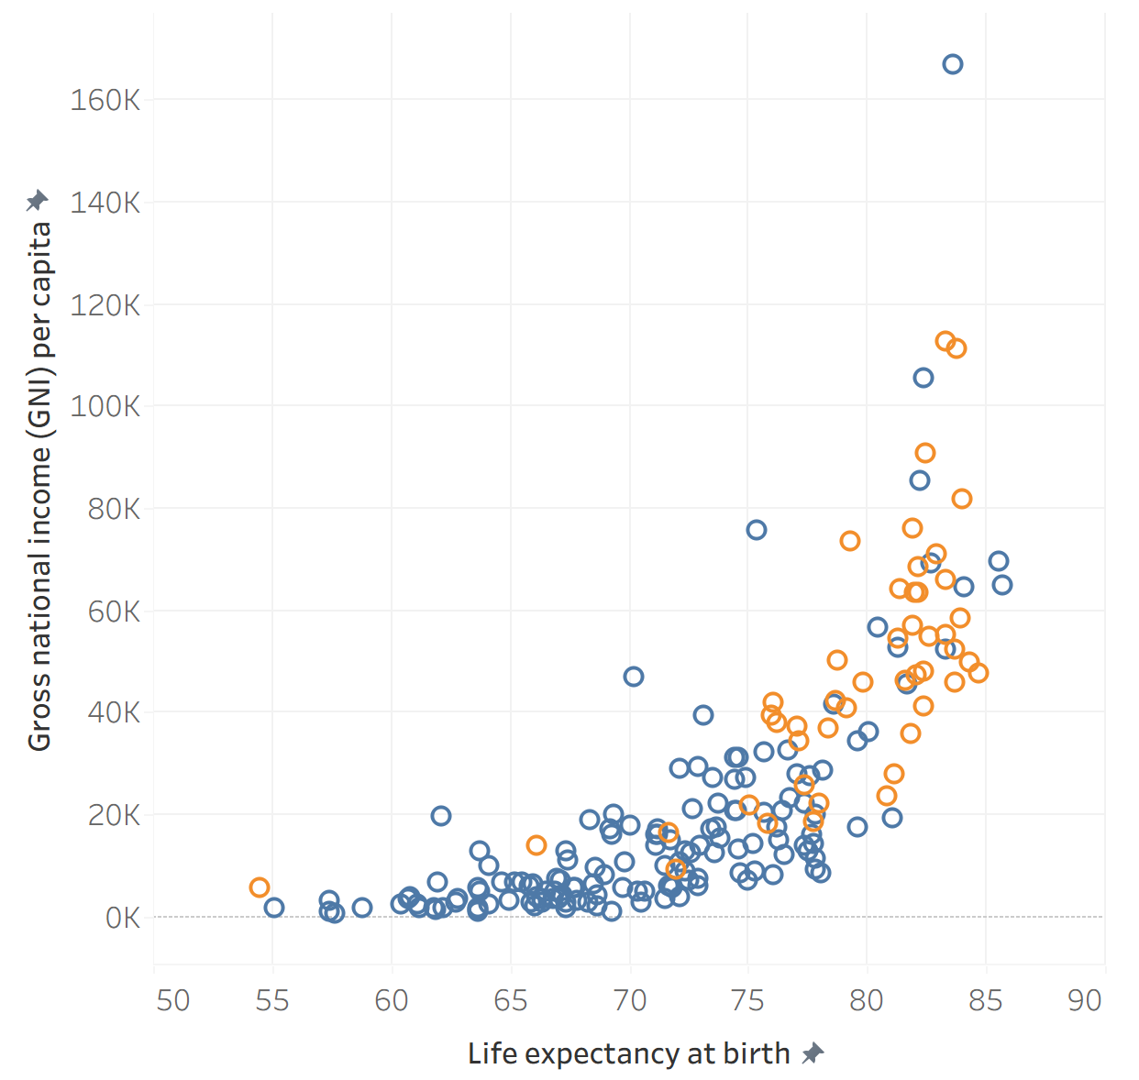
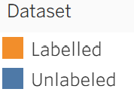
Limitations and Outlook
01
LABELLED DATASET IS BIASED TOWARDS MORE DEVELOPED COUNTRIES
CONCLUSION
National indicators provide some predictive insight into AI trust, but cannot fully explain the cross-country differences in attitudes
MORE DEVELOPED
COUNTRIES
02
LIMITATIONS
Labelled dataset contains only 47 countries, most of which are developed countries, so the model does not fully capture the diversity of less developed countries
LESS
DEVELOPED
COUNTRIES
03
IMPROVEMENTS
Expand labelled data across more developing countries, then re-evaluate model reliability before drawing stronger conclusions
PRESENTED BY KAVIN LERTSATTHA

Slide 8
Analysis Approach & Trust Profiles
Blind Trust
Moderate Trust
Purpose
Understand individual-level factors that influence how much a person trusts an AI system
Approach
1,000 interaction records
Multinomial Logistic Regression
Understand 4 trust profiles
Highly Skeptical
Skeptical
PRESENTED BY TRISTON CHEONG

Slide 9
Three Layers of Trust Framework
Response Quality
Query Context
User Characteristics
Source citation
Decision importance
AI familiarity
Hedging language
Digital literacy
Urgency level
Education level
Belief alignment
More skeptic =
Less skeptic =
PRESENTED BY TRISTON CHEONG

Slide 10
Response Quality – What the AI Says
Key finding: Transparency (including source citation) is key to building calibrated trust
Presence of Source Citation
Blind Trust
1.5 x
Moderate Trust
4 x
Skeptical
36 x
Highly Skeptical
Comparison Groups (CG)
Lower odds of being in CGs
PRESENTED BY TRISTON CHEONG

Slide 11
Query Context – Why the Person is Asking
Key finding: Trust is depressed by high-stakes decisions
Decision importance
(Low, Medium, High, or Critical)
One-unit increase (e.g. medium → high) increases the odds of a respondent being Highly Skeptical than a Blind Truster.
Blind Trust
Moderate Trust
1.9 x
Skeptical
10 x
Highly Skeptical
107 x
Comparison Groups (CG)
Higher odds of being in CGs
PRESENTED BY TRISTON CHEONG

Slide 12
User Characteristics – Who is Asking
Key finding: Experienced users tend to be more critical
AI familiarity, digital literacy, education
(e.g. Low, Medium, High, or
Expert digital literacy)
One-unit increase (e.g. medium → high) increases the odds of a respondent being Highly Skeptical than a Blind Truster.
Blind Trust
Moderate Trust
1.2 to 1.6 x (Not sig for AI familiarity)
Skeptical
2.1 to 2.7 x
Highly Skeptical
3 to 14 x
Comparison Groups (CG)
Higher odds of being in CGs
PRESENTED BY TRISTON CHEONG

Slide 13
Understanding AI Trust Loss
LLM-based tools have inherent limitations and are prone to errors and hallucinations
What happens to user trust when AI systems make mistakes?
Is the loss of trust permanent or recoverable?
What makes a person lose more, or less trust than someone else?
Dataset: 301 records of individual AI use sessions with details on users, the errors encountered, and their trust impact
PRESENTED BY TIMOTHY TAN

Slide 14
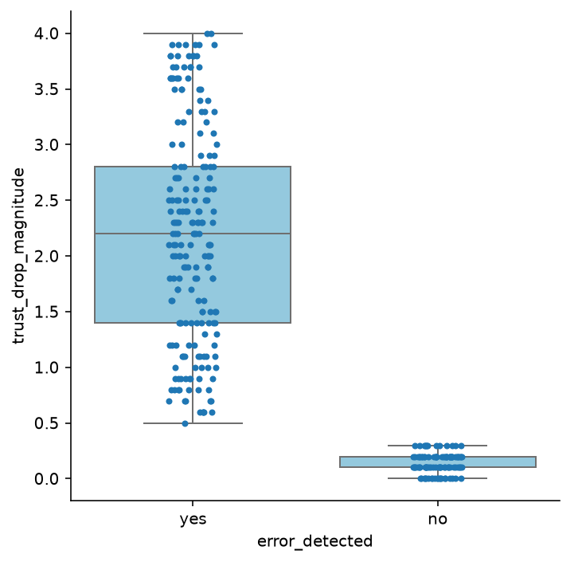
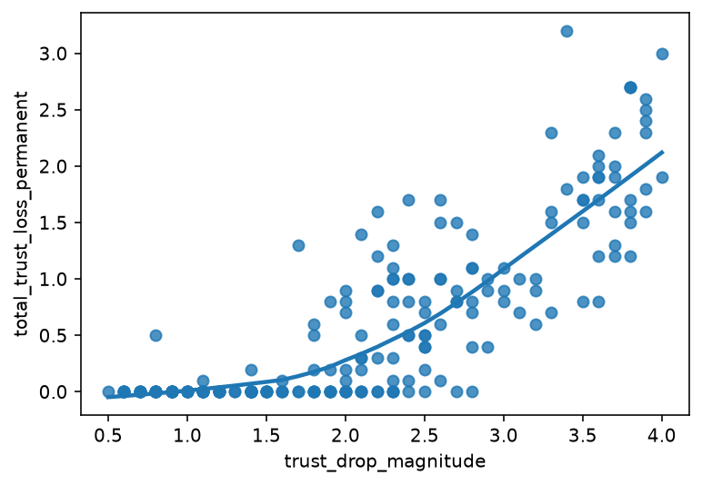
The Impact of AI Errors
When AI makes mistakes, loss of trust is almost guaranteed
Trust recoverable
Recovery uncertain
Full recovery impossible
Trust lost after an error is detected varies widely
The magnitude of initial trust loss determines whether that trust can be eventually regained
PRESENTED BY TIMOTHY TAN

Slide 15
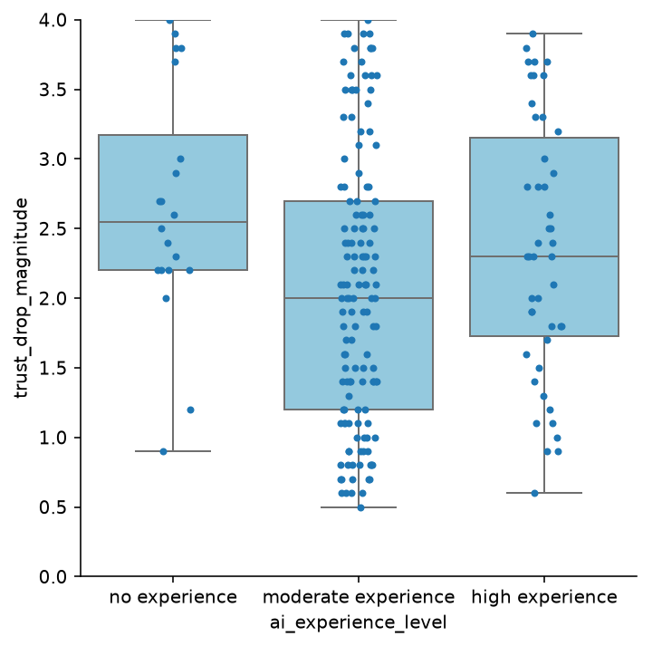
Other Trust Loss Factors
When an error occurs, what makes one person lose more trust than another?
ANOVA p-value = 0.0161
Amount of Past Experience with AI
2 groups of users tend to experience greater loss in trust:
1
New users
Reluctant to trust unfamiliar technology
Unlikely to return to AI if it betrays their trust early
2
Highly experienced users
Developed long-term use habits with AI tools
Greater sense of betrayal when mistakes are made
PRESENTED BY TIMOTHY TAN

Slide 16
Other Trust Loss Factors
2 factors identified through literature review reveal insights about user patterns, when examined with the data
Critical Thinking & Openness to Technology
Cluster | Trust Loss Magnitude | Critical Thinking Score* | Openness to Technology*
1 | 1.81 | 3.67 | 4.91
2 | 3.32 | 5.94 | 6.91
3 | 1.64 | 8.29 | 6.28
K-Means Clustering reveals 3 distinct trust loss profiles
1
Disengaged Users (Low trust loss)
Low critical thinking & openness
Do not trust or care about AI much to begin with
2
Uncritical Enthusiasts (High trust loss)
Highly open, but lack critical thinking
Unquestioning reliance, higher disappointment
3
AI Literate (Low trust loss)
Highly open, critical thinkers
Ideal user, well calibrated expectations
* Critical thinking/openness to technology scored out of 10
PRESENTED BY TIMOTHY TAN

Slide 17



Building AI Literacy and Accountability
Teach people to check AI, and check AI before it reaches them
SCHOOLS & EDUCATORS
GOVERNMENTS & COMMUNITIES
GOVERNMENTS & REGULATORS
Teach AI Verification
Bring AI familiarity to disengaged and older groups
Assurance & accountability
TARGETS
TARGETS
TARGETS
Students & Uncritical Enthusiasts
Disengaged Users & older populations
AI companies
EXAMPLE
EXAMPLE
EXAMPLE
How to SIFT with AI (Common Sense Education): students trace an AI article's citations back to the original sources.
Singapore's IMDA has run GenAI workshops for 6,000+ seniors since 2024, incl. checking answers across apps.
AI Verify (2022): firms test their AI against governance principles. and can share the results.
Moffatt v. Air Canada Lawsuit (2024)
Sources: Common Sense Education; Koh, The Straits Times (2025); PDPC (2022); Moffatt v. Air Canada, 2024 BCCRT 149
PRESENTED BY WANG GAOYANG

Slide 18



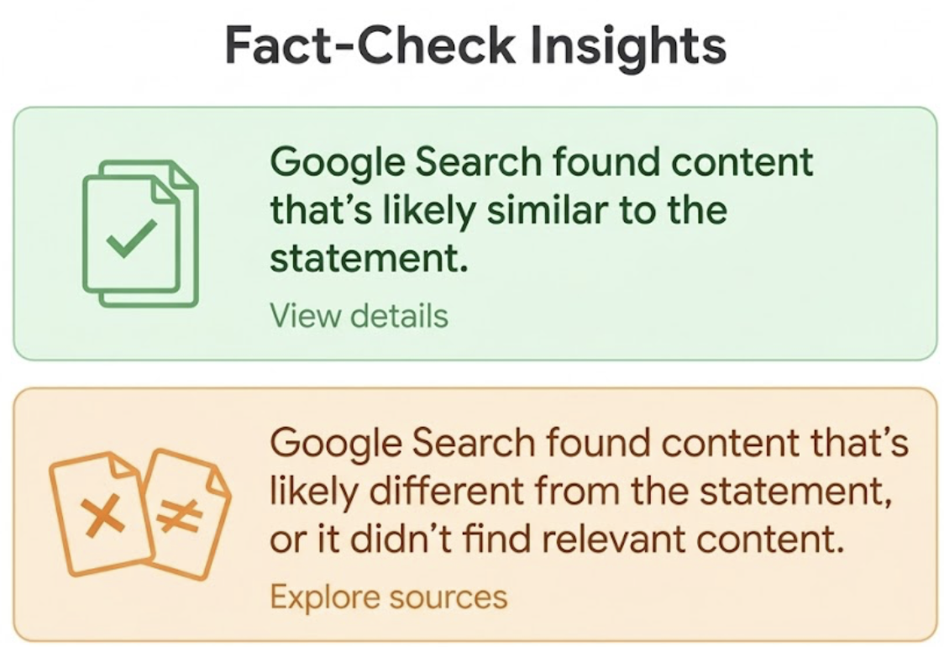
Designing AI That Signals When to Trust It
AI DEVELOPERS
AI DEVELOPERS
AI DEVELOPERS
Make sources real and checkable
Reduce sycophancy
Signal model limits, especially in high stakes
WHY
WHY
WHY
Cited answers left users 36× less likely to be highly skeptical
Belief-matching answers left users 16× less likely to be skeptical
Errors trigger trust loss, and large drops rarely recover
EXAMPLE
EXAMPLE
EXAMPLE
Mata v. Avianca Case(2023): Lawyers cited court cases entirely fabricated by ChatGPT.
Gemini's "double-check response" feature
OpenAI rolled back a GPT-4o update in 2025 for being too agreeable
Google restricted AI Overviews by limiting its display timing, content sources, and high-stakes topics like health.
Sources: Mata v. Avianca (S.D.N.Y. 2023); OpenAI (2025); Sharma et al. (2024); CNN (2023); Microsoft HAX Toolkit; Forbes (2024)
PRESENTED BY WANG GAOYANG

Slide 19
How Our Solutions Connect to the Findings
Each solution responds to at least one finding; together they aim at calibrated trust
Country level
Individual interactions
After AI errors
Teach AI verification
–
Education · Digital literacy · Source citation
Critical thinking
Bring AI familiarity to disengaged and older groups
Age dependency · Internet use
AI familiarity
AI experience · Tech openness
Assurance & accountability
Government effectiveness
Urgency
–
Real, checkable sources
–
Source citation
–
Reduce sycophancy
–
Belief alignment
Critical thinking
Signal limits clearly
–
Hedging · Decision importance · Urgency
Earlier error detection
PRESENTED BY WANG GAOYANG

Slide 20
Conclusion
01
What we found
02
What can be done
03
What comes next
Trust depends on both country level and individual factors, including users background, how high the stakes are and how response is presented.
Trust falls once users detect an error. Critical thinking and tech openness also play significant roles in trust drop.
Governments and educators should help build literacy and assurance.
AI developers should ensure sources checkable, resist sycophancy and signal limits.
Our data are observational and some may be synthetic.
Test these proposals in controlled experiments, with data on trust, AI accuracy and checking together.
"Calibrated trust is built by users, institutions and AI developers together."​
PRESENTED BY WANG GAOYANG

