Slide 1

SINGAPORE ’S
BIRTH RATE
Exploring Potential Factors through Dashboard
Group 8
PRESENTED BY
Wang Gaoyang, Huang Yixuan, Zhou Dianfeng, Tang Tongtong, Angelica Wu

Slide 2
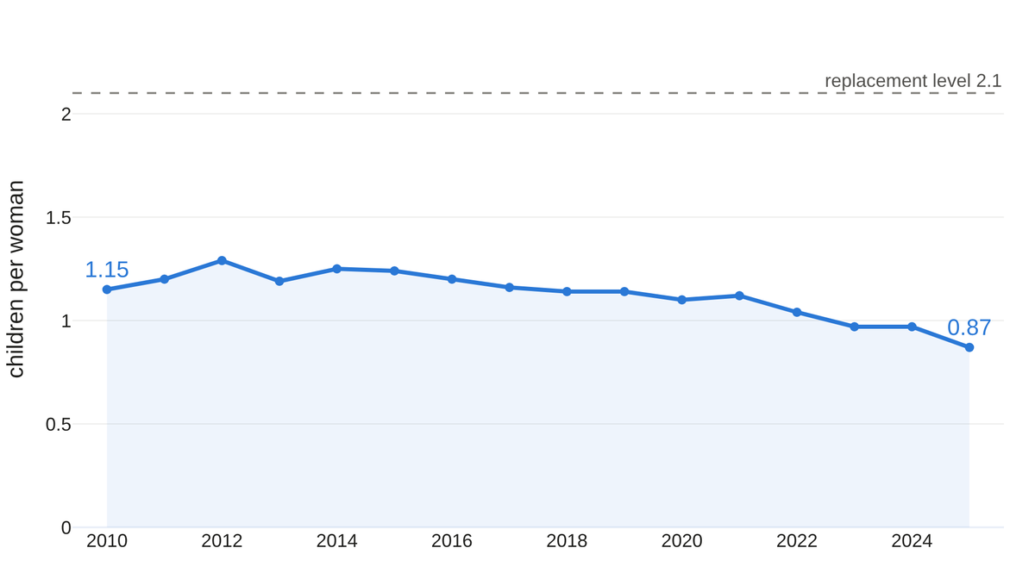
15 Years Fertility Rate Overview (2010–2025)
Total fertility rate (TFR)
FACTORS EXPLORED
01
Healthcare
02
Income
03
Housing
04
Marriage
TFR generally declined
05
Education
2010 → 2025: 1.15 → 0.87 (−24%), far below the replacement level of 2.1 — the level at which a population replaces itself from one generation to the next.
Notes:
Overall, we show that Singapore’s fertility rate declined while several costs increased. We will introduce 5 factors.

Slide 3
FACTOR 1 · HEALTHCARE
Does healthcare cost explain
the falling birth rate?
Healthcare price & Government spending
Presented by Zhou Dianfeng · Group 8
Notes:
I have a question:
To answer this question, let me move to the next slide.

Slide 4
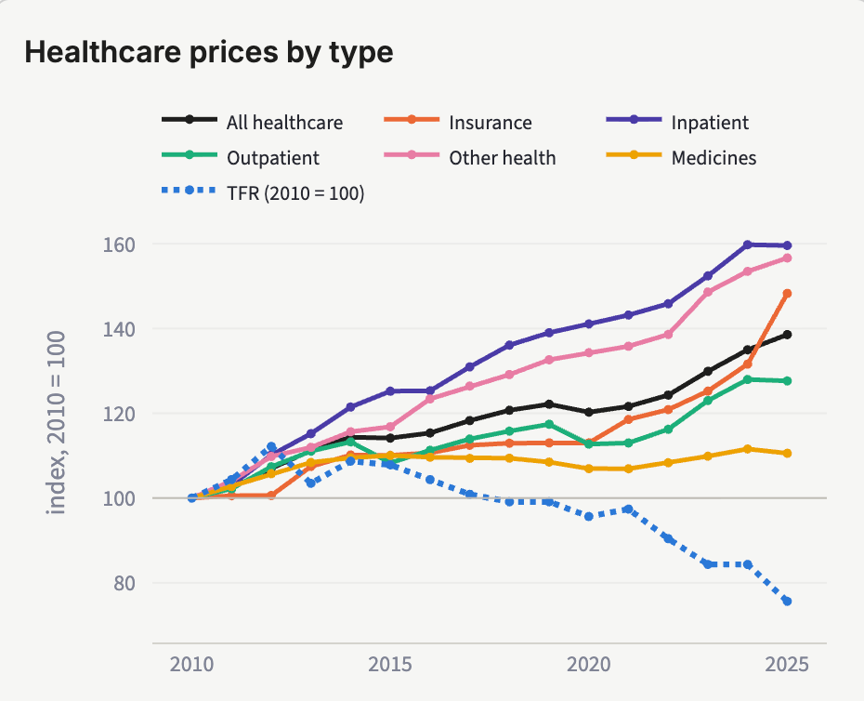
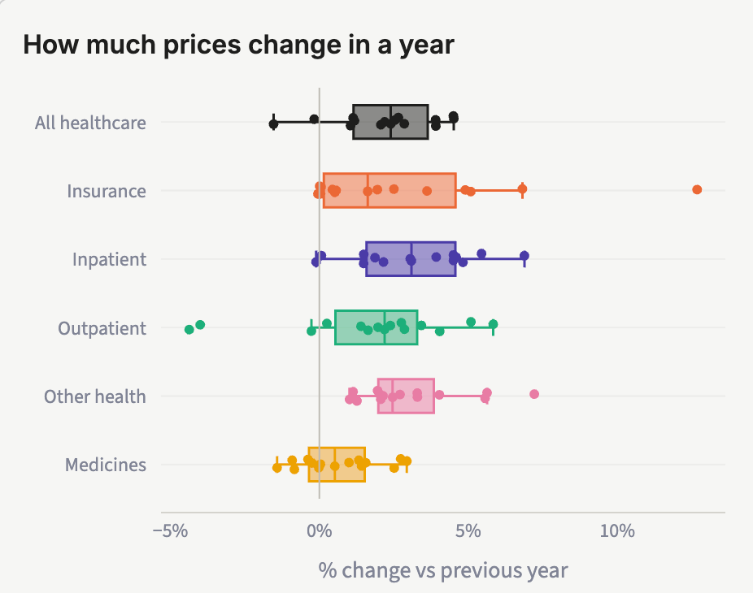
Factor 1·Healthcare: long-run price growth and annual volatility
The supplied dashboard charts show complementary views of healthcare prices
Service prices diverged over time
Annual changes were uneven
Inpatient care and other services rose most. Medicines changed less, so the overall CPI hides differences across services.
Insurance shows a pronounced upward outlier. Outpatient care includes price declines, while medicines cluster near zero.
Notes:
healthcare price increases were different across categories. Inpatient and other health services rose most over time, while medicines changed less.
The boxplot adds another insight: insurance had a sharp annual increase, while outpatient prices sometimes fell. Families may face uncertainty about future medical expenses as well as higher costs.

Slide 5
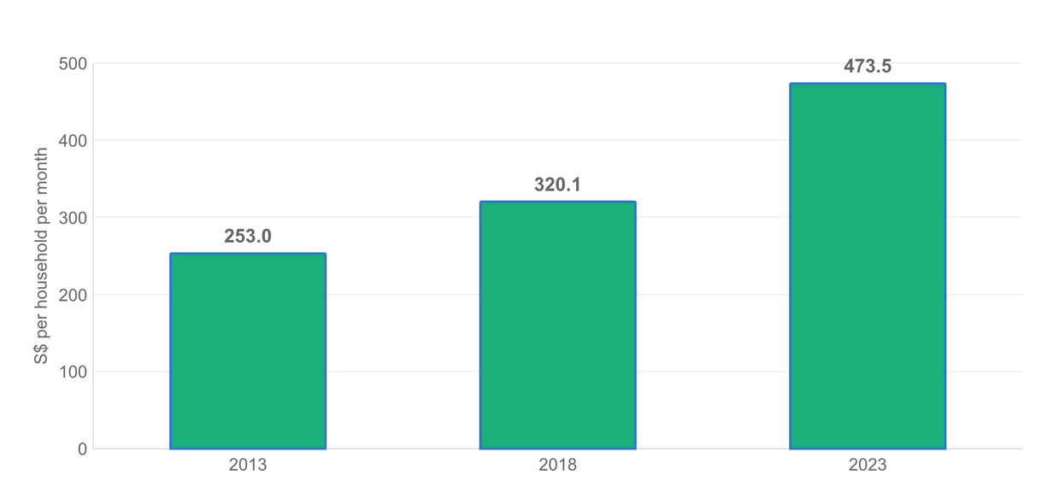
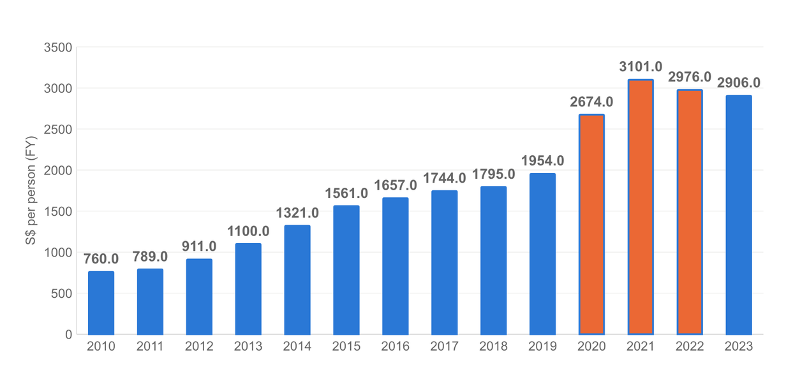
Healthcare: spending increased at home and in the public sector
Household survey years and government expenditure per person
Household monthly spending
Government spending(Healthcare) per person
A larger share of family budgets
Higher public spending has limits
Healthcare absorbed a greater spending share across survey waves, suggesting more pressure on household budgets.
Despite rising government healthcare spending, the adequacy of support for reducing childbearing costs remains in question.
Nominal values. Household data cover all households. Government series end in FY2023.
Notes:
The spending charts show that healthcare took up a larger share of household budgets. Government healthcare spending per person also increased. But the willing of helping is limited.So,we think this spending can not addresses the costs of having children.

Slide 6
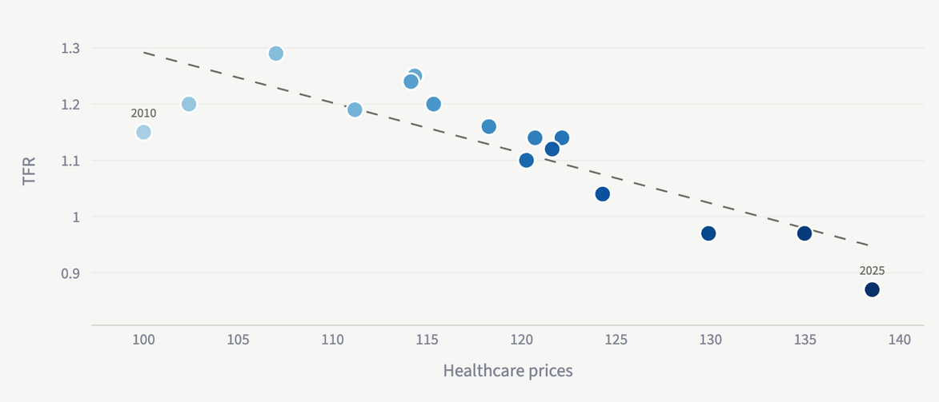
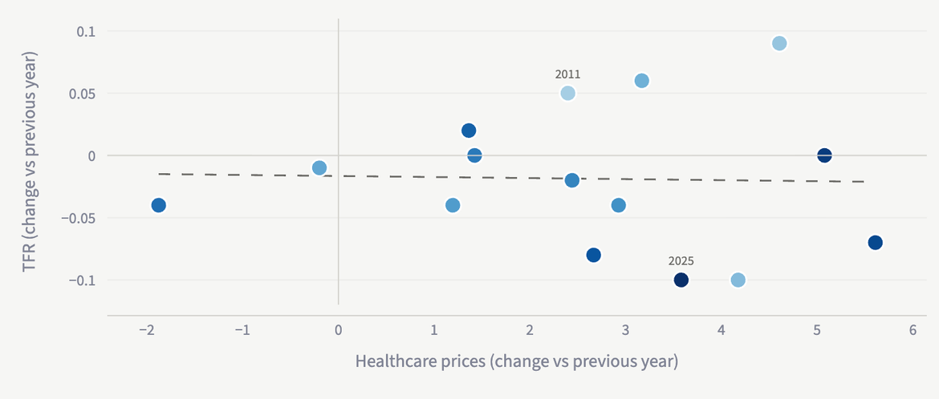
Healthcare and TFR: a strong level association needs caution
r = −0.84
p<0.001
Higher-price years generally coincide with lower TFR.
r = −0.03
p=0.918
Year-to-year movements show little linear association
The negative relationship is much weaker when comparing annual changes.
Rising healthcare costs may add to expected expense of having children, potentially discouraging or delaying parenthood.
Notes:
Finally, higher healthcare prices were associated with lower fertility. But the relationship almost disappeared when we compared annual changes.My main point is that rising medical costs may increase the expense of having children.

Slide 7
FACTOR 2 · INCOME & INEQUALITY
Does income explain
the falling birth rate?
Income per employed household member & Gini coefficient
Presented by Wang Gaoyang · Group 8

Slide 8
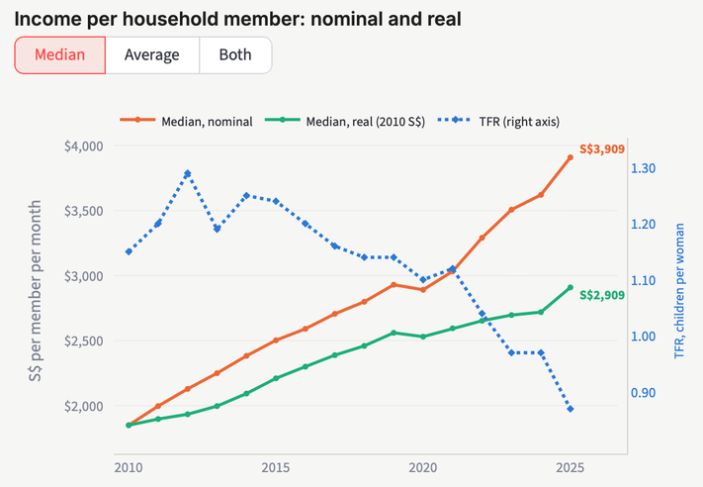
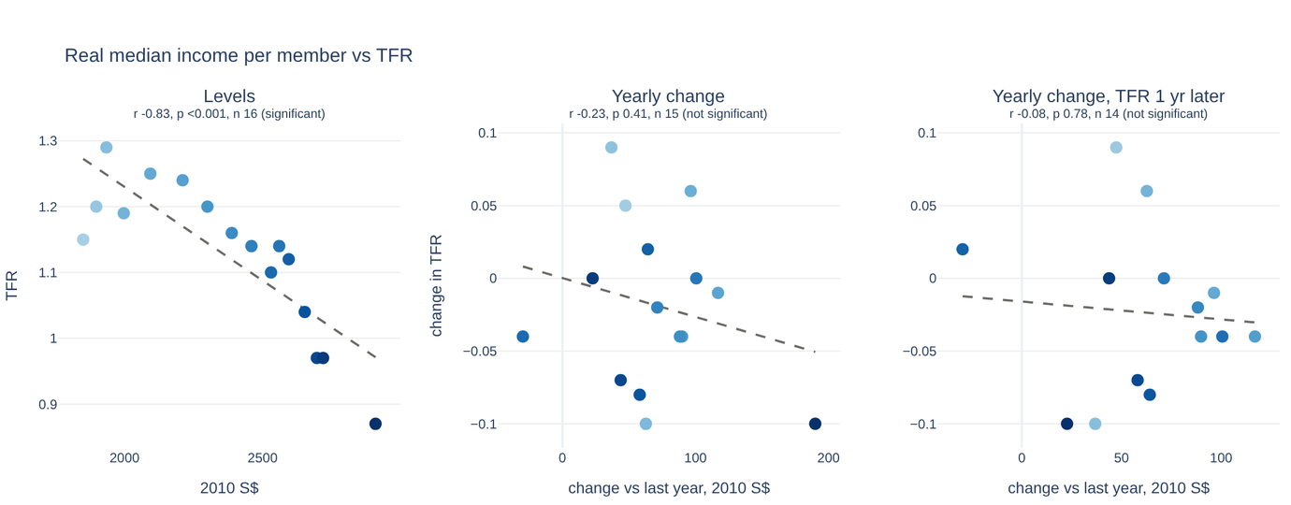
1 · INCOME
Incomes rose, even after inflation — but don’t move with TFR
Median income per member: +111% nominal, +57% real (since 2010).
Real median income fell in only one year (2020).
TFR fell 1.15 → 0.87. (−24%)
Strong r only in levels;
yearly and with 1–3-yr lags, every p > 0.2.
Correlation r (p) vs TFR | Median, nominal | Median, real
Levels | −0.88 (<0.001) | −0.83 (<0.001)
Yearly Δ | −0.29 (0.29) | −0.23 (0.41)
Yearly Δ, lag 1 | −0.20 (0.49) | −0.08 (0.78)
Yearly Δ, lag 2 | +0.11 (0.73) | +0.31 (0.31)
Yearly Δ, lag 3 | −0.09 (0.78) | +0.07 (0.83)
  r from −1 to +1: closer to +1 = move together, closer to −1 = move in opposite directions.
  p < 0.05 = significant.
SingStat 17872 , M213751 (CPI, 2010 = 100), M810091. Real = nominal ÷ CPI × 100.

Slide 9
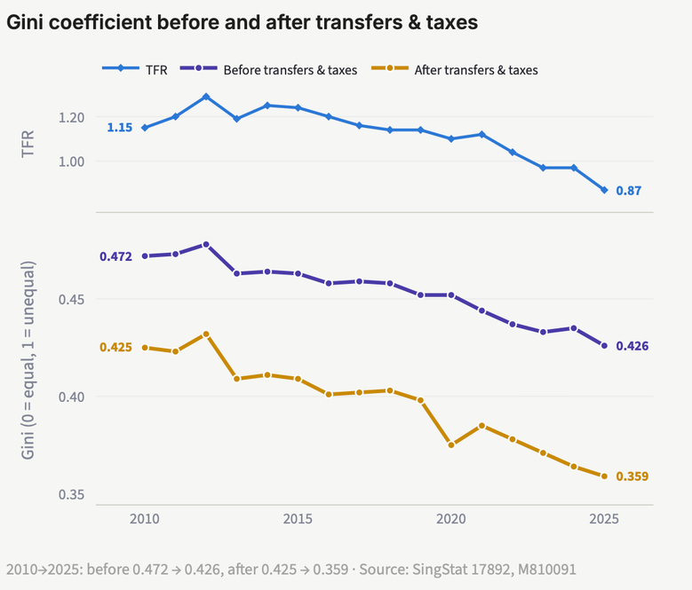
2 · INEQUALITY
Income became more equal — and TFR fell with it
r (p) vs TFR | Gini, before | Gini, after
Levels | +0.91 (<0.001) | +0.89 (<0.001)
Yearly Δ | +0.70 (0.003) | +0.65 (0.009)
Yearly Δ, lag 1 | −0.21 (0.47) | −0.48 (0.08)
Yearly Δ, lag 2 | +0.02 (0.94) | +0.19 (0.54)
Yearly Δ, lag 3 | +0.29 (0.36) | +0.41 (0.19)
  r from −1 to +1: closer to +1 = move together, closer to −1 = move in opposite directions.
  p < 0.05 = significant.
Finding: Both trend down together. Also, in years when inequality rose more than usual, TFR also rose . But with a 1–3-year lag, the link disappears.
Why: This may driven by high-income group, where their real income growth faster than other income group. Good years lift top pay and births.
-9.7%
-15.5%
A shared economic cycle, not “inequality raises births”. The link is removed with 1 year lagged.
Gini before transfers & tax
Gini after transfers & tax
SingStat 17892 , M810361 , M810091.

Slide 10
SO WHAT FOR MANAGEMENT
No — income doesn’t explain
the falling birth rate.
Once the shared trend is removed (yearly change) and births are given 1–3 years to respond (lag), income shows no link with TFR.
Income
Inequality (Gini after taxes & transfers)
What passes the test
Real median +57%, TFR −24%. No yearly or lagged link (all p > 0.2).
Look at marriage timing in the next part.
Higher Gini goes with higher TFR year to year (p = 0.009), likely because both follow the economy cycle. The link is gone with a 1-year lag.

Slide 11
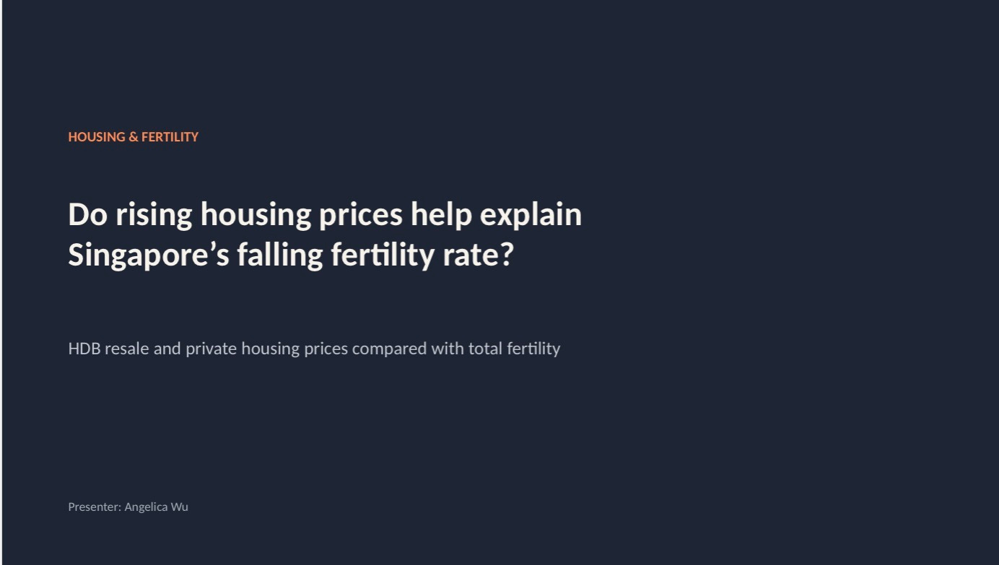
Notes:
do rising housing prices help explain Singapore’s falling fertility rate?
I’ll be comparing HDB resale and private housing prices with total fertility, using data from 2010 to 2025.

Slide 12
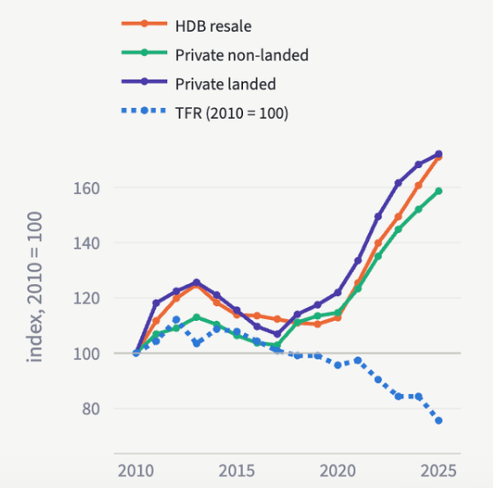
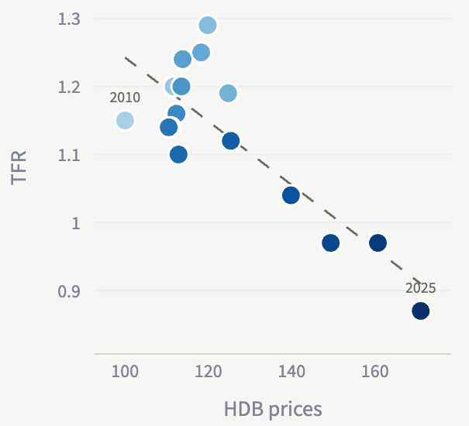
Housing prices rose as fertility fell
2010–2025. Housing indices and national TFR
Price trends
HDB prices vs TFR
Price growth since 2010
+71% HDB resale
+59% Condo
+72% landed
Same-year correlation, r (p)
Housing | Levels
HDB | −0.83 (<0.001)
Condo | −0.90 (<0.001)
Landed | −0.83 (<0.001)
The negative association appears across housing types, strongest for condo prices.
Price indices do not measure affordability. Shared time trends can exaggerate level associations.
Notes:
From 2010 to 2025, HDB resale prices increased by about 71%, condo prices by 59%, and landed prices by 72%.
Across all three housing types, higher-price years generally coincided with lower fertility. The strongest correlation was for condos, at negative 0.90.

Slide 13
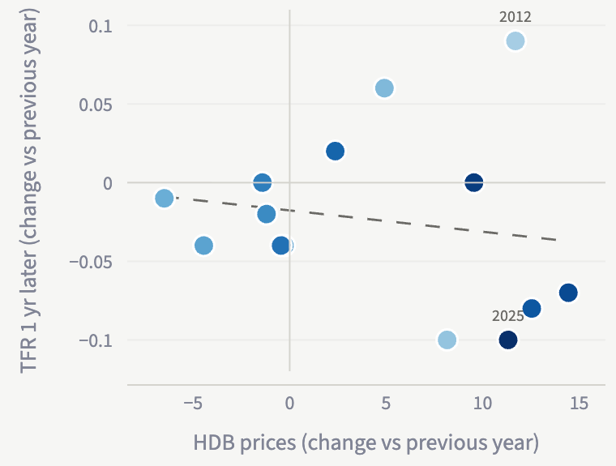
Housing and TFR
Same-year and lagged comparisons, 2010–2025
HDB yearly change, TFR 1 year later
r (p) vs TFR | HDB | Condo | Landed
Levels | −0.83 (<0.001) | −0.90 (<0.001) | −0.83 (<0.001)
Yearly change | −0.15 (0.60) | −0.27 (0.34) | −0.03 (0.93)
Yearly change, lag 1 | −0.17 (0.57) | −0.03 (0.91) | +0.14 (0.63)
Yearly change, lag 2 | −0.17 (0.58) | −0.27 (0.38) | −0.36 (0.22)
Yearly change, lag 3 | +0.08 (0.80) | +0.04 (0.89) | +0.15 (0.64)
All yearly-change p-values exceed 0.05
Allowing 1–3 years for fertility to respond does not reveal a statistically significant relationship.
Lag k pairs housing changes in year t with TFR changes in year t + k. Yearly n = 15, 14, 13, 12.
Source: supplied dashboard, SingStat M212161, M212261 and M810091. Bold blue: p < 0.05. Level results may reflect shared trends.
Notes:
Next,
For HDB, the same-year correlation weakened to negative 0.15, with a p-value of 0.60.
Across all housing types, every yearly-change comparison had a p-value above 0.05, including the delayed comparisons.
Income and marriage timing should also be considered.

Slide 14
HOUSING AND FERTILITY
Housing costs rose.
Their role in fertility is less clear.
Shared long-term trends
A weaker yearly relationship
Affordability needs context
HDB prices rose 71% since 2010.
Fertility generally declined.
HDB–TFR correlation falls from
−0.83 in levels to −0.15 in
yearly changes.
Assess housing costs alongside
income, financing and
marriage timing.
Housing remains a potential factor to investigate. These results do not establish causation.
Notes:
The main finding is that housing prices rose while fertility fell. However, the relationship becomes much weaker when we compare yearly changes.

Slide 15

MARRIAGE & FERTILITY
Does later marriage help explain
the falling birth rate?
Marriage timing, family formation and TFR
Presenter: Tongtong Tang
Notes:
OK Then I'll focus on whether the timing of marriage and family formation is associated with Singapore’s declining total fertility rate.

Slide 16
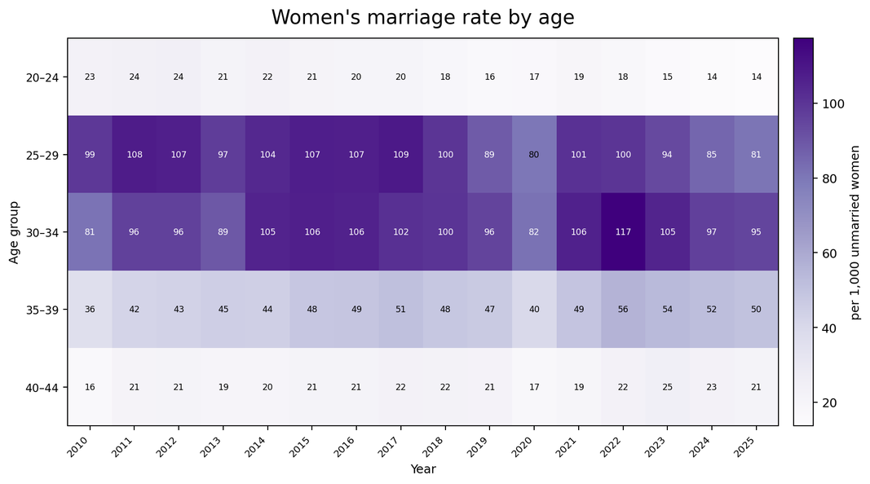
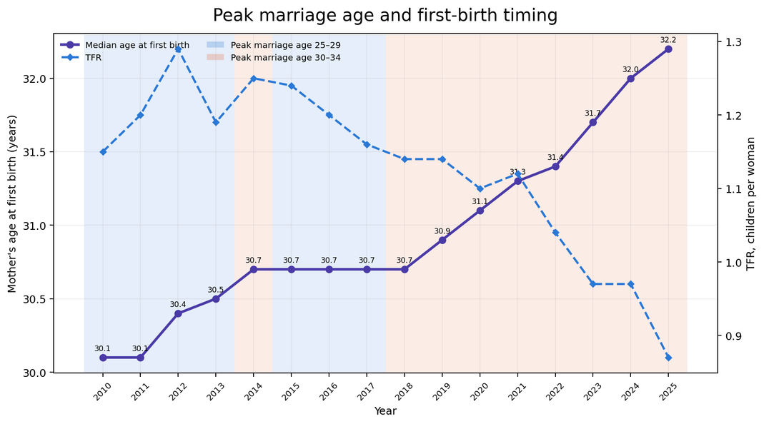
Marriage and family formation are shifting later
Singapore, 2010–2025 · What changed in marriage timing, first birth, and TFR?
AGE PROFILE
TIMING + FERTILITY
Key finding: from 2018 onward, age 30–34 becomes the consistent peak marriage-rate group. Median age at first birth rises to 32.2 while TFR falls to 0.87.
AN6100 Final Project · Marriage Factor × TFR
1
Notes:
The first two charts show a clear postponement of family formation.
Marriage rates among younger women have generally declined, while the peak marriage-rate group shifted from 25–29 to 30–34. From 2018 onwards, women aged 30–34 consistently became the peak group.
At the same time, median age at first birth increased from 30.1 to 32.2 years, while TFR fell from 1.15 to 0.87.

Slide 17
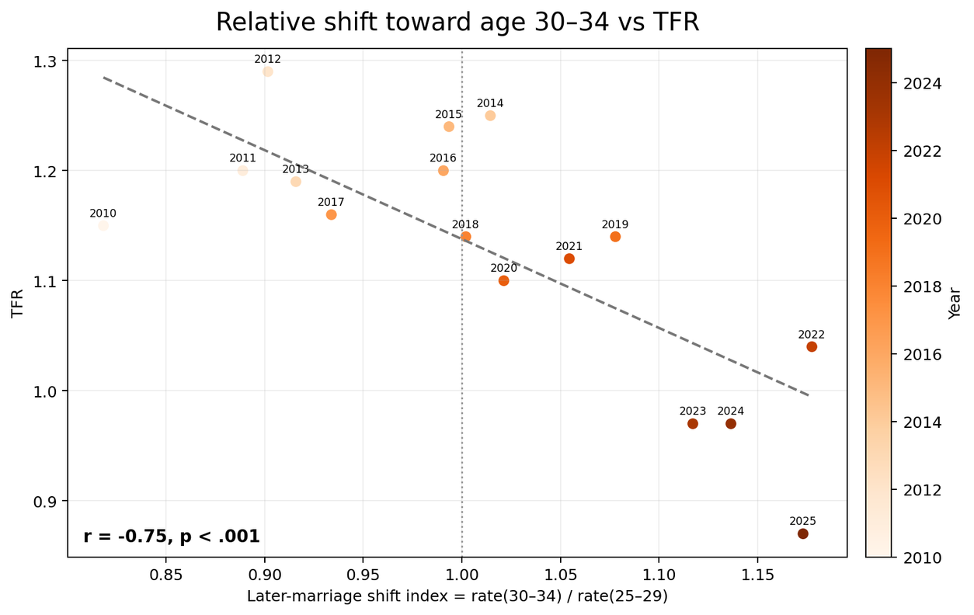
A stronger shift toward age 30–34 is associated with lower TFR
Linking the Marriage factor to fertility using a relative timing measure
Marriage factor → later marriage timing → lower TFR?
Why use a relative shift?
Later-marriage shift index
rate(30–34) ÷ rate(25–29)
Index > 1 means marriage is relatively more concentrated at age 30–34.
SHIFT INDEX
0.82 → 1.17
2010–2025 ASSOCIATION
r = −0.75 p < .001
Year-range check
2010–17 r = +0.44 p = .270
2018–25 r = −0.79 p = .020
Association ≠ causation
AN6100 Final Project · Marriage Factor × TFR
2
Notes:
To capture this change more directly, we created a later-marriage shift index by dividing the marriage rate for women aged 30–34 by that for women aged 25–29.
The index increased from 0.82 to 1.17 between 2010 and 2025. Across the full period, it shows a significant negative correlation with TFR, with an r of minus 0.75 and a p-value below 0.001.
The relationship is also much clearer after 2018, where the correlation reaches minus 0.79.

Slide 18
Later family formation is associated with lower TFR
The marriage factor matters mainly through timing, not through the raw 30–34 marriage rate alone.
1 · TIMING
2 · ASSOCIATION
3 · ROBUSTNESS
Marriage shifted to older ages
Later family formation tracks lower TFR
The long-run shift matters more than the raw rate
Peak marriage-rate group
Median age at first birth
Shift index: 30–34 ÷ 25–29
25–29 → 30–34
30.1 → 32.2
0.82 → 1.17
From 2018 onward, age 30–34 is consistently the peak group.
vs TFR: r = −0.88, p < .001
vs TFR: r = −0.75, p < .001
Later first birth shows the clearest direct association with lower fertility.
Raw 30–34 rate alone: r = −0.01, p = .96.
Yearly changes and lags are mostly not significant.
TAKEAWAY
Later marriage and later first birth are associated with lower TFR, but the evidence supports a long-run correlation rather than a short-term causal effect.
Association ≠ causation
AN6100 Final Project · Marriage Factor × TFR
3
Notes:
Overall, the marriage factor appears to matter mainly through timing. As marriage shifts toward older ages and first birth is delayed, TFR tends to be lower.
However, the analysis remains correlational, so these results indicate a long-term association rather than a direct causal effect.
Next, lets move on to the analysis about education and fertility.

Slide 19
EDUCATION & FERTILITY
Do education costs help explain
the falling birth rate?
Education prices and public support vs TFR
Presenter: Huang Yixuan
Notes:
Hi everyone, I'm Huang Yixuan, and I'll cover the education factor. My question is whether rising education costs help explain Singapore's falling birth rate.

Slide 20
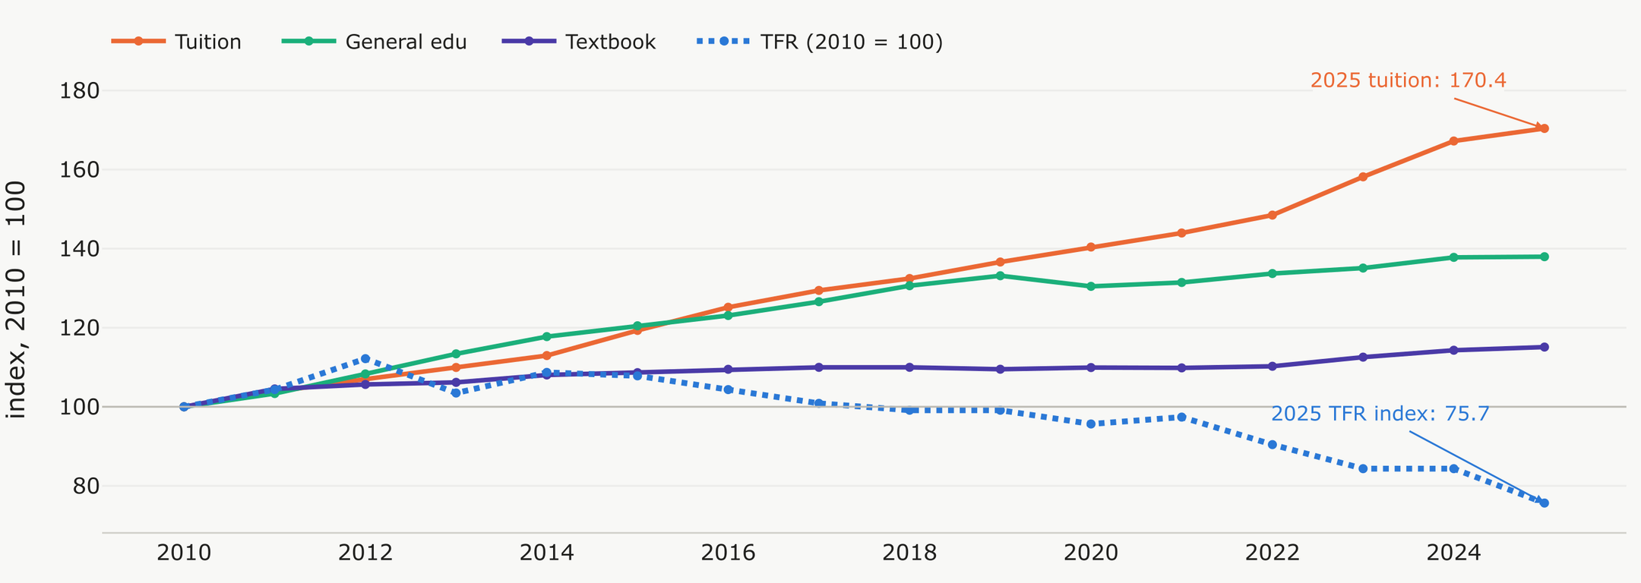
EDUCATION & FERTILITY
Presenter: Huang Yixuan
01 / 04
Education prices and TFR
2010–2025. All four series use 2010 = 100.
Tuition prices rose 70.4%, faster than general education (38.0%) and textbooks (15.1%), while TFR fell 24.3%. Higher anticipated education costs may make another child harder to afford.
Sources: SingStat M213801, M810091. TFR index 75.7 corresponds to 0.87 children per woman.
Dashboard figures reproduced as non-editable source images.
Notes:
From 2010 to 2025, tuition prices rose 70%, much faster than general education at 38% and textbooks at 15%. Over the same period TFR fell 24%, so raising a child, especially paying for tuition, became more expensive as fertility declined.

Slide 21
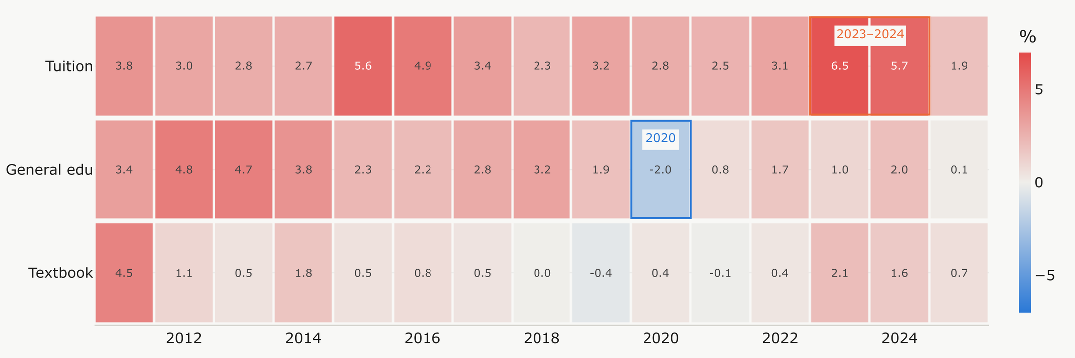
EDUCATION & FERTILITY
Presenter: Huang Yixuan
02 / 04
What drove education price changes
Annual inflation (%), 2011–2025. Highlighted episodes: 2020 and 2023–2024.
2020: preschool subsidy relief
2023–2024: possible tax pressure
Enhanced preschool subsidies reduced covered fees, helping explain the 2.0% fall in general education prices.
GST rose to 8% in 2023 and 9% in 2024, potentially adding to taxable private course fees.
Chart: SingStat M213801. Policy context: SingStat CPI paper (2021), IRAS GST guidance.
Dashboard figures reproduced as non-editable source images.
Notes:
In 2020, enhanced preschool subsidies lowered fees for more families, so general education prices fell 2%. But in 2023 and 2024 tuition jumped 6.5% and 5.7%, driven partly by the GST increases to 8% and 9% and by post-COVID inflation.

Slide 22
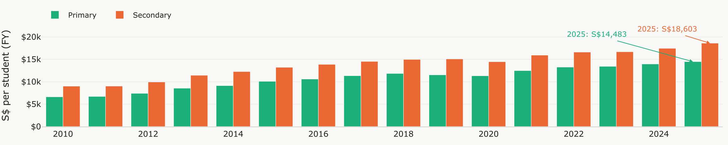
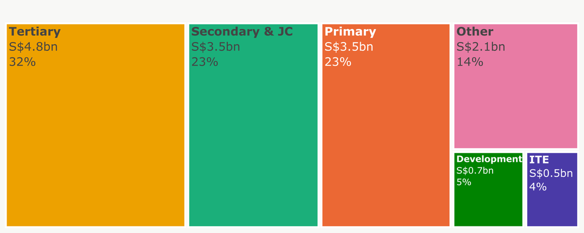
EDUCATION & FERTILITY
Presenter: Huang Yixuan
03 / 04
Public support and budget allocation
FY2010–FY2025. Per-pupil funding more than doubled. Total education spending rose 53.2%.
FY2025 Total: S$15.12bn
Spending per pupil rose 118.6% in primary and 106.5% in secondary education. Primary and secondary/JC together received 46.1% of the FY2025 budget, showing sustained support for school education.
Total funding grew 53.2%. Other and ITE gained share, while secondary/JC and tertiary shares fell despite higher spending. Capital spending recovered after FY2022.
Public provision therefore supports school resources and wider skills development, alongside the private tuition costs that families face.
Sources: SingStat M850291 and M850011. Nominal S$. FY2025 revised estimates.
Dashboard figures reproduced as non-editable source images.
Notes:
Government support also grew, with spending per pupil more than doubling and the total education budget rising 53%. However, this money goes to schools, so families still pay the rising cost of private tuition themselves.

Slide 23
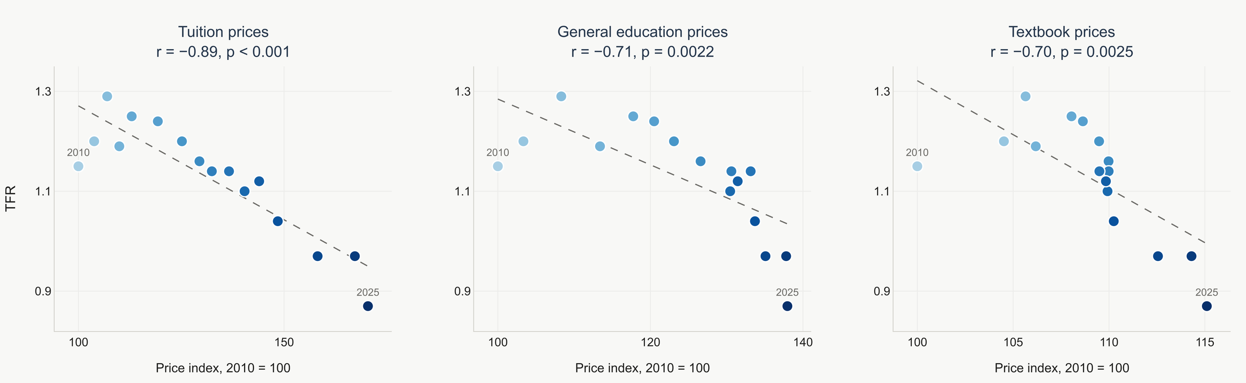
EDUCATION & FERTILITY
Presenter: Huang Yixuan
04 / 04
Education prices and TFR
2010–2025. Pearson r and two-sided p-values use 16 annual level observations.
Tuition prices show the strongest negative level correlation with TFR. General education and textbook prices show similar negative associations.
Sources: SingStat M213801 and M810091. Price indices use 2010 = 100. TFR is children per woman.
Dashboard figures reproduced as non-editable source images.
Notes:
All three education prices are negatively correlated with TFR, and all are statistically significant. Tuition shows the strongest link at −0.89, followed by general education at −0.71 and textbooks at −0.70.

Slide 24

OVERALL CONCLUSION
RESIDENT TFR
Every factor trended with falling TFR
1.15 → 0.87
−24.3% since 2010
Pearson r between each factor and resident TFR, annual levels, 2010–2025
2010
2025
Negative: factor up, TFR down
Positive: factor and TFR fall together
Not significant (p ≥ 0.05)
Healthcare
Income
Housing
Marriage
Education
5 factors
4 factors
3 factors
5 factors
3 factors
Healthcare prices, overall
Nominal Median income per member
HDB resale prices
Marriage rate, women 20–24
Tuition & course prices
−0.84
−0.88
−0.83
+0.89
−0.89
Health insurance prices
Real Median income per member
Private non-landed prices
Marriage rate, women 25–29
General education prices
−0.90
−0.83
−0.90
+0.74
−0.71
Inpatient care prices
Gini, before taxes & transfers
Private landed prices
Marriage rate, women 30–34
Textbook prices
−0.82
+0.91
−0.83
−0.01
−0.70
Medicines prices
Gini, after taxes & transfers
Later-marriage shift index
−0.35
+0.89
−0.75
Gov. health spending per person
Median age at first birth
−0.77
−0.88
01 Rising costs
02 Later family formation
03 Higher, more equal income
All metrics under Healthcare, Housing and Education prices move opposite to TFR (r −0.70 to −0.90).
Later marriage and later first birth are associated with lower TFR
Only inequality demonstrate strong correlaition on TFR
n = 16 years (government health spending n = 14). Shift index = marriage rate 30–34 ÷ 25–29. Source: SingStat via group dashboard. Correlation is not causation.
Notes:
This slide summarises the level correlations between TFR and every factor across our five categories, where orange means the factor rose while TFR fell and green means it fell together with TFR. Almost every factor is strongly correlated with TFR, at around 0.7 to 0.9, but these are correlations, not proof of cause, thank you.

Slide 25
Dashboard Demo
Presenter: Huang Yixuan

