Slide 1
Basic RISC CPU Verification
Kenny Zhang
ECE 4435: Computer Architecture and Design
April 10, 2023

Slide 2
Add Test
Program loads 0x00000040 into R1 using la instruction
Program loads 0x00000020 into R2 using la instruction
Program adds the contents of R1 and R2 and stores the result in R3
Program stores the R3 contents into memory and loads it back into R4
At the end of the program, PC = 0x00000018 and IR = 0xF8000000

Slide 3
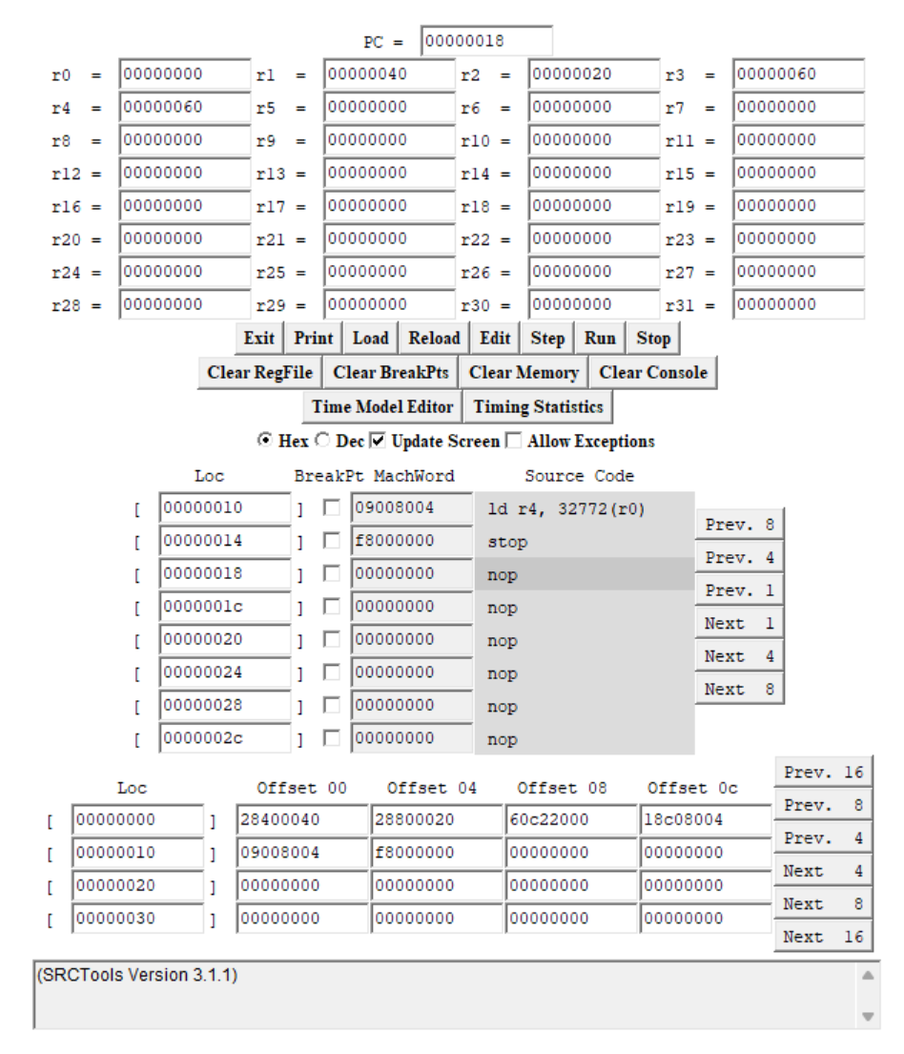
Add Test: Simulator
Register Contents
PC = 0x00000018
IR = 0xF80000000
R1 = 0x00000040
R2 = 0x00000020
R3 = 0x00000060
R4 = 0x00000060
R5-R31 = 0x00000000

Slide 4
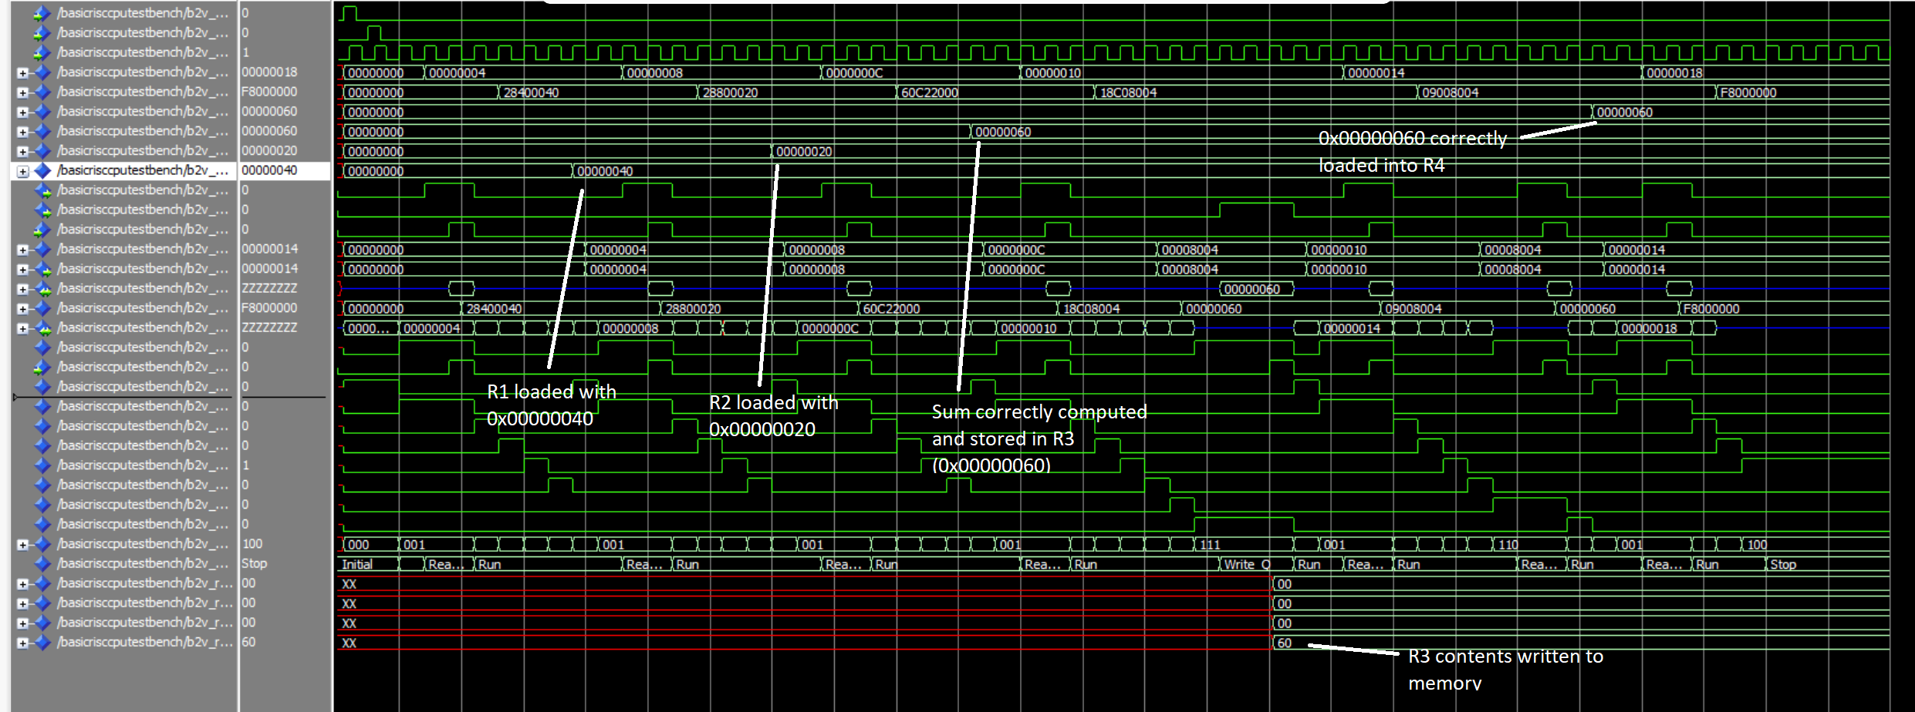
Add Test: Modelsim
Register Contents
PC = 0x00000018 R1 = 0x00000040 R2 = 0x00000020 R3 = 0x00000060 R4 = 0x00000060
IR = 0xF8000000 R5-R31 = 0x0000000-0

Slide 5
ALU Tests
Program uses a variety of arithmetic ALU operations (add, addi, or, ori, sub, neg, and) to populate R1-R11, R15, and R27 (using their register number)
Registers R16 through R23 were populated with strings to test the shift and bit manipulation operations (not, shr, shra, shl, shc)
Registers R24 through R31 were filled with their register number
At the end of the program, PC = 0x000010A8 and IR = 0xF8000000

Slide 6
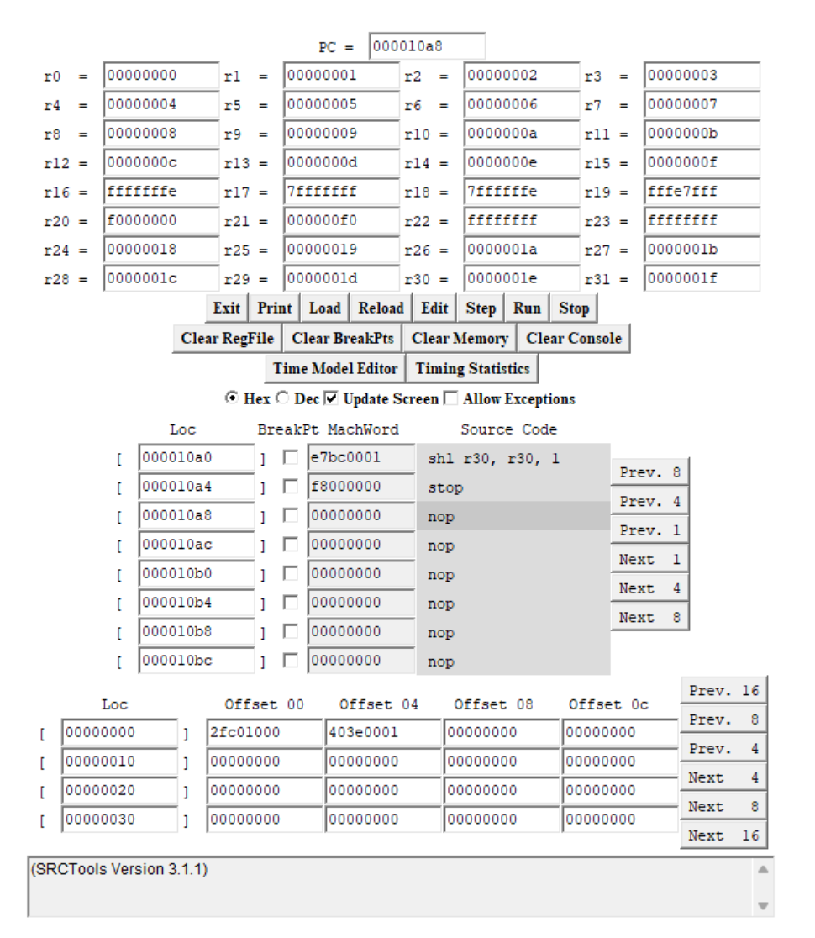
ALU Tests: Simulator
Register contents
PC = 0x000010A8
IR = 0xF8000000
R0-R15 = 0x00000000-0x0000000F (0 through 15)
R16 = 0xFFFFFFFE
R17 = 0x7FFFFFFF
R18 = 0x7FFFFFFE
R19 = 0xFFFE7FFF
R20 = 0xF0000000
R21 = 0x000000F0
R22 = 0xFFFFFFFF
R23 = 0xFFFFFFFF
R24-R31 = 0x00000018-0x0000001F (24 through 31)

Slide 7
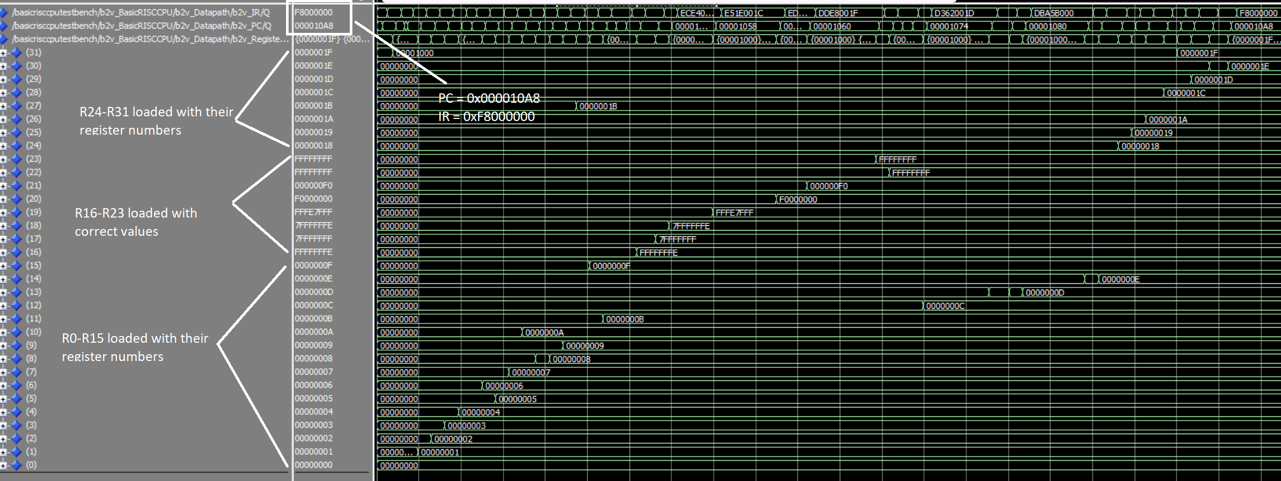
ALU Tests: Modelsim
Register Contents
PC = 0x000010A8 IR = 0xF8000000 R0-R15 = 0x00000000-0x0000000F R16 = 0xFFFFFFFE
R17 = 0x7FFFFFFF R18 = 0x7FFFFFFE R19 = 0xFFFE7FFF R20 = 0xF0000000 R21 = 0x000000F0
R22 = 0xFFFFFFFF R23 = 0xFFFFFFFF R24-R31 = 0x00000018-0x0000001F

Slide 8
Branch Tests
First, 4096 is loaded into R31 and 11 various addresses are loaded into R1-R11 using la to act as jump locations
R20 is loaded with the address of “Stop”
Various loops are used to test the different branch instructions (br, brzr, brnv, brmi, brpl, brlzr, brl, brlnv, brlnz, brlmi)
R31 loop counts from 5-0 then breaks
R30 loop counts from 7 to -1
R29 loop counts from -6 to 0
R24 loop counts from 5-0 then up to 1
R28 loop counts from 1 to 0 to -1 then breaks

Slide 9
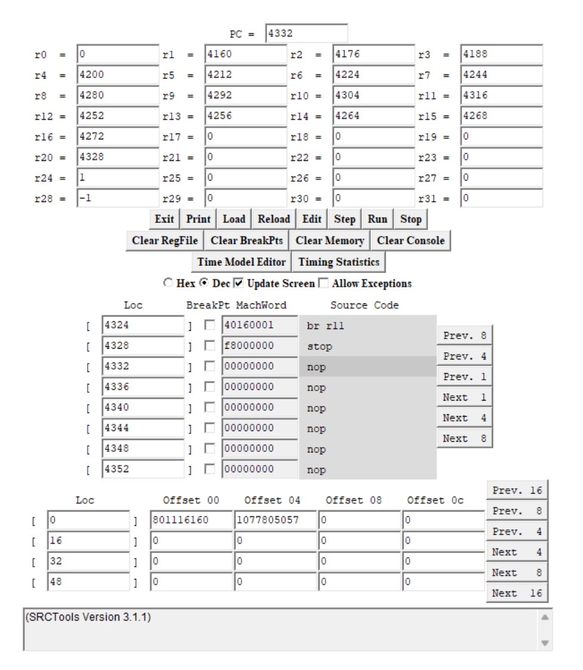
Branch Tests: Simulator
Register Contents
PC = 4332
IR = 0xF8000000
R0 = 0, R1 = 4160, R2 = 4176, R3 = 4188
R4 = 4200, R5 = 4212, R6 = 4224, R7 = 4244
R8 = 4280, R9 = 4292, R10 = 4304, R11 = 4316
R12 = 4252, R13 = 4256, R14 = 4264, R15 = 4268
R16 = 4272, R17-R19 = 0, R20 = 4328, R21-R23 = 0
R24 = 1, R25-R27 = 0, R28 = -1, R29-R31 = 0

Slide 10
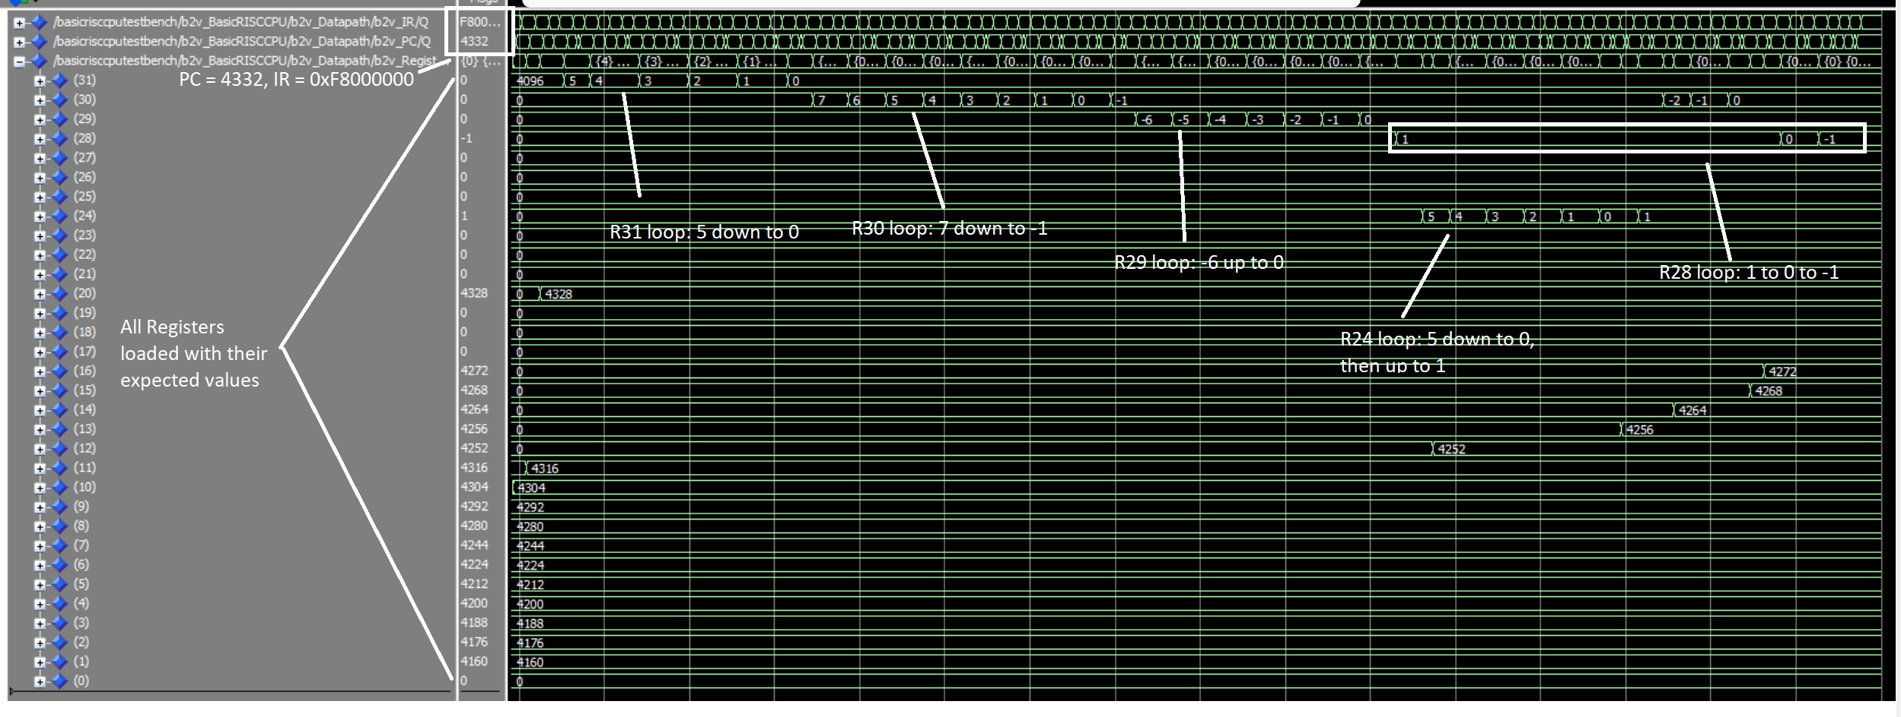
Branch Tests: Modelsim
Register Contents
PC = 4332, IR = 0xF8000000
R0 = 0, R1 = 4160, R2 = 4176, R3 = 4188, R4 = 4200, R5 = 4212, R6 = 4224, R7 = 4244
R8 = 4280, R9 = 4292, R10 = 4304, R11 = 4316, R12 = 4252, R13 = 4256, R14 = 4264, R15 = 4268
R16 = 4272, R17-R19 = 0, R20 = 4328, R21-R23 = 0, R24 = 1, R25-R27 = 0, R28 = -1, R29-R31 = 0

Slide 11
Load-Store Tests
First, R0 is loaded with the constant 0x8000 (32768)
Using the lar, str, ldr, st, ld, and la operations, each of the registers R1 through R31 are loaded with values representing their row numbers
Ex: Registers R1-R3 are in row 1, R4-R7 are in row 2, R8-R11 are in row 3, etc
At the end of the program, PC = 4252 and IR = 0xF8000000

Slide 12
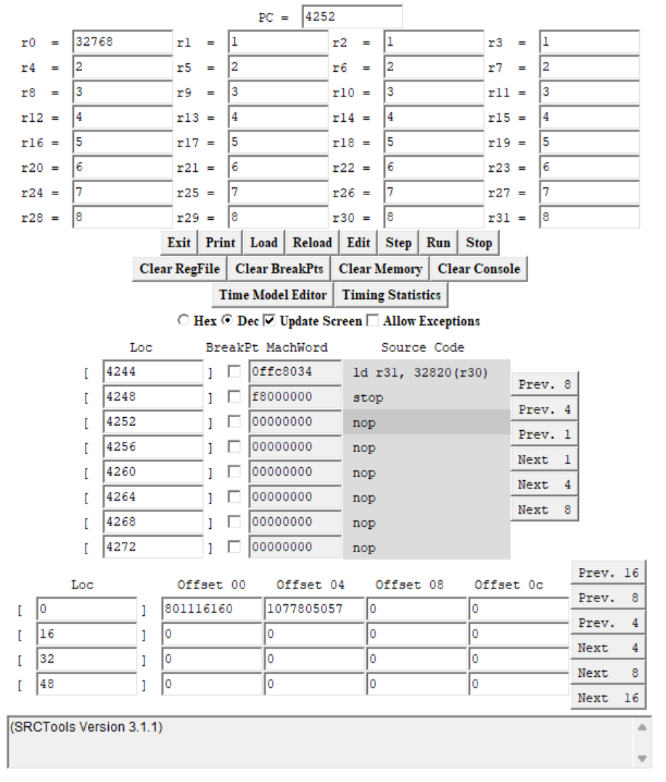
Load-Store Tests: Simulator
Register Contents
PC = 4252
IR = 0xF8000000
R0 = 32768
R1-R3 = 1
R4-R7 = 2
R8-R11 = 3
R12-R15 = 4
R16-R19 = 5
R20-R23 = 6
R24-R27 = 7
R28-R31 = 8

Slide 13
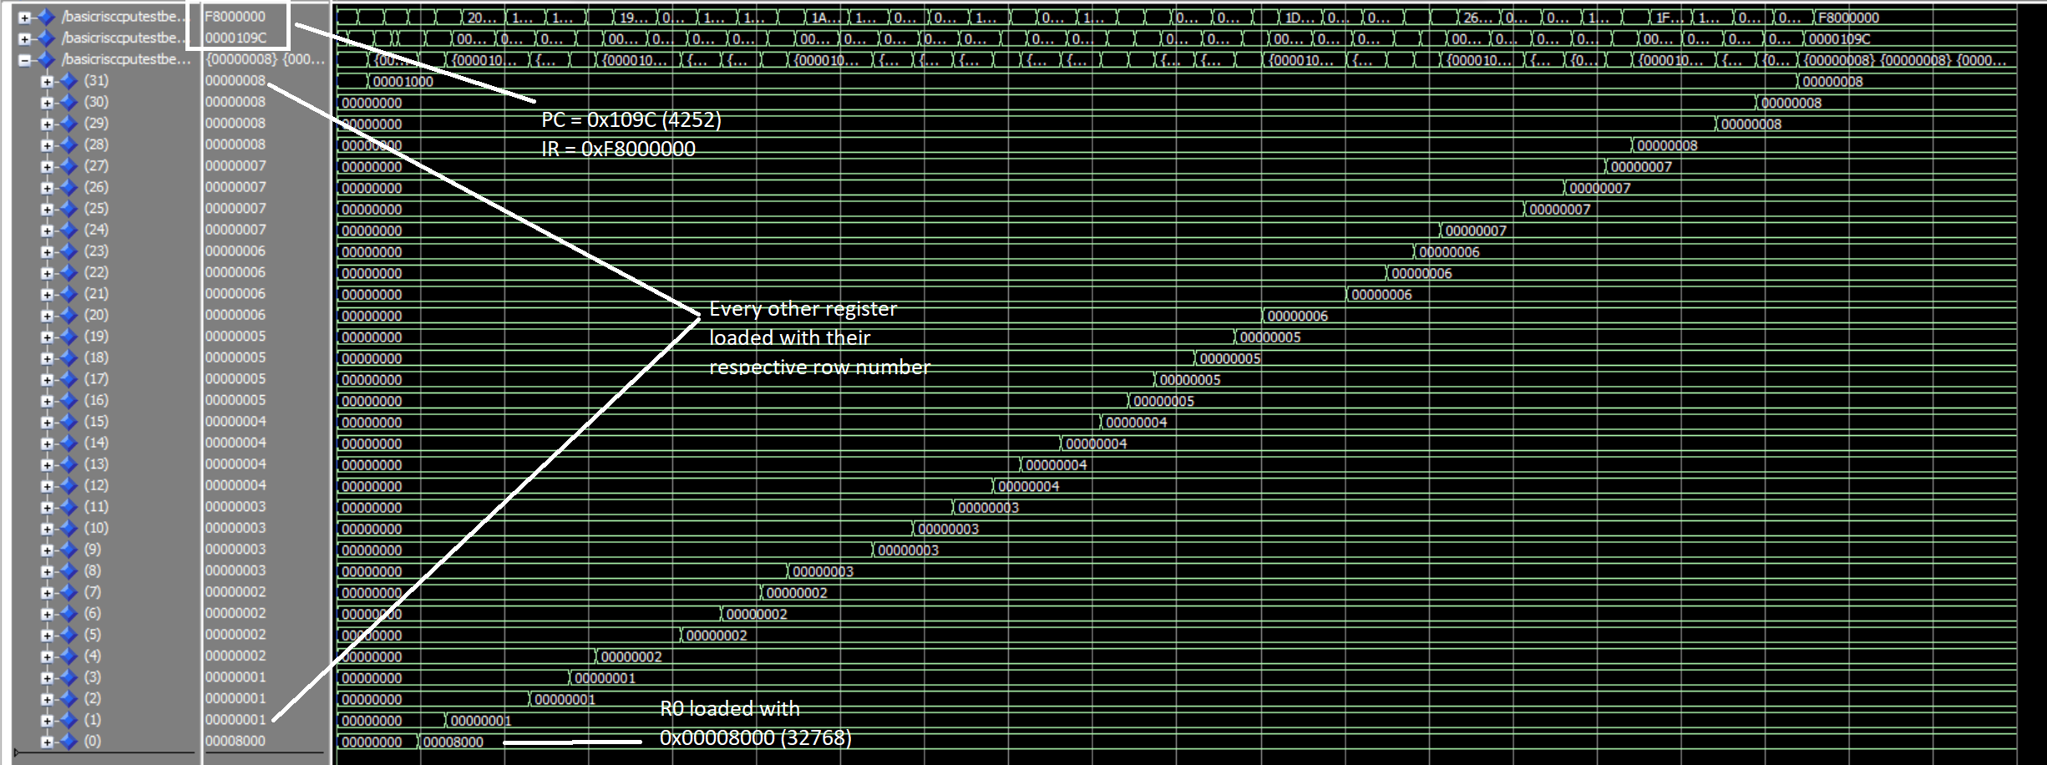
Load-Store Tests: Modelsim
Register Contents
PC = 4252 (0x0000109C), IR = 0xF8000000, R0 = 32768 (0x00008000), R1-R3 = 1
R4-R7 = 2, R8-R11 = 3, R12-R15 = 4, R16-R19 = 5, R20-R23 = 6, R24-R27 = 7, R28-R31 = 8

Slide 14
Conclusion
Collectively, all 4 of the assembly programs test all of the CPU instructions
Every Modelsim simulation matches the results produced by the assembly simulator
Thus, we can confidently say that the Basic RISC CPU that we have designed works as intended

