Slide 1
LEADERSHIP BRIEFING
Barrel & Brew
Digital Transformation
Business Requirements & Gap Analysis — June 2026
Prepared by: Ikea Onyinyechi Anita – Pod Polaris | Version 1.0 | Barrel & Brew Inc.
Notes:
Welcome leadership to the Barrel & Brew Digital Transformation briefing. This presentation summarises the gap analysis, business requirements, and proposed solution developed by Pod Polaris.

Slide 2
Executive Summary
The challenge at a glance
Problem: Barrel & Brew's rapid growth has exposed critical weaknesses across production, quality, forecasting, and communication. Manual processes, outdated equipment, and disconnected systems are preventing the business from scaling sustainably.
30%
2
0
Overtime increase
due to manual workload
Full batches discarded
from quality failures
Real-time dashboards
or data visibility tools
Proposed Solution: An integrated Brewery Management System (BMS) with automated forecasting, digital quality control, IoT-enabled equipment, and real-time cross-team dashboards.
Notes:
Barrel & Brew has grown rapidly but operational systems have not kept pace. Manual processes are causing delays, quality failures, and staff burnout. This slide sets the scene for leadership before we walk through the gap analysis.

Slide 3
Gap Analysis: Current State vs Desired State
6 capability gaps identified
1
Reliable Production
2
High Quality
3
Empowered Staff
No automated scheduling or real-time production visibility
No digital QC — reliance on manual taste tests only
Staff overwhelmed; knowledge locked in notebooks & memory
4
Streamlined Ops
5
Data-Driven Decisions
6
Modern Infrastructure
Silos between Sales & Production; no workflow automation
No forecasting data, dashboards, or real-time inventory
Fragmented, outdated tech & equipment not fit for scale
Notes:
Six capability gaps were identified through the current-state analysis. Each gap corresponds to a strategic business objective that the proposed BMS solution will address.

Slide 4
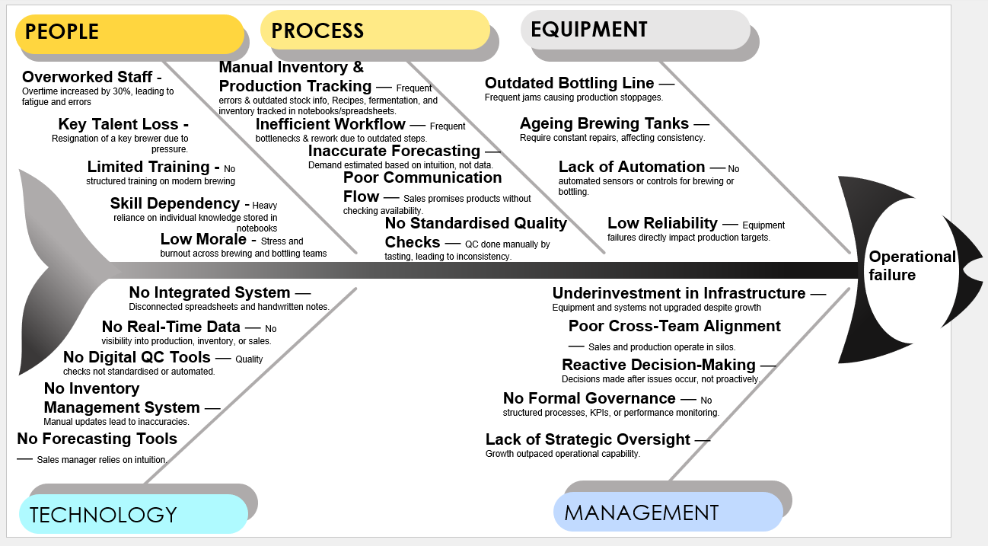
FISHBONE DIAGRAM
1
Reliable Production
2
High Quality
3
No automated scheduling or real-time production visibility
No digital QC — reliance on manual taste tests only
4
Streamlined Ops
5
Data-Driven Decisions
6
Silos between Sales & Production; no workflow automation
No forecasting data, dashboards, or real-time inventory
Notes:
Six capability gaps were identified through the current-state analysis. Each gap corresponds to a strategic business objective that the proposed BMS solution will address.

Slide 5
Current State Process: Brewing to Bottling
PAIN POINTS
1
2
3
4
5
Demand
Estimate
Production
Request
Recipe
Check
Brewing
Begins
Fermentation
Tracking
Manual intuition
Phone call to brewer
Handwritten notebooks
Fully manual
Notebook / spreadsheet
6
7
8
9
10
Quality
Check
Notify
Bottling
Bottling
Line
Stock
Count
Order
Placed
Manual taste test only
Ad hoc communication
Jams → manual fix → delays
Manual bottle count
No stock check
= Pain point / breakdown risk
Notes:
This 10-step process map reveals how many manual handoffs exist in the current brewing to bottling workflow. Red cards highlight the highest-risk steps where breakdowns, delays, and errors are most likely to occur.

Slide 6
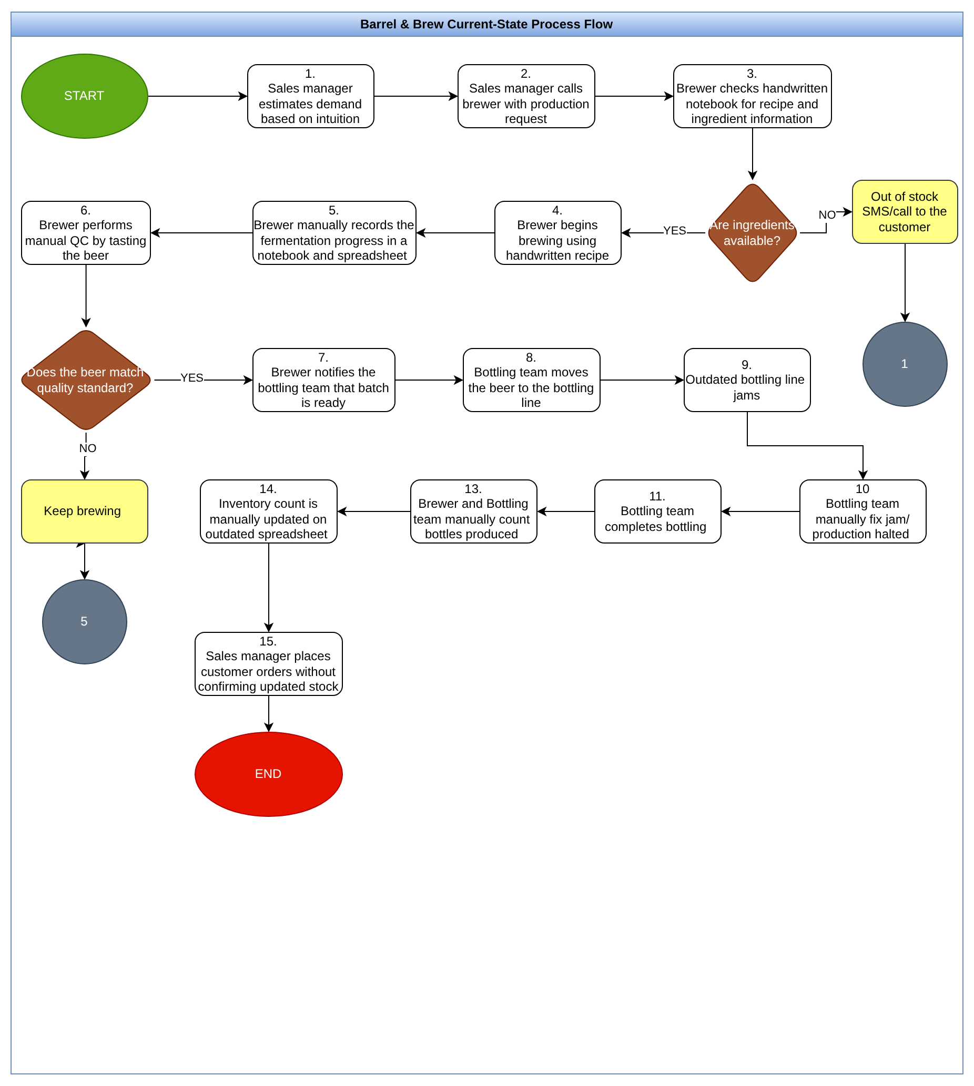
Notes:
This 10-step process map reveals how many manual handoffs exist in the current brewing to bottling workflow. Red cards highlight the highest-risk steps where breakdowns, delays, and errors are most likely to occur.

Slide 7
Proposed Solution: Integrated Brewery Management System
Demand Forecasting
Digital Recipe Mgmt
Digital QC Workflow
Automated weekly forecasts
from distributor & restaurant data
Versioned recipes with ingredient
validation & sensor integration
Auto QC checkpoints, digital
capture, hold/release capability
Automated Bottling
Real-Time Inventory
Dashboards & Analytics
Jam detection, auto-stop,
bottle count → live inventory sync
Auto-updates, low-stock alerts,
batch & expiry tracking
Production, sales, QC & inventory
KPIs exportable in PDF / Excel
Notes:
The BMS solution addresses every identified gap. Six integrated capability modules replace the fragmented manual processes currently in place. IoT sensor integration and real-time dashboards are key differentiators versus the status quo.

Slide 8
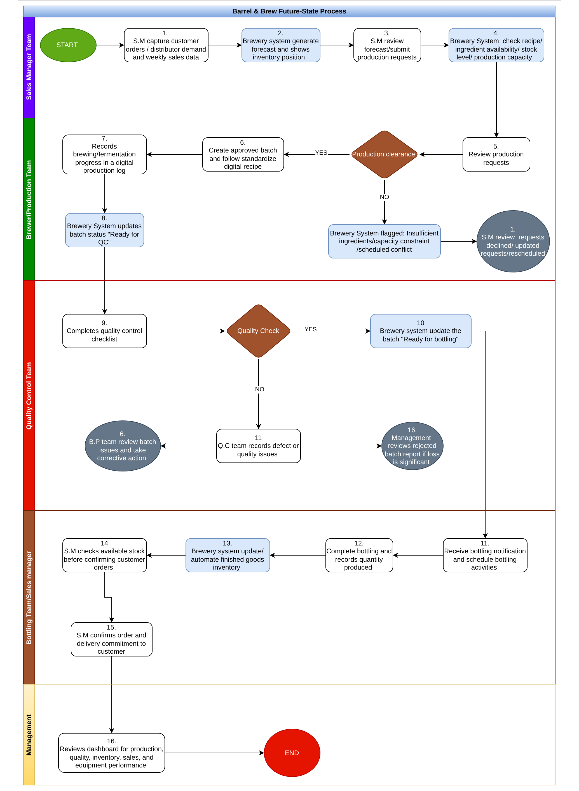
Notes:
The BMS solution addresses every identified gap. Six integrated capability modules replace the fragmented manual processes currently in place. IoT sensor integration and real-time dashboards are key differentiators versus the status quo.

Slide 9
Business Requirements Summary
FUNCTIONAL REQUIREMENTS
NON-FUNCTIONAL REQUIREMENTS
Integrate distributor & restaurant sales data
Auto-generate weekly demand forecasts
Digital recipe storage with version control
IoT sensor integration (temp, pH, gravity)
Automated QC checkpoints with digital capture
Bottling line: jam detection & auto-count
Real-time inventory updates post-brewing/bottling
Live dashboards — production, sales, QC, stock
Performance:
Real-time updates < 5 sec latency
Security:
GDPR compliant · Role-based access control
Scalability:
Supports 2× production growth in 3 years
Reliability:
System uptime ≥ 99.5%
Usability:
Intuitive for non-technical staff
Compatibility:
Mobile & tablet supported
Notes:
The BRD captures both functional and non-functional requirements. The non-functional requirements are critical for long-term scalability and regulatory compliance.

Slide 10
Projected Benefits & Business Impact
50%
100%
30%
Reduction in
production delays
Accurate real-time
inventory updates
Reduction in
overtime costs
OPERATIONAL
FINANCIAL
PEOPLE
STRATEGIC
Automated QC reduces batch failures
Improved cross-team communication
Real-time bottling & inventory sync
Reduced waste & rework costs
Lower overtime expenditure
Optimised inventory reduces overstock
Reduced manual workload for brewers
Improved staff morale & retention
Clear workflows & accountability
Scalable, data-driven operating model
Improved customer satisfaction
Platform for sustainable growth
Notes:
These projected benefits are grounded in the operational changes described in the BRD. Leadership should note the combination of quick-win cost reductions and longer-term strategic value from a scalable digital infrastructure.

Slide 11
Stakeholder Register
Stakeholder
Role
Influence
Key Responsibility
CEO
Executive Sponsor
HIGH
Approve funding & strategic direction
Brewery Manager
Process Owner
HIGH
Validate requirements, oversee delivery
Sales Manager
Business Stakeholder
HIGH
Provide sales data, validate forecasting
IT Lead / Vendor
Technical Delivery
HIGH
Implement & support the solution
Quality Technician
QC Owner
MEDIUM
Define QC requirements & standards
Inventory Controller
Operations
MEDIUM
Manage inventory workflows
Brewers
End Users
MEDIUM
Use system daily; provide feedback
Bottling Team
End Users
MEDIUM
Operate new bottling equipment
Notes:
Eight key stakeholders have been identified across executive, managerial, and operational tiers. Stakeholder engagement will be critical throughout delivery to ensure adoption and alignment.

Slide 12
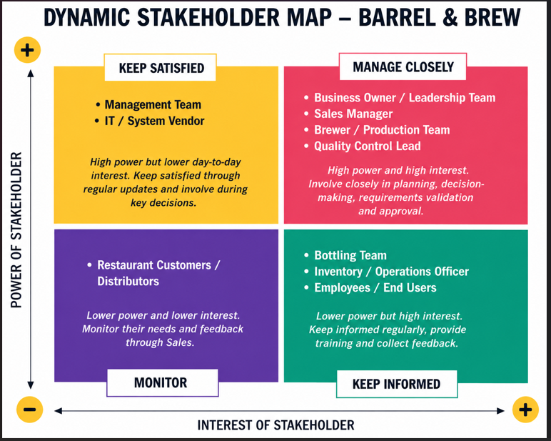

Slide 13
Next Steps
Proposed actions to bridge the gap
A
People:
Train staff on BMS tools, introduce SOPs, improve Sales–Production communication
B
Process:
Replace notebooks with digital recipe & QC management; automate inventory updates & forecasting
C
Equipment:
Replace outdated bottling line; upgrade brewing tanks with IoT sensors; automate bottle counting
D
Technology:
Implement integrated BMS; enable real-time dashboards; integrate distributor sales data
E
Management:
Establish KPIs, governance framework, and proactive planning cadence across all teams
Leadership approval required to proceed to vendor selection and solution design phase.
Notes:
Five action streams address the gaps across People, Process, Equipment, Technology, and Management. Leadership approval is the critical enabler to advance to vendor selection and solution design.

Slide 14
Thank You
Barrel & Brew — Digital Transformation
BRD & Gap Analysis · Pod Polaris · June 2026
Questions & Discussion
Prepared by: Ikea Onyinyechi · Pod Polaris · Barrel & Brew Digital Transformation Project

