Slide 1
BUSINESS ANALYSIS CAPSTONE PROJECT
Canteen Ordering System
Reimagining the Unilever UK Lunch Experience
COMPANY
PREPARED BY
DOCUMENT TYPE
Unilever UK Office
Ikea Onyinyechi Anita
Project Documentation
Prepared for Senior Management Review

Slide 2
01 · BACKGROUND
A Growing Company, an Ageing Lunch Process
1,500
2
300
12–1pm
Employees
across 12 floors
Canteens
serving the entire office
Max seats
available at any one time
Peak demand window
for lunch
Unilever is a British-Dutch FMCG company headquartered in London, one of the oldest in the world, with products sold in around 190 countries. In the UK office, both canteens together can only seat about 300 of the 1,500-strong workforce at once, and most staff take lunch in the same one-hour window.
THE RIPPLE EFFECT
Long queues and congestion during the lunch rush
Popular dishes sell out while others go to waste
No visibility of demand ahead of meal prep
CANTEEN ORDERING SYSTEM · PROJECT POLARIS
2

Slide 3
02 · BUSINESS CASE
The Business Problem & What We Must Achieve
THE PROBLEM
Employees spend around 60 minutes away from their desk for lunch, but only 10–15 minutes is actually spent eating. The rest is lost to queuing, hunting for seats, and moving between floors, while the canteen team plans meals with no visibility of real demand.
BUSINESS OBJECTIVES
1
Reduce long queues and overcrowding during lunch hours
2
Cut the time employees spend away from their workstation
3
Enable advance meal ordering for a better lunch experience
4
Help the canteen team plan meals against confirmed orders
HOW A 60-MINUTE LUNCH BREAK IS SPENT
Reduce food shortage and food wastage
5
6
Improve order tracking from selection through to delivery
Queuing / walking ~45 min
Eating ~12 min
7
Support monthly salary deductions for meals ordered
Some popular dishes sell out early while others are thrown away at day's end, creating both food shortage and food wastage.
CANTEEN ORDERING SYSTEM · PROJECT POLARIS
3

Slide 4
02.5 · PROPOSED SOLUTION
A Web-Based Canteen Ordering System
Employees order meals online before 11am and receive lunch at their workstation at a selected time, viewing the daily menu, checking prices, and editing orders before checkout. The canteen team updates menus, views confirmed orders, prepares meals, assigns delivery, and generates payroll deduction reports.
IN SCOPE
OUT OF SCOPE
Employee login and role-based access
Daily menu creation, update, and display
Online lunch ordering before 11am
Order editing and locking after confirmation
Canteen dashboard and dish quantity summary
Meal prep, delivery assignment & closure
Feedback submission & payroll deduction report
Online card payment / payment gateway
Cash collection or external vendor payment
Home delivery outside the office
Table reservation or canteen space expansion
Real-time GPS tracking for delivery staff
CANTEEN ORDERING SYSTEM · PROJECT POLARIS
4

Slide 5
02.7 · OPTIONS APPRAISAL
Three Options, One Clear Recommendation
OPTION 1
OPTION 2
RECOMMENDED
Do Nothing
Stagger Lunch Times
OPTION 3
Canteen Ordering System
Continue with the current canteen process.
Process change only
Order online, receive lunch at the workstation.
ADVANTAGE
ADVANTAGE
No immediate cost
No/low cost
ADVANTAGE
Cuts congestion, saves time, improves planning, cuts waste
DISADVANTAGE
DISADVANTAGE
Solves nothing; queues, waste and lost time continue
No automation, hard to enforce
DISADVANTAGE
Needs development, training and change management
CANTEEN ORDERING SYSTEM · PROJECT POLARIS
5

Slide 6
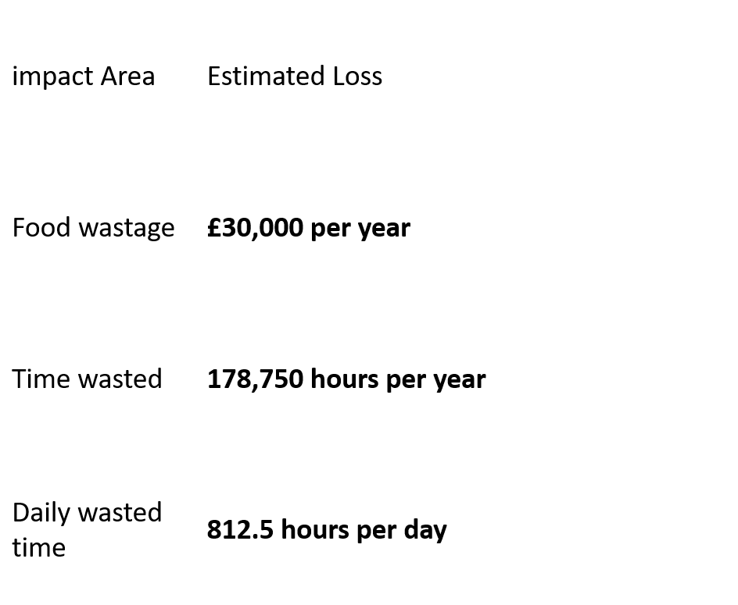
02.9 · FINANCIAL ANALYSIS
Total Project Cost
Estimated Annual Benefit
Payback Period
Return on Investment
£140,000
£1.68M
1 month
1,100%
Category | Details | Estimated Amount
System Development Cost | Design and development of the web-based canteen ordering system | £60,000
Testing and Deployment Cost | User testing, bug fixing, deployment, and go-live support | £15,000
Payroll Integration Cost | Setup of payroll deduction report and integration with payroll process | £20,000
Training and Communication Cost | Training for employees, canteen staff, delivery staff, and payroll team | £10,000
Support and Maintenance Cost | First-year support, issue resolution, and minor system improvements | £20,000
Contingency Cost | Extra allowance for unexpected project needs | £15,000
Total Estimated Project Cost | Total investment required to implement the system | £140,000
Productivity Saving | 900 employees saving about 20 minutes daily for 220 working days at £25 per hour | £1,650,000
Food Waste Reduction | Estimated reduction in unsold or wasted meals due to better demand planning | £30,000
Total Estimated Annual Benefit | Productivity saving plus food waste reduction | £1,680,000
Net Annual Benefit | Total annual benefit minus total project cost | £1,540,000
Payback Period | £140,000 ÷ £1,680,000 | 0.08 years, about 1 month
Return on Investment, ROI | (£1,680,000 - £140,000) ÷ £140,000 × 100 | 1,100%
CANTEEN ORDERING SYSTEM · PROJECT POLARIS
6

Slide 7
02.9 · FINANCIAL ANALYSIS
A Business Case That Pays for Itself in a Month
£140,000
£1.68M
1 month
1,100%
Total Project Cost
Estimated Annual Benefit
Payback Period
Return on Investment
COST BREAKDOWN
ANNUAL BENEFIT COMPOSITION
CANTEEN ORDERING SYSTEM · PROJECT POLARIS
6

Slide 8
02.10–12 · BENEFITS & METRICS
Expected Benefits, Measured by Clear Targets
EXPECTED BENEFITS
SUCCESS METRICS
Reduced lunch-hour waiting time
Reduced food shortage and food wastage
Lunch waiting time reduction
≥ 50%
Employee adoption (3 months)
≥ 60%
Reduced canteen congestion at peak
Improved order tracking & delivery accountability
Order delivery accuracy
≥ 95%
On-time delivery rate
≥ 90%
Improved employee productivity & experience
Simpler payment via salary deduction
Food wastage reduction
≥ 30%
Employee satisfaction
≥ 80%
Better canteen planning from confirmed orders
Better service through employee feedback
Payroll deduction accuracy
≥ 98%
CANTEEN ORDERING SYSTEM · PROJECT POLARIS
7

Slide 9
03 · STAKEHOLDER ANALYSIS
Who Is Involved, and Why They Matter
Stakeholder | Influence | Impact | Justification
Senior Management | High | High | Controls approval, funding & final decisions
Employees / Canteen Users | Medium | High | Main users directly affected by the new process
Menu Manager | Medium | High | System depends on accurate daily menu updates
Canteen Manager / Order Processor | High | High | Manages the operational flow after orders are placed
IT / System Development Team | High | High | Project cannot be delivered without this team
Business Analyst | High | High | Connects business needs with system requirements
Payroll Department | High | High | Ensures accurate monthly salary deductions
CANTEEN ORDERING SYSTEM · PROJECT POLARIS
8

Slide 10
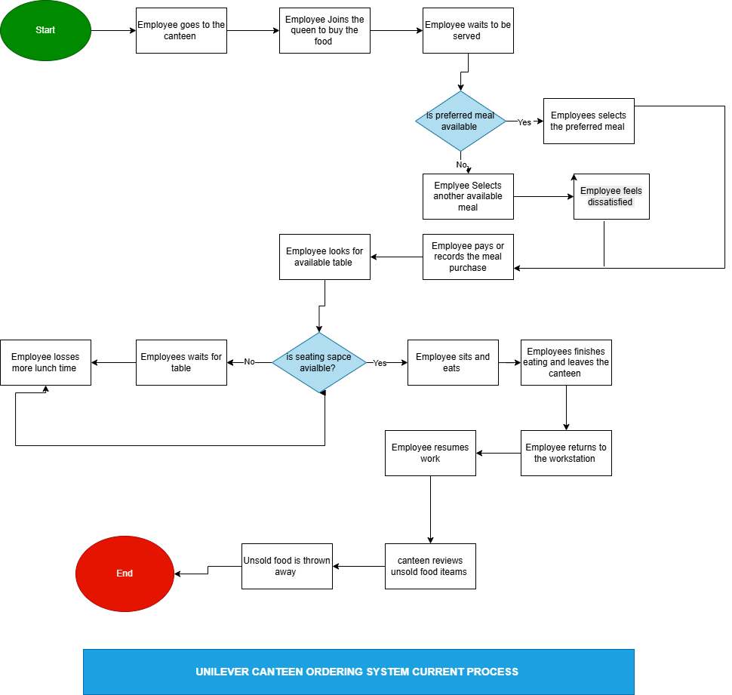
As-Is Process Map
06 · CURRENT FLOW PROCESS
How lunch ordering works today
Employee leaves workstation
Employee goes to the canteen
Employee joins the queue to buy food
Employee waits to be served
Decision: Is preferred meal available? If Yes, employee selects preferred meal. If No, employee selects another available meal and may feel dissatisfied.
Employee pays or records meal purchase
Employee looks for available table
Decision: Is seating space available? If No, employee waits for table and loses more lunch time. If Yes, employee sits and eats.
Employee finishes eating and leaves the canteen
Employee returns to workstation
Employee resumes work
Canteen reviews unsold food items
Unsold food is thrown away
CANTEEN ORDERING SYSTEM · PROJECT POLARIS
9

Slide 11
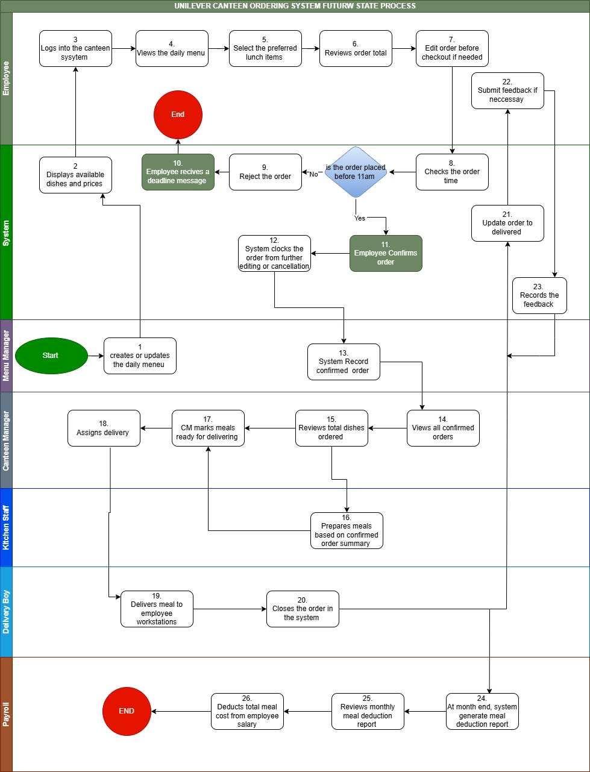
To-Be Process Map
07 · FUTURE FLOW PROCESS
How the Canteen Ordering System will work
Menu Manager creates or updates the daily menu
System displays available dishes and prices
Employee logs into the Canteen Ordering System
Employee views daily menu
Employee selects preferred lunch items
Employee reviews order total
Employee edits order before checkout, if needed
System checks the order time
Decision: Is the order placed before 11am? If No, system rejects the order and employee receives deadline message. If Yes, employee confirms order.
System locks the order from further editing or cancellation
System records confirmed order
Canteen Manager views all confirmed orders
Canteen Manager reviews total dishes ordered
Kitchen Staff prepares meals based on confirmed order summary
Canteen Manager marks meals ready for delivery
Canteen Manager assigns delivery
Delivery Boy delivers meal to employee workstation
Delivery Boy closes the order in the system
System updates order status to Delivered
Employee submits feedback, if necessary
System records feedback
At month end, system generates meal deduction report
Payroll reviews monthly meal deduction report
Payroll deducts total meal cost from employee salary
CANTEEN ORDERING SYSTEM · PROJECT POLARIS
10

Slide 12
05 & 08 · REQUIREMENTS & USER STORIES
What the System Must Do
1
2
3
4
Secure Access
Daily Menu & Pricing
Order & Checkout
Order Locking
Company-credential login; role-based, authorised access only
View dishes, prices and availability updated by the Menu Manager
Select, edit and confirm meals before the 11am cut-off
Orders lock after checkout and the deadline is enforced automatically
5
6
7
8
Kitchen Dashboard
Delivery Workflow
Feedback Loop
Payroll Reporting
Confirmed orders and dish-quantity summaries drive meal prep
Assign, deliver, and close orders to the employee's workstation
Employees rate food and delivery to drive service improvement
Automatic monthly deduction report by employee and amount due
CANTEEN ORDERING SYSTEM · PROJECT POLARIS
11

Slide 13
10 · SPRINT PLAN
Delivering in Three Two-Week Sprints
SPRINT 1
SPRINT 2
SPRINT 3
Menu & Employee Ordering
Checkout, Order Control & Prep
Delivery, Feedback, Payroll & Access
View daily menu, prices, place & edit orders; menu management for the canteen team.
Confirm orders before 11am, lock orders, enforce the deadline, and prepare meals from order summaries.
Delivery assignment and closure, feedback capture, payroll deduction reporting and role management.
USER STORIES
USER STORIES
USER STORIES
UMOS6 · UMOS7 · UMOS8 · UMOS9 · UMOS13
UMOS10 · UMOS11 · UMOS12 · UMOS14 · UMOS15 · UMOS16
UMOS 17 · UMOS18 · UMOS19 · UMOS20 · UMOS21 · UMOS23.
CANTEEN ORDERING SYSTEM · PROJECT POLARIS
12

Slide 14
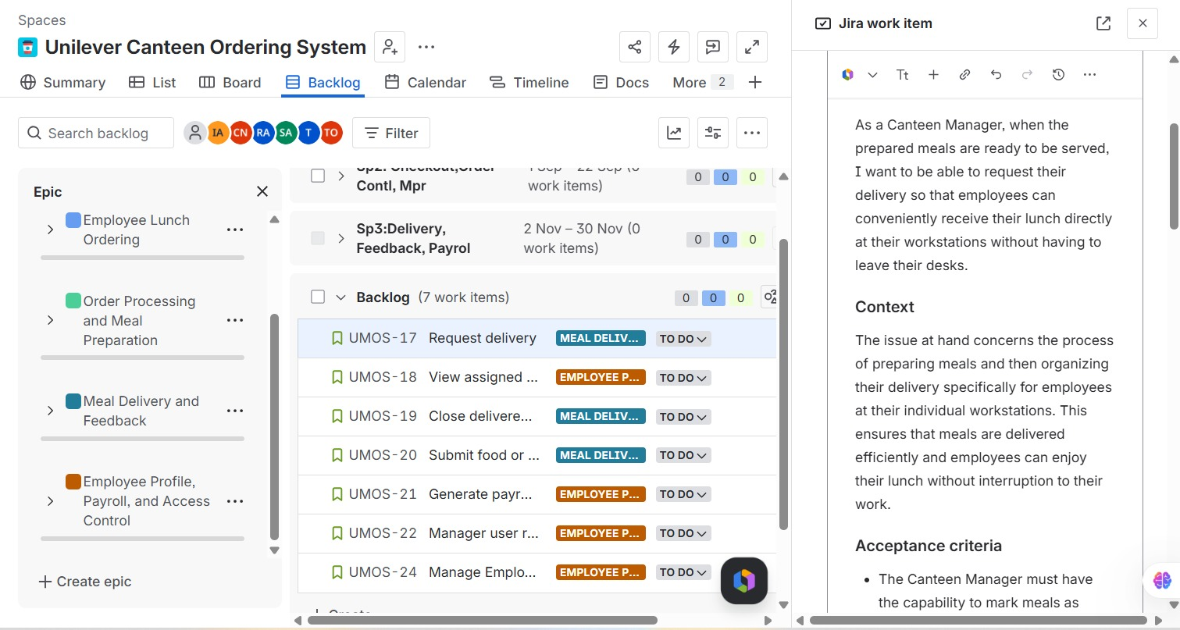
11 · JIRA SCREENSHOTS
Project Set-Up in Jira
Scrum board configured for the Canteen Ordering System
CANTEEN ORDERING SYSTEM · PROJECT POLARIS
13
PROJECT KEY
BOARD TYPE
SPRINT LENGTH
SPRINTS
COS
Scrum
2 weeks
3

Slide 15
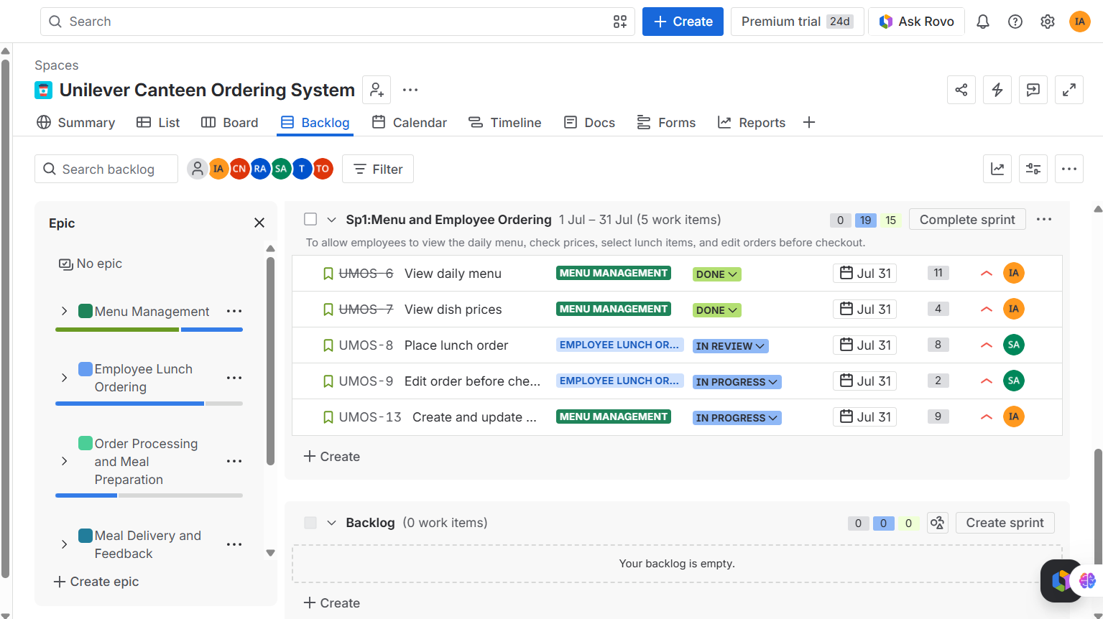
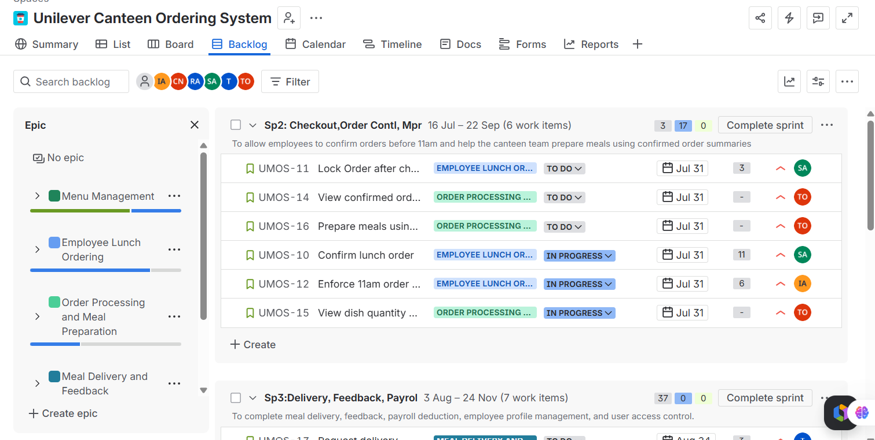
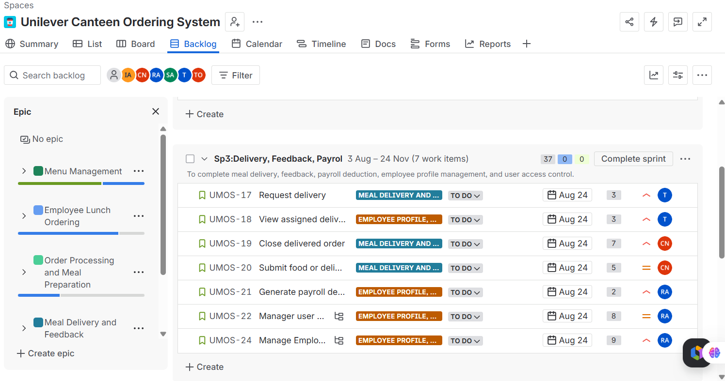
11 · JIRA SCREENSHOTS
Sprint Boards
Backlog broken down and tracked sprint by sprint
SPRINT 1
SPRINT 2
SPRINT 3
CANTEEN ORDERING SYSTEM · PROJECT POLARIS
14

Slide 16
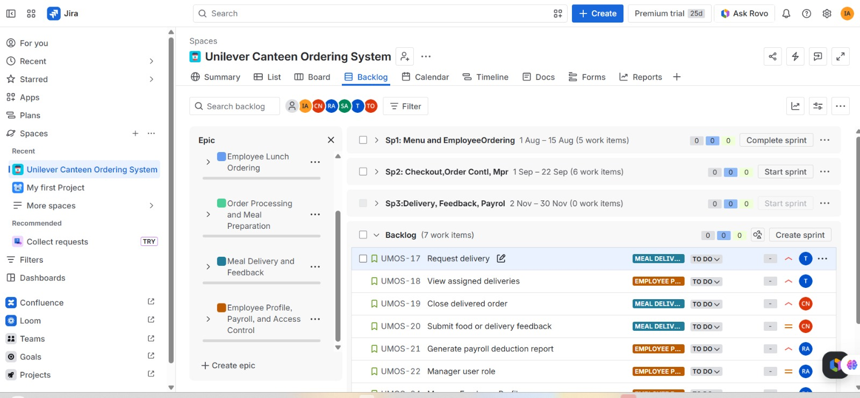
11 · JIRA SCREENSHOTS
Active Sprint Tracking
To Do → In Progress → In Review → Done
CANTEEN ORDERING SYSTEM · PROJECT POLARIS
15

Slide 17
02.11 · RISK MANAGEMENT
Risks We're Watching, and How We Manage Them
!
Employees forget to order before 11am
!
Menu not updated on time
MITIGATION
MITIGATION
Reminder notifications ahead of the deadline
Clear ownership assigned to the Menu Manager
!
Employees resist the new system
!
Delivery is delayed
MITIGATION
MITIGATION
Communication, user guides and training
Clear delivery schedule and proper staff assignment
!
Payroll deduction errors
!
System downtime affects ordering
MITIGATION
MITIGATION
Monthly reports with payroll review before deduction
IT support in place plus a backup process
CANTEEN ORDERING SYSTEM · PROJECT POLARIS
16

Slide 18
12 · FINAL PROJECT CONCLUSION
Recommended for Approval and Implementation
The Canteen Ordering System solves Unilever UK's lunch-hour challenges — reducing congestion, improving employee experience, supporting better meal planning, and cutting food wastage. Employees will order online before 11am and receive lunch at their workstation, while the canteen team gains accurate, confirmed demand to plan against.
£140,000
Project Cost
£1,680,000
Annual Benefit
Based on the business problem, stakeholder impact, functional requirements, process improvement, and financial analysis, the project is recommended for implementation.
~1 month
Payback Period
1,100%
ROI
PREPARED BY POD POLARIS · BUSINESS ANALYSIS CAPSTONE PROJECT

