Slide 1
CO₂ Emissions vs Temperature of the U.S. Over Time
Michael Trias, Kevin Li, Kenny Sun

Slide 2
Hypothesis: If CO₂ emissions go up, then temperature will go up as well.
Questions to consider:
Does CO₂ emissions have an immediate effect on temperature?
Certain states have higher emissions than others. Is there a larger increase in temperature in certain areas?
Can we see an effect during a specific timeframe? (e.g. summer months like June, July, August)

Slide 3
Summary
Global warming has always been apparent in our lives. Since gaining these new skills and observing the data around us, we wanted to see it firsthand through raw data.
We asked our questions to observe the most noticeable trend which would be temperature over time. This gives us a broad overview of the effects of CO₂ emissions.
Although there is a lot of data surrounding this topic, we weren’t able to find any conclusive evidence because there are other factors that contribute to changes in temperature.
Overall, we were satisfied because we were able to gain insight through our findings in such a short amount of time.

Slide 4
What type of Data is needed?
We required data from emissions each year, the change in temperature over time for the U.S. as a whole and per state.
We pulled our data from reputable sources such as Kaggle, Datahub, EIA.gov (U.S. Energy Information Administration)
Kaggle (Some datasets were pulled from Nasa, Lawrence Livermore Labs, etc.)

Slide 5
Data Cleanup & Exploration
Cleanup Process
Downloaded .csv files and imported into the jupyter notebook. Filtered out information based on region /date
Grouped data together to create a cleaner dataset to work with
We sorted each dataset and used what was useful to us
Insight
The U.S. has made a large effort to decrease emissions.
Certain datasets did not provide a large enough sample to show any significant correlation.
Some datasets were incomplete and we had to reformulate our question to include the important data in these datasets.

Slide 6
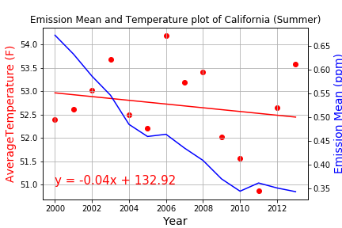
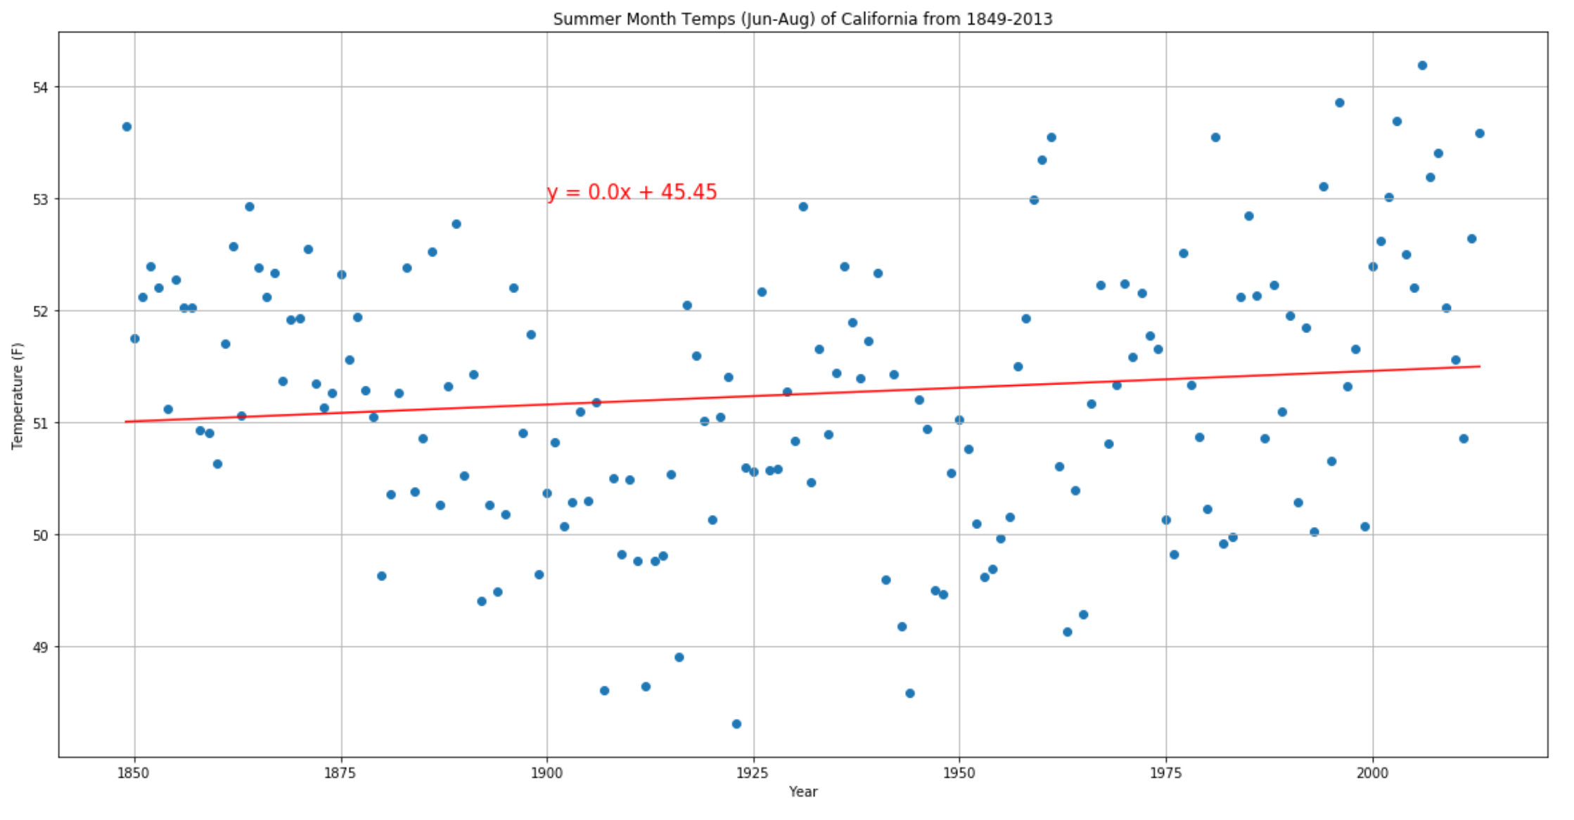
Data Analysis: California – Summer Data

Slide 7
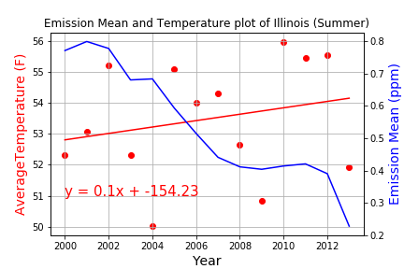
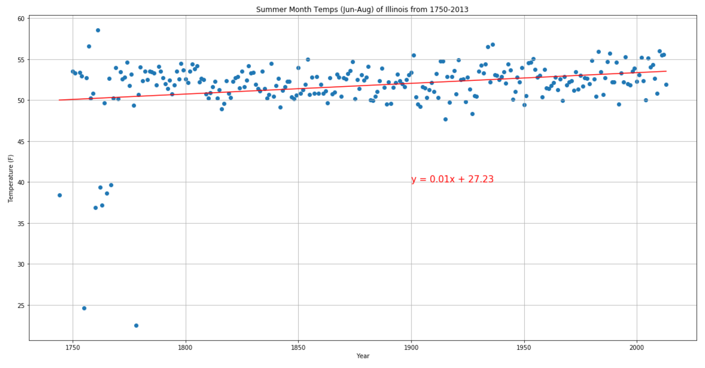
Data Analysis: Illinois – Summer Data

Slide 8
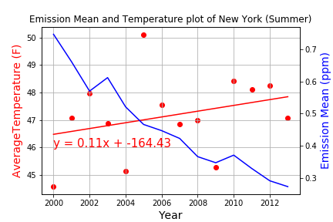
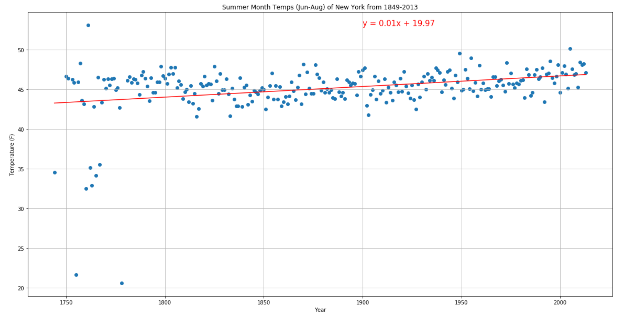
Data Analysis: New York – Summer Data

Slide 9

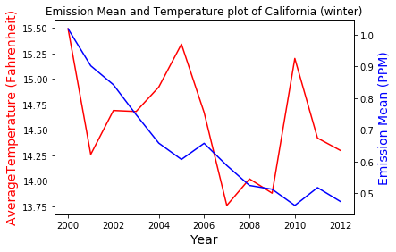
California – Winter Data

Slide 10
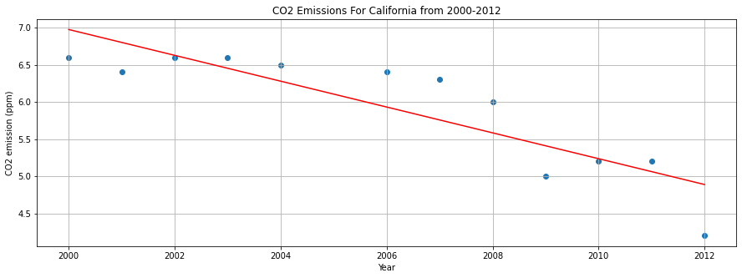
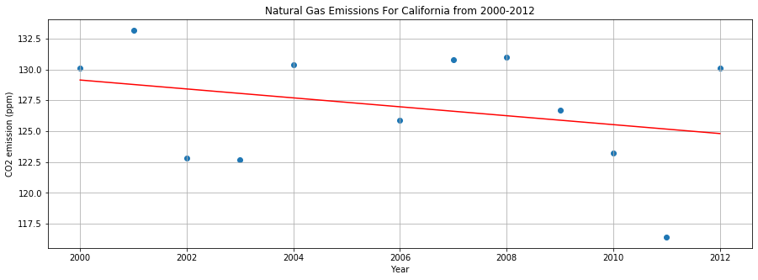
California – Winter Data

Slide 11
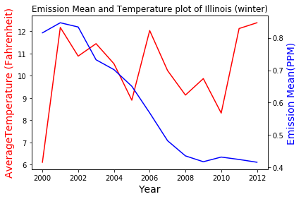
Illinois – Winter Data

Slide 12
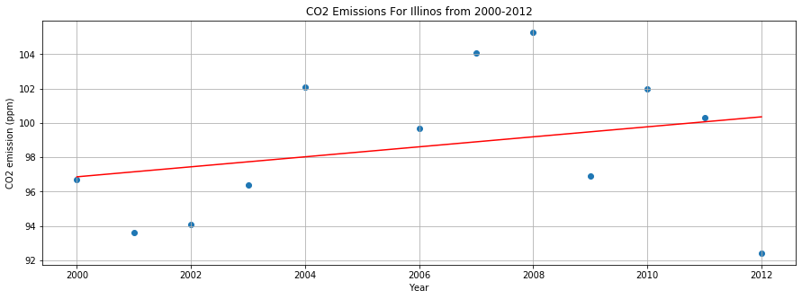
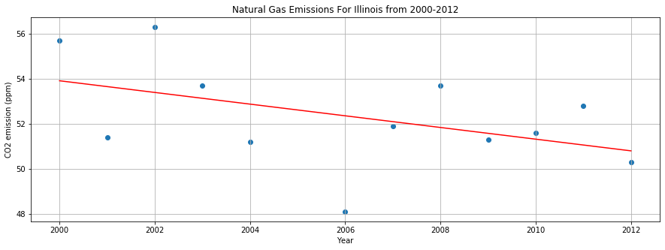
Illinois – Winter Data

Slide 13
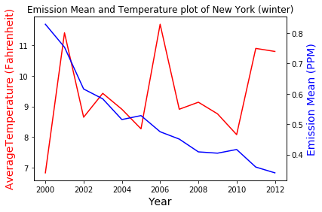
New York – Winter Data

Slide 14
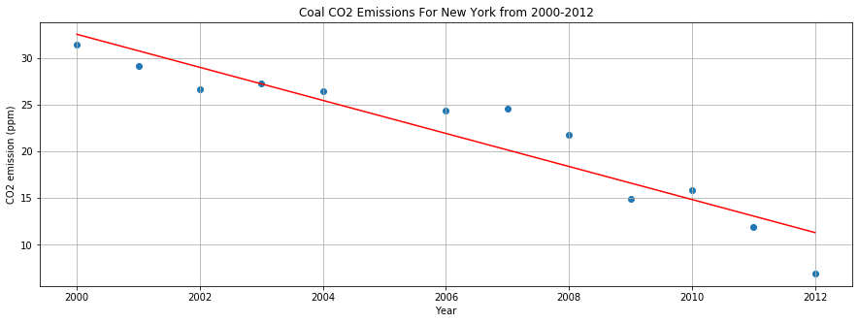
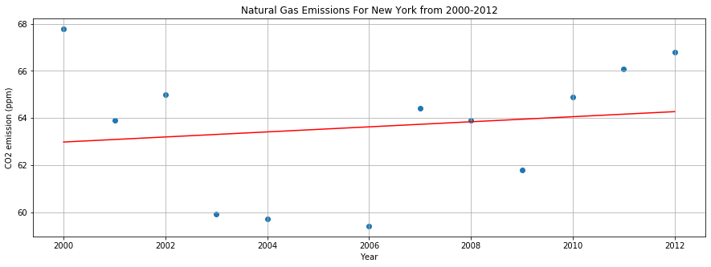
New York – Winter Data

Slide 15
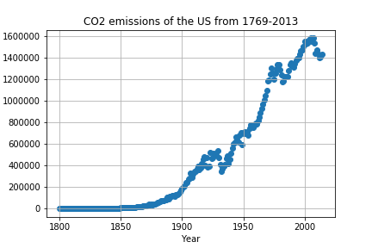
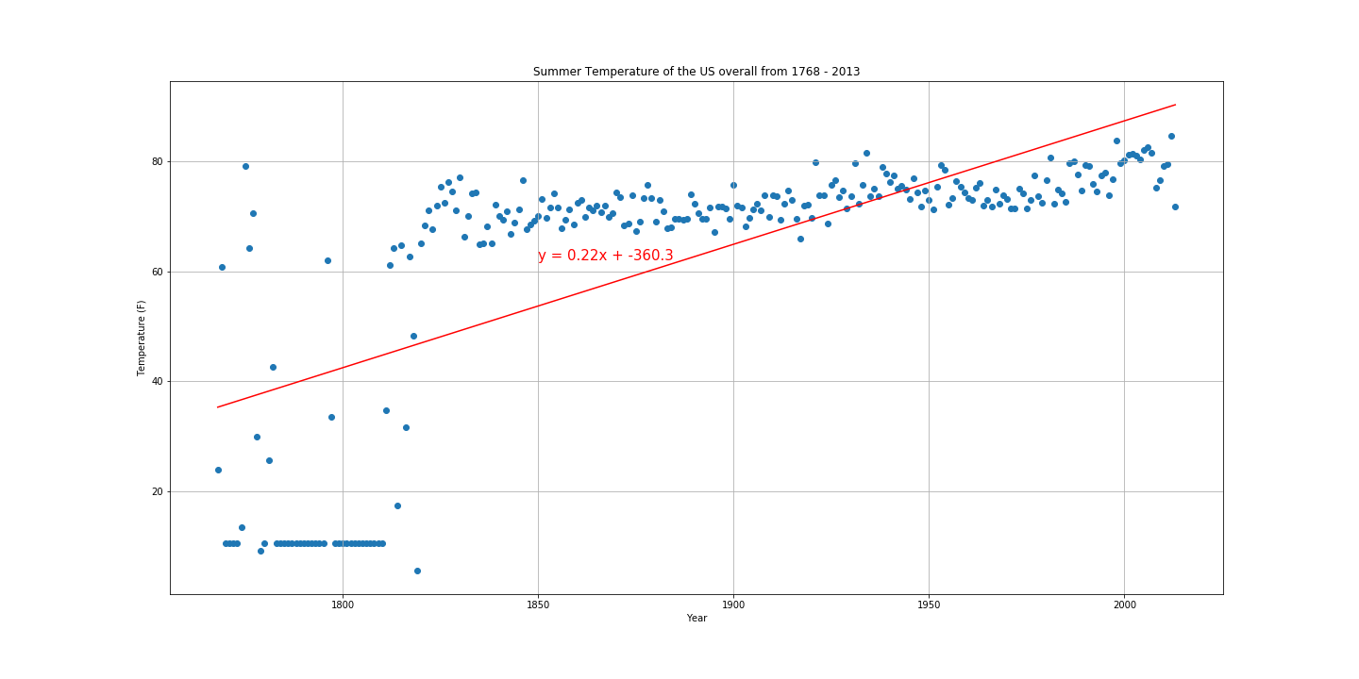
Data Analysis: U.S. Overall

Slide 16
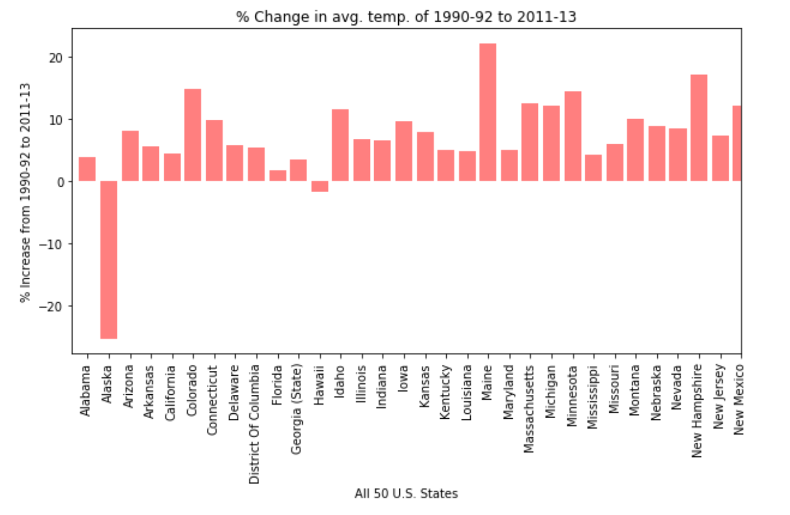
Data Analysis: U.S. Overall Continued…

Slide 17
Discussion
Does CO₂ emissions have an immediate effect on temperature?
The data doesn’t show a significant increase in temperature in a small time frame. Changes could be due to other external factors. More data is required.
Certain states have higher emissions than others. Is there a larger increase in temperature in certain areas?
Data is inconclusive because other factors may have came into play. Change was too small to attribute it to be mainly Co₂ emissions.
(e.g. geographic location, weather patterns, population size)
Can we see an effect during a specific timeframe? (e.g. summer months like June, July, August)
Although it does look like there’s a correlation, the data was not able to accurately depict any significant changes. We are unable to give a conclusive answer due to lack of data.

Slide 18
Post Mortem
* Discuss any difficulties that arose, and how you dealt with them
Large datasets required a lot more time to sort through and clean.
Some datasets were not large enough to create an accurate representation.
Collaborating with groupmates using a new unfamiliar system. (e.g. github)
Due to current pandemic, all meetings had to be virtual. Harder to coordinate with teacher and groupmates.
* Discuss any additional questions that came up, but which you didn't have time to answer: What would you research next, if you had two more weeks?
If we had two more weeks, probably include more datasets. Maybe incorporate an api like a weather api or the google map api.
Additional questions:
“Does geography play a large factor in temperature changes?”
“Does population size have an effect on temperature in a region?”
“Avg CO₂ emissions per capita per state (Carbon Footprint)”

Slide 19

Questions?

