Slide 1
Neural Networks
an exemplary introduction
Keno Pecht

Slide 2
Neural Networks
a concrete introduction with the example of object detection in images
The aim of this presentation is to give an intuition of what happens inside a neural network.
The aim is not to be complete.
A toy model of a Convolutional Neural Network that detects lamps on lampposts will be presented.
When there was a conflict between faithfulness to reality and teachability, the latter took precedence.

Slide 3
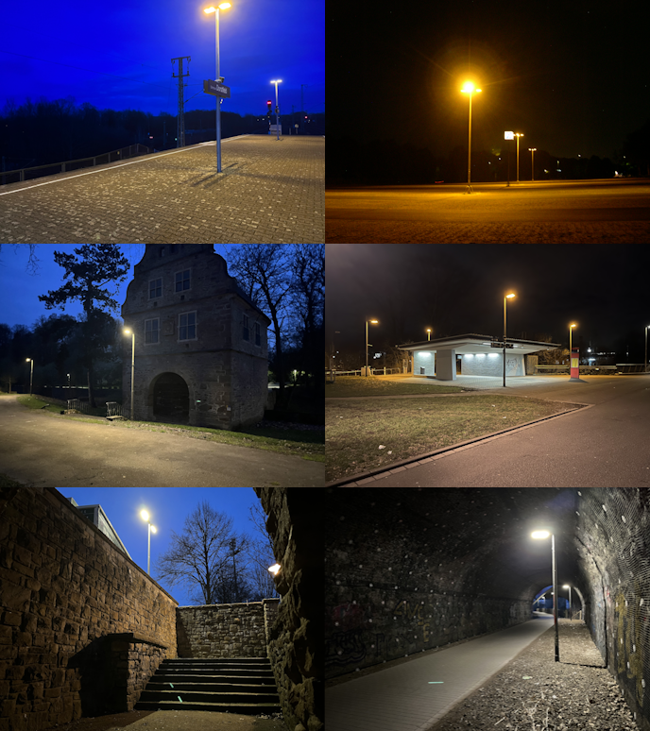
Neural Networks
a concrete introduction with the example of object detection in images
The toy model is in Moodle as an Excel-file.
I intentionally changed some of the parameters so that it does not work currently.
I hope to be able to get you to reason through what those missing parameters should be.

Slide 4
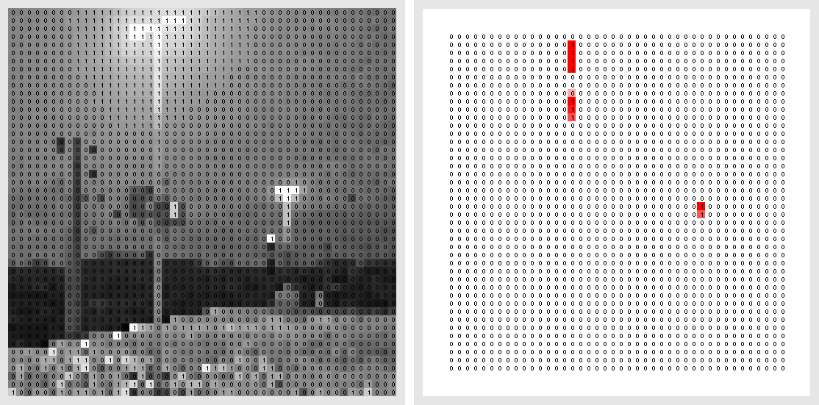
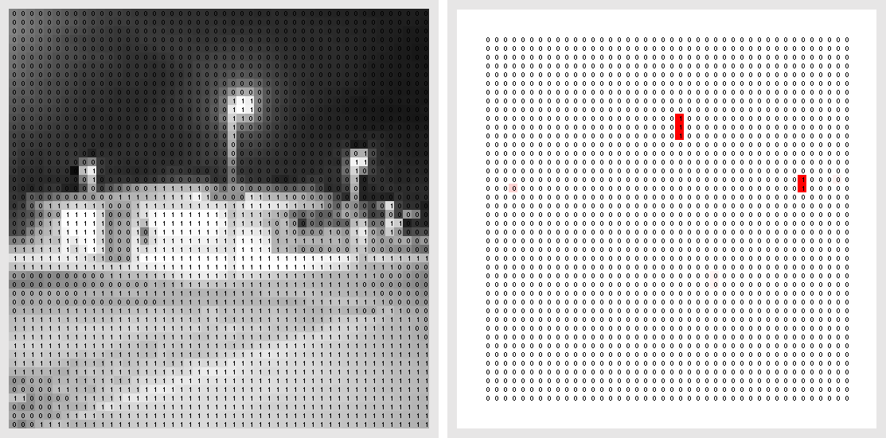
Object detection in images
The problem described in terms of data
The input is an image
i.e.: a 2D grid of brightness values [0,1]
The output is an image as well
Also, with pixel values [0,1]
This image highlights where some object was detected in the input

Slide 5
Convolution(al neural network)s
How they work
Let us look just at the convolution layers today.
Each pixel value in an output layer is a function of its neighbours in its input layer.
The values in the convolution kernel are learned during the training process. Though they can be chosen manually.

Slide 6
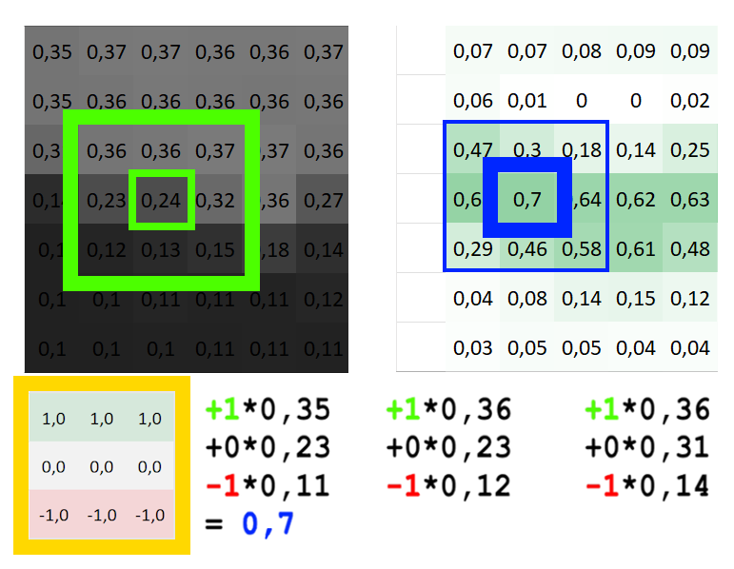
Convolutions
Edge detection
This kernel is setup to detect horizontal edges.
o = I : K + b
The bias (b) is added. It is learned as well. Here it is 0.
The top pixels are brighter than the bottom pixels. Therefore, the sum ends up positive.

Slide 7
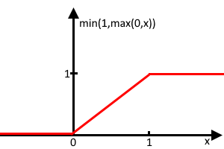
Convolutions
The activation function
For my design values are restricted to lie between 0 and 1.
Activation function: f(x) = min(1,max(0,x))
The full function therefore looks like this: o = min(1,max(0, I : K + b))
This nonlinearity is required to represent complex relationships.

Slide 8
Convolutions - interactive
Edge & line detection
Now we are taking the role of the training process and choose some kernel parameters.
This is normally done by a training algorithm.
Collectively
Let us try to detect an edge with the opposite direction.
What should the kernel be?

Slide 9
Convolutions - interactive
(2) Individually
Let us try to detect bright vertical lines on a darker background.
What should the kernel be?
Some Notes:
Use relatively low numbers as weights.
Try to make the kernel´s average be close to zero

Slide 10
Lamppost detector
The rest of the network was already set up by me. It was not automatically trained.
You can see it detects the lampposts, with restrictions:
The image must have high contrast between the mast and the background
The post must brighter then the background
It must glow at the top
The image must be exposed so that the glow is close to maximum brightness

Slide 11
Lamppost detector
Briefly; How does it work?
There are more layers.
Some take a previous layer as input.
D is a filter over B which intern detects overexposed areas (lamps).
C filters the vertical line detector, so that (hopefully) only actual posts remain.
The output layer O activates in areas where both C and D are activated.

Slide 12
Conclusion
Usually kernel parameters are much less straight forward to interpret then they are here.
Nonetheless, you now hopefully have a better intuition of how neural network might detect objects or do any other task.
This is only one kind of architecture for a neural net. Other purposes require other kinds of neural nets.
THANK YOU FOR YOUR ATTENTION!

Slide 13
Copyright
© 2026 by Keno Pecht. This work is licensed under a Attribution-ShareAlike 4.0 International License.
Link to license: https://creativecommons.org/licenses/by-sa/4.0/deed.en
Images are my own work and fall under the license unless stated otherwise.
The presentation layout and symbols of the University Witten/Herdecke do not fall under this license.
Link to work: https://github.com/KenoPecht-Public/Neural-Networks-an-exemplary-introduction

Slide 14
Images
GIF on “Convolution(al neural network)s” slide:
https://commons.wikimedia.org/wiki/File:2D_Convolution_Animation.gif license: CC BY-SA 3.0

Slide 15
Resources
https://stanford.edu/~shervine/teaching/cs-230/cheatsheet-convolutional-neural-networks/
https://doi.org/10.48550/arXiv.1511.08458
https://www.mi.uni-koeln.de/wp-znikolic/wp-content/uploads/2019/06/11-Odenthal.pdf

