Slide 1
Our Dataset
https://www.kaggle.com/datasets/akashdeepkuila/bakery/data
Our dataset is a comprehensive database which contains 10,507 entries and over 9000 transactions from a bakery which include items, transaction numbers, date and time of sales.
Goal is to discover association between items and sales times.

Slide 2
Challenges and Data Preprocessing
Since our dataset is generally clean with few outliers the challenges and data preprocessing needed is very little.
Main focus should be on removal of any extreme outliers.
i.e transactions with improbable item counts or dates.
This will ensure reliability of further analysis.
Provides a solid foundation for accurate association rule mining.

Slide 3
Metrics Employed
We used metrics to track transaction patterns over time.
Such as number of transaction per date, hour, and minute to identify peak business periods.
Also tracked item popularity and associations.
Count of transaction per item.
Association metrics such as support, confidence, and lift.

Slide 4
Justification of Metrics
Transaction patterns over time
This helps us understand the customer flow which helps schedule staff and set hours of operation.
Item Analysis and Associations
Helps manage inventory for popular products and formulate promotional strategies.

Slide 5
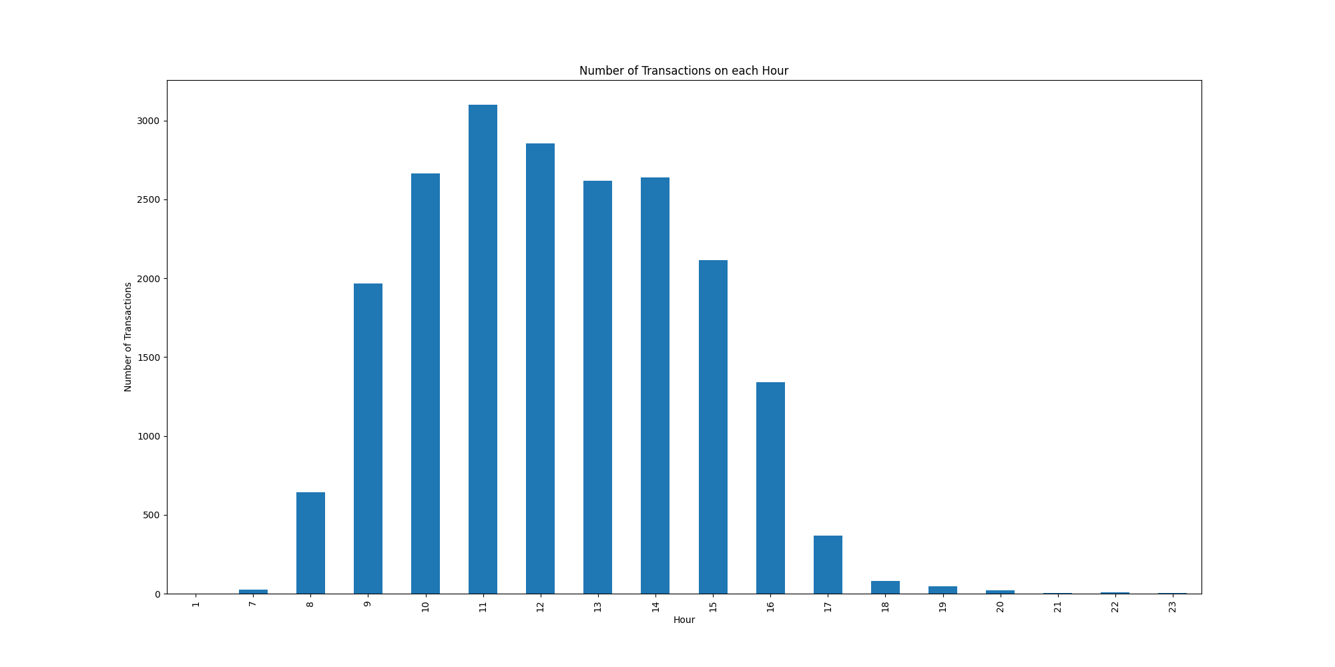
Justification Example – Transaction on Each Hour

Slide 6
Summary of Evaluation Methodology
We use our Kaggle Dataset to extract associations between the sale times of items.
Dataset is generally clean with minimal outliers.
Metrics such as transactions per date, hour and minute paired with item popularity and associations.
These metrics help us understand busy hours and item popularity.

