Slide 1
Bakery Rules Association Analysis
By Toby Clark, John Kendall, Ryan Luders, Joshua Burk, Joan Njenga, Boaz Glassberg

Slide 2
Brief Overview
For our project, we chose to analyze Bakery Sales, finding associations among products in the dataset to be able to make conclusions about:
Which products should be sold on their own.
Which products should be sold together.
Used trees, patterns, and
The sales dataset was analyzed via a Python program, taking advantage of Python’s built-in modules and libraries to help complete datamining tasks.

Slide 3
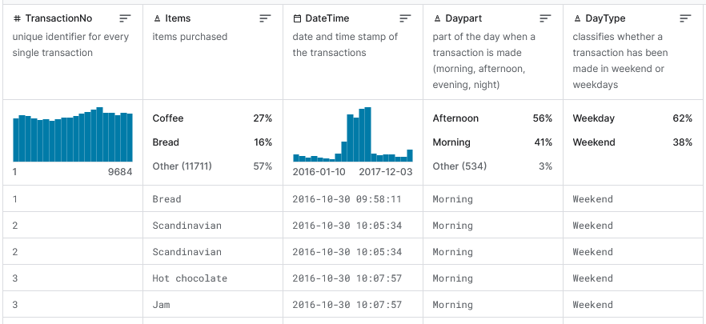
The Bakery Dataset
Dataset:
Belongs to a bakery in Edinburgh, Scotland.
Contains transaction details of customers who ordered different items online from this bakery from December 2003 to January 2011.
https://www.kaggle.com/datasets/akashdeepkuila/bakery

Slide 4
Motivation From Real-World Applications
In modern-day Commerce, products and sales are being increasingly digitally tracked and recorded.
Businesses must use their sales datasets to refine their sales strategies if they want to keep up.
Datamining sales data can help:
Determine which sales would maximize profits.
Determine when products should be prepared at a given date and time.
Particularly, when pairs of products should be prepared together, determined through finding associations between products.

Slide 5
Data Mining Questions
We want to be able to determine from datamining:
Which products are the most popular?
Which products should be sold on their own?
Which products sell the best together?
Which products should be sold together?

Slide 6
Personal Motivation
Datamining sales data helps determine when different products should be prepared at given dates and times for a business, by making associations, such as finding similarities in sales data, between products.
Analyzing Bakery sales trends in particular is unique in how quickly certain products must be sold, due to many bread-related items having short shelf-lives.
This makes analyzing Bakery sales trends to find associations more crucial than some other fields in regards to:
Finding dates to prepare certain foods which will sell in spite of short expiration dates.
Optimizing production schedule.
An industry with no way to stockpile many items (pasteries, coffee).
Finding combinations of products to sell with short-expiration dated foods.

Slide 7
Challenges
Some challenges found in analyzing the Bakery Sales Dataset:
A lack of detail regarding the typing of many products.
There is a differentiation between different hot beverages, but no differentiation given from the dataset about differentiations between two beverages of the same type.
This means a hot chocolate, ordered cold, is treated and recorded as a hot chocolate within our chosen dataset.
In our approach, one way we get around this is putting the data in bar graphs and pie charts when analyzing, so as not to focus too hard on one sale which could be an exceptional case not noted in the sales dataset.
Data preprocessing
Pandas was used in the approach to help in extracting individual hour, minute, and date attributes.
In grouping this particular data, operations like sort_index() was used to sort counts of occurrences of unique values related to time for preprocessing.
Unstack() used to pivot the data when needed on DataFrames.
Mapping numerical day of the week and month pairs to their written English counterparts made visually interpreting analysis results easier.

Slide 8
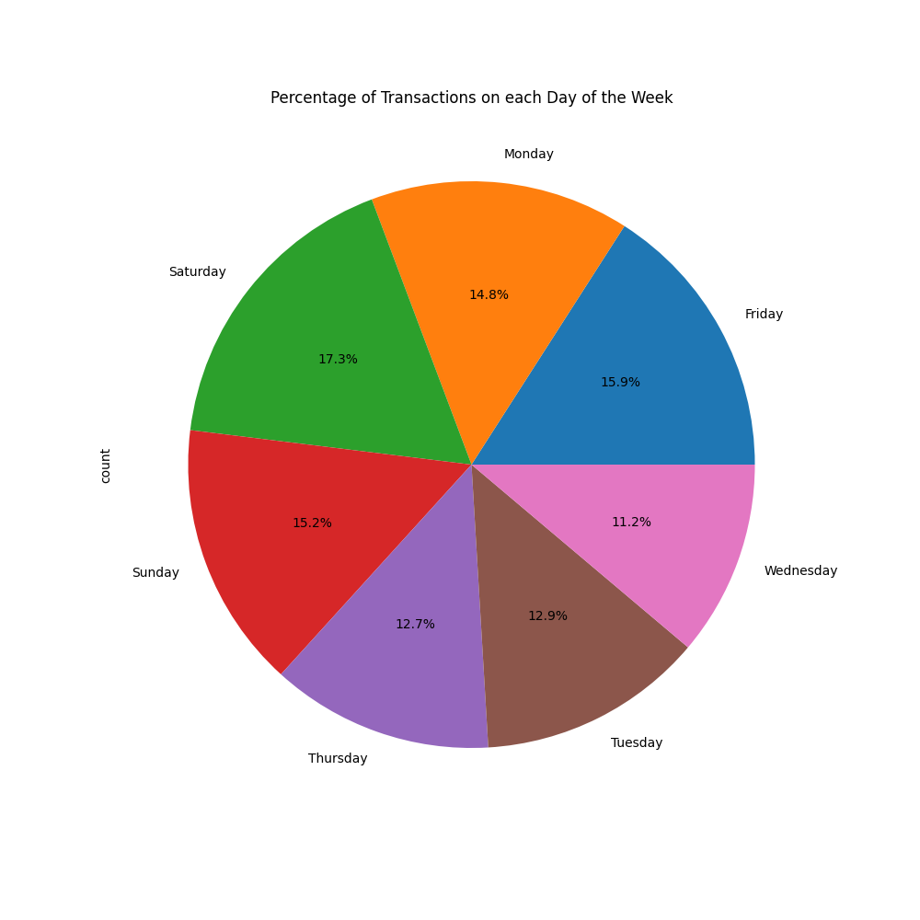
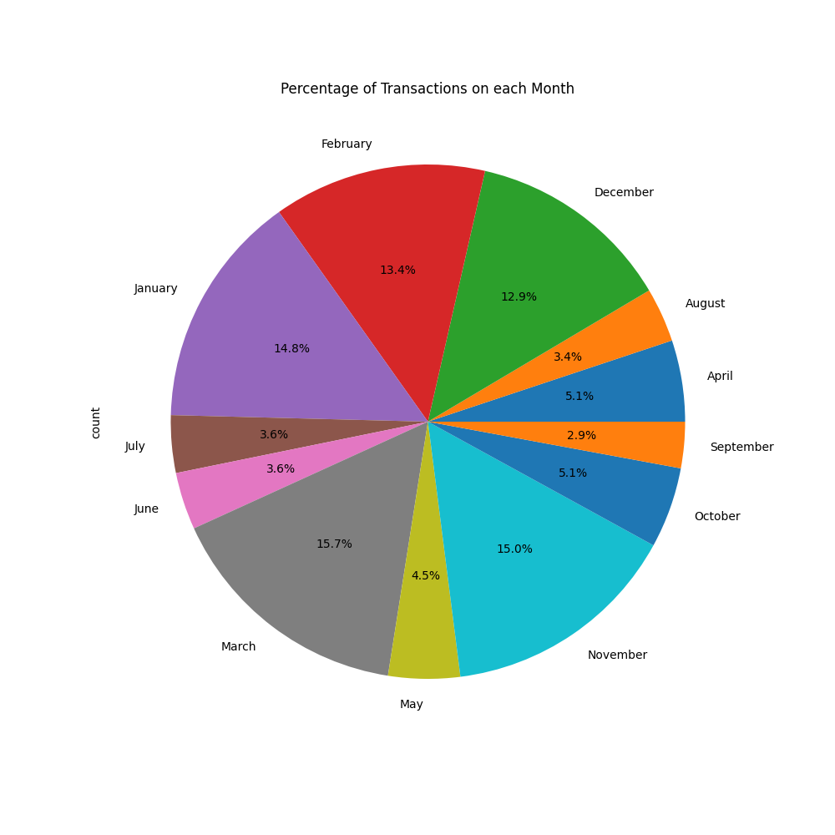
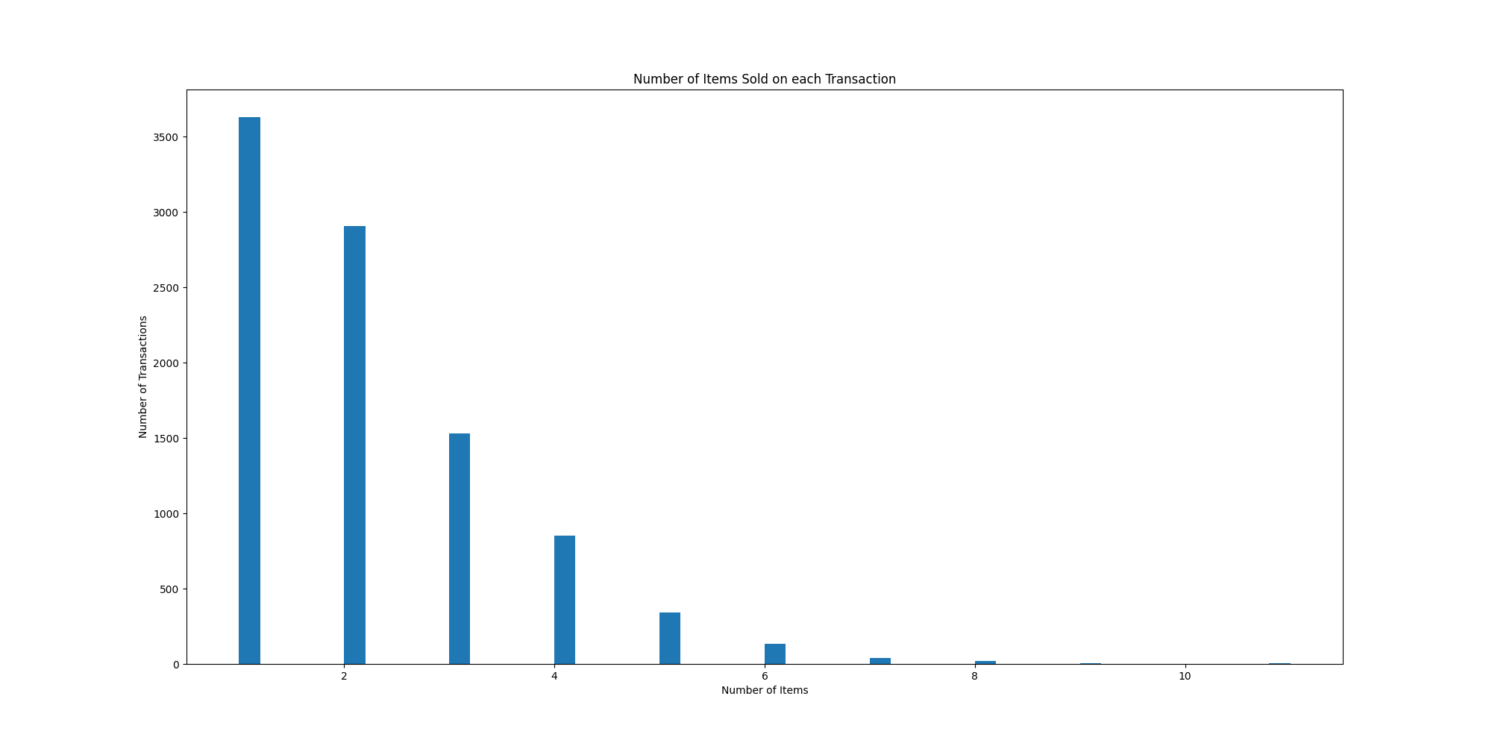
Results Found (Broad)
Saturdays sell the best overall at the bakery, followed by Friday and Sunday afterwards. Winter/Spring months sell best.
More transactions consist of more than one item sold at a time.

Slide 9
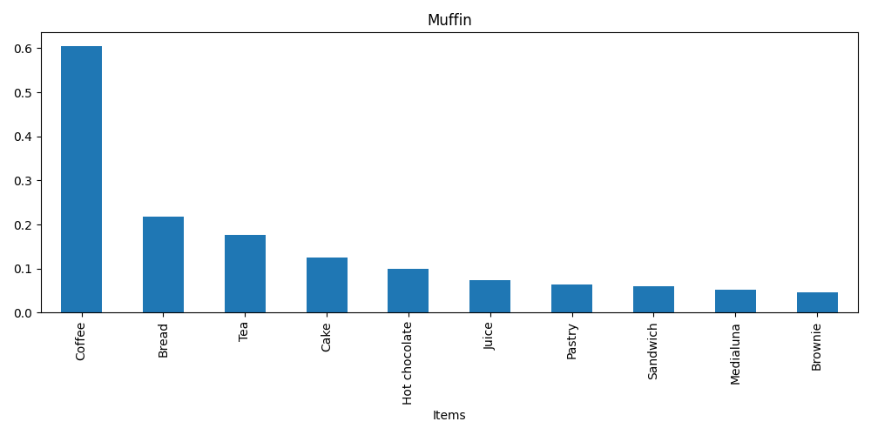
Results Found (Specific)
Charts displaying the top 10 confidence, lift, and support of specific items:
Bread
Coffee
Cookies
Hot Chocolate
Jam
Medialuna
Muffin
Pastry
Scandinavian
Tea

Slide 10
Our Evaluation Methodology

Slide 11
Our Dataset
https://www.kaggle.com/datasets/akashdeepkuila/bakery/data
Our dataset is a comprehensive database which contains 10,507 entries and over 9000 transactions from a bakery which include items, transaction numbers, date and time of sales.
Goal is to discover association between items and sales times.

Slide 12
Challenges and Data Preprocessing
Since our dataset is generally clean with few outliers the challenges and data preprocessing needed is very little.
Main focus should be on removal of any extreme outliers.
i.e transactions with improbable item counts or dates.
This will ensure reliability of further analysis.
Provides a solid foundation for accurate association rule mining.

Slide 13
Metrics Employed
We used metrics to track transaction patterns over time.
Such as number of transaction per date, hour, and minute to identify peak business periods.
Also tracked item popularity and associations.
Count of transaction per item.
Association metrics such as support, confidence, and lift.

Slide 14
Justification of Metrics
Transaction patterns over time
This helps us understand the customer flow which helps schedule staff and set hours of operation.
Item Analysis and Associations
Helps manage inventory for popular products and formulate promotional strategies.

Slide 15
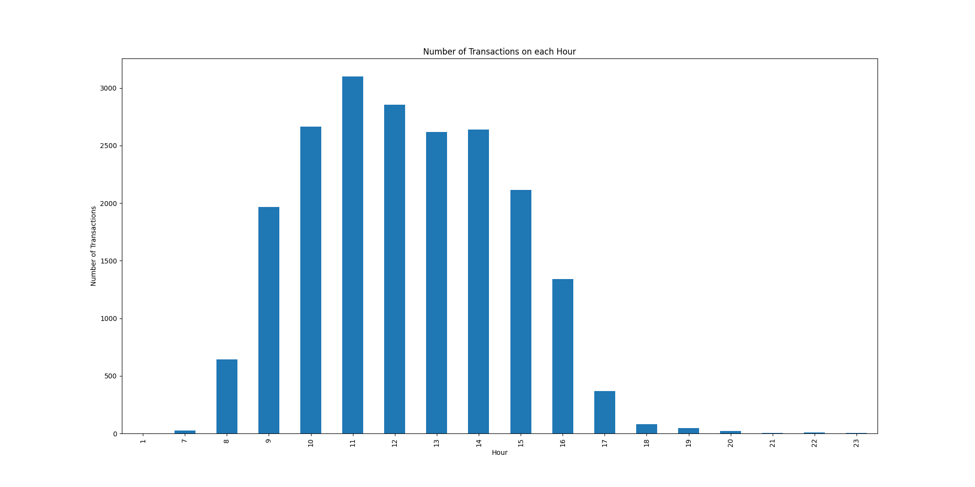
Justification Example – Transaction on Each Hour

Slide 16
Summary of Evaluation Methodology
We use our Kaggle Dataset to extract associations between the sale times of items.
Dataset is generally clean with minimal outliers.
Metrics such as transactions per date, hour and minute paired with item popularity and associations.
These metrics help us understand busy hours and item popularity.

Slide 17
Our Data Mining Tasks

Slide 18
Our Tasks
In order to help the bakery refine their sales and production strategies, we tasked ourselves to do the following:
Datamine temporal transaction information to analyze the traffic flow to the bakery to find their busiest Months, Days, and Hours.
Datamine the best-selling items and when they sell to maximize workplace efficiency and customer satisfaction.
Datamine items that are frequently bought together to maximize business profit.

Slide 19
Datamining Temporal Information
The Question we wanted to answer:
What month/day/hour does the bakery get the most traffic?
Key Challenges:
Recognizing and correctly identifying trends.

Slide 20
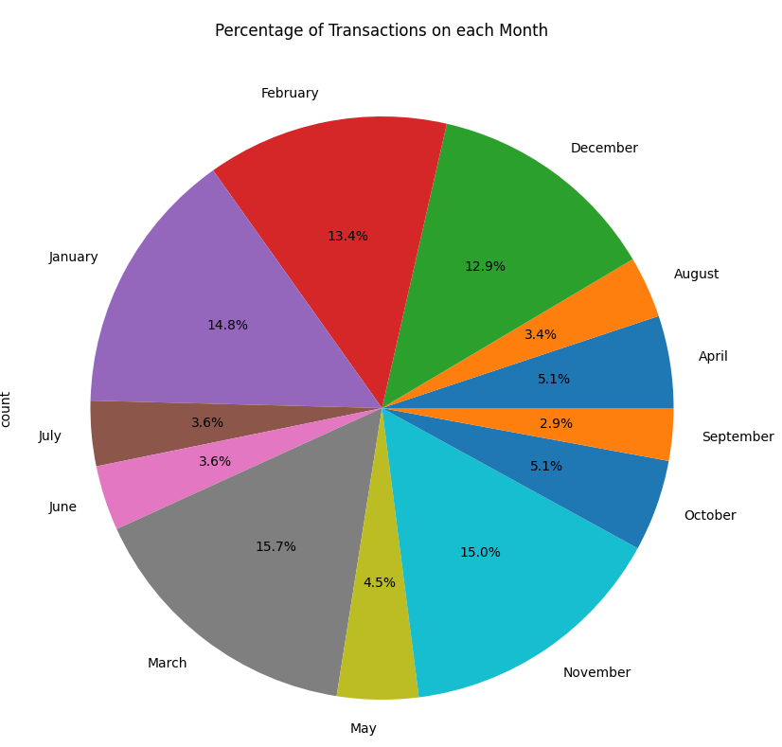
Data Mining Monthly Transactions
We want to find which months are the busiest and which are not.
This data can help with shift scheduling and item stock acquisition to prepare for busier months

Slide 21
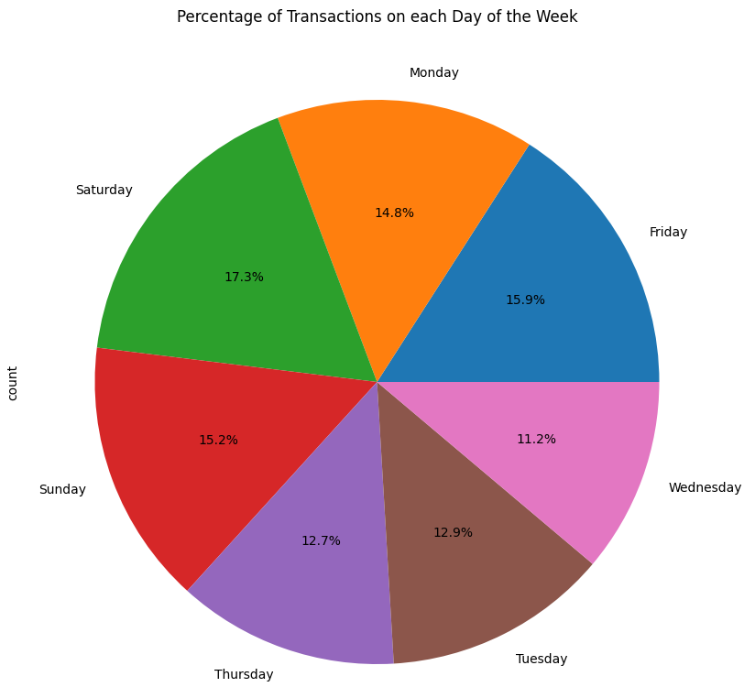
Data Mining Daily Transactions
We want to find which days are the busiest and which are not.
Once again, this data can help with shift scheduling and item stock acquisition to prepare for busier days.

Slide 22
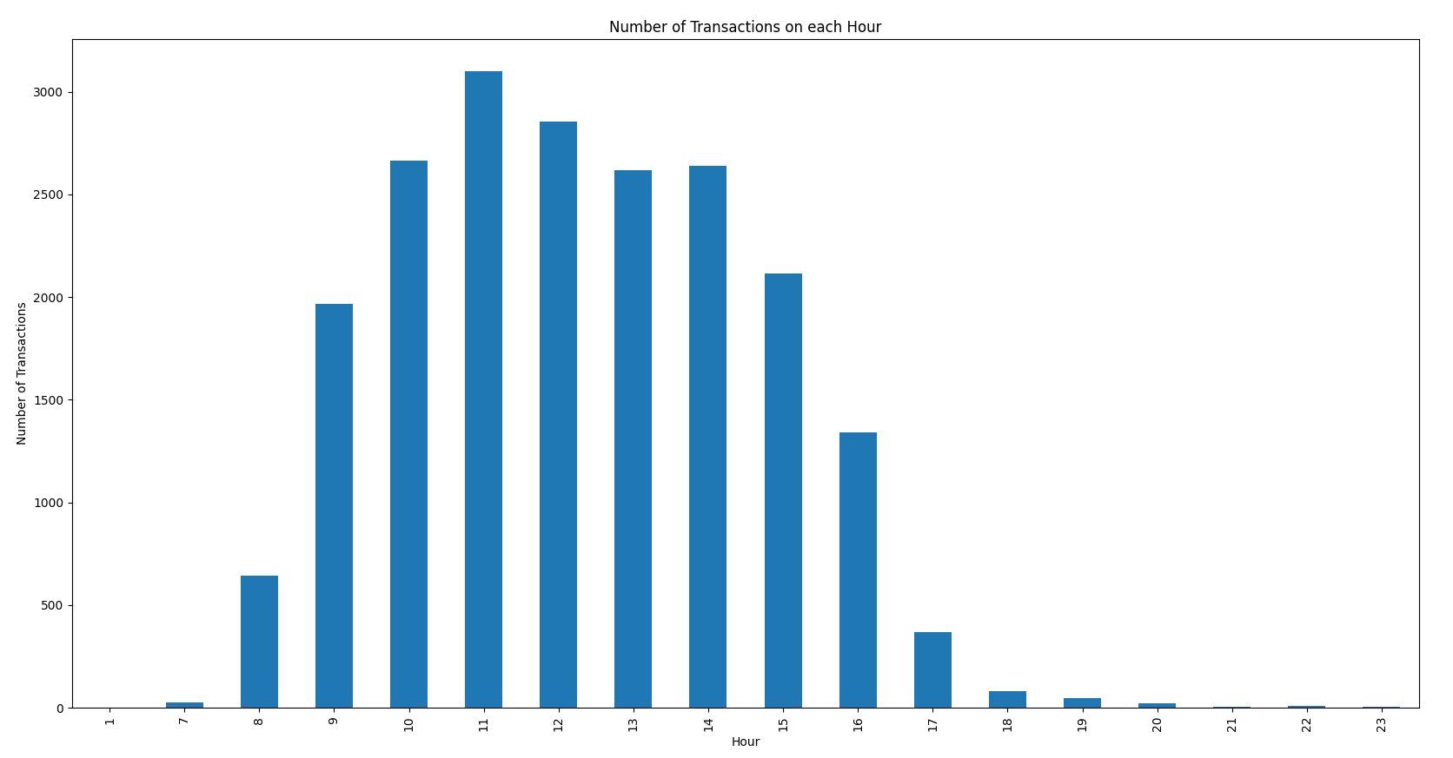
Data Mining Hourly Transactions
We want to find the bakery’s busiest time of day.
This can be used to tell them when they should start baking and how many things to back to have enough products satisfy the flow of customers.
Also helps in determining when shifts should start/end.

Slide 23
Data Mining Best-Selling Items
The Question we wanted to answer:
Which items are the best sellers within the bakery and how do these sales vary over different times such as day, week, month.
Can we identify any noticeable patterns in sales that could indicate time of day preferences for items.
Key Challenges:
Identifying best sellers using transaction counts.
Utilizing time and date segmentation to analyze sales patterns.

Slide 24
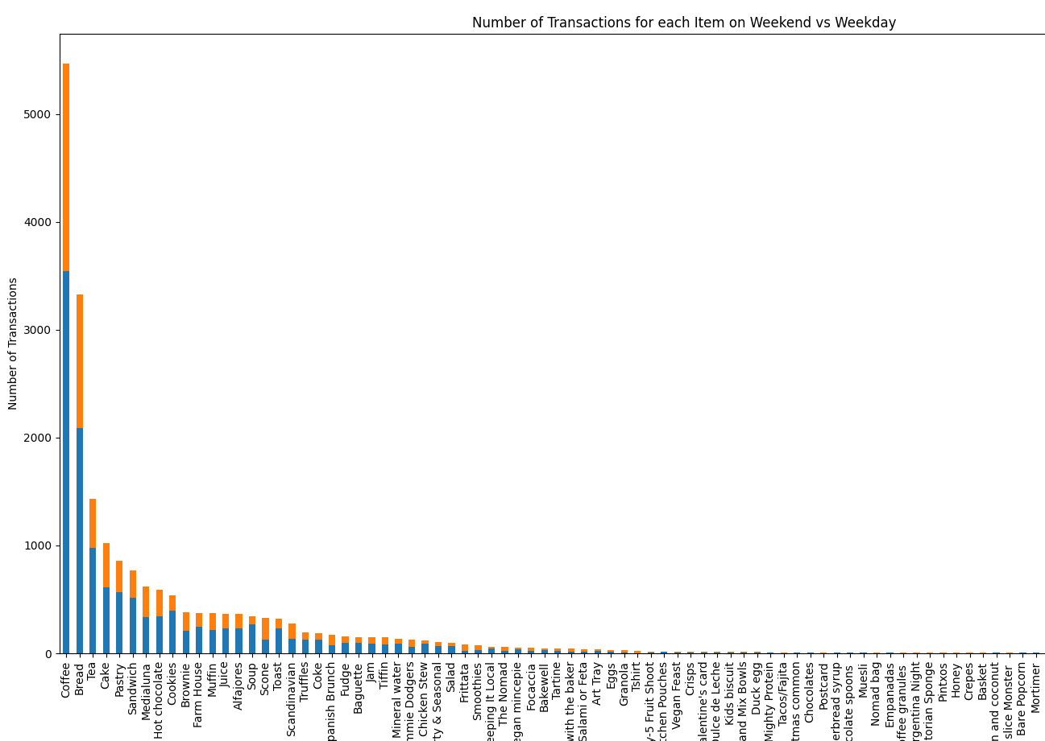

Data Mining Best-Selling Items
We aim to find which items sell the best from the bakery and when they tend to sell.
This data can be used to determine service times for certain items.
Can also help when to advertise certain products to draw in more customers
Analyze any seasonal items they plan on selling.

Slide 25
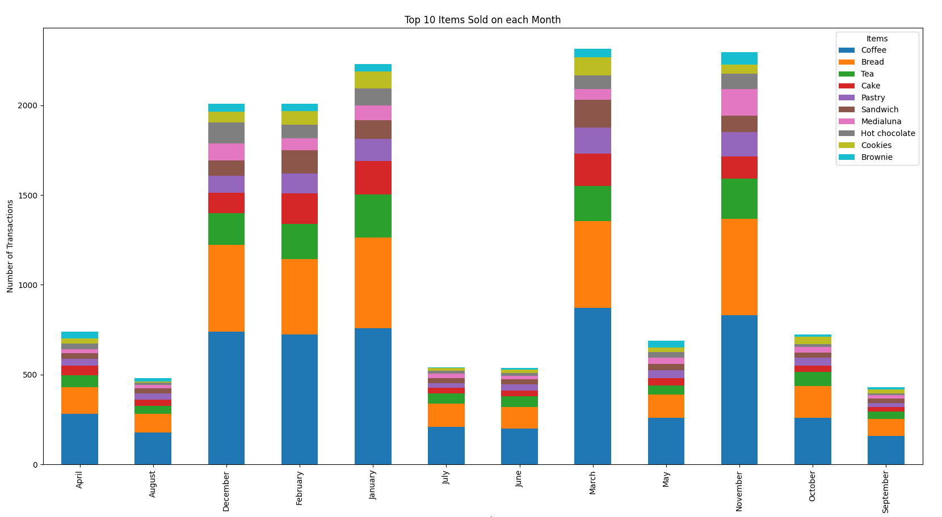
Best-Selling Items Example Output Graph

Slide 26
Datamining Frequent Item sets
The Question we wanted to answer:
How can we identify which bakery items are frequently purchased together?
Key Challenges:
Dealing with a large volume of data.
Pattern discovery so that we can determine the correct level of support and confidence.
Avoiding correlations that do not give any insight in relations to business decisions.

Slide 27
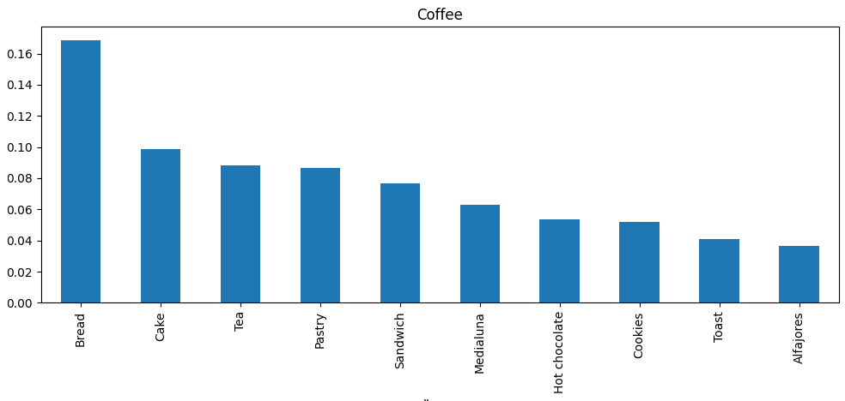
Frequent Item sets
We want to find what items are commonly purchased together.
This can be used to optimize the placement of items on menu’s or displays to entice customers to buy more items per transaction.

Slide 28
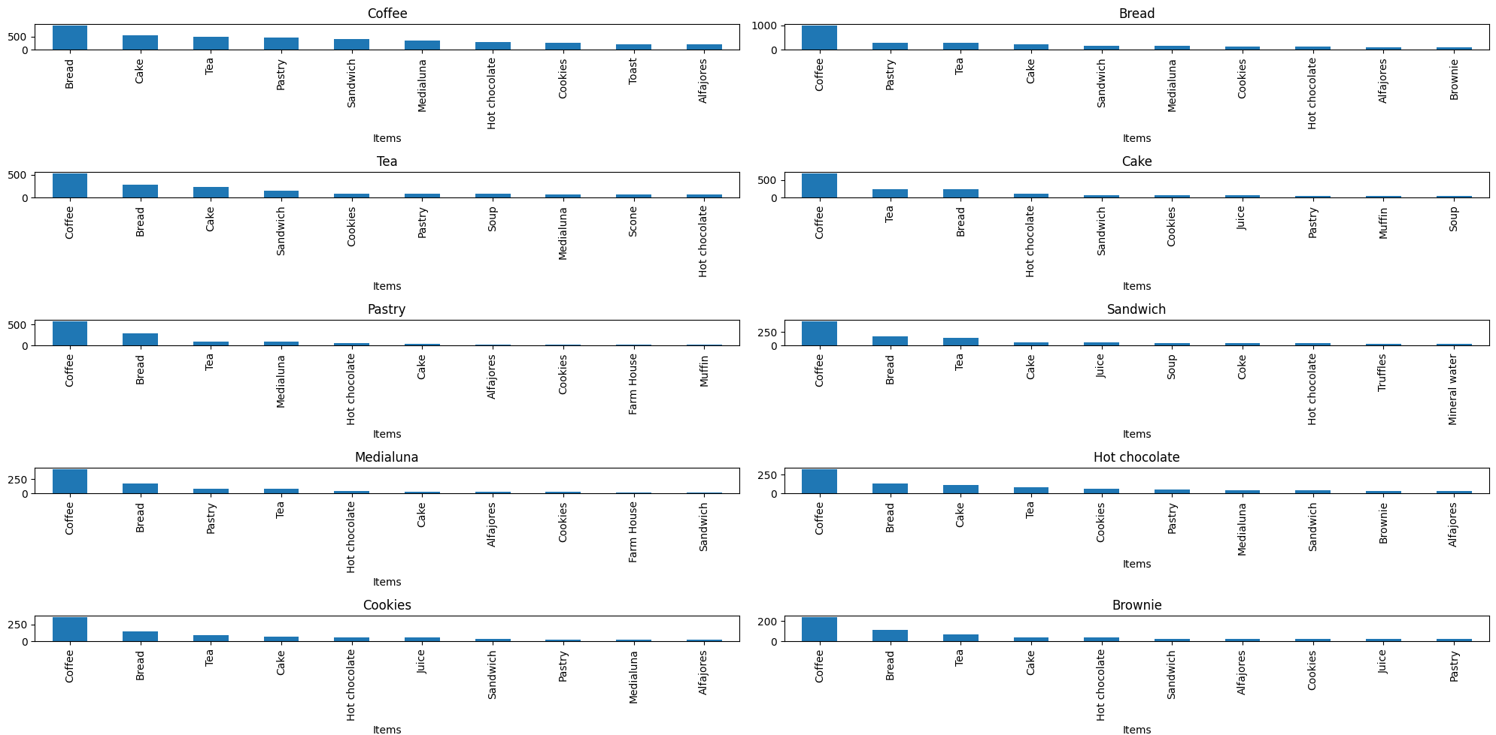
Frequent Item-Sets Example Output

Slide 29
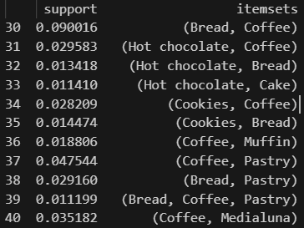
Frequent Item-Sets Example Output
We also analyze console output to gain a more detailed understanding of the interactions between these items.

Slide 30
Our Technical Approach

Slide 31
Technical Approach
Our goal was to use rule association to find sales opportunities for the bakery.
We did this using several different types key metrics and algorithms discussed in this class.

Slide 32

Support
The support of an item, or a set of items is the frequency that it appears in the dataset.
We use support to find the most popular items and item combinations, to find out the best deals to offer and items to increase or decrease our production of.
We calculate this using this code:

Slide 33

Confidence
The confidence of a set of items is the prevalence of the second item in entries that already have the first.
We use confidence to find the best pairing deals to suggest to a customer (i.e. they may be interested in a bread item if they are buying coffee)
We calculate this using the following code:

Slide 34

Lift
The lift of a set of items is the confidence divided by the support for the second item alone
Lift is the key to determining what is a well-targeted sale, while all items will be heavily associated with coffee in a bakery, that isn’t necessarily a well-targeted sale.
We calculate lift using the following code:

Slide 35
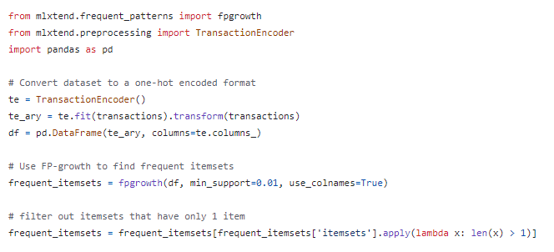
Rule Associations Using FP-Growth
The FP-Growth algorithm is an algorithm that identifies frequent association rules by creating a frequent pattern tree.
We implement this algorithm using the mlxtemd python library like this, which finds rules with a minimum support:

Slide 36
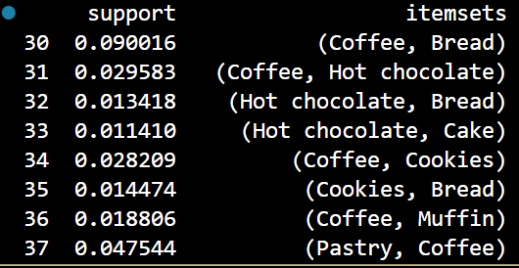
Issues With This Approach
You can see that at the end we have to filter out groups with only 1 item, this is because those will show up most prevalently always but aren’t very useful data.
After doing this we get much better results:

Slide 37
Summary of Solution Approach
We use a combination of Support, lift, confidence, and association rule mining to arrive at a list of best fit items for sales together.
Some insights will come from naively using support and confidence: coffee and bread are very popular and should be targeted for sales.
Other more targeted insights will come from lift and rule association mining: Hot chocolate and cake are very commonly bought together, despite being less popular items.

Slide 38
Our Results

Slide 39
Results
When selling expirable products, any items that go unsold are wasted.
By analyzing sales data, companies can predict when customers are most likely to order perishable items and plan appropriately.
Additionally, certain items such as beverages and pastries are often sold together.
Preparing often-paired items together is more efficient for sales

Slide 40
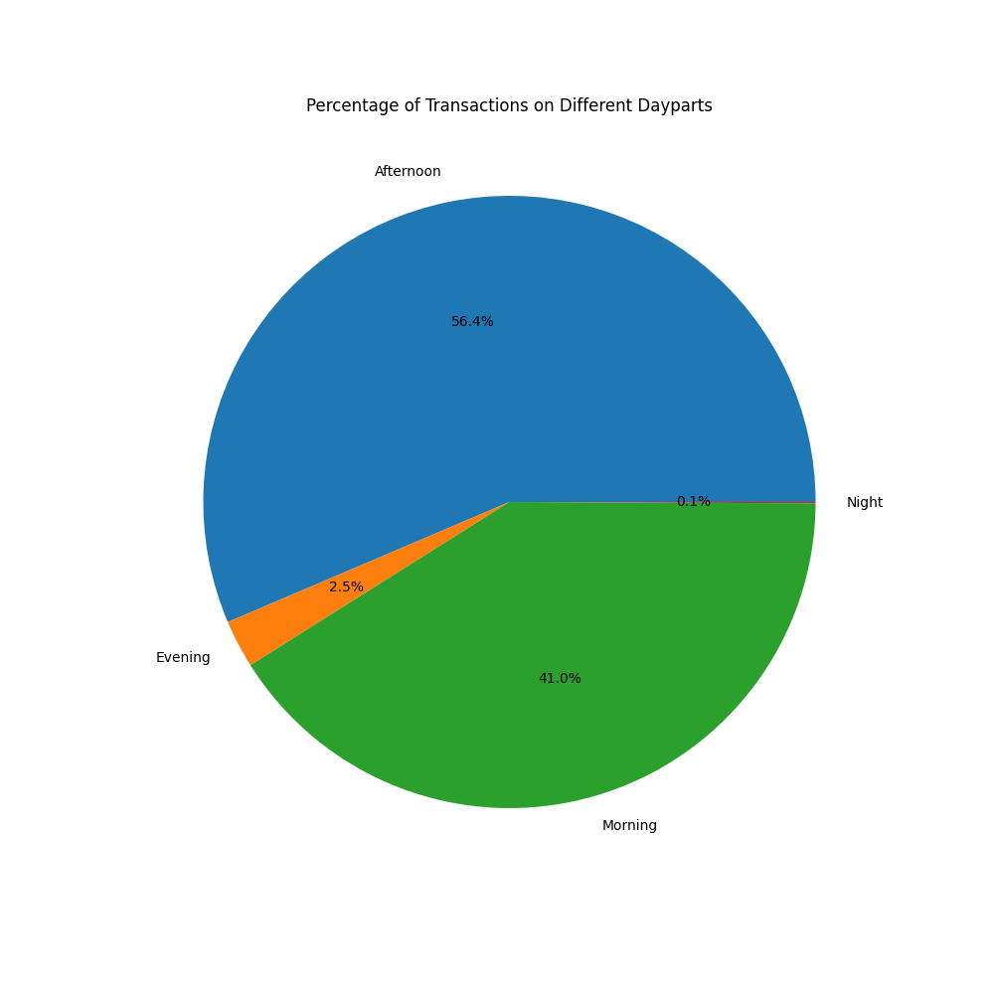
Percentage of Transactions by Time of Day
56.4% Afternoon
2.5% Evening
41% Morning
0.1% Night

Slide 41
Number of Transactions on each Hour
Helps businesses prepare for rush hours ahead of time

Slide 42
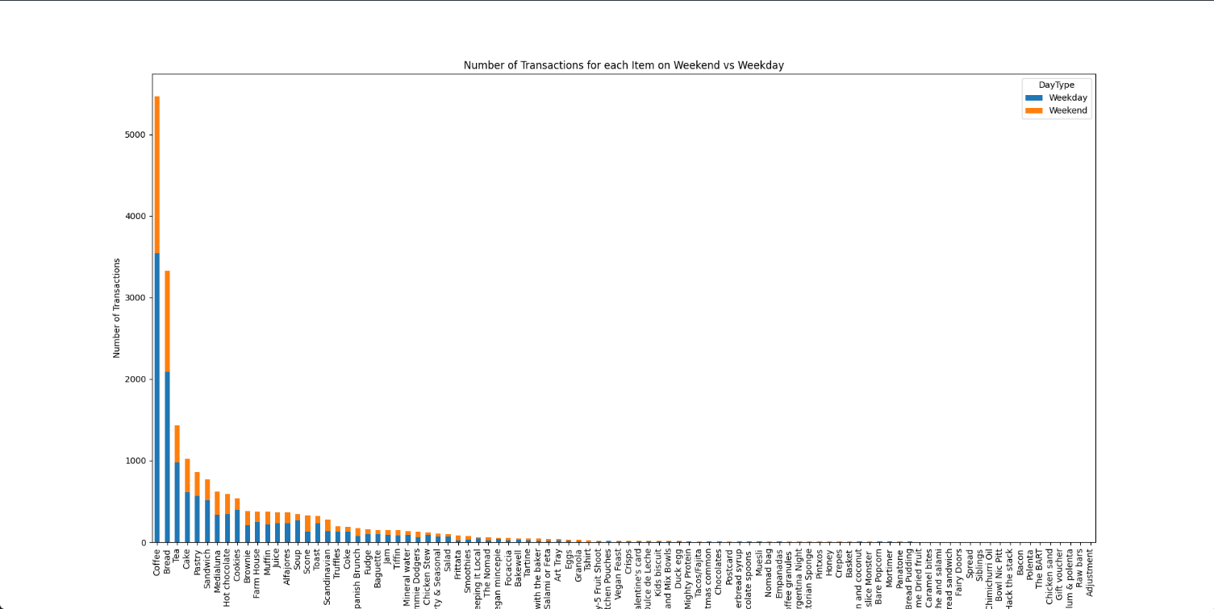
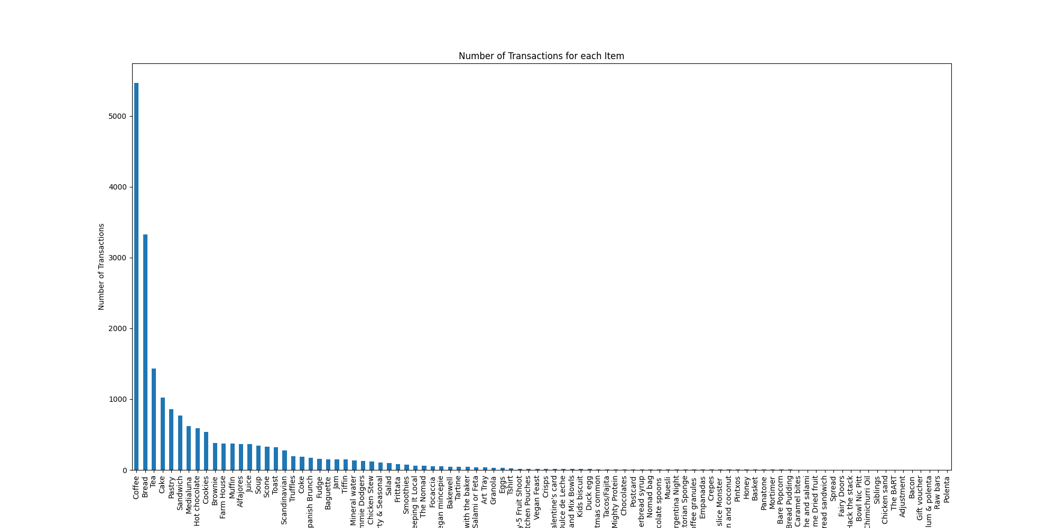
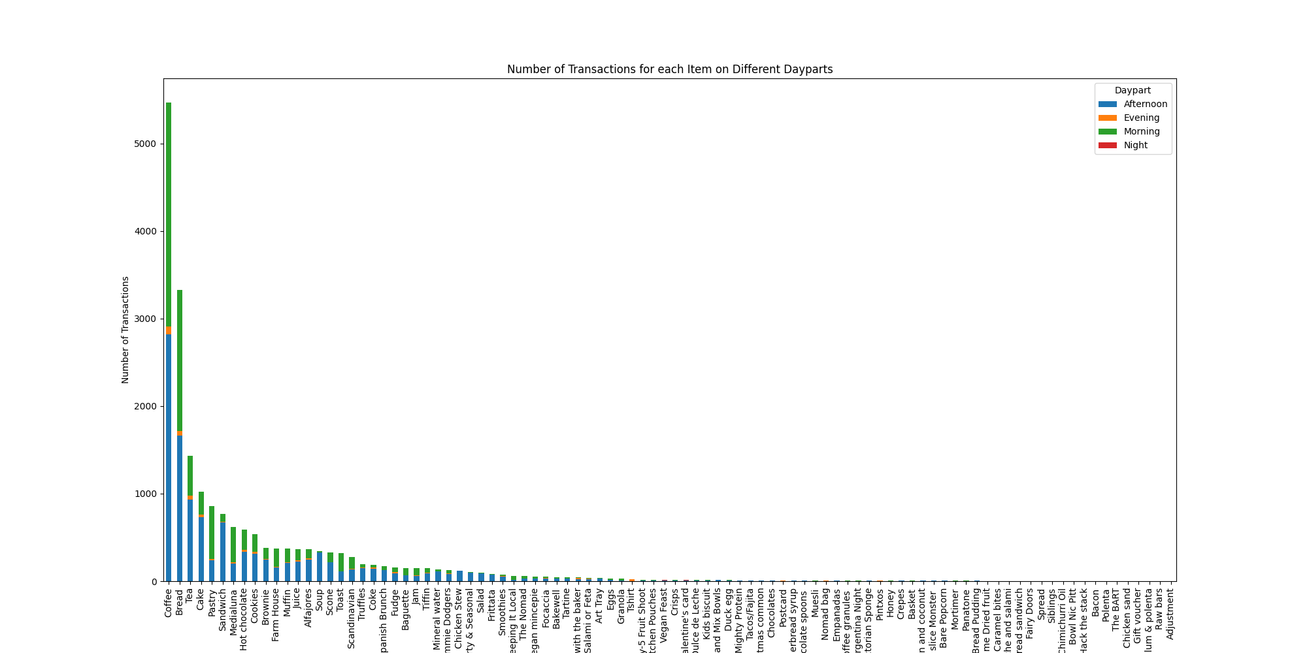

Number of Transactions for each item
Cake sells overwhelmingly more in the afternoon compared to the morning
Pastries are the opposite

Slide 43
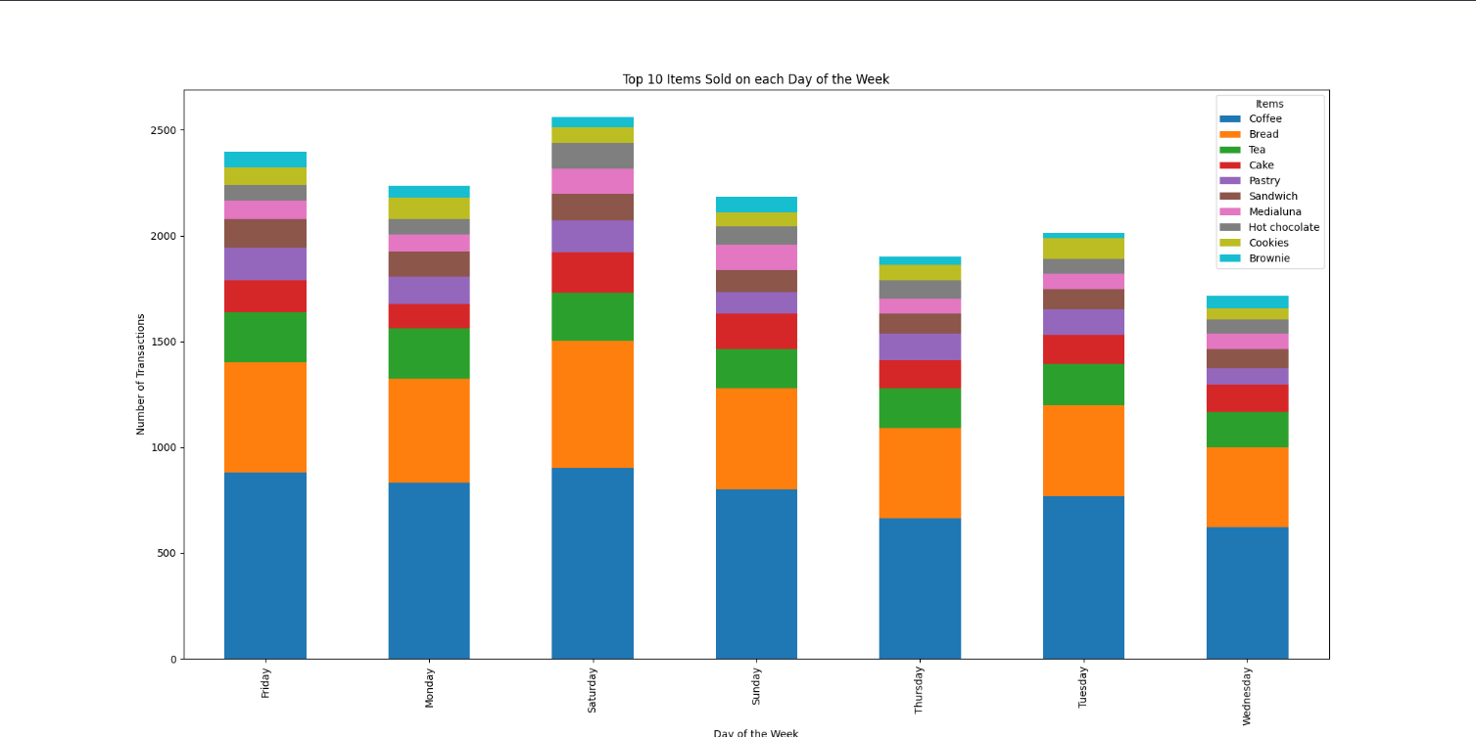
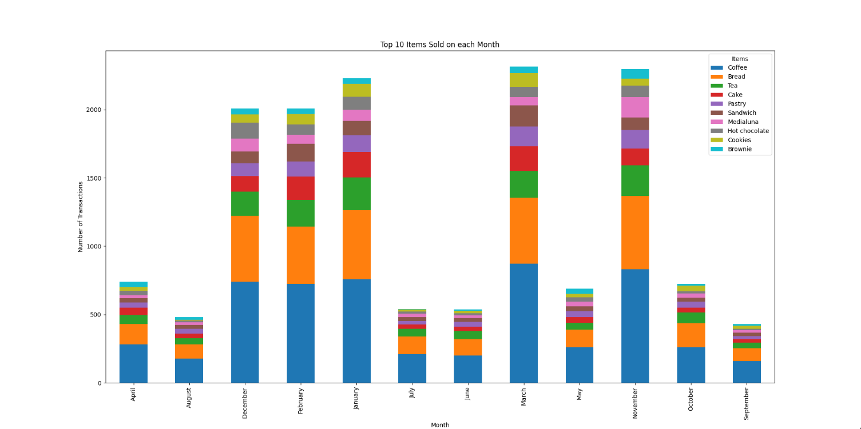
Top Items Sold by Day & Month
Many companies hire seasonal employees

Slide 44
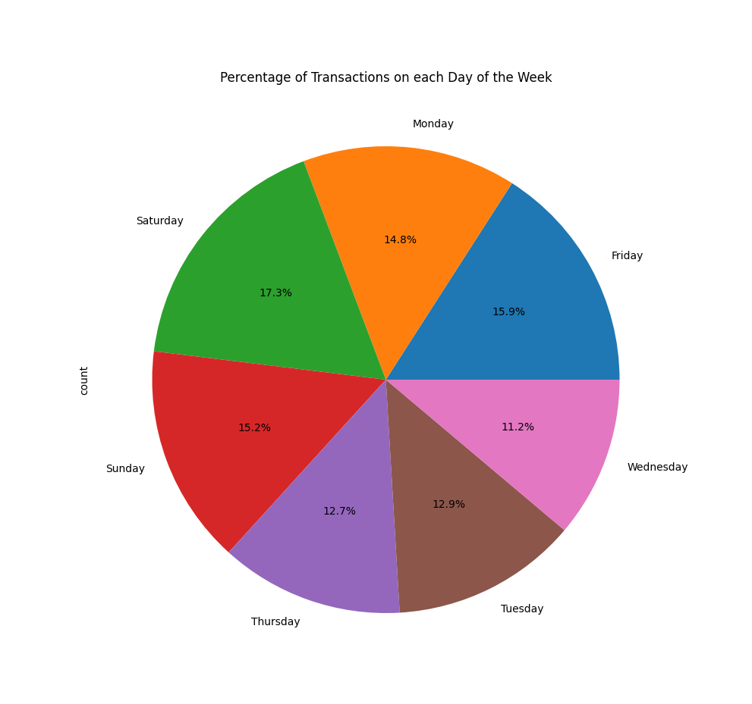

Slide 45
Number of items Sold on each Transaction
Sales are not in a vacuum
Most transactions include more than one item

Slide 46
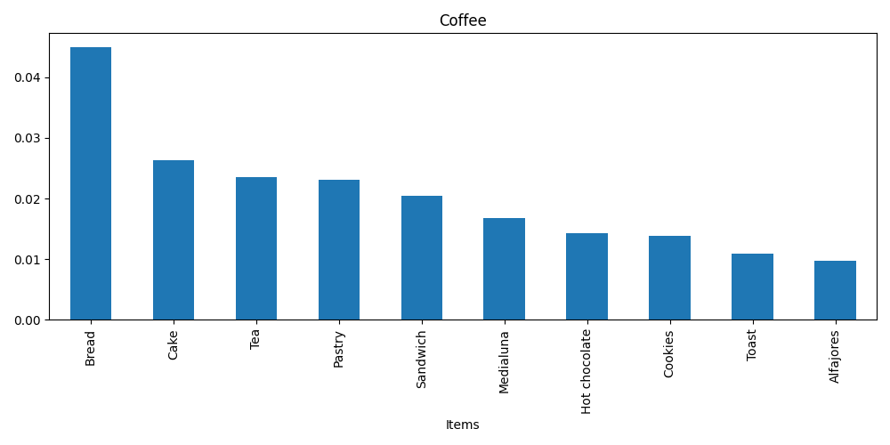
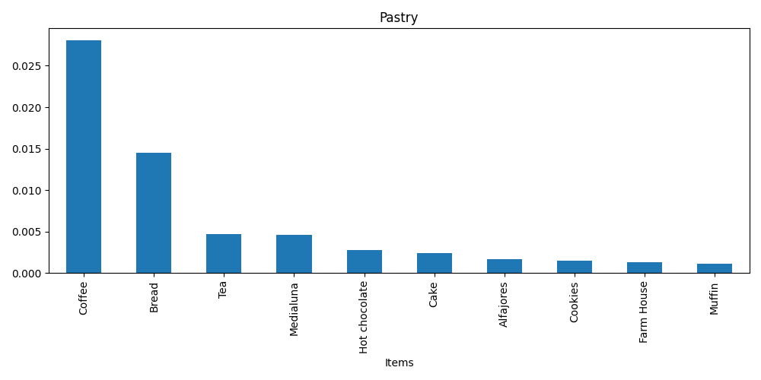
Top 10 Items by Support
While coffee sells well with pastries, pastry sales are dependent on coffee

Slide 47
Impact
Analyzing trends of sales data can reveal which items are bought together, how often, and at what time of day.
Accurate predictions of consumer behavior allow employees to preemptively bake items without fear of letting them go unsold
On a corporate scale, it reveals how many employees should be scheduled for each day, or how many temporary employees to hire during high-traffic months

Slide 48
Reproducing Our Algorithms

Slide 49
Reproducibility and Observations
The reproduction process is aimed at replicating previous results.
Its importance is in showing that a method will continue to be applicable in scenarios other than the original.
Reproducibility ensures the validity and reliability of findings.
Reproducibility emphasizes transparency in methodologies, documentation, and code sharing.

Slide 50
Data Preprocessing and Analysis
Started by importing the bakery sales data set from kaggle using pandas.
Preprocess the data by removing outliers
Extract relevant features such as date, time.
Analyze the data by creating relevant visuals with pyplot

Slide 51
Associate Rule Mining
We used the FP-growth algorithm to find frequent itemsets in the dataset.
Useful for uncovering associations and correlations between items in transaction data, which can inform marketing strategies and inventory management.
Analyzed the results by plotting the top 10 pairs of items with the highest confidence, lift, and support in a bar chart.

Slide 52
Reasons for lack of reproducibility
Data Quality
Missing Entries
Erroneous Entries
Parameter Settings
Market Dynamics

Slide 53
Steps to Reproduce our Analysis
Go to our github repository @ https://github.com/Tobyclark/BakerySalesTrendsAnalysis
Download the repository and run:
python data_analysis.py

Slide 54
How Reproducible will our methods be?
The analysis focuses solely on association rules between products and times of sale within the bakery sales dataset.
This work may not be reproducible for more complex datasets.
This work may not be reproducible for data in other industries.

Slide 55
Reproducing the FP-Growth algorithm
We use a library for this algorithm, but if you wish to implement it yourself here is a quick summary:
Insert each piece of data into a tree data structure called an FP-Tree
Generate conditional FP-Trees for each item in the tree and recursively mining these conditional trees to find frequent patterns.
Use "path pruning" to reduce the search space by removing infrequent items and branches from the FP-tree.

Slide 56
Questions and Concerns
Any questions, concerns or discussion points anyone would want to be addressed?

