Slide 1
Title Slide [name?]
By Toby Clark, John Kendall, Ryan Luders, ...

Slide 2
Brief Overview
For our project, we chose to analyze Bakery Sales, finding associations among products in the dataset to be able to make conclusions about:
Which products should be sold on their own.
Which products should be sold together.
Used trees, patterns, and
The sales dataset was analyzed via a Python program, taking advantage of Python’s built-in modules and libraries to help complete datamining tasks.

Slide 3
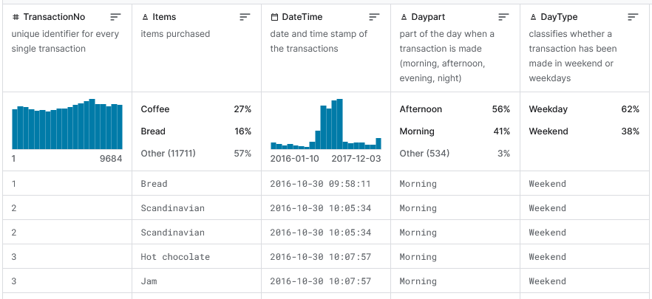
The Bakery Dataset
Dataset:
Belongs to a bakery in Edinburgh, Scotland.
Contains transaction details of customers who ordered different items online from this bakery from December 2003 to January 2011.
https://www.kaggle.com/datasets/akashdeepkuila/bakery

Slide 4
Motivation From Real-World Applications
In modern-day Commerce, products and sales are being increasingly digitally tracked and recorded.
Businesses must use their sales datasets to refine their sales strategies if they want to keep up.
Datamining sales data can help:
Determine which sales would maximize profits.
Determine when products should be prepared at a given date and time.
Particularly, when pairs of products should be prepared together, determined through finding associations between products.

Slide 5
Data Mining Questions
We want to be able to determine from datamining:
Which products are the most popular?
Which products should be sold on their own?
Which products sell the best together?
Which products should be sold together?

Slide 6
Personal Motivation
Datamining sales data helps determine when different products should be prepared at given dates and times for a business, by making associations, such as finding similarities in sales data, between products.
Analyzing Bakery sales trends in particular is unique in how quickly certain products must be sold, due to many bread-related items having short shelf-lives.
This makes analyzing Bakery sales trends to find associations more crucial than some other fields in regards to:
Finding dates to prepare certain foods which will sell in spite of short expiration dates.
Optimizing production schedule.
An industry with no way to stockpile many items (pasteries, coffee).
Finding combinations of products to sell with short-expiration dated foods.

Slide 7
Challenges
Some challenges found in analyzing the Bakery Sales Dataset:
A lack of detail regarding the typing of many products.
There is a differentiation between different hot beverages, but no differentiation given from the dataset about differentiations between two beverages of the same type.
This means a hot chocolate, ordered cold, is treated and recorded as a hot chocolate within our chosen dataset.
In our approach, one way we get around this is putting the data in bar graphs and pie charts when analyzing, so as not to focus too hard on one sale which could be an exceptional case not noted in the sales dataset.
Data preprocessing
Pandas was used in the approach to help in extracting individual hour, minute, and date attributes.
In grouping this particular data, operations like sort_index() was used to sort counts of occurrences of unique values related to time for preprocessing.
Unstack() used to pivot the data when needed on DataFrames.
Mapping numerical day of the week and month pairs to their written English counterparts made visually interpreting analysis results easier.

Slide 8
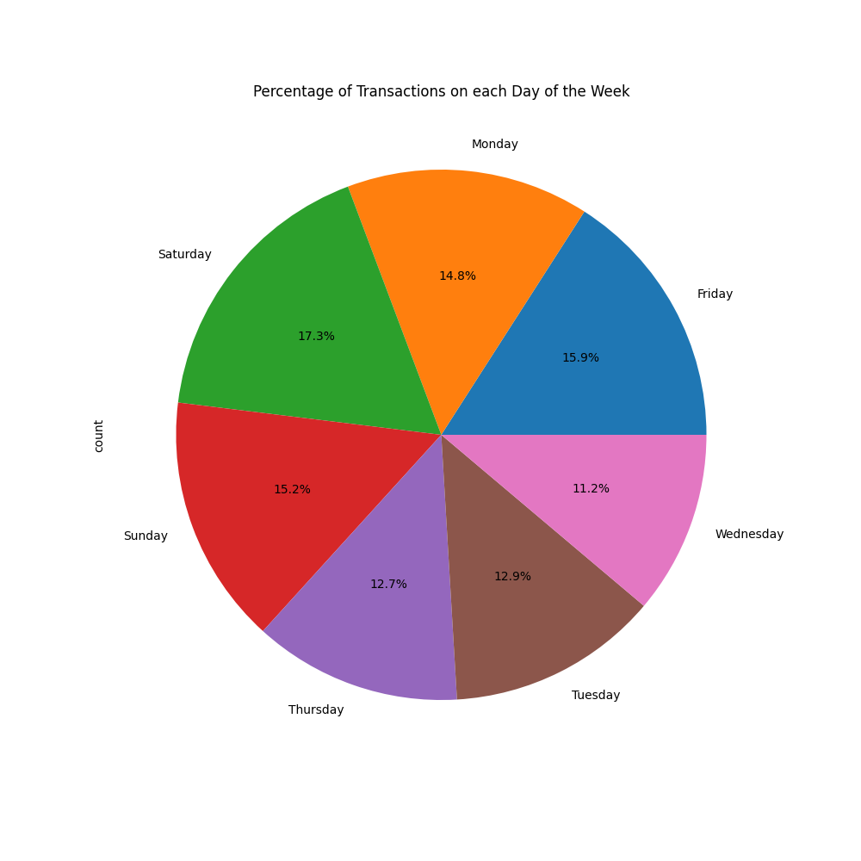
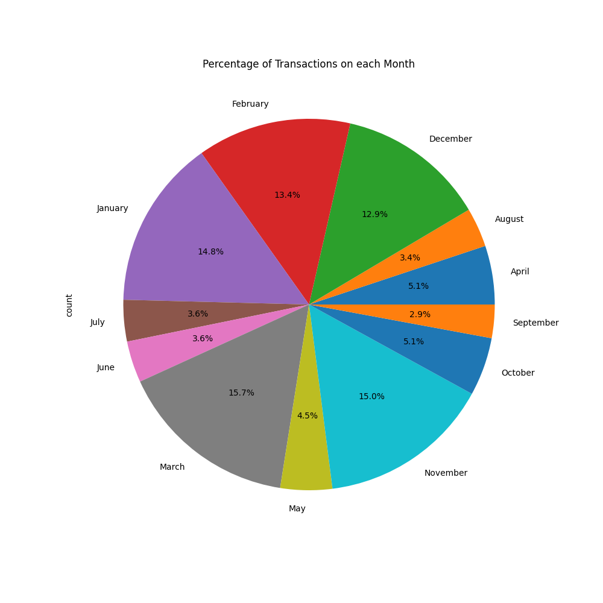
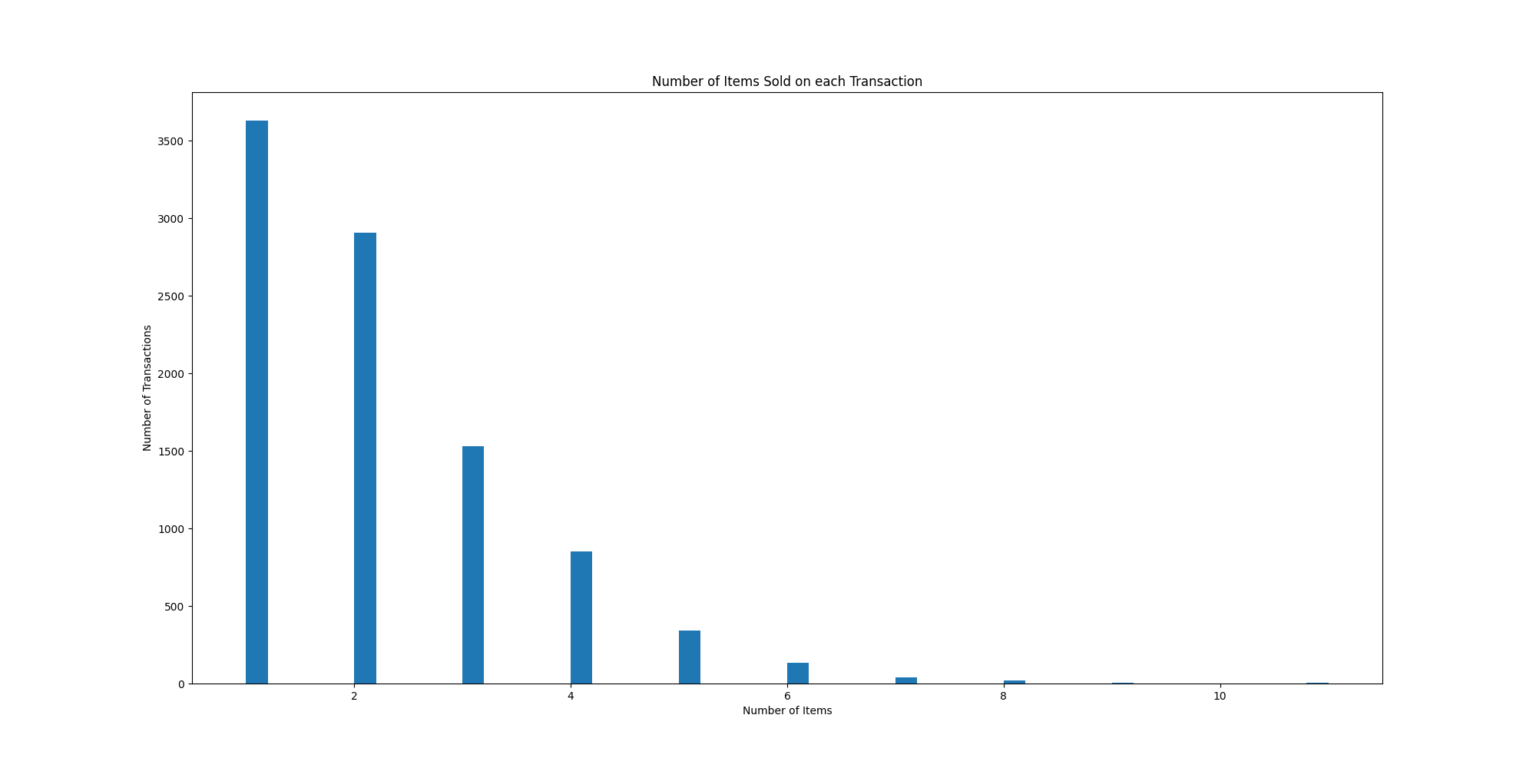
Results Found (Broad)
Saturdays sell the best overall at the bakery, followed by Friday and Sunday afterwards. Winter/Spring months sell best.
More transactions consist of more than one item sold at a time.

Slide 9
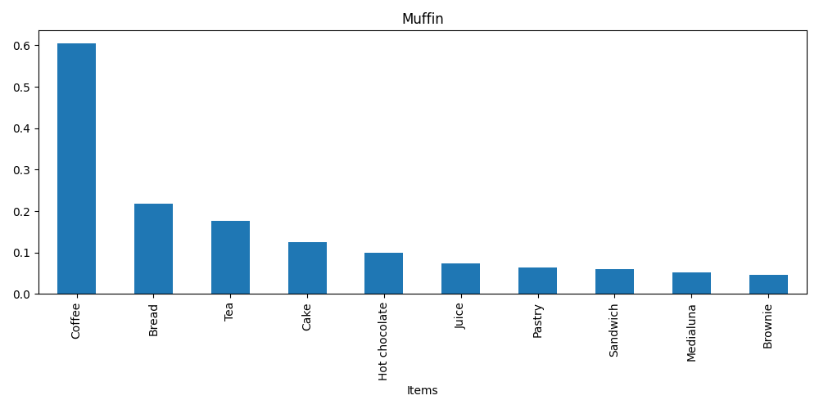
Results Found (Specific)
Charts displaying the top 10 confidence, lift, and support of specific items:
Bread
Coffee
Cookies
Hot Chocolate
Jam
Medialuna
Muffin
Pastry
Scandinavian
Tea

