Slide 1
Results
When selling expirable products, any items that go unsold are wasted.
By analyzing sales data, companies can predict when customers are most likely to order perishable items and plan appropriately.
Additionally, certain items such as beverages and pastries are often sold together.
Preparing often-paired items together is more efficient for sales

Slide 2
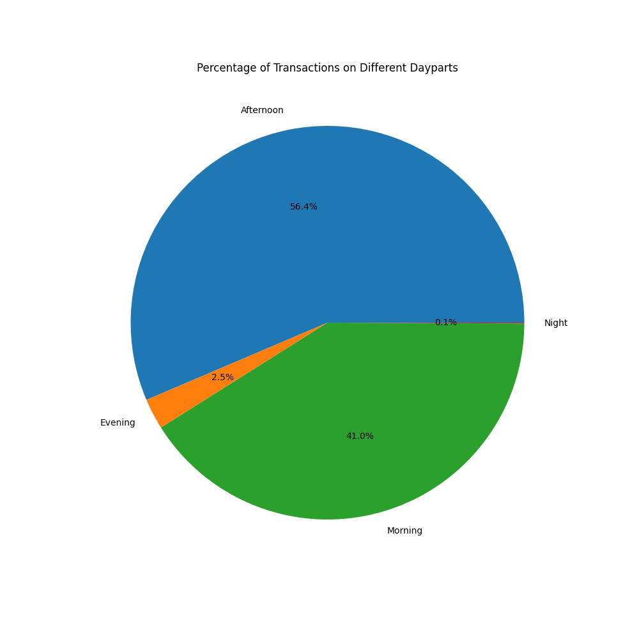
Percentage of Transactions by Time of Day
56.4% Afternoon
2.5% Evening
41% Morning
0.1% Night

Slide 3
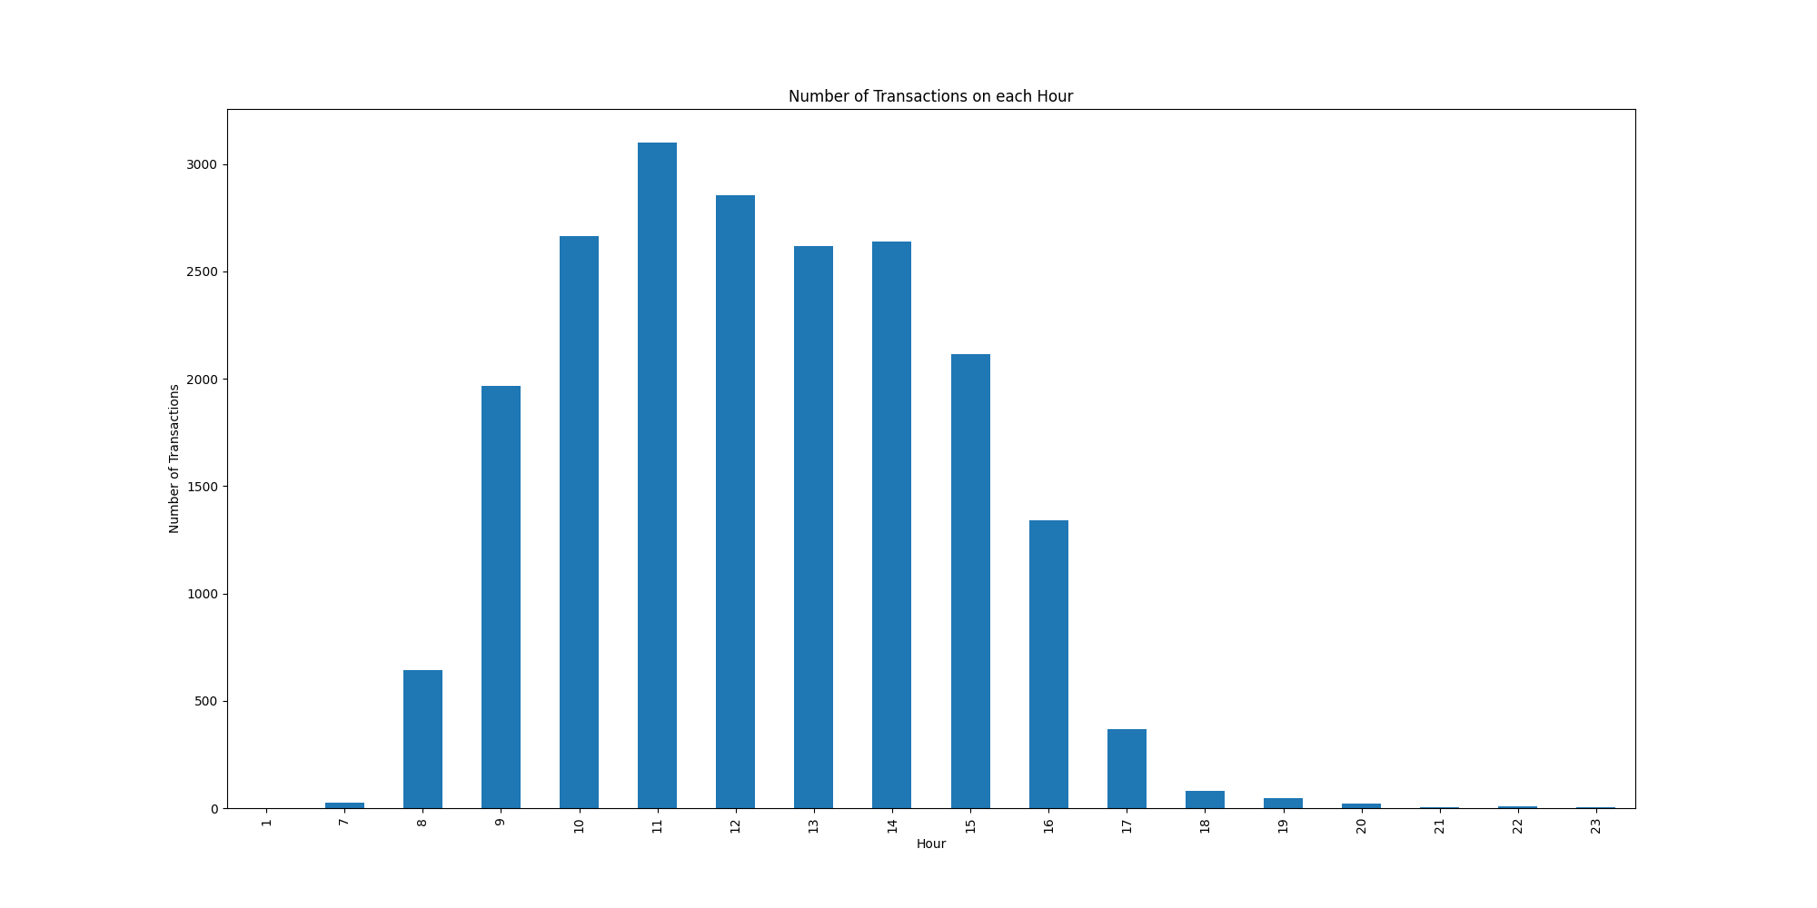
Number of Transactions on each Hour
Helps businesses prepare for rush hours ahead of time

Slide 4
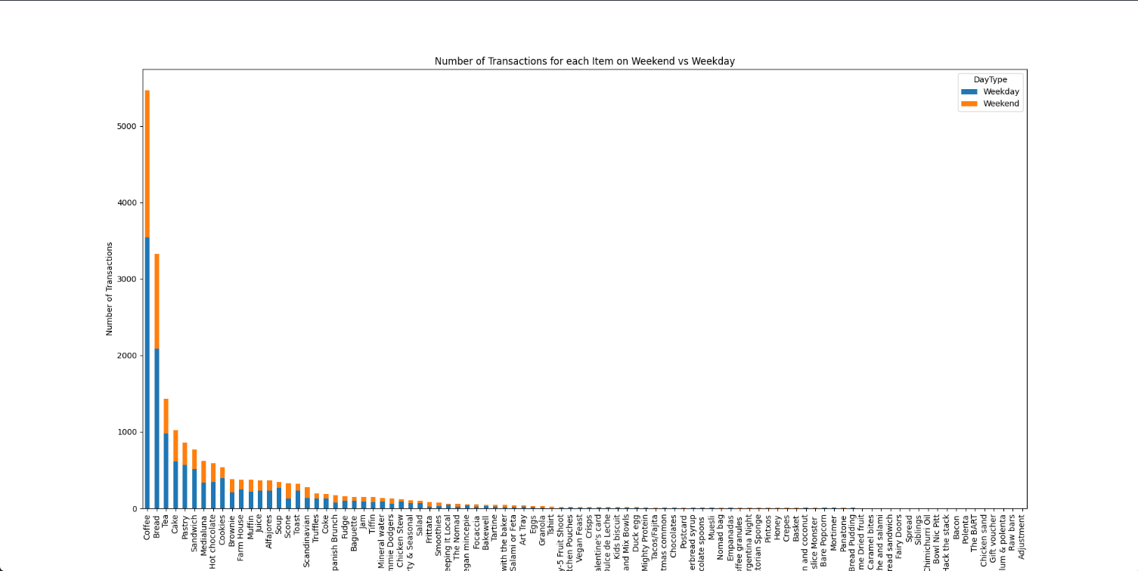
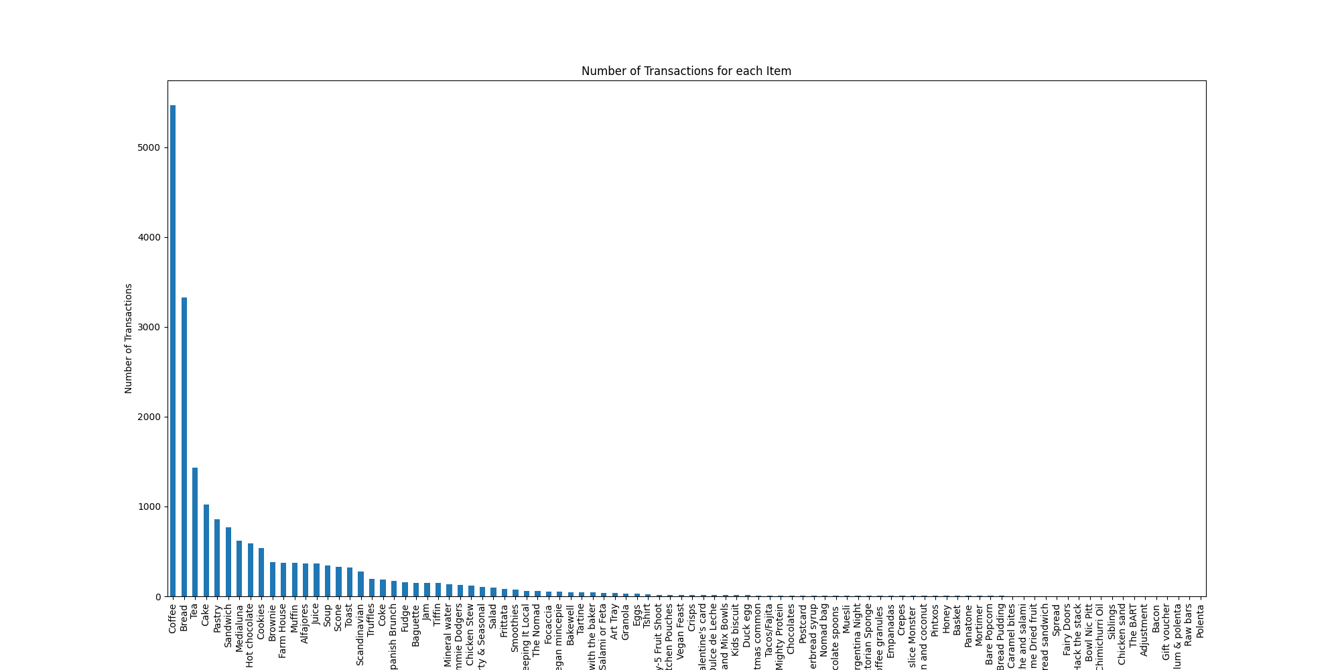
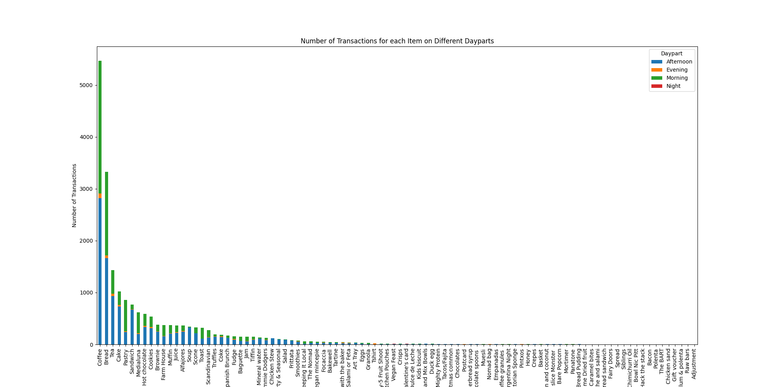

Number of Transactions for each item
Cake sells overwhelmingly more in the afternoon compared to the morning
Pastries are the opposite

Slide 5
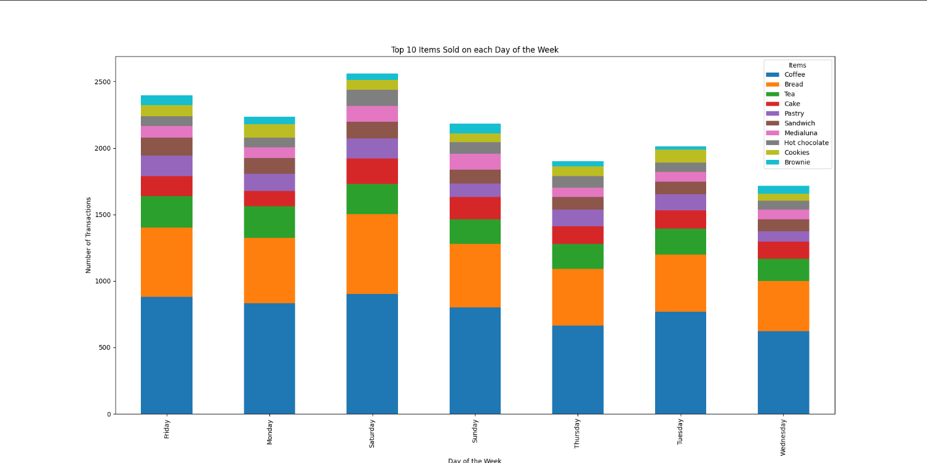
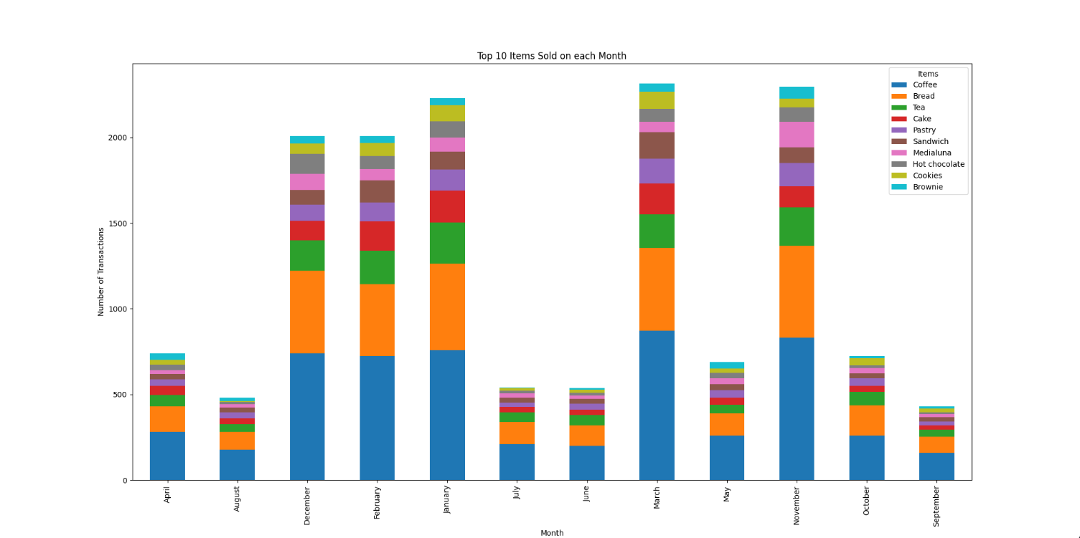
Top Items Sold by Day & Month
Many companies hire seasonal employees

Slide 6
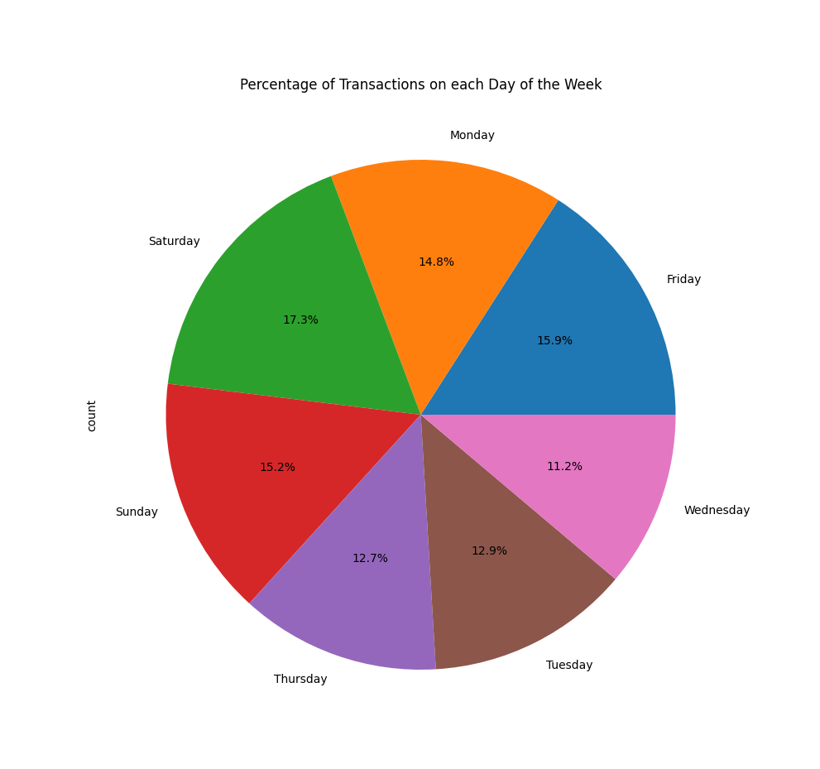
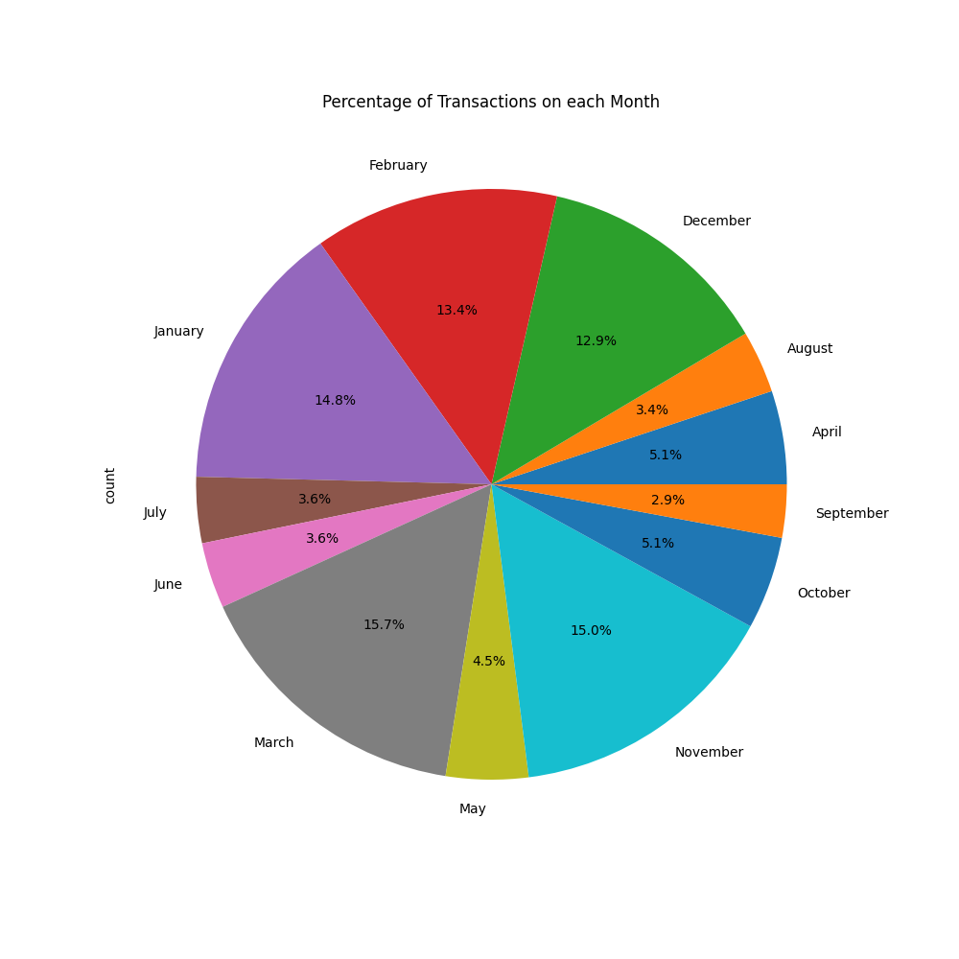

Slide 7
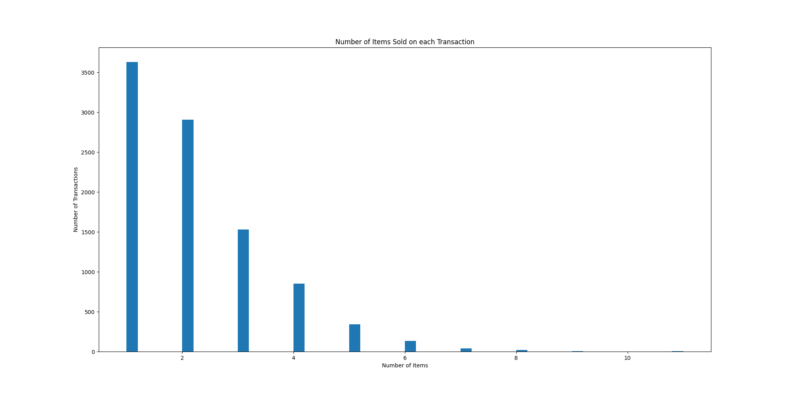
Number of items Sold on each Transaction
Sales are not in a vacuum
Most transactions include more than one item

Slide 8
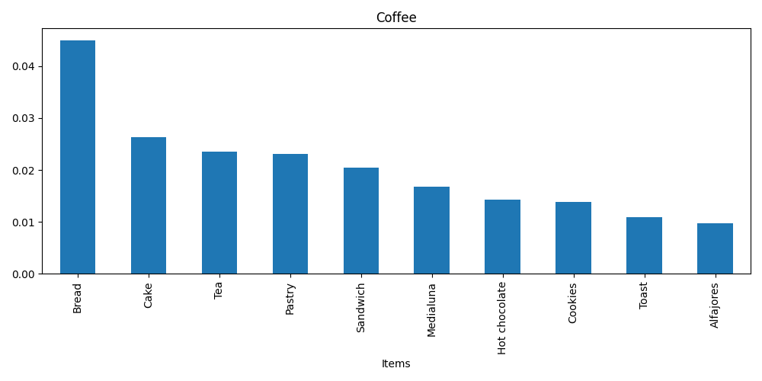
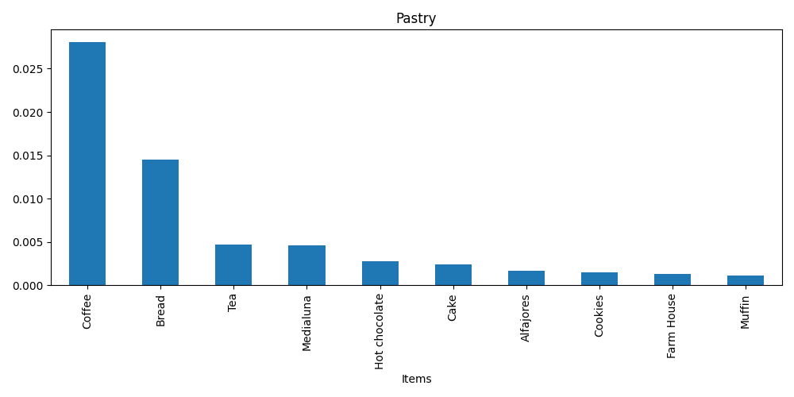
Top 10 Items by Support
While coffee sells well with pastries, pastry sales are dependent on coffee

Slide 9
Impact
Analyzing trends of sales data can reveal which items are bought together, how often, and at what time of day.
Accurate predictions of consumer behavior allow employees to preemptively bake items without fear of letting them go unsold
On a corporate scale, it reveals how many employees should be scheduled for each day, or how many temporary employees to hire during high-traffic months

