Slide 1

Servlets
By: Brian Kenoyer

Slide 2
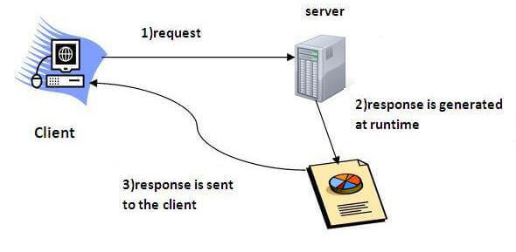
Servlet
Servlet Technology is useful for creating web applications that reside on the server and are then dynamically made on request.
Java is very good at being a server-side programming language. Before Java, CGI (Common Gateway Interface) scripting language was used, but was very inefficient. Java can minimize the load on the server in comparison to the CGI setup.

Slide 3


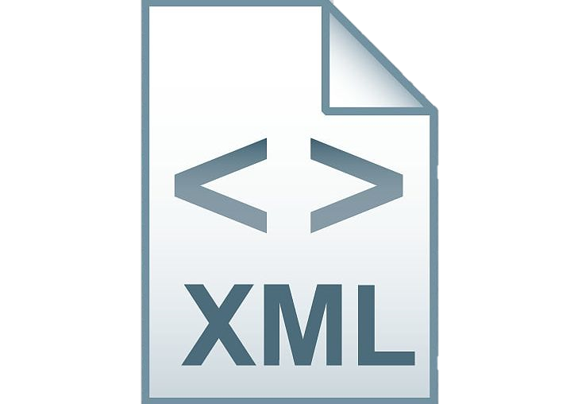

Servlet
Servlets require four things. The initial web page(index.jsp), a web.xml, the Java Code and some server application like Apache Tomcat.

Slide 4

Apache Tomcat
To get Apache Tomcat working, you need to start by downloading it from Apache.org https://tomcat.apache.org/download-90.cgi
Place the zip file somewhere on your drive where you will have it working. Then unzip it.
Copy the path to the directory for use in Eclipse.

Slide 5

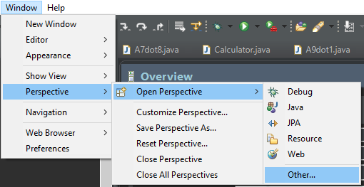
Apache Tomcat
Now, open eclipse and click on Window/Perspective/Open Perspective/Other.
If Java EE is not present, you will have to install it. To do this, click on Help/Install New Software. Then open the Work With bar and select 2018-12 - http://download.eclipse.org/releases/2018-12. Then scroll down and check Web,XML,Java EE and OSGI Enterprise Development. Then click next to install it. Eclipse will need to restart after install to use Java EE.

Slide 6
Apache Tomcat
Now that Java EE Perspective is open and Apache Tomcat is installed, we now need to connect it to eclipse. Do this by selecting Servers, then click the link to add a server.
Open the Apache file and select Tomcat v9.0 Server. Then paste the folder where you unzipped Tomcat into the line for Tomcat installation directory.
Now you should be able to start the tomcat server by right clicking it and pressing start.
For details about the server, double click it to see the settings of the server instance.

Slide 7
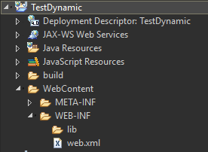
Dynamic Web Project
At this stage, we can now create our Dynamic Web Project or convert a java project into a Dynamic Web Project.
When we do this, we can create the HTML () XML and the Java portions. During the creation, make sure to check the box to generate web.xml deployment descriptor.
It will create your xml under the WebContent/WEB-INF/lib under the project.

Slide 8
Dynamic Web Project
At this point, we now need to create the index.jsp file.
Right click the WEB-INF file and press new, then jsp file. Change the file name to index.jsp as this is what is specified within the XML file by default.
Once index.jsp is created, you can now make your html to connect to the rest of the java. I used a simple html button to initialize mine.

Slide 9
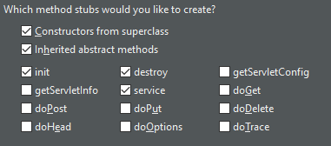
Dynamic Web Project
Now we can create the java portion. Right click the project and press new servlet. Set the name of the package and class. The press next twice to get to the method stub creation.
You will want a init, destroy and service method created. This can be done manually, but eclipse can do it for you also. Uncheck any other methods that it might have unless you plan on using them.
Click finish to create the Java project portion of the servlet.

Slide 10
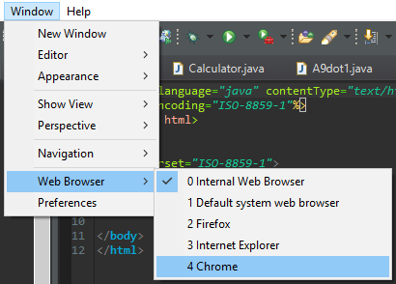
Dynamic Web Project
To test the project, right click on the index.jsp file and press Run As/1 Run on Server. This will open the internal Eclipse web browser to run the project from your apache webserver. If you want to run it from Chrome or Firefox, you can change the default web browser by going to Window/Web Browser.

Slide 11
Sources
Java T Point:
https://www.javatpoint.com/servlet-tutorial
Geeksforgeeks:
https://www.geeksforgeeks.org/java-io-printwriter-class-java-set-1/
Telusko:
https://www.youtube.com/watch?v=7TOmdDJc14s&t=184s https://www.youtube.com/watch?v=PH-bK3g2YmU

