Slide 1
WIN PREDICTION ANALYSIS
Kenny D

Slide 2
Table of Contents
No. | Particular | Slide Number
1 | Problem Statement | 3
2 | Objective | 4
3 | Data Description | 5
4 | Data Cleaning | 6
5 | Exploratory Data Analysis | 7
 | 5.1 Top 5 VP-Manager Combination | 20
6 | Models Built | 21
 | 6.1 Random Forest Classifier Report
7 | False Prediction Loss Calculation | 23
8 | Training and Cross Validation Summary | 24
9 | Results | 25
10 | Recommendations | 26

Slide 3
Problem Statement
An IT Consulting company needs analysis and prediction of win possibility for potential client deals using variable combinations in order to optimally allocate staff and resources, to mount the company’s profitability & meet the growth targets.
Our company earns revenue by providing IT solutions to clients from various sectors through successful deals.
In this extremely competitive market, it is vital for company to maximize the successful deals count by exercising caution and prudence in allocation of resources for bidding proposals.
As a result, our company requires a machine learning (ML) model for making predictive analysis around the defined problems assuring maximum accuracy.

Slide 4
Objective
Objective 1: Predictive Analytics - Build a ML model to predict the probability of win/loss for bidding activities for a potential client.
In this project through exploratory data analysis & predictive algorithms, we will endow various combinations using the given criteria that enhances the possibility of winning a deal.
Objective 2: Prescriptive Analytics – Identify variable/s that are most likely to help in converting an opportunity into a win.
The project also aims to predict finest VP & Manager combinations for allocation of deals in order to improve the success rate in bids .
Further we will evaluate the total amount of Deal Cost Lost due to incorrect prediction which can be used as reference for upcoming deals success predictions.

Slide 5
Data Description
Data set contains 1 target variable (Deal status code), 8 Deal criteria & 10061 closed deals data for period of 8 years.
Column Name | Data Type | Description
Client Category | Categorical | Industry in which the client works
Solution Type | Categorical | The solution group the client requires
Deal Date | Date | The date the opportunity was created (Pitch date)
Sector | Categorical | The sector for which the solution is to be provided
Location | Categorical | Client location
VP Name | Categorical | Vice President – main contact dealing with the client
Manager Name | Categorical | Manager of the team working on the project
Deal Cost | Numerical | The initial cost of the deal (assuming currency as USD)
Deal Status Code (Target) | Categorical | Final status of the deal (Won/Lost)

Slide 6
Data Cleaning
Before working on the data, few preliminary checks were done to weed out any data discrepancy.
Criteria | Number of Rows | Action Taken | Rationale
Deal Cost = 0 | 246 | Deals removed. | As data is taken from CRM framework, an entry of 0 is not possible. Hence its an error.
Duplicate deals | 13 | Deals removed. | Duplicate deals might be due to a clerical error. Such entries would incorrectly skew the results.
Client Category = NA | 73 | Replaced with “Unknown” | Imputing category as mode might skew the data towards that category. Hence, better to rename it to avoid loss of data.
Remaining Number of Deals | 9802 | EDA & Model Building | Data set with 9802 rows of closed deals was used in ML model building.

Slide 7
EXPLORATORY DATA ANALYSIS
Win Possibility
Client
Category
Location
VP
Manager
Sector
Solution
Deal Cost
Column Name | Unique Values
Client Category | 42
Solution Type | 67
Deal Date | 2530
Sector | 25
Location | 13
VP Name | 43
Manager Name | 276
Deal Cost | 1468
Deal Status Code | 2

Slide 8
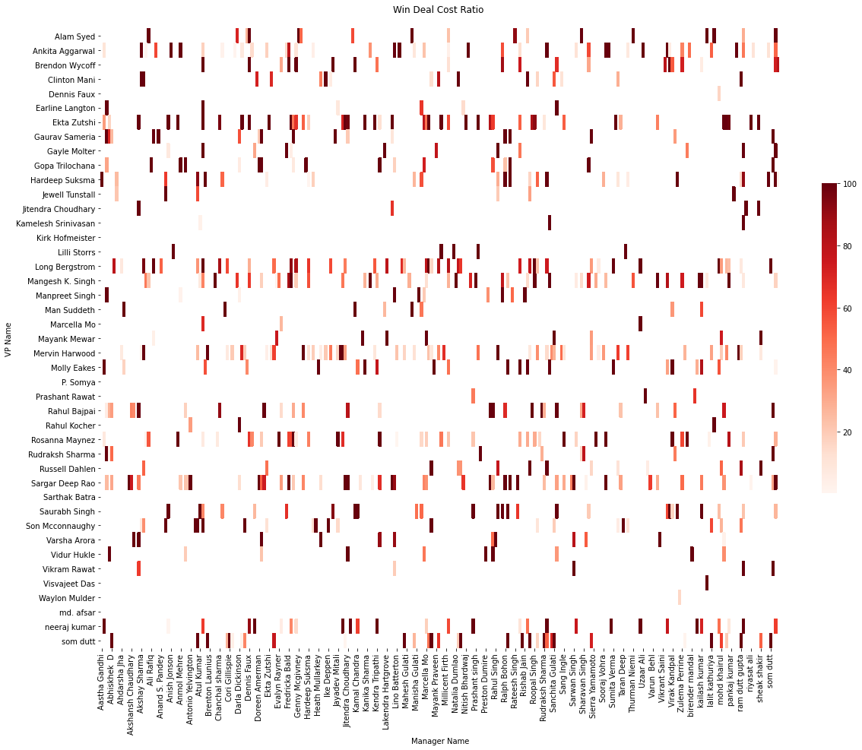
Won Deals Analysis
Adjacent Heatmap derives there are numerous combinations who have positively converted more than 50% of their deals.
Total number of deals won are 3751 & Sum of Won deals cost is $ 2,947,958,825 which is 38.25 % of total deals .
Total Sum of deals won is further bifurcated in to 4 ranges for detail analysis.
The combinations with ratio above 0.5 can be given more deals as they have potential.
Sum of won deals cost range | VP & Manager Combination | Deals Won
0-25 | 423 | 836
26-50 | 126 | 1012
51-75 | 96 | 937
76-100 | 307 | 966

Slide 9
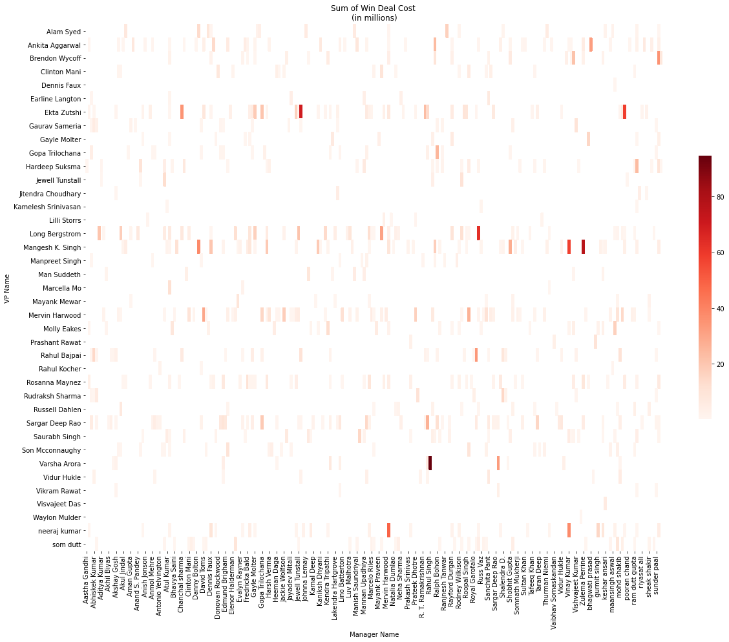
VP & Manager Combinations
Data Contains a total of 960 unique combinations of VP & Managers.
Our Company hired 43 VP’s & 276 Managers for contribution of company revenue.
Data reveals very few VP and Manager combinations are highly successful.
The Dark red bars are VP Manager combinations who have brought high Deal Revenue to the company.
Top 5 combination of VP & Managers contribute to 3.15% of won deals.
From the horizontal bars, we see that VP have more weight over Winning a deal than does Manager.

Slide 10
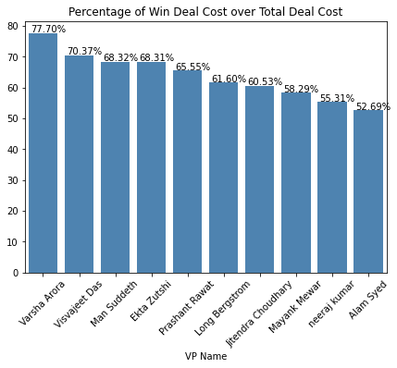
Win Deal Cost Percentage of VP Name
We have further singled out the top 5 VP’s on basis of highest revenue generation.
VP Name | Manager Name | Win Deal Total Costs $ ’ Mn | Number of Win Deals
Varsha Arora | Rahul Singh | 94.70 | 6
Mangesh K. Singh | Zulema Perrine | 76.65 | 9
Ekta Zutshi | Jitendra Choudhary | 69.73 | 11
Long Bergstrom | Russell Dahlen | 63.15 | 75
Ekta Zutshi | Neeraj Kumar | 58.52 | 40

Slide 11
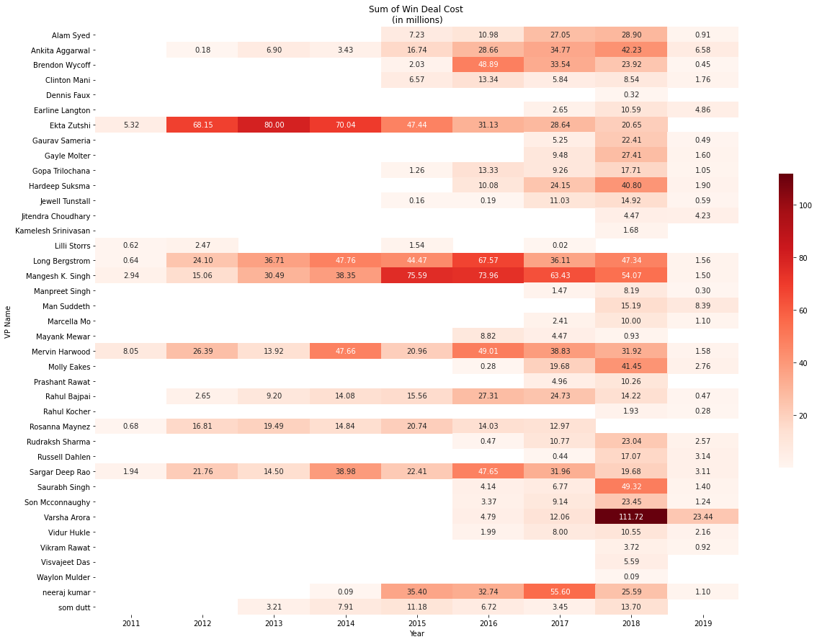
VP Name and Year Combinations
Some VPs have made no deals in year 2018 and 2019.
Two inferences
VP has left the company
VP is on sabbatical
VP Name | Year | Win Deal Total Cost $ ’ Mn | Number of Win Deals
Varsha Arora | 2018 | 111.72 | 24
Ekta Zutshi | 2013 | 80.00 | 88
Mangesh K. Singh | 2015 | 75.59 | 53
 | 2016 | 73.96 | 34
Ekta Zutshi | 2014 | 70.04 | 73

Slide 12
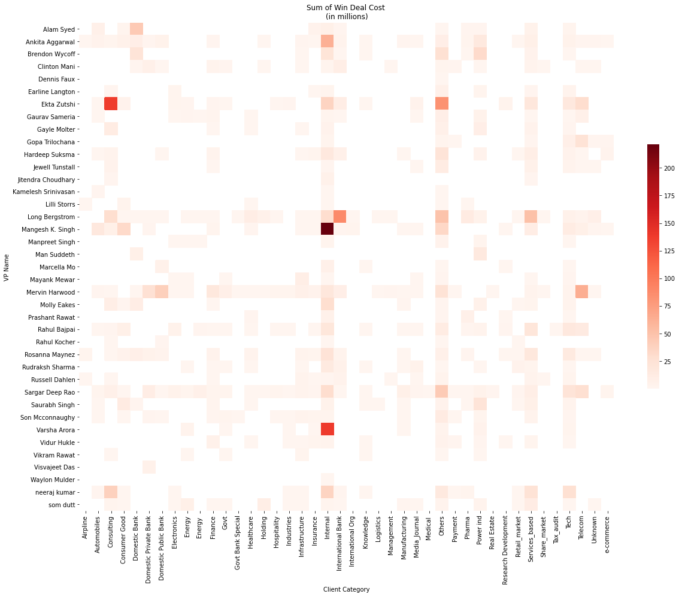
VP Name & Client Category Combinations
Our company successfully provides solutions to 42 unique clients.
Client Categories such as Internal, Others, Tech, Consulting and Service Based have brought in high revenue to our organization.
Mangesh K Singh has brought in most Revenue from Internal category deals which has a deal win ration of 53%.
Further to the analysis, we recommend our top performing VP’s to be delivered to these client bids to increase the chance of winning.

Slide 13
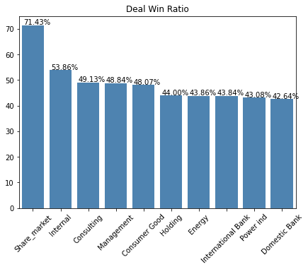
Win Deal Cost Percentage of Top 5 VP in Client Category
Below mentioned are the clients who have generated high revenue to company along with respective VP’s and percentage of their deals on basis of total won deals .
VP Name | Client Category | Win Deal Total Costs $ ’ Mn | Number of Win Deals
Mangesh K. Singh | Internal | 221.12 | 107
Varsha Arora | Internal | 138.55 | 19
Ekta Zutshi | Consulting | 137.87 | 52
Long Bergstrom | International Bank | 88.56 | 84
Ekta Zutshi | Others | 83.04 | 108

Slide 14
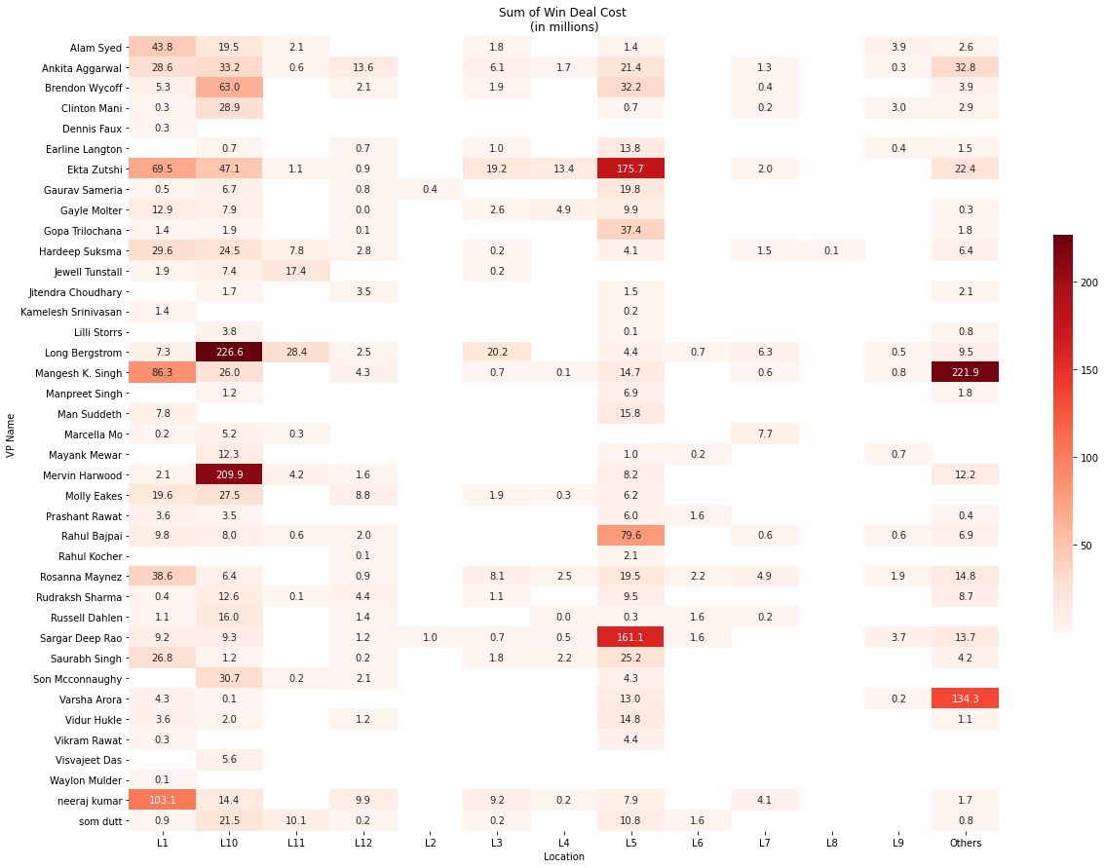
VP Name and Location Combinations
L1, L10 and L5 seem to be the Win Deal Hot spots.
We have count of 2726 deals won in these sectors out of 3715 total won deals which contributes to 73% success rate.
Year 2018 stands out with successful deal count of 627 from these sectors.

Slide 15
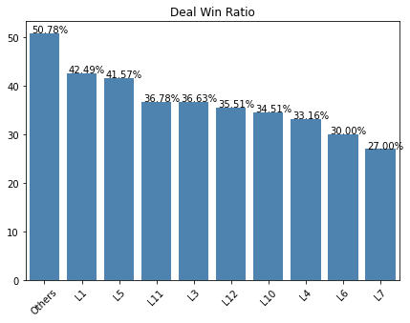
Win Deal Cost Percentage of Top 5 VP in Location
We have further singled out the top 5 VP’s with respect to Location on basis of highest revenue generation.
VP Name | Location | Win Deal Total Cost $ ’ Mn | Number of Win Deals
Long Bergstrom | L10 | 226.56 | 270
Mangesh K. Singh | Others | 22.89 | 94
Mervin Harwood | L10 | 209.94 | 312
Ekta Zutshi | L5 | 175.68 | 119
Sargar Deep Rao | L5 | 161.06 | 249

Slide 16
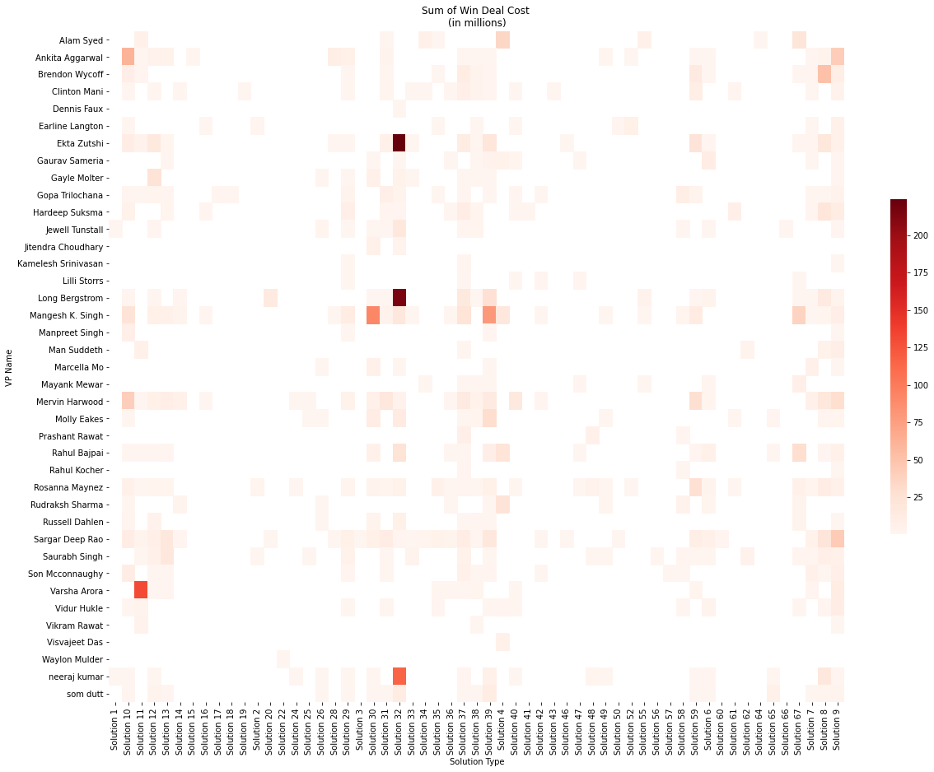
VP Name and Solution Type Combinations
57 unique solutions have win deals on a total of 67 solution types.
Solution 32 has brought in the highest Revenue.
It has the highest count of 813 win deals over a period of 8 years.
Solutions from 30 to 32, 39 to 39 and Solution 7 to 9 are better performers than others.

Slide 17
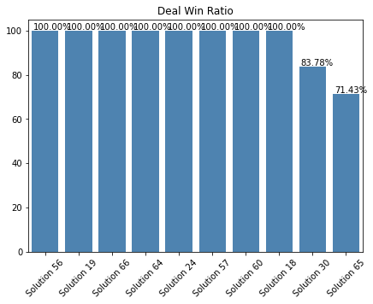
Win Deal Cost Percentage of Top 5 VP in Solution Type
We have further singled out the top 5 VP’s with respect to Solution on basis of highest revenue generation.
VP Name | Solution Type | Deal Cost $ ’ Mn | Number of Deals
Ekta Zutshi | Solution 32 | 224.17 | 197
Long Bergstrom | Solution 32 | 215.58 | 261
Varsha Arora | Solution 11 | 130.77 | 19
neeraj kumar | Solution 32 | 116.30 | 172
Mangesh K. Singh | Solution 30 | 91.31 | 14

Slide 18
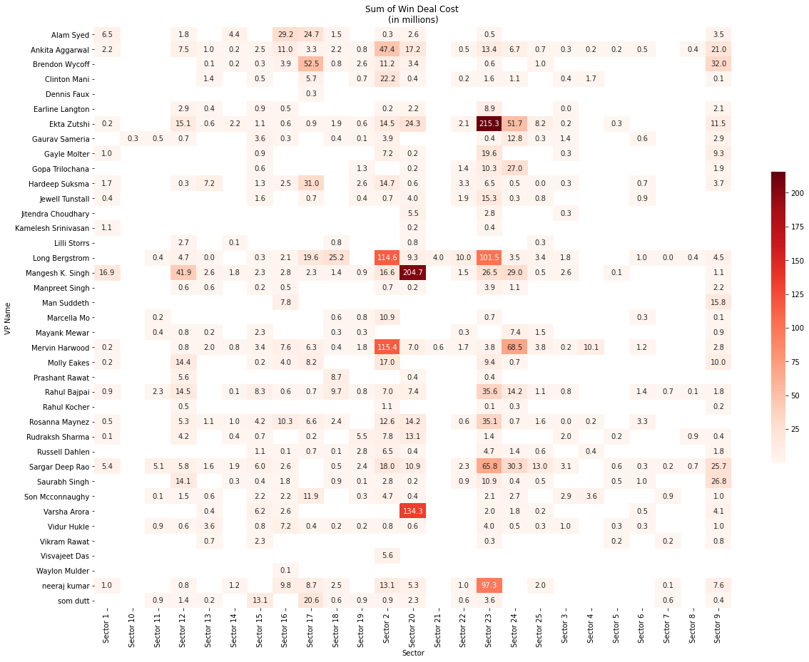
VP Name & Sector Combinations
All the 25 sectors have given successful bids in providing solutions to the clients
Top 5 sectors and their win deals analysed from the adjacent heat map are as below:
Sector | Won Deals Count
Sector 23 | 1053
Sector 2 | 596
Sector 20 | 389
Sector 24 | 217
Sector 12 | 201

Slide 19
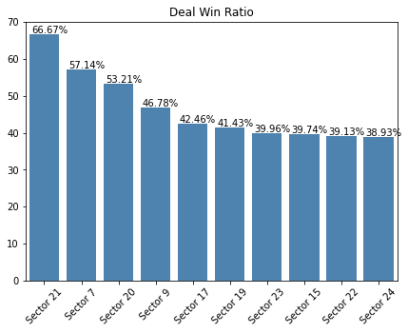
Win Deal Cost Percentage of Top 5 VP in Sector
We have further singled out the top 5 VP’s with respect to Sector on basis of highest revenue generation.
VP Name | Sector | Deal Cost $ ’ Mn | Number of Deals
Ekta Zutshi | Sector 23 | 215.30 | 191
Mangesh K. Singh | Sector 20 | 204.69 | 80
Varsha Arora | Sector 20 | 134.28 | 17
Mervin Harwood | Sector 2 | 115.43 | 184
Long Bergstrom | Sector 2 | 114.63 | 125

Slide 20
Top 5 VP- Manager Combinations
Combining inferences from the EDA, we analyze major factors contribute to the efficiency of a VP-Manager Head combinations.
These are the number of deals transacted , Sum of Cost of Deals Won & Time period .
Below table contains those top 5 VP-Managers that balance the criteria
VP - SBU Head Combination | Number of Deals Won | Won Deal Cost ($’ Mn)
Long Bergstrom & Russell Dahlen | 75 | 63.2
Neeraj Kumar & Molly Eakes | 62 | 49.0
Mangesh K.Singh & Darin Vath | 35 | 37.9
Neeraj Kumar & Vinay Kumar | 51 | 37.5
Rahul Bajpai & Rudraksh Sharma | 72 | 33.8

Slide 21
Model Building
Feature Engineering
Frequency Encoding - All variables are frequency encoded considering the high number of sub categories within each categorical variable.
Standard Scaling - Variables are scaled to similar range to avoid skew.
Train Test Split - Data frame is split into Train and Test in 75% : 25% ratio.
Models Built - Multiple Algorithms are used to check its respective performance. Few of these are – Random Forest, Decision Tree , K Nearest Neighbour & SVM
Performance Validation - To gauge performance, accuracy score, confusion matrix, and classification report were calculated.

Slide 22
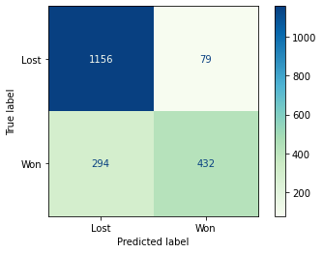
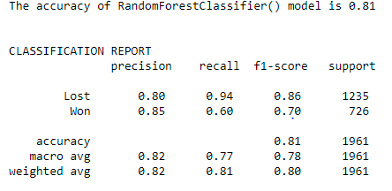
Random Forest Classifier

Slide 23
Model Cross Validation Summary
Model Name | Precision | Recall | Accuracy | AUC | Type II Error
Decision Tree Model | 72% | 62% | 74% | 0.74 | 272
Random Forest Classifier | 84% | 60% | 81% | 0.77 | 294
K Nearest Neighbour | 57% | 47% | 67% | 0.63 | 387
GaussianNB | 60% | 11% | 64% | 0.53 | 646
Logistic Regression | 39% | 2% | 63% | 0.50 | 713
Support Vector Machine | 0% | 0% | 63% | 0.50 | 726
SGDClassifier | 0% | 0% | 63% | 0.50 | 726
Perceptron | 0% | 0% | 63% | 0.50 | 726
Summary:

Slide 24
False Prediction Loss Calculation
If a Deal Status is actually “Won”, but is predicted as “Lost”, then company will lose that potential deal amount.
This is a Type II Error.
In Random Forest Classifier, the number of False Negative deals are 294.
Summing the Deal Costs of such deals, we get an opportunity cost loss of $ 222.05 million
FALSE PREDICTION LOSS = $ 222.05 million

Slide 25
Results
Our aim is to build a Machine Learning model to predict the win/loss probability for IT Consulting Company .
We performed exploratory data analysis to identify factors that correlate with winning probability of deals.
Later, we used these factors to create different models & found Random Forest Classifier with highest accuracy of 81% win prediction probability for the Organization.
Firstly we conclude stating that quantitative methods should not take precedence over known information or justifiable sentiments about the chances of winning a particular deal.
However there is a place for win prediction modeling play a competitive edge in securing a deal.

Slide 26
Recommendations
To conclude
In the absence of a reliable subjective gauge of a deal’s likelihood of being won, a quantitative model provides an anchor point for determining the viability of a deal within the opportunities pipeline.
In this deal win prediction we further identified the opportunity deal loss for 294 deals leading to $222.05 million such upcoming deals can be turned into profits with added due diligence.
From analysis, we conclude that Best VP and Manager combinations for any variable is determined by the combination of win ratio and volume of win deals.

Slide 27
Thank You
Kenny D B L DEEPTHI Aditi GOYAL Arjun S

