Slide 1
Lecture 3 Network Models

Slide 2
Module 3: Protocols and Models
Introduction to Networks 7.0 (ITN)
Notes:
Cisco Networking Academy Program
Introduction to Networks v7.0 (ITN)
Module 3: Protocols and Models

Slide 3
The Rules, Protocols
Protocol Suites, Standards Organizations
Reference Models
Data Encapsulation, Data Access

Slide 4
The Rules Communications Fundamentals
There are 3 elements to any communication:
There will be a source (sender).
There will be a destination (receiver).
There will be a channel (media) that provides for the path of communications to occur.
Protocols are the rules that communications will follow.
Protocols must account for the following requirements:
An identified sender and receiver
Common language and grammar
Speed and timing of delivery
Confirmation or acknowledgment requirements
Notes:
3 – Protocols and Models
3.1 – The Rules
3.1.2 –Communications Fundamentals

Slide 5
The Rules Network Protocol Requirements
In addition to identifying the source and destination, computer and network protocols define the details of how a message is transmitted across a network:
Message encoding and decoding
Message formatting and encapsulation
Message size
Message timing
Message delivery options
Notes:
3 – Protocols and Models
3.1 – The Rules
3.1.5 – Network Protocol Requirements

Slide 6
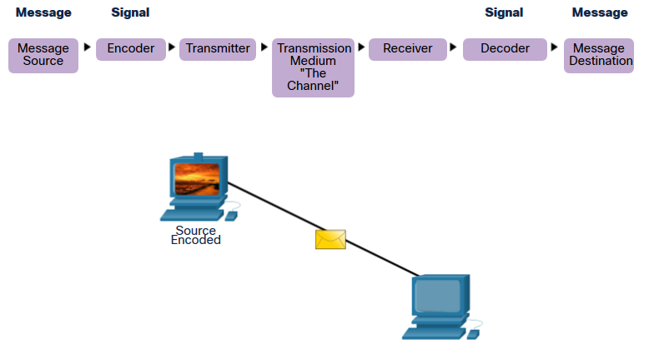
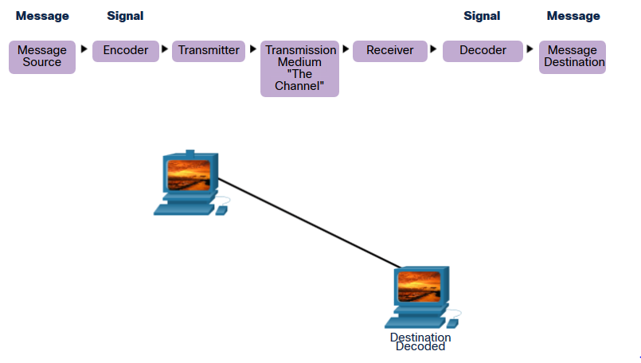
The Rules Message Encoding and Decoding
Encoding is the process of converting information into another acceptable form for transmission.
Decoding reverses this process to interpret the information.
Notes:
3 – Protocols and Models
3.1 – The Rules
3.1.6 – Message Encoding

Slide 7
The Rules Message Formatting and Encapsulation
When a message is sent, it must use a specific format or structure.
Encapsulation is the process of placing one message format inside another message format (data > segment > packet > frame > bit).
De-encapsulation occurs when the process is reversed by the recipient and the message is retrieved.
Notes:
3 – Protocols and Models
3.1 – The Rules
3.1.7 – Message Formatting and Encapsulation

Slide 8
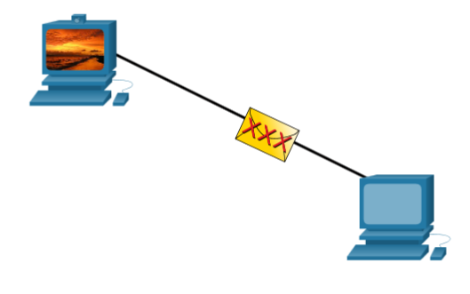
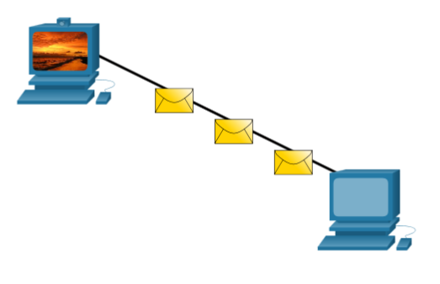
The Rules Message Size
Long messages must also be broken into smaller pieces (segmentation) to travel across a network.
Each piece is sent in a separate frame.
Each frame has its own addressing information.
A receiving host will reconstruct multiple frames into the original message.
Notes:
3 – Protocols and Models
3.1 – The Rules
3.1.8 – Message Size

Slide 9
The Rules Message Timing
Message timing includes the following:
Flow Control – Manages the rate of data transmission and defines how much information can be sent and the speed at which it can be delivered.
Response Timeout – Manages how long a device waits when it does not hear a reply from the destination.
Access method - Determines when someone can send a message.
There may be various rules governing issues like “collisions”. This is when more than one device sends traffic at the same time and the messages become corrupt.
Some protocols are proactive and attempt to prevent collisions; other protocols are reactive and establish a recovery method after the collision occurs.
Notes:
3 – Protocols and Models
3.1 – The Rules
3.1.9 – Message Timing

Slide 10
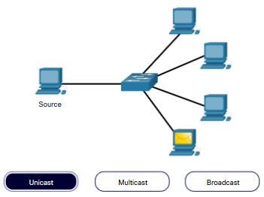
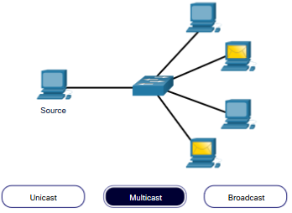
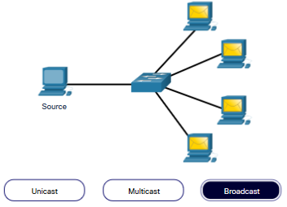
The Rules Message Delivery Options
one-to-one one-to-many one-to-all
Note:
Broadcasts are used in IPv4 networks (not an option for IPv6).
A packet sent to an IPv6 anycast address is routed to the nearest device having that unicast address.
Notes:
3 – Protocols and Models
3.1 – The Rules
3.1.10 – Message Delivery Options

Slide 11
Protocols Network Protocol Types
Network protocols define a common format and set of rules for exchanging messages between devices.
The table below lists the various types of protocols that are needed to enable communications across one or more networks.
Protocol Type | Description
Network Communications | enable two or more devices to communicate over one or more networks
Network Security | secure data to provide authentication, data integrity, and data encryption
Routing | enable routers to exchange route information, compare path information, and select best path
Service Discovery | used for the automatic detection of devices or services
Notes:
3 – Protocols and Models
3.2 – Protocols
3.2.1 – Network Protocol Overview

Slide 12
Protocols Network Protocol Functions
Devices use agreed-upon protocols to communicate.
The table below lists the functions of theses protocols.
Function | Description
Addressing | Identifies sender and receiver
Reliability | Provides guaranteed delivery
Flow Control | Ensures data flows at an efficient rate
Sequencing | Uniquely labels each transmitted segment of data
Error Detection | Determines if data became corrupted during transmission
Application Interface | Process-to-process communications between network applications
Notes:
3 – Protocols and Models
3.2 – Protocols
3.2.2 – Network Protocol Functions

Slide 13
Protocols Protocol Interaction Example
Some common network protocols that are used when a device sends a request to a web server for its web page.
Protocol | Function
Hypertext Transfer Protocol (HTTP) | Governs the way a web server and a web client interact Defines content and format
Transmission Control Protocol (TCP) | Manages the individual conversations Provides guaranteed delivery Manages flow control
Internet Protocol (IP) | Delivers messages globally from the sender to the receiver
Ethernet | Delivers messages from one NIC to another NIC on the same Ethernet Local Area Network (LAN)
Notes:
3 – Protocols and Models
3.2 – Protocols
3.2.3 – Protocol Interaction
3.2.4 – Check Your Understanding - Protocols

Slide 14
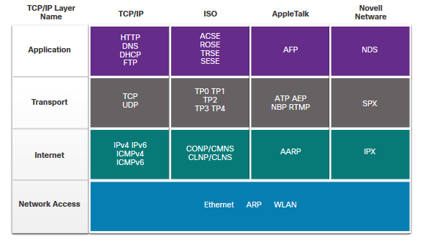
Protocol Suites Network Protocol Suites
A protocol suite is a set of protocols that work together to provide comprehensive network communication services.
Internet Protocol Suite or TCP/IP- The most common protocol suite and maintained by the Internet Engineering Task Force (IETF)
Open Systems Interconnection (OSI) protocols- Developed by the International Organization for Standardization (ISO) and the International Telecommunications Union (ITU)
AppleTalk- Proprietary suite release by Apple Inc.
Novell NetWare- Proprietary suite developed by Novell Inc.
Notes:
3 – Protocols and Models
3.3 – Protocol Suites
3.3.2 – Evolution of Protocol Suites

Slide 15
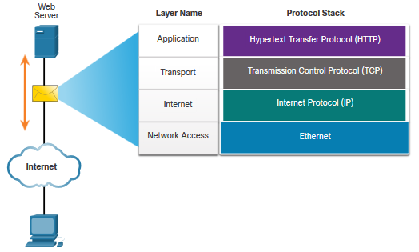
Protocol Suites TCP/IP Protocol Example
TCP/IP protocols operate at the application, transport, and internet layers.
The most common network access layer LAN protocols are Ethernet and WLAN (wireless LAN).
Notes:
3 – Protocols and Models
3.3 – Protocol Suites
3.3.3 – TCP/IP Protocol Example

Slide 16
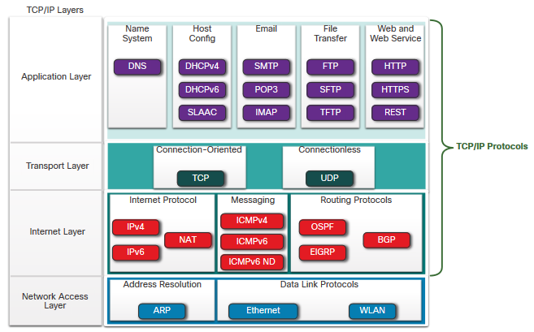
Protocol Suites TCP/IP Protocol Suite
TCP/IP is the protocol suite used by the internet and includes many protocols.
TCP/IP is:
An open standard protocol suite that is freely available to the public and can be used by any vendor
A standards-based protocol suite that is endorsed by the networking industry and approved by a standards organization to ensure interoperability
Notes:
3 – Protocols and Models
3.3 – Protocol Suites
3.3.4 – TCP/IP Protocol Suite

Slide 17
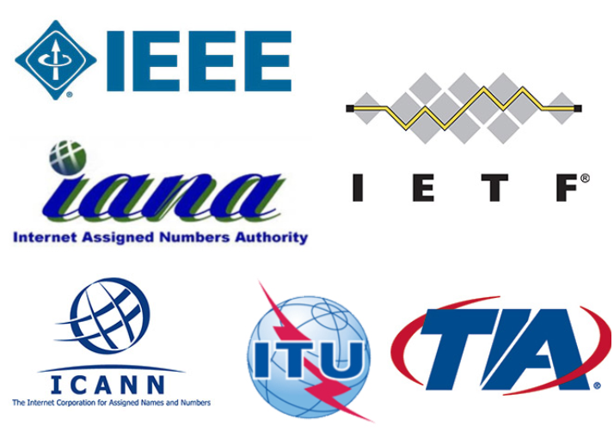
Standards Organizations Open Standards
Standards organizations are:
vendor-neutral
non-profit organizations
established to develop and promote the concept of open standards.
Open standards encourage:
interoperability
competition
innovation
Notes:
3 – Protocols and Models
3.4 – Standards Organizations
3.4.1 – Open Standards

Slide 18
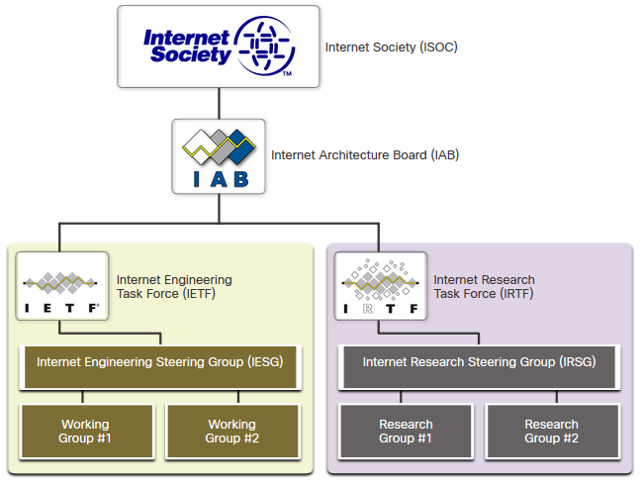
Standards Organizations Internet Standards
Internet Society (ISOC) - Promotes the open development and evolution of internet
Internet Architecture Board (IAB) - Responsible for management and development of internet standards
Internet Engineering Task Force (IETF) - Develops, updates, and maintains internet and TCP/IP technologies
Internet Research Task Force (IRTF) - Focused on long-term research related to internet and TCP/IP protocols
Notes:
3 – Protocols and Models
3.4 – Standards Organizations
3.4.2 – Internet Standards

Slide 19
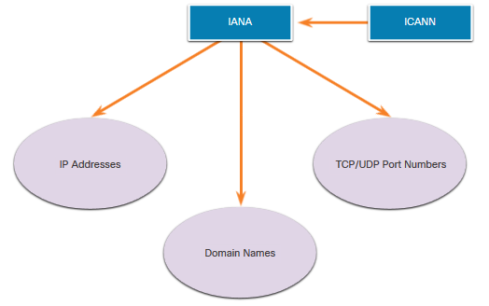
Standards Organizations Internet Standards (Cont.)
Standards organizations involved with the development and support of TCP/IP
Internet Corporation for Assigned Names and Numbers (ICANN) - Coordinates IP address allocation, the management of domain names, and assignment of other information
Internet Assigned Numbers Authority (IANA) - Oversees and manages IP address allocation, domain name management, and protocol identifiers for ICANN
Notes:
3 – Protocols and Models
3.4 – Standards Organizations
3.4.2 – Internet Standards (Cont.)

Slide 20
Standards Organizations Electronic and Communications Standards
Institute of Electrical and Electronics Engineers (IEEE) – Organization of electrical engineering and electronics dedicated to advancing technological innovation and creating standards in a wide area of industries including power and energy, healthcare, telecommunications, and networking.
Electronic Industries Alliance (EIA) - Best known for its standards related to electrical wiring, connectors, and the 19-inch racks used to mount networking equipment.
Telecommunications Industry Association (TIA) - Responsible for developing communication standards in a variety of areas including radio equipment, cellular towers, Voice over IP (VoIP) devices, satellite communications, and more.
International Telecommunications Union-Telecommunication Standardization Sector (ITU-T) - One of the largest and oldest communication standard organizations. The ITU-T defines standards for video compression, Internet Protocol Television (IPTV), and broadband communications, such as a digital subscriber line (DSL).
Notes:
3 – Protocols and Models
3.4 – Standards Organizations
3.4.2 – Internet Standards

Slide 21
Reference Models Layered Models
Benefits of using a layered model:
Assist in protocol design because protocols that operate at a specific layer have defined information that they act upon and a defined interface to the layers above and below
Prevent technology or capability changes in one layer from affecting other layers above and below
Foster competition because products from different vendors can work together
Provide a common language to describe networking functions and capabilities
Two layered models describe network operations:
Open System Interconnection (OSI) Reference Model
TCP/IP Reference Model
Notes:
3 – Protocols and Models
3.5 – Reference Models
3.5.1 – The Benefits of Using a Layered Model

Slide 22
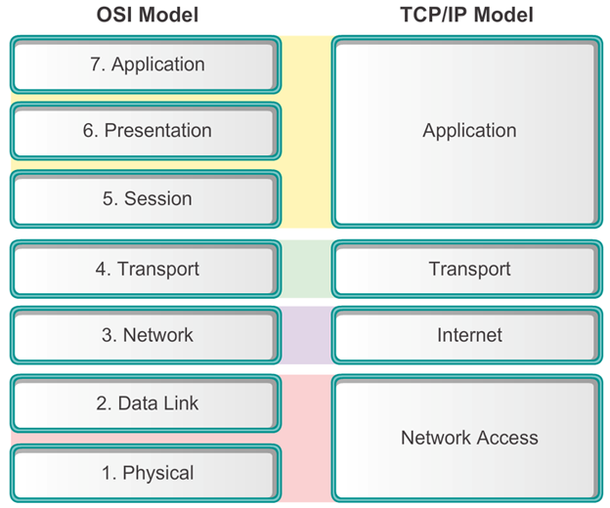
Reference Models The OSI and the TCP/IP Models
7. Contains protocols used for process-to-process communications.
6. Provides for common representation of the data transferred between application layer services.
5. Provides services to the presentation layer and to manage data exchange.
4. Defines services to segment, transfer, and reassemble the data for individual communications.
3. Provides services to exchange the individual pieces of data over the network.
2. Describes methods for exchanging data frames over a common media.
1. Describes the means to activate, maintain, and de-activate physical connections.
Represents data to the user, plus encoding and dialog control.
Supports communication between various devices across diverse networks.
Determines the best path through the network.
Controls the hardware devices and media that make up the network.
Notes:
3 – Protocols and Models
3.5 – Reference Models
3.5.2 – The OSI Reference Model

Slide 23
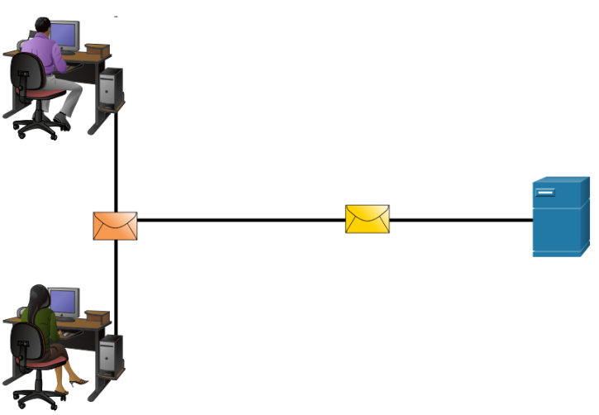
Data Encapsulation Segmenting Messages
Segmenting messages is the process of breaking up messages into smaller units. Segmenting messages has two primary benefits:
Increases speed - Large amounts of data can be sent over the network without tying up a communications link.
Increases efficiency - Only segments which fail to reach the destination need to be retransmitted, not the entire data stream.
Multiplexing is the processes of taking multiple streams of segmented data and interleaving them together.
Notes:
3 – Protocols and Models
3.6 – Data Encapsulation
3.6.1 – Segmenting Messages

Slide 24
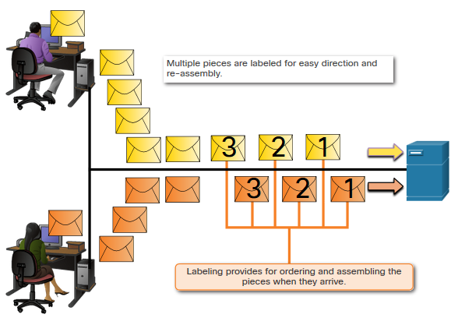
Data Encapsulation Sequencing Messages
Sequencing messages is the process of numbering the segments so that the message may be reassembled at the destination.
TCP is responsible for sequencing the individual segments.
Notes:
3 – Protocols and Models
3.6 – Data Encapsulation
3.6.2 – Sequencing

Slide 25
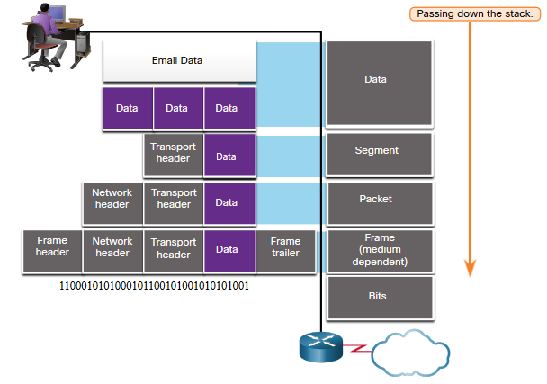
Data Encapsulation Protocol Data Units
As application data is passed down the protocol stack on its way to be transmitted across the network media, various protocol information is added at each level (encapsulation process).
The form that a piece of data takes at any layer is called a protocol data unit (PDU).
At each layer, a PDU has a different name to reflect its new functions:
Data (Data Stream)
TCP Segment/UDP Datagram
Packet
Frame
Bits (Bit Stream)
Notes:
3 – Protocols and Models
3.6 – Data Encapsulation
3.6.3 – Protocol Data Units

Slide 26
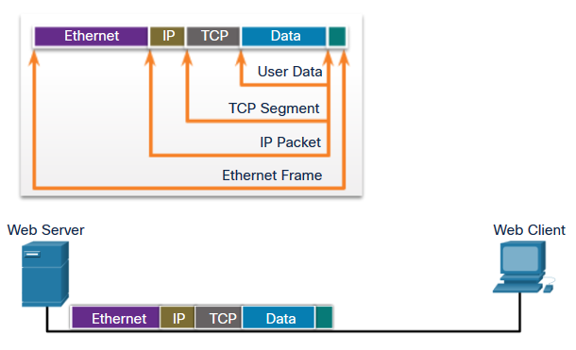
Data Encapsulation Encapsulation Example
When messages are being sent on a network, the encapsulation process works from top to bottom.
At each layer, the upper layer information is considered data within the encapsulated protocol.
As a web server sends a web page to a web client, the encapsulation process is:
> User Data
> TCP Segment
> IP Packet
> Ethernet Frame
Notes:
3 – Protocols and Models
3.6 – Data Encapsulation
3.6.4 – Encapsulation Example

Slide 27
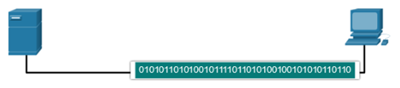
Data Encapsulation De-encapsulation Example
The process is reversed at the receiving host and is known as de-encapsulation.
When a layer completes its process, that layer strips off its header and passes it up to the next level to be processed. This is repeated at each layer until it is a data stream that the application can process.
Received as Bits (Bit Stream)
Frame
Packet
Segment
Data (Data Stream)
Notes:
3 – Protocols and Models
3.6 – Data Encapsulation
3.6.5 – De-encapsulation Example
3.6.6 – Check Your Understanding – Data Encapsulation

Slide 28
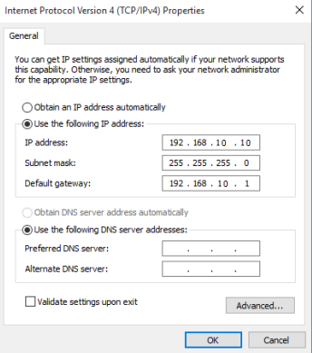
Data Access Enable IP on a Host
Dynamically Assigned IP Address – IP Address information is dynamically assigned by a server using Dynamic Host Configuration Protocol (DHCP).
Statically Assigned IP address – The host is manually assigned an IP address, subnet mask and default gateway. A DNS server IP address can also be assigned.
Notes:
3 – Protocols and Models
3.7 – Data Access
3.7.1 – Addresses

Slide 29
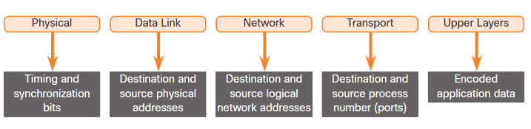
Data Access Addresses
Data link layer source and destination addresses – Responsible for delivering the data link frame from one network interface card (NIC) to another NIC on the same network (layer 2 address / MAC address / physical address / data link address).
Network layer source and destination addresses - Responsible for delivering the IP packet from original source to the final destination (layer 3 address / IP address / logical address / hierarchical address / network address).
Well-known port numbers identify the applications being used.
Notes:
3 – Protocols and Models
3.7 – Data Access
3.7.1 – Addresses

Slide 30
Data Access IP Address
An IP address contains two parts:
Network portion (IPv4) or Prefix (IPv6)
The left-most part of the address indicates the network group which the IP address is a member.
Each LAN or WAN will have the same network portion.
Host portion (IPv4) or Interface ID (IPv6)
The remaining part of the address identifies a specific device within the group.
This portion is unique for each device on the network.
Notes:
3 – Protocols and Models
3.7 – Data Access
3.7.2 – Layer 3 Logical Address (Cont.)

Slide 31

Data Access IP Packet
The IP packet contains two IP addresses:
Source IP address - The IP address of the sending device, original source of the packet.
Destination IP address - The IP address of the receiving device, final destination of the packet.
These addresses may be on the same link or remote.
Notes:
3 – Protocols and Models
3.7 – Data Access
3.7.2 – Layer 3 Logical Address

Slide 32
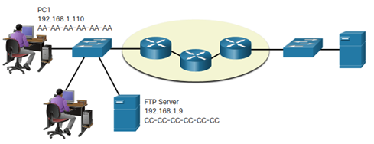
Data Access Sending to a Device on the Same Network
When devices are on the same network the source and destination will have the same number in network portion of the address.
PC1 – 192.168.1.110
FTP Server – 192.168.1.9
Notes:
3 – Protocols and Models
3.7 – Data Access
3.7.3 – Devices on the Same Network-

Slide 33
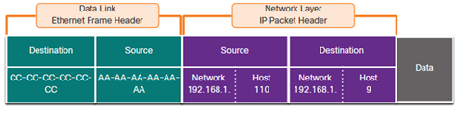
Data Access Sending to a Device on the Same Network (Cont.)
MAC addresses are physically embedded into the Ethernet NIC and are local addressing.
When devices are on the same Ethernet network the data link frame will use the MAC address of the destination NIC as the Destination MAC address.
The Source MAC address will be that of the originator on the link.
Notes:
3 – Protocols and Models
3.7 – Data Access
3.7.4 – Role of the Data Link Layer Addresses: Same IP Network

Slide 34
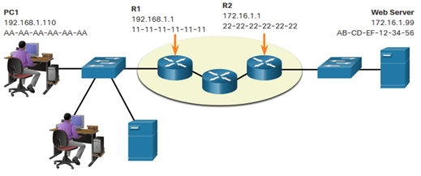
Data Access Sending to a Device on a Remote Network
When the source and destination have a different network portion, this means they are on different networks.
PC1 – 192.168.1.110
Web Server – 172.16.1.99
Notes:
3 – Protocols and Models
3.7 – Data Access
3.7.6 – Role of the Network Layer Addresses

Slide 35
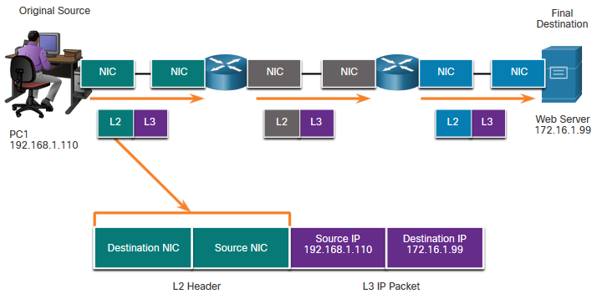
Data Access Sending to a Device on a Remote Network (Cont.)
The MAC addressing for the first segment is:
Source – (PC1 NIC) sends frame
Destination – (First Router- default gateway interface) receives frame
Notes:
3 – Protocols and Models
3.7 – Data Access
3.7.8 – Data Link Addresses

Slide 36
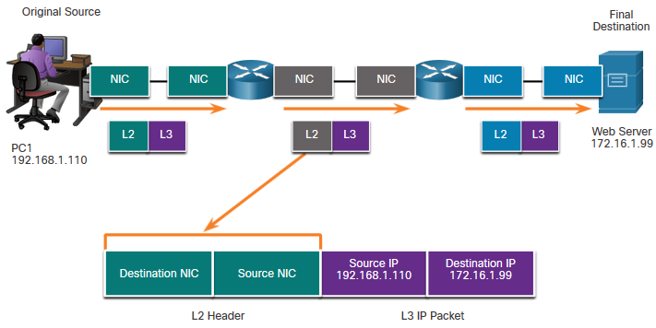
Data Access Sending to a Device on a Remote Network (Cont.)
The MAC addressing for the second hop is:
Source – (First Router - exit interface) sends frame
Destination – (Second Router – entrance interface) receives frame
The packet is not modified.
Notes:
3 – Protocols and Models
3.7 – Data Access
3.7.8 – Data Link Addresses (Cont.)

Slide 37
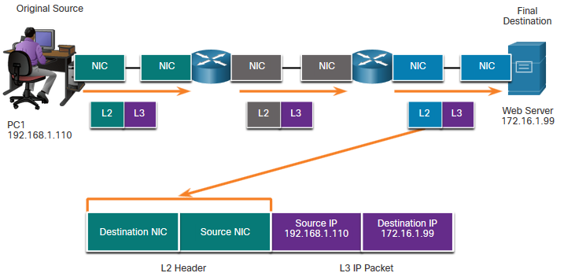
Data Access Sending to a Device on a Remote Network (Cont.)
The MAC addressing for the last segment is:
Source – (Second Router- exit interface) sends frame
Destination – (Web Server NIC) receives frame
The packet is not modified.
Notes:
3 – Protocols and Models
3.7 – Data Access
3.7.8 – Data Link Addresses (Cont.)

