Slide 1
Unlocking Wellness Insights from Bella Beat Smart Devices
Data-Driven Insights to Inform Marketing Strategy
Presented by: Kent Ward
April 2025

Slide 2
Goal & Data Overview
Goal of This Analysis
Understand how BellaBeat users engage with smart devices related to activity, sleep, and health tracking.
Identify user behavior trends that can inform more personalized and effective marketing strategies.
Empower the marketing team with data-driven insights to target the right audience with the right message.
Data Overview
Source: Fitbit + BellaBeat device usage (Kaggle: Fitabase Dataset)
Sample: 30–60 days of anonymized wellness data from female users
Tools: R, tidyverse, ggplot2, custom analysis scripts
Supplemental Data: Statista, NIH, PMC — wearable trends, user segments, behavior patterns
Notes:
We combined internal device data with external market research to create a full-picture view of BellaBeat’s users and how they use the product. This helped us translate raw data into clear recommendations that align with BellaBeat’s mission and audience.

Slide 3
Summary of Key Findings
📍 Behavioral Insights
📊 64% of users manually log their weight → Strong sign of habit and engagement with the feature
🛌 Sleep duration has very weak correlation with step count (r = -0.19) → Movement doesn’t predict rest — sleep should be marketed as a separate benefit
🪑 Sedentary behavior dominates → Even highly active users spend most of their day sedentary
🎯 Strategic Implications
Bellabeat should decouple sleep and activity in messaging
Focus on micro-habit nudges for sedentary users
Promote manual tracking features as tools to build routines and self-awareness
Notes:
These findings help us see our users not as fitness-focused, but behaviorally diverse. Sleep, movement, and self-tracking need to be treated as separate journeys with their own motivations and messages

Slide 4
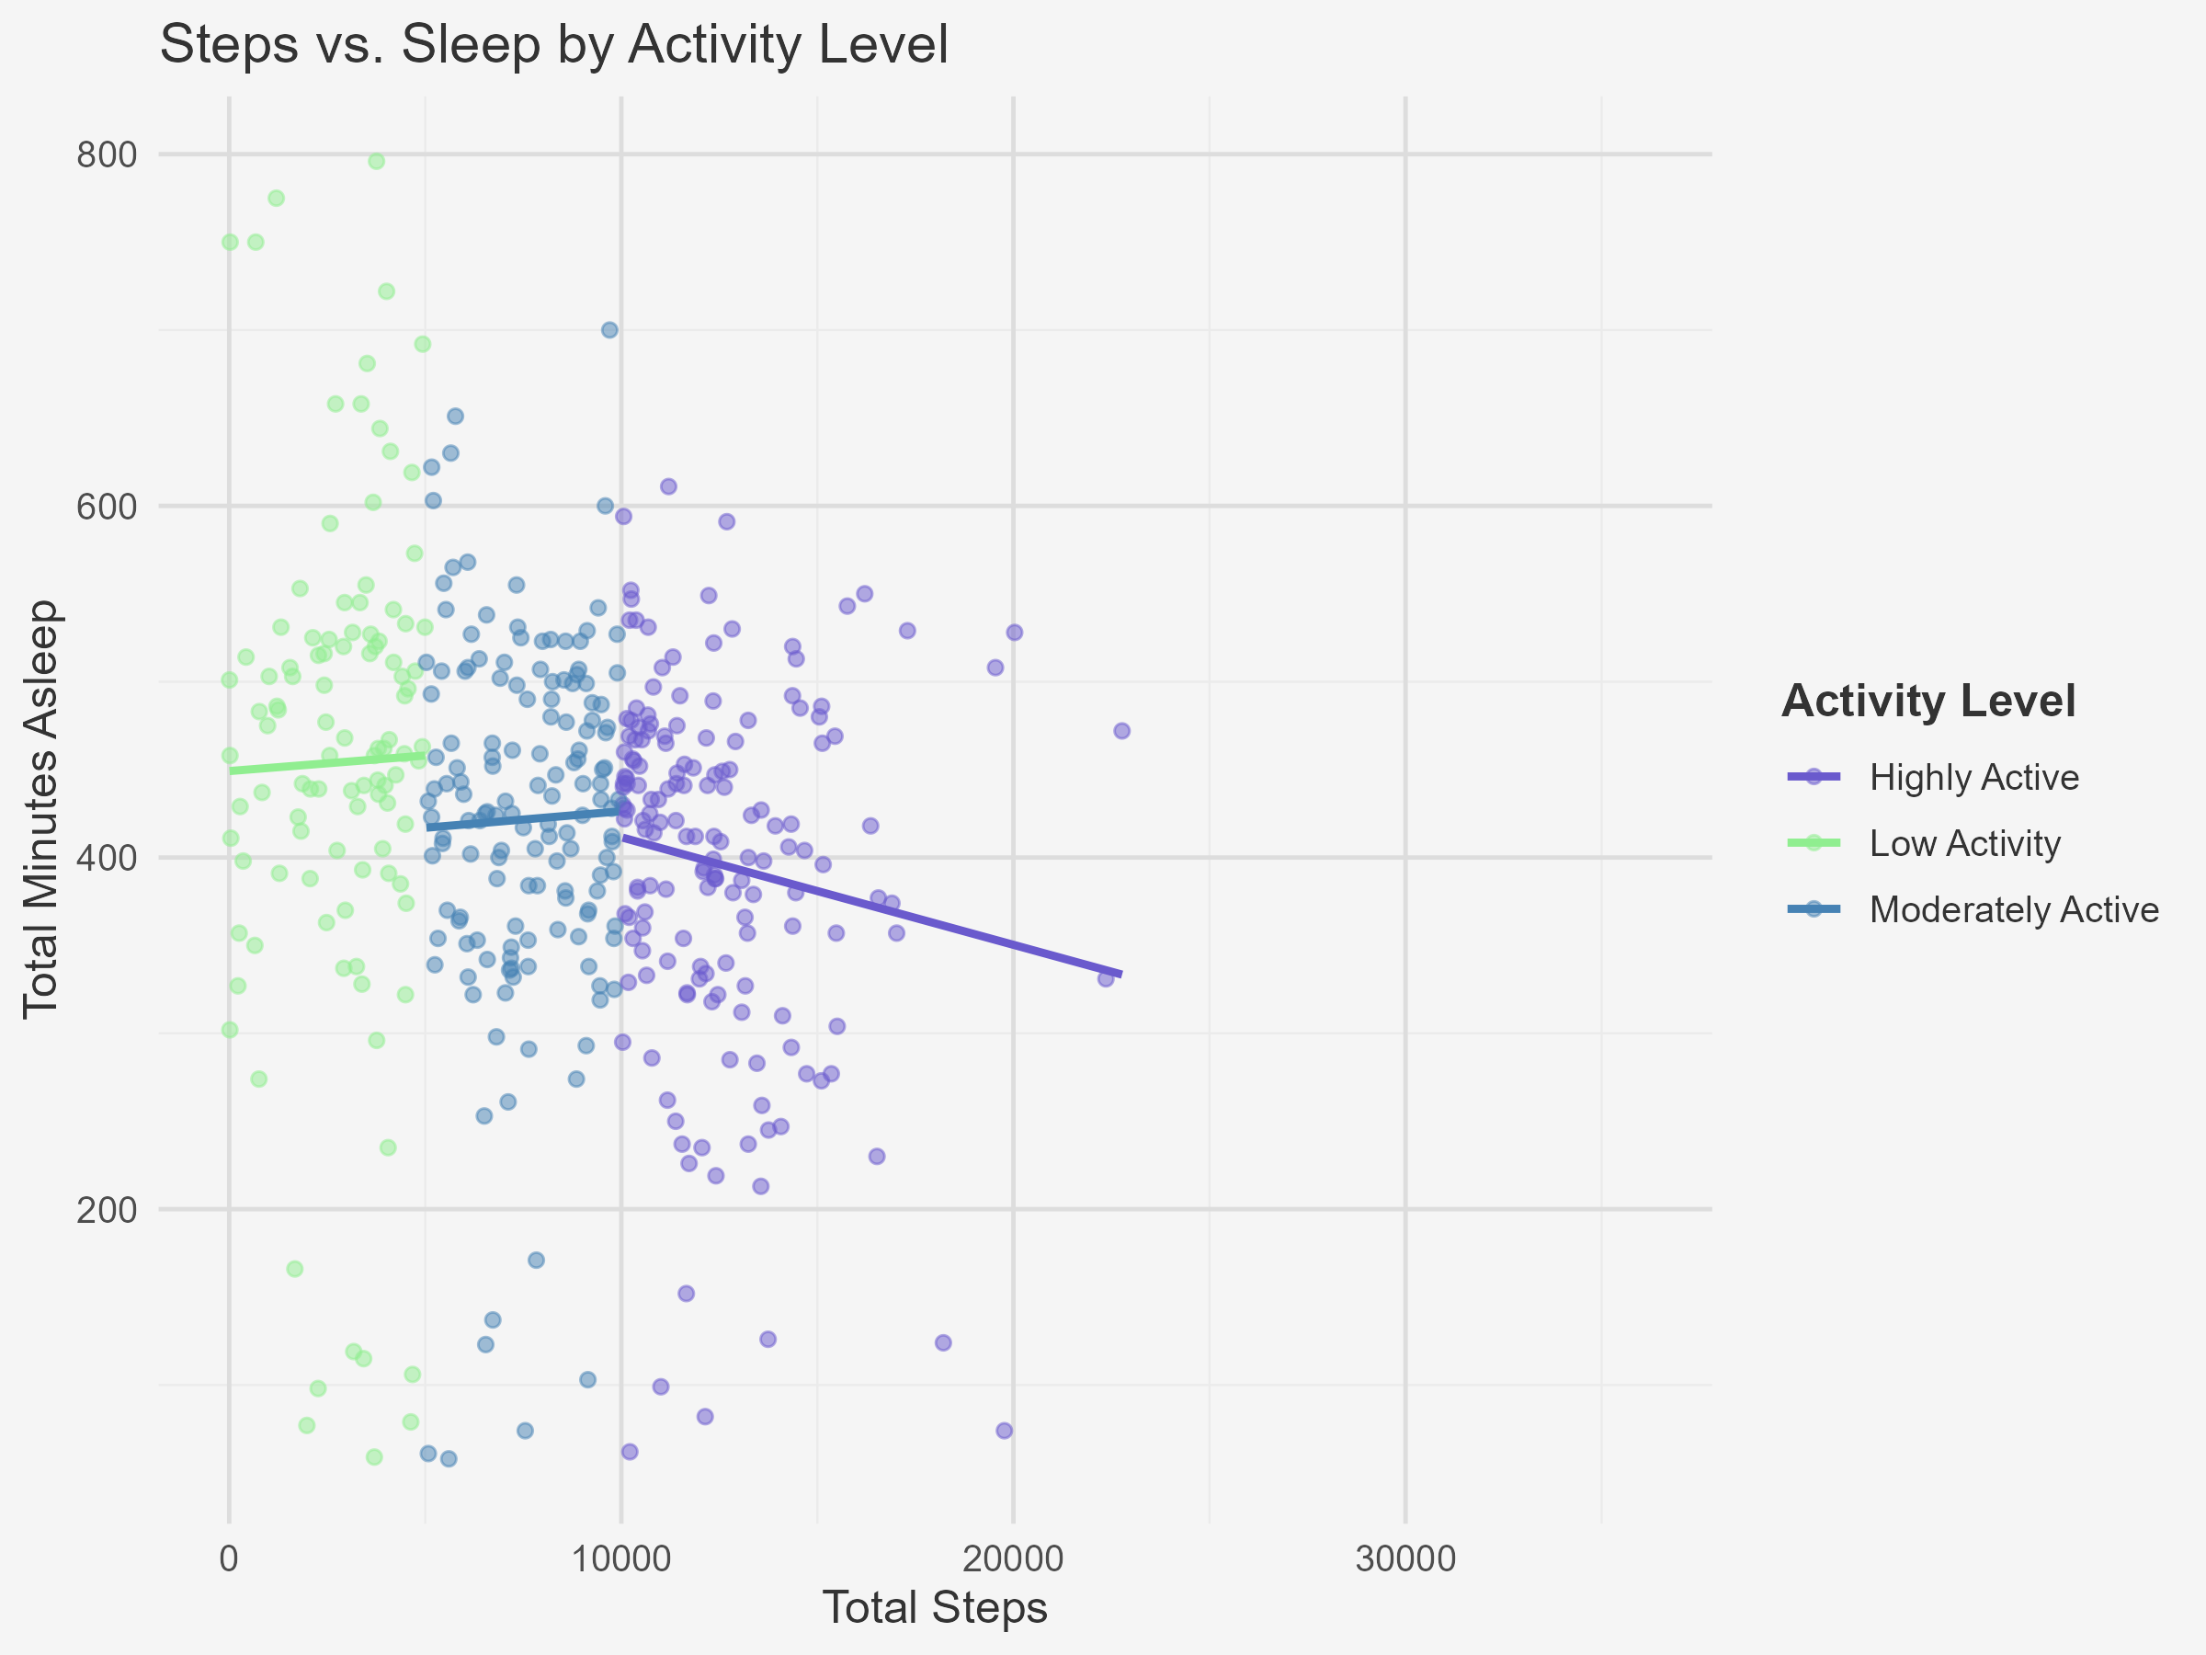
Sleep vs Steps: Weak Correlation Insight
📉 Insight
Users who walk more do not necessarily sleep more.
Analysis shows a very weak correlation (r = -0.19) between daily step count and minutes of sleep.
🎯 Implication
BellaBeat users are likely motivated by different health goals — sleep and movement habits are not directly connected.
Sleep improvement strategies should be treated separately in marketing — not bundled with fitness activity.
Notes:
This weak correlation means users might value sleep as its own wellness priority, not just an outcome of movement. That gives BellaBeat a unique opportunity to market sleep features as part of a lifestyle-first narrative
💡 Opportunity
Position Bellabeat’s sleep tracking and wellness tools as a stress-reduction and recovery feature, not just a fitness add-on.
Tailor campaigns that emphasize rest, balance, and mindfulness, especially for low-activity users.

Slide 5
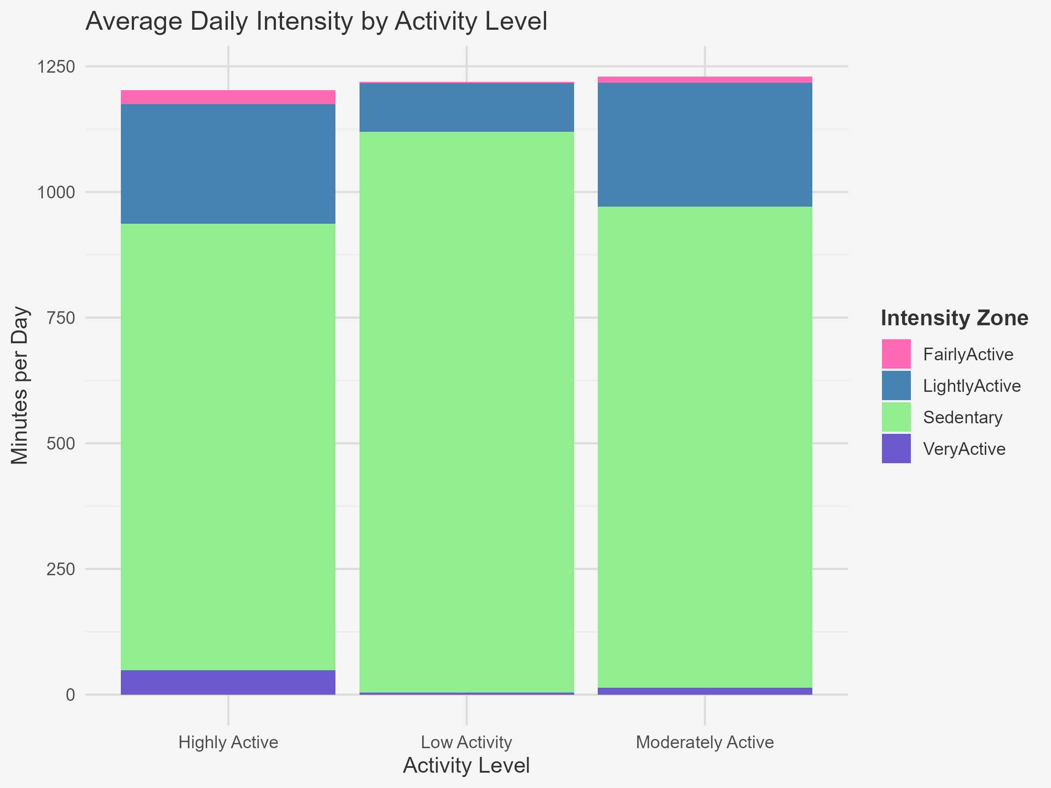
Most Users Are Sedentary — Even the Active Ones
📊 What the Data Shows
Most users spend the majority of their day in Sedentary or Lightly Active zones — even those classified as “Highly Active.”
The gap between step count and actual movement patterns reveals untapped opportunities for engagement.
💡 Opportunity
Introduce micro-movement nudges (e.g., “Take a 2-minute walk,” “Stand up and stretch”) using app notifications or smart reminders.
Market Bellabeat as a daily wellness companion, not just a tracker — supportive in small, realistic ways throughout the day.
Notes:
This is one of our strongest behavioral insights. Even users with high total steps show long periods of inactivity. By addressing this through encouraging micro-movements, Bellabeat can promote daily consistency, reduce friction, and build lasting habits
🧠 Insight (more details if the previous note doesn’t explain enough)
Sedentary behavior dominates across all user types.
Even active users aren’t consistently moving throughout the day — they tend to cluster activity in short windows.

Slide 6
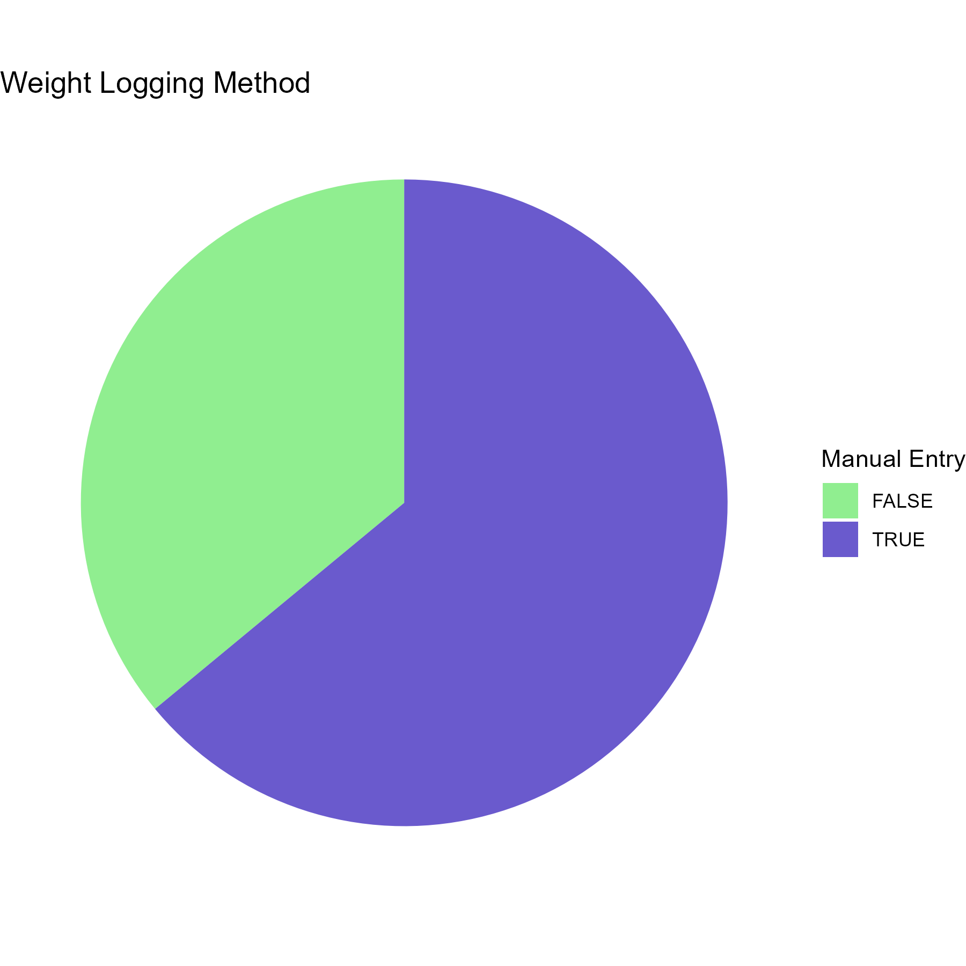
Weight Logging Engagement
⚖️ What We Found
64% of users log their weight manually
Several users log 30+ times within the sample period
💡 Opportunity
Promote weight logging as a habit-building tool (not just a data feature)
Introduce streaks, badges, or “celebrate your consistency” nudges
Consider in-app visualizations that reward regular tracking
Notes:
🧠 Insight
Manual logging shows intent and consistency — a strong indicator of user-driven habit formation
This is not a passive feature — users engage with it intentionally
Not only are 64% of users logging their weight manually, but one user logged 44 times in this period — showing consistent engagement and habit potential. This is a great candidate for smart feedback loops or milestone-based nudges.

Slide 7
Market Trends & Audience Fit
🌎 Who’s Buying & Why
54% of wearable users are women (Statista)
Women prioritize wellness, stress reduction, and self-awareness over performance metrics (NIH, PMC)
🧠 Insight
Bellabeat users align more with lifestyle wellness than with high-performance tracking
The “optimize your life” message resonates more than “beat your best”
💡 Marketing Fit
Shift language from goals and metrics → to support, mood, and balance
Position Bellabeat as a calm tech brand: thoughtful, nurturing, not competitive

Slide 8
Recommendations for Marketing
🎯 Target Segments
Women ages 30–50
New moms and wellness seekers
Users interested in stress management and gentle routines
🛠 Tactical Suggestions
Use wellness storytelling: “You deserve to feel better” vs “track more”
Promote sleep, mindfulness, and habit-streak tools
Offer guided micro-goals (like “3-day calm challenge”)
Notes:
Incorporate insights into Q2 roadmap
User interviews to deepen findings
A/B test campaign language (e.g., “feel better”)

Slide 9
Thank You + Questions
Contact: ward.kente@gmail.com
GitHub: github.com/Kent-Ward
Notes:
This project not only showed us how users behave — it showed us how we can connect with them more meaningfully, based on their actual wellness rhythms

