Slide 1
Cal Poly SLO Hyperloop Propulsion CDR
Syed Huzefa Rauf & Kent Roberts

Slide 2
Propellant Selection
Gas | Molecular Weight | Specific Impulse (sec) | ∝ Total Impulse per unit Volume
Air | 28.9 | 74 | 2138.6
Argon | 39.9 | 57 | 2274.3
CO2 | 44 | 67 | 2948
Helium | 4 | 179 | 716
Hydrogen | 2 | 296 | 592
Nitrogen | 28 | 80 | 2240
Methane | 16 | 114 | 1824
Air is widely available for a test campaign, performance runs where T<0°C, use nitrogen

Slide 3
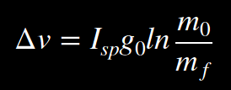


Rocket Equation
m_{f}=Inert Pod Mass (Non-Tank Pod mass + Tank Mass + Residual propellant)
m₀=Wet Pod Mass (m_{f} + Propellant Mass)

Slide 4
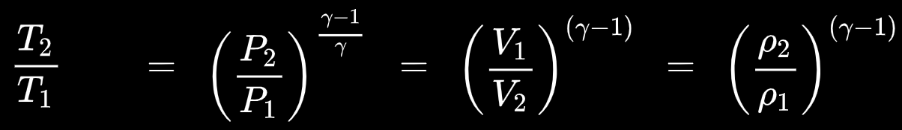
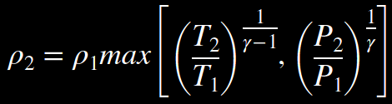
Isentropic Processes and Tank Discharge Limitations
T₂=Lower Temperature Limit of the Tank
P₂=Lower Pressure Limit (function of P_{nozzle_Inlet} and Flow Coefficient of Hardware C_{v})

Slide 5
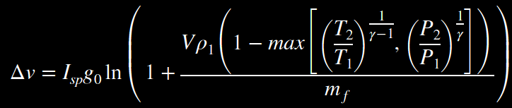

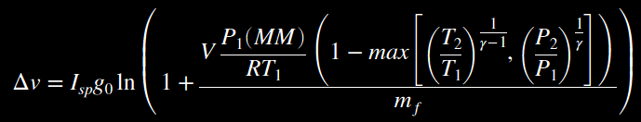
Rocket Eq. & Isentropic Process
Use the Ideal Gas Law to find ρ₁

Slide 6


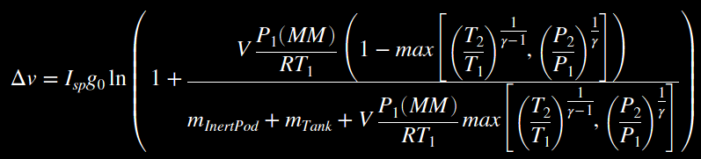
Final Mass, Pod Class

Slide 7
Valve Requirements
Inlet Pressure ~4800psi
~ASME Class 2500

