Slide 1
Cal Poly SLO Hyperloop Propulsion CDR
Kent Roberts & Syed Huzefa Rauf

Slide 2
Propellant Selection
Gas | Molecular Weight | Specific Impulse (sec) | ∝ Total Impulse per unit Volume
Air | 28.9 | 74 | 2138.6
Argon | 39.9 | 57 | 2274.3
CO2 | 44 | 67 | 2948
Helium | 4 | 179 | 716
Hydrogen | 2 | 296 | 592
Nitrogen | 28 | 80 | 2240
Methane | 16 | 114 | 1824
Air is widely available for a test campaign, performance runs where T<0°C, use nitrogen

Slide 3
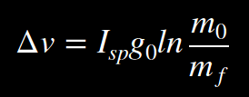


Rocket Equation
m_{f}=Inert Pod Mass (Non-Tank Pod mass + Tank Mass + Residual propellant)
m₀=Wet Pod Mass (m_{f} + Propellant Mass)

Slide 4
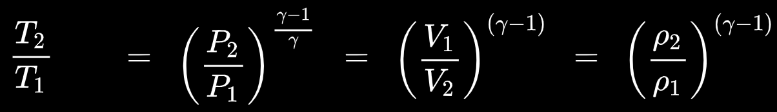
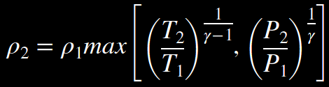
Isentropic Processes and Tank Discharge Limitations
T₂=Lower Temperature Limit of the Tank & Valve hardware
P₂=Lower Pressure Limit (function of P_{nozzle_Inlet} and Flow Coefficient of Hardware C_{v})
*Most systems with T₂~-40F and P₂~500psi are Temperature limited

Slide 5
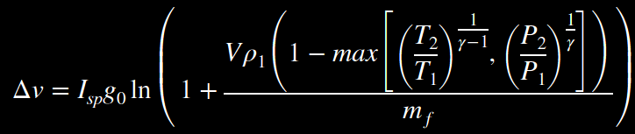

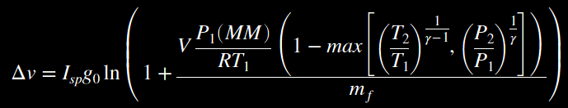
Rocket Eq. & Isentropic Process
Use the Ideal Gas Law to find ρ₁

Slide 6


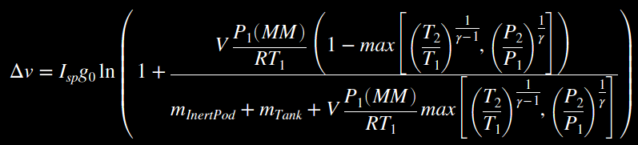

ΔV as a Function of Pod Inert Mass and Tank Specifications

Slide 7

Pod Inert mass as a function of ΔV and Tank Specifications

Slide 8
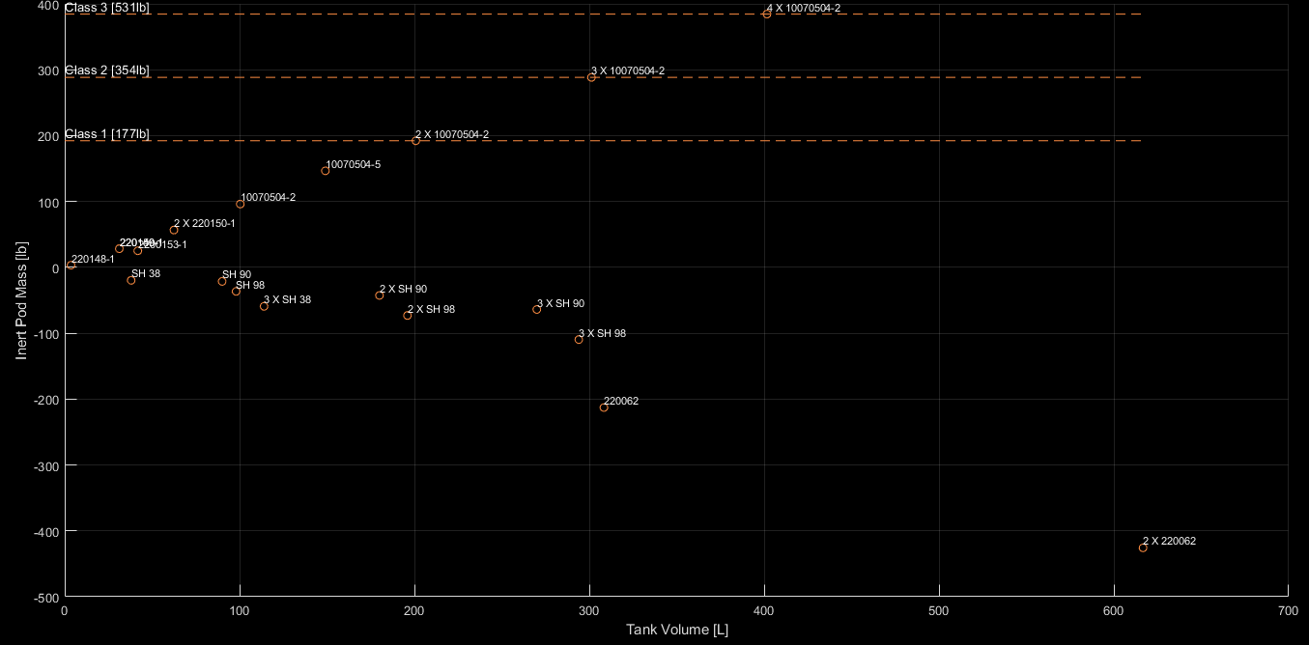
Pod Inert Mass v. Tank System ΔV=500km/hr
Values Below 0 imply that the velocity (500km/hr) is unobtainable with the given tank system)

Slide 9
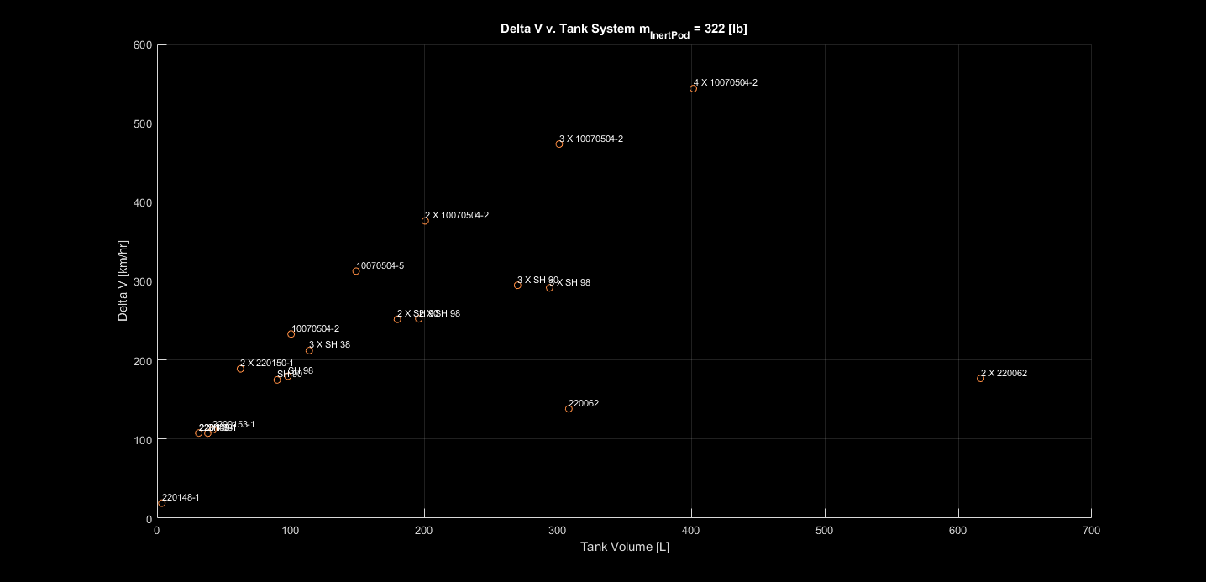
ΔV v. Tank System m_{InertPod}=322[lb]
Goal
Current Record
[463.5 km/hr]
(WARR)
Swissloop
[257 km/hr]
2019 2nd

Slide 10
Tank Dimensions
Generally, tank systems were only considered if they were within reasonable dimensions
For a more detailed breakdown, reference the google sheet document.
An initial design is further presented with the 2X10070504-2 configuration…

Slide 11
2X10070504-2 CAD

Slide 12
Mass Flow Rate
On/Off Dump v. Regulated???

Slide 13
Nozzle Design

Slide 14
Valve Requirements
Inlet Pressure ~4800psi
~ASME Class 2500

