Slide 1
Cal Poly SLO Hyperloop Propulsion CDR
Kent Roberts

Slide 2
Propellant Selection
Gas | Molecular Weight | Specific Impulse (sec) | ∝ Total Impulse per unit Volume
Air | 28.9 | 74 | 2138.6
Argon | 39.9 | 57 | 2274.3
CO2 | 44 | 67 | 2948
Helium | 4 | 179 | 716
Hydrogen | 2 | 296 | 592
Nitrogen | 28 | 80 | 2240
Methane | 16 | 114 | 1824
Air is widely available for a test campaign, performance runs where T<0°C - use nitrogen

Slide 3
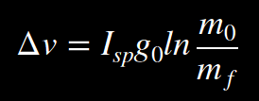


Rocket Equation
m_{f}=Inert Pod Mass (Non-Tank Pod mass + Tank Mass + Residual propellant)
m₀=Wet Pod Mass (m_{f} + Propellant Mass)

Slide 4
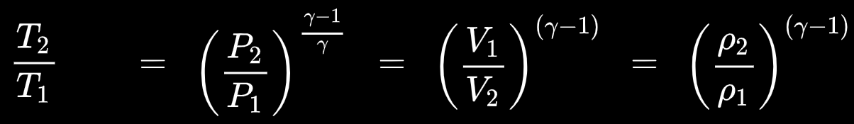
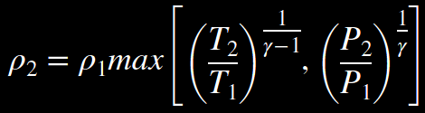
Isentropic Processes and Tank Discharge Limitations
T₂=Lower Temperature Limit of the Tank & Valve hardware
P₂=Lower Pressure Limit (function of P_{nozzle_Inlet} and Flow Coefficient of Hardware C_{v})
*Most systems with T₂~-40F and P₂~500psi are Temperature limited

Slide 5
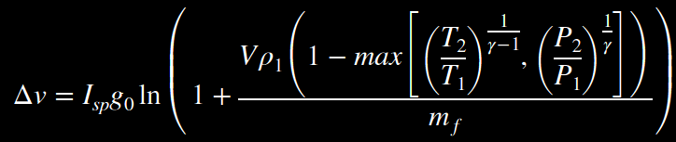

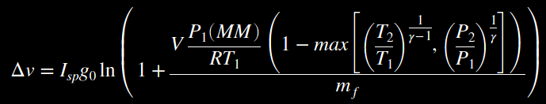
Rocket Eq. & Isentropic Process
Use the Ideal Gas Law to find ρ₁

Slide 6


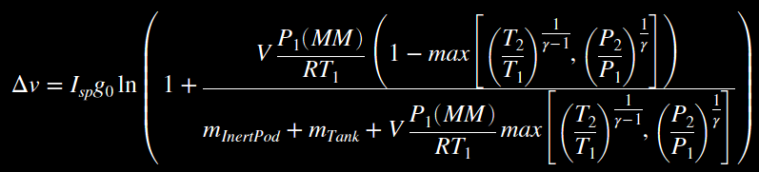

ΔV as a Function of Pod Inert Mass and Tank Specifications

Slide 7

Pod Inert mass as a function of ΔV and Tank Specifications

Slide 8
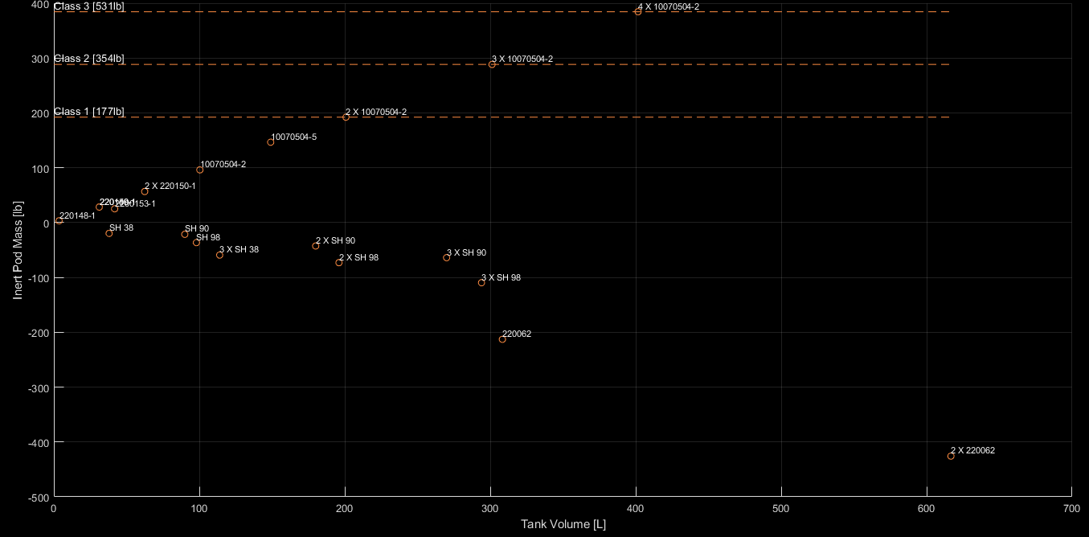
Pod Inert Mass v. Tank System ΔV=500km/hr
Values Below 0 implies that the velocity (500km/hr) is unobtainable with the given tank system

Slide 9
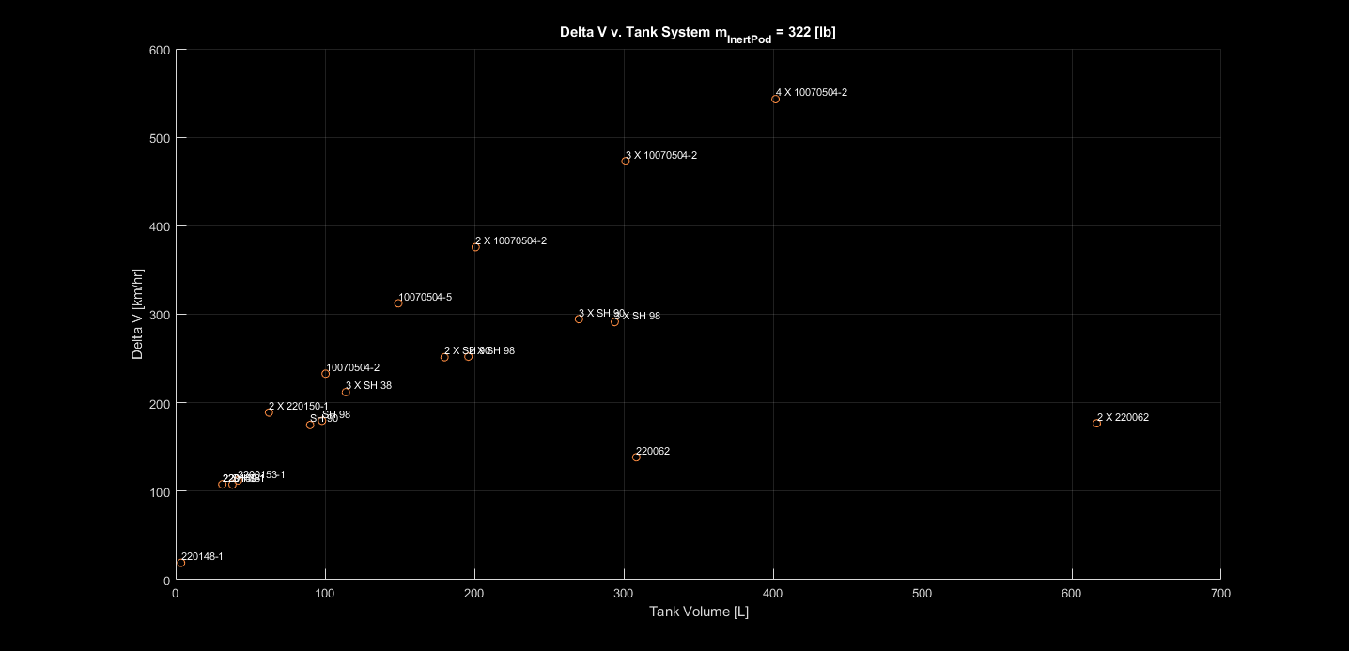
ΔV v. Tank System m_{InertPod}=322[lb]
Goal
Current Record
[463.5 km/hr]
(WARR)
Swissloop
[257 km/hr]
2019 2nd

Slide 10
Tank Dimensions
Generally, tank systems were only considered if they were within reasonable dimensions
For a more detailed breakdown, reference the google sheet document.
An initial design is further presented with the 2X10070504-2 configuration and a 2 X SH 90 alternative (Former sourced from General Dynamics, later from Steelhead Composites)
10070504-2 [15.2in⌀ X 42.3in]
SH 90 [17.1in⌀ X 39in]

Slide 11




Mass Flow Rate
Assume a constant flow rate

Slide 12
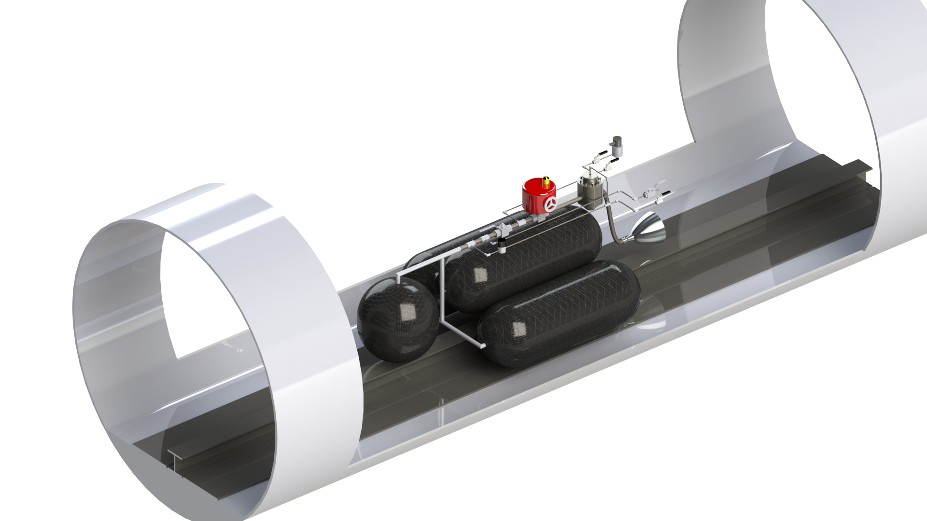
3 X10070504-2 + 1 X 220074

Slide 13
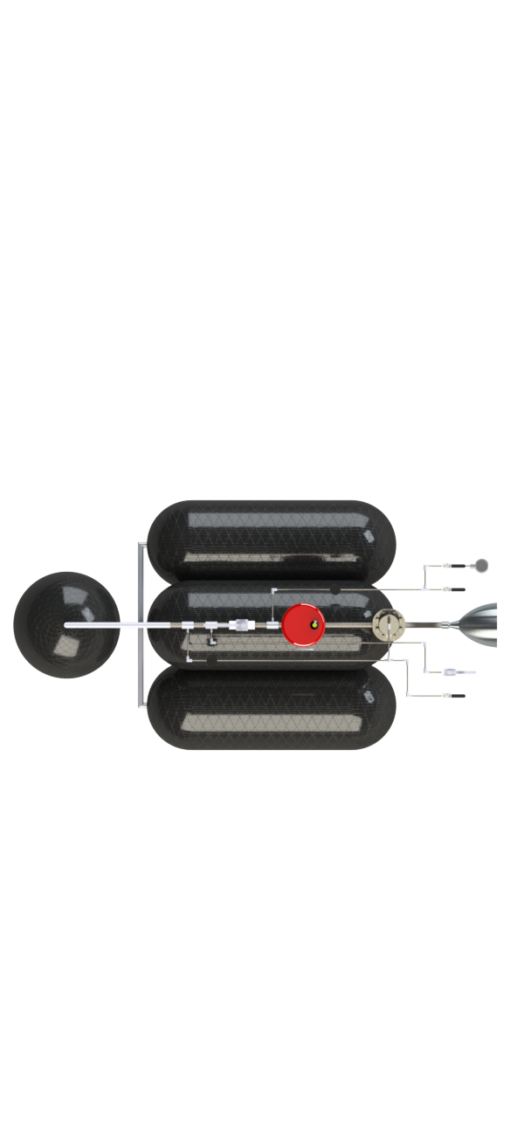
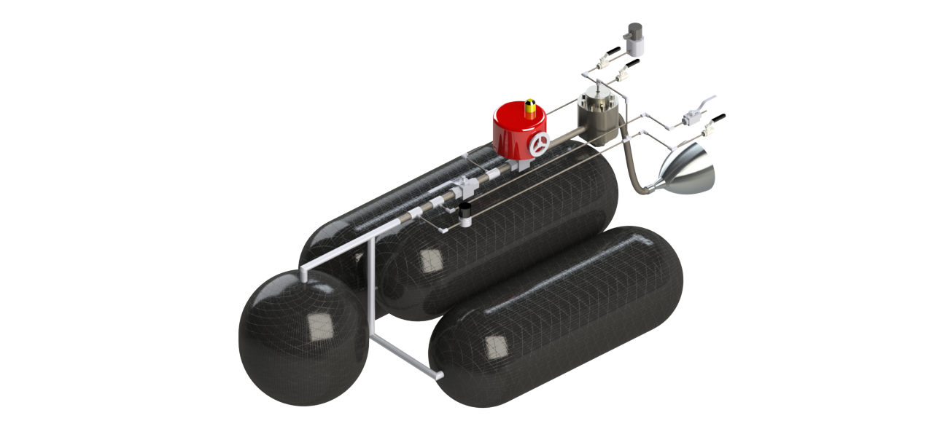
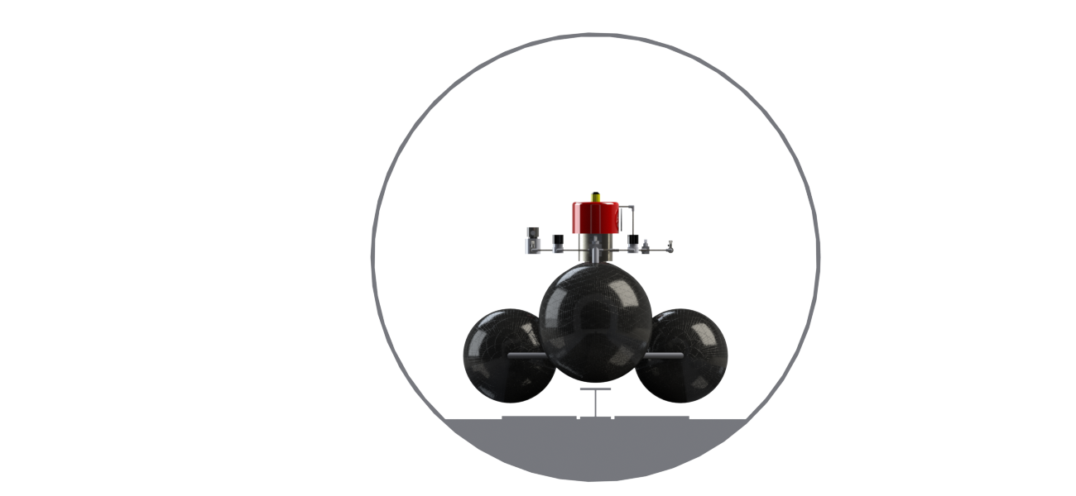

Slide 14
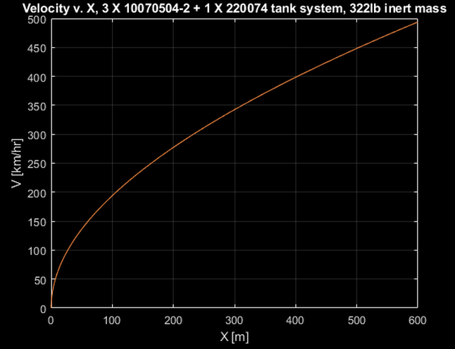
3 X10070504-2 + 1 X 220074 Performance
322 lb Inert Pod mass, 600m thrusting length, 493 km/hr max v, Cv = 12 Reg (60lb!!!!)…. Maybe Unregulated offers better performance???
V_{max} = 493 km/hr
Coast/Braking =>
L_{thrust} = 600m
m_{inert} = 322 lb
t_{MECO} = 9.03sec
p_{Nozzle_inlet} = 1496psi
ṁ = 6.59 kg/sec
d_{t} = 0.7 in
F_{thrust} = 4721 N
a_{max} = 1.7g
Hp-d-Orifice_{min}= 0.41 in
m_{0_loaded_tanks} = 430 lb
m_{0_loaded_pod} = 751 lb
The inert mass (everything except for the tanks and propellent) is probably significantly more than the 322lb assumption, give a 430lb loaded tank system…
Notes:
To use a lighter, lower Cv regulator, we need to increase the thrusting length. A higher C_v means a higher nozzle inlet pressure for a given flow rate and thus a smaller throat.

Slide 15
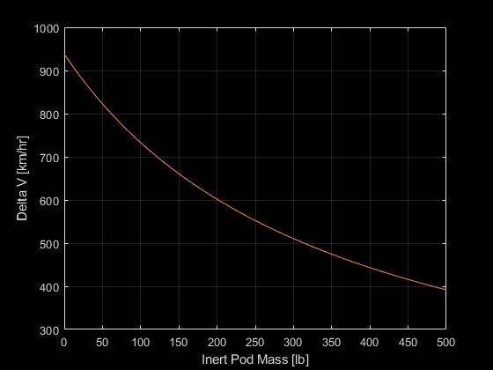
3 X10070504-2 + 1 X 220074 Performance

Slide 16
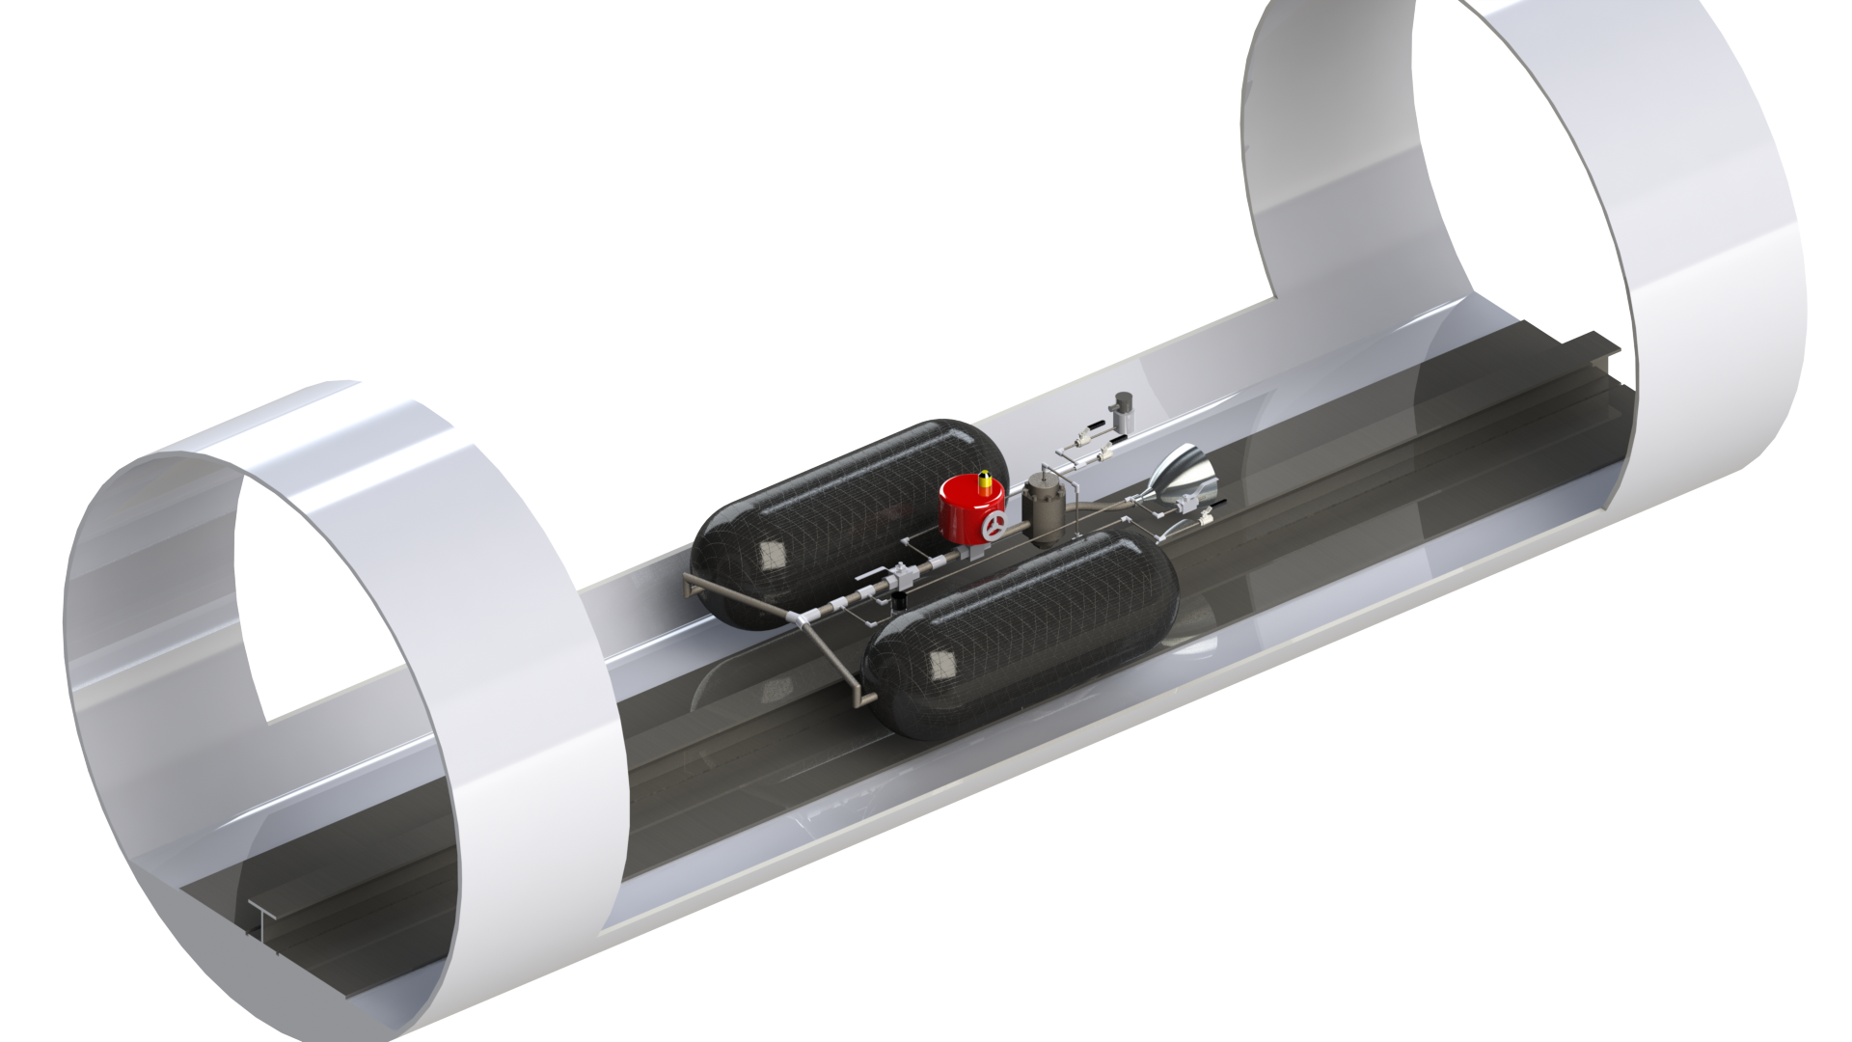
2 X10070504-2

Slide 17
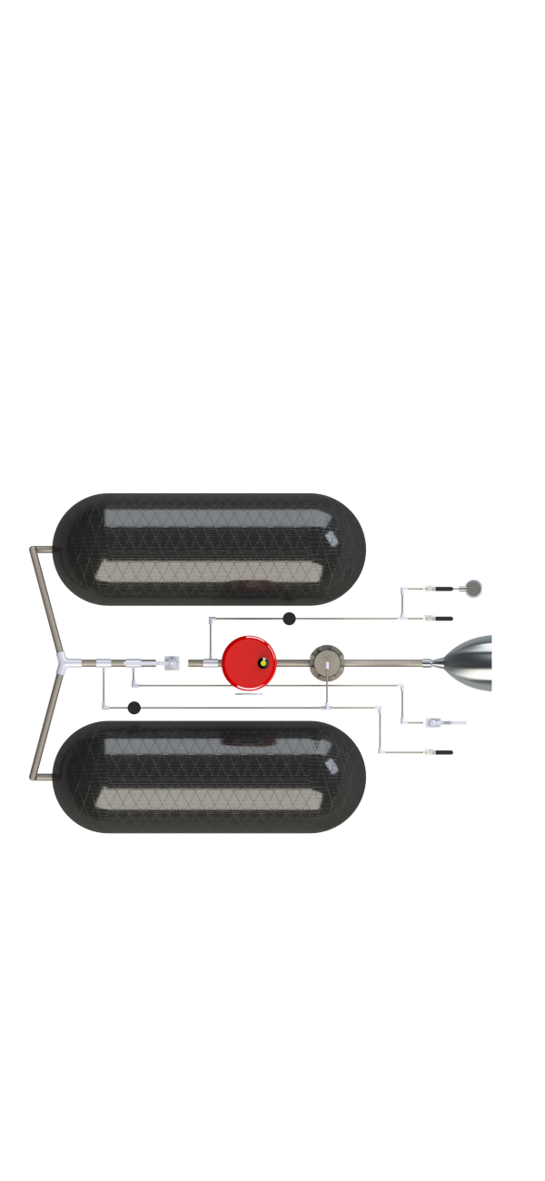
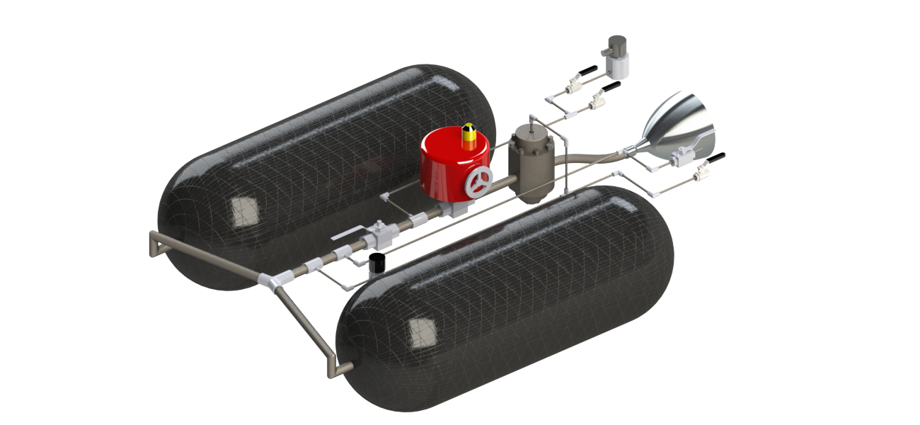
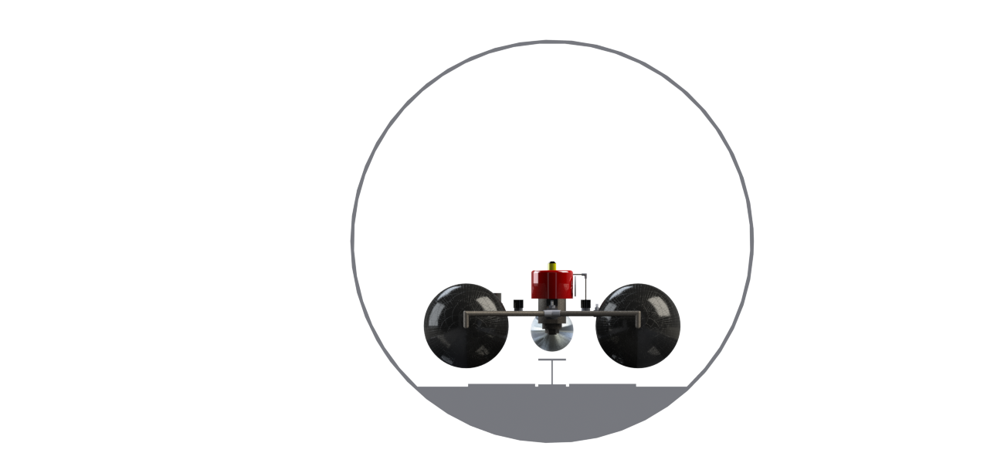

Slide 18
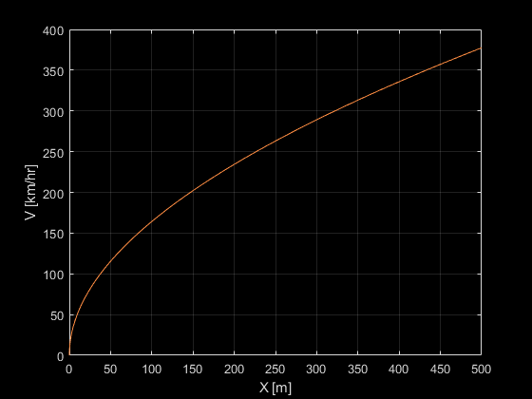
2 X10070504-2 Performance
322 lb Inert Pod mass, 500m thrusting length, 377 km/hr max v, Cv = 12 Reg (60lb!!!!)…. Maybe Unregulated offers better performance???
V_{max} = 377 km/hr
Coast/Braking =>
L_{thrust} = 500m
m_{inert} = 322 lb
t_{MECO} = 9.7sec
ṁ = 3.56 kg/sec
F_{thrust} = 2550 N
a_{max} = 1.18g
p_{Nozzle_inlet} = 1846 psi
d_{t} = 0.46 in
m_{0_loaded_tanks} = 241 lb
m_{0_loaded_pod} = 563 lb

Slide 19
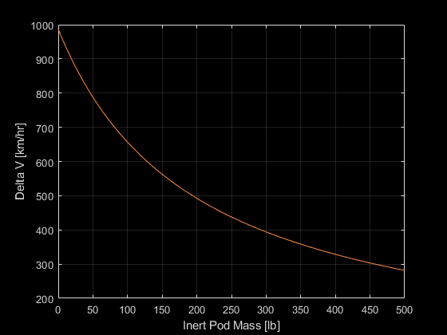
2 X10070504-2 Performance

Slide 20
Nozzle Design
Tank
Tank
Configuration options:
Tank
Tank
Straight dump
Phase through Under/Over expanded
No pressure regulation
Dynamics?
Aerospike
Variable expansion
No pressure regulator
Thermal
Manufacturing
Cool factor
Regulated
Optimal expansion
Requires pressure regulation
Additional set of nozzles for testing
Dual-Bell
One nozzle with optimal expansion for the tube & 1atm testing
Requires pressure regulation
Notes:
Dual-Bell operational advantage, test at 1 atm, system will preform predicable, go straight to test without disassembling the high-pressure system (and draining/refilling the tanks <- takes time (ISOTHERMAL))

Slide 21


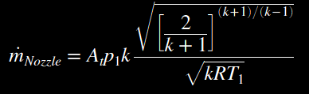
Nozzle Design
The nozzle mass flow rate must be above the physics requirement (to accelerate within the thrust length) and within the limits of the flow hardware
Avoid the possibility of supersonic flow in the hardware
Notes:
Dual-Bell operational advantage

Slide 22
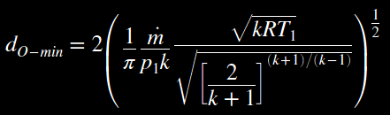

Nozzle Design
Minimum orifice
2 X 10070504-2 System (322lb):
This is for a combination of extrema of P_1 and T_1, a condition which is not predicted. (a more refined approach will be implemented later)
Notes:
Dual-Bell operational advantage

Slide 23
Tank 2 X 10070504-2
[p₀=4800psi]
Safety Relief
Relief Pressure
Regulator
TESCOM BB13AL2?B?
P
T
S
Control Relief
4800psi
M
~125psi
Manual Relief
Manual Valve
(Close during fill & Prior to operation)
Flow-Tek Triad Models HP
1” Cv = 32
Primary Control Valve
Flow-Tek Triad Models HP
1” Cv = 32
V-Port Ball?
S70 Electric Actuator?
Default Closed
Pressure Regulator (Diaphragm)
TESCOM 26-1200
1/2” MS33649 Cv = 3.3
T
P
Nozzle(s)
270psi
Safety Relief
270psi
P
Low Pressure Relief
Pilot Pressure Reg.
TESCOM BB13AH1?B?
High Pressure Fill
Low Pressure Diaphragm Reference System
Safety Relief

