Slide 1



Chi-Square Test of Independence
Presented by:
RHEGIE M. CAGA-ANAN,PhD
Notes:
Medical Science / College of Medicine should be added
Food Security and Safety

Slide 2

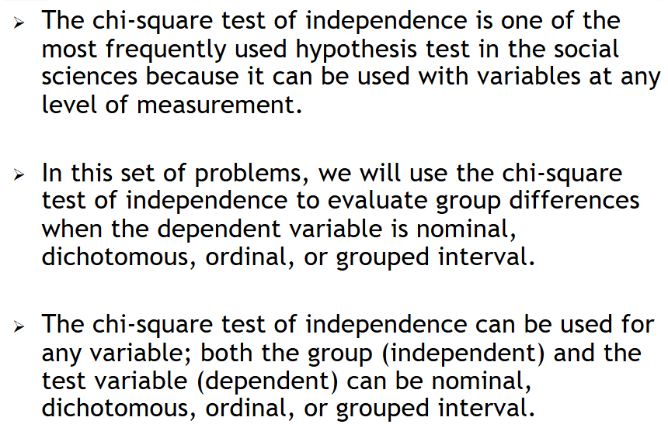

Slide 3
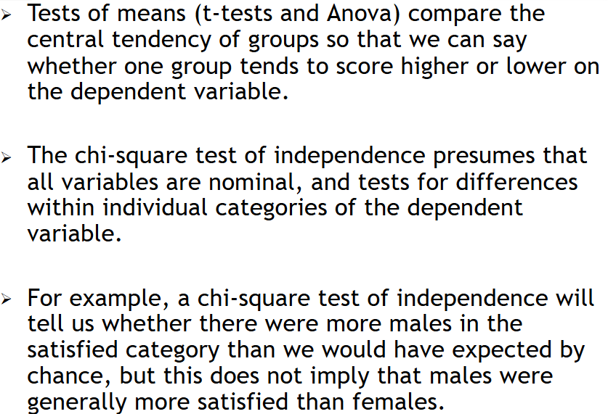

Slide 4
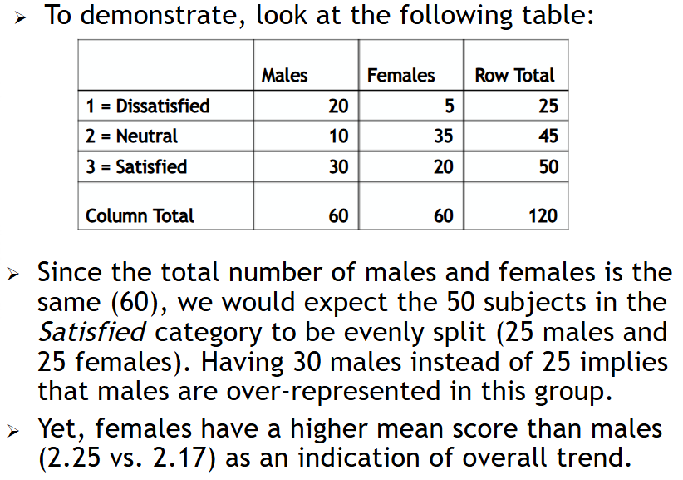
1.1
Descriptive and Inferential Statistics

Slide 5
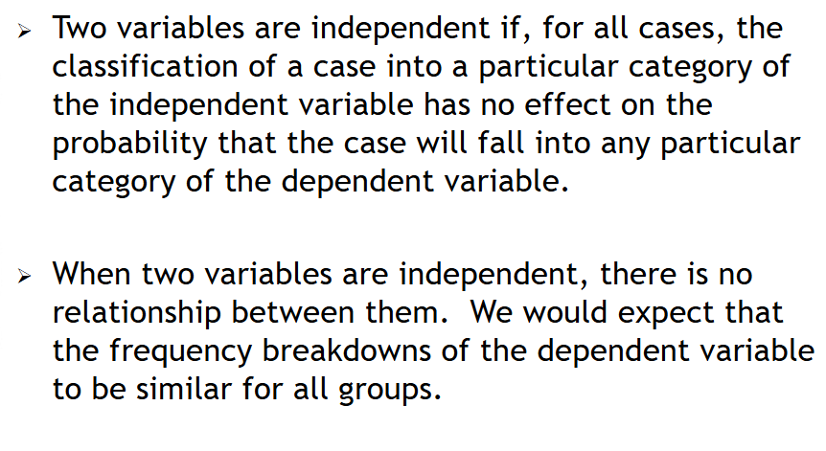

Slide 6
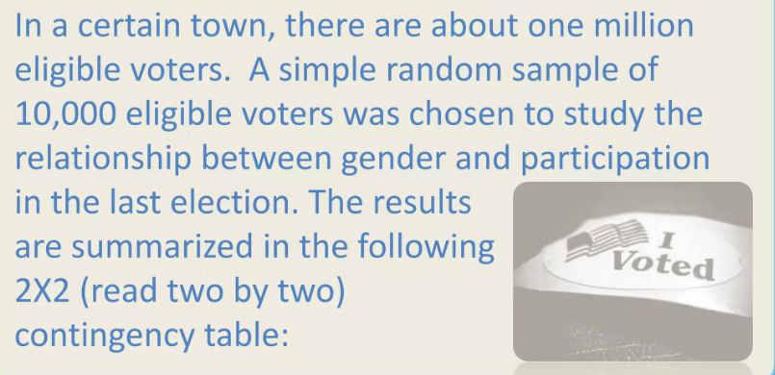

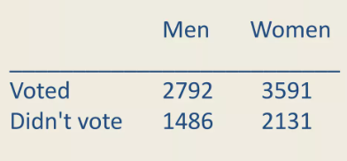


Slide 7




Slide 8
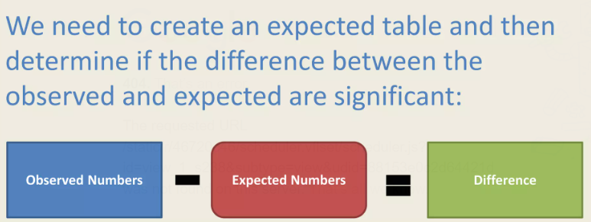



Slide 9


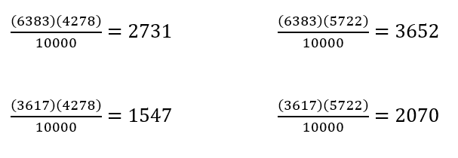
Observed Table | Men | Women | Total
Voted | 2792 | 3591 | 6383
Didn't Vote | 1486 | 2131 | 3617
Total | 4278 | 5722 | 10000
Expected Table | Men | Women
Voted | 2731 | 3652
Didn't Vote | 1547 | 2070

Slide 10
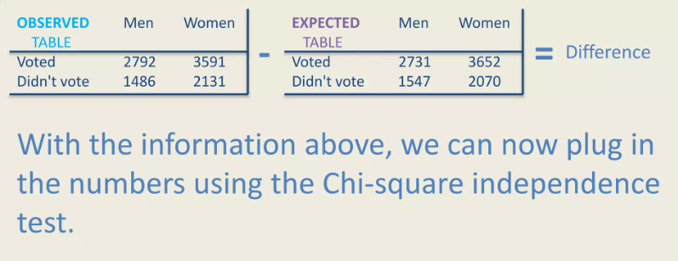
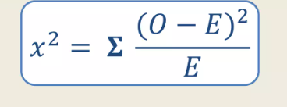

Slide 11


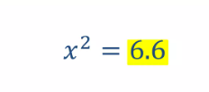


Slide 12
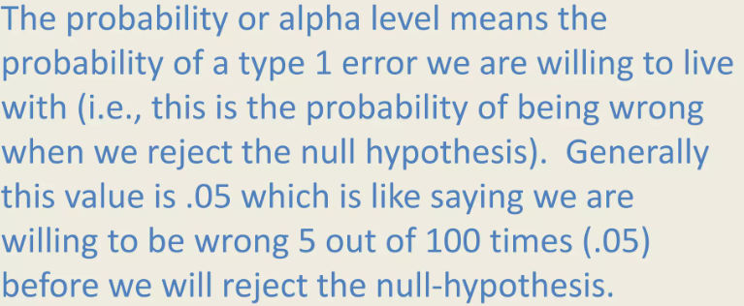



Slide 13


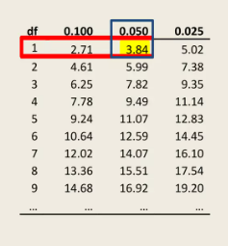



Slide 14




Slide 15

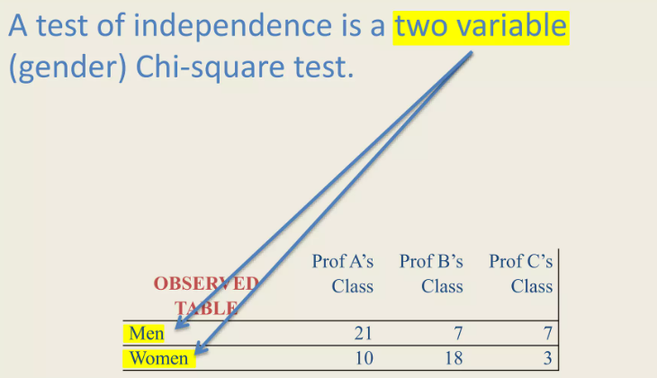

Slide 17


Slide 18


