Slide 1
Aka Image Processing System
MAN TEN Cooperation
ManTen Group

Slide 2
About US

Slide 3
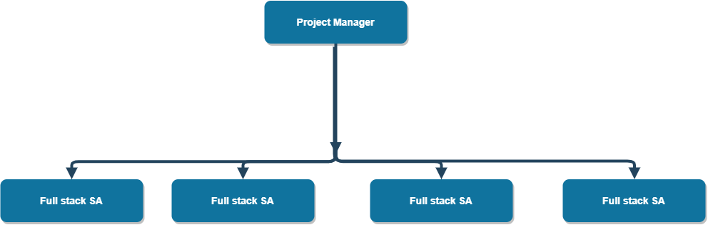
Team Organization

Slide 4
Team members
Đinh Xuân Bách (PM)
Nguyễn Gia Vũ (SA, FS DEV)
Vũ Trần Kiên (SA, FS DEV)
Nguyễn Thị Thu Hà (SA, FS TEST)
Ngô Phạm Anh Huy (SA, FS DEV)

Slide 5
System Overview

Slide 6
Vision
System for user can do anything with images such as resize, tagging, editing, sharing
System for company can reduce effort for BPO purpose such as tagging, recognizing, do OCR
System for administrator can manage user accounts, user actions, user permission

Slide 7
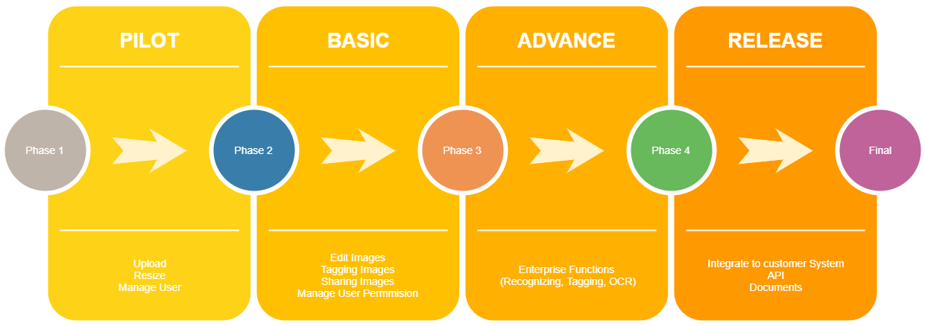
Plan

Slide 8
Functional Requirement (User)
Store images
Resize images
View stored images
Login to system

Slide 9
Non functional requirement (User)
Store image to high trust and security storage
Resize image with high resolution
View, Upload image with fast speed

Slide 10
Functional Requirement (Admin)
Login to system
List User
Confirm User

Slide 11
Non Functional Requirement (Admin)
Friendly Interface for using

Slide 12
Project Design

Slide 13
Why AWS?
Amazon Web Services (AWS) is a secure cloud services platform, offering compute power, database storage, content delivery and other functionality to help businesses scale and grow.
Our system need:
High availability storage
Scalable backend
High performance system for image processing

Slide 14
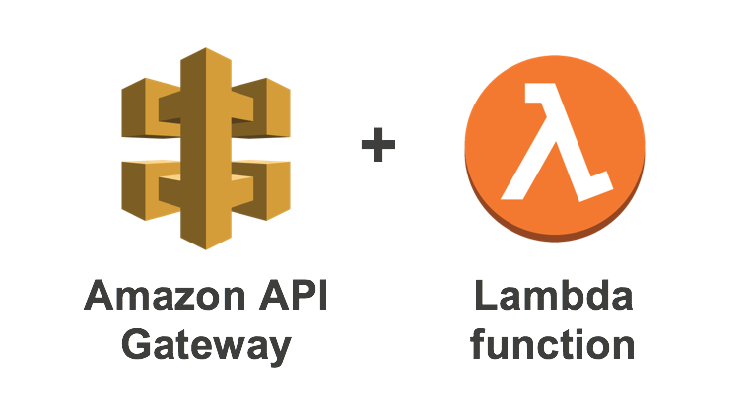


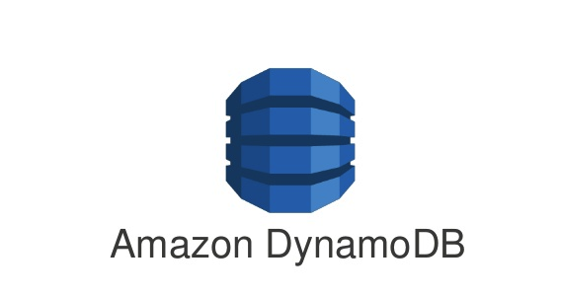

What AWS service we are using?

Slide 15
User System Architecture

Slide 16
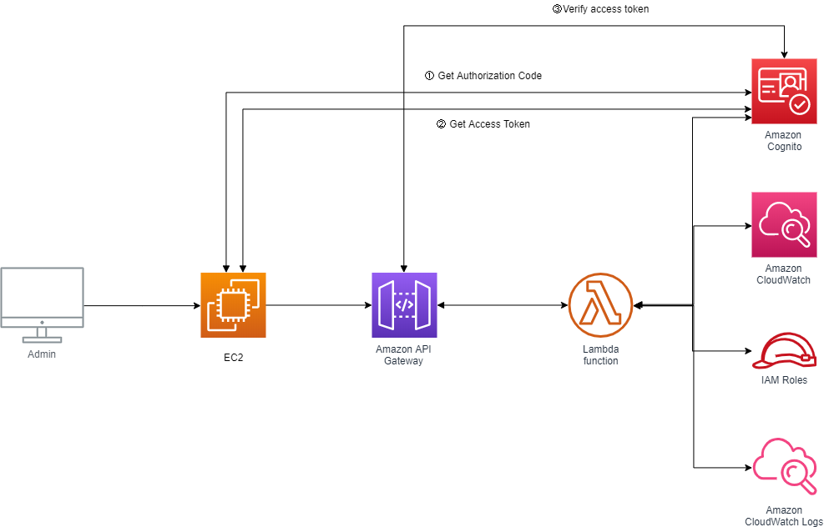
Admin System Architecture

Slide 17

Demo

Slide 18
Thanks you

