Slide 1

The Wonderful World of Fractals
Based on a Lesson by Cynthia Lanius

Slide 2
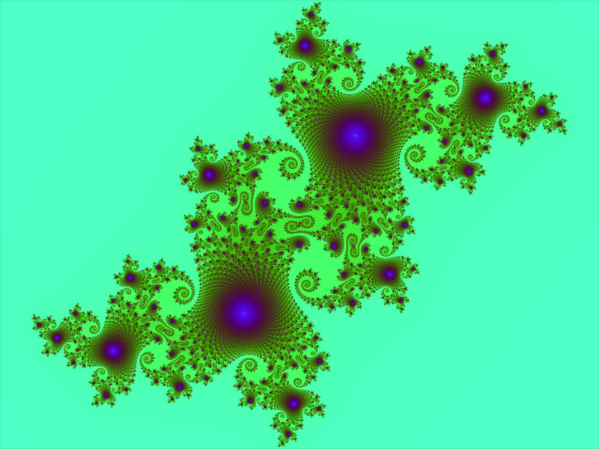
What is a Fractal?
Notes:
Begin the PowerPoint by asking if your students have ever heard of fractals.

Slide 3
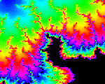
What is a Fractal?
Fractals are pictures that can be divided up into sections, and each of those sections will be the same as the whole picture.
Fractals are said to possess infinite detail.
Let’s see what this means!
Notes:
http://en.wikipedia.org/

Slide 4

Drawing Fractals
We are going to create some fractals of our own!
You’ll need white paper, a ruler, and colored pencils.

Slide 5

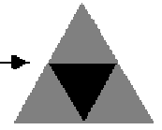
The Sierpinski Triangle
Step One: Draw an equilateral triangle and connect the midpoints of the sides, as shown below.
How many equilateral triangles do you now have?
Shade out the triangle in the center (shading shown in black). Think of this as cutting a hole in the triangle.
Notes:
http://math.rice.edu/~lanius/fractals/

Slide 6
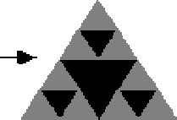
The Sierpinski Triangle
Step Two: Draw another equilateral triangle on a new piece of paper, and again connect the midpoints of the sides.
Shade the triangle in the center as before.
Now shade out another triangle in each of the three triangles on the corners by connecting the midpoints of the edges of these corner triangles, as shown below.
Notes:
http://math.rice.edu/~lanius/fractals/

Slide 7
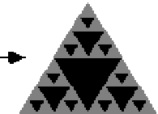
The Sierpinski Triangle
Step Three: Draw a third equilateral triangle on a new piece of paper.
Follow the same procedure as before, making sure to keep to the shading pattern. Take it an additional step to get the picture below.
You will now have 1 large, 3 medium, and 9 small triangles shaded.
Notes:
http://math.rice.edu/~lanius/fractals/

Slide 8
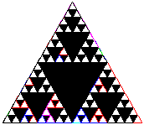
The Sierpinski Triangle
What if we kept going?
Look here!
Notes:
http://math.rice.edu/~lanius/fractals/sierjava.html

Slide 9
The Math of the Serpinski Triangle
What fraction of the triangle did you NOT shade the first time you shaded?
What fraction of the triangle did you NOT shade next time?
Notes:
We did NOT shade ¾ of the triangle the first time.
We did NOT shade 9/16 of the triangle the second time.
http://math.rice.edu/~lanius/fractals/

Slide 10
The Math of the Serpinski Triangle
What fraction did you NOT shade next time?
Do you see a pattern here?
Use the pattern to predict the fraction of the triangle you would NOT shade next time.
Notes:
We did NOT shade 27/64 of the triangle the third time.
Pattern: (3^n)/(4^n)
Try to have the students work together to figure out this pattern!

Slide 11
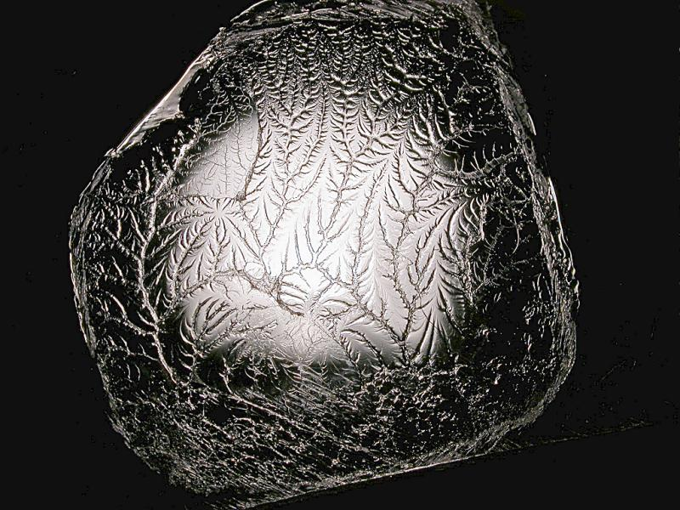
Where can Fractals be Found?
Pulling apart two glue covered sheets forms a fractal!
Notes:
http://en.wikipedia.org/wiki/Fractal#Fractals_in_nature

Slide 12
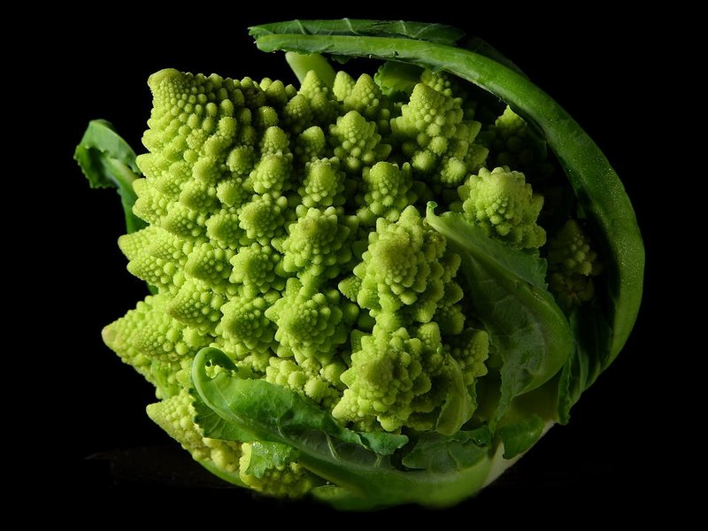
Where can Fractals be Found?
Fractals can even be found in broccoli!
Notes:
http://en.wikipedia.org/wiki/Fractal#Fractals_in_nature

Slide 13
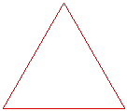
Koch Snowflake
Let’s try to build another fractal, called the Koch Snowflake.
Step One: Start with a large equilateral triangle.
Notes:
http://math.rice.edu/~lanius/frac/koch2.html

Slide 14
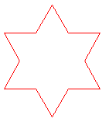
Koch Snowflake
Step Two: Make a Star.
Divide one side of the triangle into three equal parts and remove the middle section.
Replace it with two lines the same length as the section you removed.
Do this to all three sides of the triangle.
Notes:
http://math.rice.edu/~lanius/frac/koch2.html

Slide 15
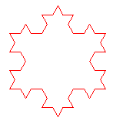
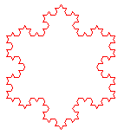
Koch Snowflake
Step 3: Repeat the pattern for each outside edge of your snowflake.
Repeat!
Notes:
http://math.rice.edu/~lanius/frac/koch2.html

Slide 16
The Koch Snowflake - Perimeter
Question: If the perimeter of the equilateral triangle that you start with is 27 units (each side is 9 units), what is the perimeter of the other figures?
Perimeter = 27 units
Perimeter = ? units
Perimeter = ? units
Notes:
The second figure has a perimeter of 36 units, since it has 12 edges, each with a length of 3 units. See if your students can deduce this.
The third figure has a perimeter of 48 units, because it has 48 edges, each with a length of 1 unit. See if your students can deduce this one too!
http://math.rice.edu/~lanius/frac/koch2.html

Slide 17
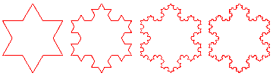
Koch Snowflake - Perimeter
What is happening to the perimeter?
This means the Koch Snowflake Fractal has INFINITE perimeter!
Do you think the area of the Koch Snowflake is infinite?
An infinite perimeter encloses a finite area... Now that's amazing!!
Notes:
The perimeter is getting larger each time, and a larger amount is being added each time. We start with a perimeter of 27 units, then we add 9 units the first time, and 12 units the second time.
We say the area is bounded by a circle surrounding the original triangle. If you continued the process oh, let's say, infinitely many times, the figure would have an infinite perimeter, but its area would still be bounded by that circle.
http://math.rice.edu/~lanius/frac/koch2.html

Slide 18
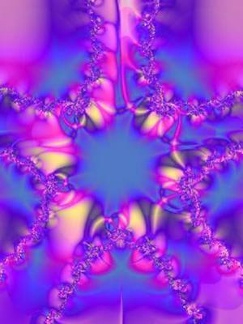
What are Fractals Used For?
Random fractals are
useful because they can be used to describe many highly irregular real-world objects.
Examples include clouds, mountains, coastlines, turbulence, and trees.
They are often used in computer and video game design, especially for graphics of organic environments

Slide 19
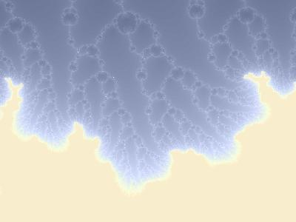
What are Fractals Used For?
Fractals are also used in:
  Medicine
  Making new music
  Making new art
  Mapping earthquakes and the movement of the earth
  Signal and image compression

