Slide 1
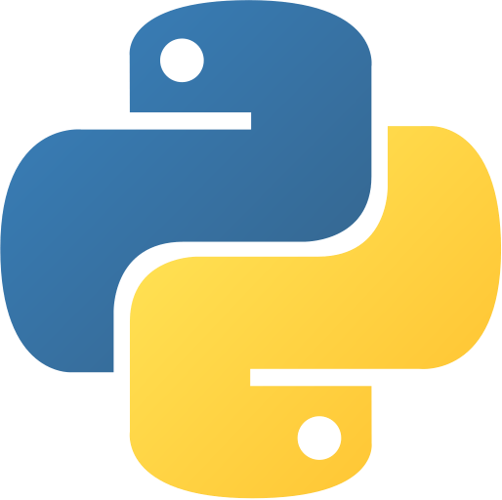
My Journal To Python
4110E236 - 柯保羅
MyDearGreatTeacher
https://github.com/Kenth963

Slide 2
Agenda
Python
What can python do?
Data types
Numbers
Strings
Operators ON data type:
CONTROLS : IF- | IF –ELSIF |-F-ELSE
LOOP: FOR |WHILE | RANGE() | BREAK | CONTINUE
FUNCTION:
PARAMETERS(ARGUMETNS)
RECURSIVE FUNCTION
LAMBDA FUNCTION

Slide 3
What is Python?
Python is a popular programming language. It was created by Guido van Rossum, and released in 1991.
It is used for:
web development (server-side),
software development,
mathematics,
system scripting
https://www.w3schools.com/python/python_intro.asp

Slide 4
What can Python do?
Python can be used on a server to create web applications.
Python can be used alongside software to create workflows.
Python can connect to database systems. It can also read and modify files.
Python can be used to handle big data and perform complex mathematics.
Python can be used for rapid prototyping, or for production-ready software development.
https://www.w3schools.com/python/python_intro.asp

Slide 5
Python Data Types
Built-in Data Types
In programming, data type is an important concept.
Variables can store data of different types, and different types can do different things.
Python has the following data types built-in by default, in these categories:
Text Type: | str
Numeric Types: | int, float, complex
Sequence Types: | list, tuple, range
Mapping Type: | dict
Set Types: | set, frozenset
Boolean Type: | bool
Binary Types: | bytes, bytearray, memoryview
None Type: | NoneType

Slide 6
Python Numbers
There are three numeric types in Python:
int
float
complex
int, or integer, is a whole number, positive or negative, without decimals, of unlimited length.
float, or "floating point number" is a number, positive or negative, containing one or more decimals.
Complex numbers are written with a "j" as the imaginary part:
Variables of numeric types are created when you assign a value to them:
x = 1 # int y = 2.8 # float z = 1j # complex
https://www.w3schools.com/python/python_numbers.asp

