Slide 1
Python Programming Language

Slide 2
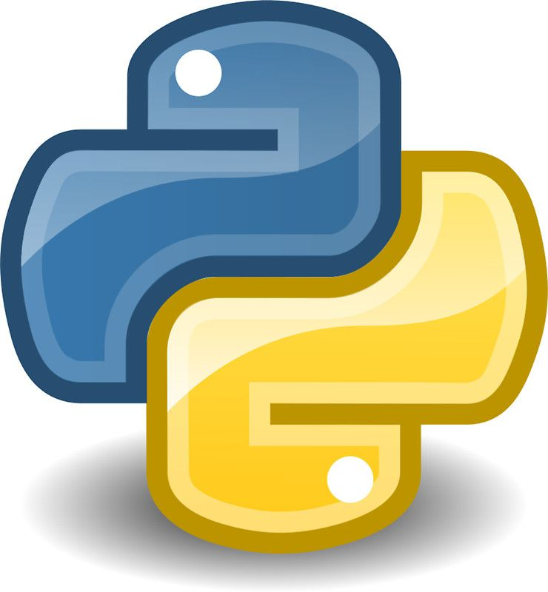
What is Python?
Python is a popular programming language. It was created by Guido van Rossum, and released in 1991.
It is used for:
web development (server-side),
software development,
mathematics,
system scripting.
What can Python do?
Python can be used on a server to create web applications.
Python can be used alongside software to create workflows.
Python can connect to database systems. It can also read and modify files.
Python can be used to handle big data and perform complex mathematics.
Python can be used for rapid prototyping, or for production-ready software development.

Slide 3
Why Python?
Python works on different platforms (Windows, Mac, Linux, Raspberry Pi, etc).
Python has a simple syntax similar to the English language.
Python has syntax that allows developers to write programs with fewer lines than some other programming languages.
Python runs on an interpreter system, meaning that code can be executed as soon as it is written. This means that prototyping can be very quick.
Python can be treated in a procedural way, an object-oriented way or a functional way.
Good to know
The most recent major version of Python is Python 3, which we shall be using in this tutorial. However, Python 2, although not being updated with anything other than security updates, is still quite popular.
In this tutorial Python will be written in a text editor. It is possible to write Python in an Integrated Development Environment, such as Thonny, Pycharm, Netbeans or Eclipse which are particularly useful when managing larger collections of Python files.

Slide 4
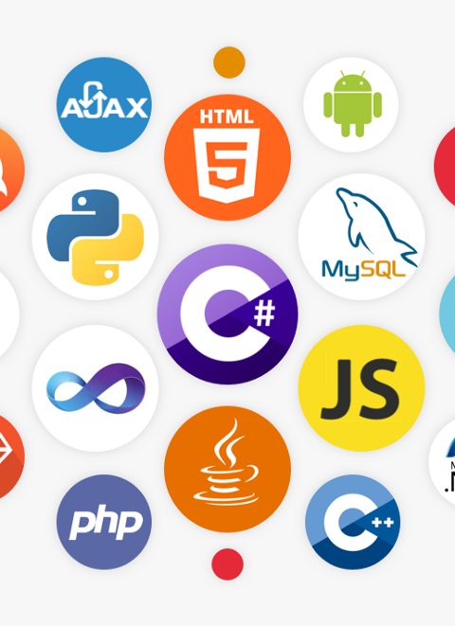
Python Syntax compared to other programming languages
Python was designed for readability, and has some similarities to the English language with influence from mathematics.
Python uses new lines to complete a command, as opposed to other programming languages which often use semicolons or parentheses.
Python relies on indentation, using whitespace, to define scope; such as the scope of loops, functions and classes. Other programming languages often use curly-brackets for this purpose.

Slide 5
Python Jobs
A professional who specializes in Python can hold a number of job titles, including Python Developer, Data Scientist, and Machine Learning Engineer. The exact work you’ll be doing will depend on the industry, company, and scope of the role, but essentially you will be using code to create sites and applications, or work with data and AI.
Web Developer
Python Developer
Software Engineer
Data Analyst
Data Scientist
Machine Learning Engineer

Slide 6
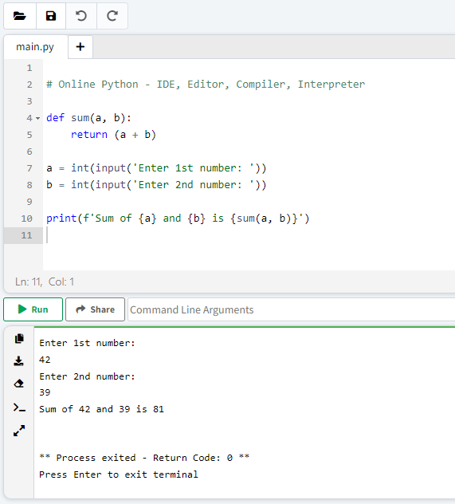
Python Online Interpreter : 1

Slide 7
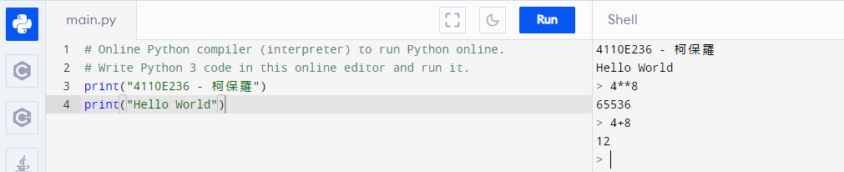
Python Online Interpreter : 2

Slide 8
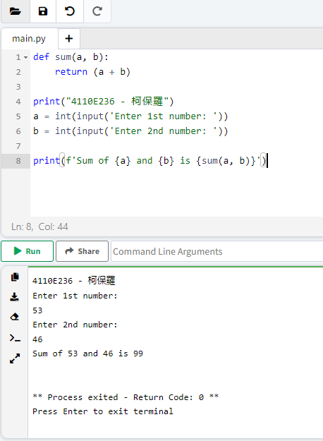
Exercise 2 : Sample

Slide 9

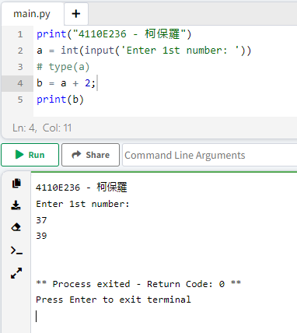
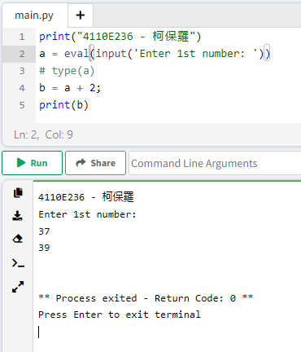
Exercise 3 : Input & Output
Question :
2 Possible Answers
A
B
int()
eval()

Slide 10
Python Data Types
Built-in Data Types
In programming, data type is an important concept.
Variables can store data of different types, and different types can do different things.
Python has the following data types built-in by default, in these categories:
Text Type: str
Numeric Types: int, float, complex
Sequence Types: list, tuple, range
Mapping Type: dict
Set Types: set, frozenset
Boolean Type: bool
Binary Types: bytes, bytearray, memoryview
None Type: NoneType

Slide 11
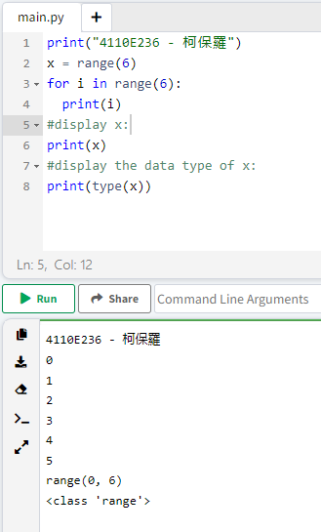
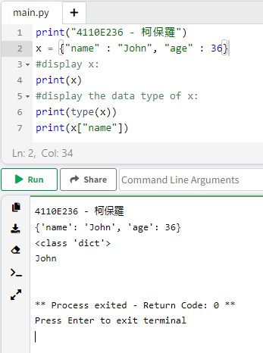
Exercise 4 : Data Types

Slide 12
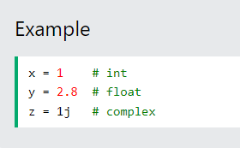
Python Numbers
There are three numeric types in Python:
Int
float
complex
Variables of numeric types are created when you assign a value to them:

Slide 13

Python Operators
Operators are used to perform operations on variables and values.
In the example below, we use the + operator to add together two values:
Python divides the operators in the following groups:
Arithmetic operators
Assignment operators
Comparison operators
Logical operators
Identity operators
Membership operators
Bitwise operators

Slide 14
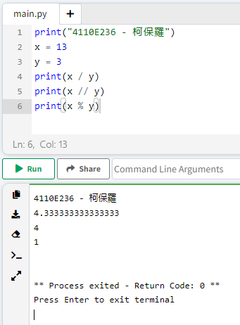
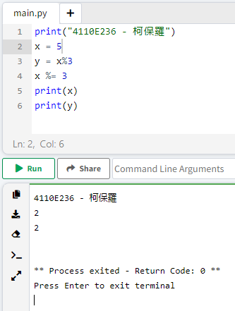
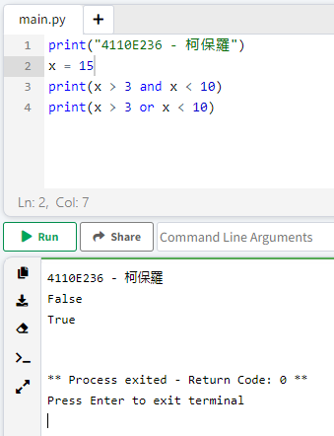
Exercise 5 : Python Numbers - Operators
Python Arithmetic Operators
Python Assignment Operators
Python Comparison Operators

Slide 15
Python is a computer programming language often used to build websites and software, automate tasks, and conduct data analysis. Python is a general-purpose language, meaning it can be used to create a variety of different programs and isn't specialized for any specific problems.

Slide 16
Python is both a free and open-source programming language. Python is the easiest language to learn. Its English-like structure aids non-technical pupils in quickly picking up the language.

Slide 17
Thank you

