Slide 1
状態遷移図
Start
1
GlcNAc 0.96
4
0.99
0.98
0.84
Gal 0.70
Fuc 0.20
Man 0.93
0.86
0
5
2
0.95
0.99
0.68
0.32
Neu5Ac 0.56
Neu5Gc 0.14
0.70
0.30
0.99
0.77
0.30
3
1
0.99
GlcNAc 1
0.70
親子関係
Man 0.96
兄弟関係
確率が0.3未満の辺は基本的に省略
ラベルのみ確率が0.1以上を出力

Slide 2
Start
1
GlcNAc 0.96
4
0.99
親子関係
0.98
0.84
兄弟関係
Gal 0.70
Fuc 0.20
Man 0.93
0.15
0.86
0
5
2
0.95
0.99
0.68
0.99
0.32
Neu5Ac 0.56
Neu5Gc 0.14
0.70
0.30
0.77
0.30
3
1
0.99
GlcNAc 1
0.70
Man 0.96

Slide 3
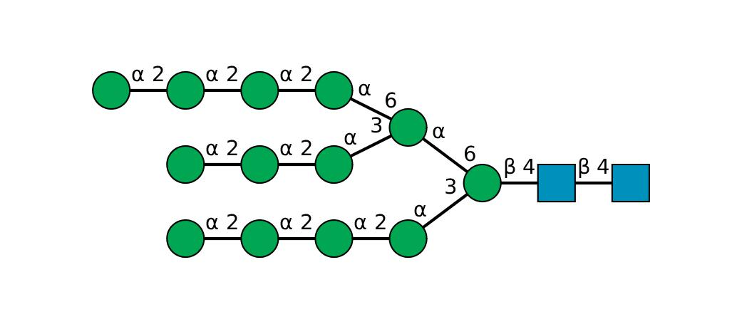
The probability that all labels are outputted along the most likely state transition: -20.665214012469935（対数表示）
0
3
3
3
3
0
3
3
3
1
4
0
3
3
3
SNFG

Slide 4
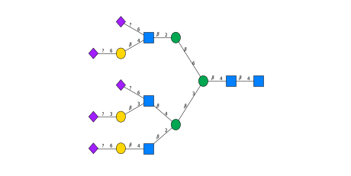
The probability that all labels are outputted along the most likely state transition: -16.14319551388468
2
4
0
2
5
3
1
4
2
4
2
5
0
2
5
4

Slide 5
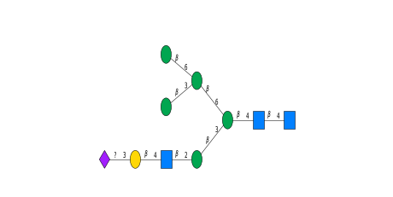
The probability that all labels are outputted along the most likely state transition: -6.291303264632852
0
3
0
3
1
4
2
5
4
0

