Slide 1
状態遷移図
Start
1
2
GlcNAc 1
0.99
0.99
0.45
GlcNAc 0.93
0.99
1
0.99
3
0.54
5
0.99
Man 0.98
GlcNAc 0.66
Fuc 0.29
0.91
0.99
0.13
0.99
0
0.79
4
Gal 0.85
Neu5Ac 0.005
0.99
親子関係
Neu5Ac 0.58
Neu5Gc 0.12
兄弟関係
0.99
確率が0.3未満の辺は基本的に省略
ラベルのみ確率が0.1以上を出力

Slide 2
Start
1
2
GlcNAc 1
親子関係
兄弟関係
0.99
0.99
0.45
GlcNAc 0.93
0.99
1
0.99
3
0.54
5
0.99
Man 0.98
GlcNAc 0.66
Fuc 0.29
0.91
0.99
0.13
0.99
0
0.79
4
Gal 0.85
Neu5Ac 0.005
0.99
Neu5Ac 0.58
Neu5Gc 0.12
0.99

Slide 3
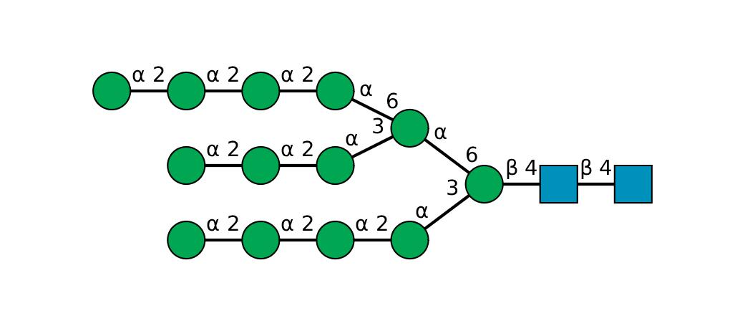
The probability that all labels are outputted along the most likely state transition: -8.825895056538032（対数表示）
3
3
3
3
3
3
3
3
3
1
2
3
3
3
3
SNFG

Slide 4
The probability that all labels are outputted along the most likely state transition: -8.825895056538032（対数表示）
3
3
3
3
3
3
3
3
3
1
2
3
3
3
3
SNFG

Slide 5
High mannose
The probability that all labels are outputted along the most likely state transition: -11.704494208726313（対数表示）
m
m
m
m
m
m
m
m
m
g’
g
m
m
m
m
SNFG

Slide 6
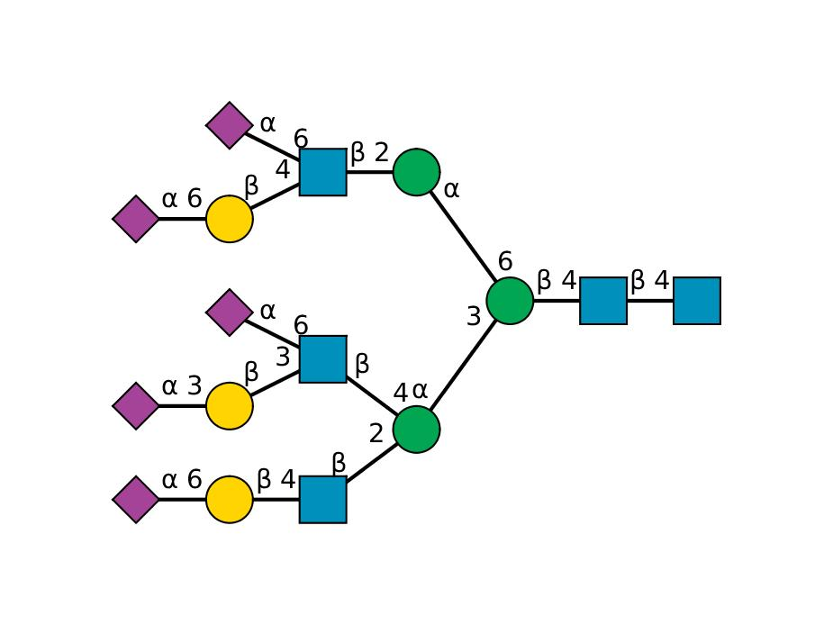
The probability that all labels are outputted along the most likely state transition: -16.14319551388468
4
5
3
0
4
3
1
2
4
5
0
4
3
0
4
5

Slide 7
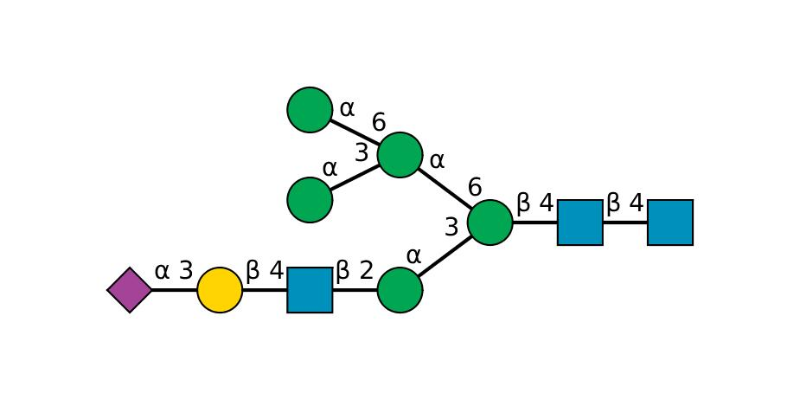
The probability that all labels are outputted along the most likely state transition: -3.933704275453596
3
3
3
3
1
2
0
4
5
3

