Slide 1
状態遷移図
Start
1
Man(a1-3) 0.85
GlcNAc 0.008
3
0.99
0.45
0.54
GlcNAc(b1-2) 0.55
Fuc(a1-6) 0.15
GlcNAc(b1-6) 0.12
0.38
0.99
0.99
GlcNAc(b1-4) 0.97
2
5
4
0.99
0.62
0.32
Gal(b1-4) 0.77
0.83
0.98
0.73
0.98
0.99
1
0
親子関係
0.62
兄弟関係
Man(b1-4) 0.87
Gal(b1-4) 0.1
Man(a1-6) 0.42
Neu5Ac(a2-3) 0.16
確率が0.3未満の辺は基本的に省略
ラベルのみ確率が0.1以上を出力

Slide 2
Start
1
Man(a1-3) 0.85
GlcNAc 0.008
3
0.99
GlcNAc(b1-2) 0.55
Fuc(a1-6) 0.15
GlcNAc(b1-6) 0.12
Man(a1-2) 0.06
0.45
0.54
0.38
0.99
0.99
GlcNAc(b1-4) 0.97
2
5
4
0.99
0.62
0.32
Gal(b1-4) 0.77
0.83
0.98
親子関係
0.73
0.98
0.99
兄弟関係
1
0
Man(b1-4) 0.87
Gal(b1-4) 0.1
0.62
Man(a1-6) 0.42
Neu5Ac(a2-3) 0.16

Slide 3
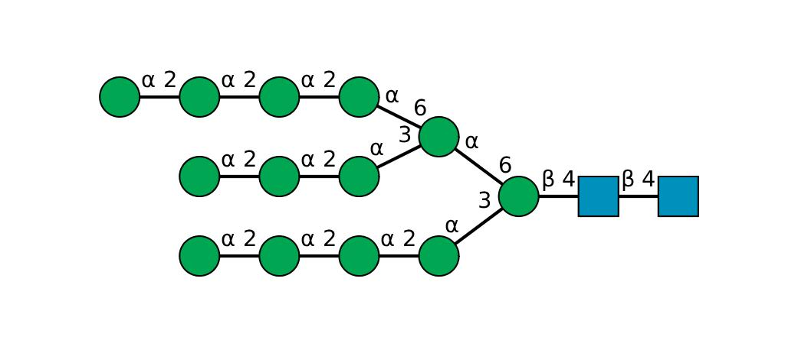
The probability that all labels are outputted along the most likely state transition: -44.88421062069136（対数表示）
0
4
5
0
0
4
5
3
1
2
3
0
4
5
3
SNFG

Slide 4
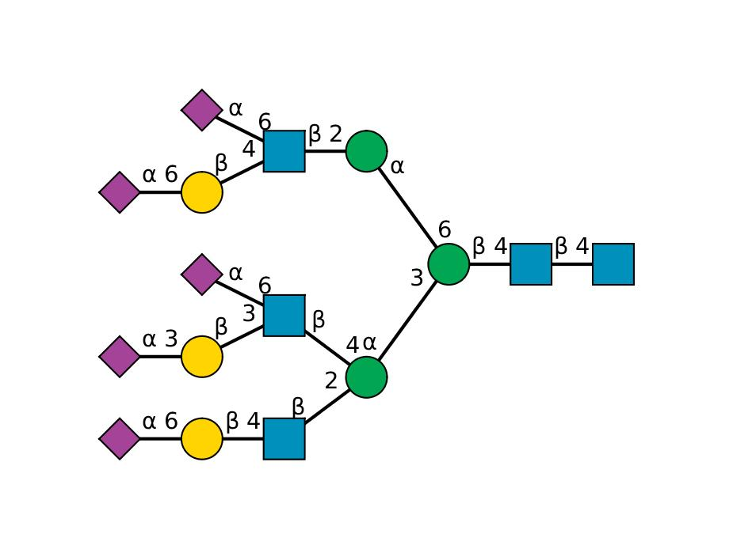
The probability that all labels are outputted along the most likely state transition: -35.45700613993277
4
5
0
0
4
1
2
3
4
2
0
4
3
0
4
5

Slide 5
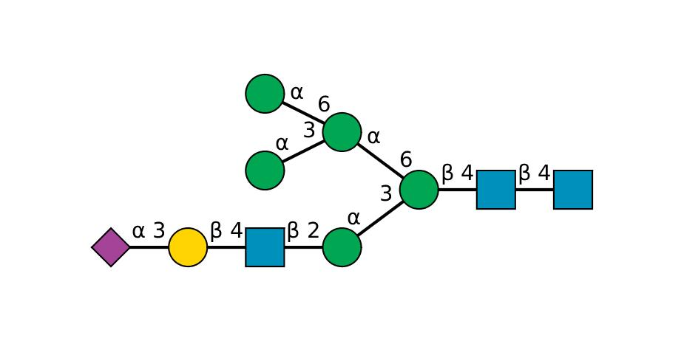
The probability that all labels are outputted along the most likely state transition: -16.000989710812703
0
0
3
1
2
3
0
4
5
3

