Slide 1
状態遷移図
0.89
0.11
0.99
0.98
4
13
0
Gal(b1-4) 0.77
11
14
10
GlcNAc(b1-2) 0.55
Fuc(a1-6) 0.15
GlcNAc(b1-6) 0.12
9
Start
8
12
6
7
3
5
2
親子関係
1
兄弟関係
確率が0.3未満の辺は基本的に省略
ラベルのみ確率が0.1以上を出力

Slide 2
状態遷移図
Man(a1-2) 0.64
Man(a1-6) 0.12
親子関係
Man(a1-3) 0.97
0.89
14
0.93
13
0.98
0
兄弟関係
ルートのみ結合情報なし
Man(a1-6) 0.79
Man(a1-3) 0.13
0.6
0.65
0.23
0.35
0.99
0.99
0.99
0.81
2
7
GlcNAc(b1-4) 0.60
GlcNAc(b1-2) 0.28
1
GlcNAc(b1-2) 0.91
5
0.96
0.88
GlcNAc(b1-4) 0.99
0.39
0.99
0.37
1
Man(b1-4) 0.87
Fuc(a1-3) 0.11
Gal(b1-4) 0.89
Neu5Ac(a2-6) 0.004
1
8
0.99
4
0.95
10
0.86
9
0.90
1
0.99
6
0.5
Start
for state 10
Man(a1-6) 0.97
GlcNAc(b1-2) 0.55
GlcNAc(b1-6) 0.37
0.96
GlcNAc 1
Neu5Ac(a2-3) 0.30
Neu5Ac(a2-6) 0.16
GlcNAc(b1-3) 0.11
0.63
12
0.95
0.99
0.57
0.99
0.93
Fuc(a1-6) 0.64
GlcNAc(b1-4) 0.17
D-Fuc(a1-6) 0.11
3
0.32
11
for state 14
GalNAc(b1-4) 0.48
Gal3Me(b1-6) 0.29
Tyv(b1-3) 0.12
0.99
GlcNAc(b1-4) 0.67
Gal(b1-3) 0.13
0.99

Slide 3
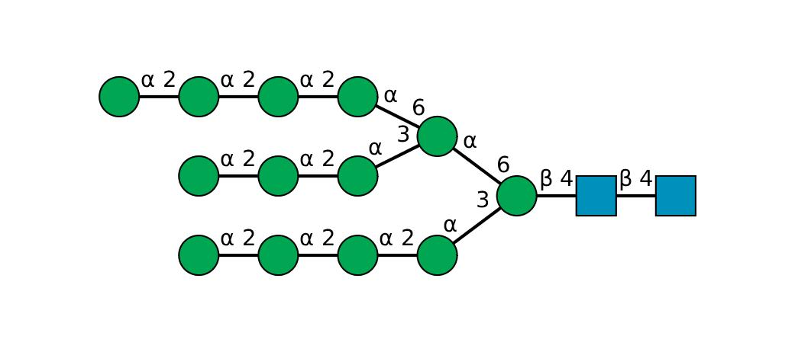
High mannose
The probability that all labels are outputted along the most likely state transition: -13.057607912859618（対数表示）
4
4
4
4
4
4
4
9
2
7
8
4
4
4
9

Slide 4
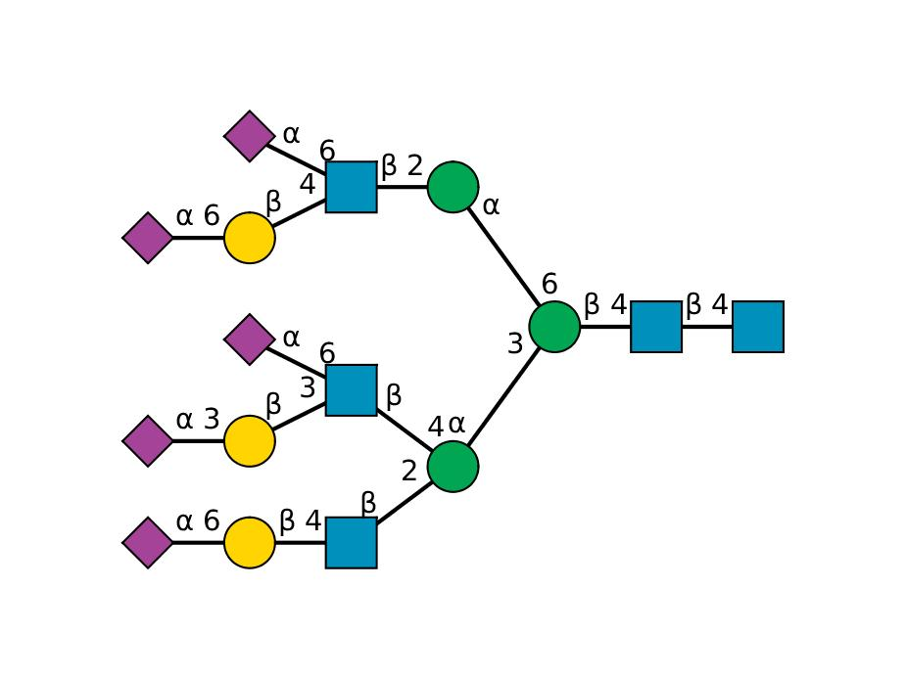
Complex
The probability that all labels are outputted along the most likely state transition: -24.63392030733235
1
3
5
6
1
1
12
7
8
10
6
1
11
6
1
3

Slide 5
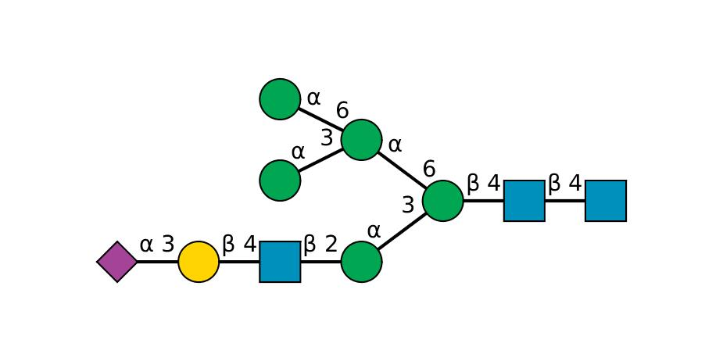
Hybrid
The probability that all labels are outputted along the most likely state transition: -8.206559783383268
5
5
11
12
7
8
6
1
3
11

Slide 6
