Slide 1
状態遷移図
Start
0.48
0.52
GlcNAc 0.94
2
GlcNAc 0.99
5
0.33
0.99
0.67
0.98
0.77
0.98
0.98
3
4
Gal 0.70
Fuc 0.20
0.74
Man 0.99
0.78
0
0.87
Man 0.97
Neu5Ac 0.54
Neu5Gc 0.12
Gal 0.12
1
0.91
親子関係
0.99
0.72
兄弟関係
確率が0.3未満の辺は基本的に省略
ラベルのみ確率が0.1以上を出力

Slide 2
Start
0.48
0.52
GlcNAc 0.94
2
GlcNAc 0.99
5
0.33
0.99
0.67
0.98
0.77
0.98
0.22
3
4
Gal 0.70
Fuc 0.20
0.74
0.98
Man 0.99
0.78
0
0.28
0.87
Man 0.97
Neu5Ac 0.54
Neu5Gc 0.12
Gal 0.12
1
0.91
0.99
0.72

Slide 3
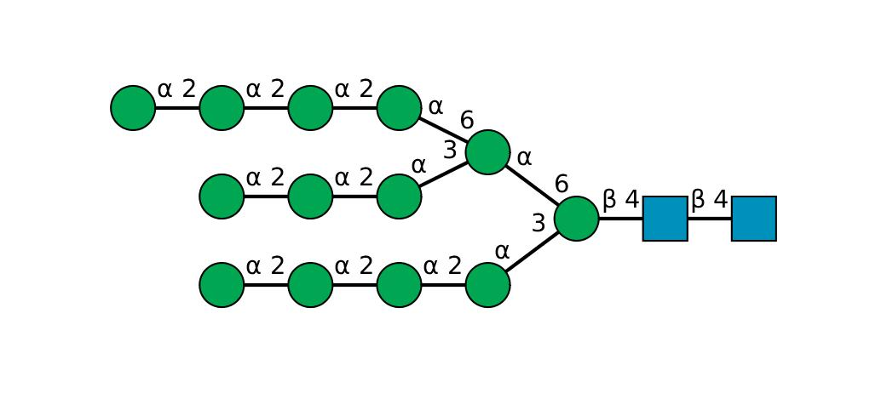
The probability that all labels are outputted along the most likely state transition: -14.434263554884174（対数表示）
0
3
3
3
3
0
3
3
3
2
2
0
3
3
3
SNFG

Slide 4
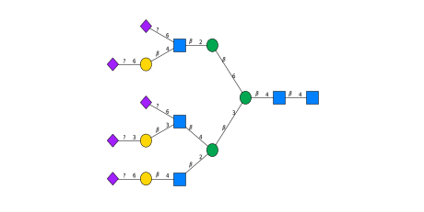
The probability that all labels are outputted along the most likely state transition: -21.303900132278038
1
5
0
1
4
3
2
2
1
5
1
4
0
1
4
5

Slide 5
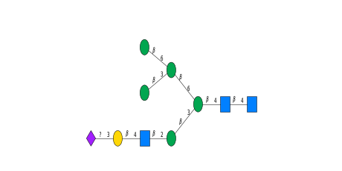
The probability that all labels are outputted along the most likely state transition: -6.871855207161273
0
3
0
3
2
2
1
4
5
0

