Slide 1
CS 5525 - Cloud Computing
Aggregated Distributed Cloud Storage
Kenton Hanifl
Student ID: 16174415

Slide 2



The Problem – Too Little Free Storage
Dropbox – 2 GB Free
GoogleDrive – 15 GB Free
Box – 10 GB Free

Slide 3

Motivation
Beat free storage limits!
Increase security
If hackers gain access to a single cloud account, they don’t have entire files to work with
Increase flexibility
Increase sizes of files you can upload

Slide 4
Accomplishments - Summary
Dropbox Integration
Google Drive Integration
Basic UI

Slide 5
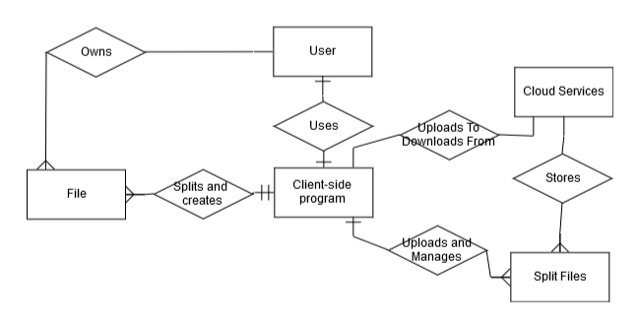
Project Architecture

Slide 6
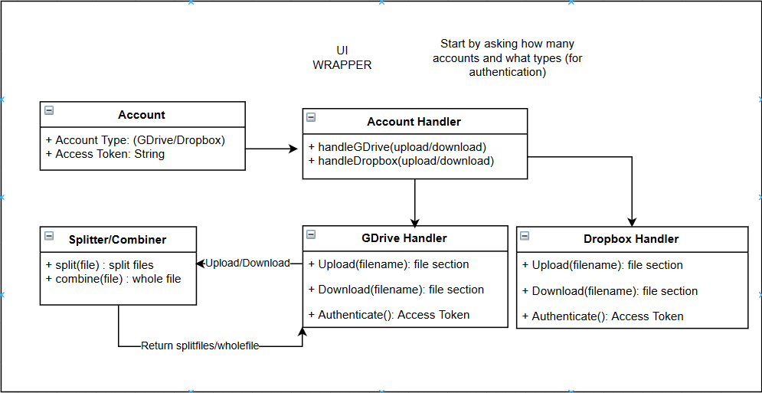
System Architecture

Slide 7
Demo

Slide 8
Difficulties - Summary
?
?
?
TkInter
Basically writing HTML by appending all of the elements in JS
Very widely used python UI library
Balancing work, other school, and life

Slide 9
Individual Learning
Cloud APIs
Specifically GoogleDrive and Dropbox
TkInter
Extremely useful for UI Python applications

Slide 10
Summary
Free storage can be beaten
Needs more work
Checking Storage Left…
Deleting accounts…
Integrating more services (AWS, Box, Github?)
Continuing the project over the summer
github.com/KentonSchool

