Slide 1
CS 5525 - Cloud Computing
Aggregated Distributed Cloud Storage
Kenton Hanifl
Student ID: 16174415

Slide 2

Aggregated - Distributed Cloud Storage
Create a distributed file system on multiple cloud storage services
Split files among a number of cloud storage services
Upon user request, fetch and recombine files
Done through Google Drive, Dropbox, AWS, possibly others

Slide 3

Motivation
Beat free storage limits!
Increase security
If hackers gain access to a single cloud account, they don’t have entire files to work with
Increase flexibility
Increase sizes of files you can upload

Slide 4
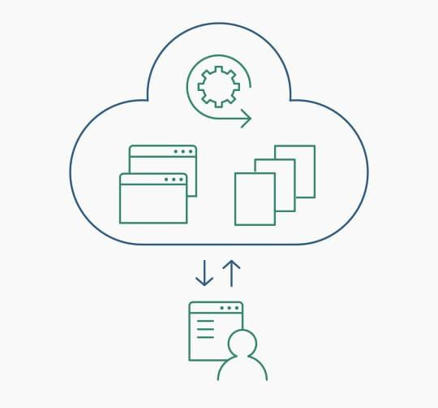
Objective
Create a service that is:
Free
Easy to use
Useful
Learn about many different cloud storage services and their APIs

Slide 5
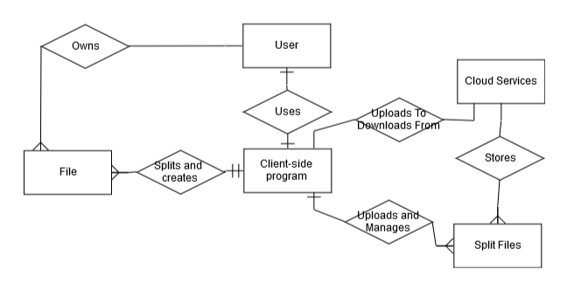
Project Architecture

Slide 6




Tools, Languages, Platforms...
Client-side program
Python
Cloud storage platforms
Google Drive
Dropbox
pCloud
AWS

Slide 7

Development Plan
Single person project
Version control and management through github

Slide 8
Expected Outcome
Simple GUI interface for the service
The service will be able to manage files across any number of cloud services
The program will be entirely open source

Slide 9
Learning Outcomes
Become intimately familiar with cloud storage systems
APIs
Setup and Management
Become even more familiar with the python programming language and GUI interfaces

