Slide 1
CS 5525 - Cloud Computing
Aggregated Distributed Cloud Storage
Kenton Hanifl
Student ID: 16174415

Slide 2



The Problem – Too Little Free Storage
Dropbox – 2 GB Free
GoogleDrive – 15 GB Free
Box – 10 GB Free

Slide 3

Motivation
Beat free storage limits!
Increase security
If hackers gain access to a single cloud account, they don’t have entire files to work with
Increase flexibility
Increase sizes of files you can upload

Slide 4
Accomplishments - Summary
Dropbox Integration
Google Drive Integration
Basic UI

Slide 5
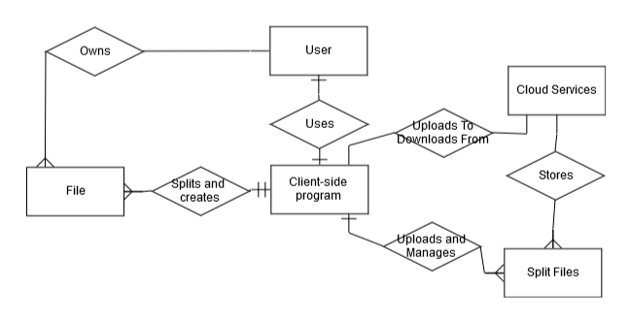
Project Architecture

Slide 6
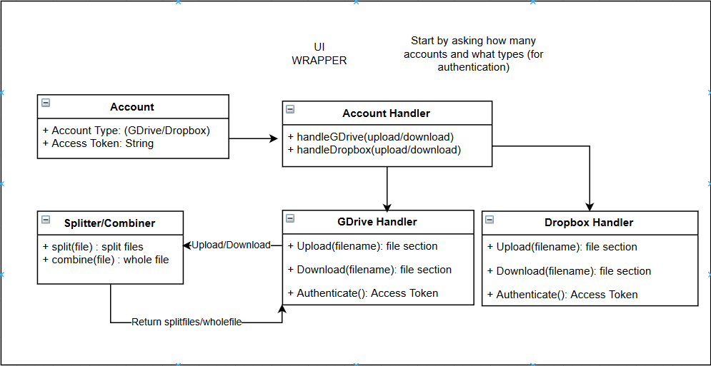
System Architecture

Slide 7
Demo

Slide 8
Difficulties - Summary
?
?
?
TkInter
Basically writing HTML by appending all of the elements in JS
Very widely used python UI library
Balancing work, other school, and life

Slide 9
Individual Learning
Cloud APIs
Specifically GoogleDrive and Dropbox
TkInter
Extremely useful for UI Python applications

Slide 10
Summary
Free storage can be beaten
Needs more work
Can integrate more services ( AWS, Box, Github? )
Continuing the project over the summer
github.com/KentonSchool

