Slide 1
EN. 601.647/667 Introduction to HLT Deep Learning
Kenton Murray
9/21/2021

Slide 2
Agenda
PyTorch
Backprop/Gradient Descent
Build an actual HLT Deep Network

Slide 3
Recap
Supervised Learning
Logistic Regression
Neural Networks

Slide 4
PyTorch
Yes, I verified … it will most likely be needed for an assignment

Slide 5
PyTorch
Yes, I verified … it will most likely be needed for an assignment
But it is also one of the most important tools you will need for HLT

Slide 6
Conda
“Conda is an open source package management system and environment management system that runs on Windows, macOS and Linux.”
https://docs.conda.io/en/latest/

Slide 7
Conda
“Conda is an open source package management system and environment management system that runs on Windows, macOS and Linux.”
“Conda quickly installs, runs and updates packages and their dependencies.”
https://docs.conda.io/en/latest/

Slide 8
Conda
“Conda is an open source package management system and environment management system that runs on Windows, macOS and Linux.”
“Conda quickly installs, runs and updates packages and their dependencies.”
“Conda easily creates, saves, loads and switches between environments on your local computer.”
https://docs.conda.io/en/latest/

Slide 9
Conda
USE IT!!!
“Conda is an open source package management system and environment management system that runs on Windows, macOS and Linux.”
“Conda quickly installs, runs and updates packages and their dependencies.”
“Conda easily creates, saves, loads and switches between environments on your local computer.”
https://docs.conda.io/en/latest/

Slide 10

https://www.anaconda.com/

Slide 11
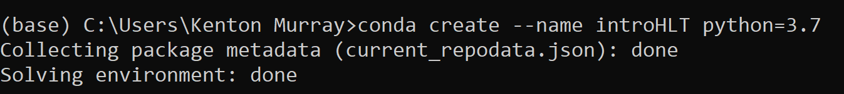
Create A New Environment
Always do this for a new project … prevents conflicts

Slide 12
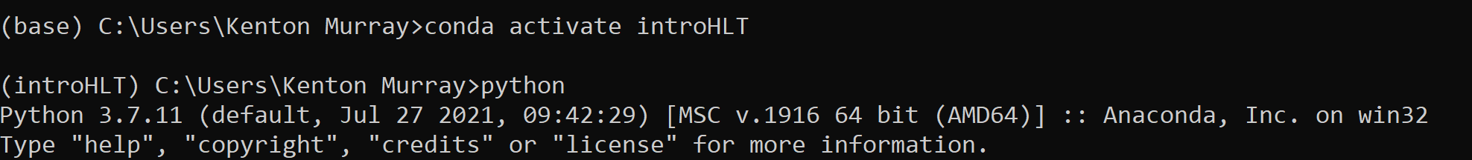
Activate Environment
Actually use it ☺

Slide 13

Pytorch

Slide 14
Pytorch

Slide 15
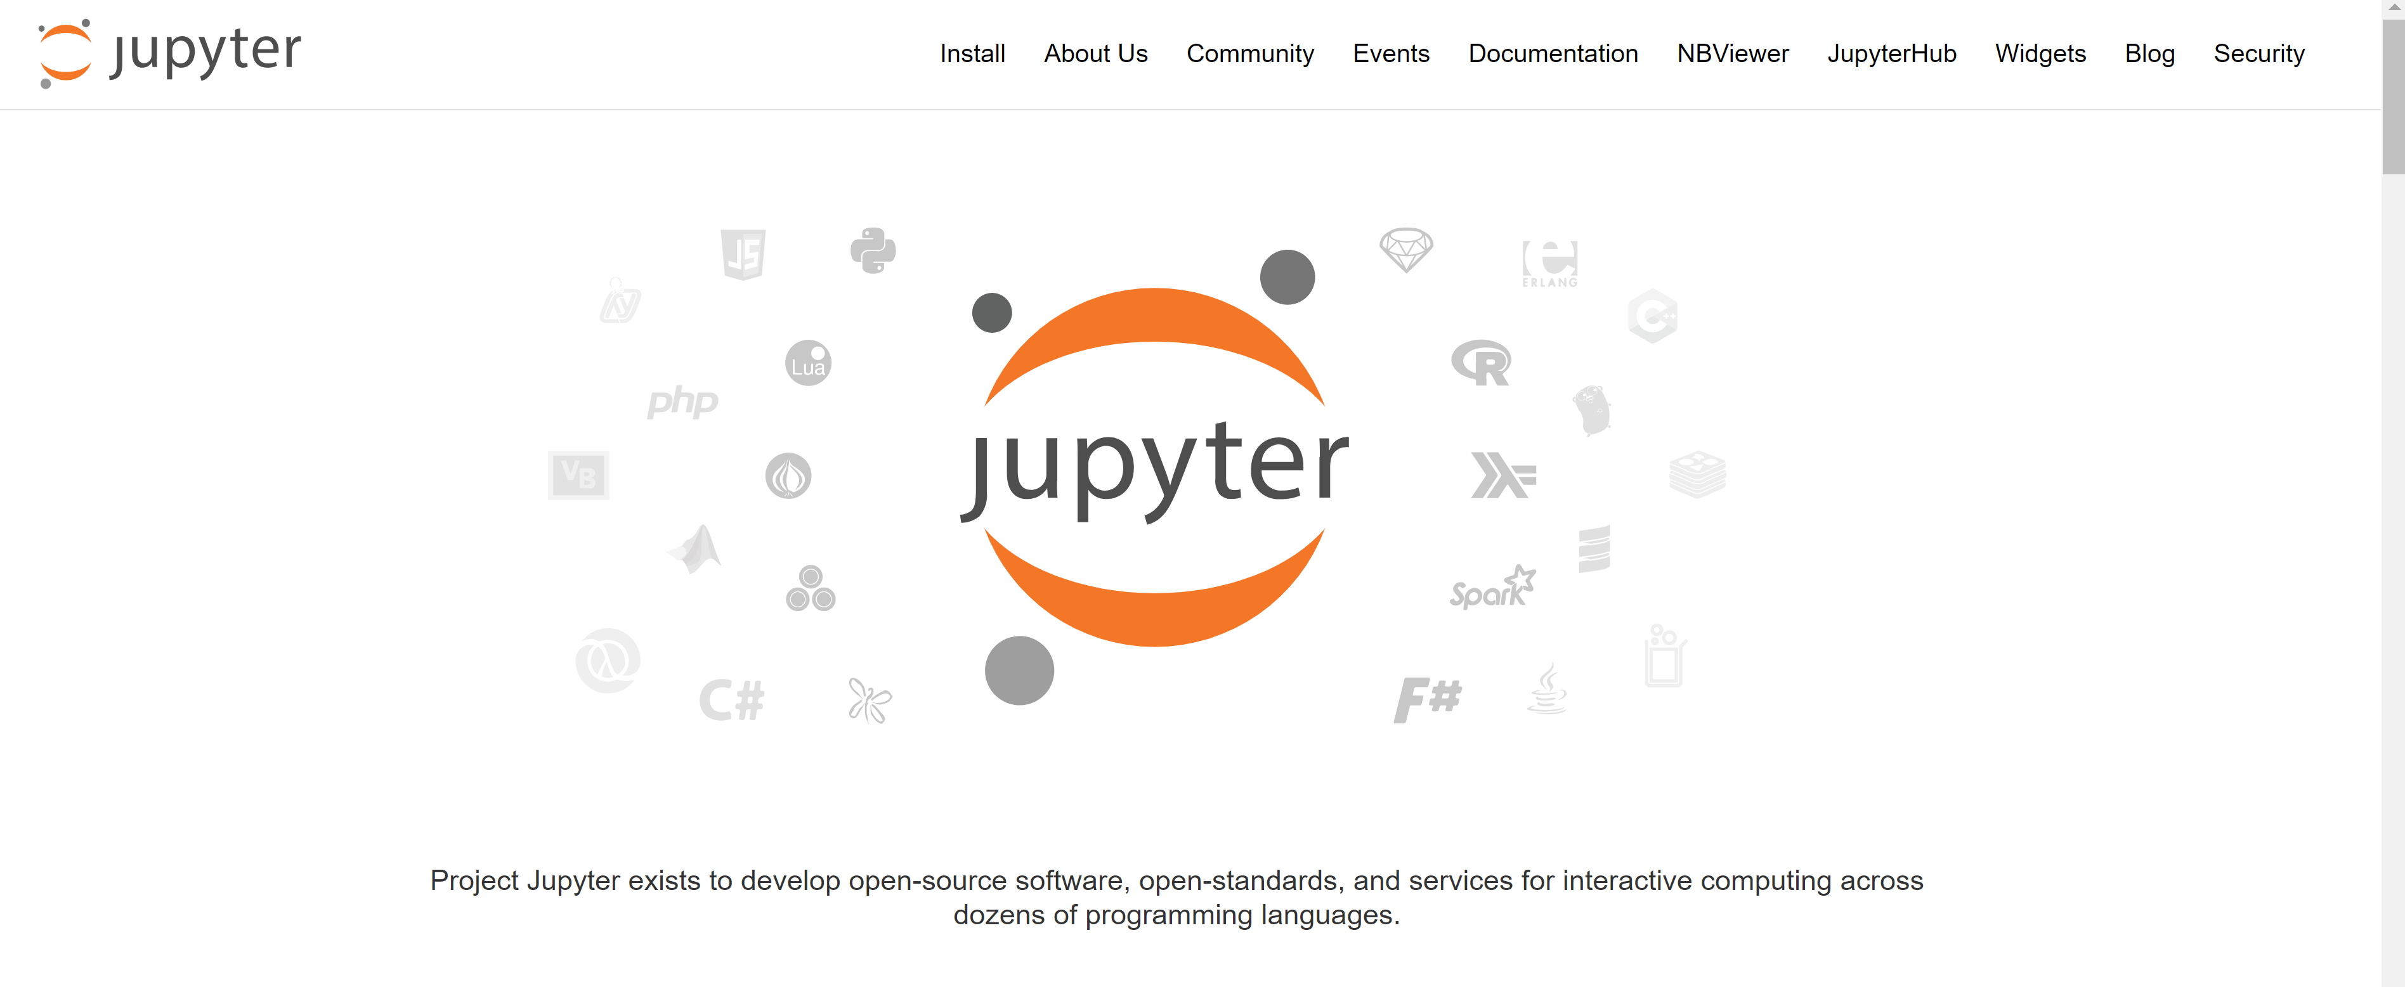
Jupyter Notebook
https://jupyter.org/

Slide 16
Jupyter Notebook

Slide 17
Switch To Notebook

Slide 18
Gradient Descent
Find local optimum of a function, f(x)
f(x)
gradient

Slide 19
One-Hot Vector
Dictionary
The And I Dog Johns ……. Me Cat
Johns Hopkins was founded in …..
0 0 0 0 1 …… 0 0

