Slide 2
COMPARISON OF NoSQL TO SQL (A CASE STUDY OF MongoDB vs SQL)
PRESENTED BY
OBASI KENNEDY E.
TO
GOMYCODE
ON
29 DECEMBER 2023

Slide 3
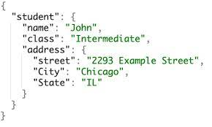
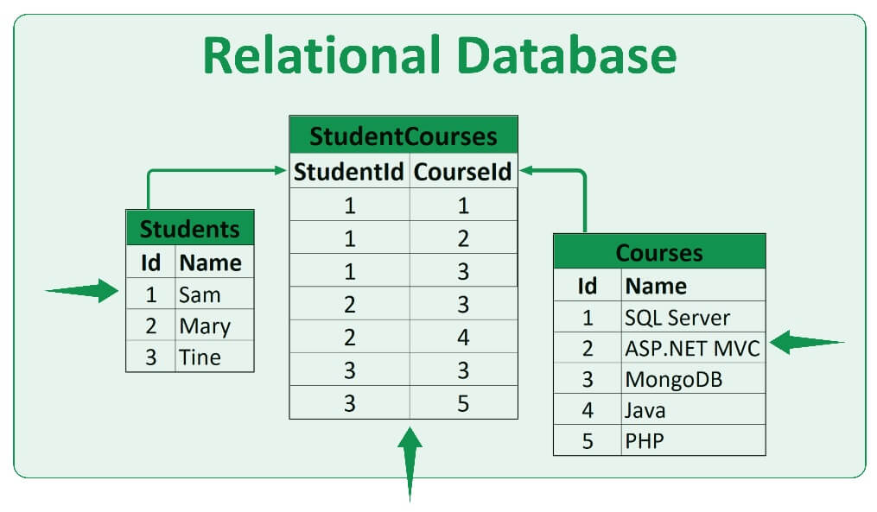
MongoDB is a non-relational database
SQL is a relational database
1

Slide 4
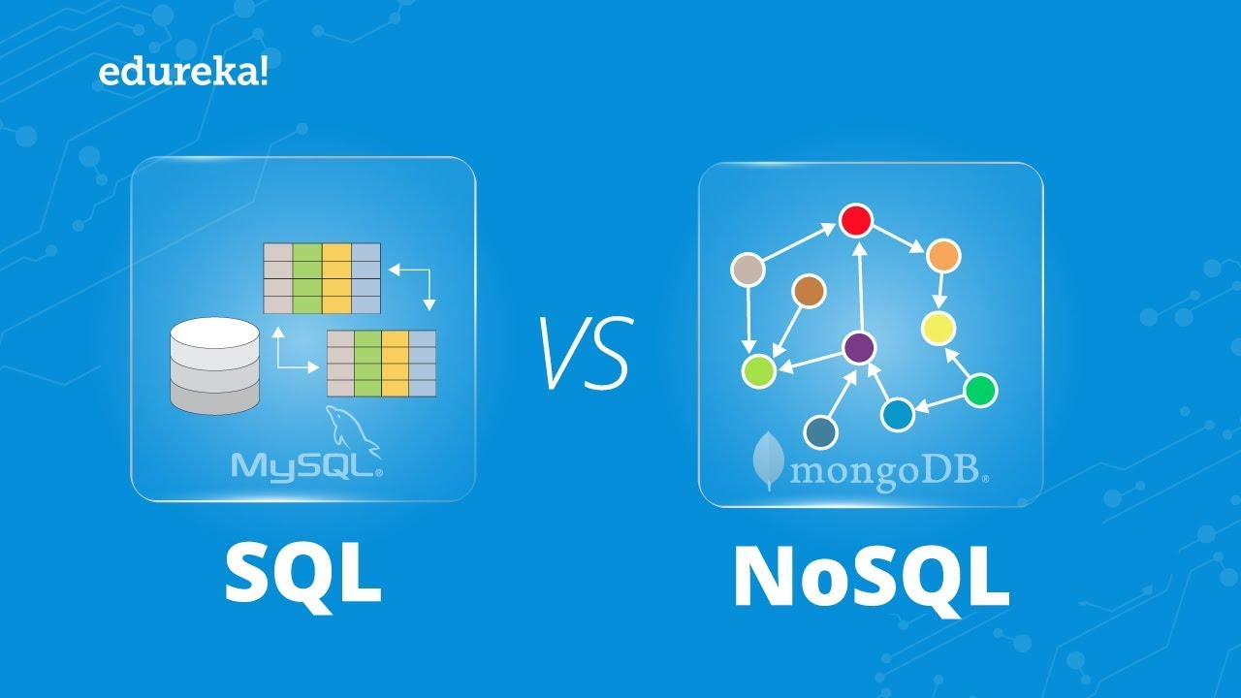
MongoDB is an unstructured database.
SQL is structured and has a predefined schema.
2

Slide 5
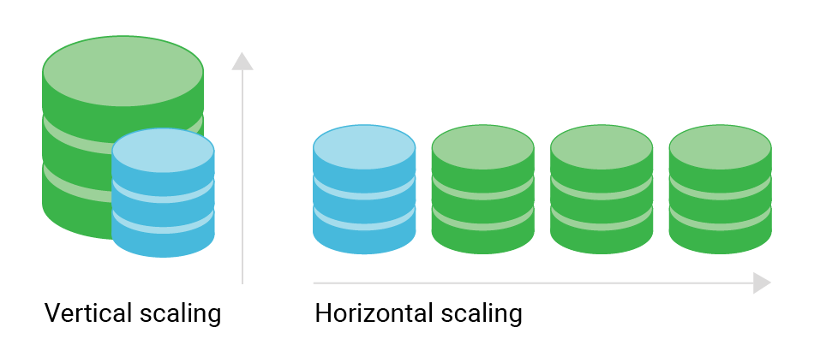
MongoDB is horizontally-scalable.
SQL is vertically- scalable.
3

Slide 6
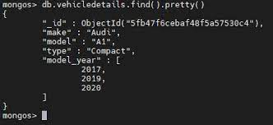
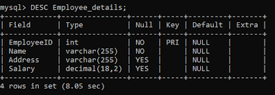
MongoDB is document-based.
SQL is table-based.
4

Slide 7


MongoDB is better for unstructured data like documents or JSON.
SQL databases are better for multi-role transactions.
5

Slide 8

Thank you for your rapt attention.

