Slide 1


KIHBS 2024 QUESTIONNAIRE REVIEW
April 11, 2024

Slide 2
Tasks
Aggregate comments received from WB and UN
Review comments, provide recommendation, implement recommended changes in questionnaire for KNBS to consider
Identify potential areas to shorten/streamline questionnaire

Slide 3
Aggregate comments received from WB and UN

Slide 4
Aggregate comments received from WB and UN
Status: COMPLETED
Compiled into single list organized by questionnaire section with source of comment
395 different comments/suggestions!
Cells created for status of comment and actions taken based on comment.

Slide 5
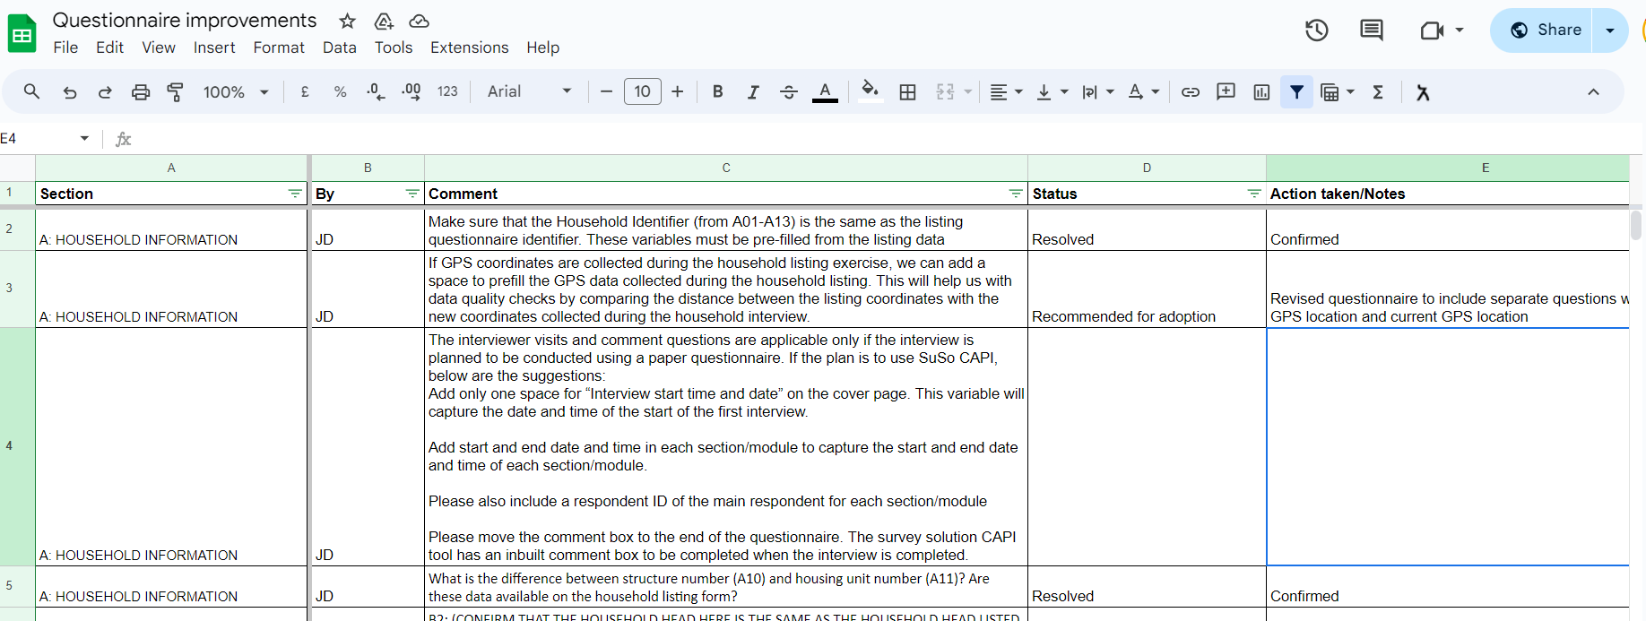

Slide 6
Review comments, provide recommendation, implement recommended changes

Slide 7
Review comments, provide recommendation, implement recommended changes
Status: PARTIALY COMPLETED
315 comments addressed with recommendations provided and implemented for KNBS’s consideration
80 remain
Revised questionnaires developed with all proposals implemented and highlighted (for tracking, especially CAPI)

Slide 8
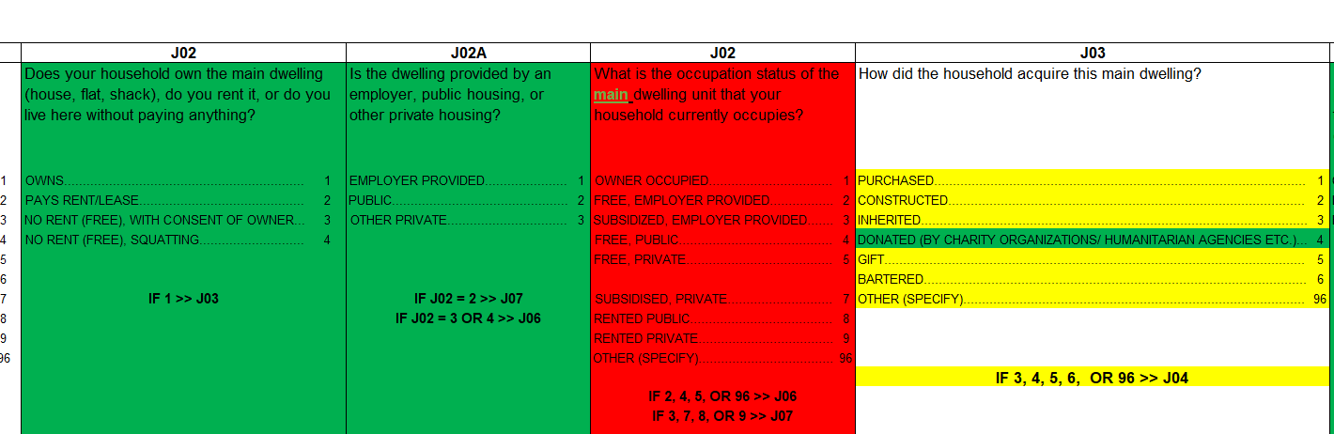
Modified questionnaires
GREEN = Proposed new questions, response options, wordings
YELLOW = Modified questions, response options, wordings
RED = Questions, response options proposed to be dropped

Slide 9
Important changes proposed
Reconciling duplicated expenditure items across modules
E.g., housing, education, energy, etc.
Preference is to ask for expenditures in their respective modules, not in nonfood expenditure list
Asked in the appropriate context, improved reliability of information provided by respondent
Still being finalized
Preparing mapping of COICOP items removed from NF modules to the relevant sections/questions where their expenditures (at the same COICOP level) can be extracted.

Slide 10
Important changes proposed
Developed completely reformulated module on transfers
Previous format complex and difficult to follow
Substantially revised format to improve flow and readability
Collecting (almost) the same information
Resolved overlaps with module on Social Protection
Incorporated international questions to identify of refugees into Migration module
Revised version of domestic tourism module proposed
Simplified and at household-level (previously individual-level)

Slide 11
Important changes proposed
Land ownership section expanded to capture SDGs 1.4.2 & 5.a.1
1.4.2: Proportion of total adult population with secure tenure rights to land, (a) with legally recognized documentation, and (b) who perceive their rights to land as secure, by sex and type of tenure
5.a.1: Proportion of total agricultural population with ownership or secure rights over agricultural land, by sex
Share of women among owners or rights bearers of agricultural land, by type of tenure
Partially captured previously, but further information needed

Slide 12
Identify potential areas to shorten/streamline questionnaire

Slide 13
Identify potential areas to shorten/streamline questionnaire
Status: PARTIALY COMPLETED
As part of questionnaire review, identified specific questions or block of questions to potentially drop
Looked across modules to identify low priority modules to consider dropping

Slide 14
Fertility, deaths, child health and anthropometry could be dropped or severely reduced
Already collected recently as part of DHS, not typically part of HBSs

Slide 15
Agriculture biodiversity & Household Justice could be considered for dropping
Niche topics not suited to an HBS
Agriculture in general could be simplified/reduced
Agricultural census coming

Slide 16
Still some potential to economize on list of nonfood expenditure items to be captured
At present 660 different nonfood expenditure items!
Working to identify nondisruptive ways to reduce length of list while remaining within COICOP framework
Consulting with our team member who is an expert on this – will come back soon with a concrete proposal

Slide 17
Community questionnaire could be considered for elimination
Use case is limited
Much of the information is alrea
dy asked directly of households or can be (often more accurately) extracted using geospatial data
Doesn’t save on HH interviews, but would free up Supervisor to focus on supervision
Nigeria dropped their community questionnaire from their latest poverty survey (for the reasons above).

Slide 18
Next steps - timeline

Slide 19
Next steps
WB to finish review/recommendations and submit to KNBS
Expected by April 19
KNBS to review submission and take final decisions on WB proposals
By May 3?

